Slide 1

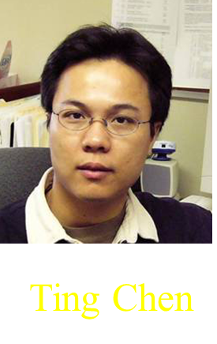

Haplotype Inference
Yao-Ting Huang
Kun-Mao Chao

Slide 2
Genetic Variations
The genetic variations in DNA sequences (e.g., insertions, deletions, and mutations) have a major impact on genetic diseases and phenotypic differences.
  All humans share 99% the same DNA sequence.
  The genetic variations in the coding region may change the codon of an amino acid and alters the amino acid sequence.

Slide 3
Single Nucleotide Polymorphism
A Single Nucleotide Polymorphisms (SNP), pronounced “snip,” is a genetic variation when a single nucleotide (i.e., A, T, C, or G) is altered and kept through heredity.
  SNP: Single DNA base variation found >1%
  Mutation: Single DNA base variation found <1%
94%
C T T A G C T T
99.9%
C T T A G C T T
6%
C T T A G T T T
0.1%
C T T A G T T T
SNP
Mutation

Slide 4
Mutations and SNPs
Observed genetic variations
_{SNPs}
_{Mutations}
Common Ancestor
time
present

Slide 5
Single Nucleotide Polymorphism
SNPs are the most frequent form among various genetic variations.
  90% of human genetic variations come from SNPs.
  SNPs occur about every 300~600 base pairs.
  Millions of SNPs have been identified (e.g., HapMap and Perlegen).
SNPs have become the preferred markers for association studies because of their high abundance and high-throughput SNP genotyping technologies.

Slide 6
Single Nucleotide Polymorphism
A SNP is usually assumed to be a binary variable.
  The probability of repeat mutation at the same SNP locus is quite small.
  The tri-allele cases are usually considered to be the effect of genotyping errors.
The nucleotide on a SNP locus is called
  a major allele (if allele frequency > 50%), or
  a minor allele (if allele frequency < 50%).
94%
A C T T A G C T T
T: Major allele
6%
A C T T A G C T C
C: Minor allele

Slide 7
Haplotypes
A haplotype stands for an ordered list of SNPs on the same chromosome.
  A haplotype can be simply considered as a binary string since each SNP is binary.
-A C T T T G C T C-
Haplotype 1
C T C
-A C T T A G C T T-
Haplotype 2
C A T
-A A T T T G C T C-
Haplotype 3
A T C
SNP₁
SNP₂
SNP₃
SNP₁
SNP₂
SNP₃

Slide 8
Genotypes
The use of haplotype information has been limited because the human genome is a diploid.
  In large sequencing projects, genotypes instead of haplotypes are collected due to cost consideration.
AC
GT
_{A}
_{G}
A T
_{A}
_{T}
_{C}
_{T}
_{C}
_{G}
C G
SNP₁
SNP₂
SNP₁
SNP₂
SNP₁
SNP₂
SNP₁
SNP₂
_{Genotype data}
_{Haplotype data}
Notes:
However, the haplotype data is not easy to be obtained because the human genome is a diploid,
Which s composed of two chromosomes.
To obtain the haplotype data, we have to separate them first and then extract the SNPs in each chromosome.
And obtain two haplotypes AT and CG.
But most large sequencing projects, because of cost considerations,
The diploid chromosomes are not separated.
and thus we obtain the less accurate information called genotype data.
Based on genotype data, we only knows the two SNPs at each locus.
But we do not know the combination between of these SNPs at different loci.
For example, we don’t know the haplotype data are AT CG or AG and CT.
So here comes the problem. We are only interested in haplotype data.
Which haplotype pair is true..

Slide 9
Problems of Genotypes
Genotypes only tell us the alleles at each SNP locus.
  But we don’t know the connection of alleles at different SNP loci.
  There could be several possible haplotypes for the same genotype.
AC
GT
_{A}
_{G}
_{A}
_{T}
_{A}
_{G}
_{C}
_{T}
_{or}
_{C}
_{G}
_{C}
_{T}
SNP₁
SNP₂
SNP₁
SNP₂
SNP₁
SNP₂
SNP₁
SNP₂
_{Genotype data}
We don’t know which haplotype pair is real.

Slide 10
Research Directions of SNPs and Haplotypes in Recent Years
SNP
Database
Haplotype
Inference
Tag SNP
Selection
…
Maximum
Parsimony
Perfect
Phylogeny
Statistical
Methods
Haplotype
block
LD bin
Prediction
Accuracy

Slide 11
Haplotype Inference
The problem of inferring the haplotypes from a set of genotypes is called haplotype inference.
  This problem is already known to be not only NP-hard but also APX-hard.
Most combinatorial methods consider the maximum parsimony model to solve this problem.
  This model assumes that the real haplotypes in natural population is rare.
  The solution of this problem is a minimum set of haplotypes that can explain the given genotypes.
Notes:
To solve this problem, most combinatorial methods consider the maximum parsimony model.
This model assume that the number of real haplotpyes is rare in the population.

Slide 12
Maximum Parsimony
_{A}
_{G}
_{A}
_{T}
_{A}
_{G}
_{C}
_{T}
h₁
h₃
G₁
_{C}
_{G}
or
_{C}
_{T}
h₂
h₄
SNP₁
SNP₂
_{A}
_{T}
_{A}
_{T}
_{A}
_{T}
h₁
G₂
_{A}
_{T}
h₁
SNP₁
SNP₂
_{A}
_{T}
_{A}
_{G}
Find a minimum set of haplotypes to explain the given genotypes.
_{C}
_{G}
_{C}
_{T}
_{A}
_{T}
Notes:
Suppose we are given two genotypes. G1 and G2.

Slide 13
Related Work
Statistical methods:
  Niu, et al. (2002) developed a PL-EM algorithm called HAPLOTYPER.
  Stephens and Donnelly (2003) designed a MCMC algorithm based on Gibbs sampling called PHASE.
Combinatorial methods:
  Gusfield (2003) proposed an integer linear programming algorithm.
  Wang and Xu (2003) developed a branching and bound algorithm called HAPAR to find the optimal solution.
  Brown and Harrower (2004) proposed a new integer linear formulation of this problem.

Slide 14
Our Results
We formulated this problem as an integer quadratic programming (IQP) problem.
We proposed an iterative semidefinite programming (SDP) relaxation algorithm to solve the IQP problem.
  This algorithm finds a solution of O(log n) approximation.
We implemented this algorithm in MatLab and compared with existing methods.
  Huang, Y.-T., Chao, K.-M., and Chen, T., 2005, “An Approximation Algorithm for Haplotype Inference by Maximum Parsimony,” Journal of Computational Biology, 12: 1261-1274.

Slide 15
Problem Formulation
Input:
  A set of n genotypes and m possible haplotypes.
Output:
  A minimum set of haplotypes that can explain the given genotypes.
_{A}
_{G}
_{A}
_{T}
h₁
G₁
_{C}
_{T}
_{C}
_{G}
_{A}
_{T}
h₂
h₁
SNP₁
SNP₂
_{C}
_{G}
_{A}
_{T}
h₂
_{A}
_{T}
_{A}
_{T}
h₁
G₂
_{A}
_{T}
h₁
SNP₁
SNP₂

Slide 16
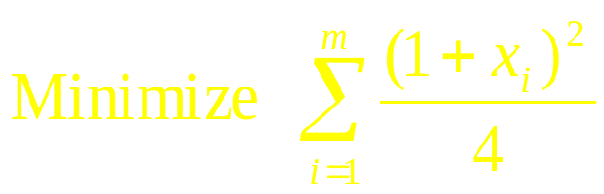
Integer Quadratic Programming (IQP)
Define x_{i} as an integer variable with values 1 or -1.
  x_{i} = 1 if the i-th haplotype is selected.
  x_{i} = -1 if the i-th haplotype is not selected.
Minimizing the number of selected haplotypes is to minimize the following integer quadratic function:
Notes:
The first step is to formulate the haplotype inference problem as an IQP problem.
Let m be the number of haplotypes and xi be the selection for each haplotype.
Xi is equal to 1 if the i-th haplotype is selected and -1 otherwise.
Because if one haplotype is selected, this term is 1. If no selected, this term is 0.
And the summation of these terms is just the number of selected haplotypes.
For each genotype at least one pair of haplotypes must be selected.
For example, G1 can be resolved by h1 h2 or h3 h4.
If h1 h2 are both selected, this equation is equal to 1.

Slide 17
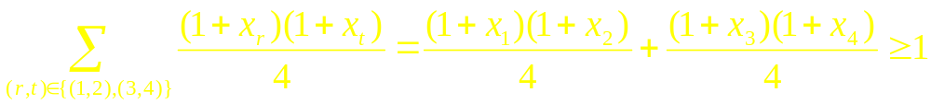
Integer Quadratic Programming (IQP)
Each genotype must be resolved by at least one pair of haplotypes.
  For genotype G₁, the following integer quadratic function must be satisfied.
Suppose h₁ and h₂ are selected
1
1
_{A}
_{G}
_{A}
_{T}
_{A}
_{G}
_{C}
_{T}
h₁
_{or}
h₃
G₁
_{C}
_{G}
_{C}
_{T}
h₂
h₄
SNP₁
SNP₂

Slide 18
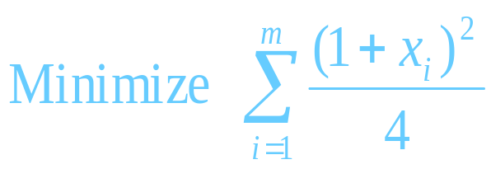
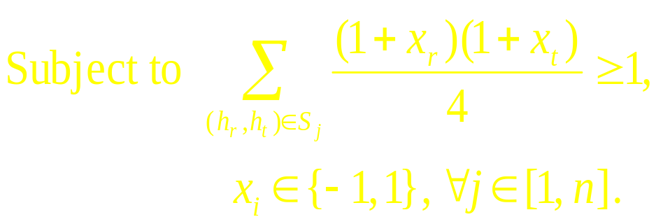
Integer Quadratic Programming (IQP)
Objective Function
Constraint Functions
Find a minimum set of haplotypes
Maximum parsimony:
We use the SDP-relaxation technique to solve this IQP problem.
to resolve all genotypes.

Slide 19
The Flow of the Iterative SDP Relaxation Algorithm
NP-hard
Relax the integer constraint
P
Reformulation
Integer Quadratic
Programming
Vector
Formulation
Semidefinite
Programming
No, repeat
this algorithm.
All genotypes
resolved?
Existing SDP solver
Yes, done.
Integral Solution
Vector
Solution
SDP
Solution
Randomized
rounding
Incomplete
Cholesky
decomposition

