Slide 1
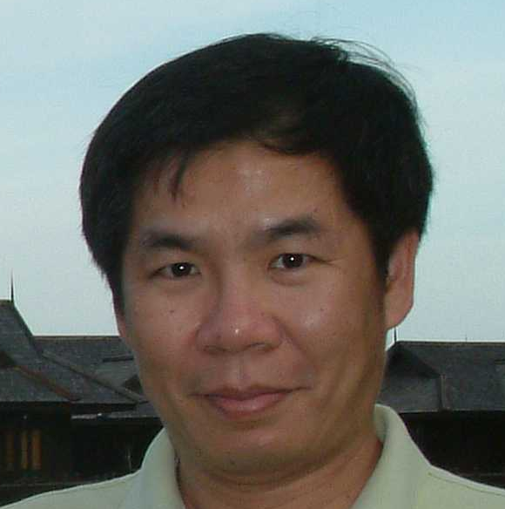
Pattern Identification in a Haplotype Block
Kun-Mao Chao (趙坤茂)
Graduate Institute of Biomedical Electronics and Bioinformatics
National Taiwan University, Taiwan
http://www.csie.ntu.edu.tw/~kmchao

Slide 2
Genetic Variations
The genetic variations in DNA sequences (e.g., insertions, deletions, and mutations) have a major impact on genetic diseases and phenotypic differences.
  All humans share more than 99% of the same DNA sequence.
  The genetic variations in the coding region may change the codon of an amino acid and alter the amino acid sequence.

Slide 3
Single Nucleotide Polymorphism
A Single Nucleotide Polymorphism (SNP), pronounced “snip,” is a genetic variation when a single nucleotide (i.e., A, T, C, or G) is altered and kept through heredity.
  SNP: Single DNA base variation found >= 1%
  Mutation: Single DNA base variation found <1%
94%
C T T A G C T T
99.9%
C T T A G C T T
6%
C T T A G T T T
0.1%
C T T A G T T T
SNP
Mutation

Slide 4
Mutations and SNPs
Observed genetic variations
_{SNPs}
_{Mutations}
Common Ancestor
time
present

Slide 5
Single Nucleotide Polymorphism
SNPs are the most frequent form among various genetic variations.
  Most of human genetic variations come from SNPs.
  SNPs occur about every 300~600 base pairs.
  Millions of SNPs have been identified (e.g., HapMap and Perlegen).
SNPs have become the preferred markers for association studies because of their high abundance and high-throughput SNP genotyping technologies.

Slide 6
Single Nucleotide Polymorphism
A SNP is usually assumed to be a binary variable.
  The probability of repeat mutation at the same SNP locus is quite small.
  The tri-allele cases are usually considered to be the effect of genotyping errors.
The nucleotide on a SNP locus is called
  a major allele (if allele frequency > 50%), or
  a minor allele (if allele frequency < 50%).
94%
A C T T A G C T T
T: Major allele
6%
A C T T A G C T C
C: Minor allele

Slide 7
Haplotypes
A haplotype stands for an ordered list of SNPs on the same chromosome.
  A haplotype can be simply considered as a binary string since each SNP is binary.
-A C T T T G C T C-
Haplotype 1
C T C
-A C T T A G C T T-
Haplotype 2
C A T
-A A T T T G C T C-
Haplotype 3
A T C
SNP₁
SNP₂
SNP₃
SNP₁
SNP₂
SNP₃

Slide 8
Tag SNP Selection
SNP
Database
Haplotype
Inference
Tag SNP
Selection
…
Maximum
Parsimony
Perfect
Phylogeny
Statistical
Methods
Haplotype
block
LD bin
Prediction
Accuracy

Slide 9
Problems of Using SNPs for Association Studies
The number of SNPs is too large to be used for association studies.
  There are millions of SNPs in a human body.
  To reduce the SNP genotyping cost, we wish to use as few SNPs as possible for association studies.
An alternative is to identify a small subset of SNPs that is sufficient for performing association studies without losing the power of using all SNPs.
  Our work is based on the haplotype-block model.

Slide 10
Haplotype Blocks and Tag SNPs
Some studies have shown that the chromosome can be partitioned into haplotype blocks interspersed by some recombination hotspots.
  Within a haplotype block, there is little or no recombination occurred.
  The SNPs within a haplotype block tend to be inherited together.
Within a haplotype block, a small subset of SNPs (called tag SNPs) is sufficient to distinguish each pair of haplotype patterns in the block.
  We only need to genotype tag SNPs instead of all SNPs within a haplotype block.

Slide 11
Recombination Hotspots and Haplotype Blocks
Haplotype patterns
Recombination
hotspots
P₁
P₂
P₃
P₄
S₁
S₂
S₃
S₄
Haplotype
blocks
: Major allele
S₅
SNP loci
S₆
: Minor allele
S₇
S₈
S₉
S₁₀
S₁₁
S₁₂
Chromosome

Slide 12
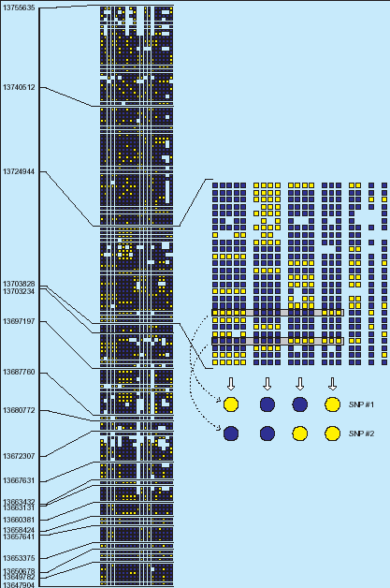
A Haplotype
Block Example
Human chromosome 21 is partitioned into 4,135 haplotype blocks over 24,047 SNPs by Patil et al. (Science, 2001).
  Blue box: major allele
  Yellow box: minor allele
Notes:
This picture shows an example of the SNPs and haplotype blocks in Chromosome 21.
When we study SNP, we usually assume that each SNP is biallelic.
In other words, at each SNP locus, there is either a major allele or a minor allele.
And no third type of allele exists..

Slide 13
Examples of Tag SNPs
Haplotype patterns
P₁
P₂
P₃
P₄
An unknown haplotype sample
S₁
S₂
Suppose we wish to distinguish an unknown haplotype sample.
We can genotype all SNPs to identify the haplotype sample.
S₃
S₄
S₅
SNP loci
S₆
S₇
S₈
S₉
: Major allele
S₁₀
S₁₁
: Minor allele
S₁₂

Slide 14
Examples of Tag SNPs
Haplotype pattern
P₁
P₂
P₃
P₄
S₁
In fact, it is not necessary to genotype all SNPs.
SNPs S₃, S₄, and S₅ can form a set of tag SNPs.
S₂
S₃
S₄
S₅
SNP loci
S₆
S₇
P₁
P₂
P₃
P₄
S₈
S₃
S₉
S₄
S₁₀
S₅
S₁₁
S₁₂

Slide 15
Examples of Wrong Tag SNPs
Haplotype pattern
P₁
P₂
P₃
P₄
S₁
SNPs S₁, S₂, and S₃ can not form a set of tag SNPs because P₁ and P₄ will be ambiguous.
S₂
S₃
S₄
S₅
SNP loci
S₆
S₇
P₁
P₂
P₃
P₄
S₈
S₁
S₉
S₂
S₁₀
S₃
S₁₁
S₁₂

Slide 16
Examples of Tag SNPs
Haplotype pattern
P₁
P₂
P₃
P₄
SNPs S₁ and S₁₂ can form a set of tag SNPs.
This set of SNPs is the minimum solution in this example.
S₁
S₂
S₃
S₄
S₅
SNP loci
S₆
S₇
S₈
P₁
P₂
P₃
P₄
S₉
S₁
S₁₀
S₁₂
S₁₁
S₁₂

Slide 17
Problems of Finding Tag SNPs
The problem of finding the minimum set of tag SNPs is known to be NP-hard.
  This problem is the minimum test set problem.
  A number of methods have been proposed to find the minimum set of tag SNPs.
Here we illustrate how to recast the tag SNP selection problem as the set cover problem and the integer linear programming problem.

Slide 18
Problem Formulation
P₁
P₂
P₃
P₄
The relation between SNPs and haplotypes can be formulated as a bipartite graph.
S₁ can distinguish (P₁, P₃), (P₁, P₄), (P₂, P₃), and (P₂, P₄).
S₂ can distinguish (P₁, P₄), (P₂, P₄), (P₃, P₄).
S₁
S₂
S₃
S₄
S₁
S₂
S₃
S₄
(1,2)
(1,3)
(1,4)
(2,3)
(2,4)
(3,4)
Given h patterns, we have pairs of patterns.
Notes:
To solve this problem, we first take a closer look at the function of each SNP.
If we pick SNP 1, we are sure that we can distinguish patterns 1 and 3,
Because they are in different color at this SNP locus.
And we formulate this relation into a bipartite graph.
SNP 1 can also distinguish patterns 1 and pattern 4. and so on.

Slide 19
Set Cover
P₁
P₂
P₃
P₄
The SNPs can form a set of tag SNPs if each pair of patterns is connected by at least one edge.
e.g., S₁ and S₃ forms a set of tag SNPs.
e.g., S₁ and S₂ does not form a set of tag SNPs.
S₁
S₂
S₃
S₄
S₁
S₂
S₃
(1,2)
(1,3)
(1,4)
(2,3)
(2,4)
(3,4)
Each pair of patterns is connected by at least one edge.
Notes:
One unanswered question is what kind of SNPs can be tag SNPs.
We can easily answer this question by seeing if the bottom nodes in the graph are all covered by edges from them.
For example, SNPs 1 and 3 are tag SNPs.
And SNPs 1 and 2 are not tag SNPs.
Because patterns 1 and 2 are not covered.
So we can not distinguish patterns 1 and 2.

Slide 20
A Greedy Algorithm
P₁
P₂
P₃
P₄
S₁
(1,2) | (1,3) | (1,4) | (2,3) | (2,4) | (3,4)
S₂
S₄
S₁
S₁
S₁
S₁
S₄
S₃
S₄
S₄
S₄
S₁
S₄
(1,2)
(1,3)
(1,4)
(2,3)
(2,4)
(3,4)
Notes:
Suppose this graph is implemented by a table-like data structure.
Roughly speaking, the greedy approach is to pick the SNP that contributes most edges to the bottom nodes.
In this example, suppose the first algorithm picks SNP 1 first.
Then it will pick SNP 4.
In other words, this algorithm is based on a row-by-row manner.

Slide 21
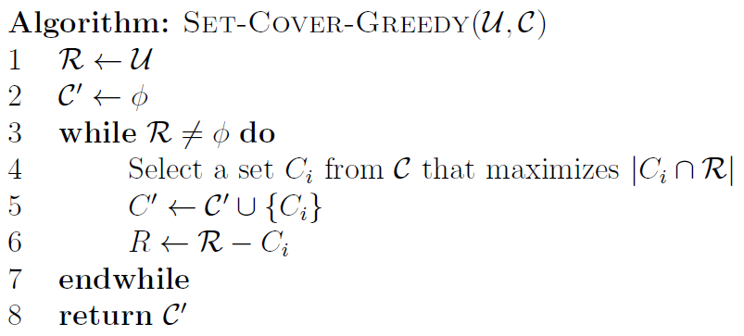
A Greedy Algorithm

Slide 22
Greedy (not Optimal)
U = {1, 2, 3, 4, 5, 6, 7, 8, 9} and
C = {C1,C2,C3}, where
    C1 = {2, 3, 4, 5, 6, 7},
    C2 = {1, 2, 3, 4, 5}, and
    C3 = {5, 6, 7, 8, 9}.
The resulting C’ is {C1,C2,C3}.
The minimum set cover is {C2,C3}.

Slide 23
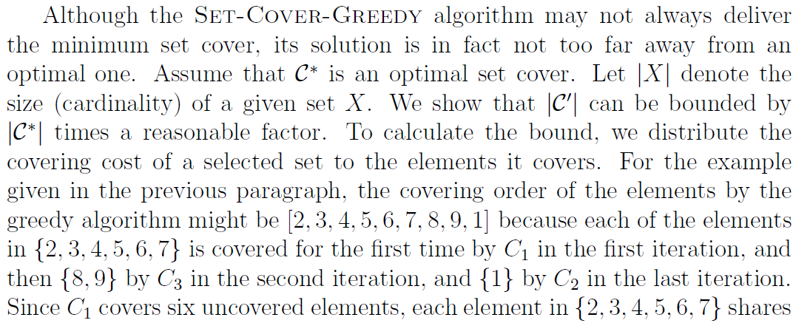
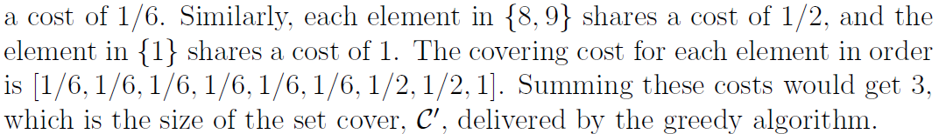
Amortized Analysis

Slide 24
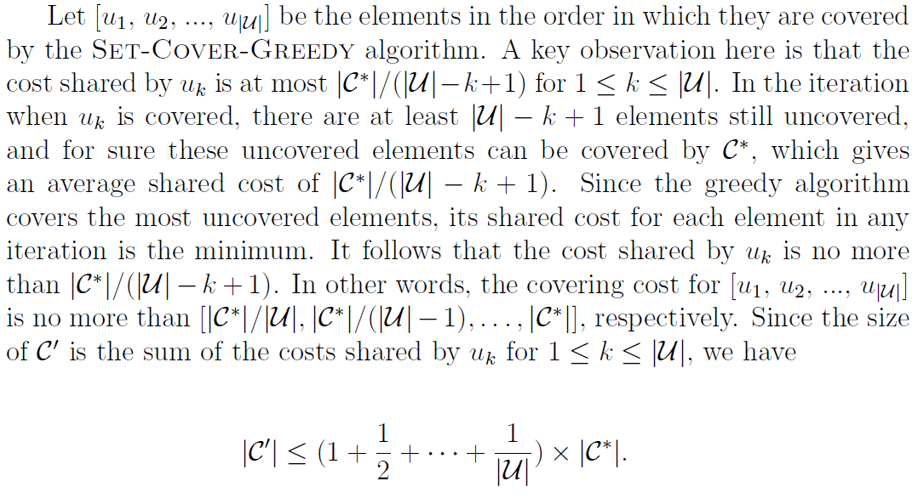
Harmonic Series

Slide 25
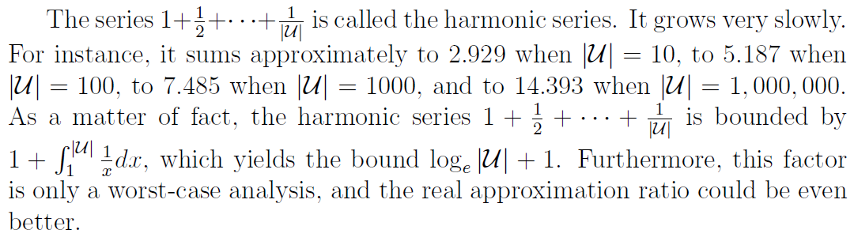
Approximation Ratio

Slide 26
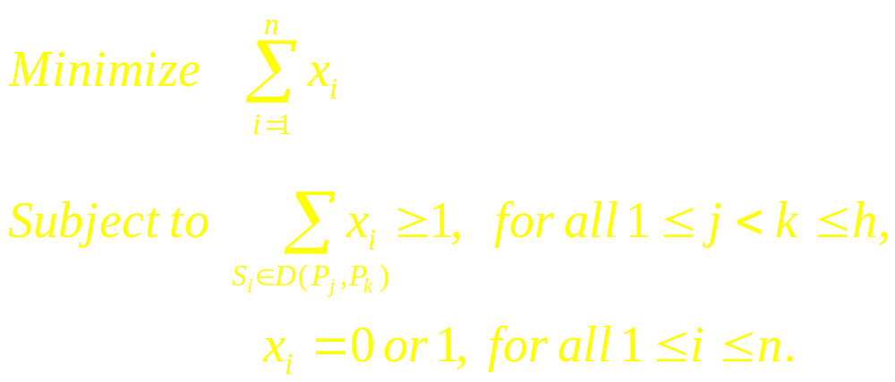
Integer Linear Programming
n SNPs, h patterns
Let x_{i} be defined as follows.
  x_{i} = 1 if the i-th SNP is selected;
  x_{i} = 0 otherwise.
Let D(P_{j}, P_{k}) be the set of SNPs that can distinguish patterns P_{j} and P_{k}.
Integer programming formulation.
Notes:
The final algorithm is a LP-relaxation algorithm.
First we need to formulate this problem as an integer programming problem.
As we mentioned, the constraint is that each bottom node needs to be covered by at least m plus 1 SNPs.

Slide 27

Problem Formulation
P₁
P₂
P₃
P₄
D(P₁, P₂)={S₃, S₄}
D(P₁, P₃)={S₁, S₃}
D(P₁, P₄)={S₁, S₂, S₄}
D(P₂, P₃)={S₁, S₄}
D(P₂, P₄)={S₁, S₂, S₃}
D(P₃, P₄)={S₂, S₃, S₄}
S₁
S₂
S₃
S₄
Notes:
To solve this problem, we first take a closer look at the function of each SNP.
If we pick SNP 1, we are sure that we can distinguish patterns 1 and 3,
Because they are in different color at this SNP locus.
And we formulate this relation into a bipartite graph.
SNP 1 can also distinguish patterns 1 and pattern 4. and so on.

Slide 28
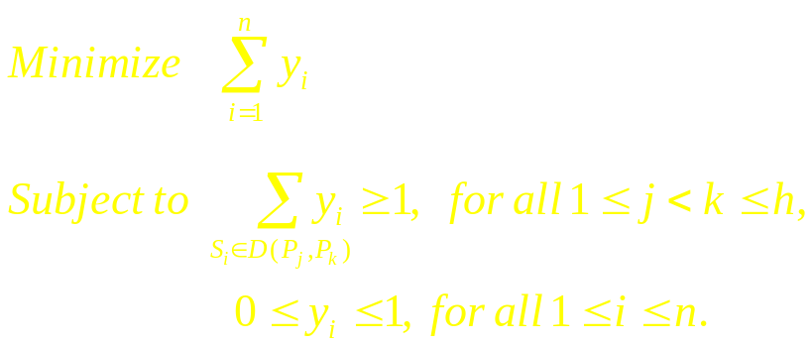
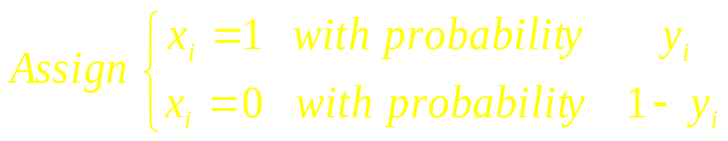
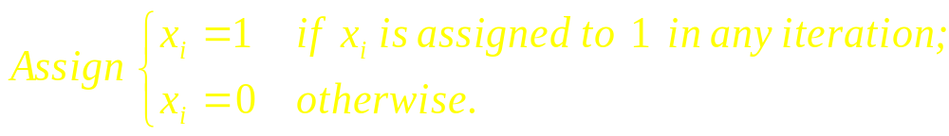
An Iterative LP-relaxation Algorithm
Linear programming relaxation.
Randomized rounding method.
Repeat the steps for those unsatisfied inequalities until all of them are satisfied.
Notes:
Then we relax the integer constraint and solve the linear programming problem.
This is so called LP-relaxation technique.
After computing the linear solutions, we obtain the integer solution by the randomized rounding method.
Finally, we check if there is any constraint still unsatisfied by this integer solution.
And repeat this process until all of them are satisfied.

Slide 29
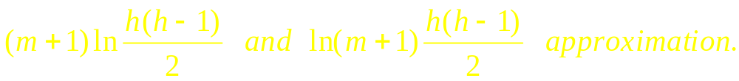

Missing Data
In reality, we may fail to obtain some tag SNPs if they do not pass the threshold of data quality.
Here we describe two greedy and one LP-relaxation algorithms to find robust tag SNPs that can tolerate missing data.
  The first and second greedy algorithms give solutions of
  The LP-relaxation algorithm gives a solution of approximation.
Notes:
The problems of finding robust and auxiliary tag SNPs are both NP-hard.
Because auxiliary tag SNPs can be found efficiently when robust tag SNPs have been computed in advance.
We will focus on finding robust tag SNPs.
We propose two greedy and one LP-relaxation algorithms to find robust tag SNPs.
And we also have mathematical proofs for the approximation bound of these algorithms.

Slide 30
The Influence of Missing Data
Haplotype pattern
P₁
P₂
P₃
P₄
P₁
P₂
P₃
P₄
S₁
S₁
S₂
S₁₂
S₃
A SNP is called missing data if it does not pass the threshold of data quality.
S₄
S₅
SNP loci
S₆
If S₁₂ is genotyped as missing data, this sample can be identified as P₂ or P₃ patterns.
S₇
S₈
S₉
S₁₀
If S₁ is genotyped as missing data, this sample can be identified as P₁ or P₃ patterns.
S₁₁
S₁₂
Notes:
Sometimes we may loss the SNP data at some locus.
This is usually called missing data.
For example, if SNP 12 is missing data, we can not tell whether this sample is P2 or P3.
If SNP S 1 is missing data, we can not distinguish whether it’s pattern 1 or 3.
This problem is what our paper trying to solve.

Slide 31
Robust Tag SNPs
P₁
P₂
P₃
P₄
S₁
P₁
P₂
P₃
P₄
S₁
S₂
S₃
S₅
S₄
S₈
S₅
S₁₂
S₆
S₇
Robust tag SNPs are a set of SNPs that can tolerate missing data.
S₁, S₅, S₈, S₁₂ can tolerate one missing tag SNP
S₈
S₉
S₁₀
S₁₁
S₁₂
Notes:
Alternatively, we can work on a set of SNPs that can tolerate missing data, called robust tag SNPs.
For example, if we wanna tolerate one missing data, we can genotype SNPs 1,5,8,12.
If any SNP is missing data, there is no identical patterns defined by the remaining three SNPs.
As a result, there will be no ambiguity.
The benefit of robust tag SNPs is that we don’t need to perform re-genotyping process whenever encountering missing data.

Slide 32
A Backup for Missing Data
P₁
P₂
P₃
P₄
S₁
If a SNP is genotyped as missing data, it is the same as the removal of its node and edges.
S₂
S₃
S₄
S₁
S₂
S₃
S₄
(1,2)
(1,3)
(1,4)
(2,3)
(2,4)
(3,4)
Suppose S₄ is genotyped as missing data
Notes:
Another important question is what’s the effect of missing data?
It is easy to tell by this graph because it’s just like removing the node and edges from the graph.

Slide 33
Problem Reformulation
P₁
P₂
P₃
P₄
To tolerate m missing tag SNPs, we need to find a set of SNPs such that each pair of patterns is covered by (m+1) edges.
e.g., We wish to find a set of robust tag SNPs that tolerates 1 missing tag SNP.
S₁
S₂
S₃
S₄
S₁
S₃
S₄
(1,2)
(1,3)
(1,4)
(2,3)
(2,4)
(3,4)
Each pair of patterns is covered by at least two edges
Notes:
From the above two observations, we claim that if we wanna tolerate m missing data,
We have to guarantee that each bottom node is covered by at least m plus 1 edges.
For example, if we wanna tolerate one missing data, SNPs 1 3 and 4 can be robust tag SNPs.
Because each node is covered by at least two edges.

Slide 34
The First Greedy Algorithm
P₁
P₂
P₃
P₄
S₁
(1,2) | (1,3) | (1,4) | (2,3) | (2,4) | (3,4)
S₂
S₄
S₁
S₁
S₁
S₁
S₄
S₃
S₃
S₃
S₄
S₄
S₃
S₃
S₄
S₁
S₃
S₄
(1,2)
(1,3)
(1,4)
(2,3)
(2,4)
(3,4)
Suppose we want to tolerate one missing tag SNP
Notes:
Suppose this graph is implemented by a table-like data structure.
Roughly speaking, the greedy approach is to pick the SNP that contributes most edges to the bottom nodes.
In this example, suppose the first algorithm picks SNP 1 first.
Then it will pick SNP 4.
In other words, this algorithm is based on a row-by-row manner.

Slide 35
The Second Greedy Algorithm
P₁
P₂
P₃
P₄
S₁
(1,2) | (1,3) | (1,4) | (2,3) | (2,4) | (3,4)
S₂
S₃
S₁
S₁
S₁
S₁
S₃
S₃
S₄
S₂
S₂
S₂
S₂
S₄
S₄
S₁
S₂
S₃
S₄
(1,2)
(1,3)
(1,4)
(2,3)
(2,4)
(3,4)
Suppose we want to tolerate one missing tag SNP
Notes:
The second algorithm picks the SNP in a scope of whole table.
For example, it will pick SNPs 1 and then SNP 2.
It doesn’t care whether the first row is not finished.

Slide 36
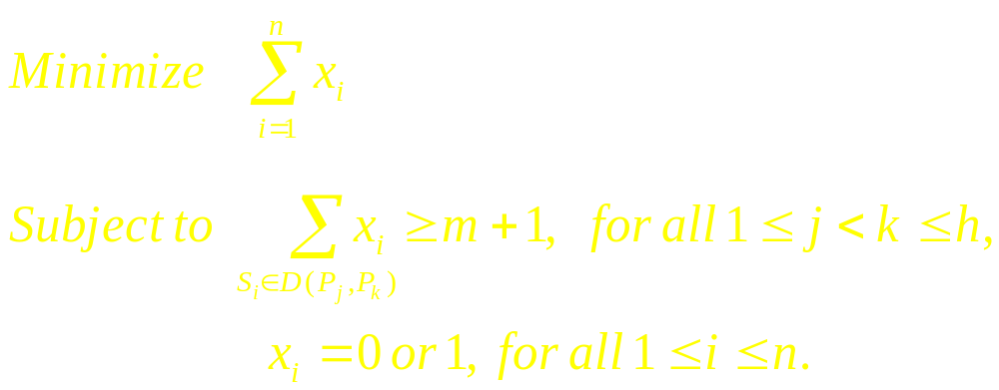
Integer Linear Programming
n SNPs, h patterns
Let x_{i} be defined as follows.
  x_{i} = 1 if the i-th SNP is selected;
  x_{i} = 0 otherwise.
Let D(P_{j}, P_{k}) be the set of SNPs that can distinguish patterns P_{j} and P_{k}.
Integer programming formulation.
Notes:
The final algorithm is a LP-relaxation algorithm.
First we need to formulate this problem as an integer programming problem.
As we mentioned, the constraint is that each bottom node needs to be covered by at least m plus 1 SNPs.

Slide 37
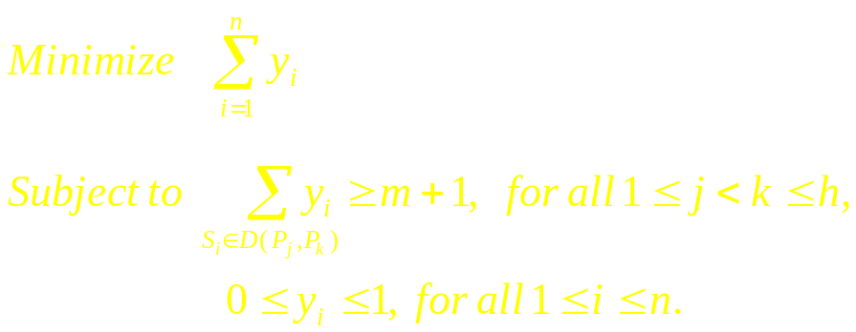
An Iterative LP-relaxation Algorithm
Linear programming relaxation.
Randomized rounding method.
Repeat the steps for those unsatisfied inequalities until all of them are satisfied.
Notes:
Then we relax the integer constraint and solve the linear programming problem.
This is so called LP-relaxation technique.
After computing the linear solutions, we obtain the integer solution by the randomized rounding method.
Finally, we check if there is any constraint still unsatisfied by this integer solution.
And repeat this process until all of them are satisfied.

Slide 38

Experimental results
The iterative LP-relaxation gives a solution of approximation.
Experimental results on the Hudson’s data sets.
  consisting of 80 haplotypes with 160 SNPs.
 | m = 0 | m = 1 | m = 2
First Greedy | 13 | 20 | 29
Second Greedy | 13 | 19 | 27
LP-relaxation | 13 | 21 | 28

Slide 39
Discussion
In this talk, we illustrate how to recast the tag SNP selection problem as the set cover problem and the integer linear programming problem.
  hard problems
  approximation algorithms
Related topics:
  LD-bins
  a specified number of tag SNPs

Slide 40




Acknowledgements
_{Yao-Ting Huang}
_{Kui Zhang}
_{Ting Chen}
_{Chia-Jung Chang}

