Slide 1

Heaviest Segments in a Number Sequence
Kun-Mao Chao (趙坤茂)
Department of Computer Science and Information Engineering
National Taiwan University, Taiwan
WWW: http://www.csie.ntu.edu.tw/~kmchao

Slide 2
C+G rich regions
locate a region with high C+G ratio
ATGACTCGAGCTCGTCA
00101011011011010
Average C+G ratio

Slide 3
Defining scores for alignment columns
infocon [Stojanovic et al., 1999]
  Each column is assigned a score that measures its information content, based on the frequencies of the letters both within the column and within the alignment.
CGGATCAT—GGA
CTTAACATTGAA
GAGAACATAGTA

Slide 4
Maximum-sum segment
Given a sequence of real numbers a₁a₂…a_{n} , find a consecutive subsequence with the maximum sum.
9 –3 1 7 –15 2 3 –4 2 –7 6 –2 8 4 -9
For each position, we can compute the maximum-sum interval ending at that position in O(n) time. Therefore, a naive algorithm runs in O(n²) time.

Slide 5
Computing a segment sum in O(1) time?
Input: a sequence of real numbers a₁a₂…a_{n}
Query: the sum of a_{i} a_{i+1}…a_{j}

Slide 6
Computing a segment sum in O(1) time
prefix-sum(i) = a₁+a₂+…+a_{i}
  all n prefix sums are computable in O(n) time.
sum(i, j) = prefix-sum(j) – prefix-sum(i-1)
i
j
prefix-sum(j)
prefix-sum(i-1)

Slide 7
Maximizing sum(i, j)
O(n)-time Method 1
sum(i, j) = prefix-sum(j) – prefix-sum(i-1)
For each location j, prefix-sum(j) is fixed. To compute the maximum-sum interval ending at position j can be done by finding the minimum prefix-sum before position j.
i
j
prefix-sum(j)
prefix-sum(i-1)

Slide 8


Maximum-sum interval
Sequence 9 –3 1 7 –15 2 3 –4 2 –7 6 –2 8 4 -9
prefix-sum(j) 0 9 6 7 14 -1 1 4 0 2 -5 1 -1 7 11 2
prefix-min(j) 0 0 0 0 0 0-1-1 -1-1 -1-5 -5 -5 -5 -5
max_sum(j) 0 9 6 7 14 -1 2 5 1 3 -4 6 4 12 16 7
prefix-sum(j)= a₁+a₂+…+a_{j}
The maximum sum
prefix-min(j): the minimum prefix-sum before position j
max_sum(j)= prefix-sum(j)-prefix-min(j)
The maximum-sum interval: 6 -2 8 4

Slide 9
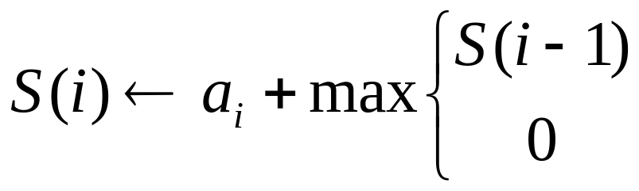
Maximum-sum interval
(The recurrence relation)
Define S(i) to be the maximum sum of the intervals ending at position i.
O(n)-time Method 2
a_{i}
If S(i-1) < 0, concatenating a_{i} with its previous interval gives less sum than a_{i} itself.

Slide 10
Maximum-sum interval
(Tabular computation)
9 –3 1 7 –15 2 3 –4 2 –7 6 –2 8 4 -9
S(i) 9 6 7 14 –1 2 5 1 3 –4 6 4 12 16 7
The maximum sum

Slide 11
Maximum-sum interval
(Traceback)
9 –3 1 7 –15 2 3 –4 2 –7 6 –2 8 4 -9
S(i) 9 6 7 14 –1 2 5 1 3 –4 6 4 12 16 7
The maximum-sum interval: 6 -2 8 4

Slide 12
Maximum-average segment
Maximum-average interval
3 2 14 6 6 2 10 2 6 6 14 2 1
The maximum element is the answer. It can be done in O(n) time.

Slide 13
Computing segment average in O(1) time
prefix-sum(i) = S[1]+S[2]+…+S[i],
  all n prefix sums are computable in O(n) time.
sum(i, j) = prefix-sum(j) – prefix-sum(i-1)
density(i, j) = sum(i, j) / (j-i+1)
i
j
prefix-sum(j)
prefix-sum(i-1)

Slide 14
Maximum average segments
Define A(i) to be the maximum average of the segments starting at position i.
How to compute A(i) efficiently?

Slide 15
Right-Skew Decomposition
Partition S into substrings S₁,S₂,…,S_{k} such that
  each S_{i} is a right-skew substring of S
    the average of any prefix is always less than or equal to the average of the remaining suffix.
  density(S₁) > density(S₂) > … > density(S_{k})
[Lin, Jiang, Chao]
  Unique
  Computable in linear time.
  The Inventors of the Right-Skew Decomposition (Oops! Wrong photo!)
  The Inventors of the Right-Skew Decomposition (This is a right one. more)

Slide 16
Right-Skew Decomposition
Decreasingly right-skew decomposition (O(n) time)
5
7.5
6
5
9
8
9
8
7
8
9 7 8 1 9 8 3 7 2 8

Slide 17
Right-Skew pointers p[ ]
5
7.5
6
5
9
8
9
8
7
8
9 7 8 1 9 8 3 7 2 8
1 2 3 4 5 6 7 8 9 10
p[ ] 1 3 3 6 5 6 10 8 10 10
A[ ] 9 7.5 8 6 9 8 5 7 5 8

Slide 18
Left-Skew Decomposition
Define B(i) to be the maximum average of the segments ending at position i.
Partition S into substrings S₁,S₂,…,S_{k} such that
  each S_{i} is a left-skew substring of S
    the average of any suffix is always less than or equal to the average of the remaining prefix.
  density(S₁) < density(S₂) < … < density(S_{k})
Compute B(i) in linear time

Slide 19
Left-Skew Decomposition
Increasingly left-skew decomposition (O(n) time)
5
6
7.5
5
8
7
8
9
8
9
8 2 7 3 8 9 1 8 7 9

