Slide 1
Multiple Sequence Alignment
Kun-Mao Chao (趙坤茂)
Department of Computer Science and Information Engineering
National Taiwan University, Taiwan
WWW: http://www.csie.ntu.edu.tw/~kmchao

Slide 2
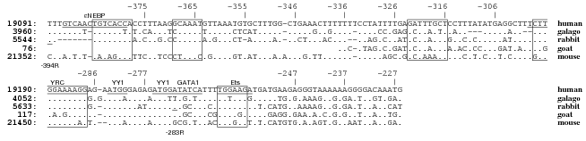
MSA

Slide 3
Multiple sequence alignment (MSA)
The multiple sequence alignment problem is to simultaneously align more than two sequences.
Seq1: GCTC
Seq2: AC
Seq3: GATC
GC-TC
A---C
G-ATC

Slide 4
How to score an MSA?
Sum-of-Pairs (SP-score)
GC-TC
A---C
Score
GC-TC
A---C
G-ATC
+
GC-TC
G-ATC
Score
Score
=
+
A---C
G-ATC
Score

Slide 5

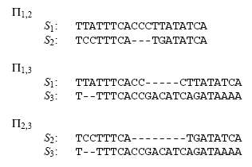

Slide 6

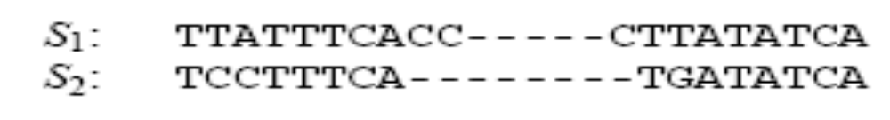
Gaps

Slide 7
MSA for three sequences
an O(n³) algorithm

Slide 8
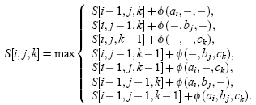
MSA for three sequences

Slide 9
General MSA
For k sequences of length n: O(n^{k})
  Both n and k are input variables
  k = 100 & n = 100 ➔ 100¹⁰⁰= 10²⁰⁰!
NP-Complete (Wang and Jiang)
The exact multiple alignment algorithms for many sequences are not feasible.
Some approximation algorithms are given.
(e.g., 2- l/k for any fixed l by Bafna et al.)

Slide 10
Progressive alignment
A heuristic approach proposed by Feng and Doolittle.
It iteratively merges the most similar pairs.
“Once a gap, always a gap”
A B C D E

Slide 11
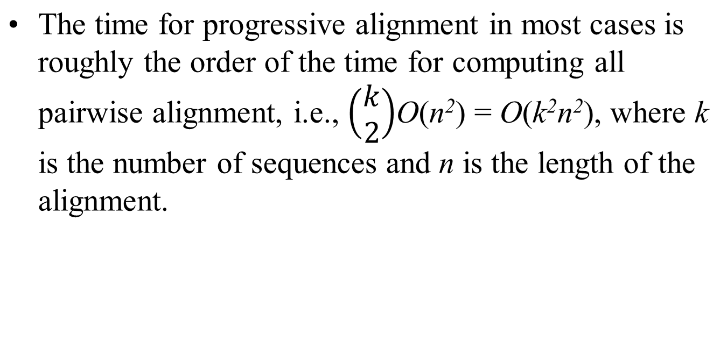
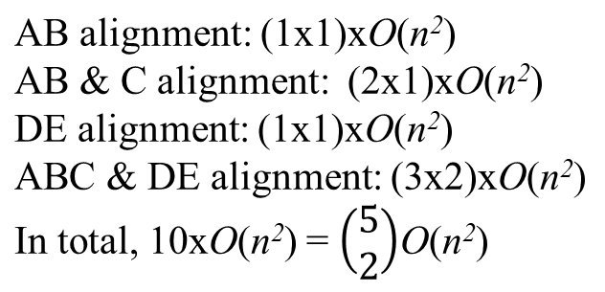
Progressive alignment
A B C D E

Slide 12
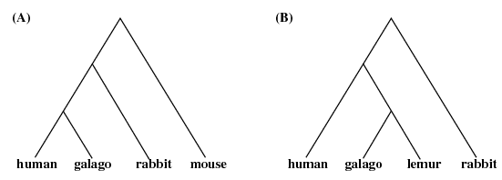
The Guide Trees

Slide 13
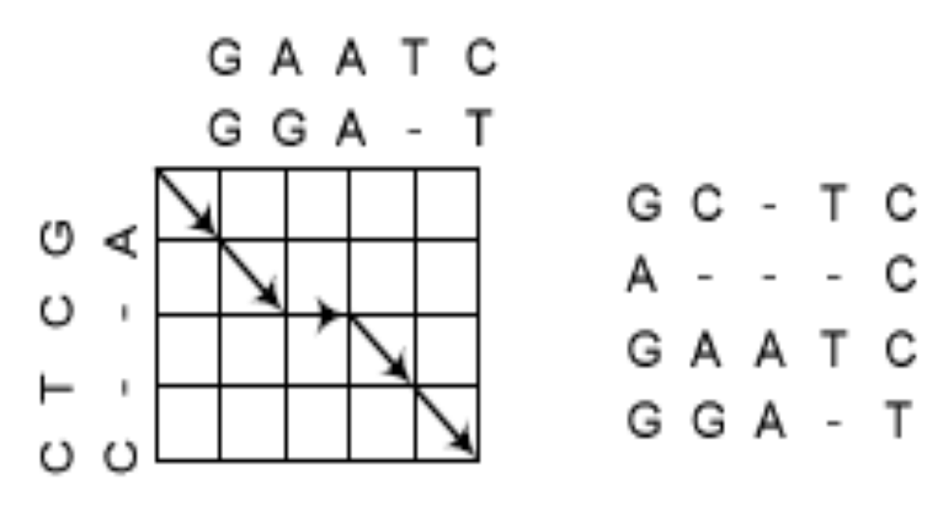
Aligning Alignments
It can be seen that a path in the alignment graph corresponds to an alignment of the two alignments. Note that the path in this example may not be optimal.

Slide 14
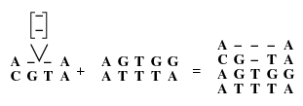
Affine Gaps
For affine gap penalties, the computation of the current column does not depend simply on its previous column.

Slide 15
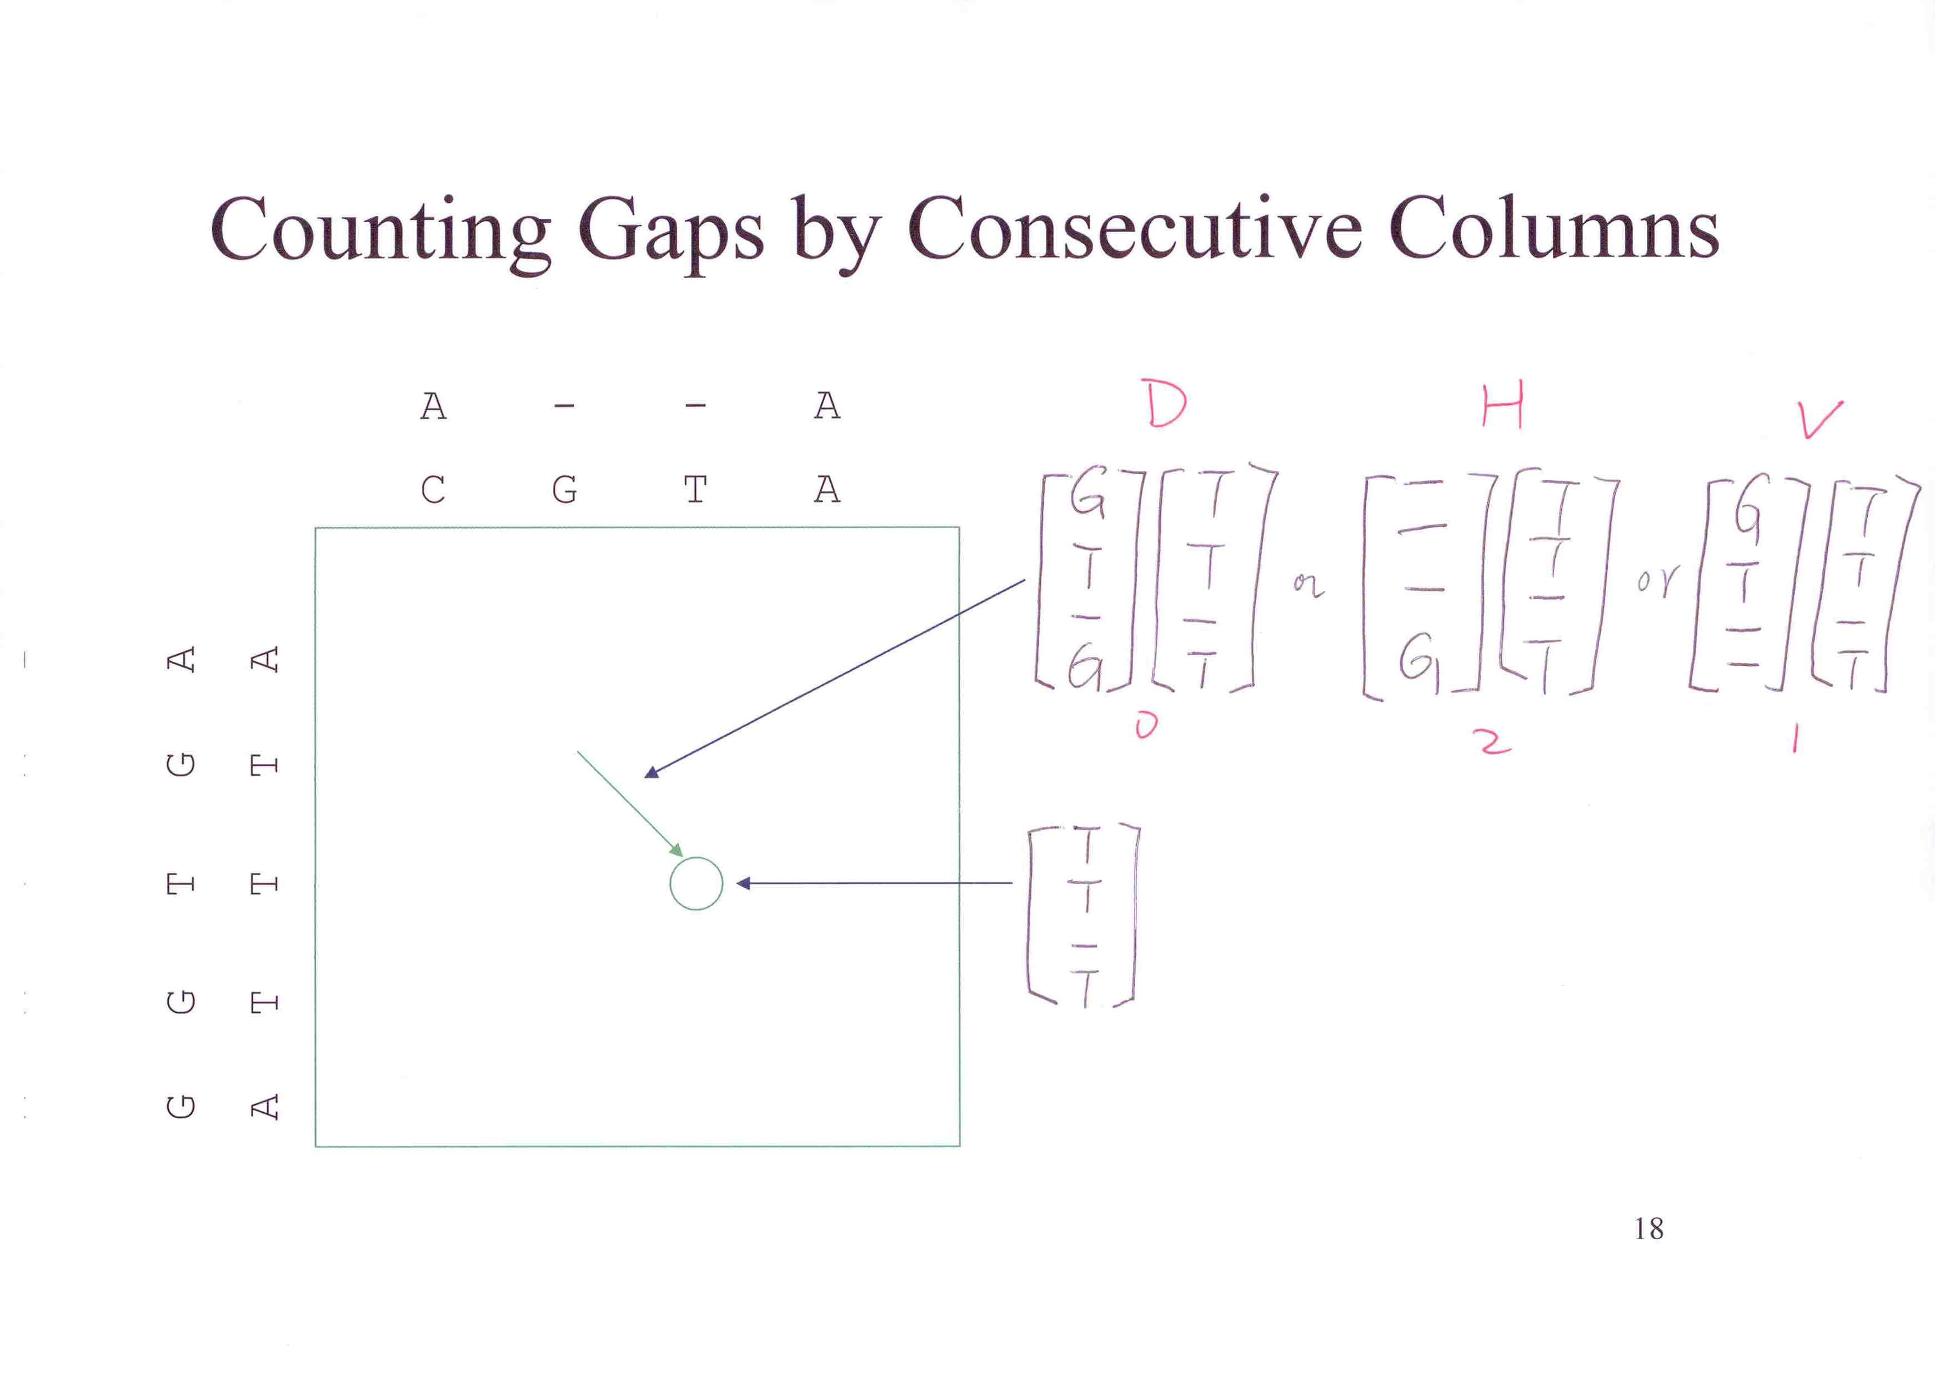

Slide 16
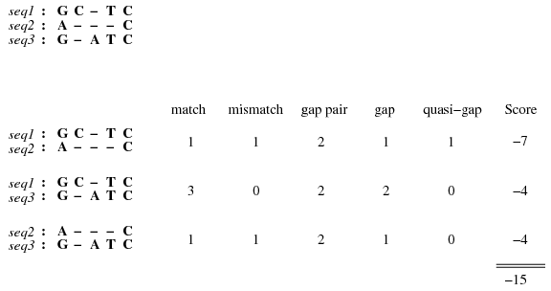
Quasi-Gaps
match: +1, mismatch:-1, gap-pair:-0.5, gap(penality):-3

Slide 17

Gap Starts & Gap Ends

Slide 18
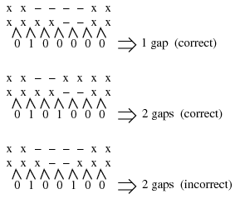
Gaps

Slide 19
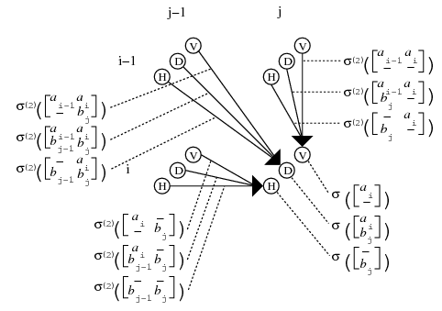
Nine Ways In

Slide 20
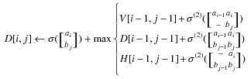
D[i, j]

