Slide 1

Space-Saving Strategies for Analyzing Biomolecular Sequences
Kun-Mao Chao (趙坤茂)
Department of Computer Science and Information Engineering
National Taiwan University, Taiwan
URL: http://www.csie.ntu.edu.tw/~kmchao

Slide 2
Linear-space ideas
Hirschberg, 1975; Myers and Miller, 1988
m/2
Partition line

Slide 3
S⁻(i, j) and S⁺(i, j)
S⁻(i, j): the best score of a path from (0, 0) to (i, j)
S⁺(i, j): the best score of a path from (i, j) to (m, n)
S⁻(i, j) + S⁺(i, j): the best score of any path passing through (i, j)
S ⁻
S ⁺

Slide 4
Mid-partition-points
S⁻(m/2, j): the best score of a path from (0, 0) to (m/2, j)
S⁺(m/2, j): the best score of a path from (m/2, j) to (m, n)
Select the point that maximizes S⁻(m/2, j) + S⁺(m/2, j)
S ⁻
The middle row m/2
S ⁺

Slide 5
Match: 8
Mismatch: -5
Gap symbol: -3
C G G A T C A T
0 | -3 | -6 | -9 | -12 | -15 | -18 | -21 | -24
-3 | 8 | 5 | 2 | -1 | -4 | -7 | -10 | -13
-6 | 5 | 3 | 0 | -3 | 7 | 4 | 1 | -2
-9 | 2 | 0 | -2 | -5 | 5 | 2 | -1 | 9
-12 | -1 | -3 | -5 | 6 | 3 | 0 | 10 | 7
-15 | -4 | -6 | -8 | 3 | 1 | -2 | 8 | 5
-18 | -7 | -9 | -11 | 0 | -2 | 9 | 6 | 3
-21 | -10 | -12 | -14 | -3 | 8 | 6 | 4 | 14
C
T
T
A
A
C
T
optimal score

Slide 6
C T T A A C – T
C G G A T C A T
8 – 5 –5 +8 -5 +8 -3 +8 = 14
C G G A T C A T
0 | -3 | -6 | -9 | -12 | -15 | -18 | -21 | -24
-3 | 8 | 5 | 2 | -1 | -4 | -7 | -10 | -13
-6 | 5 | 3 | 0 | -3 | 7 | 4 | 1 | -2
-9 | 2 | 0 | -2 | -5 | 5 | 2 | -1 | 9
-12 | -1 | -3 | -5 | 6 | 3 | 0 | 10 | 7
-15 | -4 | -6 | -8 | 3 | 1 | -2 | 8 | 5
-18 | -7 | -9 | -11 | 0 | -2 | 9 | 6 | 3
-21 | -10 | -12 | -14 | -3 | 8 | 6 | 4 | 14
C
T
T
A
A
C
T

Slide 7
Match: 8
Mismatch: -5
Gap symbol: -3
S⁻ Matrix
C G G A T C A T
0 | -3 | -6 | -9 | -12 | -15 | -18 | -21 | -24
-3 | 8 | 5 | 2 | -1 | -4 | -7 | -10 | -13
-6 | 5 | 3 | 0 | -3 | 7 | 4 | 1 | -2
-9 | 2 | 0 | -2 | -5 | 5 | 2 | -1 | 9
-12 | -1 | -3 | -5 | 6 | 3 | 0 | 10 | 7
-15 | -4 | -6 | -8 | 3 | 1 | -2 | 8 | 5
-18 | -7 | -9 | -11 | 0 | -2 | 9 | 6 | 3
-21 | -10 | -12 | -14 | -3 | 8 | 6 | 4 | 14
C
T
T
A
A
C
T

Slide 8
Match: 8
Mismatch: -5
Gap symbol: -3
S⁺ Matrix
C G G A T C A T
 |  |  |  |  |  |  |  | -21
 |  |  |  |  |  |  |  | -18
 |  |  |  |  |  |  |  | -15
 |  |  |  |  |  |  |  | -12
 |  |  |  |  |  |  |  | -9
 |  |  |  |  |  |  |  | -6
 |  |  |  |  |  |  |  | -3
-24 | -21 | -18 | -15 | -12 | -9 | -6 | -3 | 0
C
T
T
A
A
C
T

Slide 9
Match: 8
Mismatch: -5
Gap symbol: -3
S⁺ Matrix
C G G A T C A T
14 | 3 | 6 | 8 | 10 | 12 | 1 | -10 | -21
3 | 6 | 8 | 11 | 13 | 2 | 4 | -7 | -18
5 | 8 | 11 | 13 | 16 | 5 | 7 | -4 | -15
7 | 10 | 13 | 16 | 5 | 8 | 10 | -1 | -12
9 | 12 | 15 | 18 | 8 | 10 | 13 | 2 | -9
-2 | 1 | 4 | 7 | 10 | 13 | 3 | 5 | -6
-13 | -10 | -7 | -4 | -1 | 2 | 5 | 8 | -3
-24 | -21 | -18 | -15 | -12 | -9 | -6 | -3 | 0
C
T
T
A
A
C
T

Slide 10
Match: 8
Mismatch: -5
Gap symbol: -3
S⁻ and S⁺ Matrix
C G G A T C A T
0 14 | -3 3 | -6 6 | -9 8 | -12 10 | -15 12 | -18 1 | -21 -10 | -24 -21
-3 3 | 8 6 | 5 8 | 2 11 | -1 13 | -4 2 | -7 4 | -10 -7 | -13 -18
-6 5 | 5 8 | 3 11 | 0 13 | -3 16 | 7 5 | 4 7 | 1 -4 | -2 -15
-9 7 | 2 10 | 0 13 | -2 16 | -5 5 | 5 8 | 2 10 | -1 -1 | 9 -12
-12 9 | -1 12 | -3 15 | -5 18 | 6 8 | 3 10 | 0 13 | 10 2 | 7 -9
-15 -2 | -4 1 | -6 4 | -8 7 | 3 10 | 1 13 | -2 3 | 8 5 | 5 -6
-18 -13 | -7 -10 | -9 -7 | -11 -4 | 0 -1 | -2 2 | 9 5 | 6 8 | 3 -3
-21 -24 | -10 -21 | -12 -18 | -14 -15 | -3 -12 | 8 -9 | 6 -6 | 4 -3 | 14 0
C
T
T
A
A
C
T

Slide 11
Match: 8
Mismatch: -5
Gap symbol: -3
S⁻ and S⁺ Matrix
C G G A T C A T
0 14 | -3 3 | -6 6 | -9 8 | -12 10 | -15 12 | -18 1 | -21 -10 | -24 -21
-3 3 | 8 6 | 5 8 | 2 11 | -1 13 | -4 2 | -7 4 | -10 -7 | -13 -18
-6 5 | 5 8 | 3 11 | 0 13 | -3 16 | 7 5 | 4 7 | 1 -4 | -2 -15
-9 7 | 2 10 | 0 13 | -2 16 | -5 5 | 5 8 | 2 10 | -1 -1 | 9 -12
-12 9 | -1 12 | -3 15 | -5 18 | 6 8 | 3 10 | 0 13 | 10 2 | 7 -9
-15 -2 | -4 1 | -6 4 | -8 7 | 3 10 | 1 13 | -2 3 | 8 5 | 5 -6
-18 -13 | -7 -10 | -9 -7 | -11 -4 | 0 -1 | -2 2 | 9 5 | 6 8 | 3 -3
-21 -24 | -10 -21 | -12 -18 | -14 -15 | -3 -12 | 8 -9 | 6 -6 | 4 -3 | 14 0
C
T
T
A
A
C
T

Slide 12
Match: 8
Mismatch: -5
Gap symbol: -3
S⁻ + S⁺ Matrix
C G G A T C A T
14 | 0 | 0 | -1 | -2 | -3 | -17 | -31 | -45
0 | 14 | 13 | 13 | 12 | -2 | -3 | -17 | -31
-1 | 13 | 14 | 13 | 13 | 12 | 11 | -3 | -17
-2 | 12 | 13 | 14 | 0 | 13 | 12 | -2 | -3
-3 | 11 | 12 | 13 | 14 | 13 | 13 | 12 | -2
-17 | -3 | -2 | -1 | 13 | 14 | 1 | 13 | -1
-31 | -17 | -16 | -15 | -1 | 0 | 14 | 14 | 0
-45 | -31 | -30 | -29 | -15 | -1 | 0 | 1 | 14
C
T
T
A
A
C
T

Slide 13
Match: 8
Mismatch: -5
Gap symbol: -3
S⁻ + S⁺ Matrix
C G G A T C A T
14 | 0 | 0 | -1 | -2 | -3 | -17 | -31 | -45
0 | 14 | 13 | 13 | 12 | -2 | -3 | -17 | -31
-1 | 13 | 14 | 13 | 13 | 12 | 11 | -3 | -17
-2 | 12 | 13 | 14 | 0 | 13 | 12 | -2 | -3
-3 | 11 | 12 | 13 | 14 | 13 | 13 | 12 | -2
-17 | -3 | -2 | -1 | 13 | 14 | 1 | 13 | -1
-31 | -17 | -16 | -15 | -1 | 0 | 14 | 14 | 0
-45 | -31 | -30 | -29 | -15 | -1 | 0 | 1 | 14
C
T
T
A
A
C
T

Slide 14
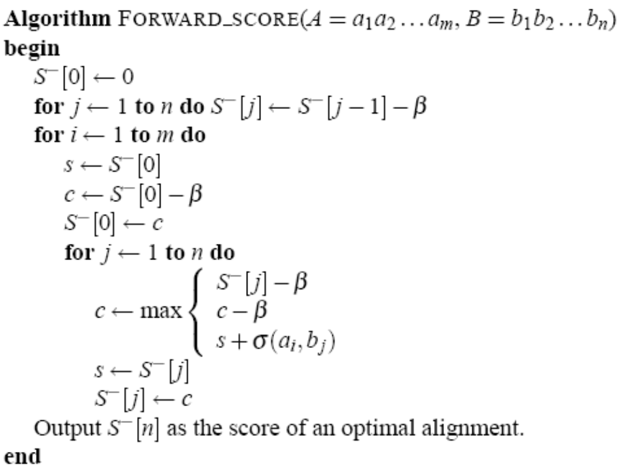
Consider the case where the penalty for a gap is merely proportional to the gap’s length, i.e., k x β for a k-symbol gap.

Slide 15
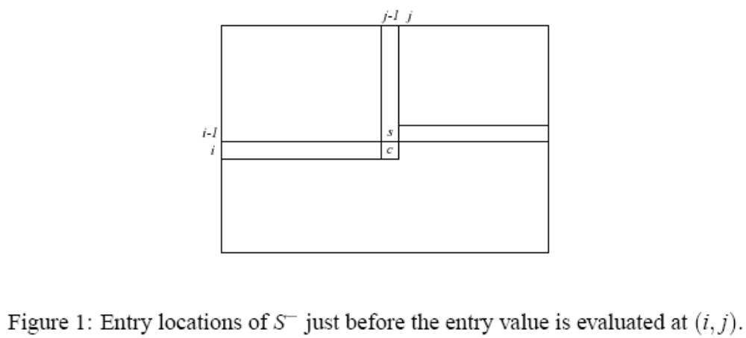

Slide 16
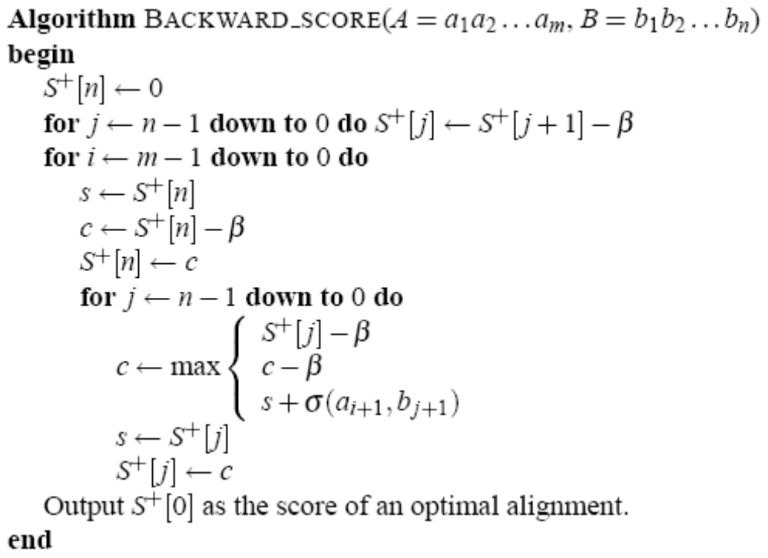

Slide 17
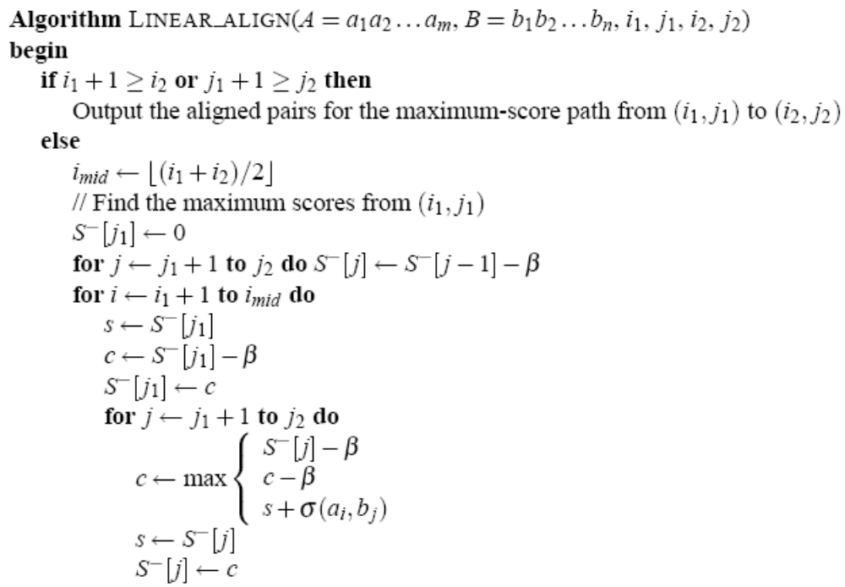

Slide 18
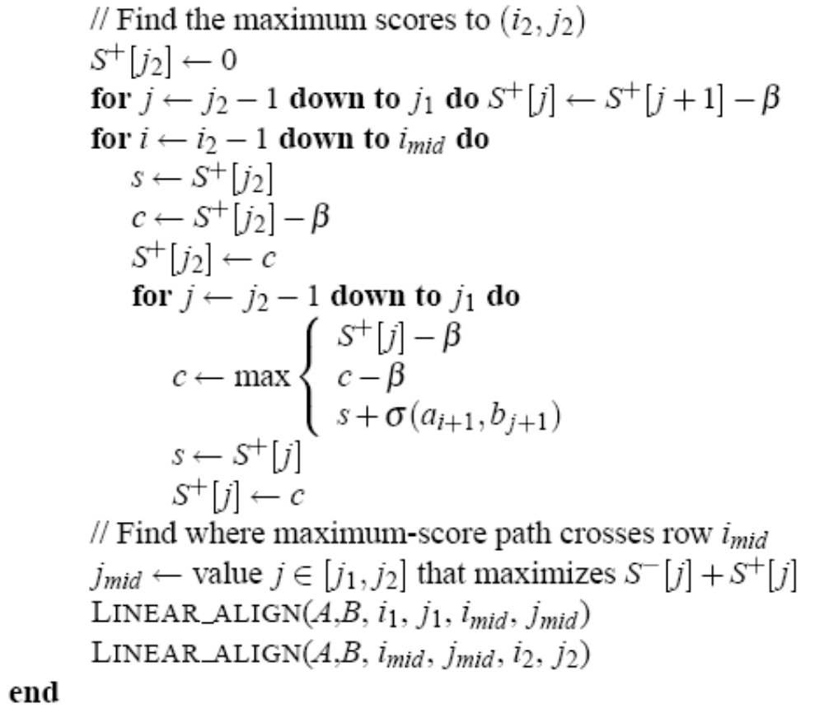

Slide 19
Match: 8
Mismatch: -5
Gap symbol: -3
S⁻ + S⁺ Matrix
C G G A T C A T
14 | 0 | 0 | -1 | -2 | -3 | -17 | -31 | -45
0 | 14 | 13 | 13 | 12 | -2 | -3 | -17 | -31
-1 | 13 | 14 | 13 | 13 | 12 | 11 | -3 | -17
-2 | 12 | 13 | 14 | 0 | 13 | 12 | -2 | -3
-3 | 11 | 12 | 13 | 14 | 13 | 13 | 12 | -2
-17 | -3 | -2 | -1 | 13 | 14 | 1 | 13 | -1
-31 | -17 | -16 | -15 | -1 | 0 | 14 | 14 | 0
-45 | -31 | -30 | -29 | -15 | -1 | 0 | 1 | 14
C
T
T
A
A
C
T

Slide 20
Match: 8
Mismatch: -5
Gap symbol: -3
S⁻ and S⁺ Matrix
C G G A T C A T
0 | -3 | -6 | -9 | -12 | -15 | -18 | -21 | -24
-3 | 8 | 5 | 2 | -1 | -4 | -7 | -10 | -13
-6 | 5 | 3 | 0 | -3 | 7 | 4 | 1 | -2
-9 7 | 2 10 | 0 13 | -2 16 | -5 5 | 5 8 | 2 10 | -1 -1 | 9 -12
9 | 12 | 15 | 18 | 8 | 10 | 13 | 2 | -9
-2 | 1 | 4 | 7 | 10 | 13 | 3 | 5 | -6
-13 | -10 | -7 | -4 | -1 | 2 | 5 | 8 | -3
-24 | -21 | -18 | -15 | -12 | -9 | -6 | -3 | 0
C
T
T
A
A
C
T

Slide 21
Match: 8
Mismatch: -5
Gap symbol: -3
S⁻ and S⁺ Matrix
C G G A T C A T
0 | -3 | -6 | -9 | -12 | -15 | -18 | -21 | -24
-3 | 8 | 5 | 2 | -1 | -4 | -7 | -10 | -13
-6 | 5 | 3 | 0 | -3 | 7 | 4 | 1 | -2
-9 7 | 2 10 | 0 13 | -2 16 | -5 5 | 5 8 | 2 10 | -1 -1 | 9 -12
9 | 12 | 15 | 18 | 8 | 10 | 13 | 2 | -9
-2 | 1 | 4 | 7 | 10 | 13 | 3 | 5 | -6
-13 | -10 | -7 | -4 | -1 | 2 | 5 | 8 | -3
-24 | -21 | -18 | -15 | -12 | -9 | -6 | -3 | 0
C
T
T
A
A
C
T

Slide 22
Two subproblems
½ original problem size
m/4
m/2
3m/4

Slide 23
Four subproblems
¼ original problem size
m/4
m/2
3m/4

Slide 24
Time and Space Complexity
Space: O(m+n)
Time:
O(mn)*(1+ ½ + ¼ + …) = O(mn)
2

Slide 25

Local Alignment
Finding two end-points in linear space
Applying Hirschberg’s approach

Slide 26
Find two end-points in linear space
(Recording the start-end pairs)
The best end

Slide 27
Find two end-points in linear space
(Backtracking from the end)
The best end

Slide 28
Band Alignment
(Joint work with W. Pearson and W. Miller)
Sequence A
Sequence B

Slide 29
Band Alignment in Linear Space
The remaining subproblems are no longer half the size of the original problem. In the worst case, this could cause an additional log n factor in time.
W
O(log n)
O(nW)*(1+1+…+1)
=O(nW log n)

Slide 30
Band Alignment in Linear Space

Slide 31
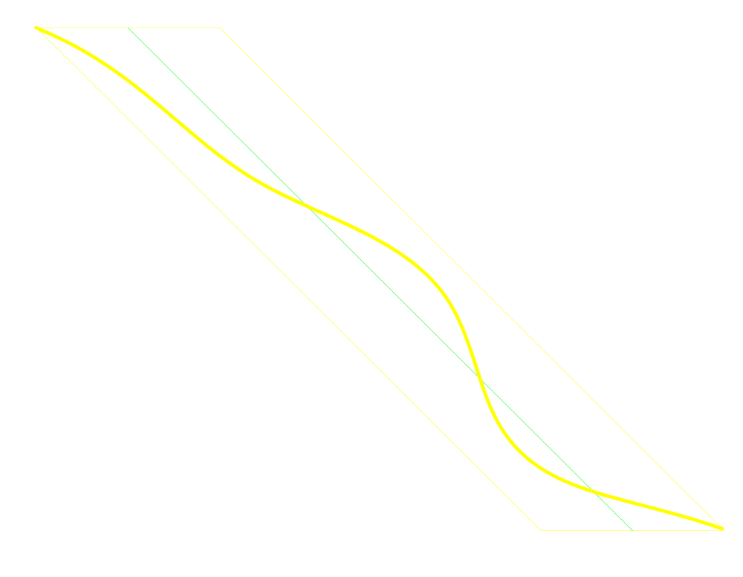
Parallelogram

Slide 32
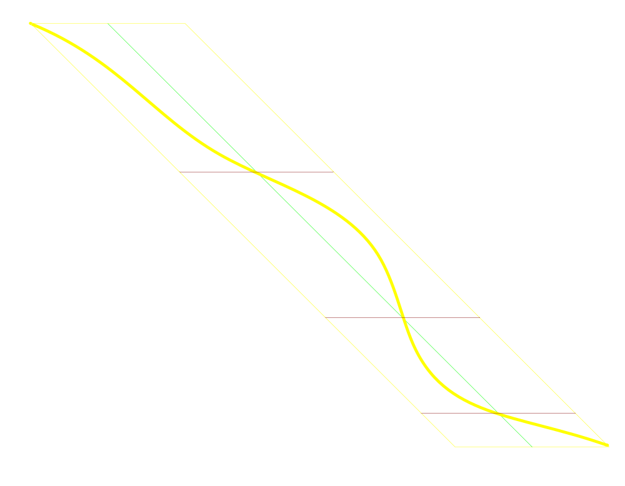
Parallelogram

Slide 33
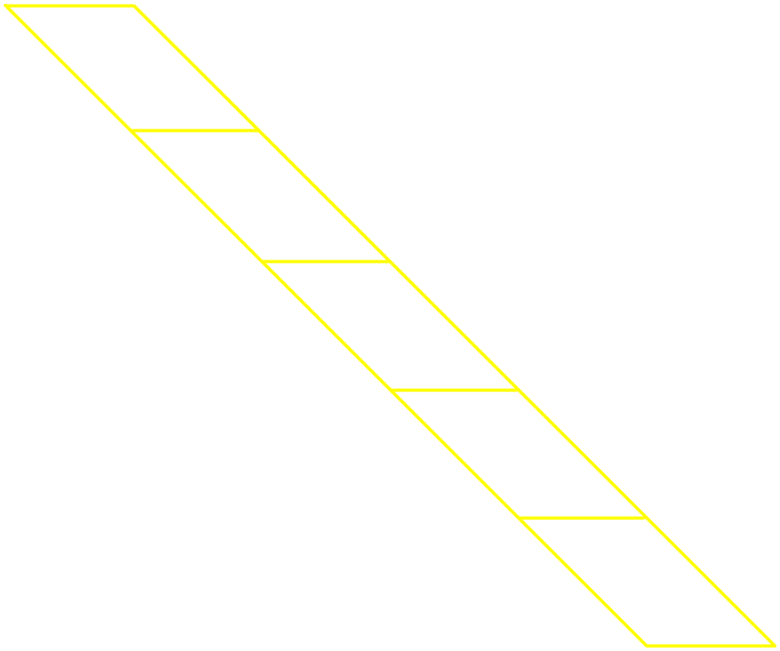
Yet another partition line
Band width W

Slide 34
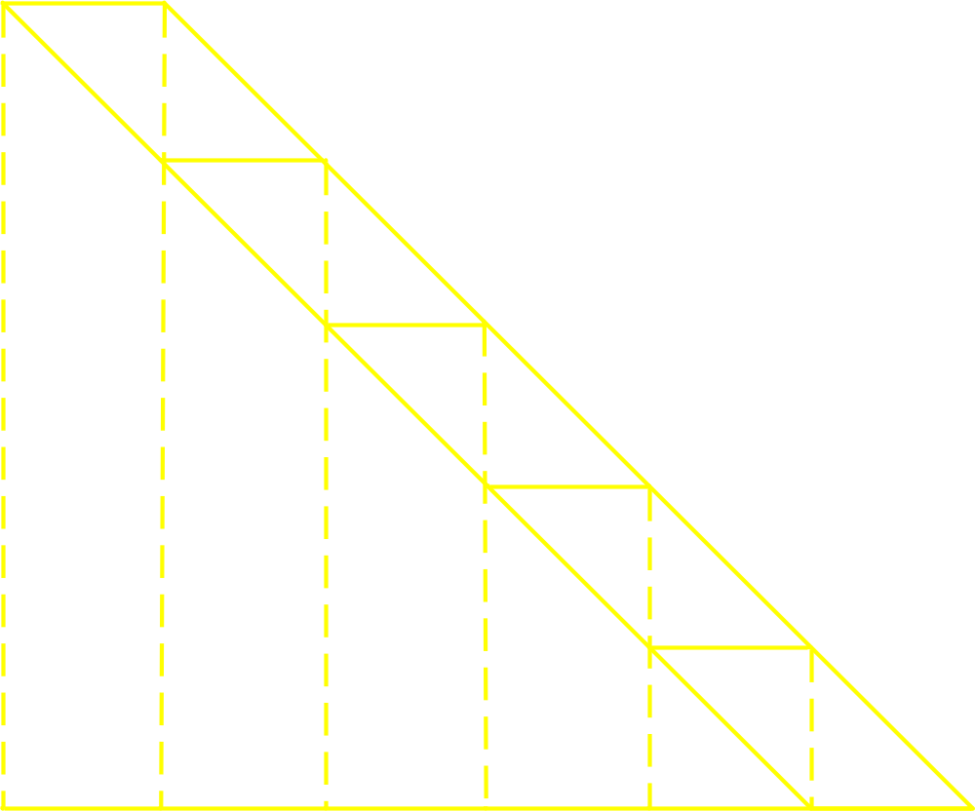
Yet another partition line
O(n)

Slide 35
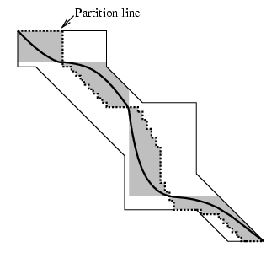
Arbitrary region

Slide 36
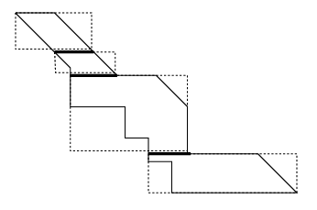
Arbitrary region

