Slide 1
neo4j Graph Algorithms Library Extension
資工所 易大中
網媒所 王郁婷
資科所 蔡昀達
電機丙 蘇彥齊

Slide 2
Agenda
Neo4j Graph Algorithm Library Introduction
Neo4j Procedure Template
Approximate Nearest Neighbors
Group Centralization
Neo4j Graph Algorithm Extension
Reach Centrality
Encoding
Conclusion and Future Work

Slide 3
Introduction – Neo4j Graph Algorithm Library
Graph algorithms are for large scale graph analytics and to support machine learning pipelines on graphs, nodes, or relationships.
Algorithm with highly parallelized and large scale implementation
Directly provide insights on relevant entities in the graph
centralities, ranking
Match inherent structures
community-detection, graph-partitioning, clustering
Frequently iterative traversing through graph
random walks, bfs, dfs, pattern matching.

Slide 4
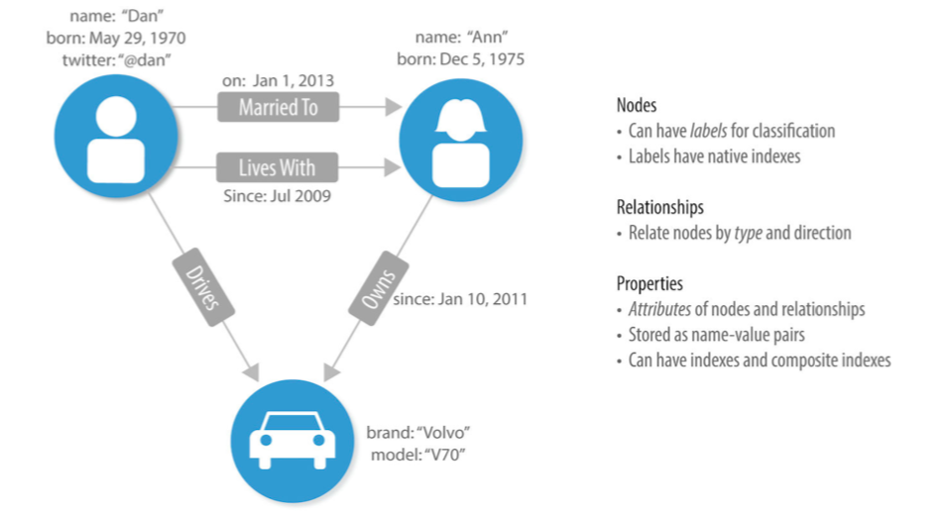

Slide 5
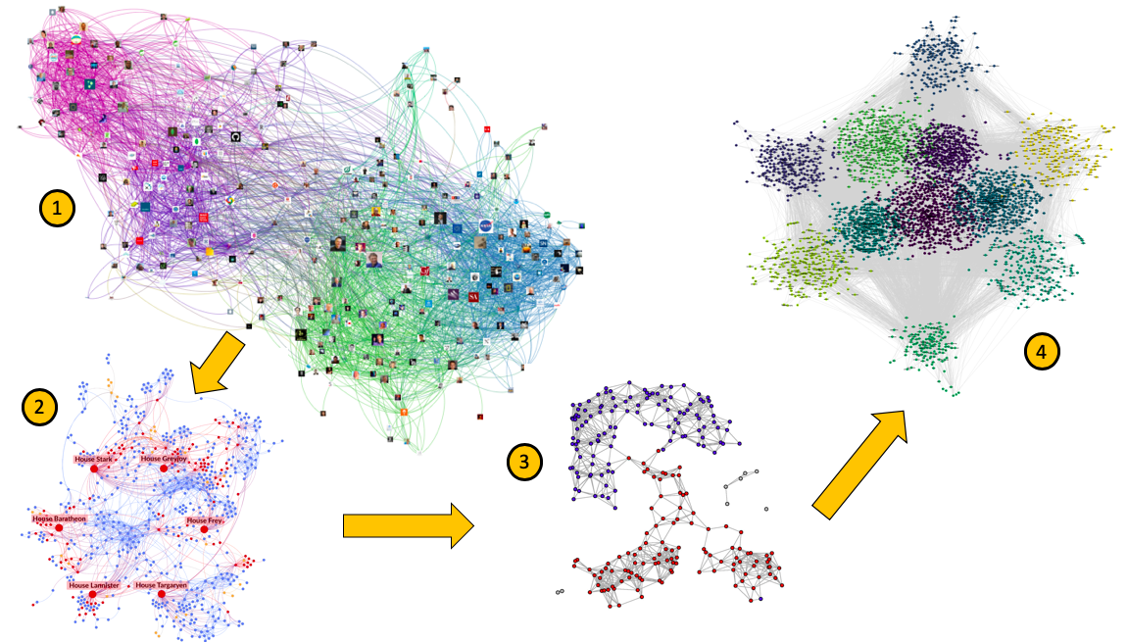

Slide 6
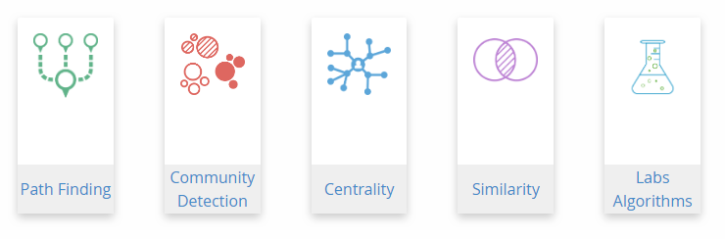
Neo4j Graph Algorithm

Slide 7
Neo4j Graph Algorithm
Centrality algorithms
Degree, Closeness, Betweenness, Eigenvector, Harmonic...
Community detection algorithms
Weakly / Strongly Connected Components, Clustering Coefficient
Graph similarity algorithms
Jaccard / Cosine / Pearson Similarity, Euclidean Distance, Approximate Nearest Neighbors

Slide 8
Neo4j Procedure Template
Enable user to extend Neo4j by writing custom code, which can be invoked directly from Cypher.
Build the project using Apache Maven and compile as a jar-file that can be deployed as plugin.
Unit test & integration test
User Defined Procedure
User Defined Function

Slide 9
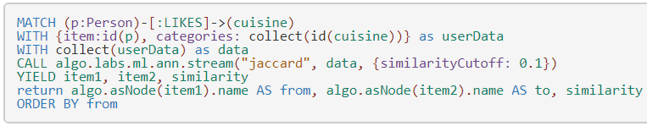
The Approximate Nearest Neighbors
The Approximate Nearest Neighbors algorithm constructs a k-Nearest Neighbors Graph for a set of objects based on a provided similarity algorithm.

Slide 10
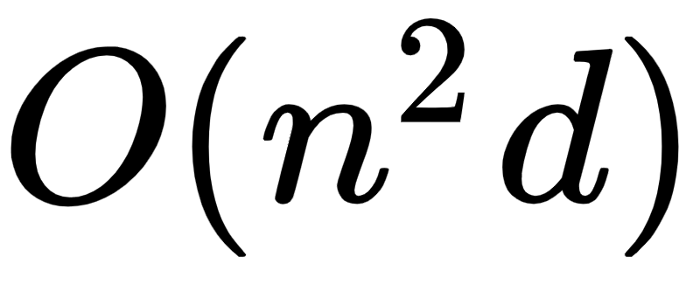
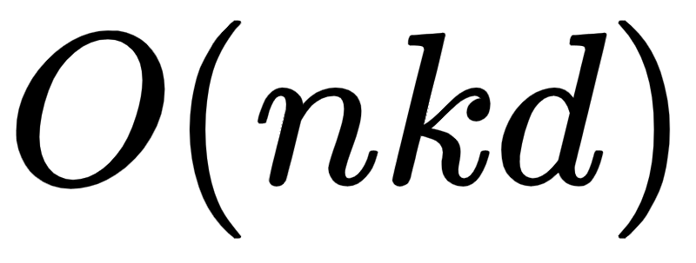
Drawback
Calculate entire graph every time with high complexity
With approximation

Slide 11
Limitation
Only relationship left after calculation
No data structure to support dynamic context
ex. R-tree*^{[1]}
Only topK relationship remain
distance matrix incomplete

Slide 12
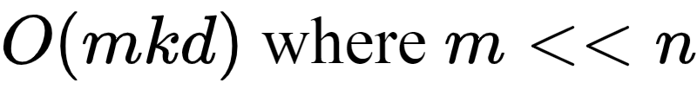
Improvements
Update new insert nodes only
Utilize existing similarity relationships → Proximity graph method
Greedy traversing algorithm
current state-of-the-art for the approximate nearest neighbors search^{[2][3][4]}

Slide 13
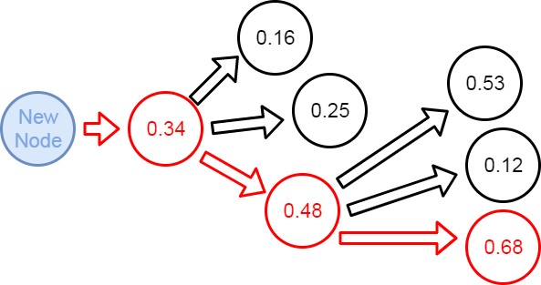
Greedy traversing algorithm

Slide 14
Interface
Original
CALL algo.labs.ml.ann.stream("jaccard", data, {writeRelationType: "SIMILAR", writeProperty: "score"})
Our new procedure
CALL algo.labs.ml.ann.update.stream("jaccard", data, {RelationType: "SIMILAR", Property: "score"})

Slide 15
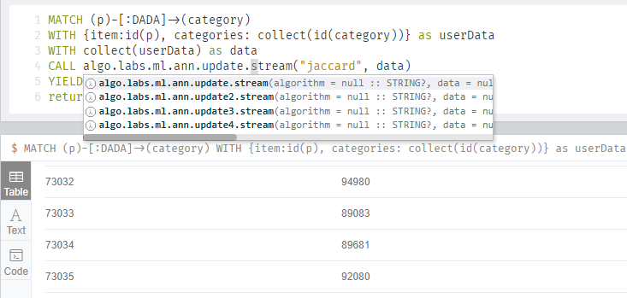
Example

Slide 16
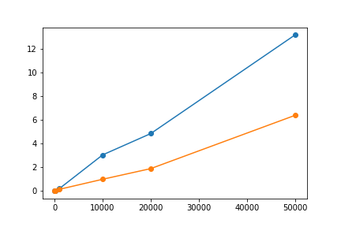
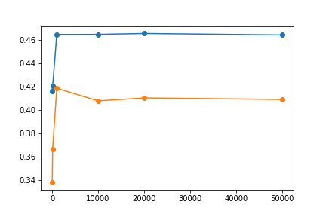
Performance
execution time
approximate error

Slide 17
Group Centralization
Group level measures allow us to compare different networks easily.
Group level index of centralization
– Shows that the larger it is, the more likely it is that a single node is quite central, with the remaining nodes considerably less central

Slide 18
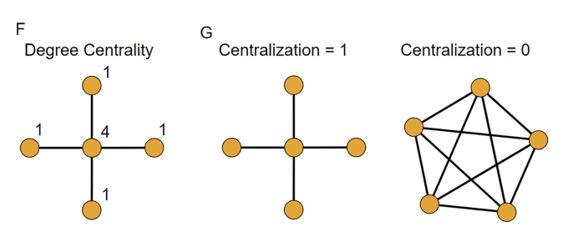
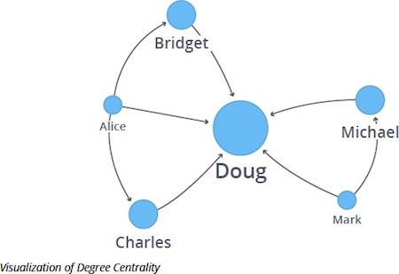
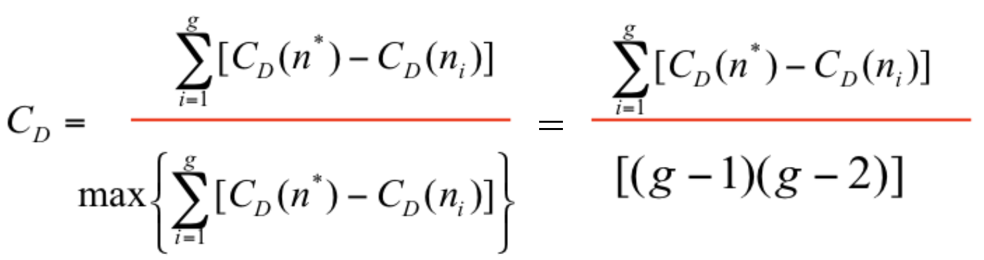
Group Degree Centralization
Degree Centrality is usually used to find the popularity of individual nodes

Slide 19
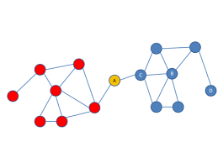
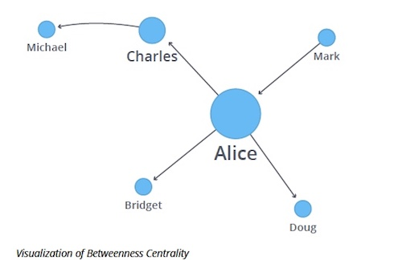
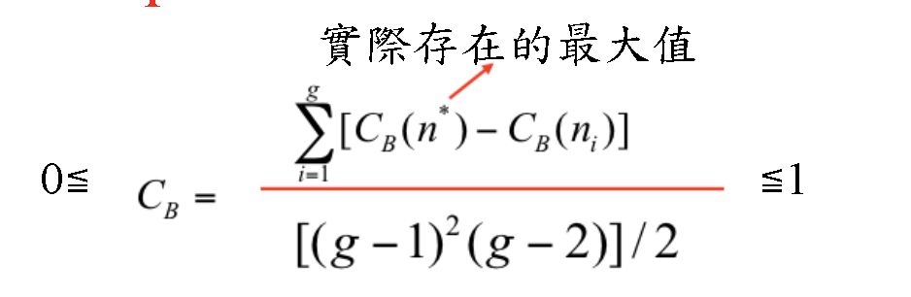
Group Betweenness Centralization
Betweenness Centrality focuses on how some weakly connected nodes can still be indispensable

Slide 20
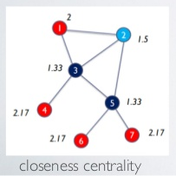
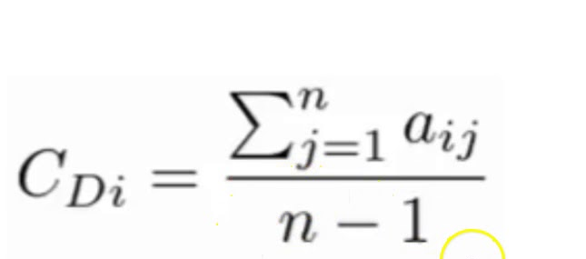
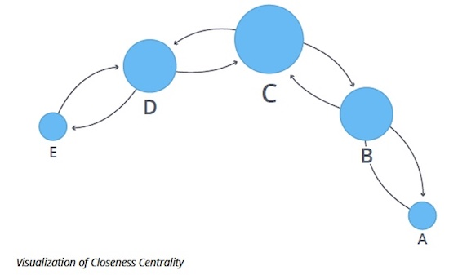
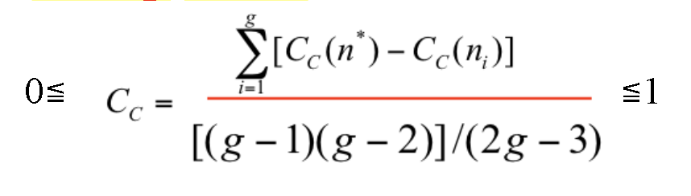
Group Closeness Centralization
Closeness Centrality focuses on how close a node is to all the other nodes in the graph

Slide 21
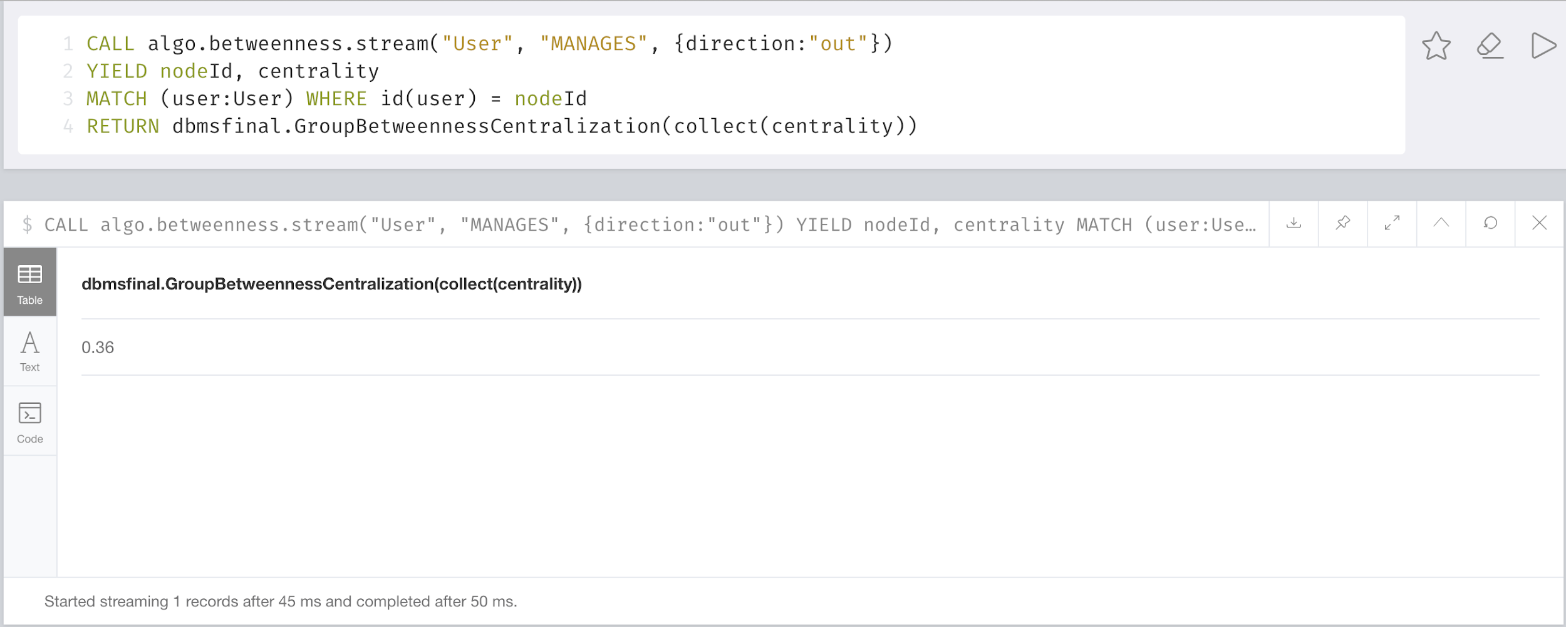
Graph Centralization Usage example
Usage: Package Name . Function Name ( parameters )
Calculated Normalized Group Betweenness Centralization value

Slide 22
Neo4j Graph Algorithm Extension
Not all algorithm can be implemented by procedure template.
Algorithm which needs more information of the graph
Directly implement in Neo4j graph algorithm package.
Notes:
System的架構
畫架構圖
解釋如果要新增演算法要怎麼加 -> Neo4j Procedure Template

Slide 23
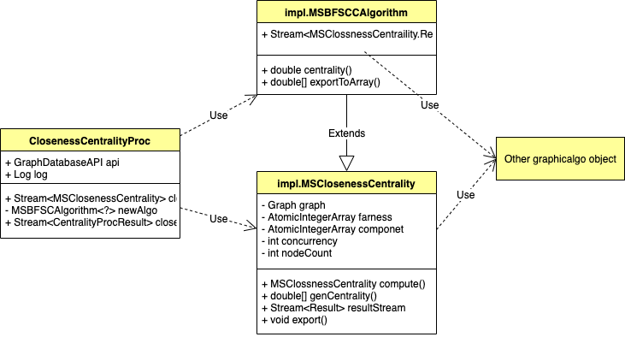
Neo4j Graph Algorithm Extension
Notes:
System的架構
畫架構圖
解釋如果要新增演算法要怎麼加 -> Neo4j Procedure Template

Slide 24
Neo4j Graph Algorithm Extension
Implement
Algorithm
process call的function
Graph的資訊
Implement
Algorithm
Notes:
System的架構
畫架構圖
解釋如果要新增演算法要怎麼加 -> Neo4j Procedure Template

Slide 25
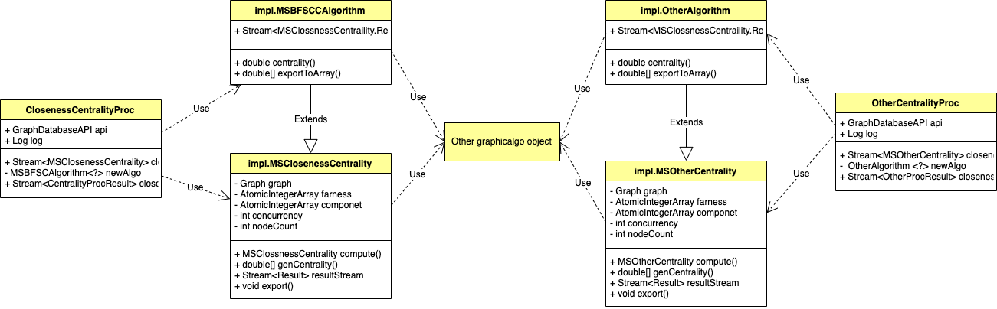
Neo4j Graph Algorithm Extension
New Algorithm
Notes:
System的架構
畫架構圖
解釋如果要新增演算法要怎麼加 -> Neo4j Procedure Template

Slide 26
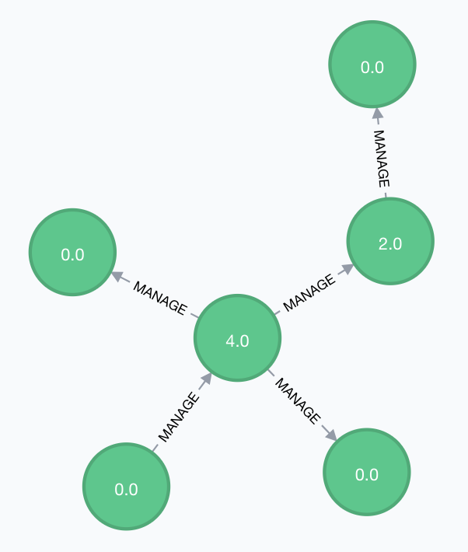
Reaching Centrality
Counts the number of nodes each node can reach in k or less steps.
For this node
when k = 1, Reaching Centrality = 4
when k = 2, Reaching Centrality = 5

Slide 27
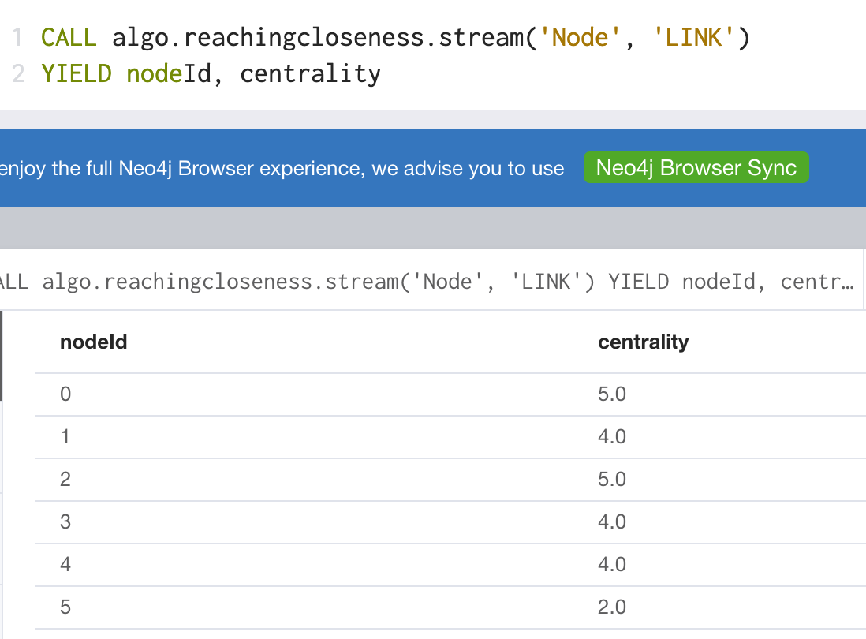
Reaching Centrality
Use k = 2 as example
Node id = 5
Node id = 2
Node id = 3
Node id = 0
Node id = 1
Node id = 4

Slide 28
Encoding
Preprocessing functions and procedures in the Neo4j Graph Algorithm Library
OneHotEncoding
OrdinalEncoding
LabelEncoding
BinaryEncoding
BaseNEncoding

Slide 29
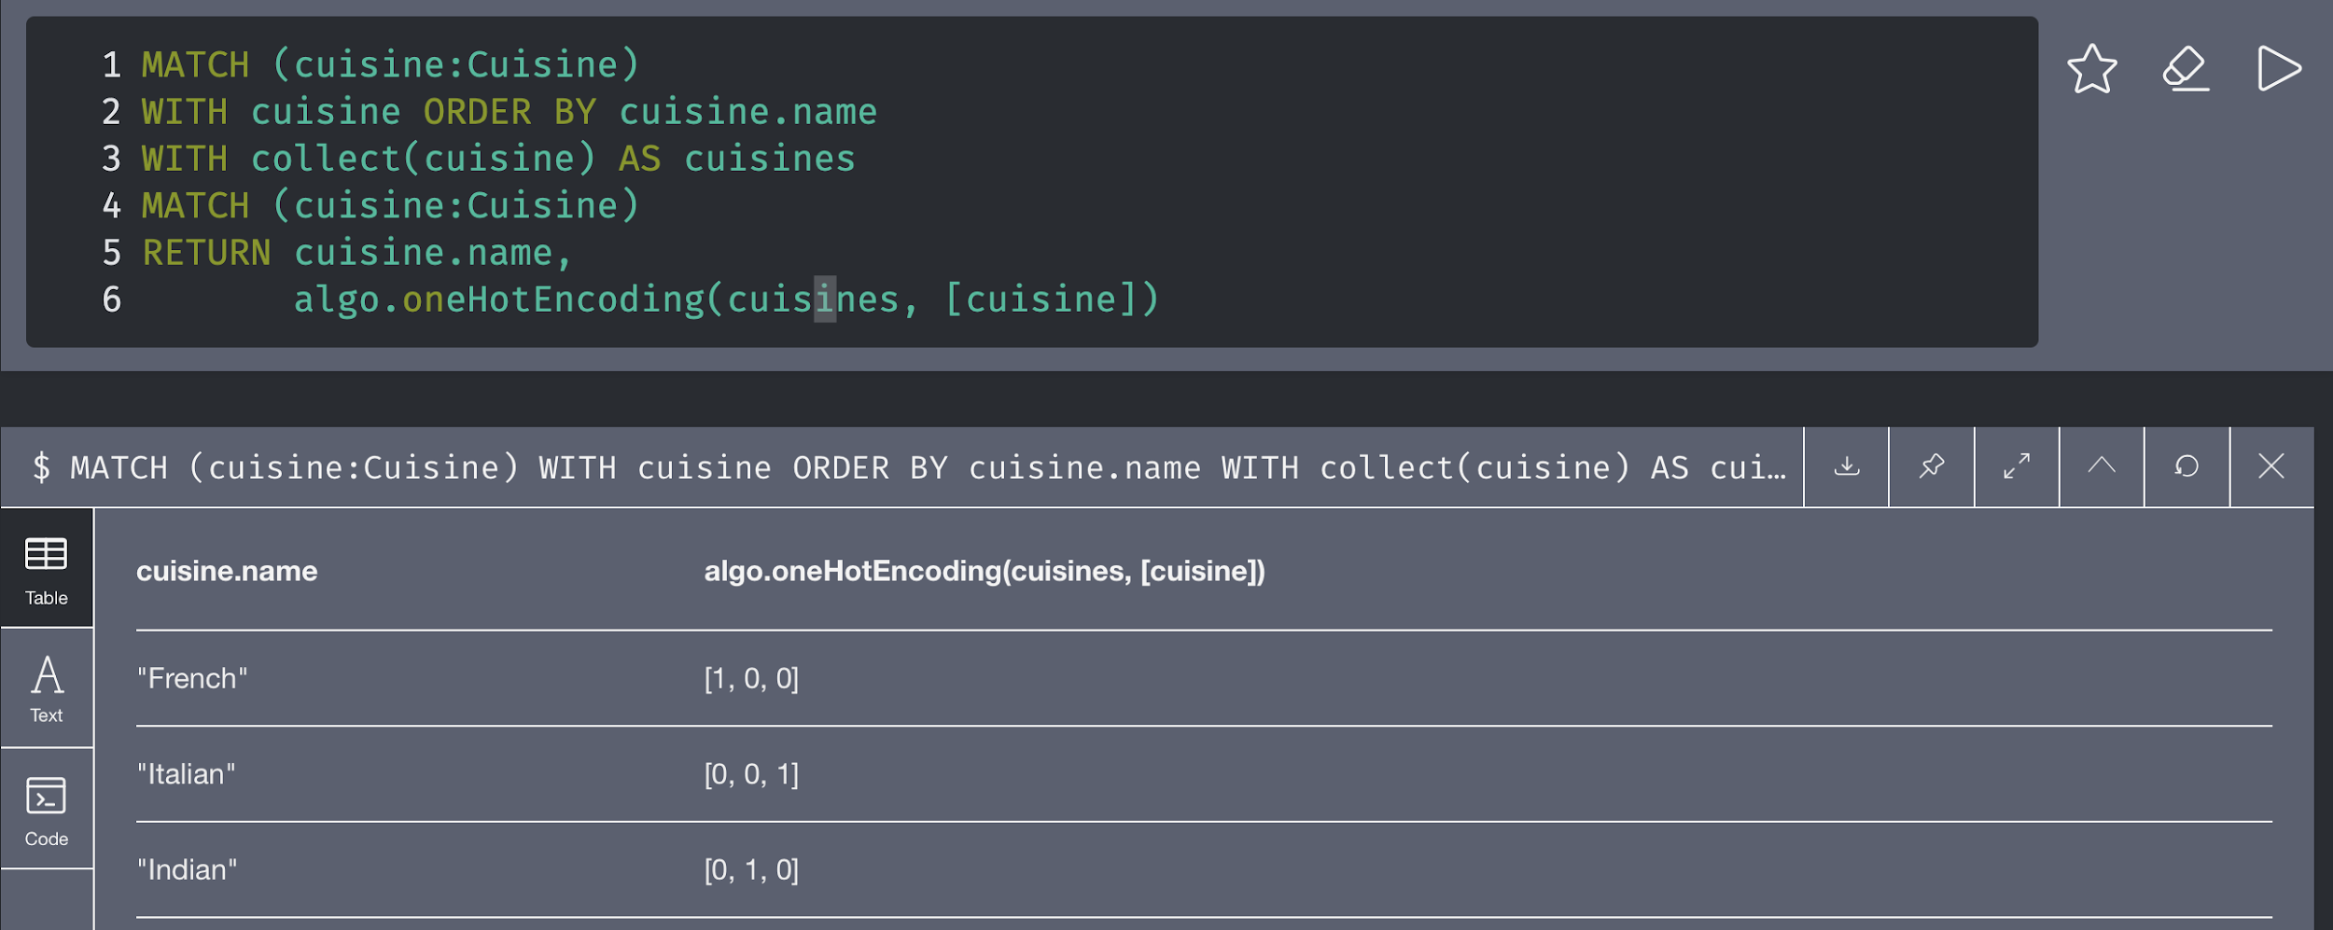
One Hot Encoding

Slide 30
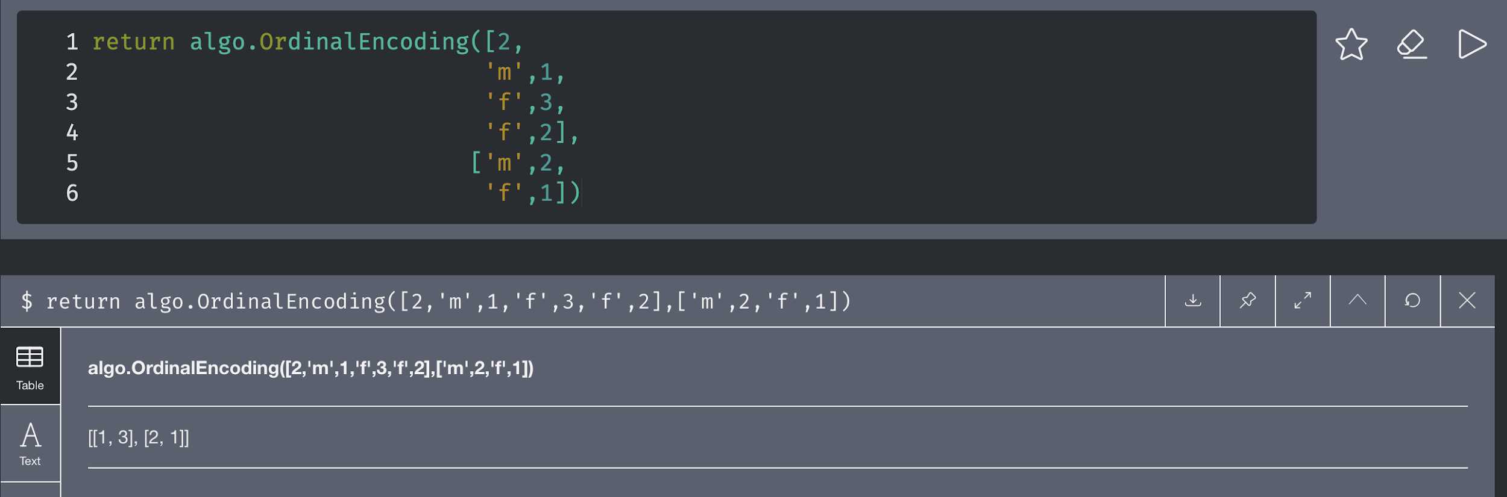
Ordinal Encoding

Slide 31
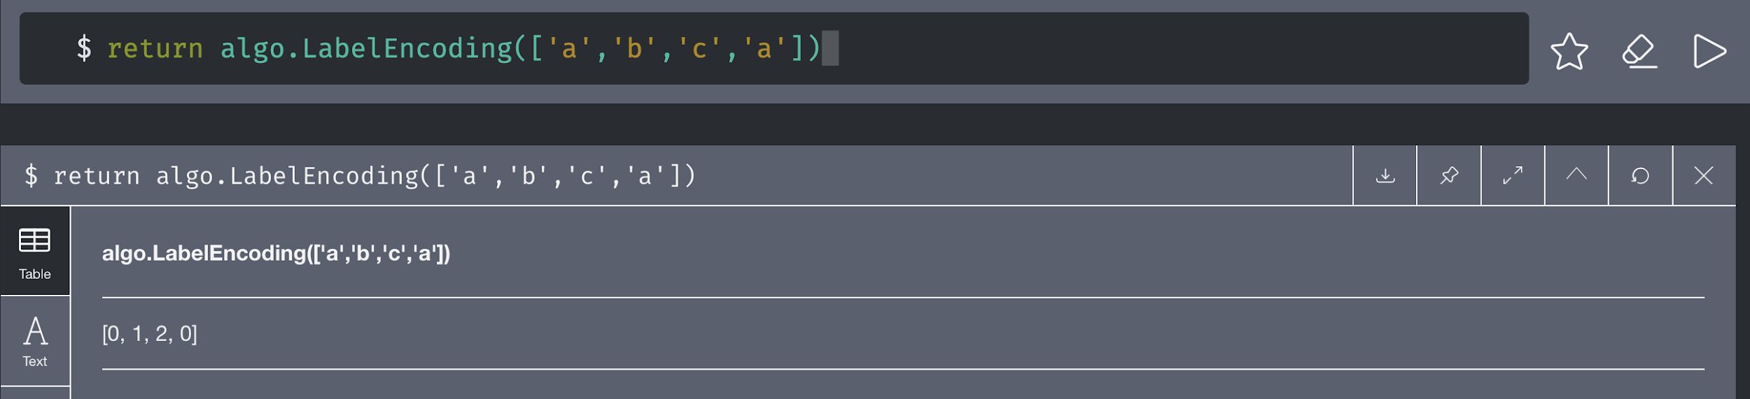
Label Encoding

Slide 32
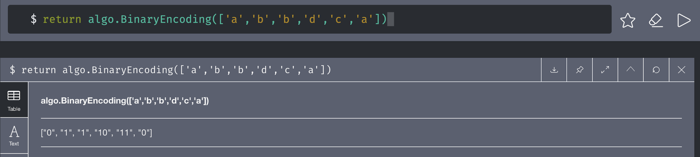
Binary Encoding

Slide 33
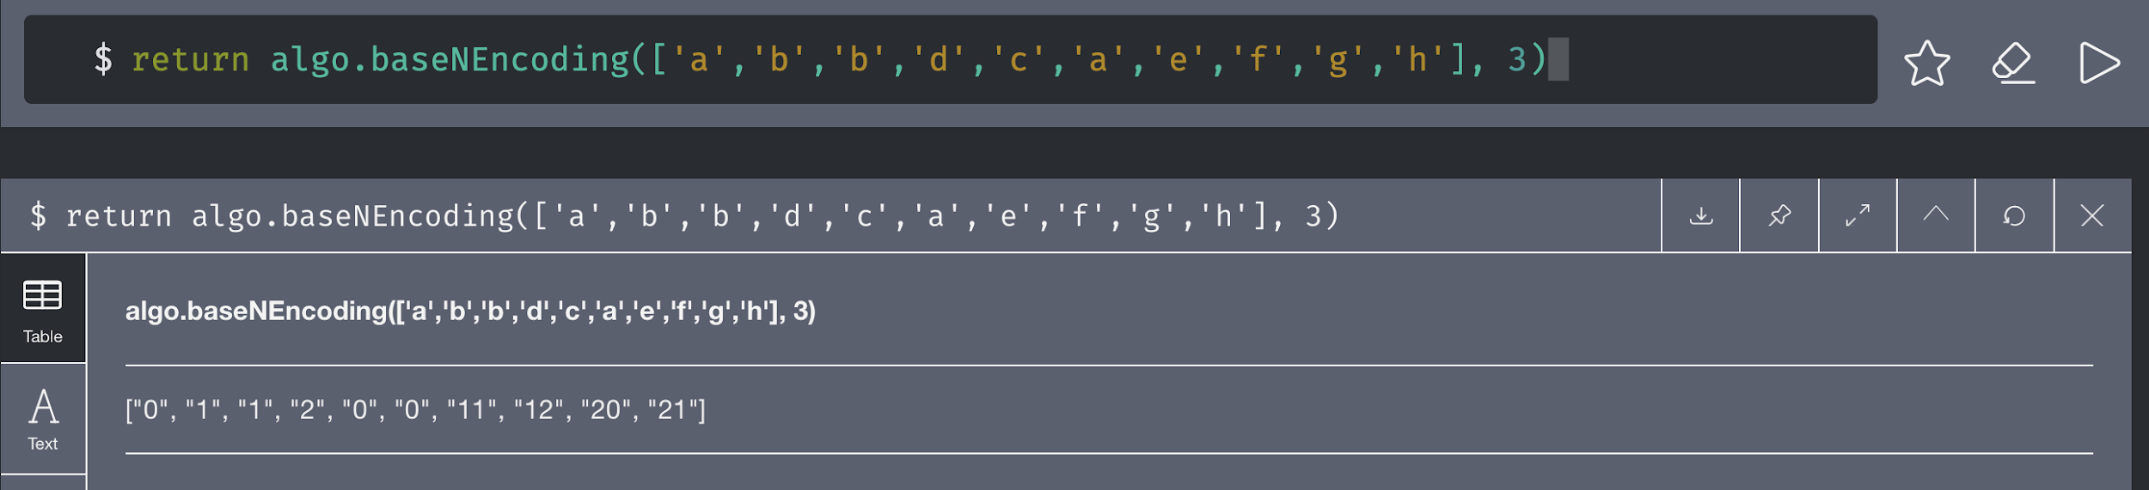
Base N Encoding

Slide 34
Conclusion and Future Work
What we have done
Approximate Nearest Neighbors
Group Centralization
Reach Centrality
Encoding
Future Work
Extend other algorithm
Parallelism

Slide 35
Reference
Roussopoulos, N.; Kelley, S.; Vincent, F. D. R. (1995). "Nearest neighbor queries". Proceedings of the 1995 ACM SIGMOD international conference on Management of data – SIGMOD '95. p. 71. doi:10.1145/223784.223794. ISBN 0897917316.
Malkov, Yury; Yashunin, Dmitry (2016). "Efficient and robust approximate nearest neighbor search using Hierarchical Navigable Small World graphs". arXiv:1603.09320
"New approximate nearest neighbor benchmarks"
"Approximate Nearest Neighbours for Recommender Systems"

