Slide 1
Homework 1: AES trace simulator

Slide 2
Outline
Why do we need side-channel leakage simulation?
Homework 1 requirements
Demo

Slide 3
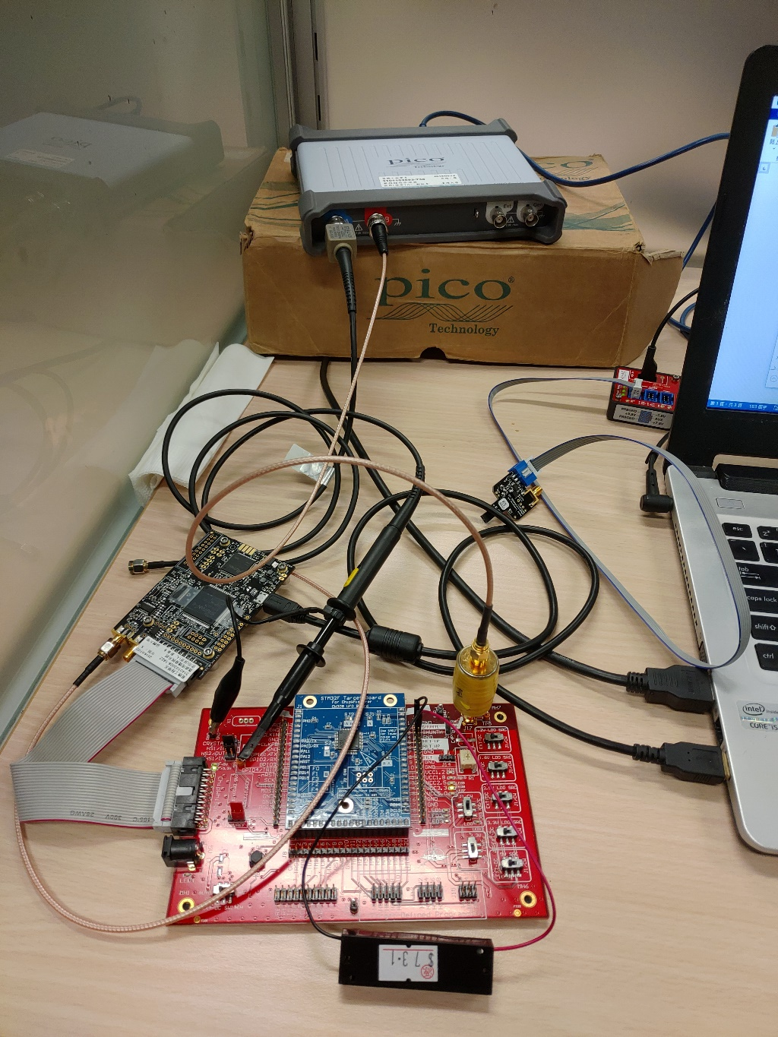
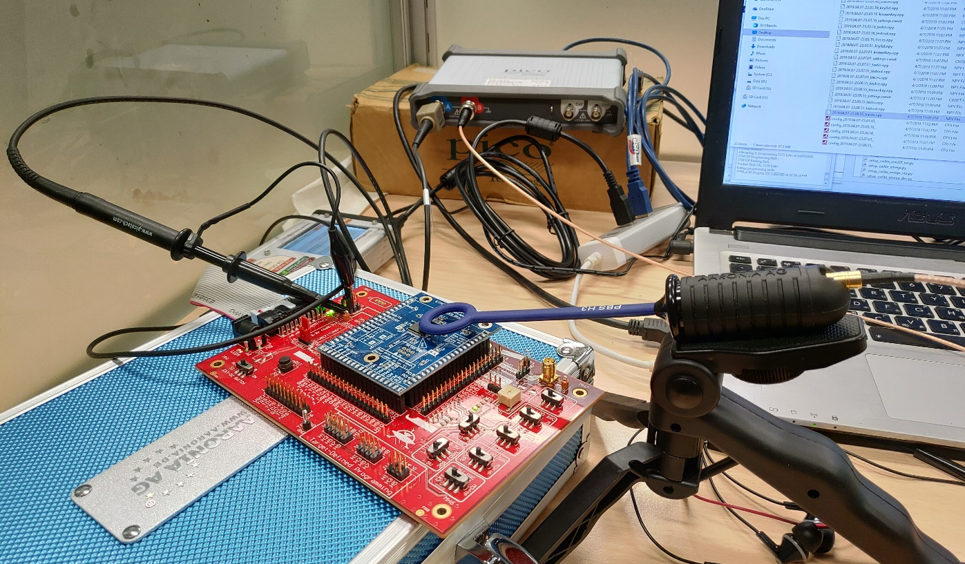
Side-Channel Analysis
It can be quite messy!
What if we don’t have the measurement equipment?

Slide 4

Side-Channel Leakage Simulation
Why do we need a simulation?
Simulation to the rescue

Slide 5
Side-Channel Leakage Simulation
For Hackers:
Make sure your attack program works
Testing new attack method
For Designers:
Understanding the side-channel effect of your design
Testing your design without measurement equipment
Evaluate different side-channel countermeasures

Slide 6
Outline
Why do we need side-channel leakage simulation?
Homework 1 requirements
Demo

Slide 7
Homework 1: AES trace simulator
Please implement an AES-128 encryption program that can:
Encrypt a given plaintext file. (.csv format)
Generate the simulated leakage trace for each encryption.
The encryption key is the MD5 digest of your student ID.
Student ID: r06921000
Key: 3220db6534d687f844c41b6de5a4c737 (128-bit)

Slide 8
Input/Output Specification
Input: Plaintext.csv
Optional: b, noise. (Default: b = 1.0, noise = 0.0)
Output: Ciphertext.csv, Traces.csv
Plaintext.csv
AES_simulator
key: MD5(Student_ID)
Ciphertext.csv
Traces.csv
(b,noise)

Slide 9
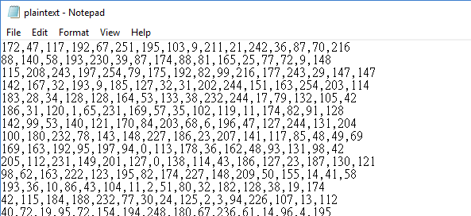
Input Format
16
Plaintext 1
Plaintext 2
Plaintext 3
N
…
Plaintext N

Slide 10
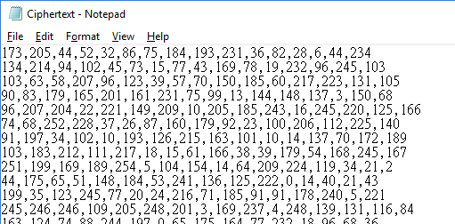
Output Format
16
Ciphertext 1
Ciphertext 2
Ciphertext 3
N
…
Ciphertext N

Slide 11
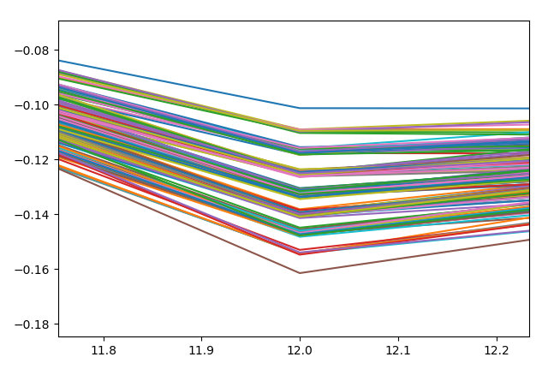
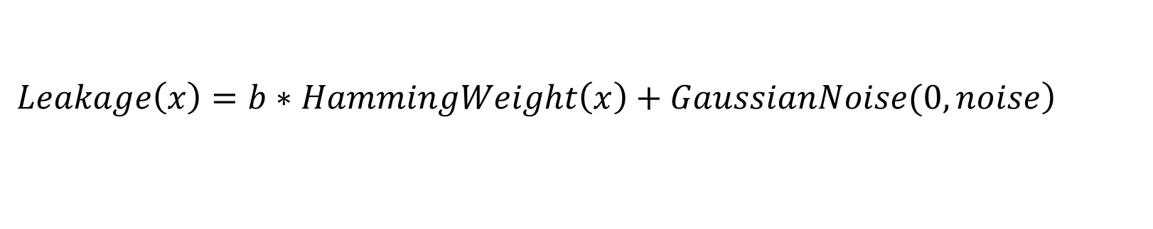
Leakage Model
Assuming the device is leaking the Hamming Weight information of the processing data.
$$\left.Leakage\left(x\right)=b∗HammingWeight\left(x\right)+GaussianNoise(0,noise\right)$$

Slide 12
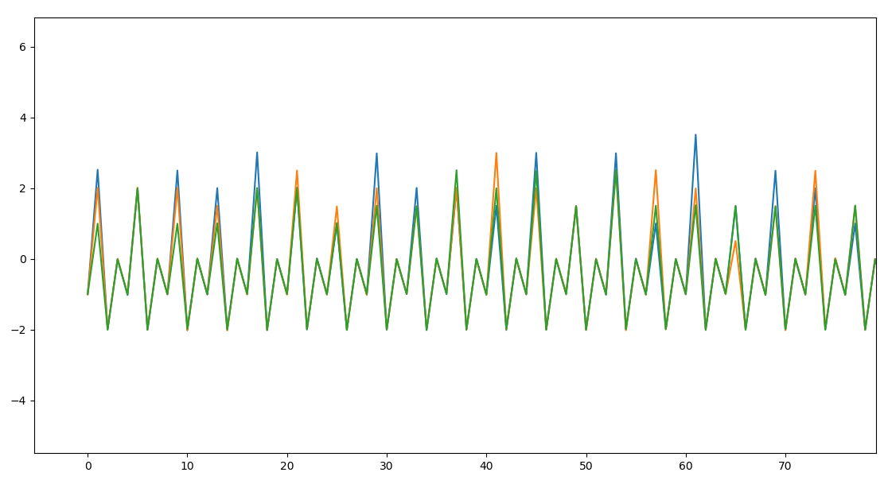
Trace Simulation
Device: 8-bit microprocessor
Leakage: output of each subroutines
Trace: 2560 samples in each power trace
4 sample*16 bytes*4 subroutines*10 rounds
AddRoundKey
SubBytes
ShiftRows
MixColumns
AddRoundKey
SubBytes
ShiftRows
AddRoundKey

Slide 13
Trace Simulation
Turning the intermediate values into power trace
Set the sampling frequency: 4*clock_rate
Only the 2nd sample contain the leakage information
b*HW(x)+noise
b*HW(x)+noise
b*HW(x)+noise
0+noise
0+noise
0+noise
-1+noise
-1+noise
-1+noise
-2+noise
-2+noise
-2+noise

Slide 14
Any Questions?

