Slide 1

- Make Data Make Sense
Educating and Inspiring the Next Generation of Data Scientists

Slide 2
Why aren’t you a member of
I've never heard of it before
Because I don't know what is it
Only just discovered data sense
I am, actually
I think I am…
I am a DataSense Member, but no e-mail

Slide 3
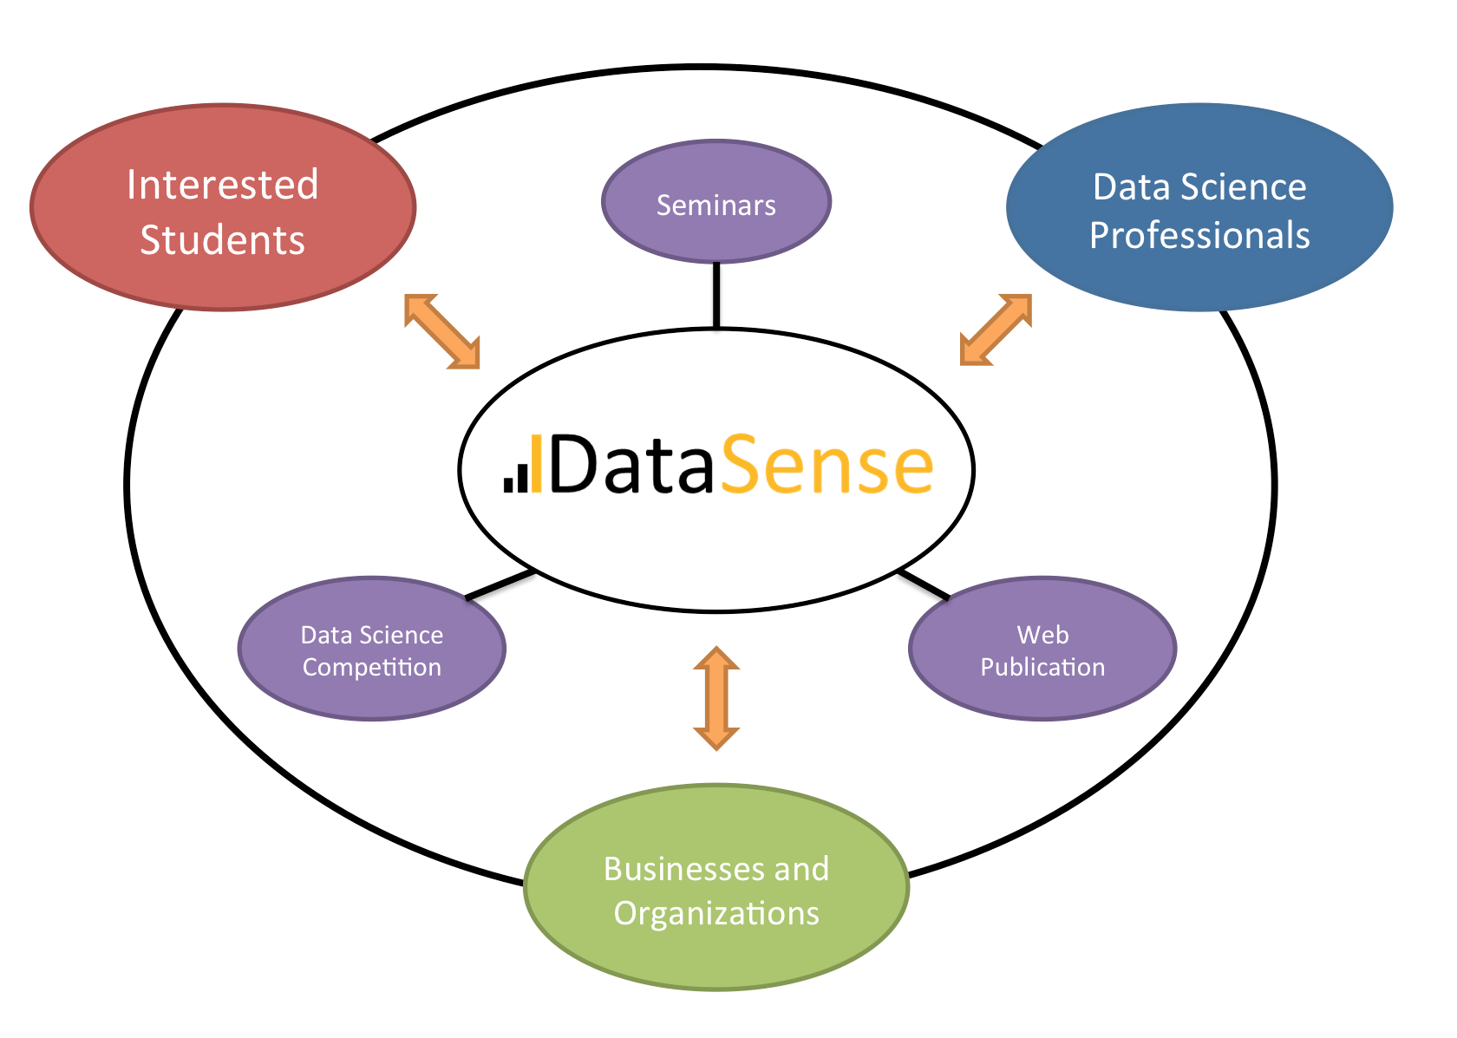
- Make Data Make Sense
Educating and Inspiring the Next Generation of Data Scientists

Slide 4
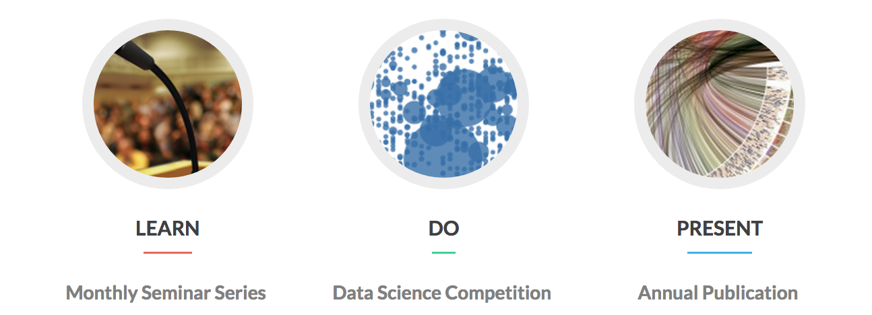
- Make Data Make Sense
Educating and Inspiring the Next Generation of Data Scientists
Are you a student who’s interested in Data Science?
Sign up at MakeDataSense.ca to become a member (free!)
In fact, use the typical membership fee you would have spent for typical clubs to buy yourself a cup of coffee – think of it as our treat!

Slide 5




The City of Vancouver Business Licence Dataset
1997 to 2015 - all business licences issued in Greater Vancouver
13 MB per year, 250 MB in total
24 Columns
60,000 entries per year (wow!)

Slide 6
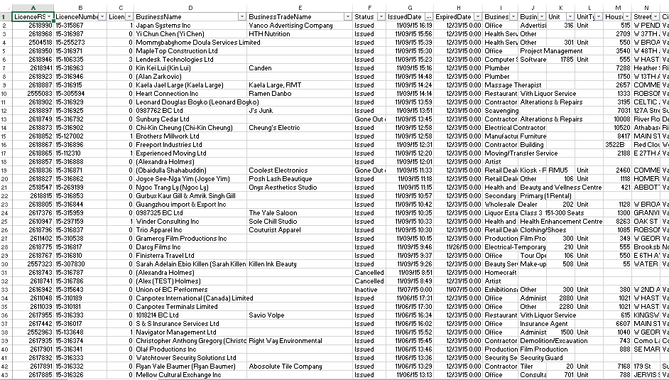
The City of Vancouver Business Licence Dataset

Slide 7
Some example questions (feel free to branch out!)
What is the average life span of a particular business/ business type / industry?
How long do businesses usually stay open? Does it vary by local areas?
Hint: track by Business Name and Address attributes

Slide 8
Some example questions (feel free to branch out!)
What is the average life span of a particular business/ business type / industry?
How long do businesses usually stay open? Does it vary by local areas?
Hint: track by Business Name and Address attributes
What are the trends in businesses?
eg. Does Vancouver have more small businesses over time?
Do these trends correlate with the change in characteristics of a particular city area(s)?

Slide 9
Some example questions (feel free to branch out!)
What is the average life span of a particular business/ business type / industry?
How long do businesses usually stay open? Does it vary by local areas?
Hint: track by Business Name and Address attributes
What are the trends in businesses?
eg. Does Vancouver have more small businesses over time?
Do these trends correlate with the change in characteristics of a particular city area(s)?
Is business type X more popular in a particular neighbourhood?

Slide 10
Submission Format and Deadline
Work in groups of 1-3 people
Maximum 5 figures and 500 words
Report in HTML or PDF format

Slide 11
Submission Format and Deadline
Work in groups of 1-3 people
Maximum 5 figures and 500 words
Report in HTML or PDF format
Deadline for submissions is November 23rd at 8:00 pm
E-mail your submission to hello@makedatasense.ca with the following subject:
"DataSense VanData Competition“ and your team name

Slide 12
Top 8 “power-pitch”
Top 8 submissions will be selected to give a 5-minute “pitch” on November 25 at 6:00 pm
If you are selected as the top 8, you must provide the full documentation for how you got your results
That means reproducible code or full write-up of whatever software you used

Slide 13
Top 8 “power-pitch”
Top 8 submissions will be selected to give a 5-minute “pitch” on November 25 at 6:00 pm
If you are selected as the top 8, you must provide the full documentation for how you got your results
That means reproducible code or full write-up of whatever software you used
Judges select top 3 submissions:
Antonio Cangiano, IBM
Polong Lin, IBM
Dr. Hasan Cavusoglu, Sauder School of Business
Val Cheung, City of Vancouver

Slide 14
Why should you even care?
Top 3 teams get free entry to SportsHack – thanks IBM!
City of Vancouver potentially awarding other prizes
INFOX Consulting (data science recruiters) will be on-site to mock interview outstanding students

Slide 15

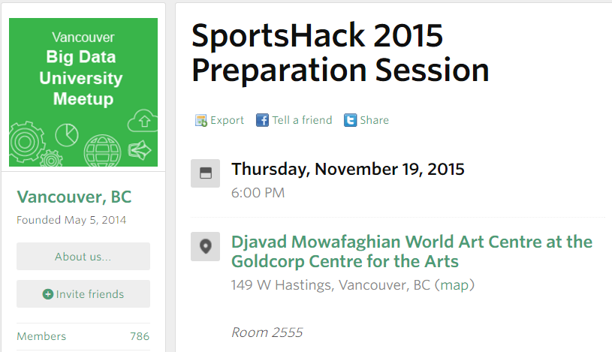

Slide 16
- Make Data Make Sense
Educating and Inspiring the Next Generation of Data Scientists

Slide 17
Go here to learn more about and access the data:
MakeDataSense.ca/VanData

Slide 18


