Slide 1
Interval-Asynchrony: Delimited Intervals of
Localised Asynchrony for Fast Parallel SGD
Jacob Garby
<garby@chalmers.se>
Philippas Tsigas
<tsigas@chalmers.se>
Notes:
Good afternoon everyone!
Today I’m going to discuss our recent paper on speeding up highly parallel neural network training. I’m Jacob, and this paper was co-authored by Philippas Tsigas.

Slide 2
Outline
The problem
Background
  SGD
  [A]synchrony
Interval-Asynchrony (our contribution)
  The algorithm
  Results & Evaluation
Notes:
I’ll talk about the problem we set out to address,
which will include a short refresher on an optimisation algorithm called stochastic gradient descent, for anyone who’s not familiar.
I’ll then talk about the pros and cons of state of the art methods for scaling this algorithm up,
then explain how our technique improves upon these.

Slide 3
The Problem
Scalable machine learning is important, with emphasis on shared-memory many-core CPU systems.
Inter-thread synchronisation tends to introduce bottlenecks, and asynchronous designs lead to lower accuracy.
How can we improve the scalability of machine learning training algorithms (specifically SGD) while maintaining good accuracy?
Notes:
So first, here’s an overview of our problem.
Machine learning is becoming more and more important.
ML models tend to only be as good as the quality and quantity of training data, and the complexity of the model, all of which make training take longer. It follows that faster training facilitates better models.
Focus on CPU training for shared-memory systems. Scaling the training to use many threads is a promising way to speed up.

Slide 4
Quick Background: Gradient Descent
We want to find the minimum of a certain function, θ* = argminθ L(θ)
First, pick an arbitrary θ0.
Then, iteratively move against the gradient of L at θi to produce θi+1.
L =
θ*
Notes:
All sorts of ML training algorithms for different problems, but we’re focussing on gradient descent.
Imagine we want to train the parameters of a prediction model = theta
We can quantify the performance of some parameters with the “Loss function”, here shown in purple. Less is better.
The gradient descent algorithm is simply an iterative process of estimating the gradient of the loss function at the current parameters, and using this to “roll down” the curve.
Stochastic is…
Parallelisation, how?

Slide 5
Prior Work: How to Parallelise SGD?
Synchronous
Asynchronous
t1
t2
t3
Parameters to optimise, θ
Avg.
θ*
Time
Each iteration is accurate; follows sequential semantics.
But, there is a lot of idle time. It could be faster!
Avg.
Avg.
Notes:
A parallel implementation of SGD is quite simple.
Divide each batch among a bunch of threads.
Each thread computes a gradient, and once every thread finishes, the gradients are averaged.
This is semantically identical to sequential.
Synchronisation is a bottleneck.

Slide 6
Prior Work: How to Parallelise SGD?
Synchronous
Asynchronous
t1
t2
t3
t1
t2
t3
Parameters to optimise, θ
Avg.
θ*
Time
Each iteration is accurate; follows sequential semantics.
But, there is a lot of idle time. It could be faster!
Avg.
Some updates are stale, which tend to be less accurate.
Higher throughput, but more steps to converge.
Avg.
Notes:
What happens if you remove the synchronisation?
Now, a thread can update the parameters as soon as it computes its own gradient. Important that the threads share the exact same model in memory.
<demonstrate...>
Now, a gradient will often be applied to the parameters at a different state, or position, than the gradient was based on. We refer to such updates as stale.
Less accurate.
Much faster.

Slide 7
Interval-Asynchrony
Proposal: A semi-asynchronous thread synchronisation scheme which can change how asynchronous it is during runtime.
Semi-asynchrony may allow us to balance the throughput of async with the accuracy of synchronous execution.
Runtime-adaptiveness is important since we found staleness is more impactful later in the execution.
Notes:
We wondered if we could find a balance between synchronous and asynchronous?
In theory, maybe we can get the best of both!
In preliminary tests we realised that the impact of stale updates varies throughout the execution.

Slide 8
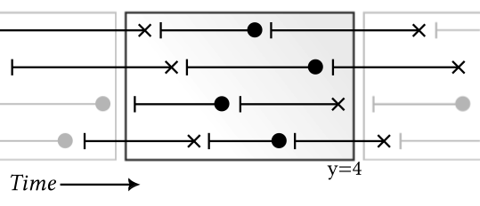
Interval-Asynchrony
•••
Idea: A series of asynchronous intervals, defined by their size in number of updates.
SGD runs asynchronously within intervals, but an update may not cross an interval border.
Interval size is parameterised (y), and can be changed at runtime.
Accept
Reject
Time
•••
Notes:
The basic idea: dynamically split the execution into windows, a.k.a. intervals.
SGD updates which begin and end in the same interval are allowed to run entirely async.
This diagram represents an example with four threads. X = time, y = thread. Each line segment is one SGD step. You can see how only four steps are accepted within the interval.
Here, you can see how the average staleness depends on the interval size we select.
Efficient so as not to introduce a new bottleneck.

Slide 9
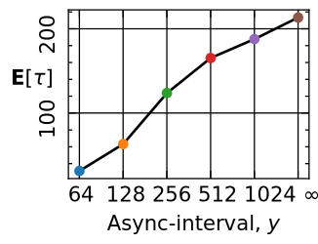
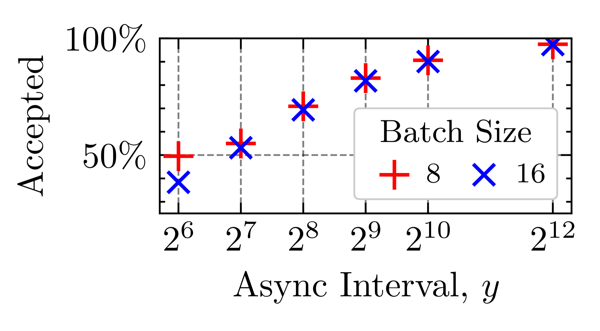
Interval-Asynchrony: Interval Size
Staleness decreases, and is bounded ≤ y.
Fraction of accepted steps increases logarithmically with y.
A)
B)
(256 threads)

Slide 10
•••
Time
•••

Slide 11
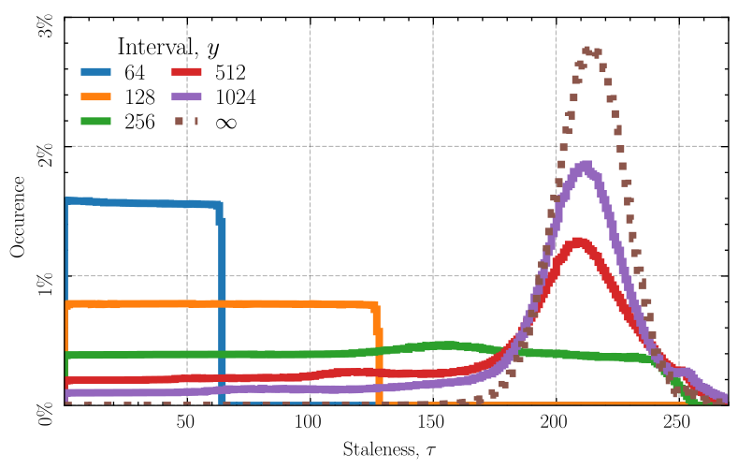
Interval-Asynchrony: Staleness Distribution
Not only a bound on maximum staleness, but the whole distribution is shifted lower!
Notes:
You may be tempted to think that we’re simply running asynchronous SGD and ignoring any updates with staleness > y, BUT
By introducing the async windows, we actually _shift_ the staleness distribution.
At the start of a window we expect to get a good amount of fresh updates, which wouldn’t happen without it.

Slide 12
Interval-Asynchrony: Adjusting Interval Size
Option 1: Decay
Staleness is more impactful closer to convergence, so just reduce interval size over time.
How to pick the rate though?
Option 2: Probing
Attempt to automatically find time-varying optimal interval size by intermittently evaluating nearby values.
Inspired by some recent work^{[1]} on adjusting number of threads.
[1]K. Bäckström, ‘Adaptiveness, Asynchrony, and Resource Efficiency in Parallel Stochastic Gradient Descent’, Chapter D, Chalmers University of Technology, 2023. Available: https://research.chalmers.se/en/publication/535694
Notes:
As I mentioned earlier…
How indeed to pick rate? It’s difficult to come up with a generally good value, but we propose a certain number in the paper which works well for all situations we looked at.
Probing is more promising, but still introduces hyperparameters.
Should we go into this more?

Slide 13
Evaluation
Does Interval-Asynchrony train a model to an acceptable accuracy faster than previous methods?
Does it scale well (i.e., is it able to utilise more threads without loss of accuracy)?

Slide 14
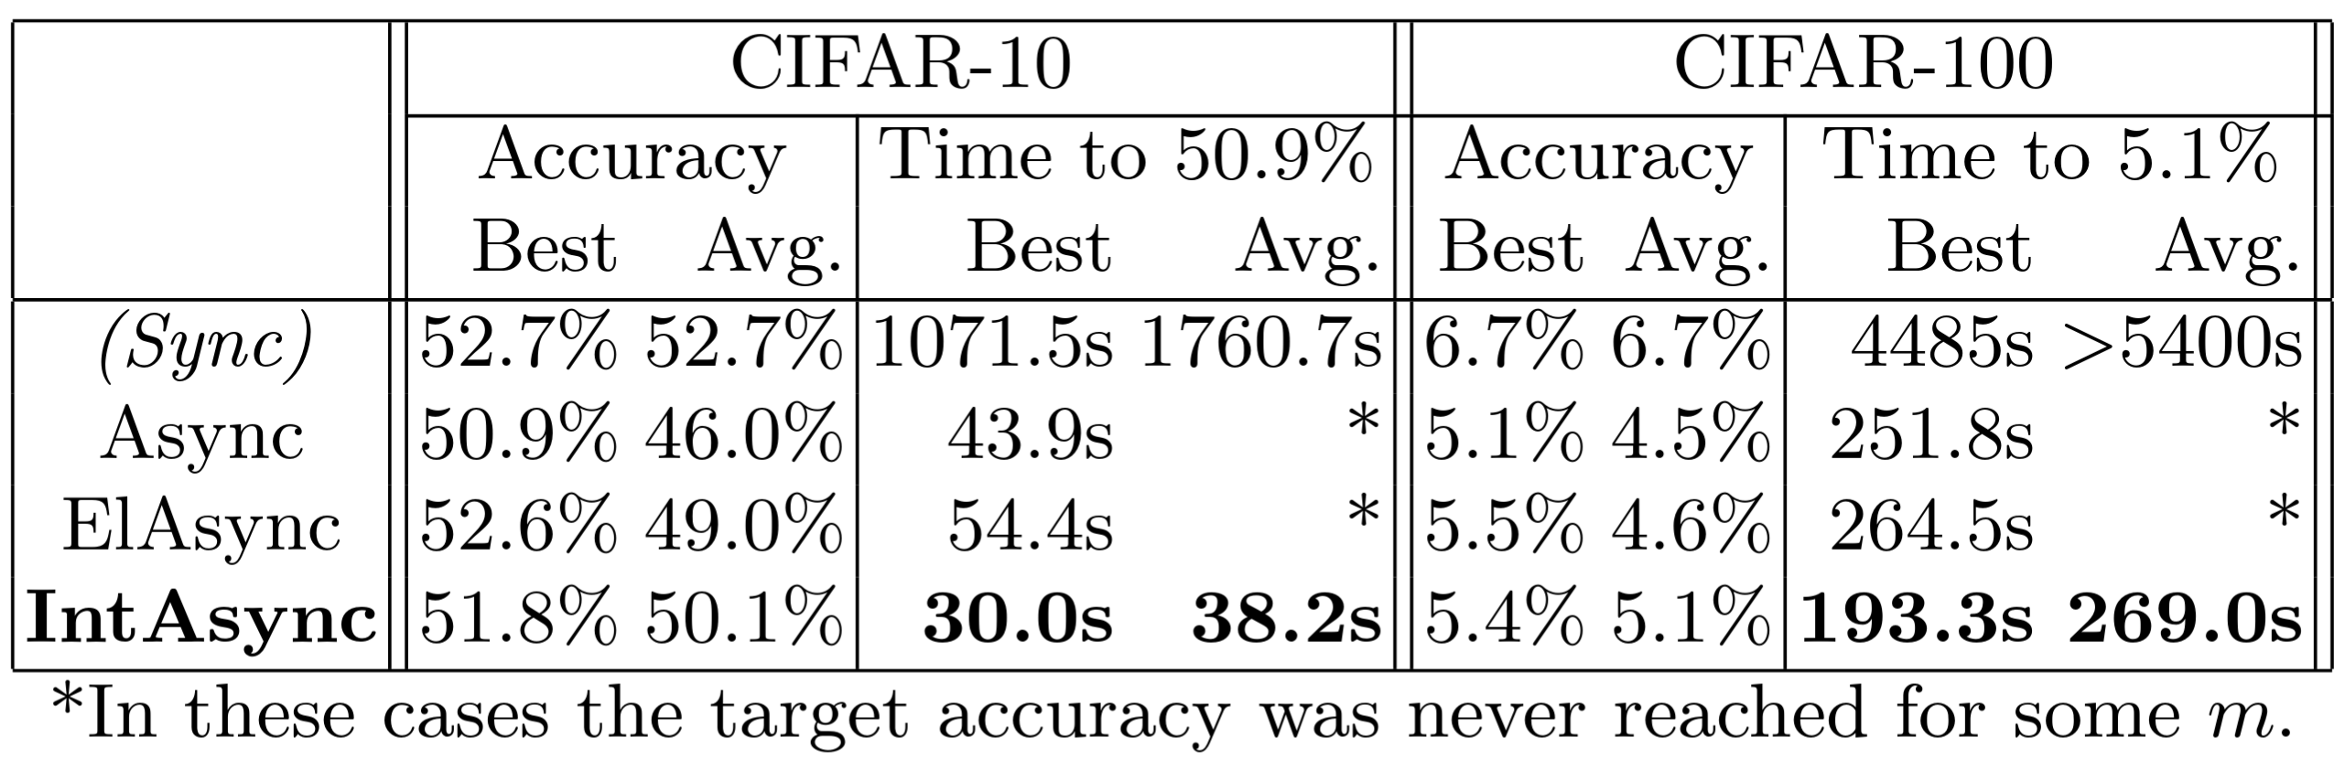
Overall Comparison to Baselines
(see paper!)
^{[1]}
[1]K. Bäckström, ‘Adaptiveness, Asynchrony, and Resource Efficiency in Parallel Stochastic Gradient Descent’, Chapter D, Chalmers University of Technology, 2023. Available: https://research.chalmers.se/en/publication/535694
Notes:
Let’s look at how our method compares to some previous techniques!
We considered fully synchronous, plain asynchronous, and an interesting method called elastic asynchrony, in which the _number_ of threads is actively finetuned in an attempt to mitigate staleness.
Accuracy: ours achieves better accuracy than other async methods, on average. MENTION elasync getting higher best accuracy, but this is the case where it scales down to barely any threads.
Time: Ours is far far superior, not even close!

Slide 15
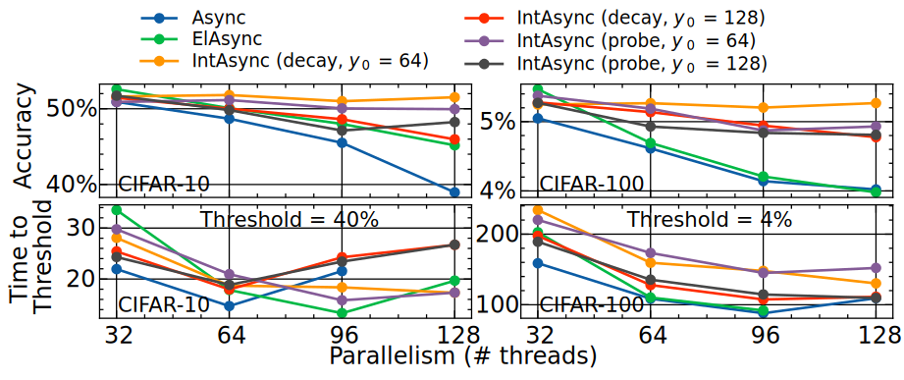
Scalability Comparison
Interval-Asynchrony is scalable due to its lower staleness distribution.
(see paper!)
In the cases that ElAsync seems faster, it also has lower accuracy, so it’s not, really.

Slide 16
Conclusions
We introduced a new algorithm for scheduling SGD threads, which is semi-asynchronous to a runtime-variable degree.
We proposed two methods to adjust the asynchrony parameter (decay and probing).
We showed its superior scalability against several baseline approaches.

Slide 17

Thanks for listening!

