Slide 1
Databricks Data Lakehouse Architecture on AWS
Modern Cloud Data Platform for Analytics & AI

Slide 2
Executive Summary
What We Built
Unified Platform: Single platform for all data workloads
Scalable & Cost-Effective: Auto-scaling with pay-per-use pricing
Data Quality: Progressive refinement (Bronze → Silver → Gold)
Security-First: Multi-layered security with encryption and audit logging
Real-Time Insights: Supports both batch and streaming analytics
Business Impact
Faster time-to-insight for business users
40-60% infrastructure cost reduction
Self-service analytics without IT bottlenecks
Foundation for AI/ML initiatives

Slide 3
Understanding the Data Lakehouse
The Evolution of Data Platforms
Data Lakehouse = Best of Both Worlds
Combines the flexibility and cost-effectiveness of data lakes with the reliability and performance of data warehouses

Slide 4
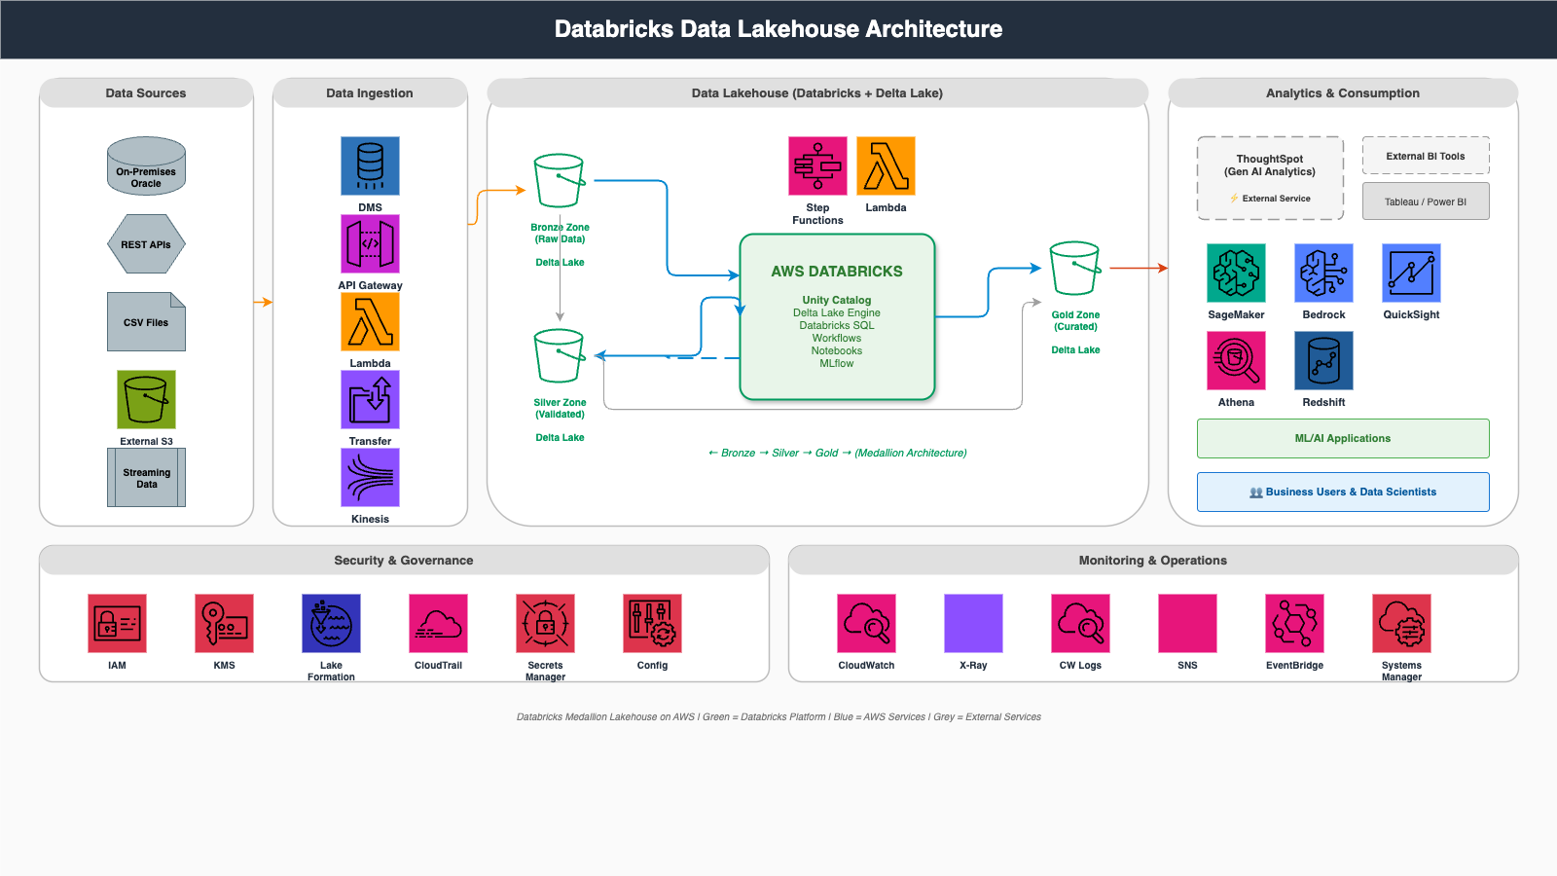
High-Level Architecture Overview

Slide 5
Data Quality Progression: Bronze → Silver → Gold
🥉 Bronze Zone - Raw Data Layer
Landing zone for all raw, unprocessed data
Exact copy of source data
Append-only, time-stamped, preserves original format
🥈 Silver Zone - Validated Data Layer
Cleaned and validated data
Schema enforcement, deduplication, data quality checks
Standardized formats, ready for business logic
🥇 Gold Zone - Curated Data Layer
Business-ready, analytics-optimized data
Aggregations, business logic, feature engineering
Optimized for queries, serving layer for BI

Slide 6
How Data Enters the Platform
Data Sources
On-Premises Oracle Database - Legacy enterprise databases
REST APIs - Real-time data from external services
CSV Files - Flat files from business systems
External S3 - Partner data or external storage
Streaming Data - IoT devices, clickstreams, logs
AWS Ingestion Services
AWS DMS - Database migration (Oracle → Bronze Zone)
API Gateway - API management (REST APIs → Lambda → Bronze)
Lambda - Serverless compute for data transformation
Transfer Family - Secure file transfer (CSV/Files → Bronze)
Kinesis - Stream processing (Real-time events → Bronze)

Slide 7
Databricks - The Heart of Our Architecture
Databricks = Unified Analytics Platform
🔧 Data Engineering: ETL/ELT pipelines, Auto Loader, Delta Lake
🔬 Data Science & ML: Notebooks, distributed training, MLflow
📊 Business Analytics: Databricks SQL, dashboards, BI integration
🎯 Real-Time Streaming: Structured Streaming, sub-second latency

Slide 8
Inside Databricks - Key Components
• Unity Catalog: Centralized metadata and governance layer
• Delta Lake Engine: ACID transaction layer for data lakes
• Databricks SQL: SQL-based analytics interface
• Workflows: Job orchestration and scheduling
• Notebooks: Interactive development environment
• MLflow: ML lifecycle management

Slide 9
Bronze → Silver → Gold Transformation
Step 1: Bronze → Silver
Data validation and quality checks
Schema enforcement and standardization
Duplicate removal and basic cleansing
Step 2: Silver → Gold
Business logic application
Data aggregations and summarizations
Feature engineering for ML
Orchestration: AWS Step Functions + Lambda + EventBridge

Slide 10
How Business Users Access Data
Analytics Tools Connected to Gold Zone
🤖 AI-Powered: ThoughtSpot (NLP search), AWS Bedrock (GenAI)
🧪 Machine Learning: Amazon SageMaker, Databricks MLflow
📊 Business Intelligence: QuickSight, Tableau, Power BI, Athena
🏢 Data Warehouse: Amazon Redshift
End User Access Patterns
Business Users: Self-service analytics via BI tools
Data Scientists: Model training in SageMaker/Notebooks
Data Analysts: Ad-hoc SQL queries
Applications: REST APIs for predictions

Slide 11
Multi-Layered Security Approach
🔐 Identity & Access: IAM, Unity Catalog, Secrets Manager
🔒 Data Encryption: KMS (at rest), TLS/HTTPS (in transit)
📋 Governance & Compliance: Unity Catalog, Lake Formation, Config
📝 Audit & Monitoring: CloudTrail, Unity Catalog Audit Logs
Security is built into every layer - from data ingestion to consumption

Slide 12
Observability & Operational Excellence
📊 Metrics & Logging: CloudWatch (centralized logging and metrics)
🔍 Distributed Tracing: X-Ray (end-to-end request tracing)
🔔 Alerting: SNS (email/SMS/Slack), EventBridge (automation)
⚙️ Infrastructure: Systems Manager (configuration and patching)

Slide 13
End-to-End Data Flow
1️⃣ Data Ingestion: Sources → AWS Services → Bronze Zone
2️⃣ Data Validation: Bronze → Databricks → Silver Zone
3️⃣ Data Curation: Silver → Databricks → Gold Zone
4️⃣ Analytics: Gold → BI Tools/ML Platforms → Insights
5️⃣ Governance: Unity Catalog + Lake Formation
6️⃣ Monitoring: CloudWatch + X-Ray
Timeline: Raw data → Analytics-ready in hours (batch) or seconds (streaming)

Slide 14
Real-World Use Cases
• Real-Time Analytics: Monitor customer behavior with live dashboards
• Machine Learning & AI: Predict customer churn proactively
• Data Warehouse Modernization: 60% cost reduction, 10x faster queries
• Self-Service Analytics: Empower users without IT bottlenecks
• Regulatory Compliance: Complete audit trail for GDPR/SOC2/HIPAA

Slide 15
Why This Architecture?
Technical Benefits
⚡ Performance: 10-100x faster queries with Delta Lake
📈 Scalability: Auto-scaling to petabyte-scale
💰 Cost: 40-60% savings vs traditional data warehouses
🔄 Flexibility: All data formats, multiple languages
Business Benefits
📊 Unified Analytics: Single platform eliminates silos
🚀 Faster Insights: Self-service without IT bottlenecks
🤝 Collaboration: Shared notebooks and workflows
🎯 AI/ML Ready: Foundation for AI initiatives

Slide 16
Complete Technology Stack
AWS Infrastructure: Lambda, S3, IAM, KMS, CloudWatch, Step Functions
Databricks Platform: Spark, Delta Lake, Unity Catalog, MLflow
Analytics & BI: SageMaker, Bedrock, QuickSight, Athena, Redshift
Integration: DMS, Kinesis, API Gateway, Transfer Family, EventBridge
Best-of-breed technologies integrated into a cohesive platform

Slide 17
Key Takeaways
1️⃣ Unified Platform: Single platform for data engineering, data science, and analytics
2️⃣ Progressive Quality: Bronze → Silver → Gold ensures data reliability
3️⃣ Cloud-Native: Auto-scaling infrastructure, pay-per-use pricing
4️⃣ Security-First: Multi-layered security with complete audit trail
5️⃣ Business Enablement: Self-service analytics and AI/ML foundation
The lakehouse is a journey, not a destination.

Slide 18
Questions & Discussion
📚 Additional Resources
Databricks Docs: https://docs.databricks.com/
AWS Lakehouse: https://aws.amazon.com/big-data/

