Slide 1
Analyzing Jeopardy! Data
M. Ball, M. Farrow, J. Harrison

Slide 2
Overview

Slide 3
Challenges

Slide 4
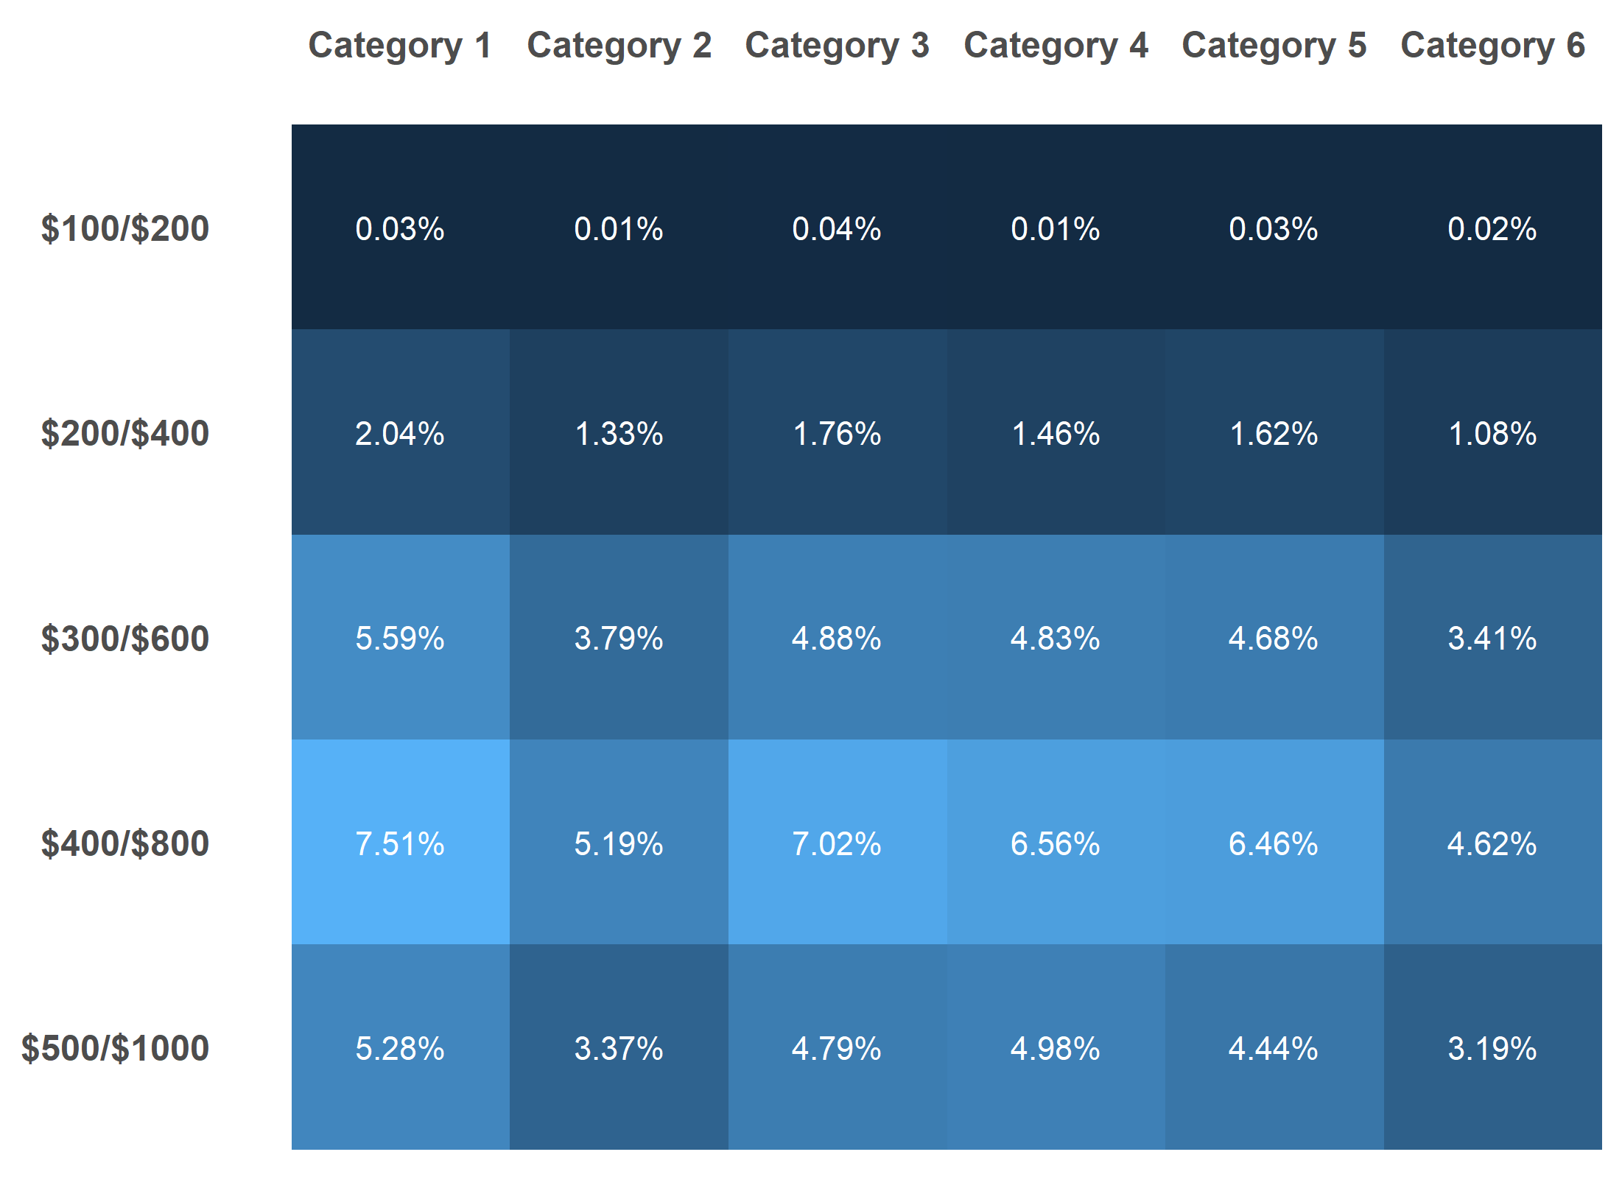
Where is the daily double?

Slide 5

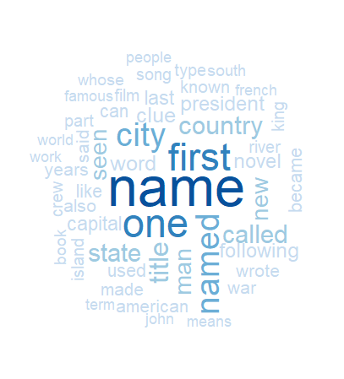
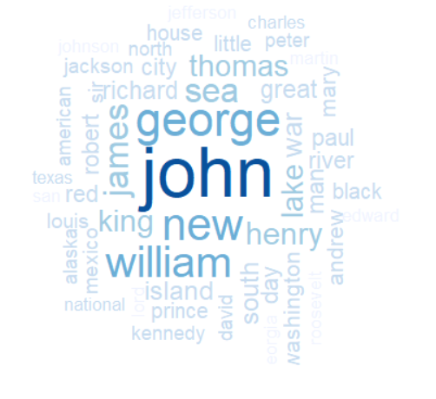
Daily Double Insights
What are the most common daily double clue categories?
What are the most common daily double clue clues?
What are the most common daily double clue answers?

Slide 6
Player Stats

Slide 7
Rshiny App Demo

