Slide 1
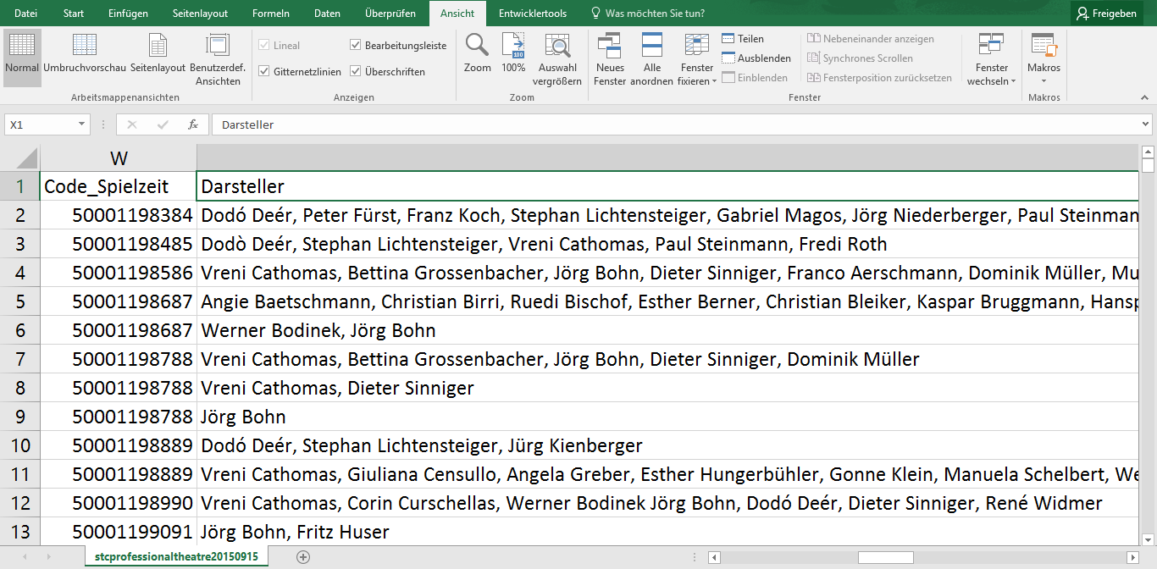
Raw data

Slide 2
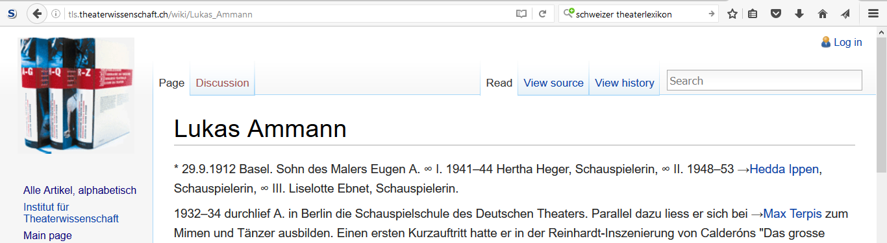
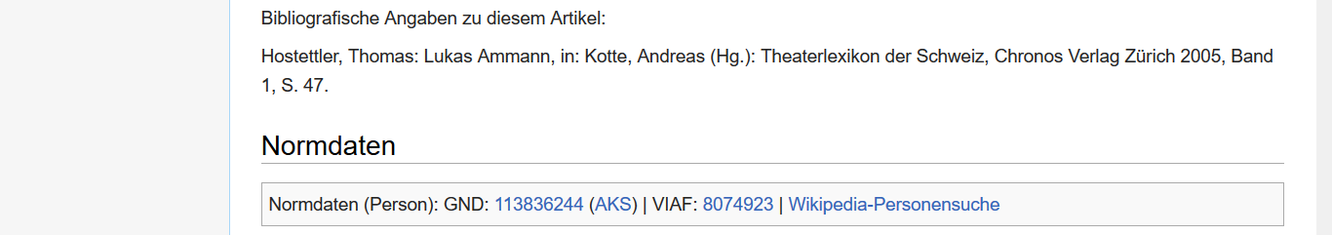
Swiss Theatre Dictionnary
…

Slide 3
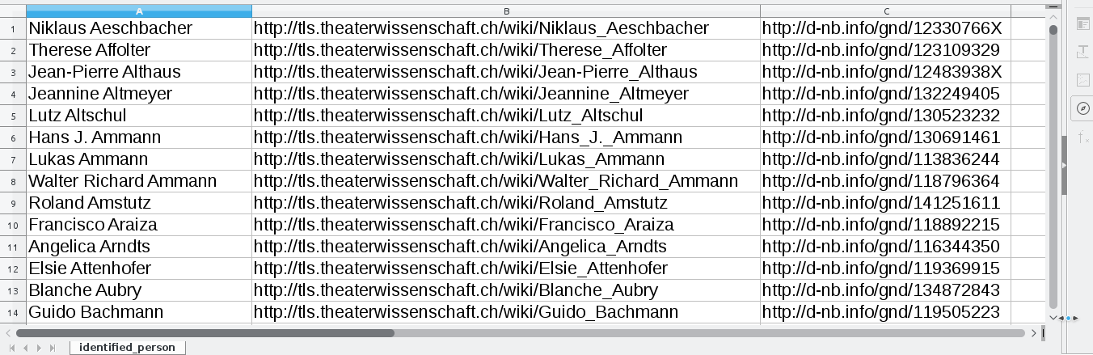
Result
1732 matches (performers)
372 matches with GND
112 matches (costume designers) - 194 matches (scenographers)
164 matches (choreographers) - 793 matches (directors)

Slide 4
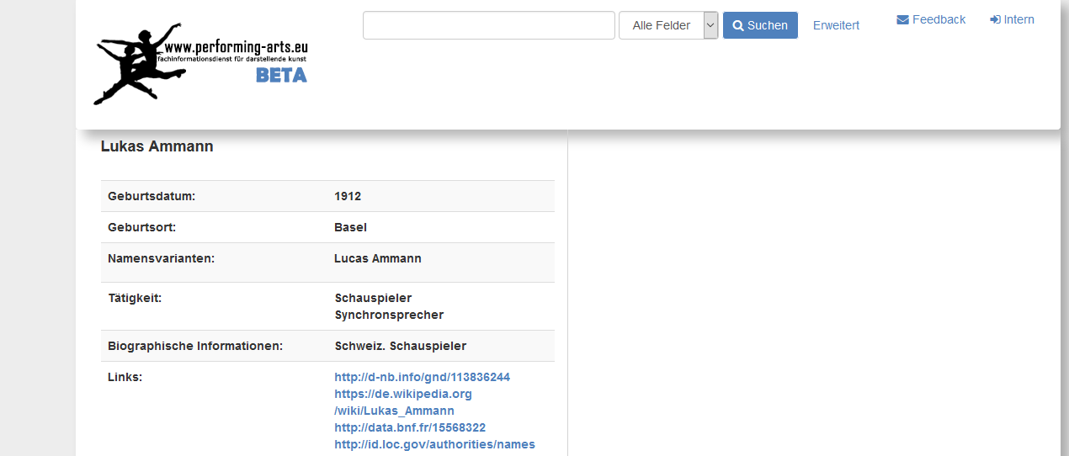
Specialised Information Service Performing Arts
http://performing-arts.eu

