Slide 1
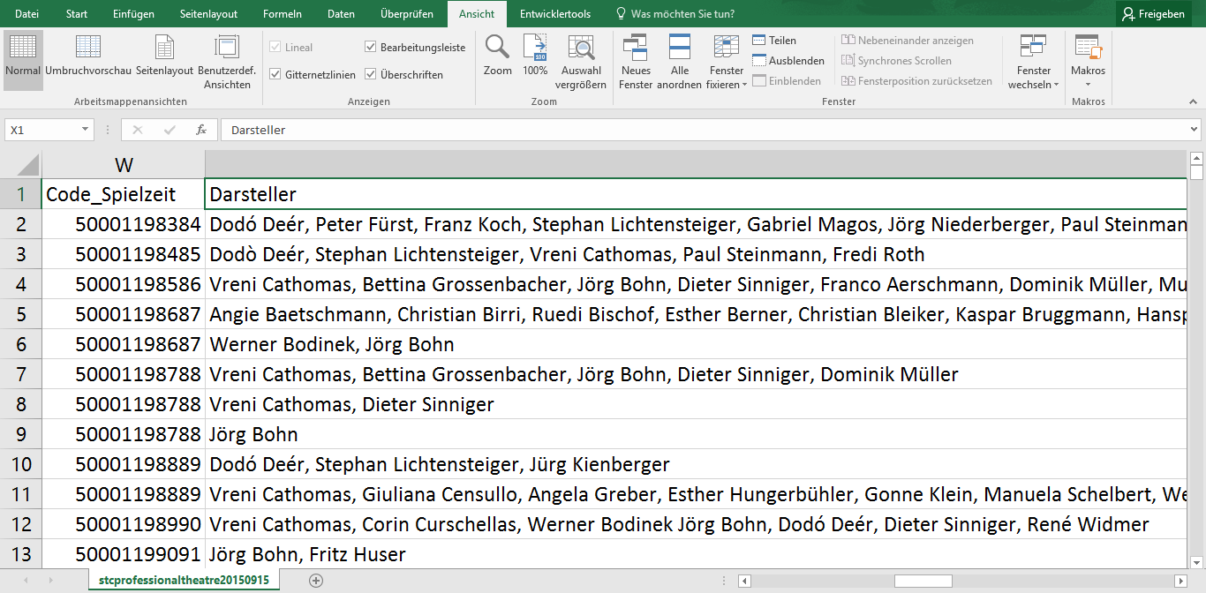
Raw data

Slide 2
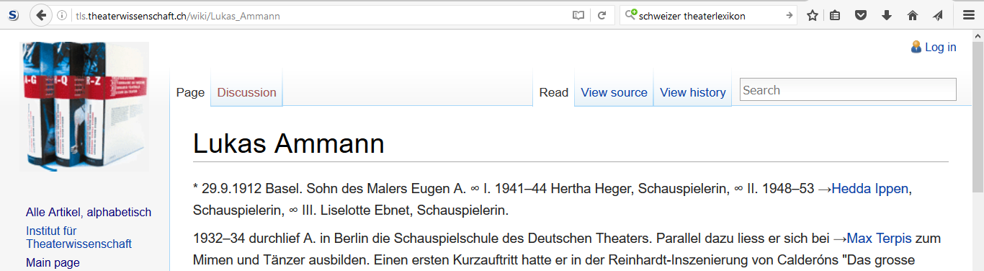
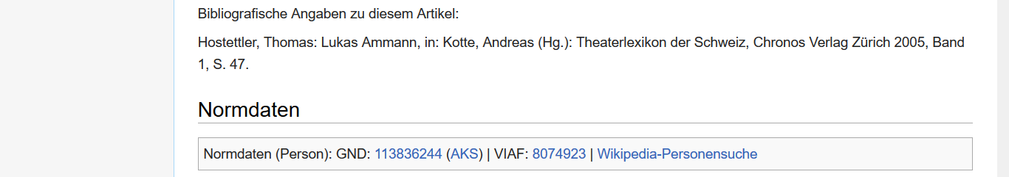
Swiss Theatre Dictionnary
…

Slide 3
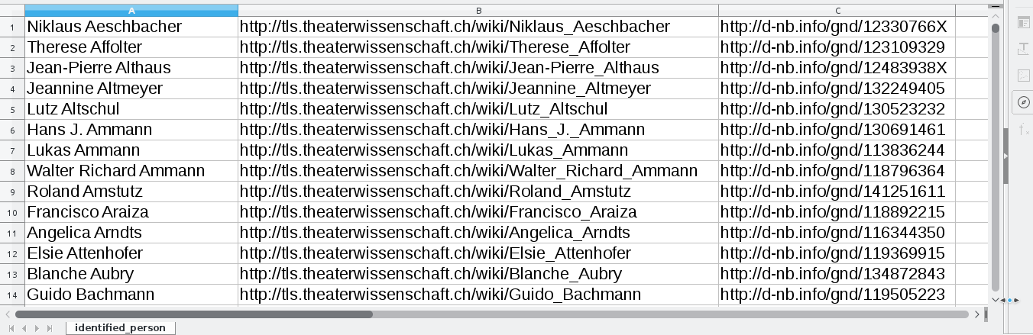
Result
1732 matches
372 matches with GND

Slide 4
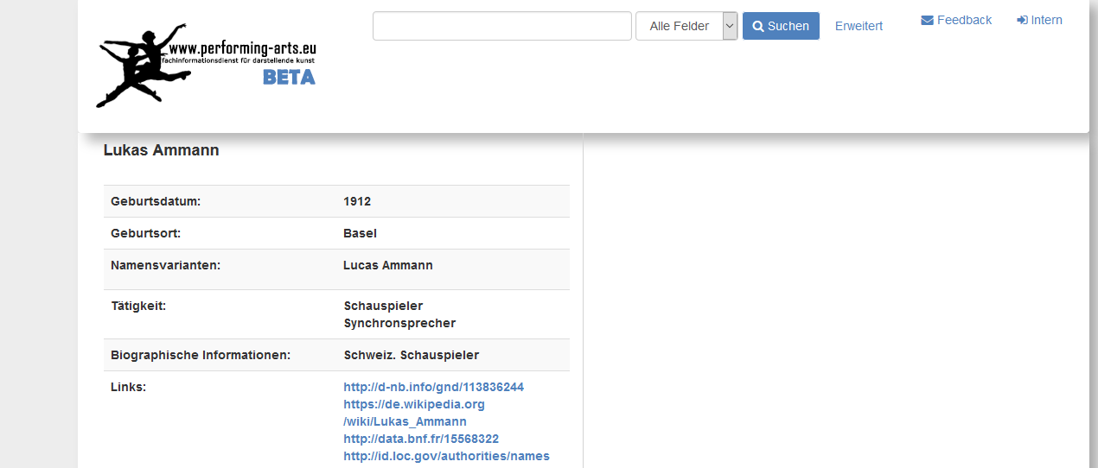
Specialised Information Service Performing Arts
http://performing-arts.eu

