Slide 1
Area Coverage with Heterogeneous Sensors in Presence of Jammers in Wireless Sensor Network
d
Presented by
Major Jaydeep Bodwadkar
Roll No: 14CS60D01
Supervisor
Dr. Arobinda Gupta
Professor
Department of Computer Science & Engineering

Slide 2
Purview
Introduction
Motivation
Broad Objective
Problem Statement
Solution Approach
Results obtained
References

Slide 3
Introduction
What are Wireless Sensor Networks (WSN)
Deployment options
Applications
Agriculture [Burrell et al 2004]
Environmental Monitoring [Cerpa et al 2001] [Mainwaring 2002]
Military Applications [Bokareva et al 2006]

Slide 4
Coverage in WSNs
Broadly classified into three main categories
Area Coverage
Every point in given area is within the sensing range
of at least one sensor
Barrier Coverage
Barrier: belt-like region surrounding an area.
Sensors spread across barrier
Barrier covered if every path that crosses through the barrier cuts the sensing regions of at least one sensor
Point Coverage
Cover set of discrete points

Slide 5
Threat by Jammers
Threat by Jammers
Attacks on the network
Jam the communication links
Disable a particular node
Attacks on the sensor
Jam the sensor’s sensing capability
Deceive by injecting false information

Slide 6
Motivation
Reconnaissance & Surveillance
Primary objective during peace time
Western frontier in Rajasthan open to infiltration
Less defensive positions
Vast open ground
Placing & maintaining troops difficult and risky
Cannot guard every inch of land
Easier to transport troops to affected areas than placing them there ab-initio
Investigate the use of WSNs in surveillance

Slide 7
Available Sensors & Jammers
Sensors available with own forces
Unattended Ground Sensor
Hand Held Thermal Imagers
Radar
Laser Range Finders
Long Range Reconnaissance Camera
Weapon Locating Radar
UAV
Jammers available with enemy forces
Only RF jammers for HF, VHF, UHF and Microwave
Static high power jammers
Expected enemy actions
Jam the network
Jam the sensor
Inject false information & deceive the sensor

Slide 8
Broad Objective
Create a Surveillance Grid using WSN
Use of heterogeneous sensors like Radar, Camera, Audio sensors, etc.
All sensors types might have different ranges
Obviate the effect of enemy jammers
Minimize the number of sensors used

Slide 9
Problem Statement
Input
Area to be under surveillance
Set of sensor types
Range
Set of sensors for each sensor type
Set of feasible locations for each sensor type
Set of Jammers
Location of each jammer
Range
Output
Set of sensors which cover the area under surveillance
Optimization problem
Optimize the cost and minimize the number of sensors in the output

Slide 10
Assumptions
Position of the enemy Jammers remain static.
Area under surveillance is a rectangle.
Unlimited number of sensors of each type are available
Feasible locations for the sensors is within the area under surveillance .

Slide 11
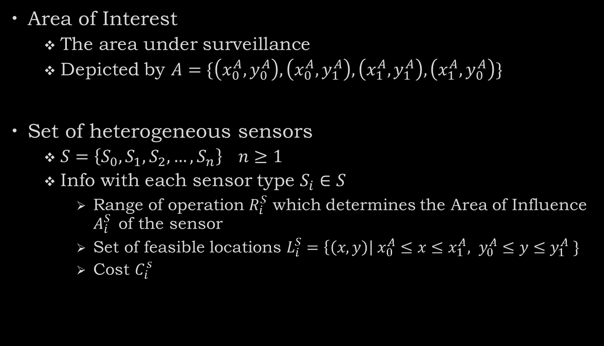
Notations
Area of Interest
The area under surveillance
Depicted by $A=\{\left(x_{0}^{A},y_{0}^{A}\right), \left(x_{0}^{A},y_{1}^{A}\right), \left(x_{1}^{A},y_{1}^{A}\right), \left(x_{1}^{A},y_{0}^{A}\right)\}$
Set of heterogeneous sensors
$S=\left\{S_{0},S_{1},S_{2},…, S_{n}\right\} n≥1$
Info with each sensor type $S_{i}∈S$
Range of operation $R_{i}^{S}$ which determines the Area of Influence $A_{i}^{S}$ of the sensor
Set of feasible locations $L_{i}^{S}=\left\{\left(x,y\right)\right| x_{0}^{A}≤x≤x_{1}^{A}, y_{0}^{A}≤y≤y_{1}^{A} \}$
Cost $C_{i}^{s}$

Slide 12
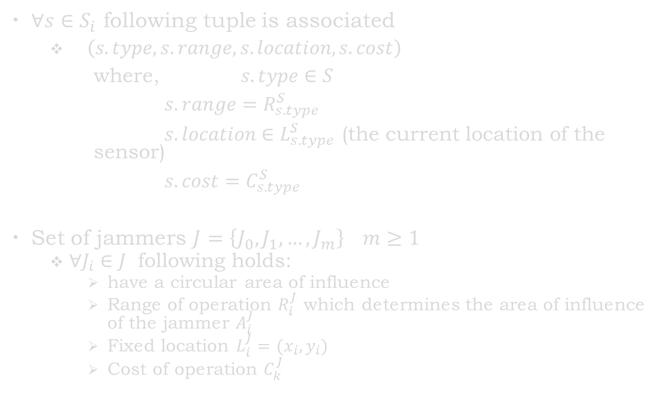
Notations (contd…)
$∀s∈S_{i}$ following tuple is associated
$\left(s.type, s.range, s.location, s.cost\right)$
where, $s.type∈S$
$s.range=R_{s.type}^{S}$
$s.location∈L_{s.type}^{S}$ (the current location of the sensor)
$s.cost=C_{s.type}^{S}$
Set of jammers $J=\left\{J_{0},J_{1},…, J_{m}\right\} m≥1$
$∀J_{i}∈J$ following holds:
have a circular area of influence
Range of operation $R_{i}^{J}$ which determines the area of influence of the jammer $A_{i}^{J}$
Fixed location $L_{i}^{J}=(x_{i},y_{i})$
Cost of operation $C_{k}^{J}$

Slide 13

Notations (contd…)
$∀S_{j}∈S$ in presence of a jammer $J_{k}$ has a probability of sensing $P_{jk}$ defines as follows:
$$P_{jk}=\left\{\begin{aligned}0 if S_{j} can be jammed by J_{k} \\ 1 if S_{j} cannot be jammed by J_{k}\end{aligned}\right. 0≤i≤m, 0≤j≤n$$

Slide 14
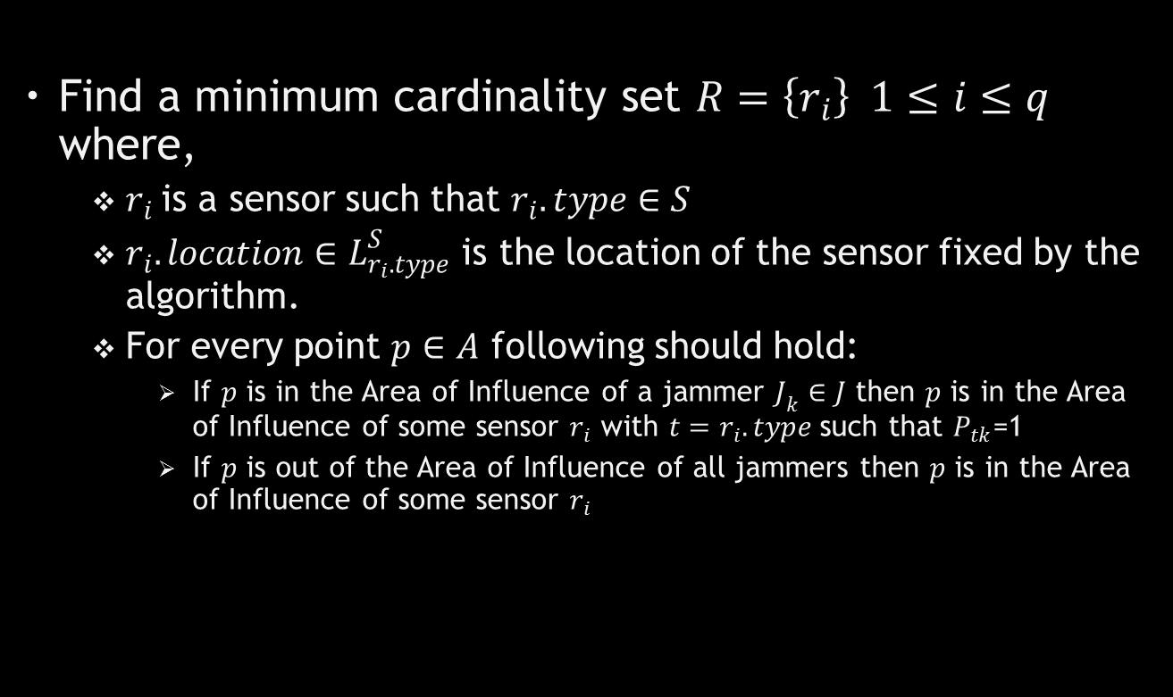
Goal
Find a minimum cardinality set $R=\left\{r_{i}\right\} 1≤i≤q$ where,
$r_{i}$is a sensor such that $r_{i}.type∈S$
$r_{i}.location∈L_{r_{i}.type}^{S}$ is the location of the sensor fixed by the algorithm.
For every point $p∈A$ following should hold:
If $p$ is in the Area of Influence of a jammer $J_{k}∈J$ then $p$ is in the Area of Influence of some sensor $r_{i}$ with $t=r_{i}.type$such that $P_{tk}$=1
If $p$ is out of the Area of Influence of all jammers then $p$ is in the Area of Influence of some sensor $r_{i}$

Slide 15
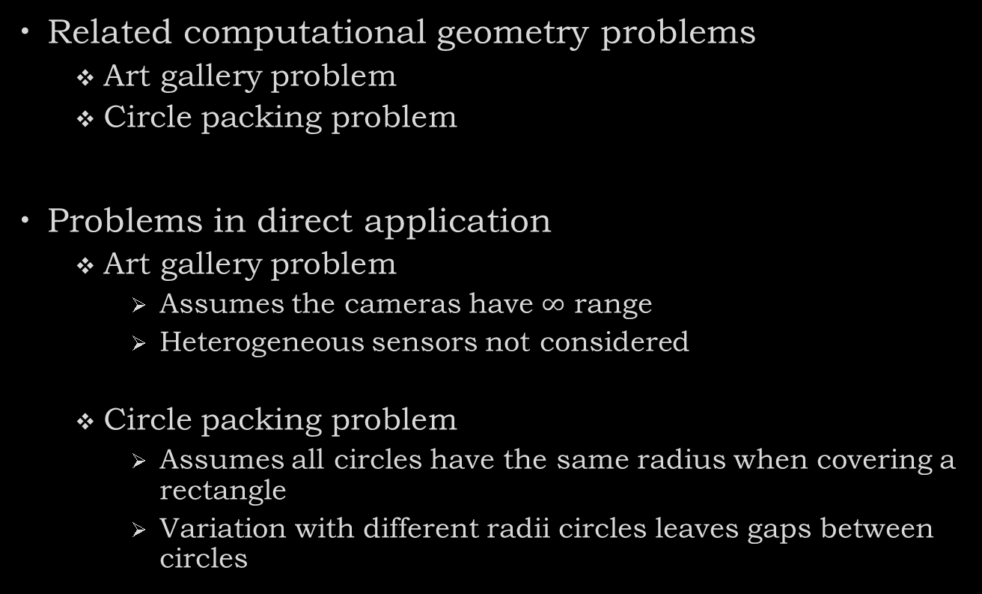
Related Work
Related computational geometry problems
Art gallery problem
Circle packing problem
Problems in direct application
Art gallery problem
Assumes the cameras have $∞$ range
Heterogeneous sensors not considered
Circle packing problem
Assumes all circles have the same radius when covering a rectangle
Variation with different radii circles leaves gaps between circles

Slide 16
Related Work (contd…)
Minimum cost coverage [Zaidi et al 2009]
Minimize the number of sensors
Minimize the cost
Arbitrary shaped region
Considers only homogeneous sensors
Area coverage for surveillance [Dhillon et al 2003]
Minimize the number of sensors
Considers uncertainty with sensor detections
Considers only homogeneous sensors
Randomized algorithm for region coverage [Hafeed et al 2007]
Selecting minimum sensors is NP-hard
Distributed algorithm
Schedules sensors for max network time
Considers only homogeneous sensors

Slide 17
Related Work (contd…)
Coverage level in area coverage [Huang, Tseng 2003]
Check for k-coverage
Area is covered if perimeter of all sensors range is covered
Considers heterogeneous sensors
This result is used for checking coverage
Sensor scheduling preserving coverage [Gao et al 2006]
Method to create disjoint sets of sensors which cover the region
Considers heterogeneous sensors
Result used to obtain the covering set of sensors

Slide 18
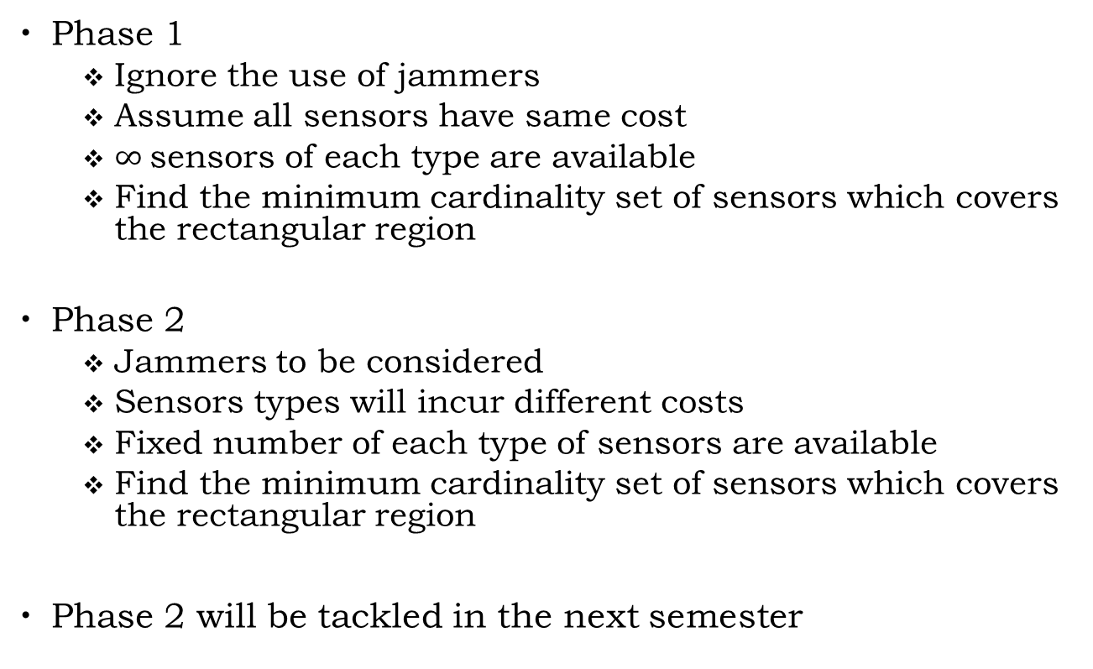
Design Approach
Phase 1
Ignore the use of jammers
Assume all sensors have same cost
$∞$sensors of each type are available
Find the minimum cardinality set of sensors which covers the rectangular region
Phase 2
Jammers to be considered
Sensors types will incur different costs
Fixed number of each type of sensors are available
Find the minimum cardinality set of sensors which covers the rectangular region
Phase 2 will be tackled in the next semester

Slide 19
Problem Subdivision
Problem can be subdivided into:
Region coverage
Identify if a rectangular region is covered by a set of heterogeneous sensors
Covering set
Find subsets of sensors which cover the region
Find the minimum cardinality subset

Slide 20
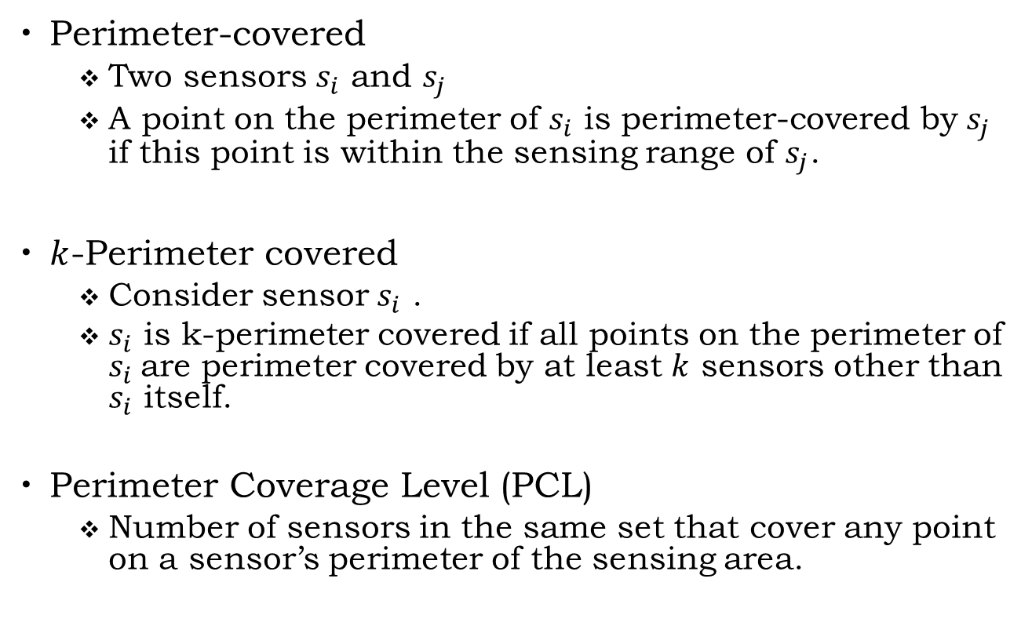
Definitions
Perimeter-covered
Two sensors $s_{i}$ and $s_{j}$
A point on the perimeter of $s_{i}$ is perimeter-covered by $s_{j}$ if this point is within the sensing range of $s_{j}$.
$k$-Perimeter covered
Consider sensor $s_{i}$ .
$s_{i}$ is k-perimeter covered if all points on the perimeter of $s_{i}$are perimeter covered by at least $k$ sensors other than $s_{i}$ itself.
Perimeter Coverage Level (PCL)
Number of sensors in the same set that cover any point on a sensor’s perimeter of the sensing area.

Slide 21
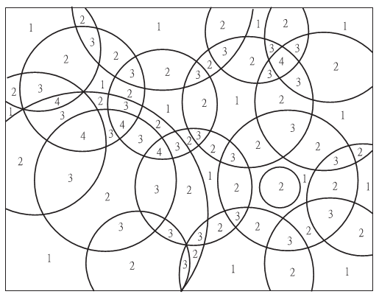
Region Coverage
Region is subdivided by sensing ranges
Sensing ranges may be of different radius
Fig: The number in each sub-region is its coverage
Rectangular region is covered if [Huang et al 2003]
Each sensor in the network is perimeter-covered
No two sensors are located in the same location.

Slide 22
Covering Subset
Sensor Scheduling Problem
Given a WSN that is fully covered
Schedule the activities of the sensors such that
Whole region remains covered
Network lifetime is maximized
Creates disjoint subsets of sensors
Finding min covering subset modelled as Sensor Scheduling Problem
Find the disjoint covering subsets
Select the min cardinality subset
Proved to be NP-hard [Gao et al 2006]
Heuristic used
Select sensor whose perimeter is covered by min sensors remaining
Select the sensor whose sensing range is max

Slide 23
Heuristic 1
Lower PCL implies smaller the node density (the number of nodes per unit area)
Choosing sensors from the area with the lowest sensor density
Sensor with a smaller PCL value will be chosen at each step
As less sensors as possible are included
Sensors are distributed as widely as possible

Slide 24
Heuristic 2
Higher chance of covering larger area with a sensor with a larger sensing range.
Deploy sensors at each location
Check if the region is covered with this arrangement
Remove sensors till no more can be removed

Slide 25
Future Work
Use of jammers will make some regions immune to some sensors
Adjust the covering subsets such that jammed regions are covered by unaffected sensors
Minimize the total cost of deployment
Every sensor incurs some cost of deployment

Slide 26
Thank You

