Slide 1
Area Coverage with Heterogeneous Sensors in the presence of Jammers in a Wireless Sensor Network environment
d
By
Major Jaydeep Bodwadkar
Roll No: 14CS60D01
Supervisor
Dr. Arobinda Gupta
Professor
Department of Computer Science & Engineering

Slide 2
Purview
Introduction
Applications
Motivation
Broad Objective
Certain Definitions
Problem Statement
Approach to Solve the problem
Experimental Setup
Results obtained
Future aim
References

Slide 3
Introduction
What are Wireless Sensor Networks (WSN)
Deployment options
Applications
Agriculture
Environmental Monitoring
Military Applications
Threat by Jammers
Attacks on the network
Attacks on the sensor

Slide 4
Coverage in WSNs
Point Coverage
Sweep Coverage
Path Coverage
Breach Coverage
Barrier Coverage
Area Coverage

Slide 5
Motivation
Reconnaissance & Surveillance
Long border with enemy
Large patches inhospitable
Can’t cover every inch of land manually
Increase in cross-border activity
Easier to transport troops to affected areas than placing them there ab-initio
Enemy will interfere with our WSN
Jam the network
Jam the sensor
Inject false information
Deceive the sensor

Slide 6
Broad Objective
Create a Surveillance Grid using WSN
Use of heterogeneous sensors like Radar, Camera, Audio sensors, etc.
All sensors types might have different ranges
Obviate the effect of enemy jammers
Minimize the number of sensors used

Slide 7
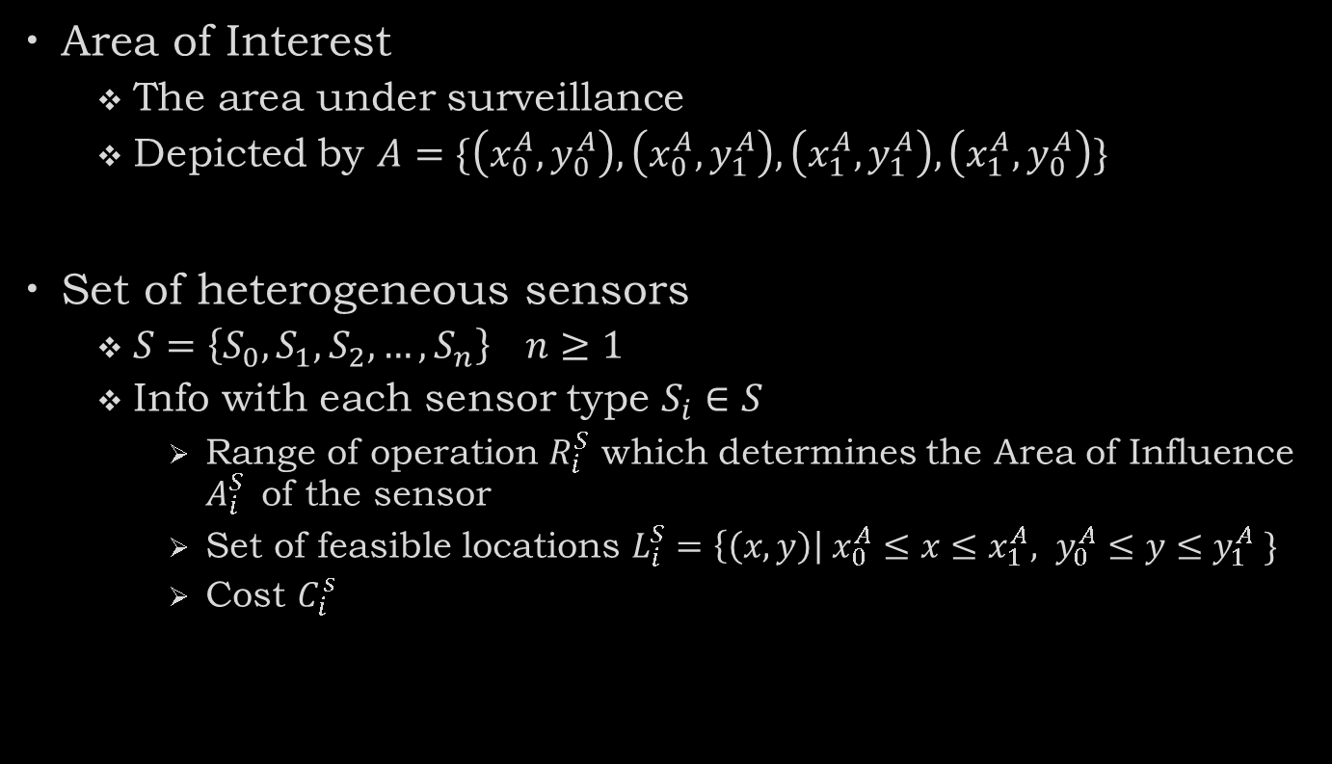
Definitions
Area of Interest
The area under surveillance
Depicted by $A=\{\left(x_{0}^{A},y_{0}^{A}\right), \left(x_{0}^{A},y_{1}^{A}\right), \left(x_{1}^{A},y_{1}^{A}\right), \left(x_{1}^{A},y_{0}^{A}\right)\}$
Set of heterogeneous sensors
$S=\left\{S_{0},S_{1},S_{2},…, S_{n}\right\} n≥1$
Info with each sensor type $S_{i}∈S$
Range of operation $R_{i}^{S}$ which determines the Area of Influence $A_{i}^{S}$ of the sensor
Set of feasible locations $L_{i}^{S}=\left\{\left(x,y\right)\right| x_{0}^{A}≤x≤x_{1}^{A}, y_{0}^{A}≤y≤y_{1}^{A} \}$
Cost $C_{i}^{s}$

Slide 8
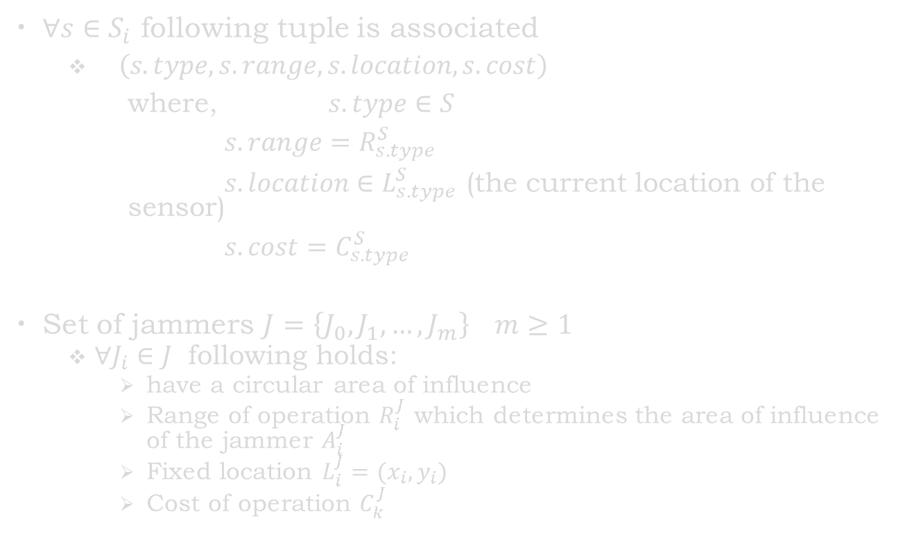
$∀s∈S_{i}$ following tuple is associated
$\left(s.type, s.range, s.location, s.cost\right)$
where, $s.type∈S$
$s.range=R_{s.type}^{S}$
$s.location∈L_{s.type}^{S}$ (the current location of the sensor)
$s.cost=C_{s.type}^{S}$
Set of jammers $J=\left\{J_{0},J_{1},…, J_{m}\right\} m≥1$
$∀J_{i}∈J$ following holds:
have a circular area of influence
Range of operation $R_{i}^{J}$ which determines the area of influence of the jammer $A_{i}^{J}$
Fixed location $L_{i}^{J}=(x_{i},y_{i})$
Cost of operation $C_{k}^{J}$

Slide 9

$∀S_{j}∈S$ in presence of a jammer $J_{k}$ has a probability of sensing $P_{jk}$ defines as follows:
$$P_{jk}=\left\{\begin{aligned}0 if S_{j} can be jammed by J_{k} \\ 1 if S_{j} cannot be jammed by J_{k}\end{aligned}\right. 0≤i≤m, 0≤j≤n$$

Slide 10
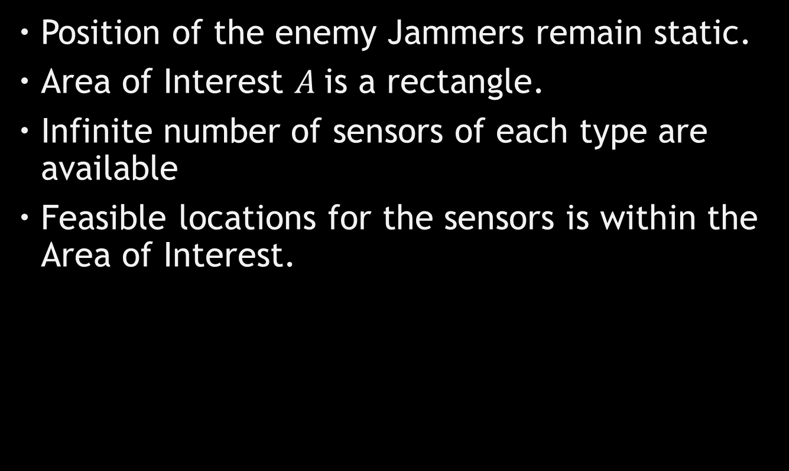
Assumptions
Position of the enemy Jammers remain static.
Area of Interest $A$is a rectangle.
Infinite number of sensors of each type are available
Feasible locations for the sensors is within the Area of Interest.

Slide 11
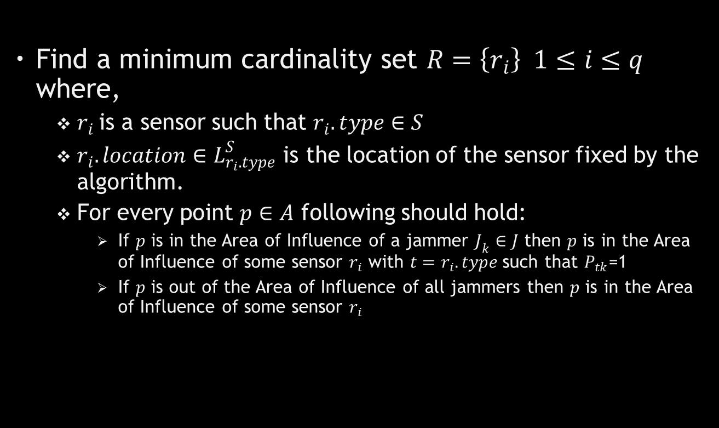
Goal
Find a minimum cardinality set $R=\left\{r_{i}\right\} 1≤i≤q$ where,
$r_{i}$is a sensor such that $r_{i}.type∈S$
$r_{i}.location∈L_{r_{i}.type}^{S}$ is the location of the sensor fixed by the algorithm.
For every point $p∈A$ following should hold:
If $p$ is in the Area of Influence of a jammer $J_{k}∈J$ then $p$ is in the Area of Influence of some sensor $r_{i}$ with $t=r_{i}.type$such that $P_{tk}$=1
If $p$ is out of the Area of Influence of all jammers then $p$ is in the Area of Influence of some sensor $r_{i}$

Slide 12
Literature Survey

Slide 13
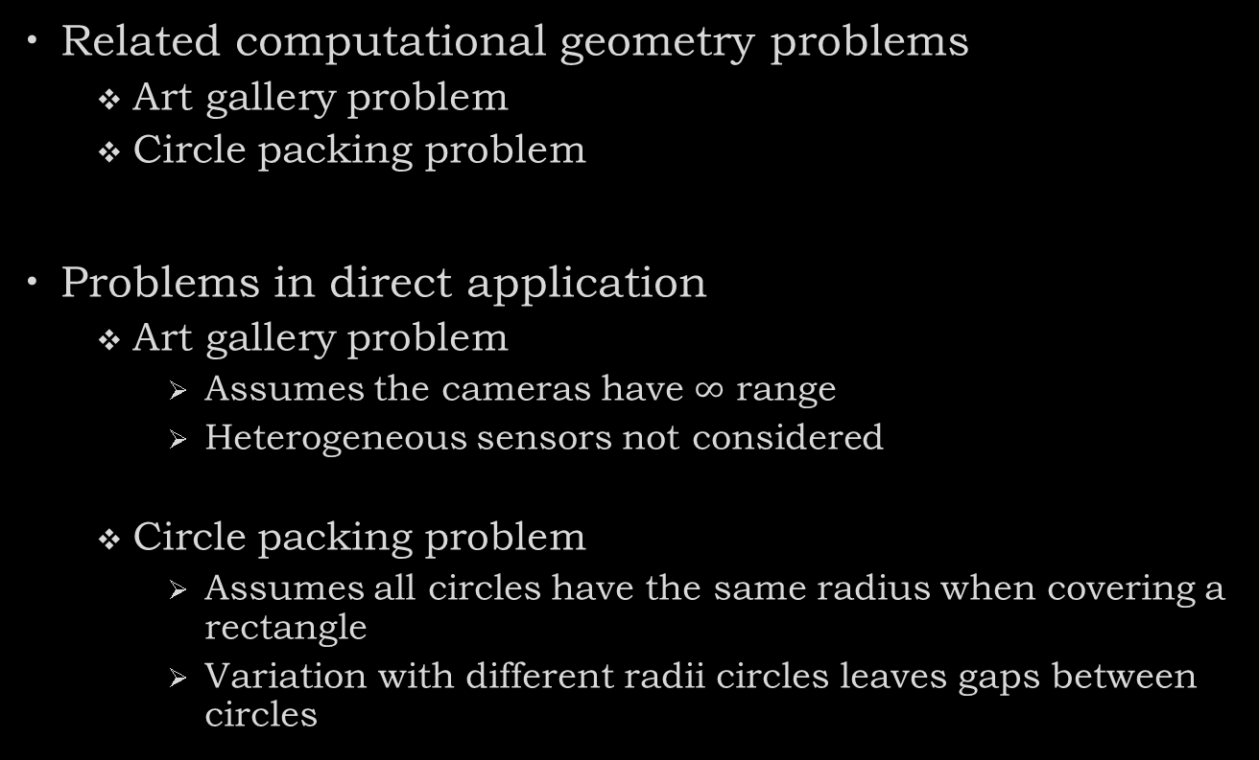
Development Approach
Related computational geometry problems
Art gallery problem
Circle packing problem
Problems in direct application
Art gallery problem
Assumes the cameras have $∞$ range
Heterogeneous sensors not considered
Circle packing problem
Assumes all circles have the same radius when covering a rectangle
Variation with different radii circles leaves gaps between circles

Slide 14
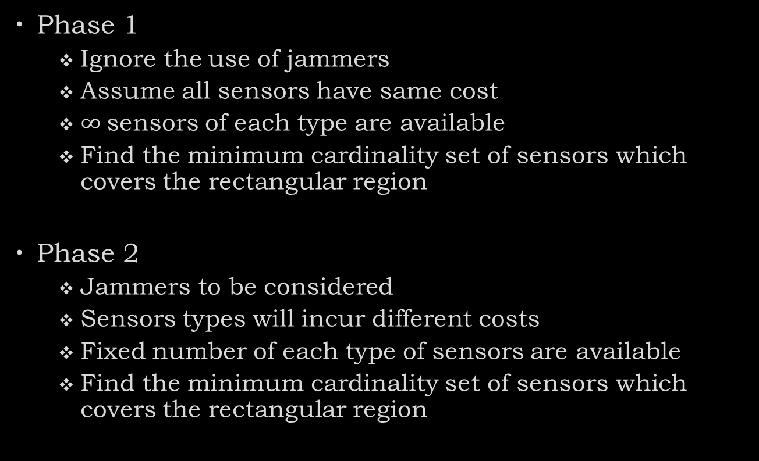
Development Approach
Phase 1
Ignore the use of jammers
Assume all sensors have same cost
$∞$sensors of each type are available
Find the minimum cardinality set of sensors which covers the rectangular region
Phase 2
Jammers to be considered
Sensors types will incur different costs
Fixed number of each type of sensors are available
Find the minimum cardinality set of sensors which covers the rectangular region

Slide 15
Problem Subdivision
Problem can be subdivided into:
Identify if a rectangular region is covered by a set of heterogeneous sensors
Find subsets of sensors which cover the region
Find the minimum cardinality subset

Slide 16
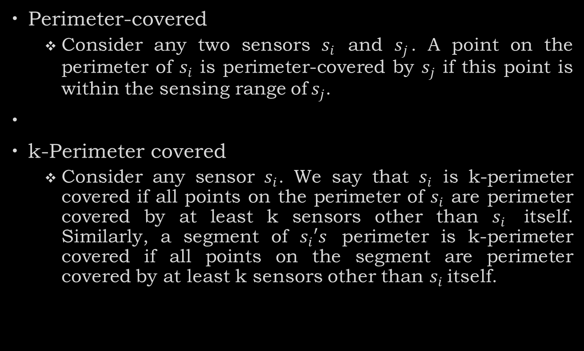
Definitions
Perimeter-covered
Consider any two sensors $s_{i}$ and $s_{j}$. A point on the perimeter of $s_{i}$ is perimeter-covered by $s_{j}$ if this point is within the sensing range of${ s}_{j}$.
k-Perimeter covered
Consider any sensor $s_{i}$. We say that $s_{i}$ is k-perimeter covered if all points on the perimeter of $s_{i}$ are perimeter covered by at least k sensors other than $s_{i}$ itself. Similarly, a segment of $s_{i}′s$ perimeter is k-perimeter covered if all points on the segment are perimeter covered by at least k sensors other than $s_{i}$itself.

Slide 17

Definitions
Perimeter Coverage Level (PCL)
PCL of a sensor $A$ is the number of the sensors in the same set that cover any point on $A$’s perimeter of the sensing area.

Slide 18
Region Coverage
Huang and Tseng in their paper titled “The Coverage Problem in a Wireless Sensor Network” prove the following:
Suppose that no two sensors are located in the same location. The whole network area A is k-covered iff each sensor in the network is k-perimeter-covered
Above result used in determining if a rectangular region is covered or not

Slide 19
Boundary Conditions

