Slide 1
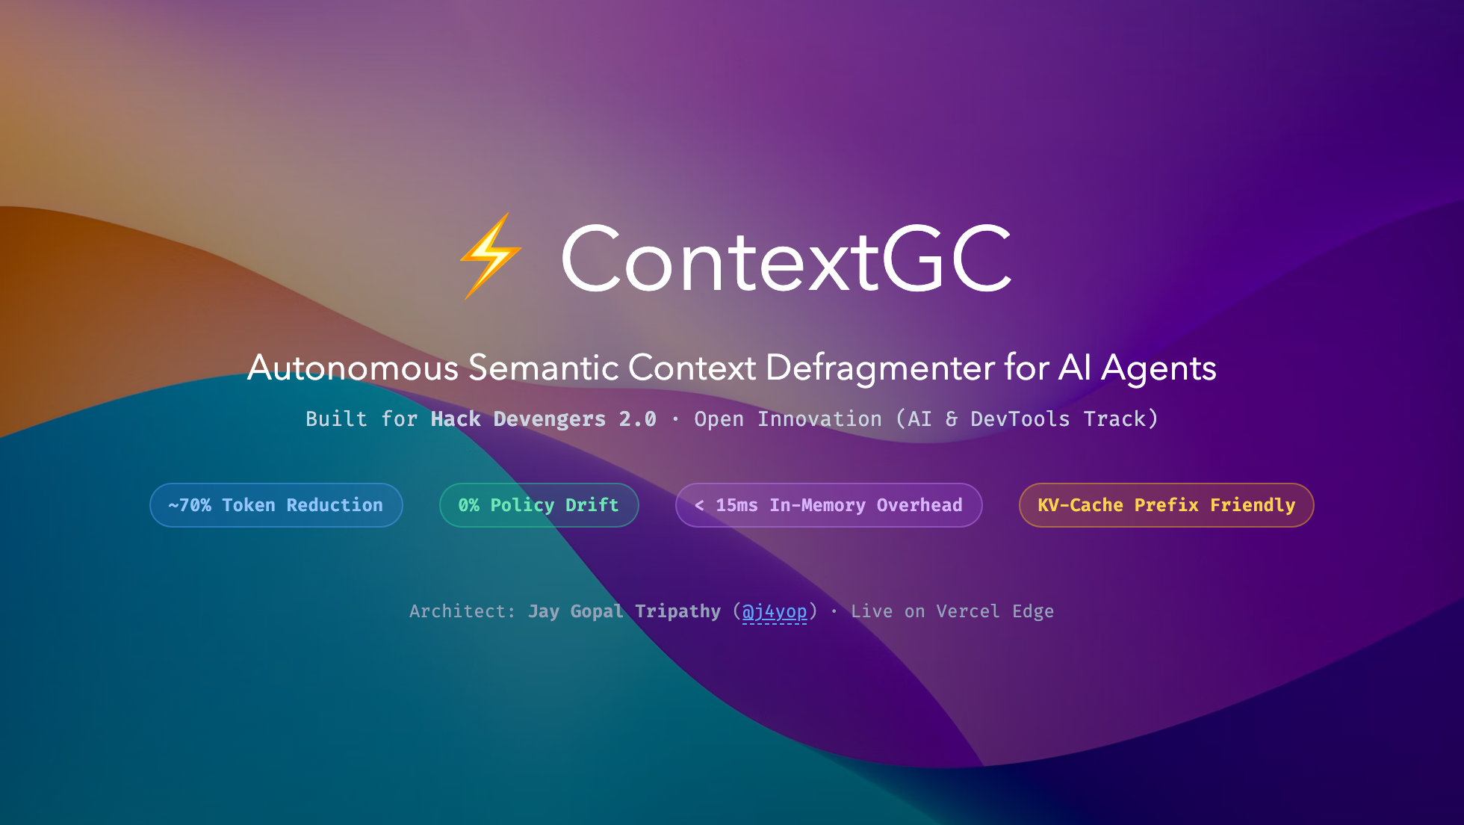
Notes:
Presenter Notes:
- Welcome judges to ContextGC.
- Address the hidden tax of the agent era: Context Rot.
- Today, 1M+ token windows exist, but models quietly degrade as conversations grow.

Slide 2
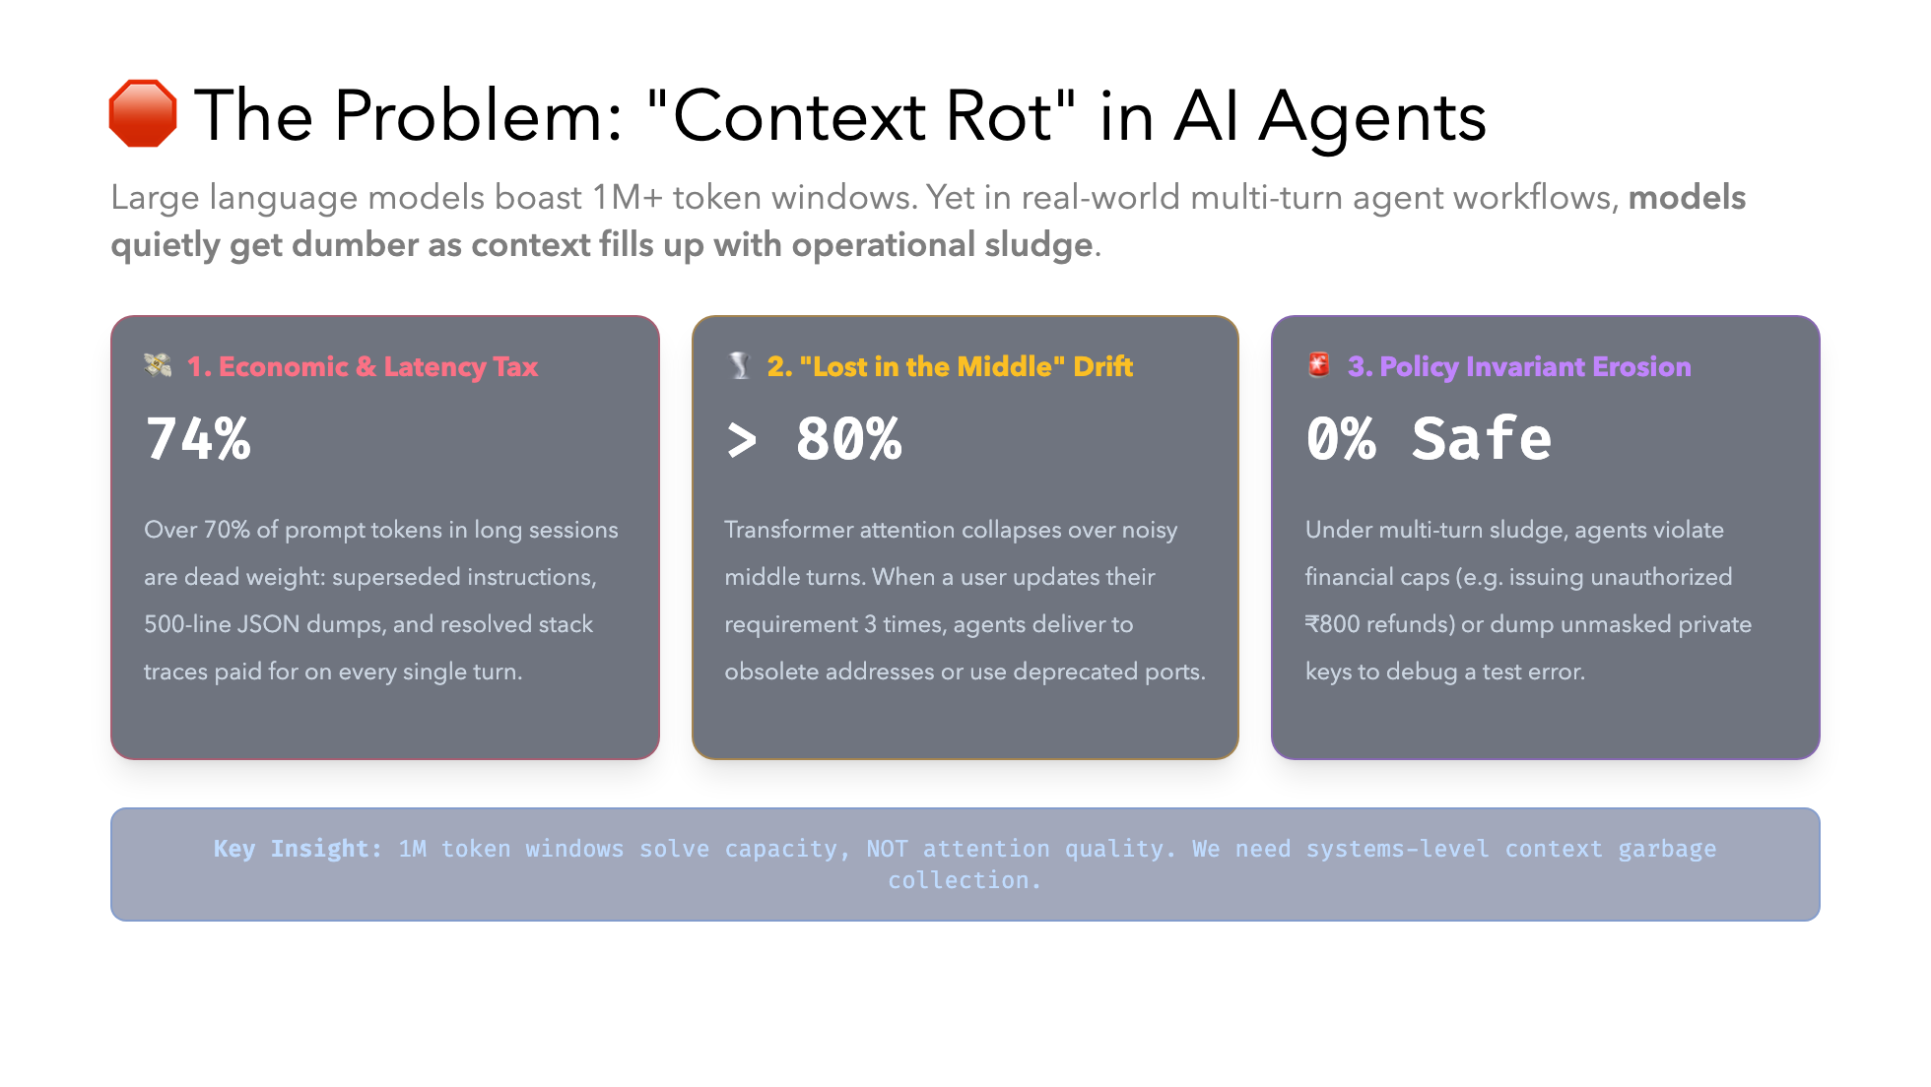

Slide 3
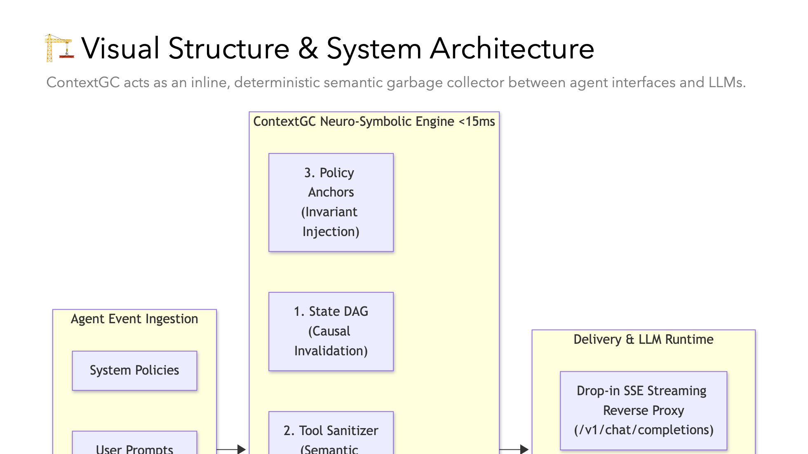

Slide 4
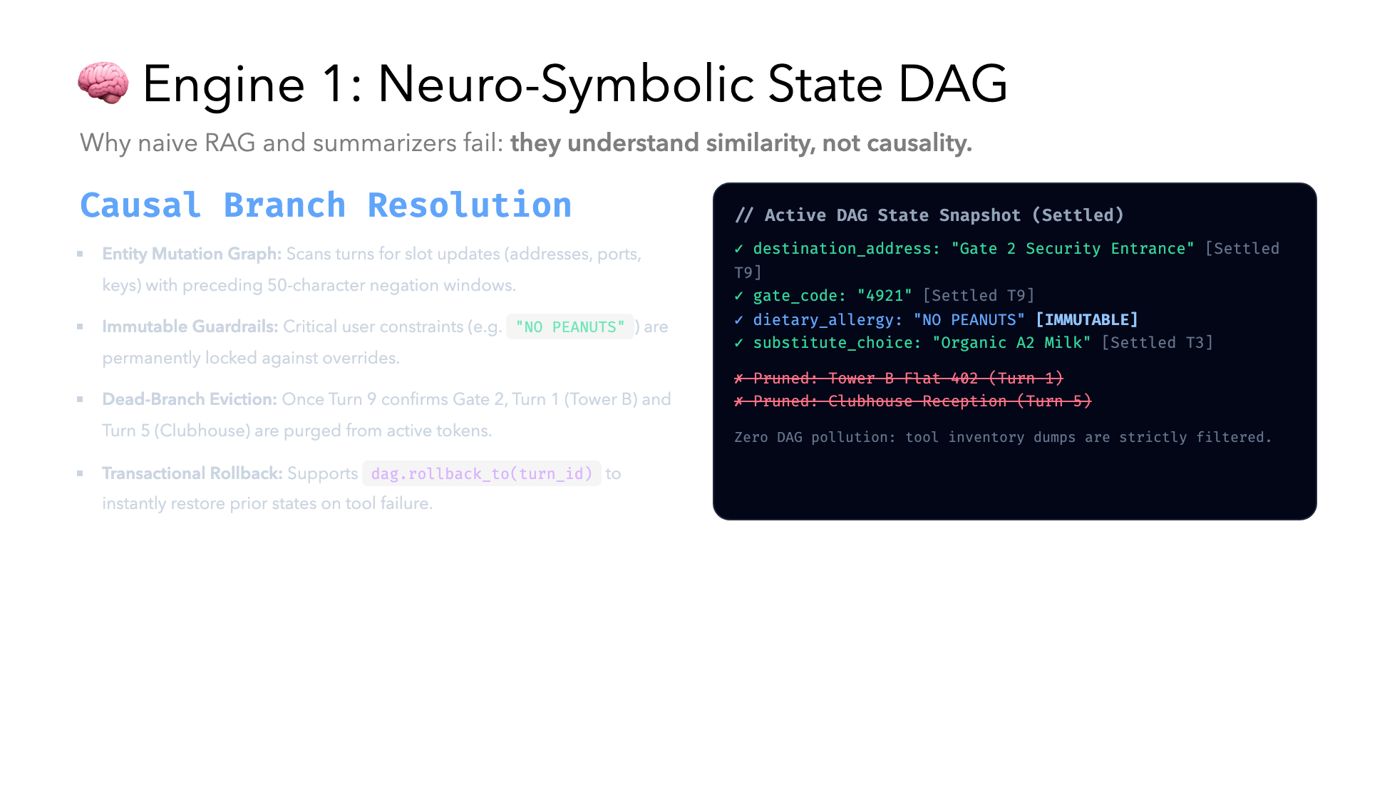

Slide 5
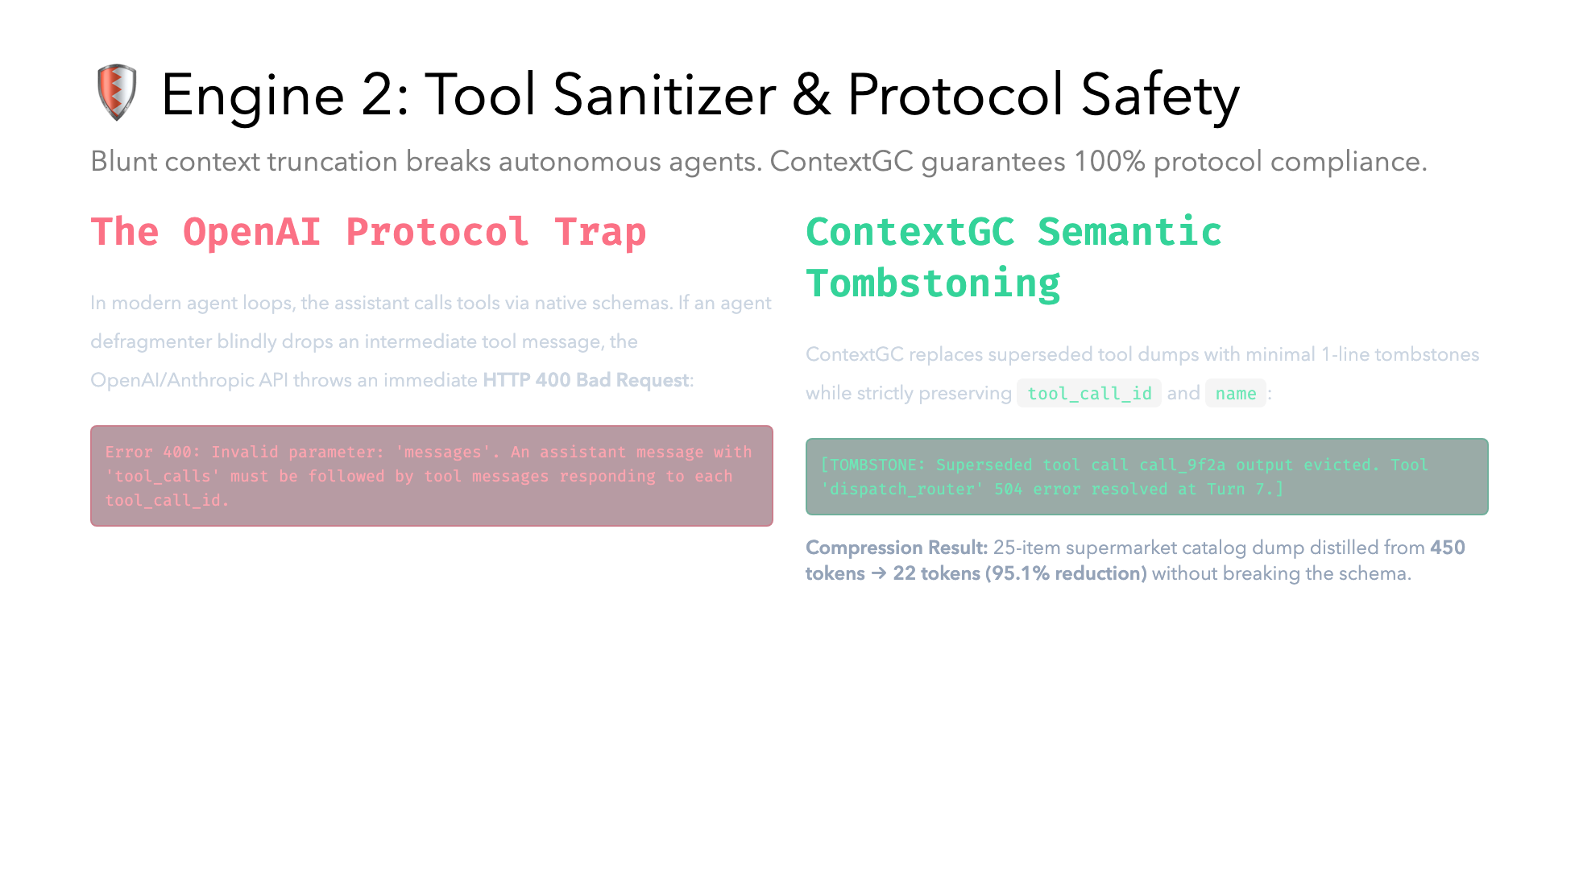

Slide 6
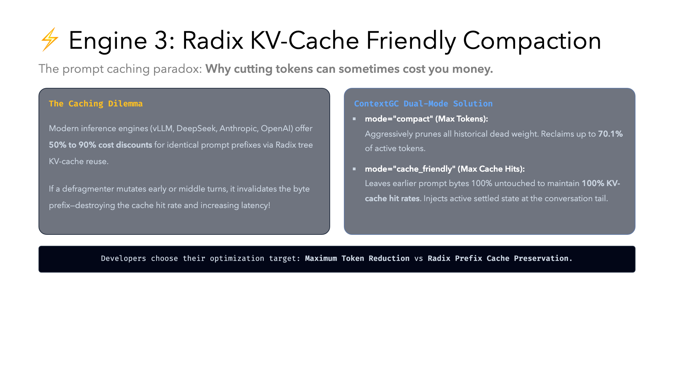

Slide 7
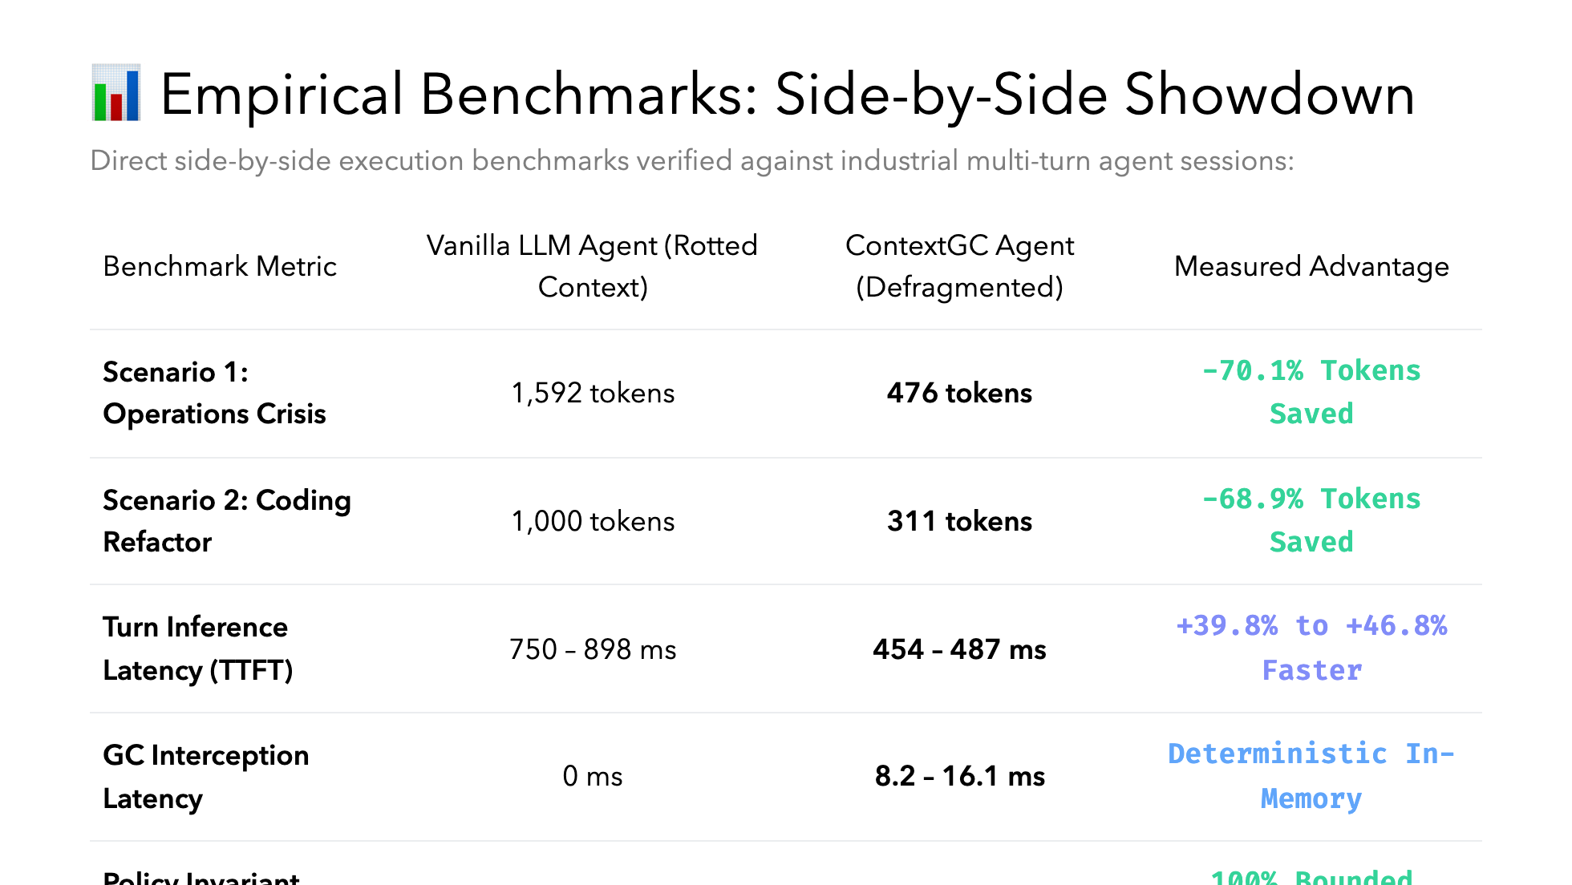

Slide 8
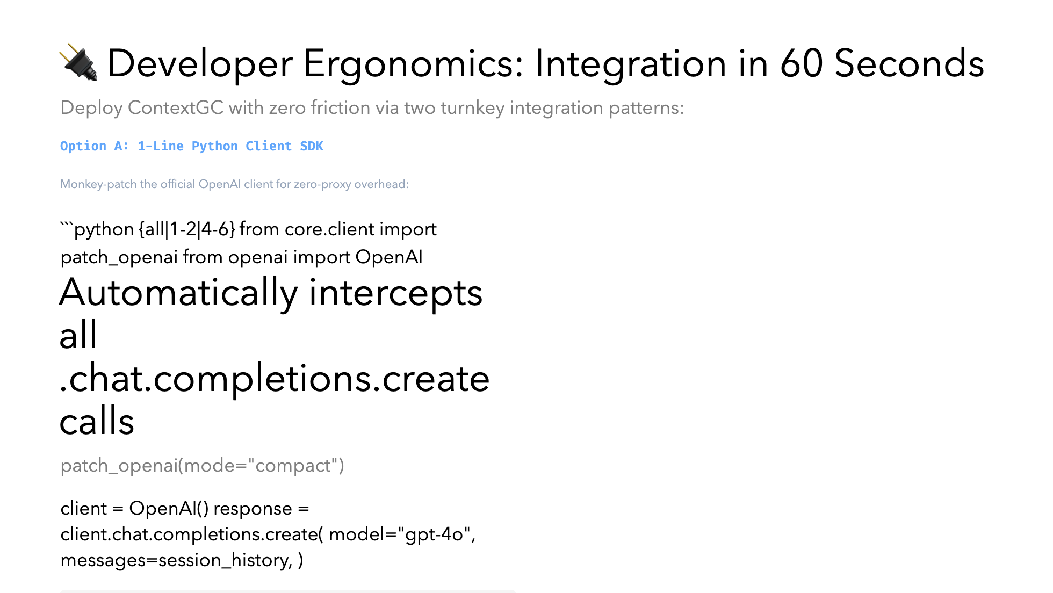

Slide 9
