Slide 1

Acoustic Localization
Siddharth Agrawal, Julien Blanchet, Mack Reiferson, and Vlado Vojdanovski
Picture source: http://www.thecrossingchurch.net/pastors-corner/marco-polo

Slide 2
Problem Statement
Localize a robot equipped with a triangular-array of 3 microphones, using 3 speakers with known positions in a room
Develop a framework in ROS for creating and testing acoustics-based SLAM

Slide 3





Problem Statement
Indoor environment
The robot knows:
Location of speakers in the room
Positions of its microphones only relative to each other
… but not:
Its own pose
Speaker 1
$${\vec{s}}_{1}$$
Device equipped with Microphone array
$${\vec{s}}_{3}$$
$$(x,y)$$
$${\vec{s}}_{2}$$
Speaker 2
$$y$$
Speaker 3
$$x$$

Slide 4
Approach
Sound
messages
Positions of speakers
Direction-of-arrival
Determine direction of incoming sound
Localization
Use directional information to calculate robot position
Speaker location vectors
State Estimate
(Pose)
Mack and Siddharth
Julien and Vlado

Slide 5
Direction of Arrival

Slide 6
Building Up and Down
Direction-of-arrival
Local-ization
Simulation Environment
Microphone Receiver
Generate waveforms
Parse TDOA’s
from waveforms
Generate time-differences of-arrival (TDOA)
Decrypt
direction-of-arrivals
from TDOA’s
Knowledge about
Speaker positions
Microphone positions
Room layout
Knowledge about
Microphone positions relative only to each other
Direction vectors

Slide 7
Demo

Slide 8












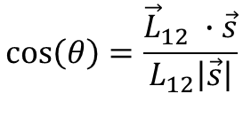
Building up Time-Difference of Arrival
Direction-of-arrival
Local-ization
$$\vec{s}$$
$${Δd}_{12}$$
$${\vec{L}}_{12}$$
$$\vec{s}$$
$$θ$$
$$θ$$
$$m_{2}$$
$$L_{12}$$
$$m_{1}$$
$$\vec{s}$$
$${Δd}_{12}=L_{12}cos⁡(θ)$$
Assume distance to speaker >> distance between mics
As a result, sound arrives at each mic from the same direction
$$y$$
$$\cos\left(θ\right)=\frac{{\vec{L}}_{12} ∙\vec{s}}{L_{12}\left|\vec{s}\right|}$$
$$x$$
$${Δt}_{12}=\frac{Δd_{12}}{v_{sound}}$$
Acknowledgement: Part 1 of this diagram is inspired by Slide XX of the linked lecture:

Slide 9
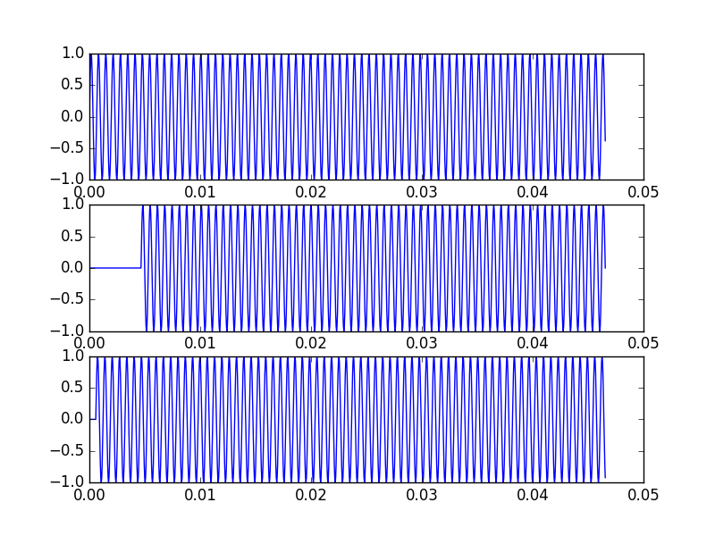



Building up Waveforms
Direction-of-arrival
Local-ization
Microphone
$$m_{1}$$
$$m_{2}$$
$$m_{3}$$

Slide 10
Getting TDOA from Waveforms
Direction-of-arrival
Local-ization
Microphone
$$m_{1}$$
$$m_{2}$$
$$m_{3}$$

Slide 11













Getting direction vectors from TDOA
Direction-of-arrival
Local-ization
$$\vec{s}$$
$${Δd}_{12}$$
$$\vec{s}$$
$${\vec{L}}_{12}$$
$$θ$$
$$θ$$
$$θ$$
$$m_{2}$$
$$θ$$
$$L_{12}$$
$$m_{1}$$
$$\vec{s}$$
$$\vec{s_{fake!}}$$

Slide 12





Getting direction vectors from TDOA
Direction-of-arrival
Local-ization
$$\vec{s}$$
$${Δd}_{13}$$
$$α$$
$$α$$
$$\vec{s}$$
$$\vec{s_{fake!}}$$
$$m_{1}$$

Slide 13


Getting direction vectors from TDOA
Direction-of-arrival
Local-ization
$$\vec{s}$$
$$α$$
$$α$$
$$\vec{s}$$
$$\vec{s}$$
$${\vec{L}}_{12}$$
$$θ$$
$$θ$$
$$m_{2}$$
$$m_{1}$$

Slide 14
Localization

Slide 15
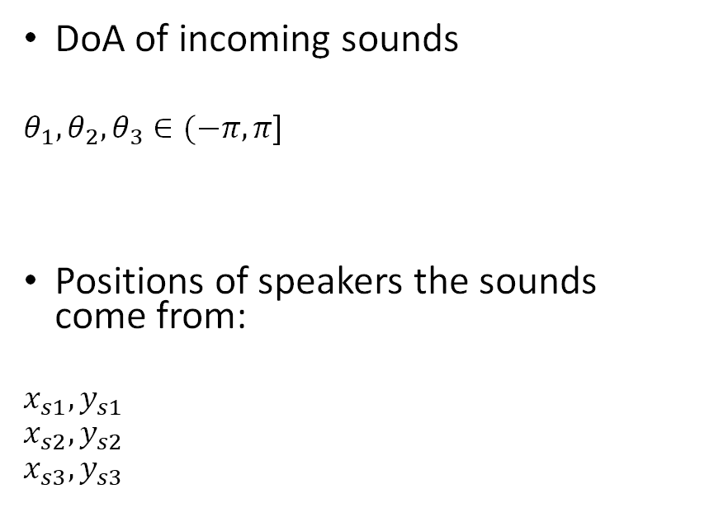


Problem Definition
Direction-of-arrival
Local-ization
Given
Find
DoA of incoming sounds
$$θ_{1}, θ_{2}, θ_{3}∈(−π, π]$$
Positions of speakers the sounds come from:
$$x_{s1}, y_{s1}$$
$$x_{s2}, y_{s2}$$
$$x_{s3}, y_{s3}$$
The pose of the robot
$${x_{r}, y_{r}∈ℝ, θ}_{r}∈(−π, π]$$
$$∈ℝ$$
Notes:
Define the problem – provide illustration, discuss the knowns and knowns for this stage of the problem.
Assumptions: 2D planar problem
Knowns: speaker positions, and relative orientations of the speakers compared the robot’s heading (DoAs)
Compare it to distance-based triangulation
One advantage: we also compute the orientation of the robot! A full pose :D

Slide 16
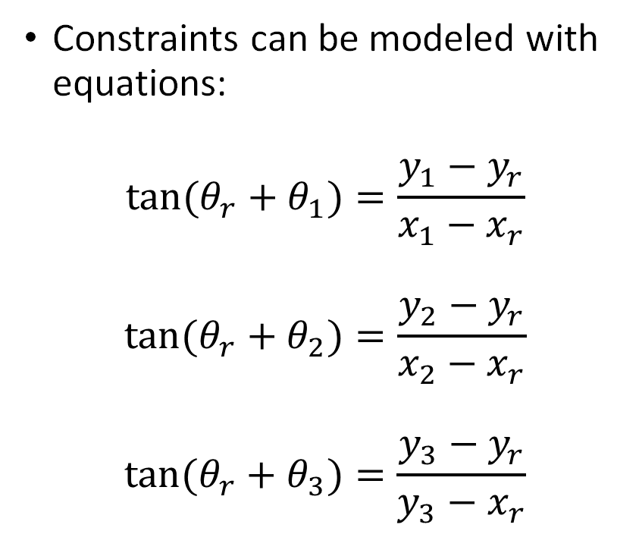
Geometric Solution?
Direction-of-arrival
Local-ization
Constraints can be modeled with equations:
$${tan⁡(θ}_{r}+θ_{1})=\frac{y_{1}−y_{r}}{x_{1}−x_{r}}$$
$${tan⁡(θ}_{r}+θ_{2})=\frac{y_{2}−y_{r}}{x_{2}−x_{r}}$$
$${tan⁡(θ}_{r}+θ_{3})=\frac{y_{3}−y_{r}}{y_{3}−x_{r}}$$
Notes:
Focus on what’s important: we have three equations and three unknowns, making the system exactly determined. There should be precisely one answer.

Slide 17
Problem Analysis
Direction-of-arrival
Local-ization
Start off showing 2 speaker DoA.
Provide speaker locations and DoA measurement
Show that there are more than one matching poses – in fact, there are infinite, and they follow an arc.
Makes sense: we have three variables, we’ll need three equations to solve.
What if we add a 3rd speaker?
Now we can have 3 curves. They only intersect at one point, and I believe that’s always the case (though don’t have a proof).
One method: locate intersection of curves

Slide 18
Localization Algorithm
Direction-of-arrival
Local-ization
2 phases:
Build list of candidate poses, based of directions of two speakers
Select pose among that list that best matches the third pose

Slide 19
Localization Algorithm
Direction-of-arrival
Local-ization
First phase
Randomly chose two speakers
Start at one speaker
Iterate over distance, finding poses that register with both speakers
Second phase
Check candidates for registration with third speaker
Closest registration wins!

Slide 20
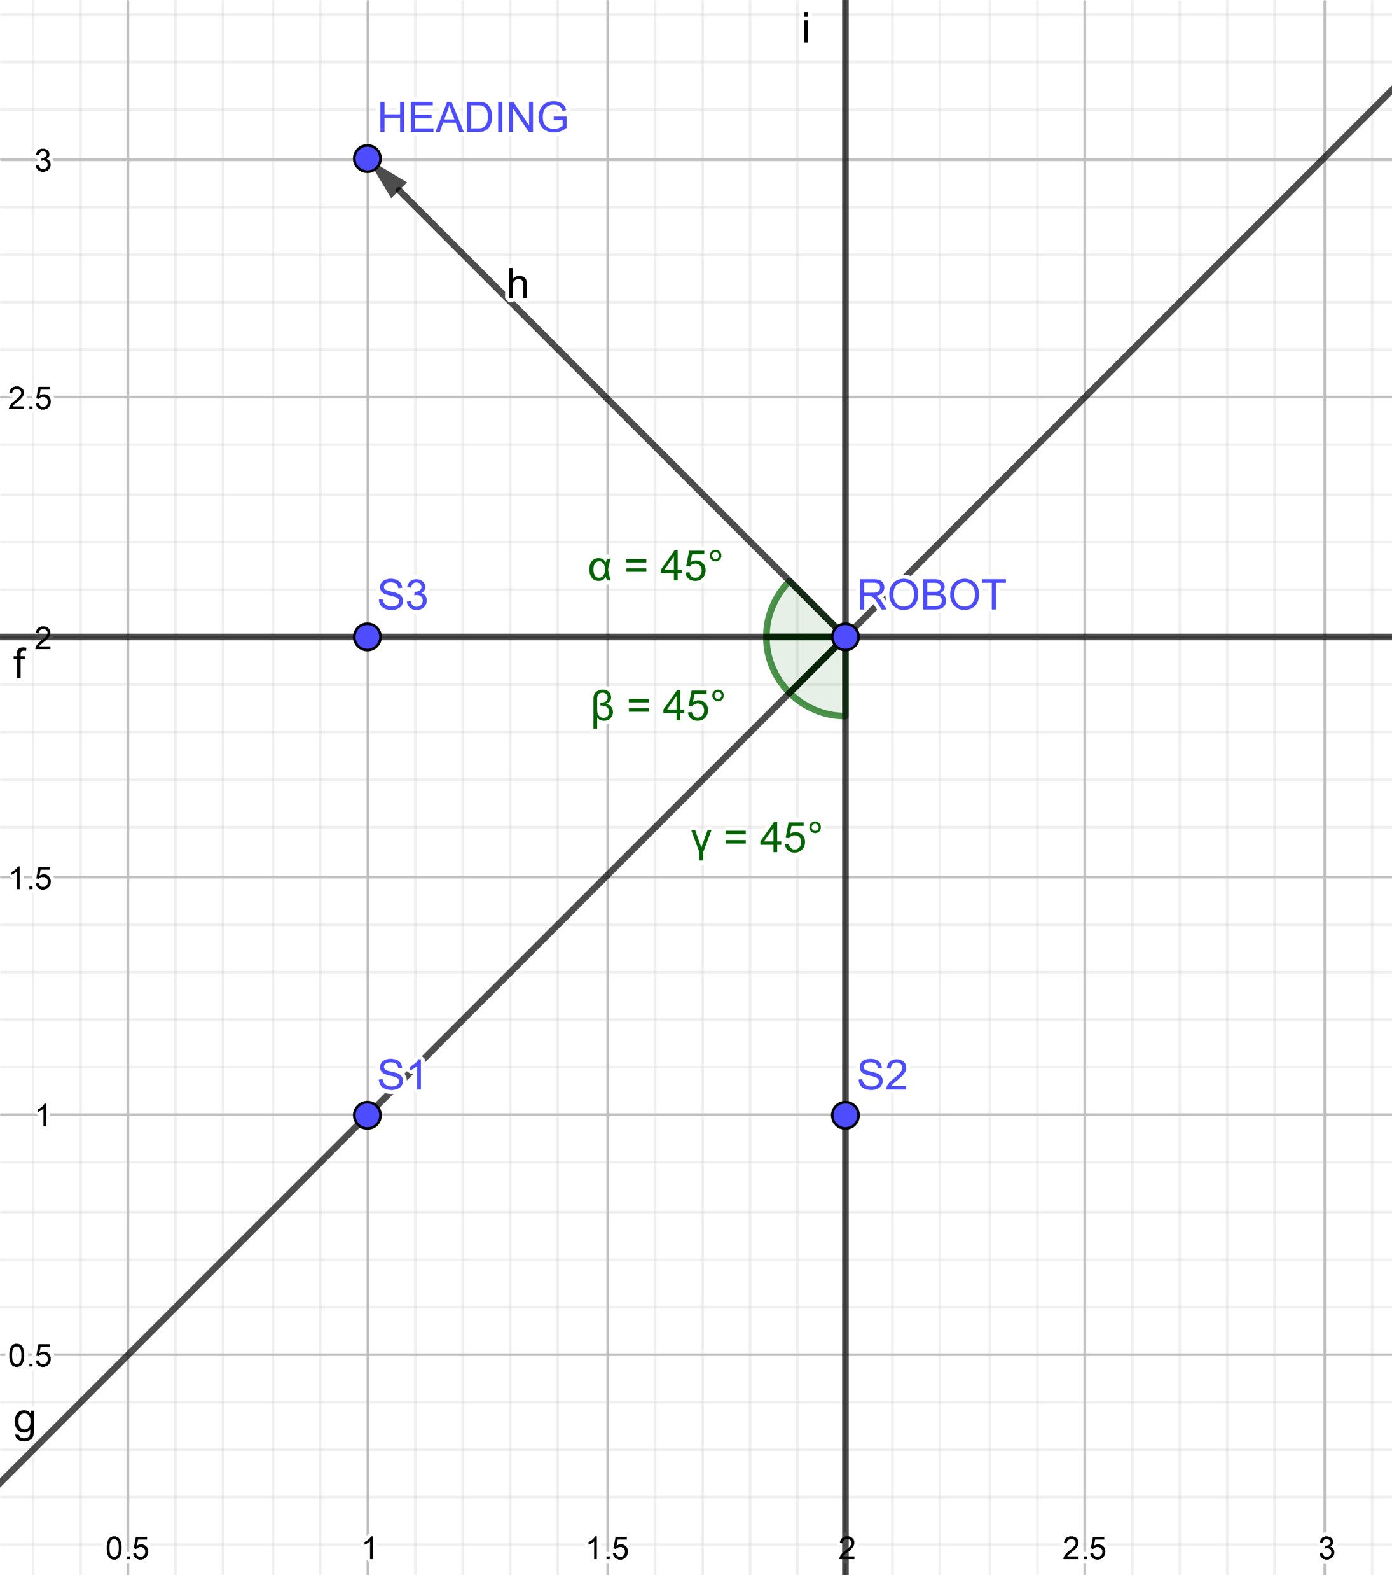
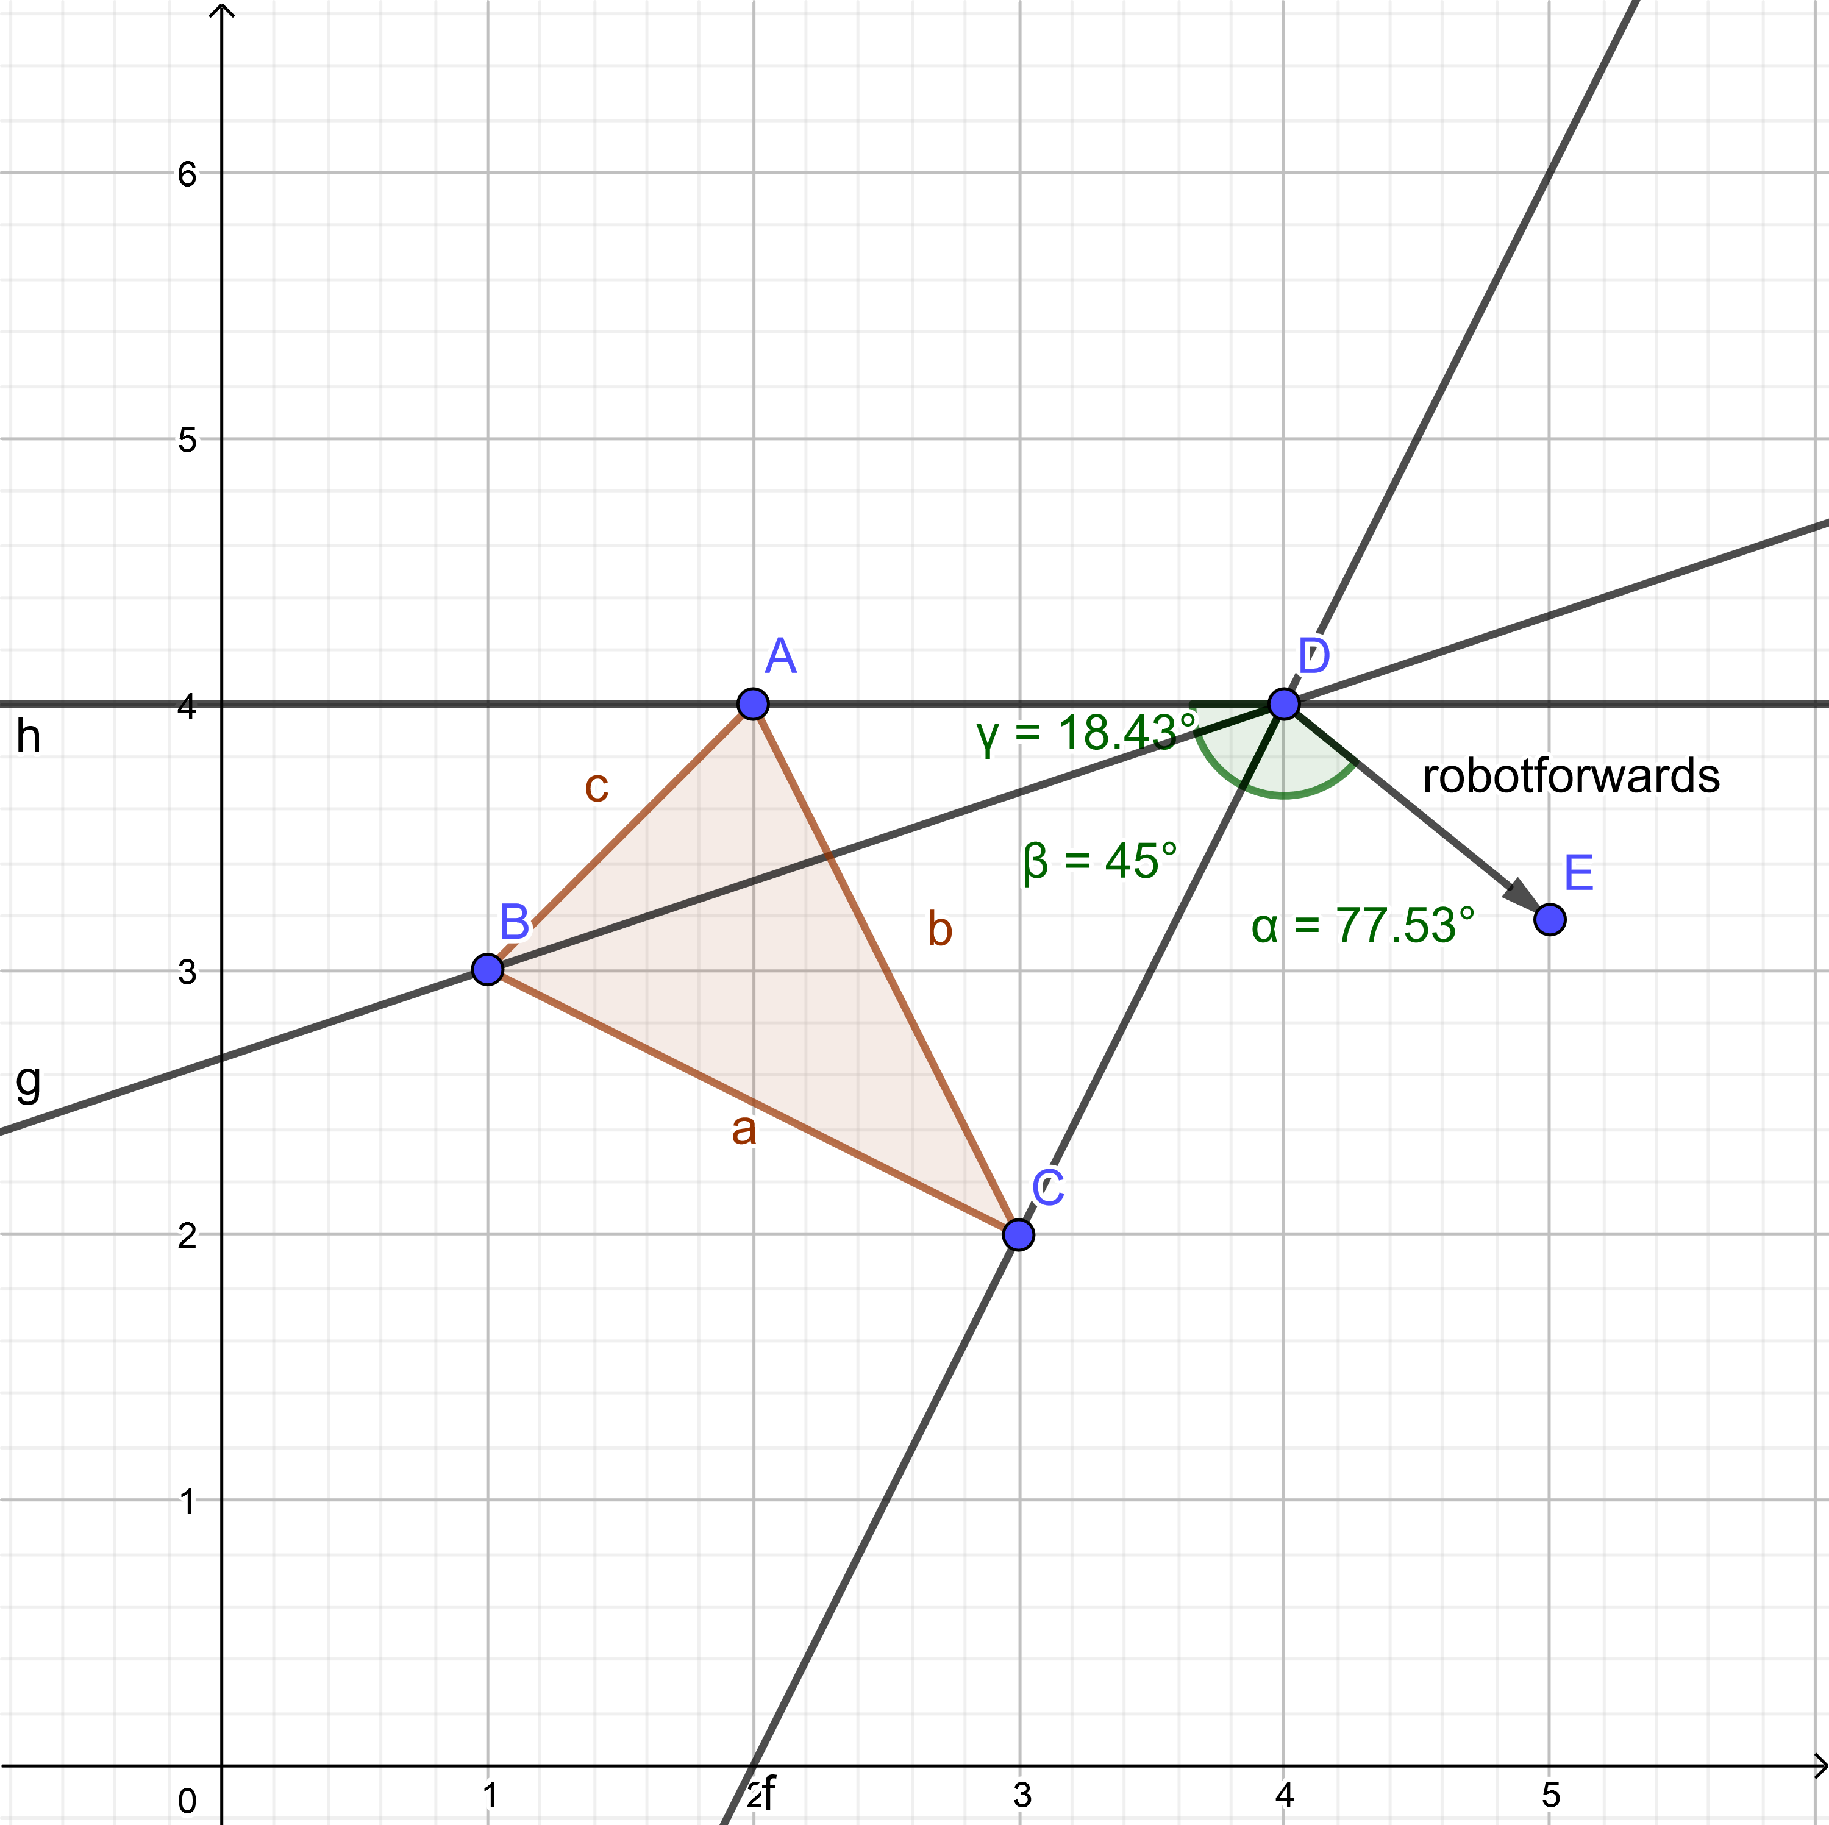
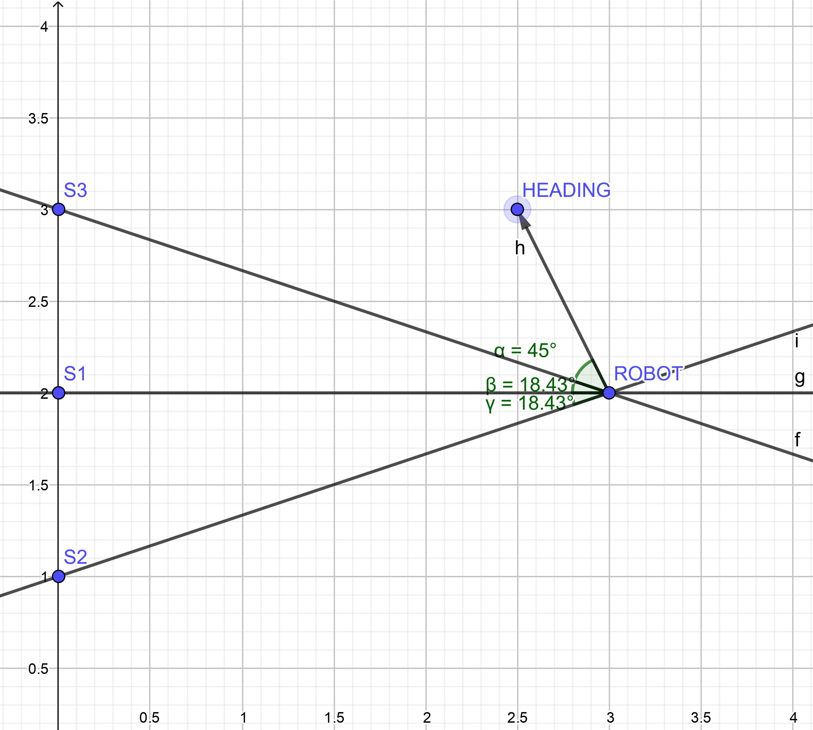
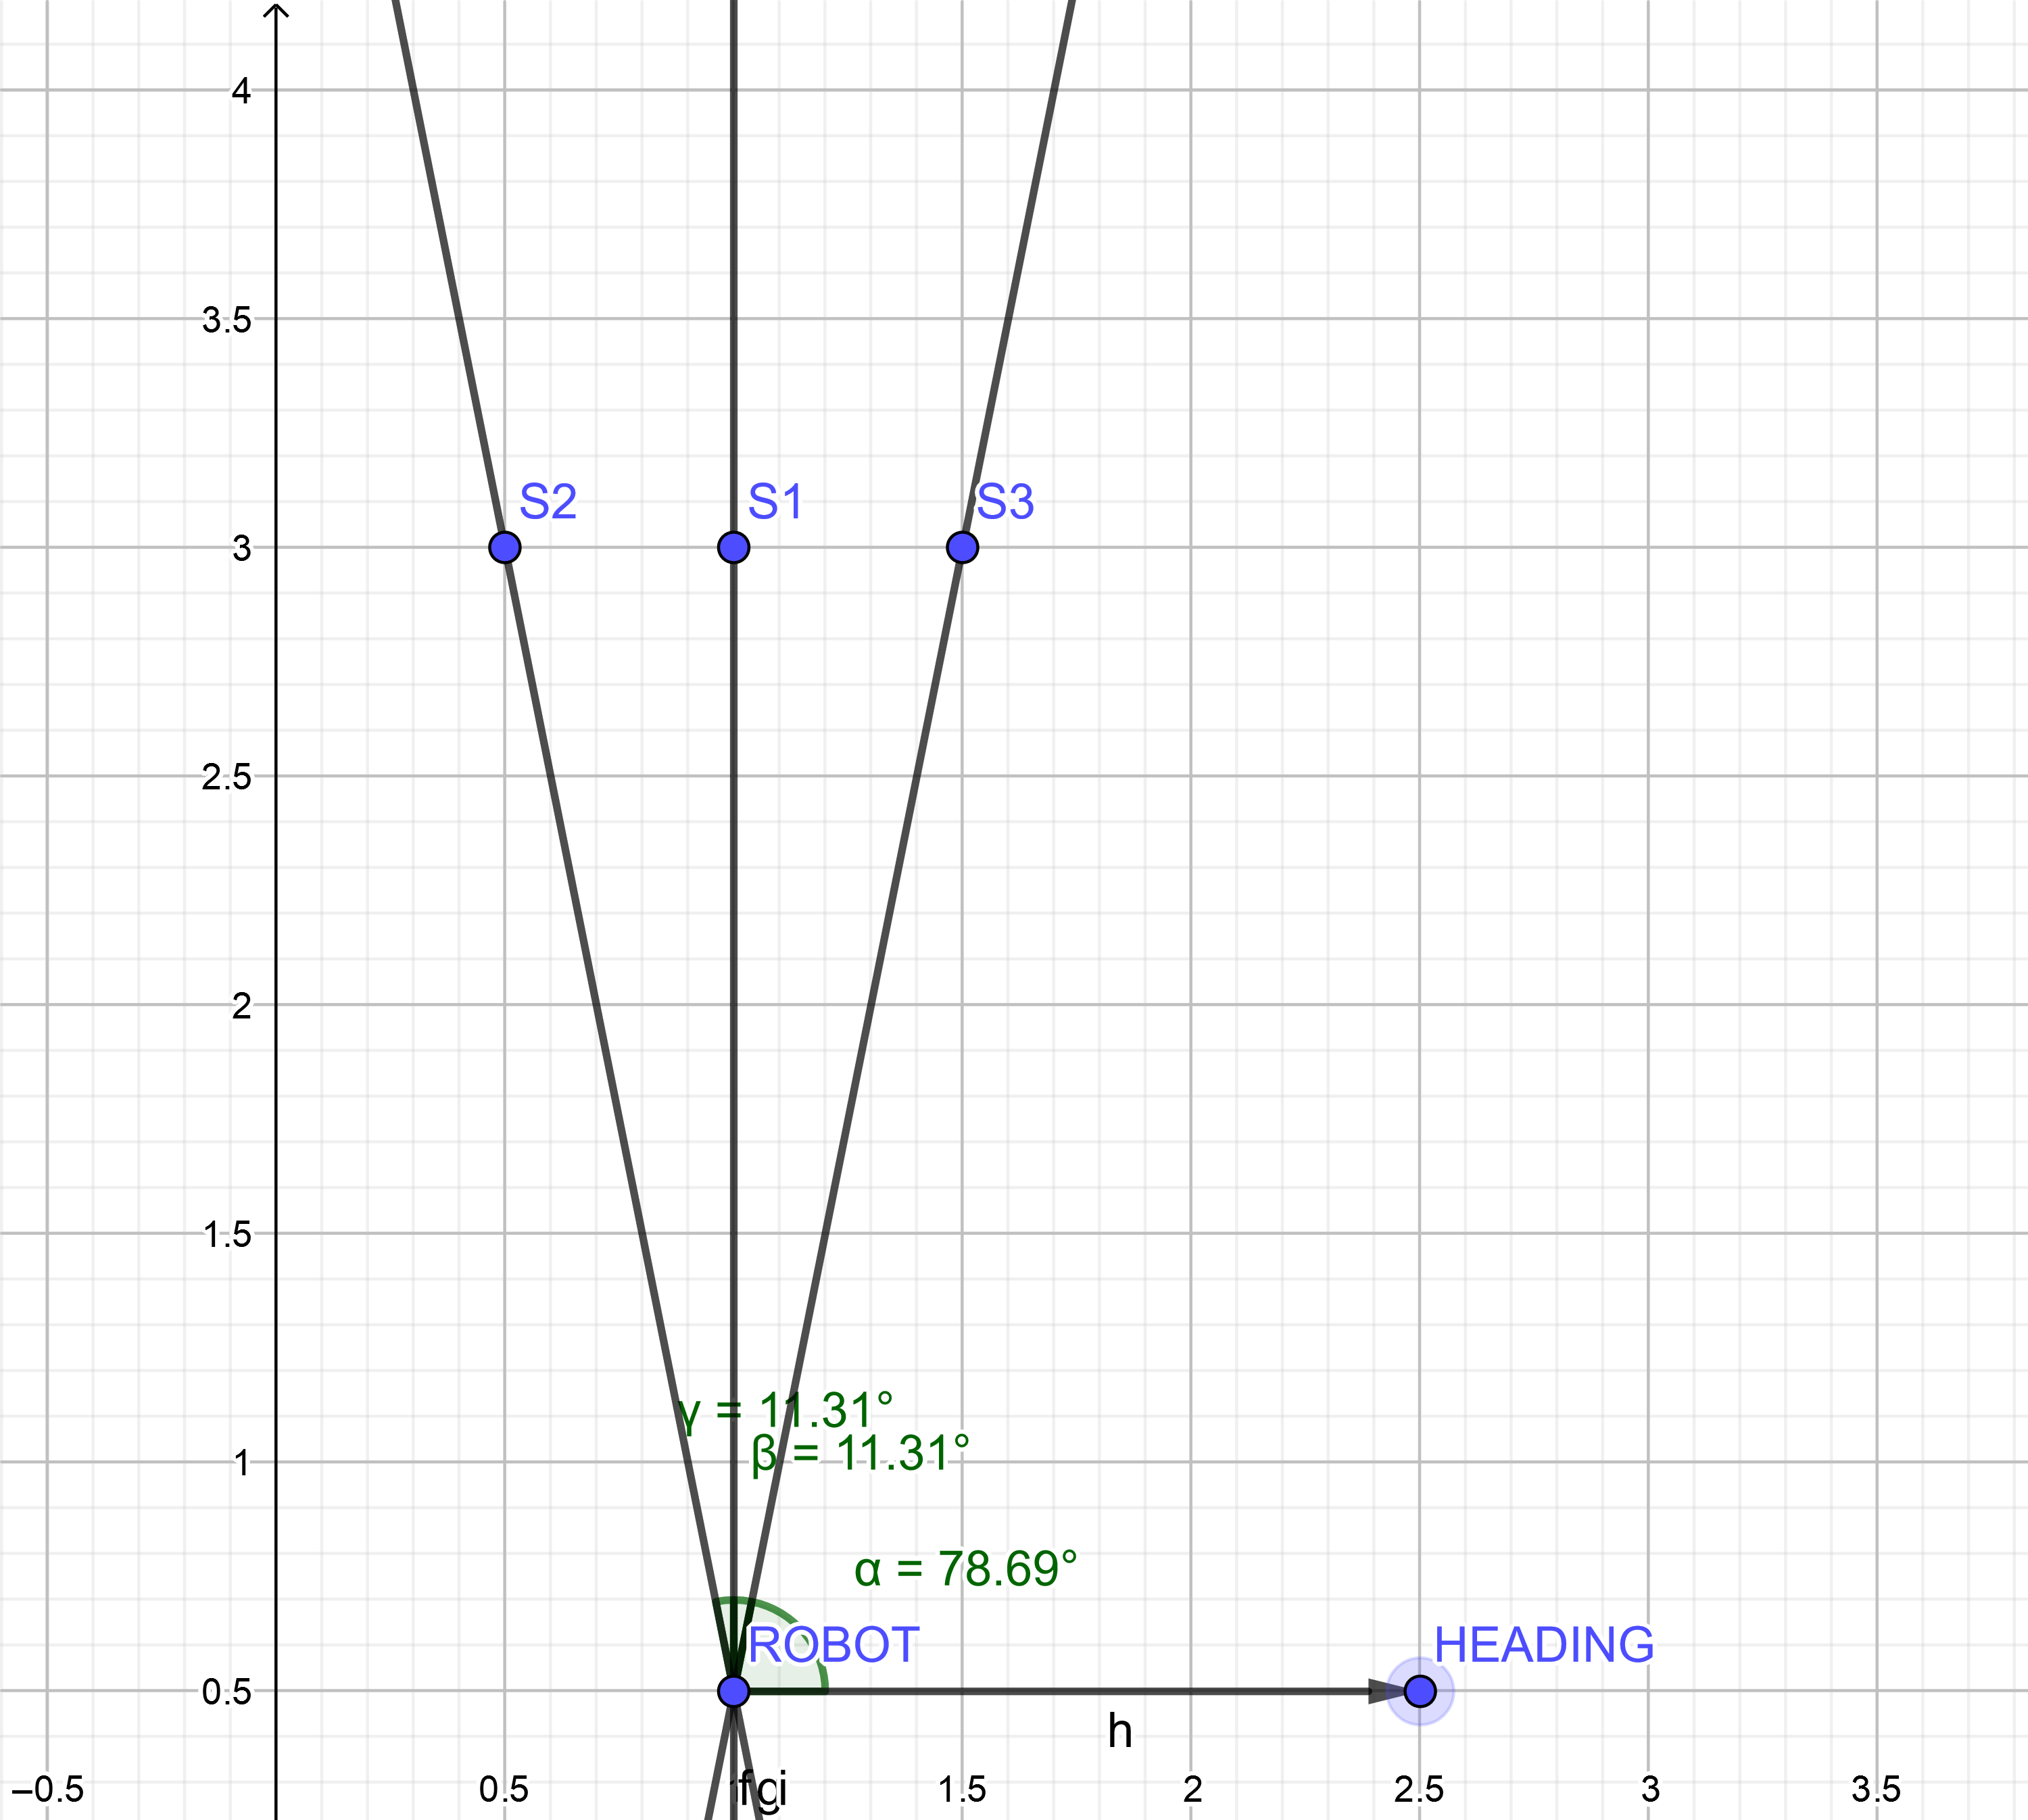
Localization Algorithm Validation
Direction-of-arrival
Local-ization
Handwritten unit tests
Results
Works – determines correct position & orientation
Slow – estimates took between 1.27s and 4.1s to compute

Slide 21
Algorithm Simulation
Direction-of-arrival
Local-ization
Demo - Vlado

Slide 22
Future Work
Many interesting directions!
Algorithm optimizations
Noise and multi-path fading
Automatically discerning speaker signals from each other
Miniaturization
Fully flesh out ROS framework
S(L)AM

Slide 23
Appendix

Slide 24


Getting direction vectors from TDOA
Direction-of-arrival
Local-ization
$$\vec{s}$$
$${Δd}_{13}$$
$$α$$
$$α$$
$$α$$
$$α$$
$$\vec{s}$$
$$\vec{s}$$
$${\vec{L}}_{12}$$
$$θ$$
$$θ$$
$$θ$$
$$m_{2}$$
$$θ$$
$$L_{12}$$
$$m_{1}$$
$$\vec{s}$$

Slide 25


Getting direction vectors from TDOA
Direction-of-arrival
Local-ization
$$\vec{s}$$
$$α$$
$${Δd}_{13}$$
$$α$$
$$α$$
$$α$$
$$\vec{s}$$
$${Δd}_{12}$$
$$\vec{s}$$
$${\vec{L}}_{12}$$
$$θ$$
$$θ$$
$$θ$$
$$m_{2}$$
$$θ$$
$$L_{12}$$
$$m_{1}$$
$$\vec{s}$$

