Slide 1
CUNYPrime iOS App Michael Rueda

Slide 2
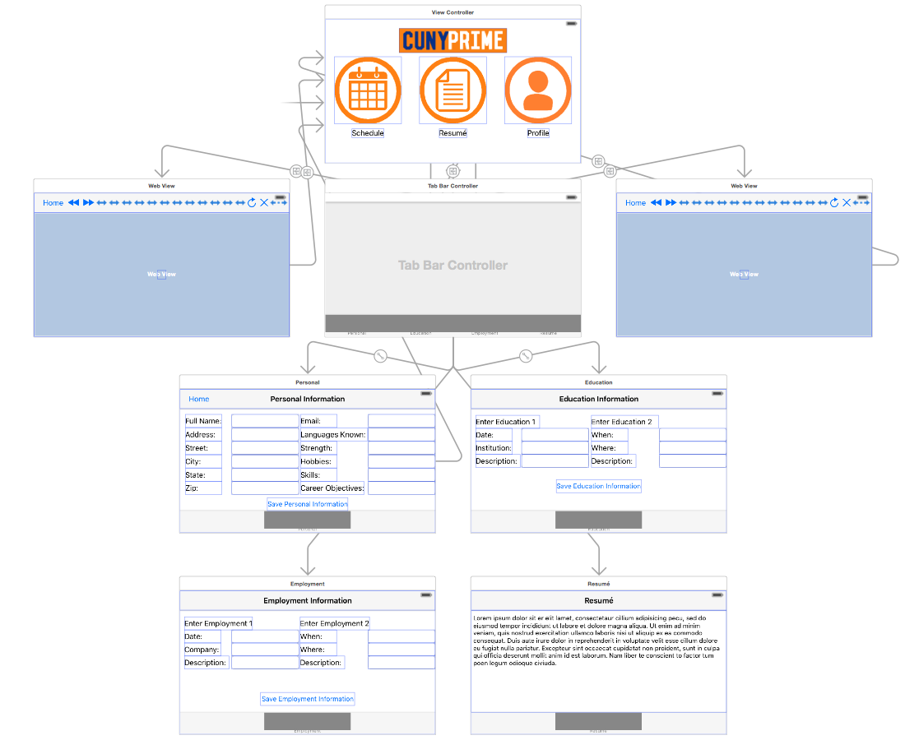
Flow Chart
Xcode Main.storyboard view
Home ViewController, Schedule WebView, Resume TabBarController and Profile WebView

Slide 3
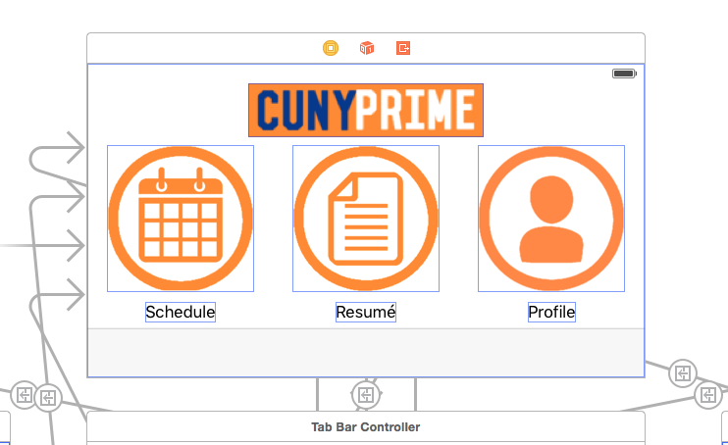
Home ViewController
Displays buttons
Segues to and from other ViewControllers

Slide 4
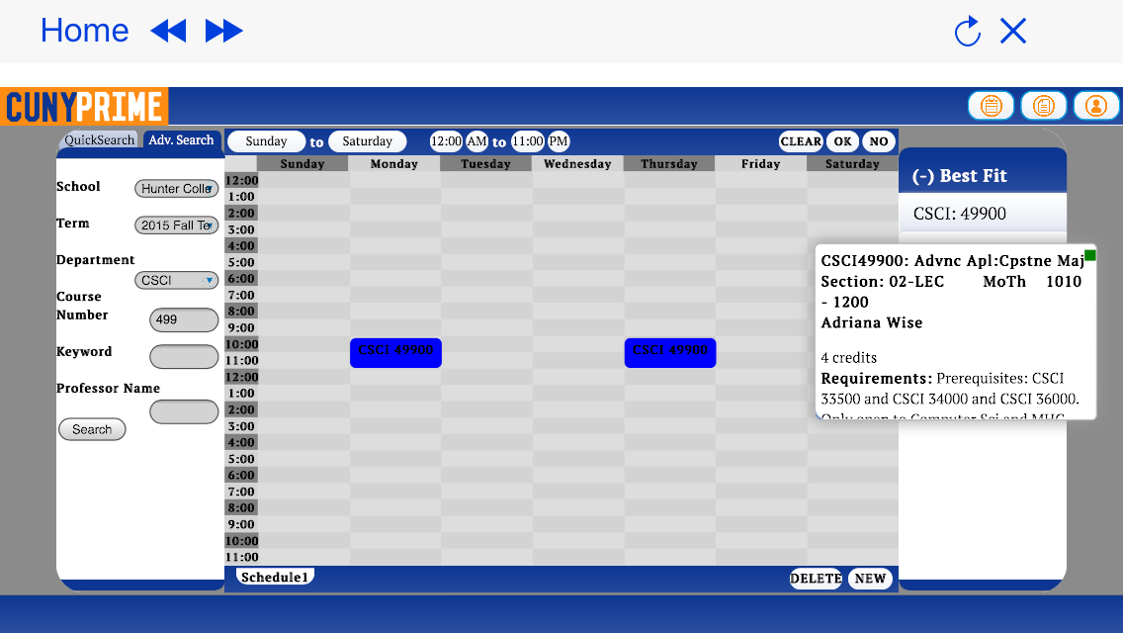
Schedule WebView
Pinch zoom
Double tap and drag to select

Slide 5
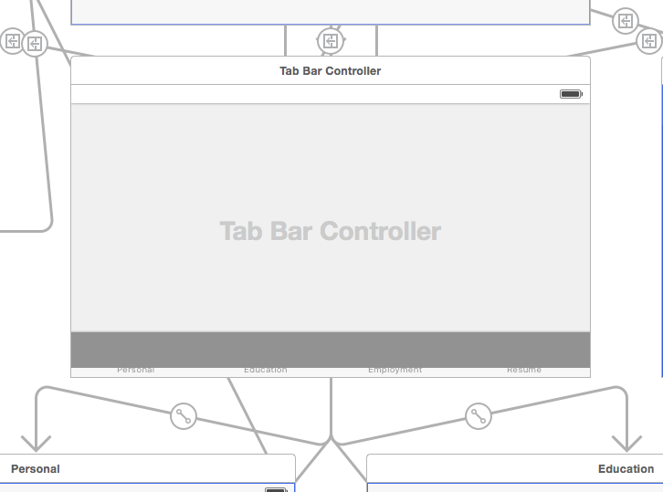
Resumé TabBarController
Segues to and from Home
Controls 4 Resumé ViewControllers

Slide 6
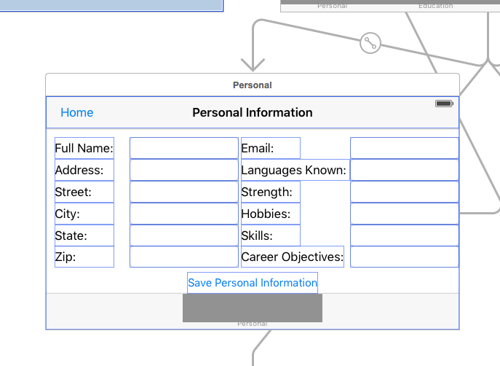
Personal Tab ViewController
Contains segue button back to Home
User enters Personal Information

Slide 7
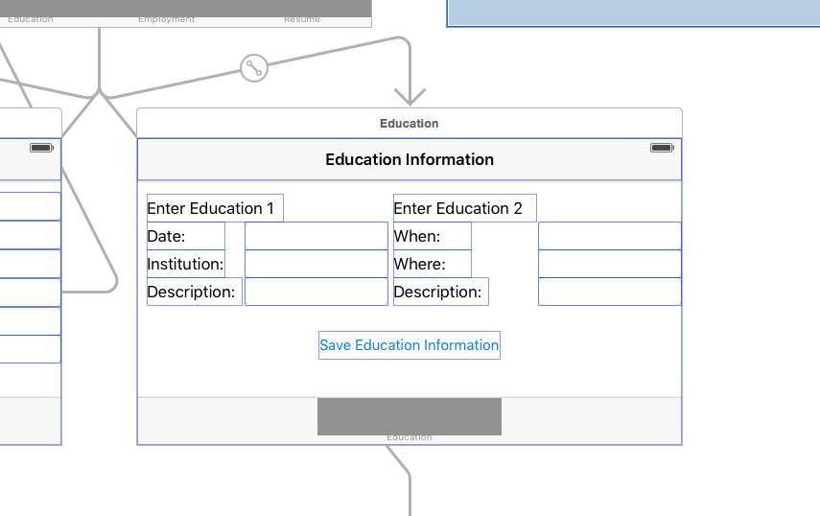
Education Tab ViewController
2nd Tab in Resumé TabBarController
User enters Education Information

Slide 8
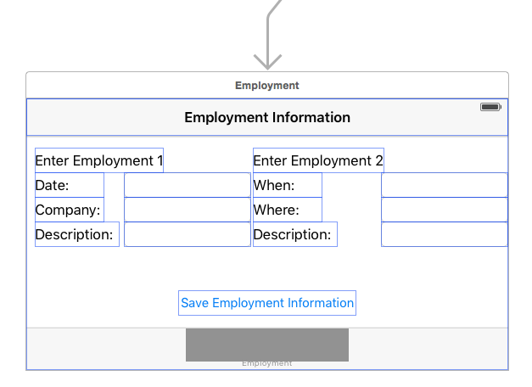
Employment Tab ViewController
3rd Tab in Resumé TabBarController
User enters Employment information

Slide 9
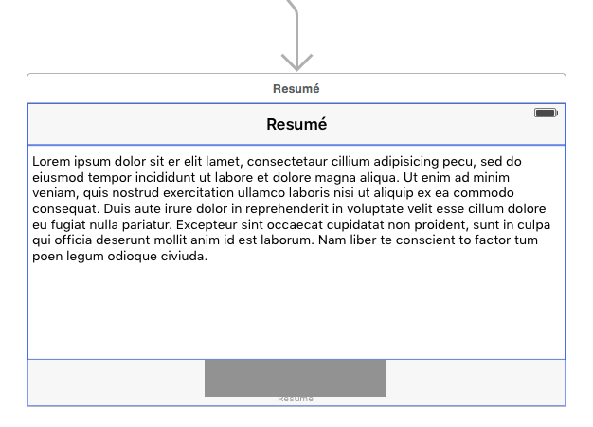
Resumé Tab ViewController
Last Tab in Resumé TabBarController
ViewController for Resumé output

Slide 10
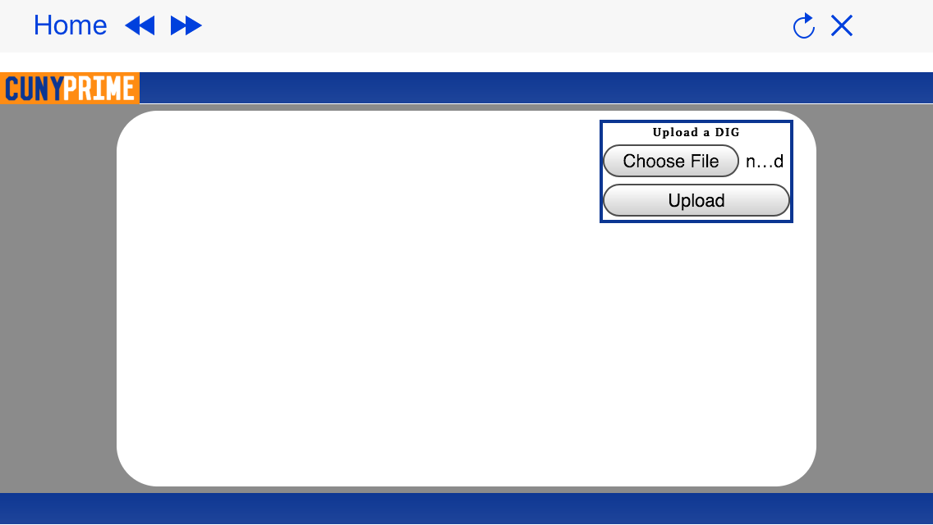
Profile WebView
Segue button back to home
Upload DIG from iOS device and iCloud

Slide 11
Written in Swift 2.0 for iOS 9.0 in Xcode 7.0

