Slide 1
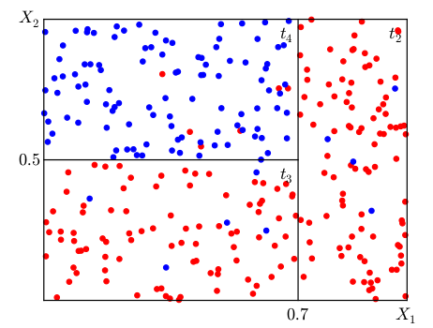
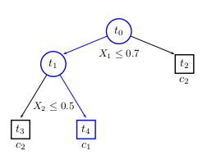
Decision Tree Representation
- All of the data plotted together (this is called feature space) can be thought of as a node (root node)
- Plot all the data (this is called feature space) and use some decision criteria to divde the data based on a cost function (each divided area is called a subspace)
- Each new node decision criteria depends on the root node
- One keeps dividing the subpace until the criteria to divide gives a result that is not similar to the root node result
- A prediction is decided by the bottom nodes (called terminal nodes)
Depending on x1, x2 one can be in class 0 or class 1 (x# is the number of features)
class 0
class 1
If you have a lot of data points
in the same spot, the outputs
will be biased to one class
In our case this happened, but there were just as many predictions for the other class so our metrics comparing TP to FP did not say it was biased to one class

Slide 2
Decision tree is to make the subspaces as homogeneous as possible
https://www.kdnuggets.com/2020/01/decision-tree-algorithm-explained.html

Slide 3
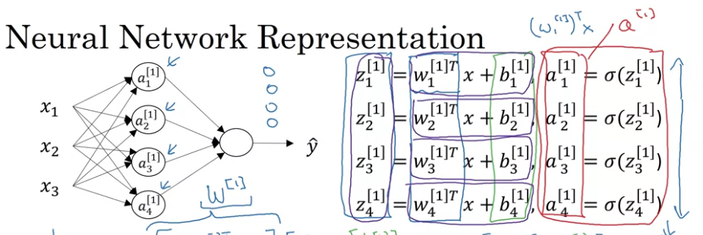
With a NN, we multiply each feature (x) by
A weigth (w) and then shift (b) and stretch (function sigma) the value.
The last node is a probablistic function that calculates the probablity for one class, the largest probablitly is the output class y_hat
Constant/categorical features
are weighted and
averaged with the other
features, no biases
occur for constant/categorical
features

Slide 4
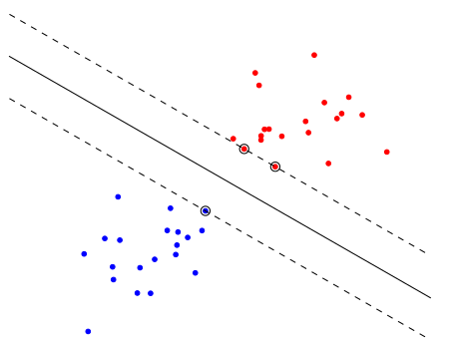
SVM Representation
- Plot all the data (this is called
feature space)
- try to find a line that separates
the data into the number of classes,
where the distance from the
bisector line and the data points
In each group are maximized
x1
no biases occur for
constant/categorical features
x2

Slide 5
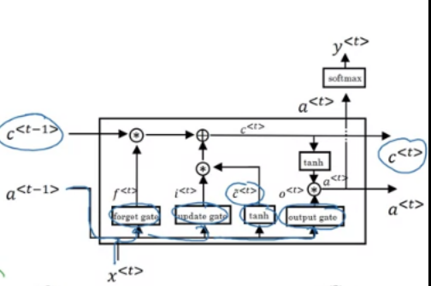
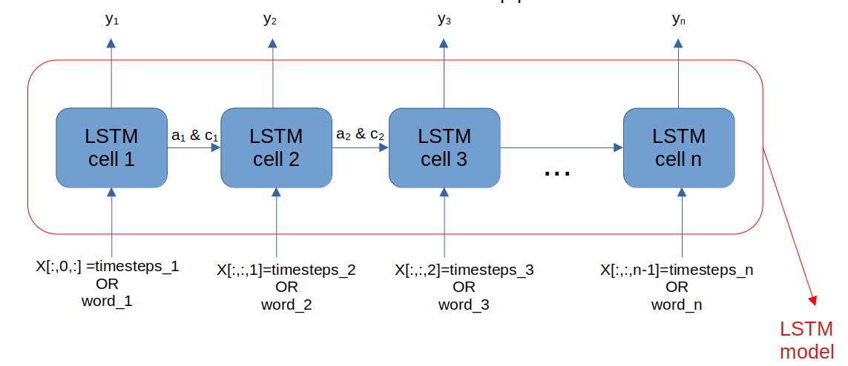
LSTM Representation
- We feed all features in for each sample/trial
and obtain one prediction y_# for that sample/trial
- If we fold each sample smaller than a trial, we
can measure human response delay
- Each LSTM cell is calculating the transformations
shown in the top right corner
Feature1=
position
x<t>=all features for the 1st sample
Feature1=
position
Feature1=
position

Slide 6
Options
Option 1 : remove Decision tree and do LSTM, leave SD classification
Computer problems were the problem with this option
1 month to run 1000+ runs
Option 2 : redo Decision tree with correct data, and do LSTM, leave SD classification
He returns the first week of July, try to have most of the results by then
Option 3 : remove Decision tree, leave SD classification
Fastest : replot existing results and do writing
Option 4 : Remove SD classification and try to publish
He thinks that the work won’t be publishable

