Slide 1
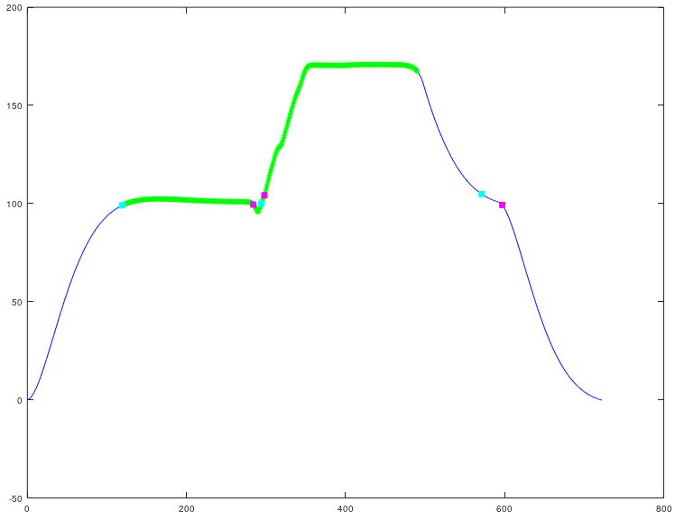
4) ind3
Robot reinitializes
to baseline
Robot reinitializes
to initial position
Translational
UD data :
Automatic
Selection of
Trial start-stop
index
3) stoptrial_index_temp
Max of signal from starttrial_index to stoptrial_indexUD,
baseline shifted to
zero and abs
marg
1) starttrial_index(tr,1) = value_st(1,1)
Find baseline : this baseline has the largest mode.
Make zone about baseline to determine when we go out and in zone.
marg
4) stoptrial_index
First value that is outside of the baseline zone around the max
of signal
1) value_end(end,1)
Translational FB and LR data :
automatic selection of trial start-stop index
2) stoptrial_indexUD
Last max peak of this signal derivative
1) starttrial_index(tr,1)=0
First value in cell array
4) stoptrial_index
First value that is outside of the baseline zone around the max
of signal
2) stoptrial_index_derv
Last max peak of this signal derivative
5) Choose between stoptrial_indexUD, stoptrial_index, and value_end(end,1) as the stop point
(If length from starttrial_index to stoptrial_index is equal to or greater than 200, choose stoptrial_index, else choose stoptrial_indexUD)
3) stoptrial_index_max
Max of signal from starttrial_index to stoptrial_index_derv,
baseline shifted to
zero and abs

Slide 2
1) Detect initial start-stop trial index : separate data that crosses the x-axis at zero
    Use baseline detection method of cabin movement w/ margin of [rot, trans]=[0.1, 0.01]
2) Axis and stimulus detection
  - Axis
    Rot : RO/PI/YA : experimental matrix, confirmed w/ max abs cabin movement values
    Trans : (1) UD : LR and UD cabin movement is similar [search for initial position starting baseline], (2) FB and LR : max cabin movement values
  - Stimulus (sub/sup)
    Rot and Trans : sign from the data and the magnitude from experimental matrix, confirmed w/ cabin movement max abs cabin movement (corr=X)
3) Detect bad trials (robot stopped=line discontiunities, vertically short : cabin height <[0.5m,0.1m]=[UD,LRFB], horizontally short : time < [rot, trans]=[,22s])
4) Remove bad trials
5) Refine start-stop index for only stimulus period : remove UDinit, UDreinit, FBreinit, LRreinit
6) Search for UD-trial after a UD-trial and separate the trials : we remove the 1st UDreinit also
  (1) Search criteria : 3 periods of where the line is at the initial baseline position (3 brakes in the signal), (2) the 2nd brake is about half the data length, and (3) the length of the data is larger than an average trial length

Slide 3
Notes about pre-processing
A large majority of vertically short trials were also horizontally short, indicating that during these trials the system sampling frequency was faster than required (250Hz)
    Trial time is less than 12/22 seconds, it performed trial movement too fast such that it could not execute the correct position trajectory (the trajectory profile is correct, but not the actual position)

Slide 4
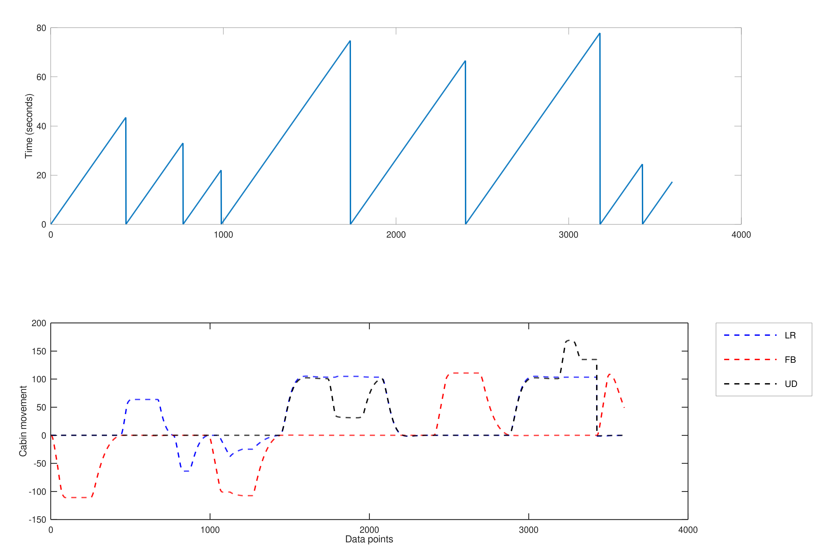
Justification for keeping translational time
time is timelocked to simulink events, not expected experimental axis events
FB and LR had different timing
organization than UD, because
UD needed to do an additional
position initialization higher to
allow equal vertical distance
up/down
Simulink events include : LR stimulus, LR reinitialization, FB stimulus, FB reinitialization, UD initialization, UD stimulus, UD reinitialization
Thus, eventhough the time vector is not per experimental axis condition (like LR, FB, UD) we can shift the time vector and use the time interval for calculating time per axis condition
FBstim +
FBreinit
LRstim +
LRreinit
LRstim+
LRreinit
FBstim+
Fbreinit +
UDinit
UDstim +
UDreinit +
FBstim
FBreinit +
UDinit +
UDstim
Robot STOP

Slide 5
Meaning of classification analysis
Classification w/ detection label (use entire trial data)
  - distinguish concious task-directed control-policy from a non-task directed policy
Classfication w/ control performance label (use data from detection to end of trial – everyone is « on-task »)
  - distinguish good vestibular deadreckoning control from poor control
  - the CR absolute performance measure logically reports that everyone controls poorly during a vestibular deadreckoning task, but vestibular deadreckoning needs to be evaluated using a relative metric (performance measure from « correction-to-correction » or « bin-to-bin ») - and if you need people to do vesibular deadreckoning better you need to give them additional information (momentary feedback + force feedback with respect to absolute)

Slide 6
Standardization : confirmation of experimental parameters
Joystick axis ordering
Directional control orientation (at junction 2 in the block diagram of the system, joy + cab = u : is there a negative before joy somewhere in the simulink diagram? ) (1) joy + cab = u, so joystick movement needs to be opposite cabin movement , (2) -joy + cab = u, so joystick movement needs to be in the same direction as cabin movement
Load deadzone margin

Slide 7
Up
Backward
RollN
PitchN
Left
x
RollP
PitchP
Right
YawP
YawN
Forward
Down
y
Robot base
z

Slide 8
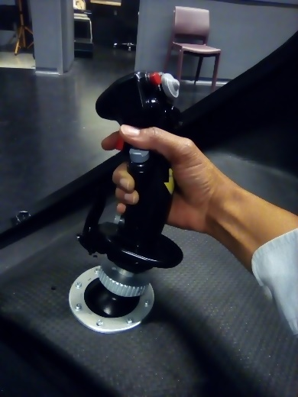
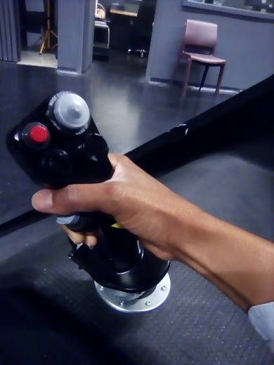
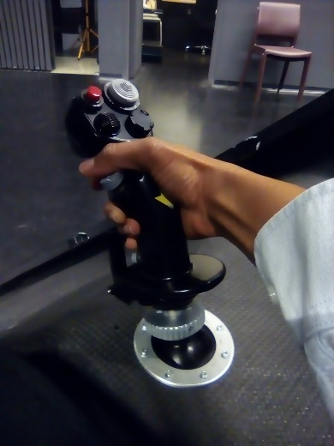
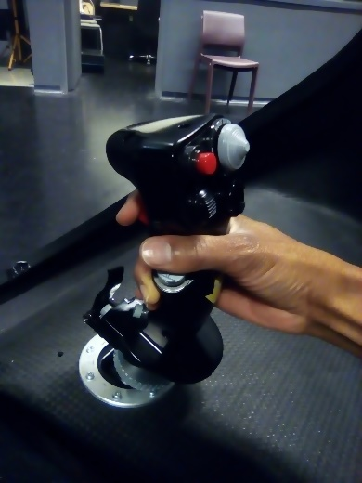
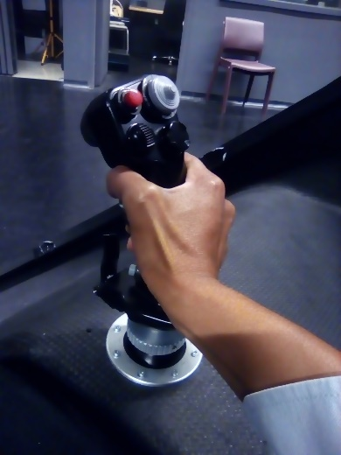
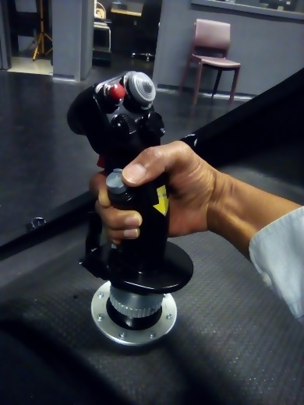
Roll right/
Translate right
Roll left/
Translate left
Pitch down/
Translate forward
Pitch up/
Translate backward
Yaw right/
Translate down
Yaw left/
Translate up

Slide 9
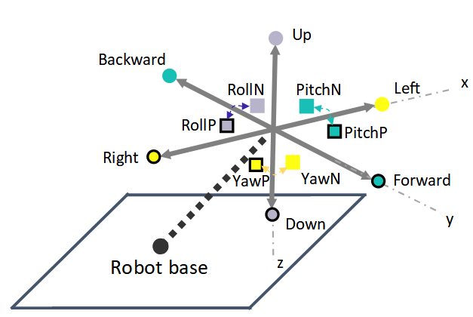
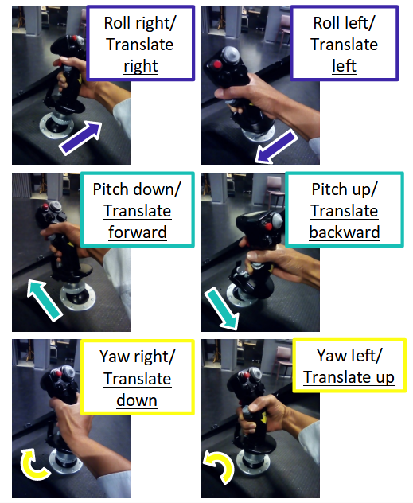
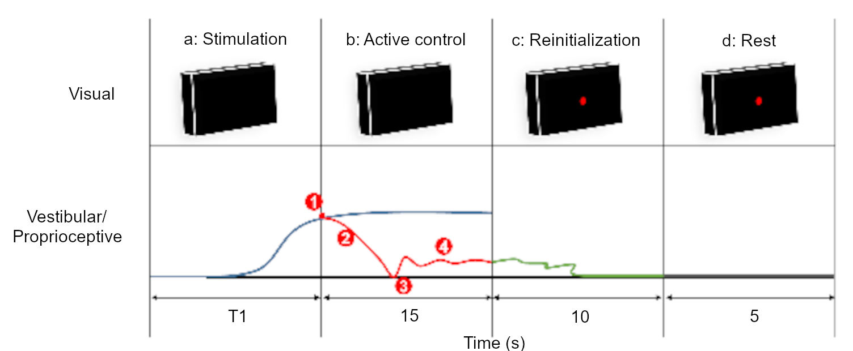
A
B
C

Slide 10
B
A

Slide 11
Each tick is 1 unit
•
Stimulation
Visual
A
Detection
C
Reinitialization
D
Rest
Vestibular &
Proprioceptive
T1
2
10
5
Time (s)

Slide 12
Each tick is 2 units
Stimulation
•
Visual
A
Detection
C
Reinitial
D
Rest
Vestibular &
Proprioceptive
T1
2
10
5
Time (s)

Slide 13
Each tick is 2 units
•
Stimulation
Visual
A
Detection
B
Active control
C
Reinitial
D
Rest
Vestibular &
Proprioceptive
15
10
5
Time (s)

Slide 14

A
B
Stimulation
No initial response
Initial response
•
•
Visual
A
Detection
C
Reinitial
D
Rest
A
Detection
B
Active control
C
Reinitial
D
Rest
Vestibular &
Proprioceptive
T1
2
10
5
>T1
15
10
5
Time (s)

Slide 15
A
Stimulation
No initial response
•
Visual
A
Detection
C
Reinitial
D
Rest
Vestibular &
Proprioceptive
T1
2
10
5

Slide 16
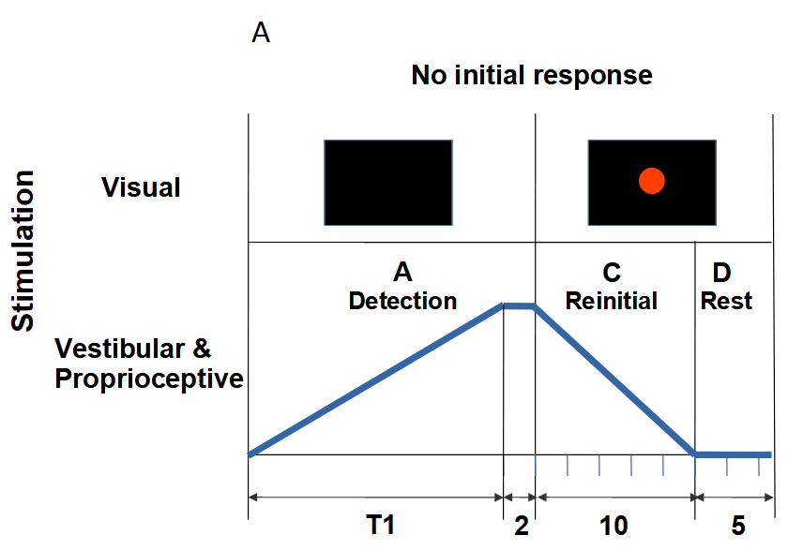
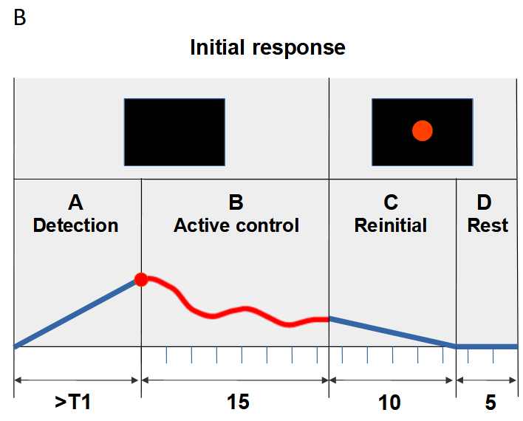
A
B
Time (s)

Slide 17
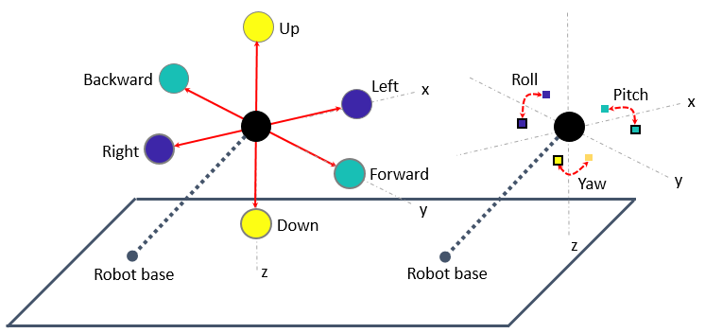
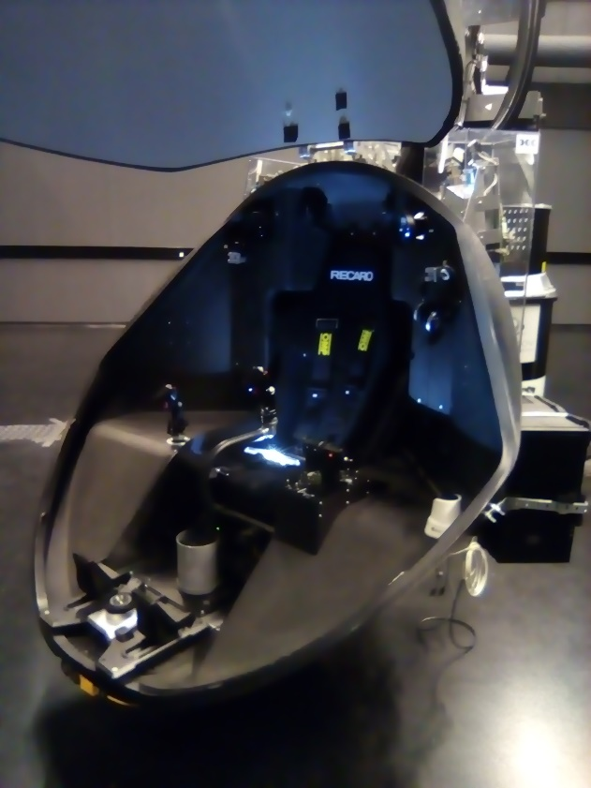
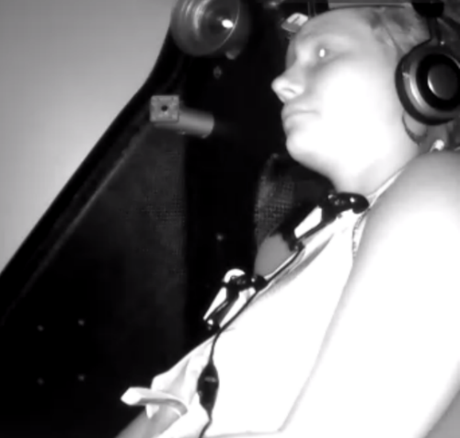
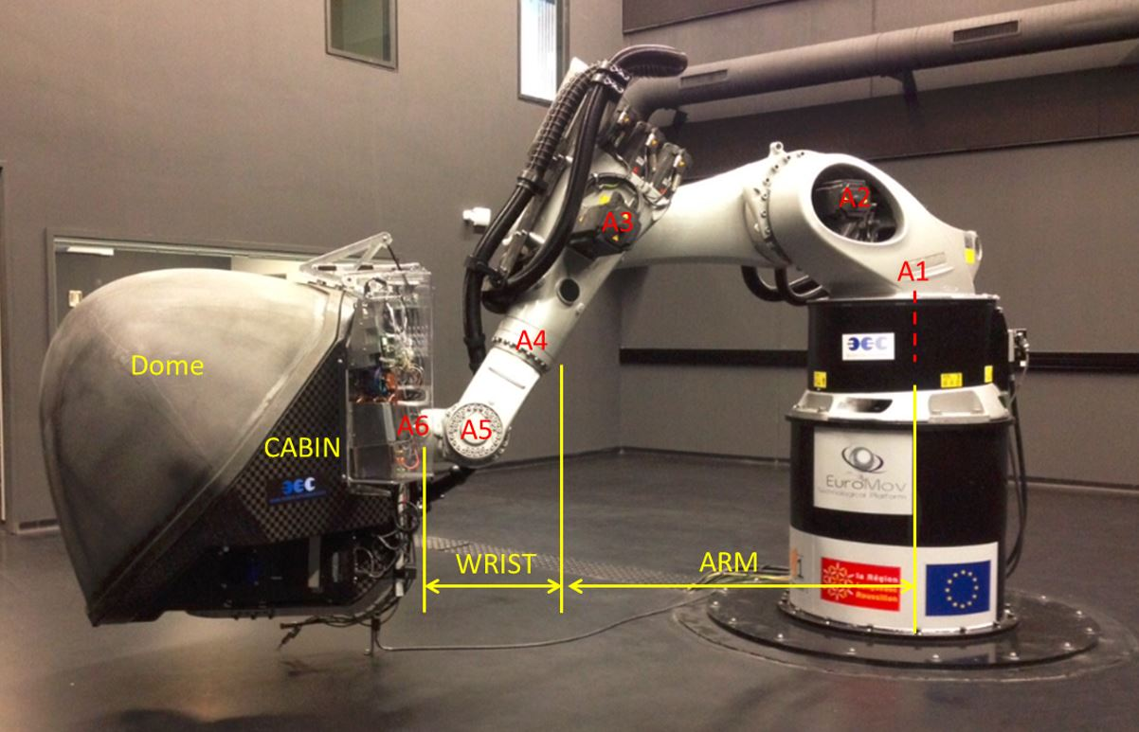
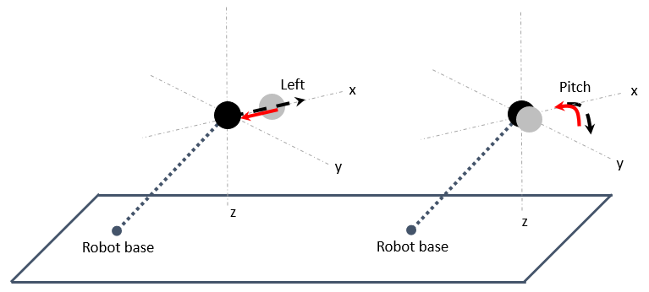
A
B
Installation
Familiarization
C
A3
A2
A1
A4
A6
A5
BASE
Practice & Experimentation

Slide 18
A
B
C

Slide 19
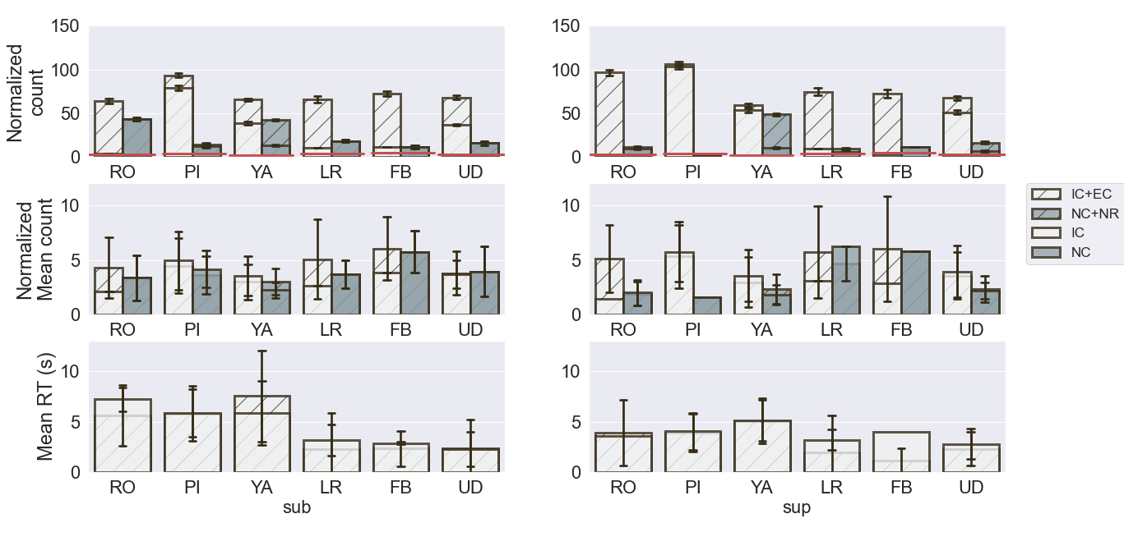
**
**
**
*
**
*
*
*
**
*
*
*
**
*
**

Slide 20
bin 1
bin 2
bin 3

Slide 21
Gain (to tune human
movement with
respect to stimulus)
(rot: gain= 10 ,
trans: gain = 30)
Input Stimulus
(given on one axis only)
Joystick
columns
(value
from -1 to 1)
Constant stimulation
rate (units: rot= degrees/sec
trans=cm/sec)
Human Operator
+
Gain
+
Actual columns
(the movement of the
cabin that the subject
feels)
We used acutal
to calculate the error
of the subject
Commanded
columns
Simulink Model (takes the commanded signal and moves the robot axes correspondingly)
If you want to calculate the stim, first look at which axis as stimulated, then calculate:
Input stimulation = Commanded – Joystick*gain

Slide 22
Robotic Simulation
System Diagram for experiments rotataion and translation
Input stimulus (ss)
(given on one axis only)
2nd order
Robot sends
joint angle position via UDP
(outSIGθ)
stim_ramp
Forward Kinematic
outSIG
cab
Human operator
outJOY
u
Robot motion
Inverse Kinematic
Robot receives
increments of command via UDP
(ΔoutSIGCOM)
outSIGCOM

Slide 23
Problem 1 :
Solve for ss using the entire system ,
But do not break the loop by removing
the human operator, just put a 1.
Solve for stim_ramp
Problem 2 :
Solve for joy_theoretical
Robotic Simulation
System reduced to a closed loop
Human-in-the-loop model
(input=stim_ramp, output=joy)
outJOY_
theo
+
+
+
stim_ramp
1
outJOY_
theo
+
cab
+
stim_ramp
Human operator
+
-
u
cab
outSIG = outSIGCOM
-
Robot motion
u
outSIG = outSIGCOM
Robot motion
Invert the numerator with the denomenator,
To solve for stim_ramp
outJOY
Closed-loop
stim_ramp
stim_ramp
Closed-loop
outJOY_theo
ss*0.05
x
stim_ramp
2nd order

Slide 24
K-means : clustering
similar data points
Temporal sequences
Additive sequences
Unsupervised
Unsupervised
Unsupervised
Binning
(population
relative error)
Binning
(change
point )
Cluster/label
Training data
(pick a k where all the
data evenly falls into each
region)
Select key
components
Statistic
(asm)
Statistic
(ttest)
Statistic
(asm)
Statistic
(ttest)
Cluster/label
Test data
(pick a k where all the
data evenly falls into each
region)
Micro
classify
Label data
(correlation)
Find unique
number
sequences
(sequences that
repeat)
See if groups are
the similar between
training and test set
Select key
sequences as
label
classify
classify
Label data
(cosine similarity)
classify

