Slide 1
My Fascinating Discoveries
By Jordan Matelsky

Slide 2
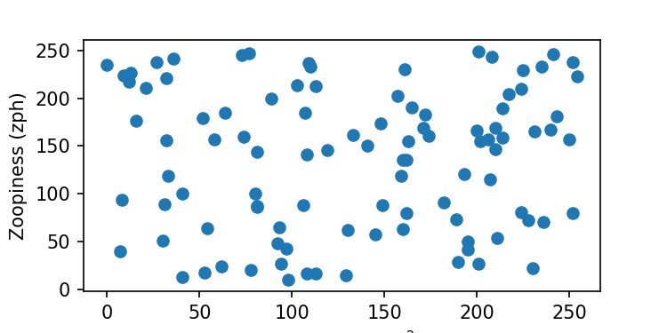
Get a load of this dataset!

Slide 3
Discussion
These data are super interesting.
I wonder what it means!
Can't wait to do more science:
  Tomorrow
  Next week
    (maybe less on the weekend)
Thanks for coming to my TED Talk!

