Slide 1
CEG3185
TUT6
Prepared by Zhenxia Zhang
Revisited by Jiying Zhao

Slide 2
HDLC
High-Level Data Link Control (HDLC) is a bit-oriented synchronous data link layer protocol developed by the International Organization for Standardization (ISO).
  Unbalanced
    Normal Response Mode (NRM)
    Asynchronous Response Mode (ARM)
  Balanced
    Asynchronous Balanced Mode (ABM)
Notes:
http://en.wikipedia.org/wiki/HDLC

Slide 3
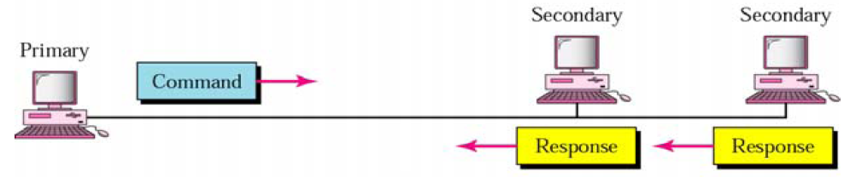
HDLC
Primary station
  Controls operation of link
  Frames issued are called commands
  Maintains separate logical link to each secondary station
Secondary station
  Under control of primary station
  Frames issued called responses
Notes:
http://en.wikipedia.org/wiki/HDLC

Slide 4
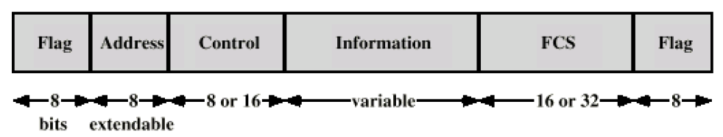
Framing
Frame delimiter: 8bits
  Each frame begins and ends with a frame delimiter.
  This sequence is '01111110', or, in hexadecimal notation, 7E
Address: 8 or more bits
    In NRM, frames include only one address, that of the secondary terminal.
Notes:
http://en.wikipedia.org/wiki/HDLC

Slide 5
Framing
Control: 8bits or 16 bits
  Information frames, or I-frames, transport user data from the network layer. In addition they can also include flow and error control information piggybacked on data.
  Supervisory Frames, or S-frames, are used for flow and error control whenever piggybacking is impossible or inappropriate, such as when a station does not have data to send. S-frames do not have information fields.
  Unnumbered frames, or U-frames, are used for various miscellaneous purposes, including link management. Some U-frames contain an information field, depending on the type.
Notes:
http://en.wikipedia.org/wiki/HDLC

Slide 6
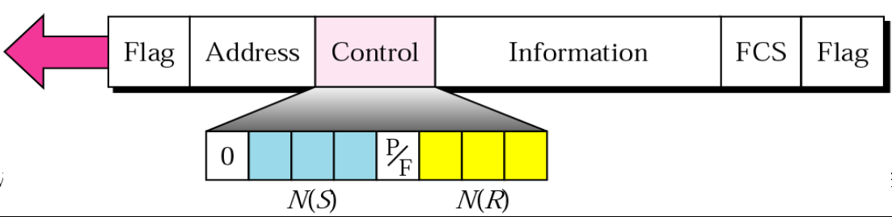
Framing
I-frame
  The least significant bit (first transmitted) is 0.
  N(S) defines the sequence number of send frame.
  P/F
  N(R) defines the receive sequence number.
Notes:
http://en.wikipedia.org/wiki/HDLC
N(R) provides a positive acknowledgement for the receipt of I-frames from the other side of the link. Its value is always the first frame not received; it acknowledges that all frames with N(S) values up to N(R)-1 (modulo 8 or modulo 128) have been received and indicates the N(S) of the next frame it expects to receive.

Slide 7
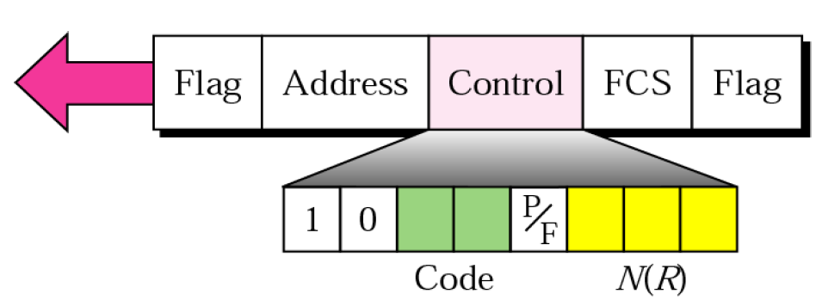
Framing
S-frame
  The first two bits are 10.
  The 2-bit code field encodes the type of S frame
    Receive Ready (RR): 00
    Receive Not Ready (RNR): 01
    Reject (REJ): 10
    Selective Reject (SREJ): 11
  P/F
  N(R)
Notes:
http://en.wikipedia.org/wiki/HDLC
Supervisory Frames, or S-frames, are used for flow and error control whenever piggybacking is impossible or inappropriate, such as when a station does not have data to send. S-frames do not have information fields.
The S-frame control field includes a leading "10" indicating that it is an S-frame. This is followed by a 2-bit type, a poll/final bit, and a sequence number. If 7-bit sequence numbers are used, there is also a 4-bit padding field.
The first 2 bits mean it is an S-frame. All S frames include a P/F bit and a receive sequence number as described above. Except for the interpretation of the P/F field, there is no difference between a command S frame and a response S frame; when P/F is 0, the two forms are exactly equivalent.
The 2-bit type field encodes the type of S frame.

Slide 8
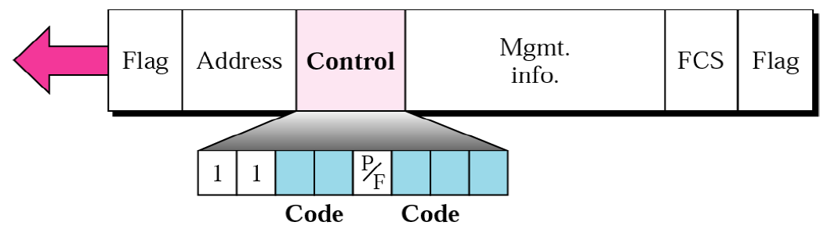
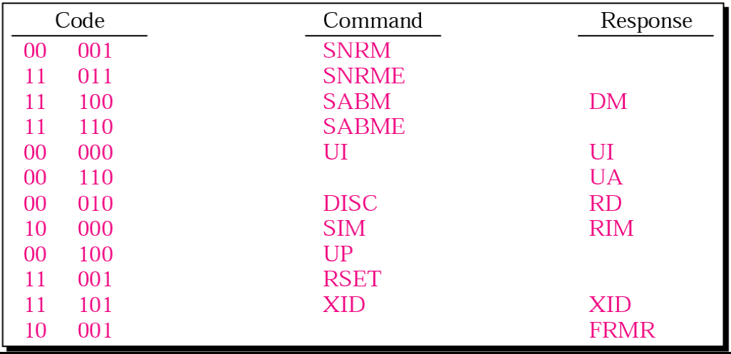
Framing
U-frame
Notes:
http://en.wikipedia.org/wiki/HDLC
Unnumbered frames are identified by the low two bits being 1. With the P/F flag, that leaves 5 bits as a frame type. Even though fewer than 32 values are in use, some types have different meanings depending on the direction they are sent: as a request or as a response. The relationship between the DISC (disconnect) command and the RD (request disconnect) response seems clear enough, but the reason for making SARM command numerically equal to the DM response is obscure.

Slide 9
Framing
Poll/Final bit
  Poll bit
    Command frame
    1 to solicit (poll) response from peer
    The primary only sends a Poll when it has received a Final back from the secondary, or after a timeout indicating that the bit has been lost.
  Final bit
    Response frame
    The secondary only sends a Final when it has received a Poll from the primary.
Notes:
http://en.wikipedia.org/wiki/HDLC
Poll/Final is a single bit with two names. It is called Poll when set by the primary station to obtain a response from a secondary station, and Final when set by the secondary station to indicate a response or the end of transmission. In all other cases, the bit is clear.

Slide 10
Framing
Bit stuffing
  Any time that 5 consecutive 1-bits appear in the transmitted data, the data is paused and a 0-bit is transmitted. This ensures that no more than 5 consecutive 1-bits will be sent. The receiving device knows this is being done, and after seeing 5 1-bits in a row, a following 0-bit is stripped out of the received data. If the following bit is a 1-bit, the receiver has found a flag.
Notes:
http://en.wikipedia.org/wiki/HDLC

Slide 11
Framing
FCS: Frame Check Sequence
  a cyclic redundancy check computed over the entire frame, including the 'Address', 'Control' and 'Information' fields.
  The Frame Check Sequence is either a 16-bit CRC-CCITT or a 32-bit CRC-32.
Notes:
http://en.wikipedia.org/wiki/HDLC

Slide 12
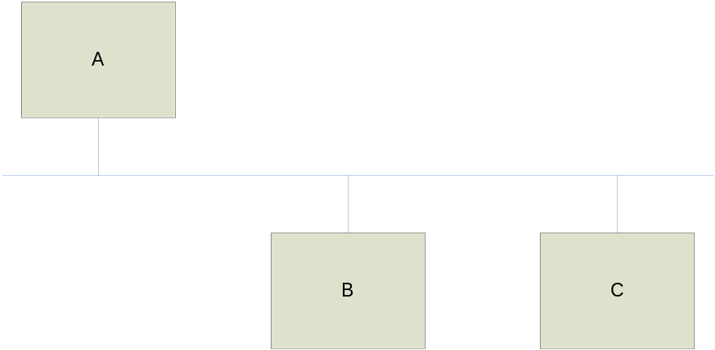
Lab6
At least three stations:
  A is primary.
  B and C are secondary.
Assumption:
  All the stations will initialize and keep correct N(S) and N(R) for the sending and receiving.
  We don’t need implement time-out, FCS and bit stuffing.
  We can use string to represent flag, address and control fields.
  Java socket is used to simulate the physical layer.
    SmtpClient: one point to another
    Chat: one to multipoint

Slide 13
Lab6 - pseudo codes for A
P0: send “SNRM” to B /*initialization*/
send “SNRM” to C
wait for “UA” from B
wait for “UA” from C
P1: send “RR,*,P” to B
received “RR,*,F” from B?
yes, goto P2
no, received “I, *, *” from B?
goto P5

Slide 14
Lab6 - pseudo codes for A
P2: send “RR,*,P” to C /*ask C whether there is anything to send*/
received “RR,*,F” from C? /* no data to send from C? */
yes, goto P3
no, received “I, *, *” from B?
goto P6
P3: any frame to send to B?
yes, send “I,*,*” to B
P4: any frame to send to C?
yes, send “I,*,*” to C
goto P0 /* next loop */

Slide 15
Lab6 - pseudo codes for A
P5: is the frame to A or C? /* process the frame form B*/
to A, consume
to C, buffer the frame to send
goto P2
P6: is the frame to A or B? /* process the frame from C */
to A, consume
to B, buffer the frame to send
goto P3

Slide 16
Lab6 - pseudo codes for B & C
S0: wait for “SNRM” from A
send “UA” to A
S1: wait for frame from A /* the frame could be RR or I */
“RR,*,P” ?
yes, any frame to send? /* RR frame */
yes, send “I,*,*” to A
goto S1
no, send “RR,*,F” to A
goto S1
S2: no, receive I frame from A /* I frame */
consume
goto S1

Slide 17
Lab6
  Week of 03/07/2016 and week of 03/14/2016
  Report due: March 23, 2016, at noon
  Lab report is required to detail the design of the medium access control, all assumptions made, algorithms (flowcharts) for the primary and secondary stations, and all other information needed for the design and implementation.
  The Java programs for both the primary and secondary stations must be submitted.
  The lab will be conducted in group of three students.

Slide 18
Lab6 - Marking
  HDLC basic function: 70%
    Sending, receiving
  Sliding window: 10%
  Report: 20%

Slide 19
Bitwise operation in Java
The unary bitwise complement operator "~" inverts a bit pattern
The bitwise & operator performs a bitwise AND operation.
The bitwise ^ operator performs a bitwise exclusive OR operation.
The bitwise | operator performs a bitwise inclusive OR operation.
Notes:
http://java.sun.com/docs/books/tutorial/java/nutsandbolts/op3.html

Slide 20
BitSet class
Constructor
  BitSet(int nbits)
    Creates a bit set whose initial size is large enough to explicitly represent bits with indices in the range 0 through nbits-1.
void set(int bitIndex)
  Sets the bit at the specified index to true.
void clear(int bitIndex)
  Sets the bit specified by the index to false.
Notes:
http://java.sun.com/docs/books/tutorial/java/nutsandbolts/op3.html

Slide 21
Converting Between a BitSet and a Byte Array
public static BitSet fromByteArray(byte[] bytes) {
BitSet bits = new BitSet();
for (int i=0; i<bytes.length*8; i++) {
if ((bytes[bytes.length-i/8-1]&(1<<(i%8))) > 0) {
bits.set(i);
}
}
return bits;
}
Notes:
http://java.sun.com/docs/books/tutorial/java/nutsandbolts/op3.html
// Returns a bitset containing the values in bytes.
// The byte-ordering of bytes must be big-endian which
// means the most significant bit is in element 0.

Slide 22
Converting Between a BitSet and a Byte Array
public static byte[] toByteArray(BitSet bits) {
byte[] bytes = new byte[bits.length()/8+1];
for (int i=0; i<bits.length(); i++) {
if (bits.get(i)) {
bytes[bytes.length-i/8-1] |= 1<<(i%8);
}
}
return bytes;
}
Notes:
http://java.sun.com/docs/books/tutorial/java/nutsandbolts/op3.html
// Returns a byte array of at least length 1.
// The most significant bit in the result is guaranteed not to be a 1
// (since BitSet does not support sign extension).
// The byte-ordering of the result is big-endian which means the most significant bit is in element 0.
// The bit at index 0 of the bit set is assumed to be the least significant bit.

