Slide 1
OPENINTEL RFC-ADOPTION ANALYSIS
How DNSSEC RFC adoption
actually changed, 2018–2026
2.76 billion DNS records · 3,127 measurement days · 3 zones · 8 RFCs
Evidence-linked: every count traces to a matched indicator and a publication-date check.

Slide 2
SCOPE
What was measured
Every DNS record was tested against all 8 RFC checklists, not one chosen in advance.
2.76B
3,127
8
2018–2026
DNSSEC records evaluated
after the record-type prefilter
measurement days
.gov, .nu, .se
DNSSEC RFCs
scored independently
observation window
(2022 and 2025 absent)
Each record is checked against every RFC's observable signature, then against that RFC's
publication date — an observation cannot evidence a standard that did not yet exist.
Counts below are exact aggregates; rankings are derived from a sampled set of worked examples.
Source: OpenINTEL forward-DNS, basis=zonefile. Analysis: openintel_rfc pipeline.

Slide 3
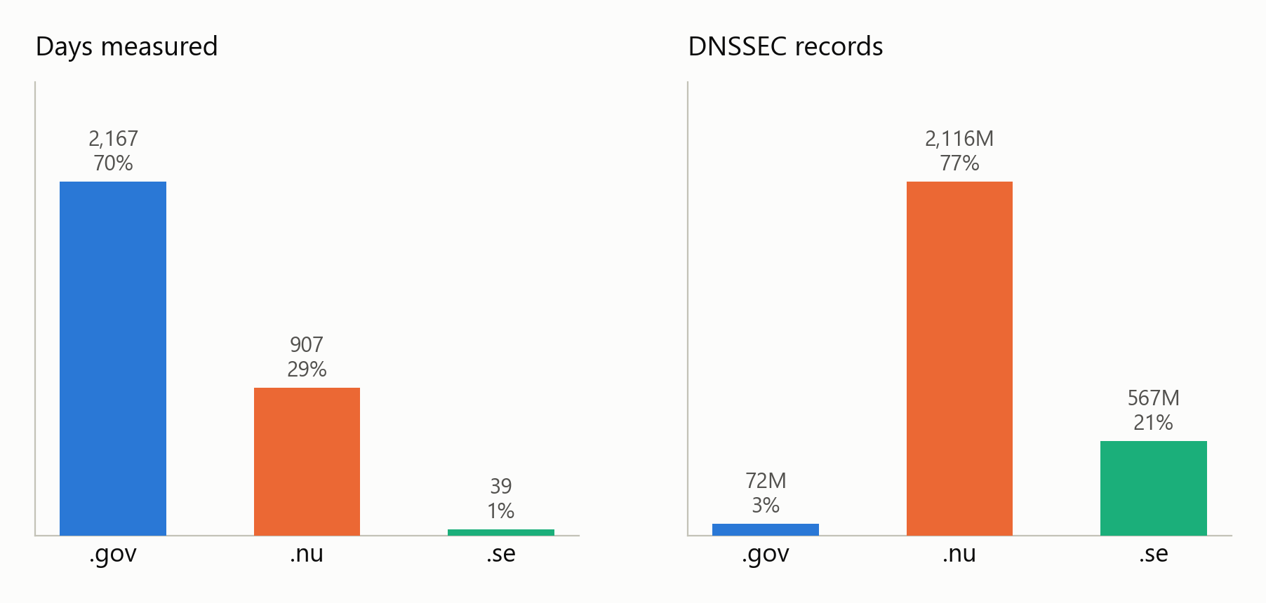
READ THIS FIRST
The three zones are not equally sampled
Totals across all zones are dominated by whichever large zone happened to be measured. Every later chart is normalised within a zone.
.gov is 70% of the days but 2.6% of the records. .se is 1.2% of the days but 20.6% of the records.
Spans are truncated, not holed: .gov 2020 stops 4 Sep, .nu 2019 stops 10 Apr, .se 2021 is 11 days. Within each span coverage is 99.6% complete.
14 .gov days (27 Apr–10 May 2021) returned near-empty objects and are excluded from per-day rates.

Slide 4
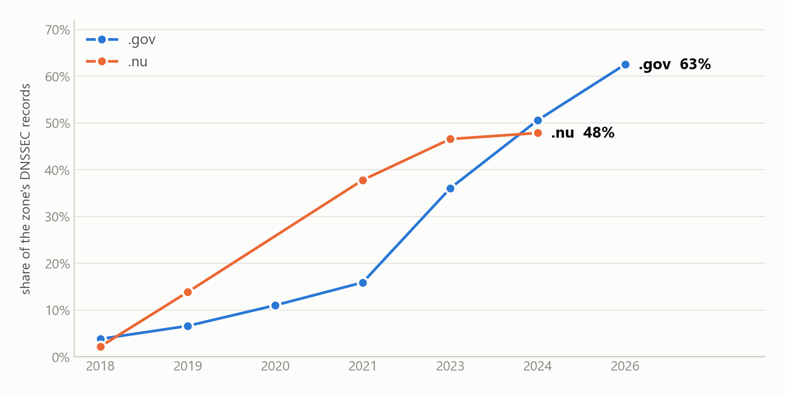
THE HEADLINE
ECDSA replaced RSA as the default
Monotonic over eight years, and real growth rather than composition: 1,035 to 30,284 records per day in .gov, a 29x rise against a 1.8x baseline.
RFC 6605 (algorithms 13/14), share of each zone's own DNSSEC records. 2022 and 2025 not measured.

Slide 5
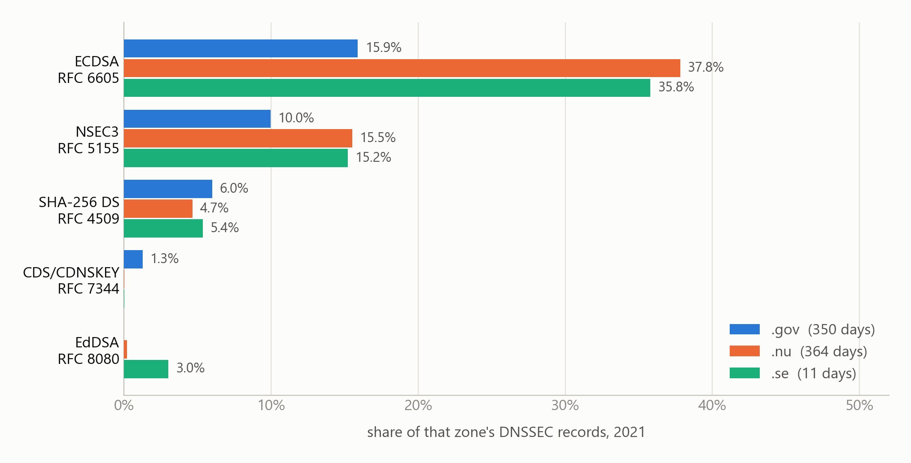
CROSS-ZONE
The same year, three zones
In 2021 the ccTLDs led .gov on ECDSA — .gov overtook them only later. Comparing each zone's latest year instead would invert this.
2021 is the only year all three zones were measured. .se rests on 11 days — directional, not precise.

Slide 6
THE NON-ADOPTION
EdDSA was standardised in 2017. It never arrived.
Nine years on, adoption is indistinguishable from zero in two of three zones.
41
0.09%
0.84%
.gov records using EdDSA
out of 72 million
of .nu DNSSEC records
of .se DNSSEC records
— 72% of all EdDSA seen
Registries consolidated on ECDSA instead. ECDSA solved a real operational problem — smaller
keys mean smaller responses, less fragmentation, less amplification. EdDSA solved nothing
that ECDSA had not already solved, and being newer and better was not enough on its own.
RFC 8080 (algorithms 15/16), published February 2017. Counts across the full 2.76 billion records.

Slide 7
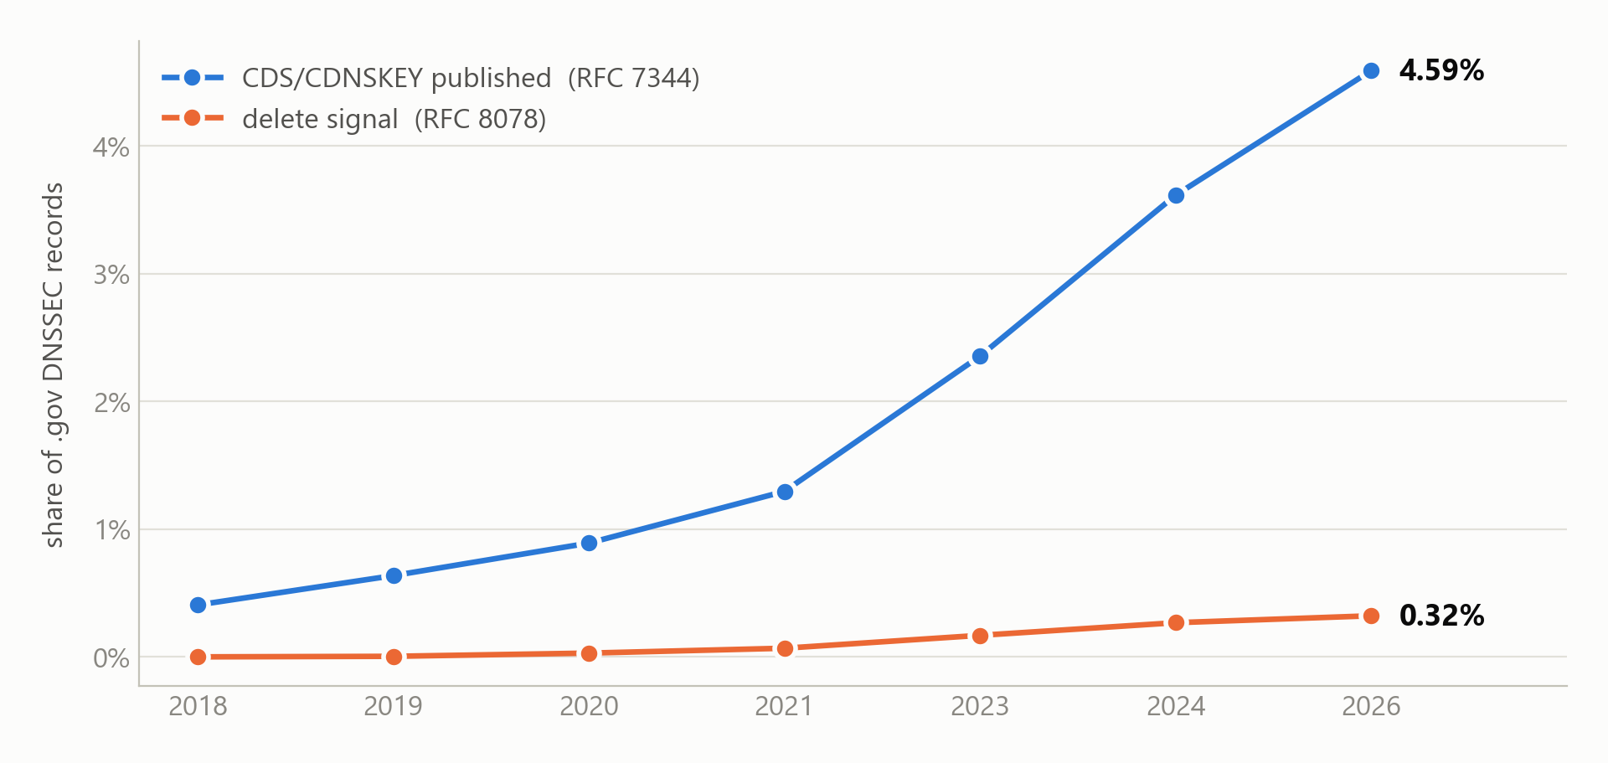
OPERATIONAL OUTLIER
.gov automates delegation; the ccTLDs do not
CDS/CDNSKEY publication grew 11× and the delete signal appeared in 2020 and kept climbing.
.gov holds 56% of all delete signals and 64% of all CDS/CDNSKEY records while being 2.6% of the data.

Slide 8
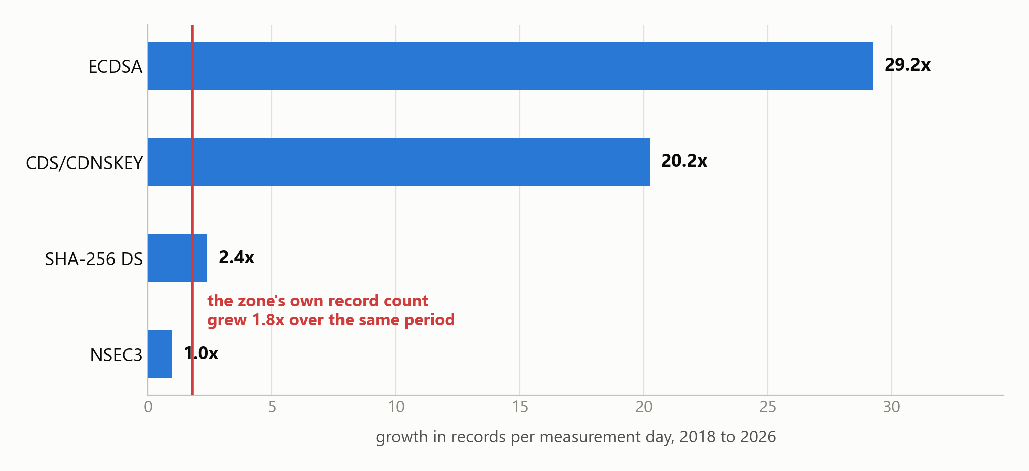
WHAT SHARES HIDE
NSEC3 did not decline. It stood still.
Its share of .gov records fell 10.9% to 5.8% — but per measurement day it held flat at ~2,900 for eight years. The share moved because the denominator grew 79%.
Per-day rates remove the shared denominator. Only growth above the zone's own 1.8x baseline is adoption.

Slide 9
ADOPTION DATES
When each RFC actually shows up
Only three rows carry a real time-to-adoption. The rest were already deployed when measurement began, so their lag is a lower bound, not a delay.
RFC
Published
First seen
Lag
Median
Last seen
Observations
RFC 4033
2005-03
2018-01 *
> 12.8y
2019-04
2026-04
2,323,653,512
RFC 4509
2006-05
2018-01 *
> 11.7y
2019-04
2026-04
135,810,997
RFC 5155
2008-03
2018-01 *
> 9.8y
2019-03
2026-04
429,544,241
RFC 6605
2012-04
2018-01 *
> 5.8y
2021-07
2026-04
549,969,844
RFC 7344
2014-09
2018-01 *
> 3.3y
2024-01
2026-04
2,290,509
RFC 8080
2017-02
2021-01 *
< 3.9y
2021-01
2024-11
6,642,303
RFC 8078
2017-03
2018-08
1.5y
2024-01
2026-04
165,951
RFC 8624
2019-06
2019-06
0.0y
2021-08
2026-04
495,136,786
* first sighting censored by the start of the corpus (lower bound) or by a coverage gap (upper bound).
Median is rate-weighted: each month counts by records per measurement day, so unevenly sampled months do not dominate.

Slide 10
LIMITS
What this does not show
Stated plainly, because each one changes how a number should be read.
Record-level, not zone-level.
“62% of .gov records use ECDSA” is not “62% of .gov zones”. Large signed zones contribute more records.
First-seen is a coverage floor.
Five RFCs report first-seen 2018-01-01 — the first day of data. They were deployed before the window.
Rankings are sampled; counts are not.
Observation counts are exact aggregates. Scores derive from 29 worked examples, ~1 per 95M rows.
Presence is not conformance.
A matching record shows the mechanism is deployed, not that the operator read the RFC.
Resolver-side issues are invisible.
KeyTrap (CVE-2023-50387) cites RFC 4033/34/35 — 84% of this data — but is fixed in resolver code. Forward DNS sees what zones publish, not what resolvers do.
The pipeline identifies ranked RFC candidates consistent with observable signals; it does not prove adoption.

Slide 11
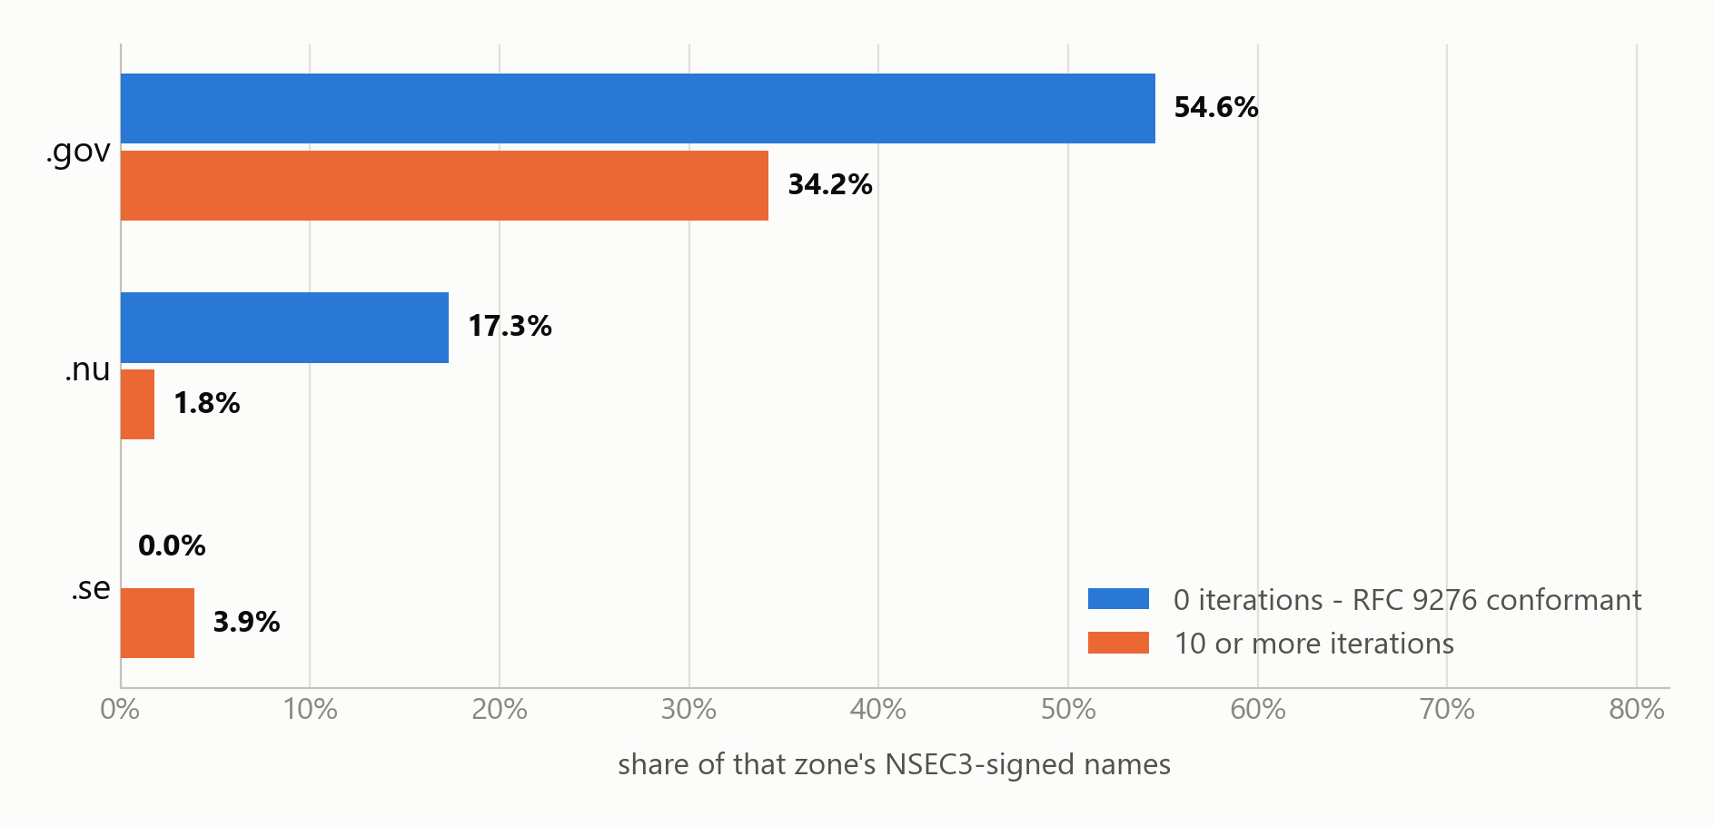
THE GAP
The most urgent DNSSEC RFC is not in this analysis
RFC 5155 lets a zone publish NSEC3 with an unbounded iteration count — the root cause of CVE-2023-50868, a resolver CPU-exhaustion attack. RFC 9276 is the fix, it is observable here, and the checklist does not track it.
Highest iteration count seen: .gov 100 · .nu 423 · .se 250. RFC 9276 says zero.
Spot measurement: one day per zone (.gov 2026-04-28, .nu 2024-03-03, .se 2021-01-11), weighted by distinct names. The .se day predates RFC 9276, so it is not a judgement of .se.

Slide 12
NEXT
What would make this publishable
Four gaps, in the order they change the conclusions.
1
Track RFC 9276
The only measurable RFC here that fixes an exploited CVE, and the one the checklist misses. One checklist entry plus a rescan.
2
Aggregate to zone level
Turns “share of records” into “share of zones” — the number a reader assumes they are already seeing.
3
Fill 2022 and 2025, and sample .se properly
.se is the largest zone and the worst covered at 39 days. The ECDSA curve needs the missing years.
4
Exact scoring in SQL
Removes the sampled-ranking caveat so scores are as exact as the counts already are.
Every figure in this deck is reproducible: openintel-rfc merge --checkpoint-dir out/final/checkpoints

