Slide 1
OPENINTEL CORPUS MEASUREMENT
Observable DNSSEC deployment signals
in .gov, .nu, and .se, 2018–2026
2.76 billion DNS records · 3,127 measurement days · 3 zones · 8 RFCs
Observations in the OpenINTEL corpus only — not a measure of global DNSSEC deployment.
Every count traces to a matched indicator and a publication-date check.

Slide 2
SCOPE
What was measured
Every DNS record was tested against all 8 RFC checklists, not one chosen in advance.
2.76B
3,127
8
2018–2026
DNSSEC records evaluated
after the record-type prefilter
measurement days
.gov, .nu, .se
DNSSEC RFCs
scored independently
observation window
(2022 and 2025 absent)
Each record is checked against every RFC's observable signature, then against that RFC's
publication date — an observation cannot evidence a standard that did not yet exist.
Counts below are exact aggregates; rankings are derived from a sampled set of worked examples.
Source: OpenINTEL forward-DNS, basis=zonefile. Analysis: openintel_rfc pipeline.

Slide 3
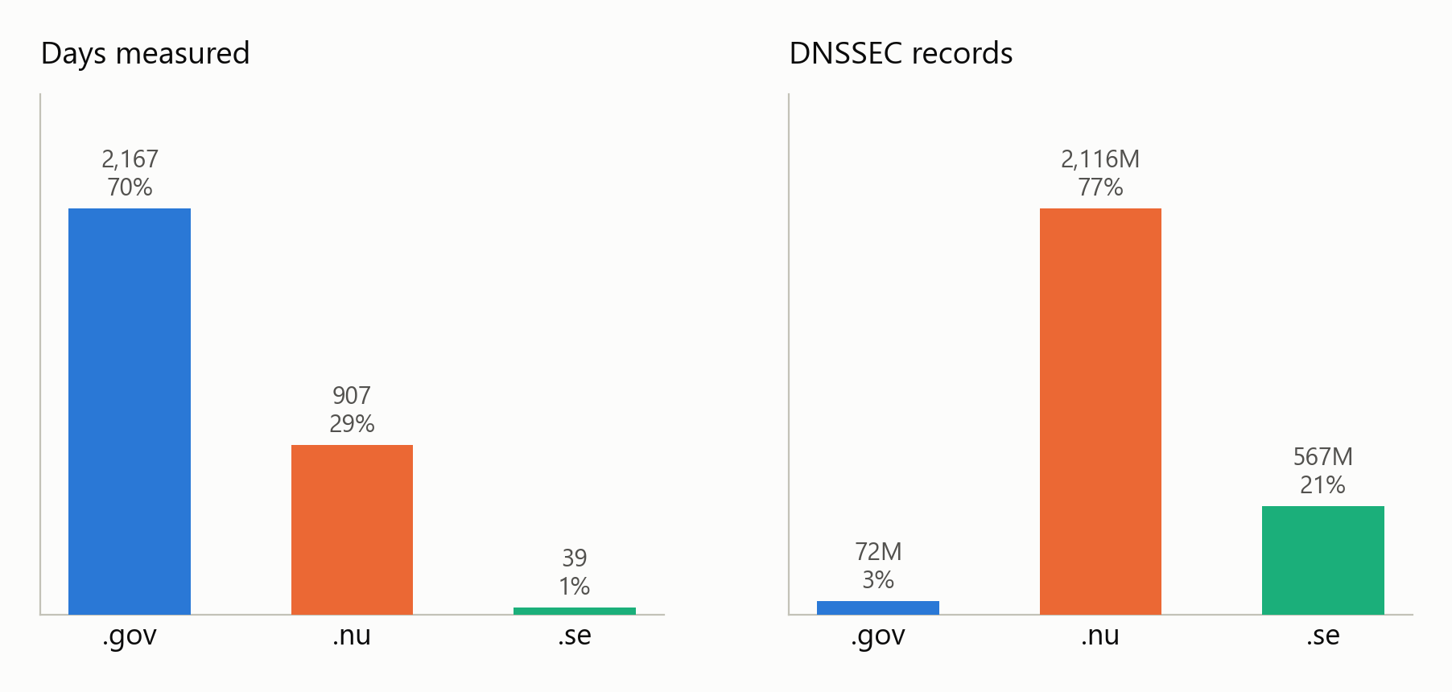
READ THIS FIRST
The three zones are not equally sampled
Totals across all zones are dominated by whichever large zone happened to be measured. Every later chart is normalised within a zone.
.gov is 70% of the days but 2.6% of the records. .se is 1.2% of the days but 20.6% of the records.
Spans are truncated, not holed: .gov 2020 stops 4 Sep, .nu 2019 stops 10 Apr, .se 2021 is 11 days. Within each span coverage is 99.6% complete.
14 .gov days (27 Apr–10 May 2021) returned near-empty objects and are excluded from per-day rates.

Slide 4
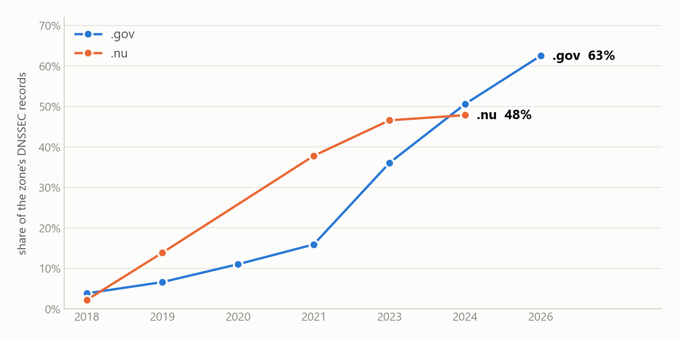
THE HEADLINE
ECDSA rose from 4% to 63% of .gov DNSSEC records
Monotonic across seven measured years: 1,035 to 30,284 records per measurement day in .gov, a 29x rise against 1.8x growth in the zone's total DNSSEC records.
RFC 6605 (algorithms 13/14) as a share of each zone's own DNSSEC records — record-level, not deduplicated to zones. 2022 and 2025 not measured.

Slide 5
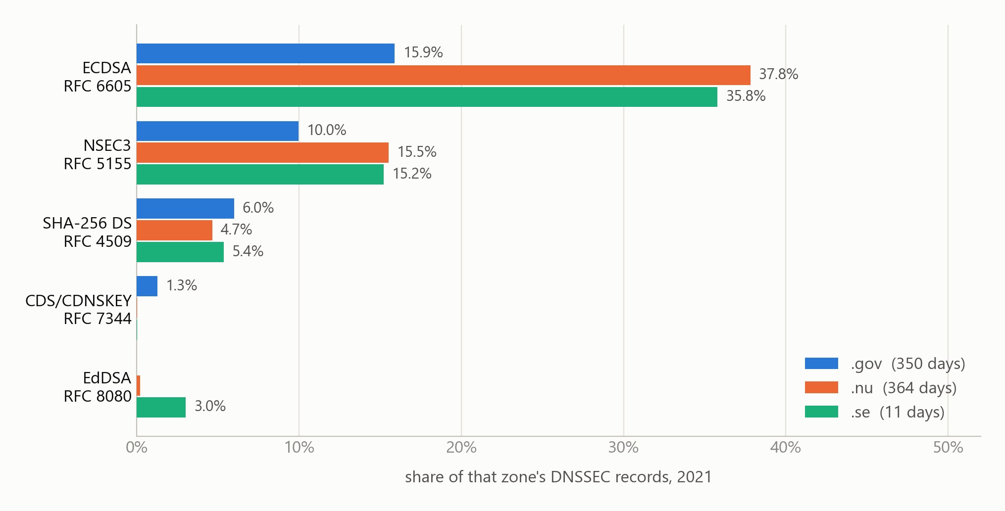
CROSS-ZONE
The same year, three zones
In 2021 the ccTLDs led .gov on ECDSA — .gov overtook them only later. Comparing each zone's latest year instead would invert this.
2021 is the only year all three zones were measured. .se rests on 11 days — directional, not precise.

Slide 6
MARGINAL DEPLOYMENT
EdDSA remained marginal despite standardisation
Present but marginal in this corpus, not absent: 0.84% of .se and 0.09% of .nu DNSSEC records, and 41 records in .gov.
41
0.09%
0.84%
.gov records using EdDSA
out of 72 million
of .nu DNSSEC records
of .se DNSSEC records
— 72% of all EdDSA seen
ECDSA was already widely deployed by the time EdDSA was standardised, and these zones show
no material migration toward it. The observation is the low deployment share itself; the
data cannot establish why, and says nothing about the algorithm's technical merits.
RFC 8080 (algorithms 15/16), published February 2017. Share of each zone's own DNSSEC records, across 2.76 billion records.

Slide 7
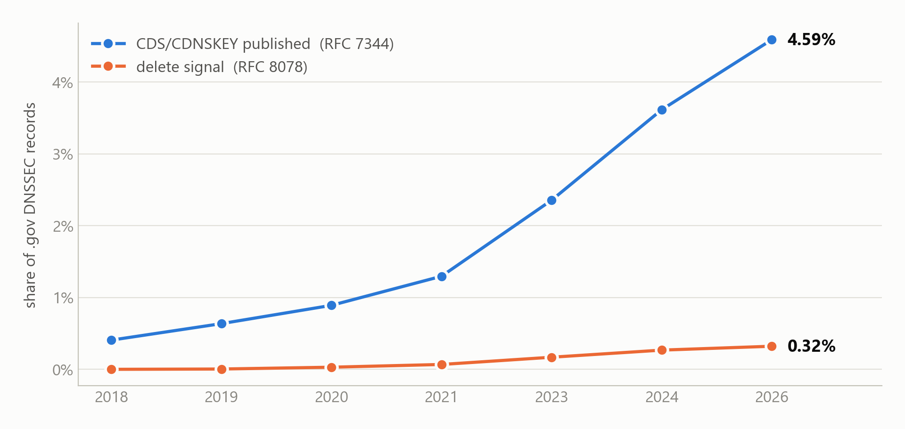
OPERATIONAL OUTLIER
CDS/CDNSKEY signaling is far more prevalent in .gov
CDS/CDNSKEY records grew from 0.41% to 4.59% of .gov DNSSEC records, and delete-signal records appear from 2019 onward.
Publication indicates signaling capability; OpenINTEL alone does not confirm that the parent acted on the signal. .gov holds 56% of delete-signal and 64% of CDS/CDNSKEY records.

Slide 8
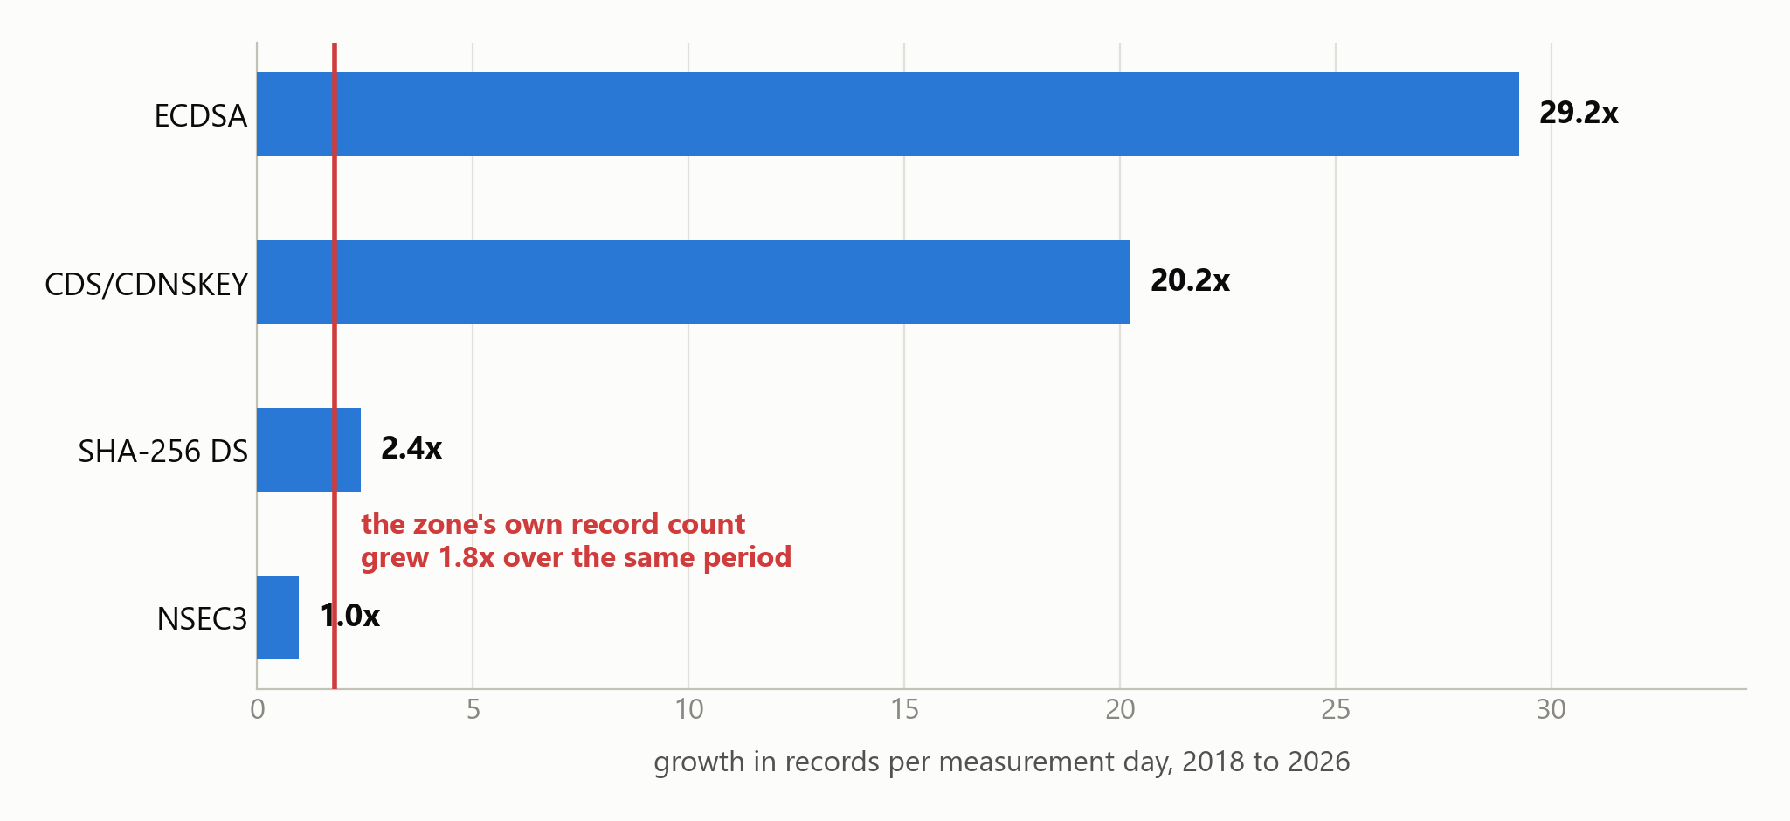
WHAT SHARES HIDE
NSEC3 did not decline. It stood still.
Its share of .gov records fell 10.9% to 5.8% — but per measurement day it held flat at ~2,900 for eight years. The share moved because the denominator grew 79%.
Per-day rates remove the shared denominator. Growth above the corpus baseline indicates expansion beyond overall record growth.

Slide 9
OBSERVATION DATES
First eligible observation versus RFC publication
A signal present on the first covered day is left-censored: its true first appearance is on or before that day, so the lag shown is the maximum possible, not the minimum.
RFC
Published
First eligible obs.
Observed lag
Median
Last seen
Observations
RFC 4033
2005-03
2018-01 *
≤ 12.8y
2019-04
2026-04
2,323,653,512
RFC 4509
2006-05
2018-01 *
≤ 11.7y
2019-04
2026-04
135,810,997
RFC 5155
2008-03
2018-01 *
≤ 9.8y
2019-03
2026-04
429,544,241
RFC 6605
2012-04
2018-01 *
≤ 5.8y
2021-07
2026-04
549,969,844
RFC 7344
2014-09
2018-01 *
≤ 3.3y
2024-01
2026-04
2,290,509
RFC 8080
2017-02
2021-01 *
≤ 3.9y
2021-01
2024-11
6,642,303
RFC 8078
2017-03
2018-08
1.5y
2024-01
2026-04
165,951
RFC 8624
2019-06
2019-06
0.0y
2021-08
2026-04
495,136,786
* Coverage-censored upper bound: the signal was already present on the first covered day (or the first day after a gap), so its true first
appearance is unknown and earlier. RFC 8624's 0.0y is the first eligible post-publication observation of pre-existing algorithm use —
not evidence of instantaneous adoption. RFC 8624 was obsoleted by RFC 9904 (Nov 2025), which moved this guidance to the IANA registries.
Median is rate-weighted: each month counts by records per measurement day, so unevenly sampled months do not dominate. Record-level throughout.

Slide 10
LIMITS
What this does not show
Stated plainly, because each one changes how a number should be read.
Record-level, not zone-level.
“63% of .gov records use ECDSA” is not “63% of .gov zones”. Large signed zones contribute more records.
First-seen is a coverage floor.
Five RFCs are first seen on 2018-01-01, the first covered day, so their lag is an upper bound, not a delay.
Rankings are sampled; counts are not.
Observation counts are exact aggregates. Scores derive from 29 worked examples, ~1 per 95M rows.
Presence is not conformance.
A matching record shows the mechanism is deployed, not that the operator read the RFC.
Resolver-side issues are invisible.
KeyTrap (CVE-2023-50387) cites RFC 4033/34/35 — 84% of this data — but is fixed in resolver software, which authoritative-side measurement cannot observe.
The pipeline identifies ranked RFC candidates consistent with observable signals; it does not prove adoption.

Slide 11
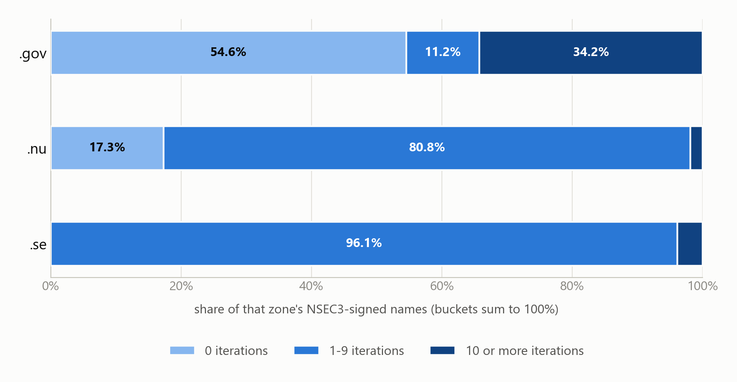
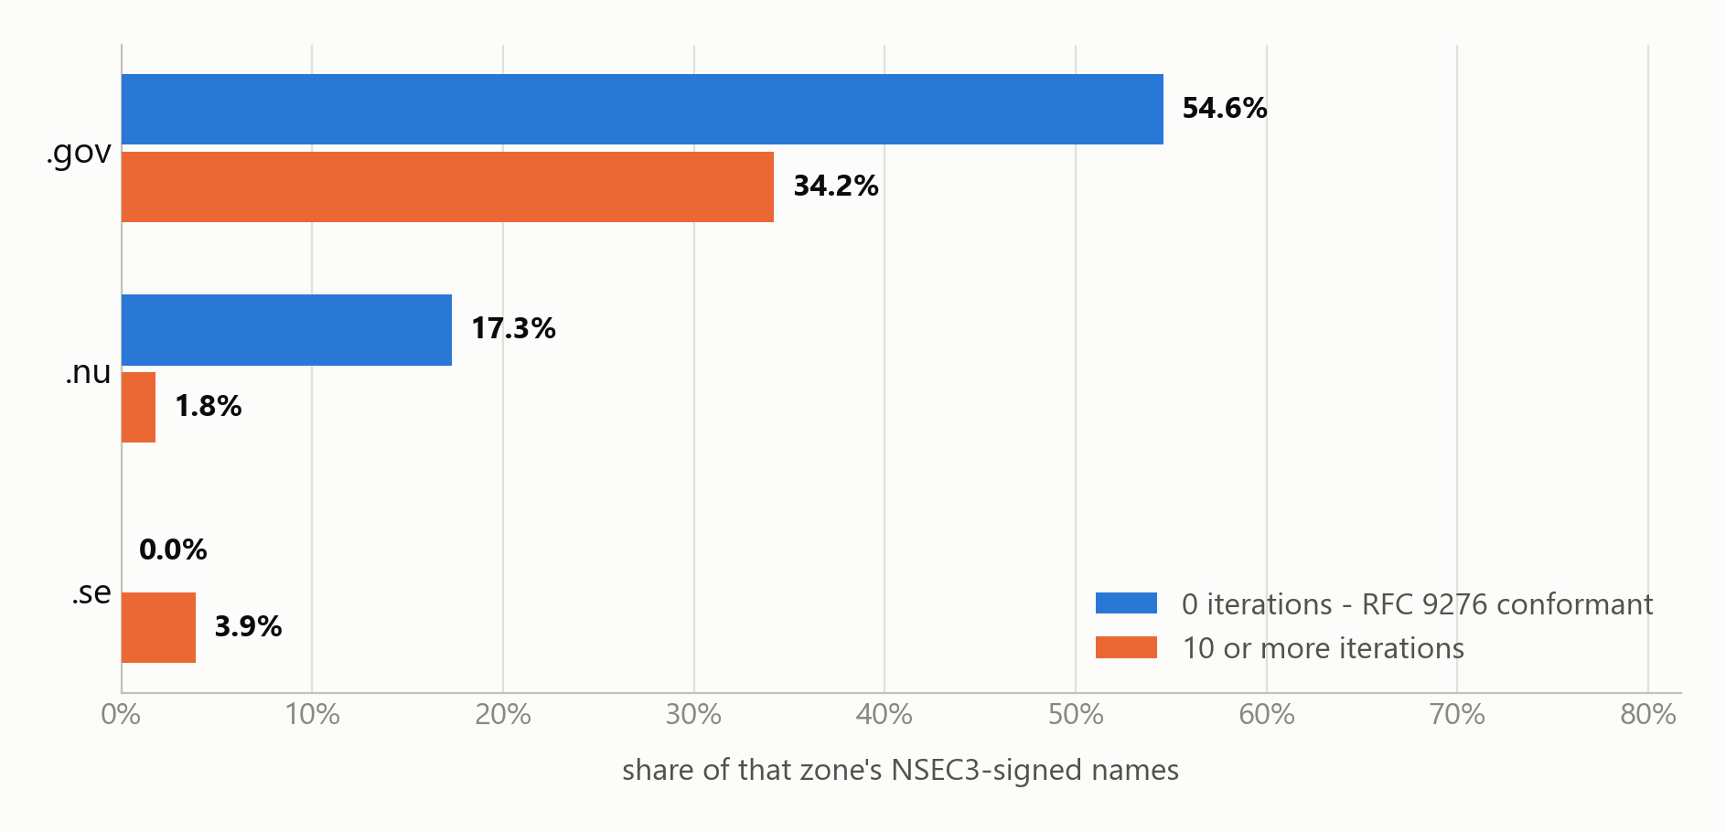
THE GAP
The checklist misses an observable signal: RFC 9276
RFC 5155 allows NSEC3 iteration counts from 0 to 65,535, and every extra iteration adds validation cost. RFC 9276 recommends zero additional iterations; resolver patches remain necessary to address CVE-2023-50868. The checklist tracks neither.
Highest iteration count observed: .gov 100 · .nu 423 · .se 250. RFC 9276 recommends zero.
Spot measurement, one day per zone (.gov 2026-04-28, .nu 2024-03-03, .se 2021-01-11), weighted by distinct NSEC3-signed names; buckets partition each zone. The .se day predates RFC 9276, so it is not a judgement of .se.

Slide 12
NEXT
What would make this publishable
Measurement validity first. More RFCs cannot fix a denominator the reader cannot trust.
1
Zone-level aggregation and deduplication
Turns “share of records” into “share of zones” — the number a reader assumes.
2
Broader, more representative zone coverage
Three zones cannot speak for the DNS. .se rests on 39 days.
3
Reproducible SQL-to-indicator mappings
Removes the sampled-ranking caveat so scores are as exact as the counts.
4
Coverage and censoring handling
Carry left-censoring and gaps through the outputs, not just the footnotes.
5
Sensitivity analysis for denominators
Show how conclusions move when the corpus composition changes.
6
Additional RFC indicators, incl. RFC 9276
Last, not first: an indicator is only as good as the coverage under it.
Every figure in this deck is reproducible: openintel-rfc merge --checkpoint-dir out/final/checkpoints

