Slide 1
REVERSE-DNS DELEGATIONS, 2009-2026
What DNSSEC zones are switching to,
and what they are leaving
25,930 algorithm changes across 13,654 delegations, tracked zone by zone.
Two complete generational handovers: RSA/SHA-1 to RSA/SHA-2 to ECDSA.
Reverse corpus only — the forward per-day records are not in this repository.

Slide 2
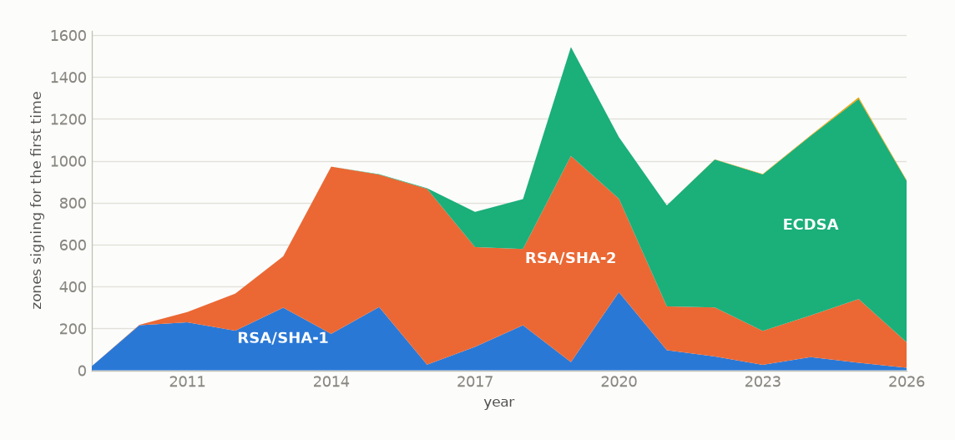
THE CHOICE
What a zone turning DNSSEC on picks
ECDSA is now 85% of new signings; it was 0% before 2015.
Zones gaining a DS record that year, by algorithm family. 2026 is nine months.

Slide 3
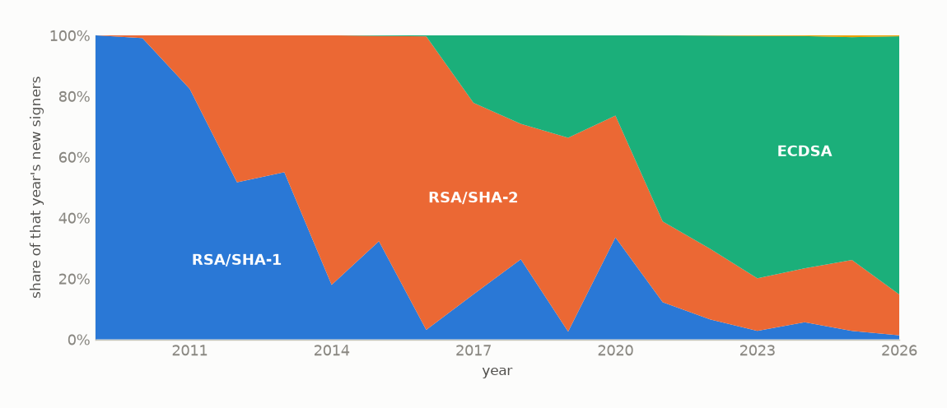
THE HANDOVER
Two complete handovers in seventeen years
ECDSA passes half of new signings in 2021 and reaches 85% by 2026.
Same data as a share of each year's total. EdDSA, standardised in 2017, never becomes visible at this scale.

Slide 4
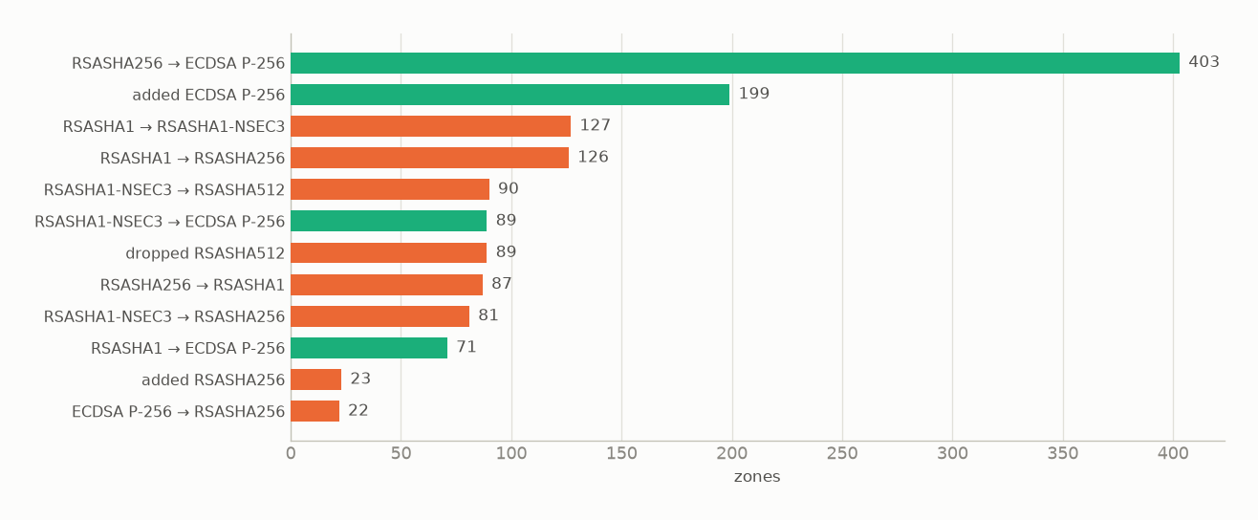
THE MIGRATION
Where zones that already had DNSSEC moved
One path dominates: 403 zones went RSASHA256 to ECDSA P-256.
"added X" is a dual-signing step, publishing the new algorithm alongside the old one — how a correct rollover begins. A quarter of rollovers pass through it.

Slide 5
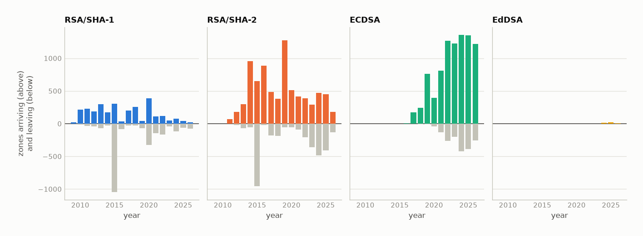
ARRIVALS AND DEPARTURES
Each family's flow, year by year
ECDSA has never had a year of net departures. RSA/SHA-1 has had eight.
A zone arrives in the year it first publishes an algorithm from that family and leaves in the year it stops.

Slide 6
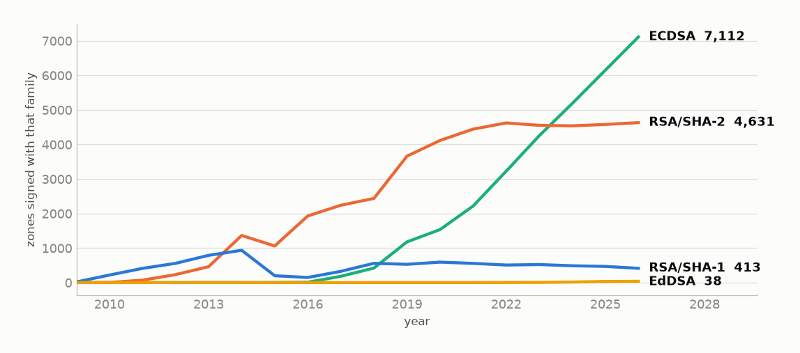
THE STOCK
The installed base those flows add up to
ECDSA 7,112 · RSA/SHA-2 4,631 · RSA/SHA-1 413 · EdDSA 38
Running total of arrivals minus departures. A net position over observed changes, not a census of the reverse DNS.

Slide 7
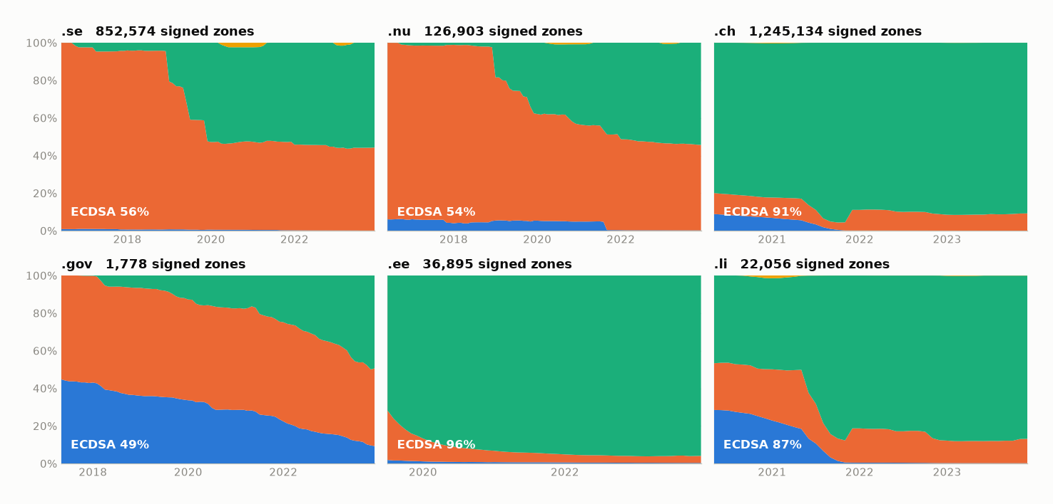
OPENINTEL
What the signed zones of each TLD actually run
.ee is 96% ECDSA and .ch 91%, but .se is only 57% and .gov still 9% RSA/SHA-1.
Share of each TLD's signed zones by family. The forward corpus runs 2016-06 to 2023-12 and TLDs enter at different dates, so each panel starts where its data does.

Slide 8
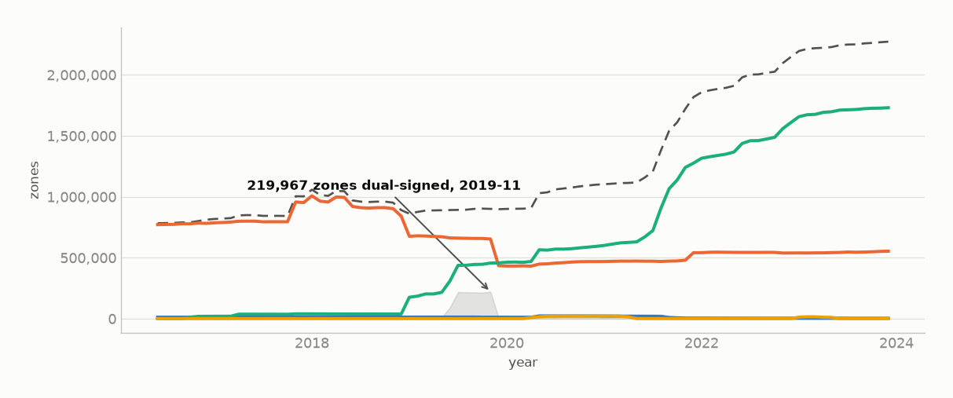
OPENINTEL
The migration, and the rollovers still in flight
219,967 zones were publishing two algorithm families at once in 2019-11.
Lines sum to more than the total because a zone rolling over publishes both algorithms; that gap is the population mid-rollover. Per-algorithm counts overlap and must never be stacked.

Slide 9
WHAT THIS SHOWS
Three things worth taking away
1
Algorithm choice turns over completely, about once a decade.
RSA/SHA-1 was the usual choice until 2013, RSA/SHA-2 until 2020, ECDSA since. From first appearance to majority of new signings took RSA/SHA-2 four years (2010 to 2014) and ECDSA six (2015 to 2021).
2
Rollovers are rare, and one path carries most of them.
1,551 rollovers against 18,205 first-time signings. Of those, 403 are RSASHA256 to ECDSA P-256 — more than the next two paths combined.
3
EdDSA has not started.
Standardised in 2017. Thirty-eight zones in the net position, against 7,112 for ECDSA. Nine years is long enough that this is a result, not a wait.
Reproducible: python reporting/algorithm_flows.py && python reporting/make_flows_deck.py

