Slide 1
THE DEFINITION
Three stages, because one date hid three answers
Each defined by an operation on the data, so nothing can hide in the name.
Stage | Test | Reads as
1 · first seen | present on ≥ 1 name, either corpus | somebody did it once — always quoted with n
2 · in use | P(value | signed names) ≥ 1% and ≥ 10 names | in real use, not the norm
3 · widely used | P(value | signed names) ≥ 10% and ≥ 10 names | a normal choice
Why three
Ed25519 appeared in the forward TLDs 1.9 years after RFC 8080, reached 2.04% of signed names, and is back to 0.003%. “Adopted after 1.9 years” and “never adopted” are both true of it.
The gaps between the stages are the measurements: onset, establishment, ascent.
Why 1% and 10%
Swept, not chosen. The number of qualifying algorithms is flat across 0.5–3% and again across 4–25%, so any value mid-plateau gives identical results; 4% or 30% would sit on a cliff.
Rogers’ 2.5/16/50/84 were tested and rejected: his curve is cumulative and cannot fall, ours is a share of a fixed population and does.
Measured on 8.24 TB · 15,179 source-days · 12 sources · 24 of 30 configured observables seen

Slide 2
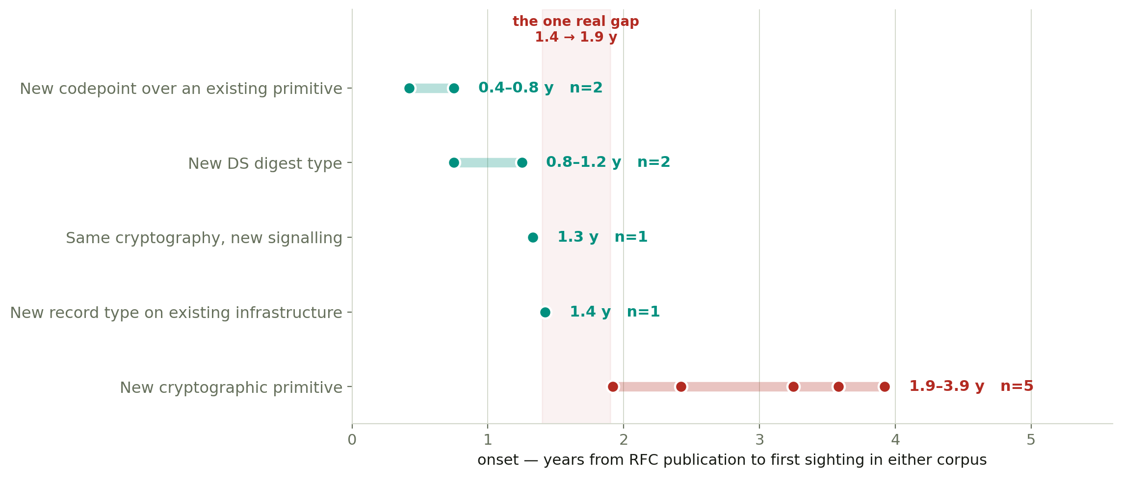
BOTTOM-UP
Bottom-up: onset tracks what the change costs an implementer
Every observable with a usable onset, grouped by what someone has to ship. Censored dates and values older than their own RFC excluded.
The ordering is strict across five groups, and the one substantial gap — 1.4 to 1.9 years — falls exactly where a change starts needing BOTH ends to ship new cryptography. A signer and a validator must agree before anything is publishable; everything faster needs one party to change a value it already supports. RFC 5218 calls that “incrementally deployable”.
Not difficulty: Ed25519 is no harder to implement than RSA/SHA-512.

Slide 3
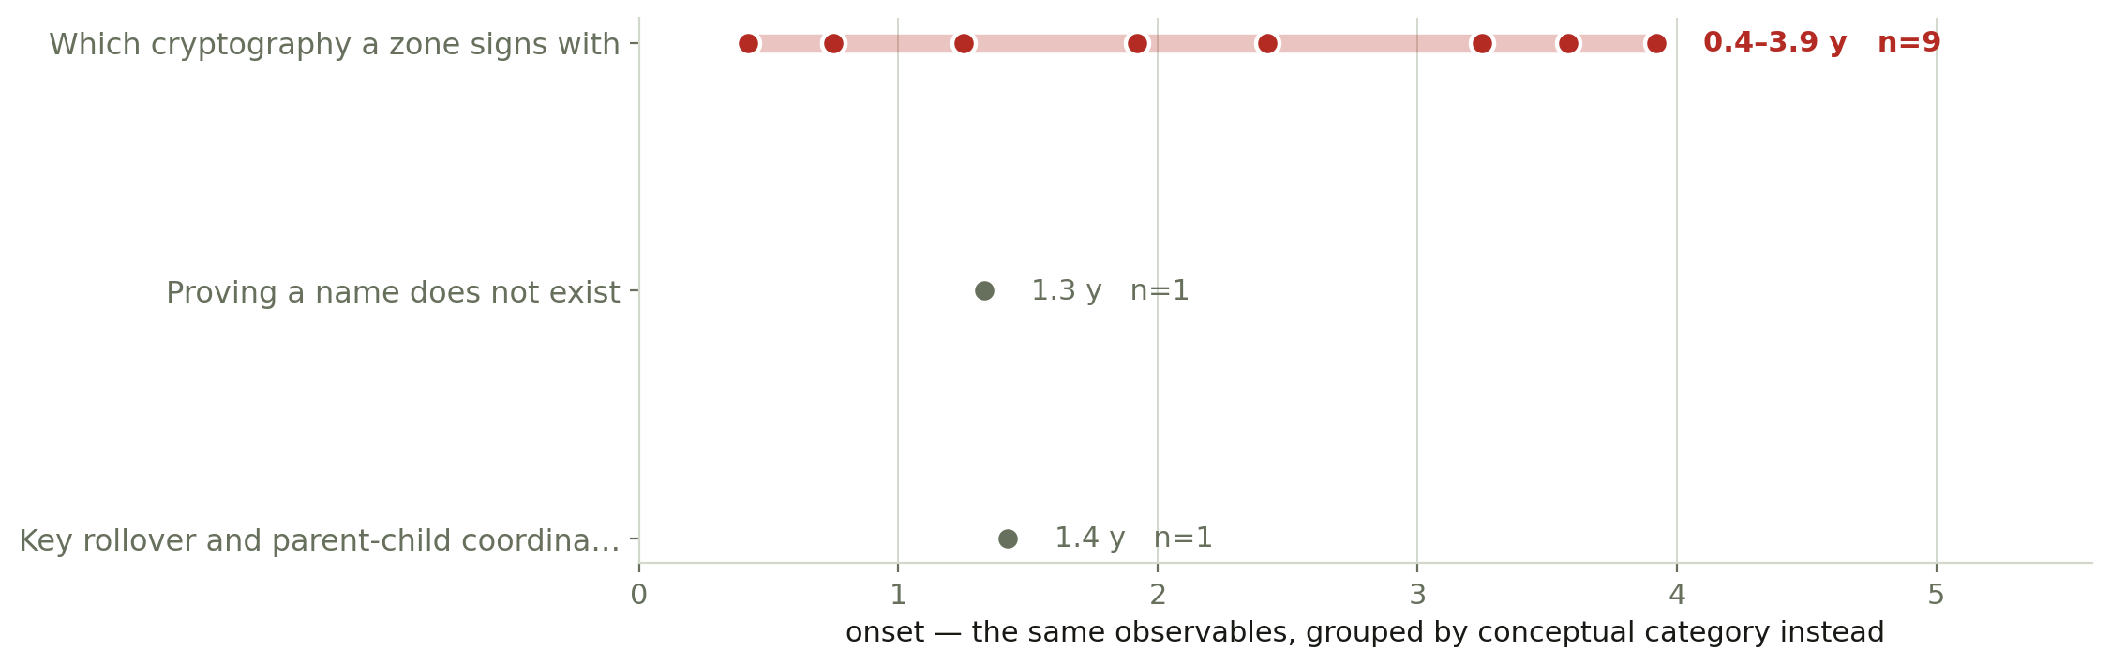
TOP-DOWN
Top-down: the categories are communicable, not predictive
The same observables, grouped by conceptual impact instead.
Category | Configured | Seen | Onset span
Base protocol: the four record types | 2 | 2 | no usable onset
Which cryptography a zone signs with | 16 | 13 | 0.4–3.9 y
Proving a name does not exist | 4 | 3 | 1.3–1.3 y
Key rollover and parent-child coordination | 2 | 2 | 1.4–1.4 y
Things built on top of DNSSEC (DANE) | 2 | 0 | no usable onset
Retiring cryptography that is no longer safe | 3 | 3 | no usable onset

Slide 4
THE RESULT
Where the two meet
One category holds almost all the evidence — and spans the whole onset range.
Cut | Groups | What it does to onset
By what an implementer must ship | 5 | partitions it — five bands, strictly ascending, one real gap
By conceptual category | 6 | does not — “which cryptography a zone signs with” alone spans 0.4–3.9 y, the full range of the data
So the two directions do not converge on one taxonomy, and that is the finding rather than a failure: they answer different questions.
The implementation-cost groups predict when something will first appear. The conceptual categories cannot — 9 of the 11 observables with a usable onset sit in a single category, and it covers every value from 0.4 to 3.9 years. The categories are the right way to explain the work to a reader and the wrong way to model it.
Two categories carry no usable evidence at all: DANE has no TLSA in either corpus, and the base protocol has no separate switch to date — a zone publishing any DS record is already evidence for RFC 4034.

Slide 5
LIMITS
What to trust, and what is next
Trust | Because
First-sighting dates and onset | Existence is a minimum over all evidence and needs no denominator. Adding the forward corpus moved 14 of them earlier.
A share, only with its corpus and month named | Forward sources are 99.6% of the population and stop at 2023-12, so a pooled share is two different measurements with a 99.6% cliff between.
Cross-corpus agreement, sparingly | Of 20 observables both corpora answer: 1 agree, 6 disagree, 10 are absent from both. The one agreement is SHA-256 DS digest, 0.10 points apart.
Not a count of decisions | One operator moved +118,961 names to ECDSA in a single month — 76% of its total that month. Forward shares largely measure provider defaults.
Next
1 · Re-run the reverse side with --pool-sources; its names overlap between RIRs, so those shares are approximate while the forward ones are exact.
2 · Extend the forward mirror past 2023-12 — RFC 9905 and 9906 published 2025-11, so deprecation is answerable only on reverse data today.
3 · Settle whether displacement is unclaimed in the literature. Every framework we found describes something arriving; none describes something being pushed out, and that is most of what our data shows.

