Slide 1
PROGRESS UPDATE
DNSSEC RFC adoption:
a second corpus, and what it corroborates
30 DNSSEC RFCs screened · two independent corpora · 2009-2026
Every figure traces to a committed checkpoint and an executed notebook.
Nothing in this deck is asserted without the cell that computes it.

Slide 2
SINCE THE LAST REVIEW
What changed
Two things: the screening got much wider, and the analysis got a second, independent corpus to check itself against.
8 → 30
1 → 2
2018 → 2009
790
DNSSEC RFCs screened.
Dates and status pulled from the RFC Editor
index and IANA registries at build time
independent corpora.
OpenINTEL forward DNS, and RIPE's
reverse-delegation archive
measurement window.
Nine more years, which turns
censored bounds into measurements
tests passing.
Including cross-engine agreement,
which caught two real bugs
The pipeline also learned to mirror rather than stream, and to pace itself against the store's rate limit — measured at ~1 request/second with a burst of five. A nightly script now keeps both corpora current unattended.
Checklist 0.2.1 · dictionary 0.2.0 · branch overnight-data

Slide 3
THE NEW CORPUS
RIPE reverse-delegation zones, 2009-2026
Every delegation in in-addr.arpa and ip6.arpa, all five RIRs. It answers two questions OpenINTEL structurally cannot.
A denominator of zones
Zone files list every delegation, signed or not — so "share of zones" is directly countable. That is the caveat that has been on half our slides.
Dates before 2018
It predates four of the algorithm RFCs, so their adoption lag is measured rather than bounded from below by when measurement began.
A different population
Network operators holding address blocks, not registrants holding domains. Where it agrees with OpenINTEL, the agreement is evidence.
199 monthly snapshots · 1,875,584 DS records · ~1.3M delegations per day
Ingested and scanned locally; the archive publishes some days as zero-byte files, which are treated as gaps rather than as empty days.

Slide 4
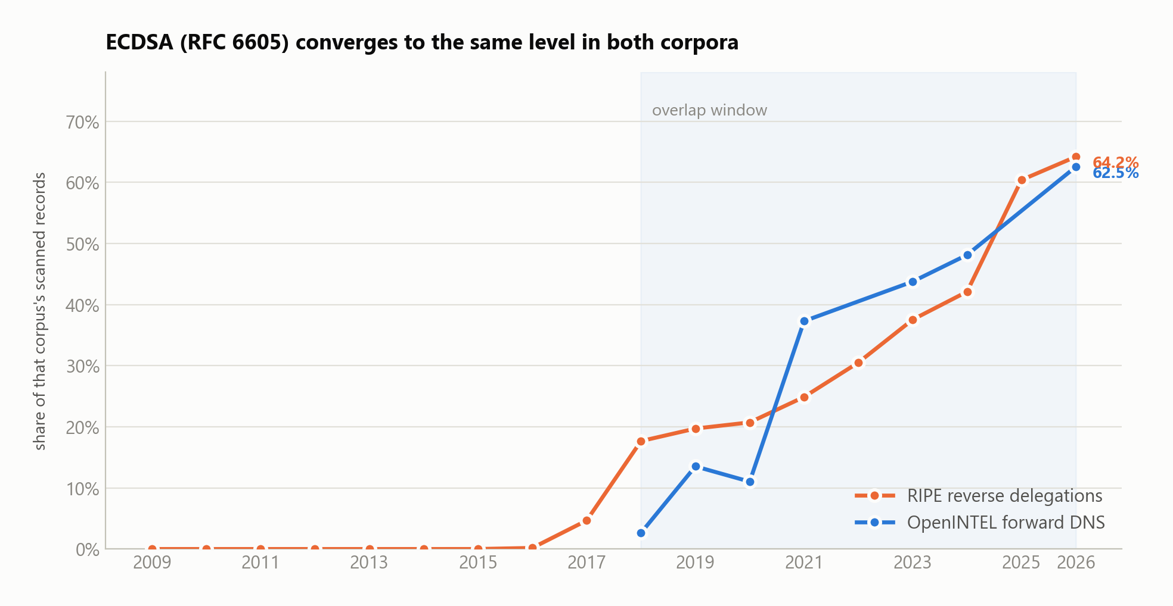
CORROBORATION
ECDSA converges in both corpora
Different infrastructure, different operators, different collection method. They start 15 points apart in 2018 and land 1.65 points apart in 2026.
Forward: share of DNSSEC records across .gov/.nu/.se. Reverse: share of DS records across all five RIRs. RFC 6605 is matched on algorithm 13/14, independent of record type, which is what makes the two comparable.

Slide 5
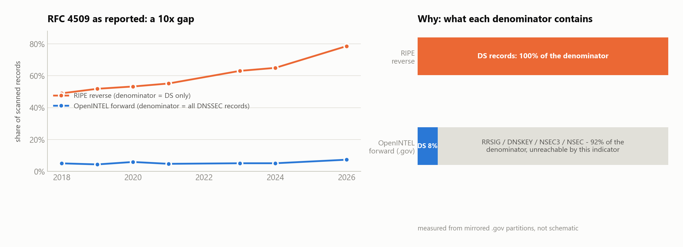
A METHODOLOGY RESULT
A 10x disagreement that was arithmetic, not behaviour
RFC 4509 reads ~5% forward and ~79% reverse. Normalised to the same denominator, the two agree to 1.1 points.
The rule we now apply: an indicator scoped by record type is not comparable across corpora with different record-type composition; one scoped by algorithm is. Every cross-corpus claim has to say which it is.

Slide 6
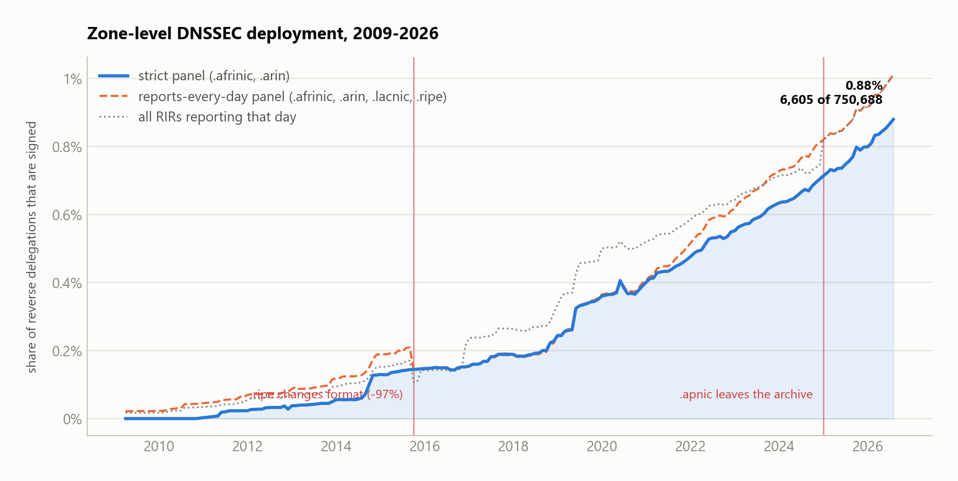
THE NUMBER THAT ANSWERS THE CAVEAT
Zone-level deployment: 0.88-1.01%
After seventeen years. The range is panel choice, not uncertainty in the data — and whether it has "crossed 1%" sits inside it.
Two composition breaks are excluded from the headline panel: APNIC leaves the archive in Jan 2025, and RIPE changes publication format in Oct 2015 and its delegation count falls 97%. Both would read as adoption if left in.

Slide 7
MEASURED, NOT BOUNDED
Each new signing algorithm took longer to arrive
The forward corpus can only bound these from above. The reverse corpus starts early enough to measure them.
0.5 y
2.5 y
3.7 y
5.6 y
RSA/SHA-2 (RFC 5702)
published 2009-10
GOST (RFC 5933)
published 2010-07
ECDSA (RFC 6605)
published 2012-04
EdDSA (RFC 8080)
published 2017-02
Monotonically increasing by publication date. Two readings, and this data does not choose between them: either the ecosystem has slowed, or RSA/SHA-2 was unusually fast because it was a drop-in change to an algorithm operators already ran, where ECDSA and EdDSA each needed new tooling and new parent support. The second is more plausible — but it is an interpretation, not a measurement.
Uncensored: the corpus begins 2009-04, before all four were published. Five other RFCs remain left-censored and are reported as upper bounds.

Slide 8
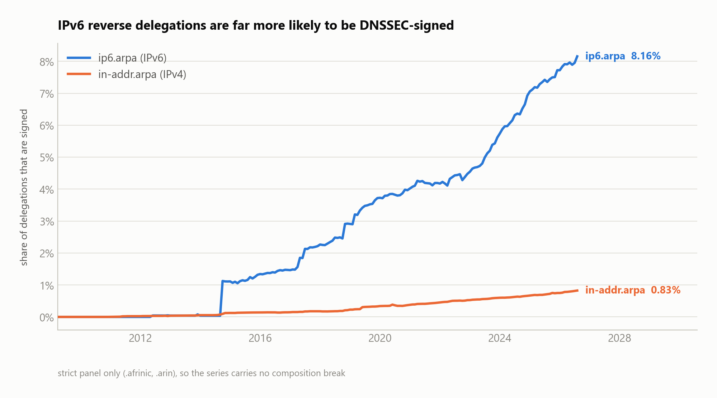
THE SHARPEST SPLIT IN THE DATA
IPv6 delegations are 9.9x more likely to be signed
8.16% of ip6.arpa delegations carry a DS, against 0.83% of in-addr.arpa. The gap has been open since 2009 and is widening.
Selection, most likely, not causation: an operator who deployed IPv6 reverse DNS has already done discretionary modern DNS work. It rests on 454 signed delegations — quote the ratio, not the curve's shape.

Slide 9
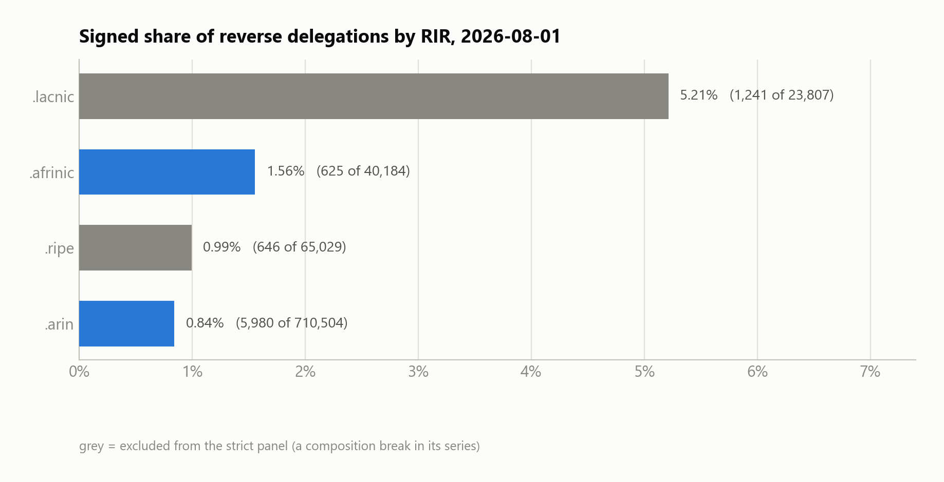
WHO THE POOLED NUMBER IS ABOUT
A six-fold spread between regions
LACNIC leads at 5.2% and ARIN trails at 0.84% — but ARIN holds 85% of all delegations, so the pooled figure is essentially ARIN's.
Any "reverse DNS is N% signed" claim is a claim about North American address space unless it says otherwise — worth stating wherever we quote the headline. Grey bars carry a composition break in their series.

Slide 10
OPERATIONAL FINDING
"SHA-1" is two mechanisms, at different levels
RFC 9905 (Nov 2025) closes both to new deployment. Reporting one number misstates the exposure by 3x and points at the wrong fix.
15.3%
4.9%
0.07%
of DS records use a SHA-1 digest (type 1).
RFC 9905: MUST NOT create new DS.
Fix: replace the DS at the parent.
point at a SHA-1 signature algorithm (5/7).
RFC 9905: MUST NOT create new DNSKEY/RRSIG.
Fix: reissue the child's keys.
still use GOST R 34.11-94.
RFC 9906 retired it in Nov 2025 —
after it had already died out.
Both remain valid for validation, so neither is switched off. RSA/SHA-1 has fallen from 81.7% of reverse DS records in 2009 to 4.9% today — the retirement is nearly complete, and this is the residue the pipeline's non-conformance signal now tracks.

Slide 11
STATED, NOT HIDDEN
What we can and cannot measure
Every one of the 30 RFCs carries a verdict and the sentence that justifies it. An RFC we cannot answer is a documented result, not a silence.
19
2
2
7
measurable
partly measurable
ambiguous only
not measurable here
Resolver-side is invisible
RFC 4035 and 8198 are properties of a query/response exchange. Authoritative measurement cannot see them — DNS-OARC's DITL could, but it is members-only.
Owner-name signatures
RFC 9615 and 7672 are identified by a label (_signal, _25._tcp). Names are provenance in our signal model, not evidence.
A limit we can fix
RFC 6840's mandatory-algorithm rules ARE visible, but need algorithm-set comparisons across records at one name. Our indicators are per-record.

Slide 12
WHAT THE CHECKS CAUGHT
Four corrections, before they reached a slide
Reported because the process working is the point — each was found by a check rather than by someone noticing later.
A retracted headline
"Crossed 1%" was wrong. A second composition break — RIPE reformatting in 2015, its count falling 97% — was not being excluded. Corrected to 0.88-1.01%.
A publication-date leak
A zero-scoring match kept its adoption verdict on a pre-publication observation. RFC 6840 showed a 2013 document first seen in 2010.
2.45M phantom matches
RFC 6840 and 9364 matched "any DNSSEC record" — the evidence RFC 4033 already claims — for 25.9% of all matched rows. Both now match nothing.
An untested correlation
"Rollovers peak when adoption is steepest" did not survive testing: r = 0.43, and the steepest year had the lowest rollover rate.

Slide 13
NEXT
Where this goes
Measurement validity first; the corpus is now wide enough that breadth is no longer the binding constraint.
1 Run both corpora at full scale
The nightly script is written and tested. Mirror once, scan locally, and the store stops being in the inner loop.
2 Cross-record indicators
Unlocks RFC 6840's mandatory-algorithm rules — a real conformance check, and the kind of misconfiguration that actually breaks validation.
3 Splice the RIPE series
Rather than dropping a whole RIR to avoid one 2015 format change. Needs someone who knows what the legacy zones held.
4 Ask about the closed sources
DNS-OARC DITL is the only thing that would let us say anything about the resolver side. It needs a membership conversation, not a crawler.
Reproducible end to end: notebooks/dnssec_crossref_openintel_ripe.ipynb runs from a clean clone and re-derives every figure in this deck.

