Slide 1
DNSSEC RFC ADOPTION — MEASUREMENT FRAMEWORK
Measuring what the data can
actually tell us
Why the existing definitions do not transfer, the one we built instead, the pipeline that computes it, and what it has found so far.
Full run: 8.24 TB · 15,179 source-days · 25,151 files · 12 sources · 5 RIRs (2009–2026) + 7 forward TLDs (2016–2023)

Slide 2
THE PROBLEM
One word was doing three jobs
Every sentence with “adoption” in it hid which of these was meant.
SOMEONE TRIED IT
IT REACHED REAL USE
IT IS SPREADING
Ed25519 first appeared in 2019-01, 1.9 years after RFC 8080.
In the forward TLDs it reached 2.04% of signed names by 2020-06.
It is not. Those same TLDs were back to 0.003% by 2023-12.
true, and almost meaningless alone
a different measure entirely
a third measure again
“Ed25519 was adopted after 1.9 years” and “Ed25519 was never adopted” are both defensible readings of the same record.
That is what makes the word unusable once a number is attached to it.

Slide 3
OTHER DEFINITIONS
What already exists, and where it comes from
The method behind each definition decides what it can and cannot say.
Framework | How it was derived | What it measures | Fits us?
Rogers / Bass diffusion | Theory + market data on consumer goods | Cumulative adopters — can only go up | No
ISA model Hovav et al. 2004 | SURVEYS of organisations (Australia, China) | Why managers decide: attitude, top-mgmt support | No
Osterweil et al. IMC 2008 | ACTIVE DNS QUERIES from resolvers | availability / verifiability / validity — does it work now | Different instrument
Chung et al. IMC 2017 | Measurement + buying domains from registrars | Who is responsible (registrar attribution) | Out of scope
RFC 5218 | Retrospective on IETF protocol histories | Why protocols succeed (“incrementally deployable”) | Partly — we cite it
The ISA model asks people why they deployed. We read what zones publish. Nothing in a zone file records intent, management support, or attitude — so a survey-derived definition cannot be computed from our data at all.

Slide 4
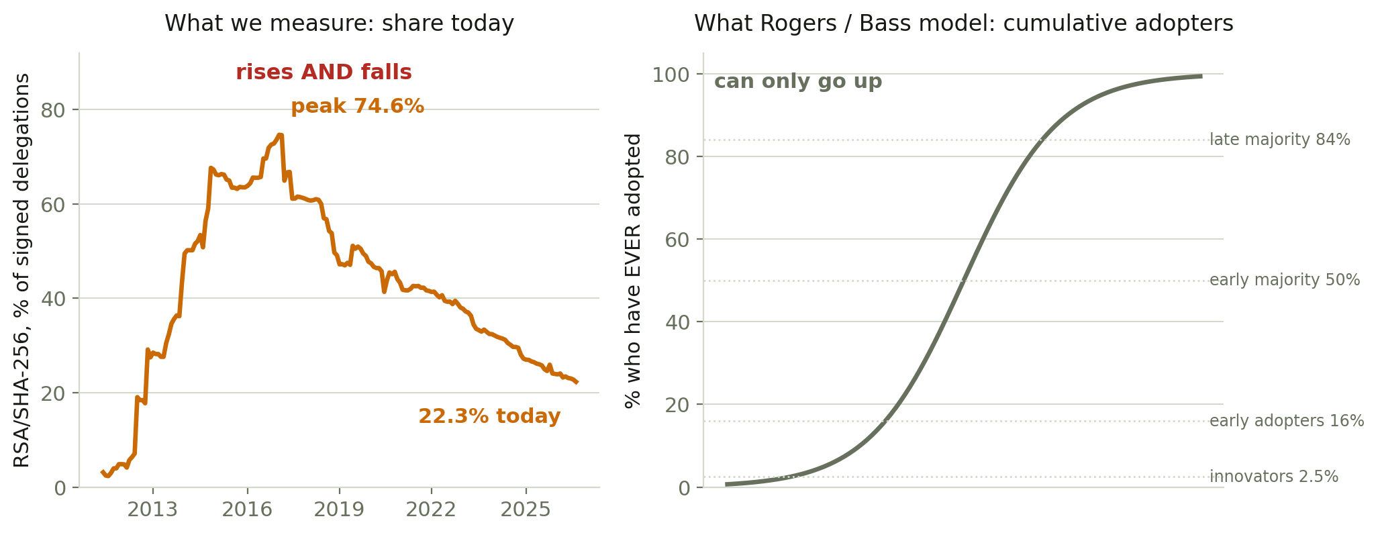
WHY THEY DON'T TRANSFER
Their curve can only go up. Ours goes down.
The same mechanism, measured two ways.
RSA/SHA-256 went 0% → 74.6% → 22.3%. Nothing failed: those zones moved to ECDSA. But cumulative adoption cannot fall, so Rogers’ thresholds would file RSA/SHA-1 as “late majority” in 2011 and “innovator” in 2026 — the same mechanism walking backwards through the categories.

Slide 5
THE DEFINITION WE USE
Three stages, each an operation on the data
Named after the arithmetic, so no inference can hide inside the name.
STAGE 1 — FIRST SEEN
STAGE 2 — PARTIAL USAGE
STAGE 3 — COMMON USAGE
Present on ≥ 1 zone,
any RIR
P(value | signed delegations)
≥ 1% AND ≥ 10 zones
P(value | signed delegations)
≥ 10% AND ≥ 10 zones
somebody did it once ·
always quoted with n
in real use, not the norm
a normal operator choice
The intervals between them are the measurements:
onset (publication → first seen) · establishment (first seen → partial) · ascent (partial → common)
Thresholds were swept, not picked. The qualifying count is flat across 0.5–3% and 4–25%, so any value mid-plateau gives identical results. The ≥10-zone guard exists because a population grows: on the reverse panel one zone was 3.1% of it in 2011 and is 0.016% now — a 201× change in what the same threshold demands.

Slide 6
WORKED EXAMPLES
The same three stages, three different endings
All three first appeared. Two reached real use, one never did, and one of those two has since fallen back.
From RFC 8080 | Onset | 1 · first seen | 2 · in use | 3 · widely used | Peak | Now
Ed25519 — forward | 1.9 y | 2019-01 | 2020-04 | never | 2.04% | 0.003%
Ed25519 — reverse | 5.5 y | 2022-08 | never | never | 0.39% | 0.37%
Ed448 — forward | 3.2 y | 2020-05 | never | never | 0.00% | 0.00%
Why the stages are separate
Why these thresholds
Ed25519 and Ed448 come from the SAME RFC, published the same day, in the same family — one date for “RFC 8080” would have averaged them into a single number.
Ed25519 appeared in the forward TLDs after 1.9 years and in reverse delegations only after 5.5, and did something different in each. Ed448 has never left first sighting anywhere.
Each row is one corpus throughout. This is why the unit is the observable change and not the document, and why a first-sighting date has to name the corpora it searched.
Swept, not picked. The number of qualifying algorithms is flat across 0.5–3% and again across 4–25%, so any value mid-plateau gives identical results. 4% or 30% would sit on a cliff.
The ≥10-zone guard: on the reverse panel, RSA/SHA-256 and RSASHA1-NSEC3 both “reach 1%” in 2011-05 on a SINGLE zone — 1% of a 32-zone population.
A ≥25 guard over-corrects, pushing RSASHA1-NSEC3 from 2.0y to 7.8y purely because it had few contemporaries.

Slide 7
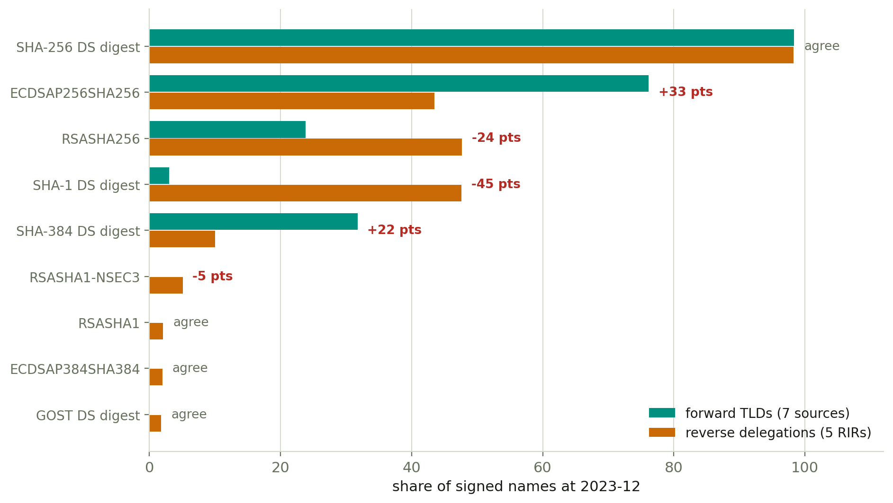
CROSS-REFERENCE
Two corpora that share nothing, compared at one date
2023-12, the last month both cover.
14 of 20 comparable observables agree within 5 percentage points — SHA-256 DS digest reads 98.34% and 98.24%, a tenth of a point apart, from corpora with no shared infrastructure, operators or method. Where they disagree the direction is consistent: forward zones have modernised and reverse delegations have not.

Slide 8
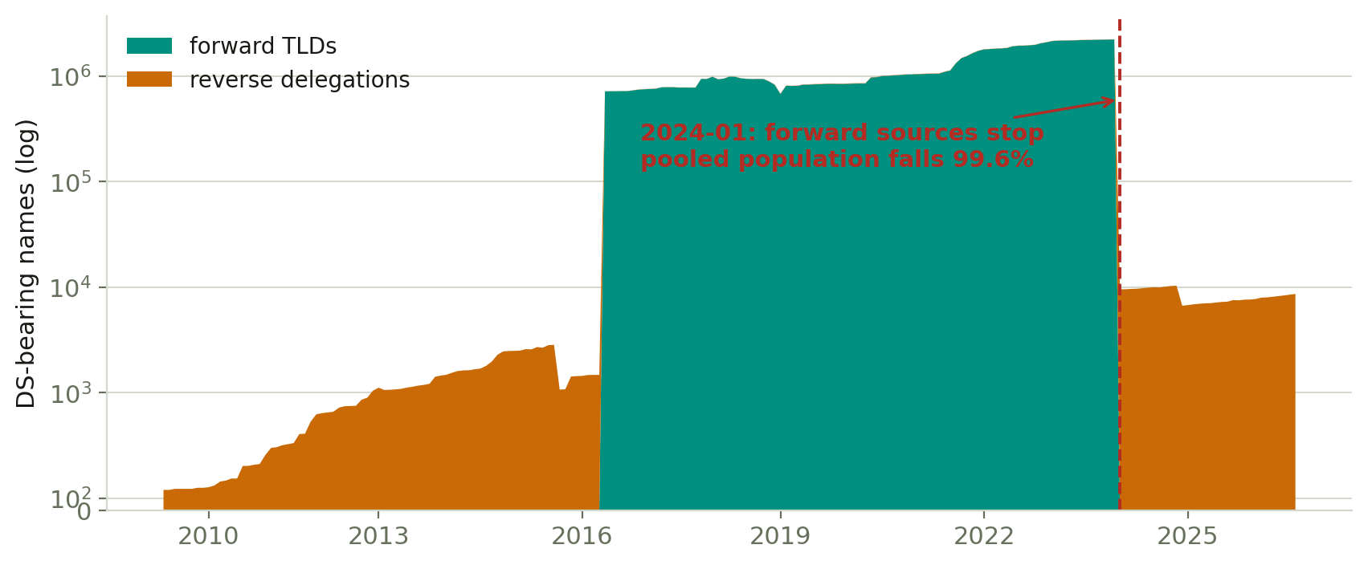
THE DENOMINATOR
Why the two are never pooled
The forward sources are 99.6% of the population, and they stop.
A pooled share is a forward number until 2023-12 and a reverse number after it, with a 99.6% cliff between. Peak and latest values routinely land on opposite sides, so 11 of 15 peak-to-latest drops in the pooled run are not comparable and none is quoted here. Every figure on this deck is one corpus at a time.

Slide 9
THE BIGGEST CAVEAT
A share of names is not a count of decisions
In the forward corpus, single operators move six figures of names in one month.
Ed25519, forward TLDs | names | share
2020-01 | 3 | 0.000%
2020-06 | 19,863 | 2.039%
2021-06 | 42 | 0.004%
2023-01 | 11,921 | 0.557%
2023-12 | 72 | 0.003%
Tens of thousands of names appearing and vanishing within months, twice, is not diffusion. It is one operator moving a portfolio — .se accounts for nearly all of it, peaking at 19,455 names.
The largest jump anywhere is ECDSA P-256: +118,961 names in 2019-02, 76% of its total that month. So “ECDSA reached common usage in 2019-02” records one bulk migration.
Forward shares therefore largely measure registrar and provider defaults, not independent decisions.
This strengthens the case against the diffusion literature rather than weakening it: that literature assumes a population of independent adopters, and this one has a handful of actors who can move six figures of names at once.

Slide 10
WHAT IT DOES
The pipeline
Five stages, each resumable, each skippable.
Stage | What happens | Output
ripe | Fetches RIPE’s reverse-delegation archive (the only stage that touches the network) | the reverse corpus
index | Walks every cache root on the NAS, merges them into one view | inventory.json
extract | One pass per source-day → tidy counts, one checkpoint each | timeline_monthly.csv
analyse | Bottom-up over observable changes, top-down over categories | bottom_up.json · top_down.json
report | Digest for humans, compact bundle for the next conversation | summary.md · analysis_bundle.json
Both analysis directions are configuration, not code — data/analysis_config.json holds the observable changes, the implementation groups, the categories and the thresholds. Adding a mechanism to measure means adding a row.

Slide 11
HOW IT WORKS
Three design decisions that protect the numbers
MULTI-DRIVE, MERGED
EVERY SHARE CARRIES ITS DENOMINATOR
SHARDED ACROSS MACHINES
The cache spans a main path and a spill path. A day’s files can sit on both.
Each dimension emits its own _total row alongside the values.
Same command, different --shard. Balanced on bytes, no coordinator.
Reading one path alone reports a PARTIAL day as a complete one — indistinguishable from a month when fewer zones signed.
The same fact reads 68%, 64% or 0.6% depending only on what you divide by. P(x | population) is recomputable, never guessed.
3 shards over the corpus: 0.0% spread, and identical results to a single-machine run across 30 changes × 7 fields.
A partial corpus produces entirely plausible numbers, so each shard reports when it finishes and the analysis refuses to stay silent if the set is incomplete.

Slide 12
THE FULL RUN
What the full corpus changed
Adding 8.24 TB of forward data moved 14 dates and refuted one finding.
MEASURABLE OBSERVABLES
FIRST-SEEN DATES MOVED EARLIER
A FINDING WITHDRAWN
14 → 24
14 of them
no longer true
Ten became measurable for the first time. The forward corpus carries NSEC3 parameters, DNSKEY flags and CDS, which delegation data cannot.
Existence is a minimum over all evidence, so more corpus can only move a date earlier. Largest: SHA-384 digest −4.1 y, Ed25519 −3.7 y.
“Each new algorithm takes longer to appear” held in reverse data and fails on the full corpus.
New cryptographic primitive | Published | Reverse only | Full corpus
ECC-GOST | 2010-07 | 2.5 y | 2.4 y
ECDSA P-256 | 2012-04 | 3.7 y | 3.6 y
ECDSA P-384 | 2012-04 | 4.0 y | 3.9 y
Ed25519 | 2017-02 | 5.6 y | 1.9 y ← the newest is the fastest
Ed448 | 2017-02 | 5.8 y | 3.2 y
Reverse only: 3.7 → 4.0 → 5.6 → 5.8, monotonic. Full corpus: 2.4 → 3.6 → 3.9 → 1.9 → 3.2, not monotonic. The pattern was a property of one corpus: reverse-DNS operators adopt late, so every newer algorithm looked slower. .se had Ed25519 in 2019-01; the RIRs not until 2022-08.

Slide 13
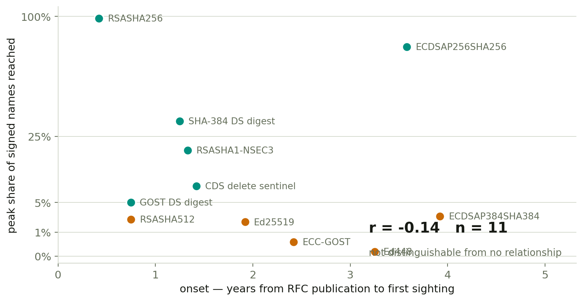
INSIGHT 1
Being early tells you nothing about ending up used
Peak share, not today's — “today” is 2023-12 for the forward-only observables and 2026-08 for the DS ones, so one axis cannot carry both. At n=11 the correlation is not distinguishable from zero under either endpoint (−0.14 on peak, +0.33 on latest). This is the evidence FOR splitting the definition, not an assumption behind it.

Slide 14
INSIGHT 2
What does predict onset: how many parties must ship code
What the change requires | Measured on | Onset | n
A new codepoint — the cryptography is already linked in | algorithms 8, 10 | 0.4 – 0.8 y | 2
A new DS digest — a hash, parent side only | digests 3, 4 | 0.8 – 1.2 y | 2
Same cryptography, new signalling | algorithm 7 | 1.3 y | 1
A new record type on existing infrastructure | CDS delete | 1.4 y | 1
A NEW PRIMITIVE — signer AND validator must both ship | algorithms 12–16 | 1.9 – 3.9 y | 5
Five groups, strictly ascending, on the full corpus. The claim to make is about the ORDERING: the middle gaps are 0.1 y with n=1, which is not a boundary. Only the last gap is substantial — 1.4 y to 1.9 y, where a change starts needing both ends.
Not difficulty: Ed25519 is no harder to implement than RSA/SHA-512. RFC 5218 calls it “incrementally deployable”, which is the citation for the mechanism.

Slide 15
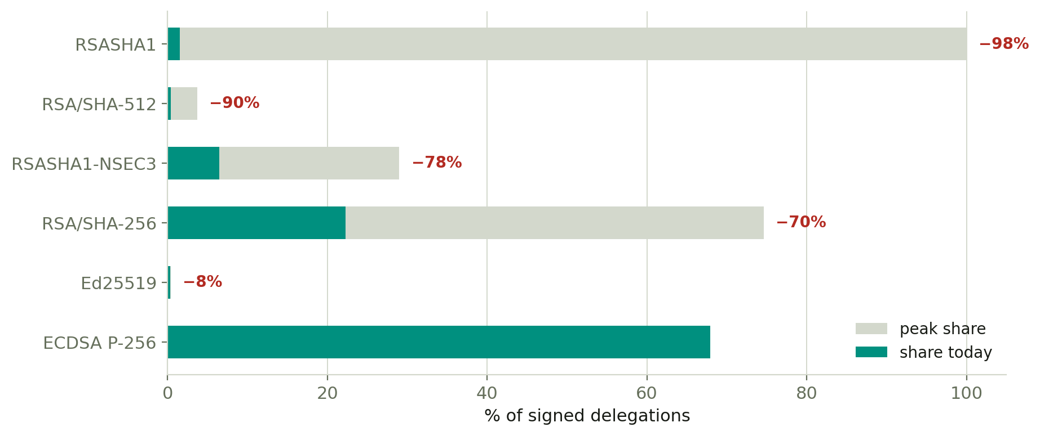
INSIGHT 3
Most of what happens is retreat, not arrival
Reverse panel, the one series with no composition break: four of six mechanisms sit below their own peak.
Every framework in the literature describes something arriving. None describes something being pushed out. In a fixed population that is half of what happens — and in our data it is the bigger half. This looks like the contribution.

Slide 16
INSIGHT 4
Deprecation runs on an inverted clock
The question is not when it appeared but how much is still there.
RFC 9905 — SHA-1 SIGNING
RFC 9905 — SHA-1 DS DIGEST
RFC 9906 — ECC-GOST
7.30%
15,888 records
18.26%
19,652 records
0
zero records
still published after the RFC forbade new use
a different fix: replace the DS at the parent
documented an ending rather than causing one
The two halves of RFC 9905 need different remedies — replace the DS at the parent, versus reissue the child’s keys — so they are reported as two numbers, never one “SHA-1 exposure”.
Both RFCs published 2025-11 and the forward corpus ends 2023-12, so the entire post-publication window is reverse data — a property of the corpus, not a choice.

Slide 17
LIMITS
What this cannot see
Stated so no one reads a blank as a zero.
Limit | Consequence
Forward and reverse cover different periods | Forward ends 2023-12, the RIRs run to 2026-08. Any share spanning 2024-01 compares two populations: 11 of 15 peak-to-now drops are not comparable, and none of them is quoted.
Only TLSA is still unreachable | The forward corpus closed the rest — 2 observables have no denominator anywhere, down from 9. Untestable, not negative.
We read published zone data, never live queries | availability / verifiability / validity (Osterweil’s three) are outside the instrument entirely.
Nothing in a zone file records intent | We never claim an RFC CAUSED a change. An operator whose provider changed a default is indistinguishable from one who read the RFC.
Our checklist covers 29 of 105 current DNSSEC RFCs | 13 of the uncovered ones are measurable from zone data — ZONEMD, compact denial of existence, multi-signer, OPENPGPKEY, SSHFP.

Slide 18
NEXT
What needs to be done
 | Work | Why it matters
1 | Analyse forward and reverse separately, never pooled | They cover different periods, so a pooled share crosses a break at 2024-01. This is the one thing blocking the prevalence numbers; it needs no rescan, only the analyse stage.
2 | Extend the forward mirror past 2023-12 | RFC 9905 and 9906 published 2025-11, so the whole deprecation question is answerable only on reverse data until the forward mirror catches up.
3 | Decide: share measure, cumulative measure, or both | A cumulative measure would let us inherit Rogers’ thresholds, but it cannot see displacement.
4 | Settle whether displacement is genuinely unclaimed | If it is, it is a stronger contribution than the timeline. Needs someone who knows the literature better than a search does.
5 | Add the 13 measurable RFCs we do not screen | ZONEMD, compact denial of existence, multi-signer. Mechanical work that would extend the story rather than just widen it.

