Slide 1
8 PROGRAMS · 1,083 RELEASES · 434 CVEs · OPENINTEL + REVERSE DNS
Does DNS software explain
when DNSSEC RFCs get adopted?
BIND 9, Unbound, NSD, Knot DNS, Knot Resolver, PowerDNS Auth/Recursor and OpenDNSSEC: when each one implemented an RFC, when it made it the default, when Ubuntu and Debian shipped that version, and which CVEs touched it -- lined up against what zones actually did in the OpenINTEL zone files and in reverse DNS.
Short version: code is never the wait; a default only ever changes what a newly signed zone gets, so it never shows as a spike; operators switch in sudden batches and the trigger cannot be identified; one RFC was forced by validators before it was published; and no CVE led a push, including that one, where the CVE and the vendor caps are the same event rather than a cause.

Slide 2
WHAT WE DID
Four sources, one time axis
Software
8 projects cloned; 1,083 stable release dates from git tags (BIND development branches excluded). For each RFC: the first release that signs or validates it, the release that changed the default, and validator caps. All but two rows carry the commit, checked to be contained in the cited release; 10 of 38 are dated from a changelog or documentation instead and are marked approximate.
OS packages
Debian 9-13 and Ubuntu LTS 16.04-24.04 by version (Launchpad, sources.debian.org) and RHEL majors by date. One delivery path among several, and a partial one: RHEL base carries only BIND, Knot and PowerDNS come from EPEL, and FreeBSD, Alpine, containers and source builds are not represented at all.
CVEs
434 CVEs across the eight products from NVD; 97 are DNSSEC mechanisms, classified by the mechanism the description names (NSEC3, validation, trust anchor, algorithm...). Five products are matched by NVD CPE; knot, kresd, opendnssec have no usable CPE and are keyword-matched, so a CVE is never attributed to them.
Zones
OpenINTEL zone files for seven TLDs, entering at different dates: .se and .nu 2016-06, .gov and .fed.us 2017-05, .ee 2019-07, .ch and .li 2020-05, all to 2023-12. Reverse DNS for five RIRs, 2009-03 to 2026-08 with ten missing months, with the strict AFRINIC+ARIN panel for reverse shares and a per-delegation change ledger.
Tests
onset decomposition (RFC -> code -> first zone); event studies and a detrended release scan with a circular-shift null; a spike ledger naming what preceded every spike, against the chance rate; new signings vs rollovers; and the share of new reverse signings choosing each algorithm around every default change.

Slide 3
FINDING 1
Code is never the wait; operators are
RFC | published | first signer release | code lag (y) | first zone seen | operator lag (y) | verdict
RFC 5702 | 2009-10 | bind9 9.7.0 2010-02 | +0.3 | 2010-03 | 0.1 | fast
RFC 5933 | 2010-07 | bind9 9.6.2 2010-02 | -0.4 | 2012-12 | 2.8 | never
RFC 6605 | 2012-04 | pdns-auth 3.0.1 2012-01 | -0.2 | 2015-11 | 3.8 | slow
RFC 8080 | 2017-02 | knot 2.6.0 2017-09 | +0.6 | 2019-01 | 1.3 | never
RFC 5155 | 2008-03 | bind9 9.6.0 2008-12-21 | +0.8 | 2009-08 | 0.7 | slow
RFC 7344 | 2014-09 | pdns-auth 4.0.0 2016-07 | +1.8 | 2017-10 | 1.2 | niche by design
Across the algorithm and record-type RFCs the code lag runs -0.4 to +1.8 years (negative: a signer shipped it from the draft), while the lag from that release to the first zone runs 0.1 to 3.8 years. The RFC is never waiting for an implementation; it is waiting for an operator.
Defaults sit closer to take-off than RFCs do, but no event study or release scan finds a release month that moves the curve: after detrending, the smallest circular-shift p across the eight projects is 0.11. 95% of the 210 months from 2009-03 to 2026-08 contain a stable release of one of the eight, so 'a release came just before' is always true and never evidence. Where a default could show at all is in what newly signed zones choose, and there the picture is sudden batches, not diffusion (slide 5).
Verdict rule: FAST = first zone within a year of the RFC and 10% of signed delegations within four; SLOW = reached 10%, later; NEVER = under 1% of signed zones today.

Slide 4
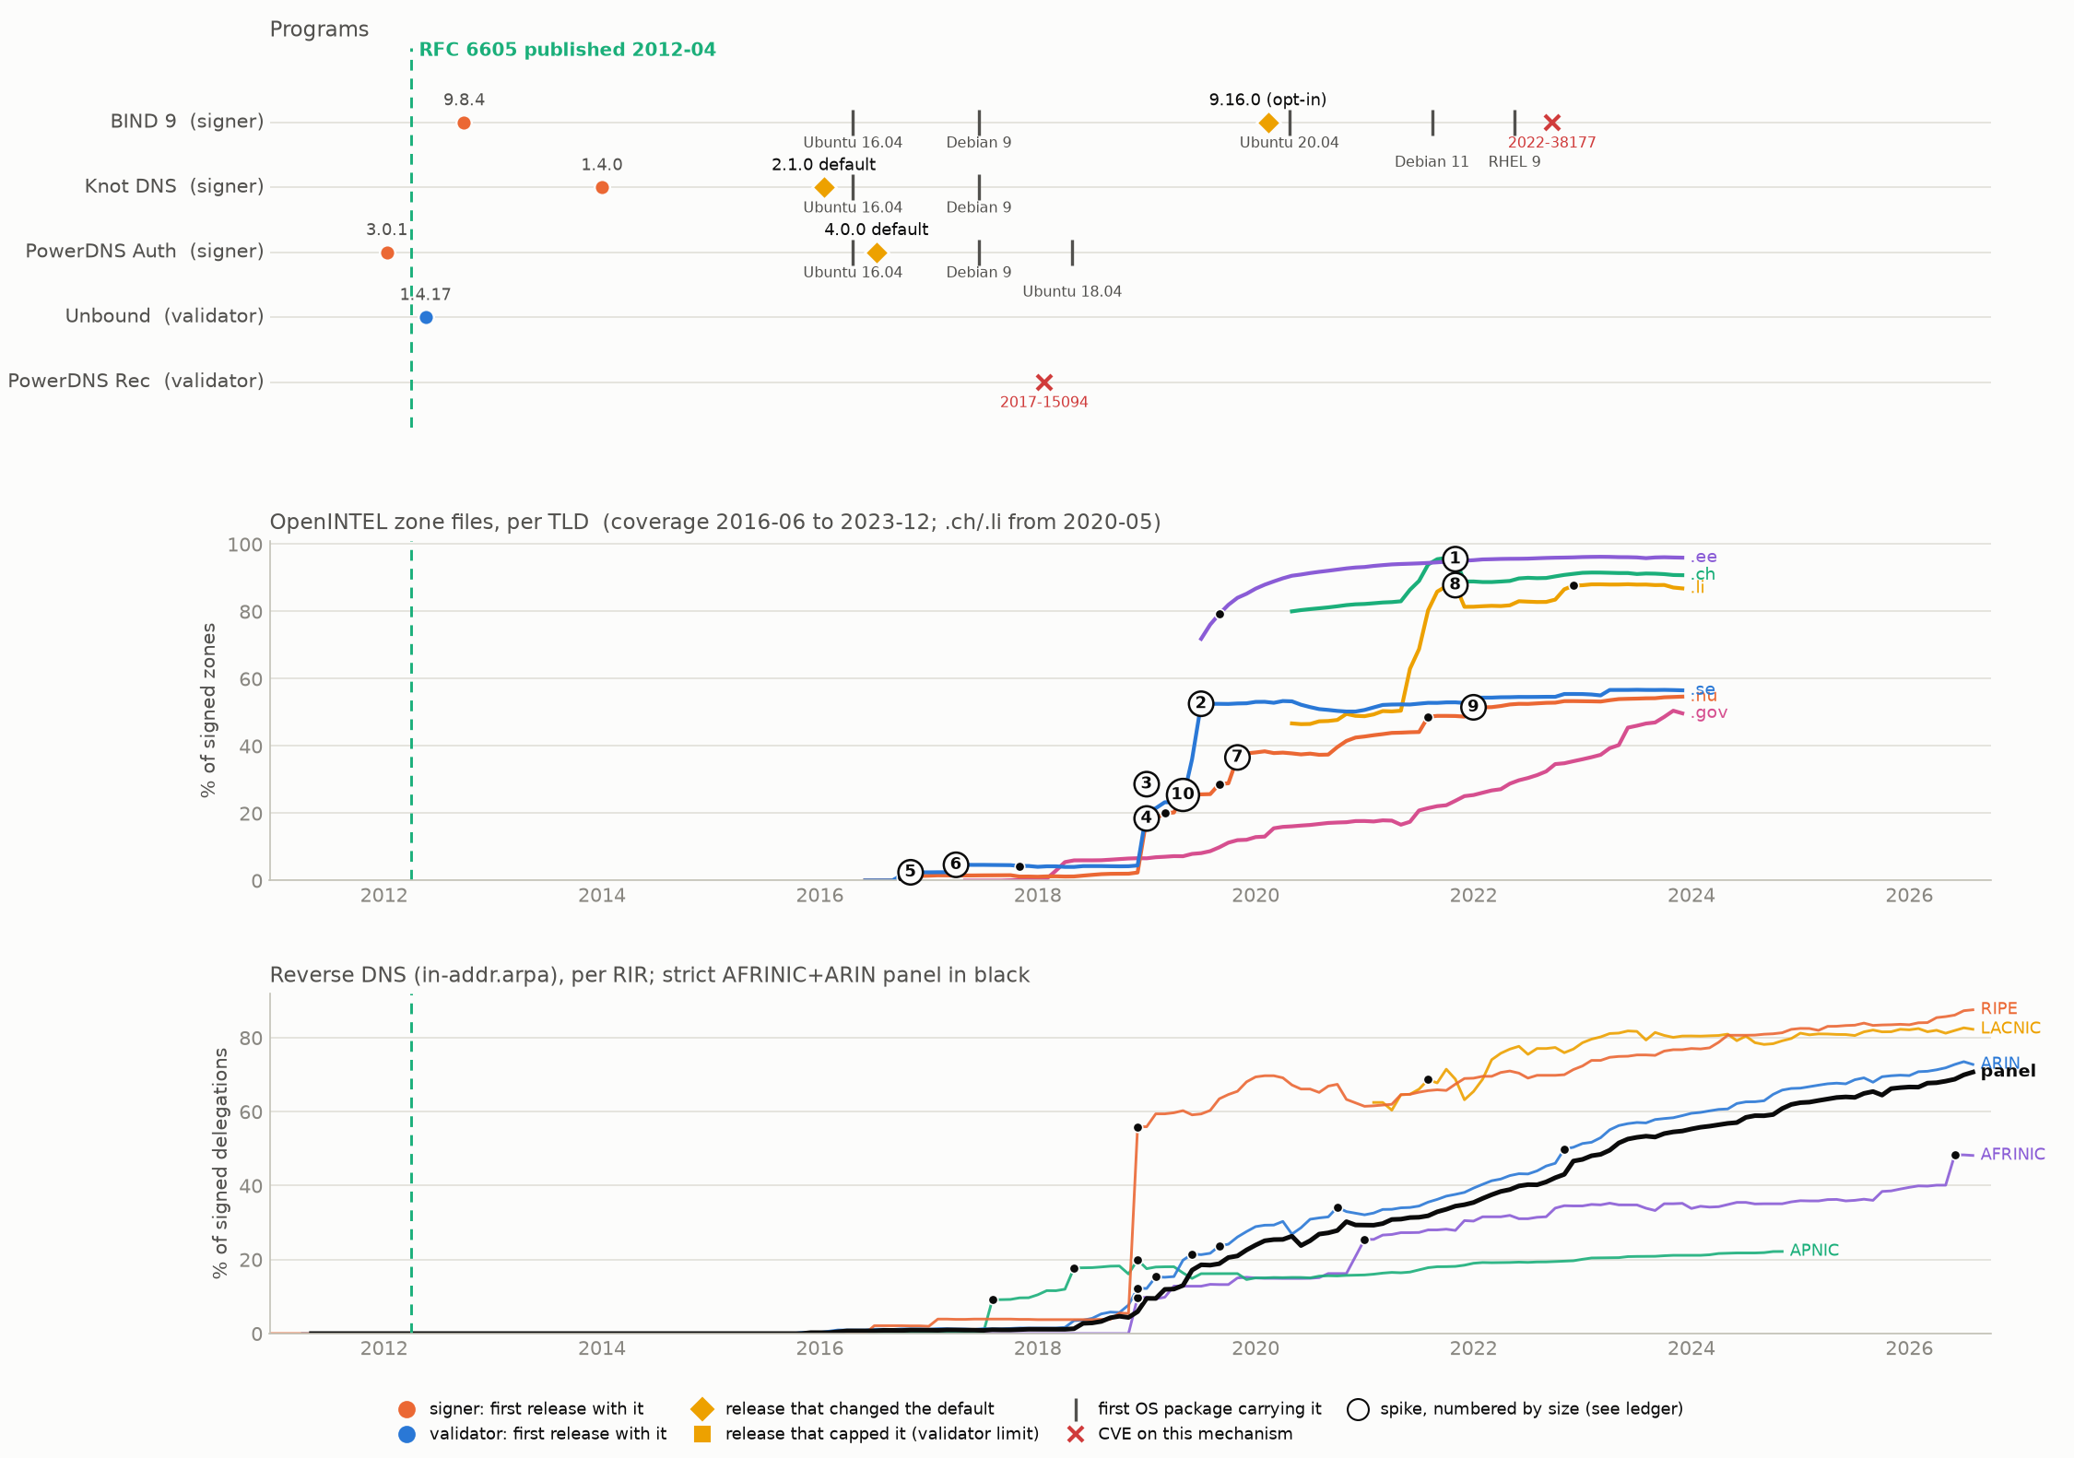
FINDING 2 · RFC 6605 ECDSA
Defaults changed in 2016; the zones moved years later, when operators chose
Knot 2.1.0 (2016-01) and PowerDNS 4.0.0 (2016-07) made ECDSA the default; BIND 9.16.0 (2020-02) offered it as an opt-in policy. The first forward move, .se 2016-10 +17,193, is 3 months after the PowerDNS default but 10,748 of those zones were existing zones rolling over: an operator decision, not an update.
In .se the moves that took ECDSA to the majority were entirely rollovers, 30-35 months after any default (2019-06..2019-07 +217,437); .nu crossed 50% on new signings instead (2022-01), and .ch and .li were already past it when the corpus first sees them. The .ch wave of 2021-06..2021-11 (+591,333) was new signings choosing ECDSA 99% of the time -- that is where a default acts: silently, on new zones, years after it changed. 2 of 31 spikes sit within 3 months of a default, against a 9% chance rate.

Slide 5
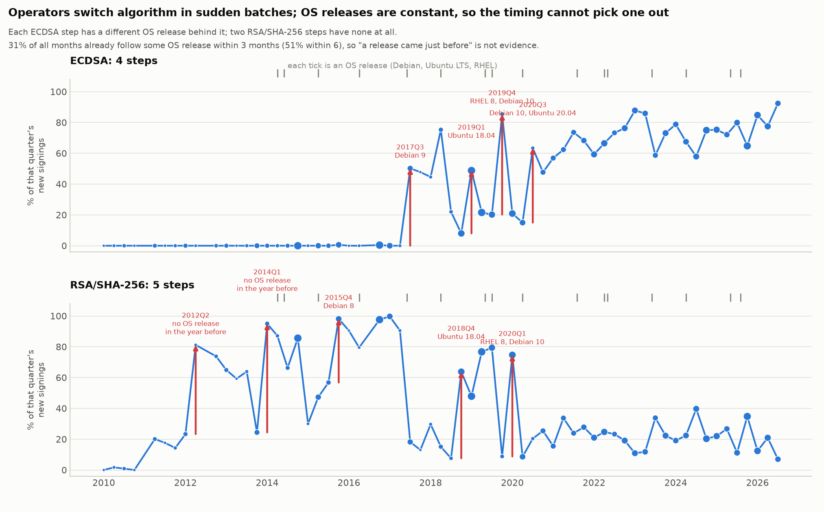
FINDING 3 · THE AUTO-UPDATE TEST
Updates change what a new zone gets, never an existing one
An update cannot roll an existing zone; it can only change what a zone signed after the update gets. So the test is the share of NEW signings choosing the algorithm, which the reverse ledger records per delegation.
ECDSA: on their upstream dates the 2016 Knot and PowerDNS defaults left no trace (0.2% -> 0.3%, 0.3% -> 0.2%). Instead new signings stepped 4 times between 2017 and 2020. The first, 2017Q3, is 157 signings with 155 of them in one month, all but 2 in APNIC and one parent block 40% of it. Operators moved in batches, not as a population.
An OS release precedes each of those steps, but a different one each time (Debian 9, Ubuntu 18.04, RHEL 8 / Debian 10, Ubuntu 20.04), 31% of all months follow some OS release within 3 months anyway, and two of the five RSA/SHA-256 steps have none at all. The timing cannot name a delivery path, and RHEL -- which ships no Knot or PowerDNS in base -- had no ECDSA-default signer until 2022.
RSA/SHA-256 is the same story earlier: new signings go from 0% in 2010Q4 to 20% in 2011Q2 and 81% in 2012Q2, and the step detector puts the step at 2012Q2 -- 15 months after OpenDNSSEC 1.2.0 made RSASHA256 its default and 27 after BIND 9.7.0 shipped it. The 2011 rise is 88 signings across three RIRs with one parent block a third of them.
EdDSA: never a default anywhere; 14 rollovers to it in the whole ledger; two forward episodes, both withdrawn. No default, no adoption.

Slide 6
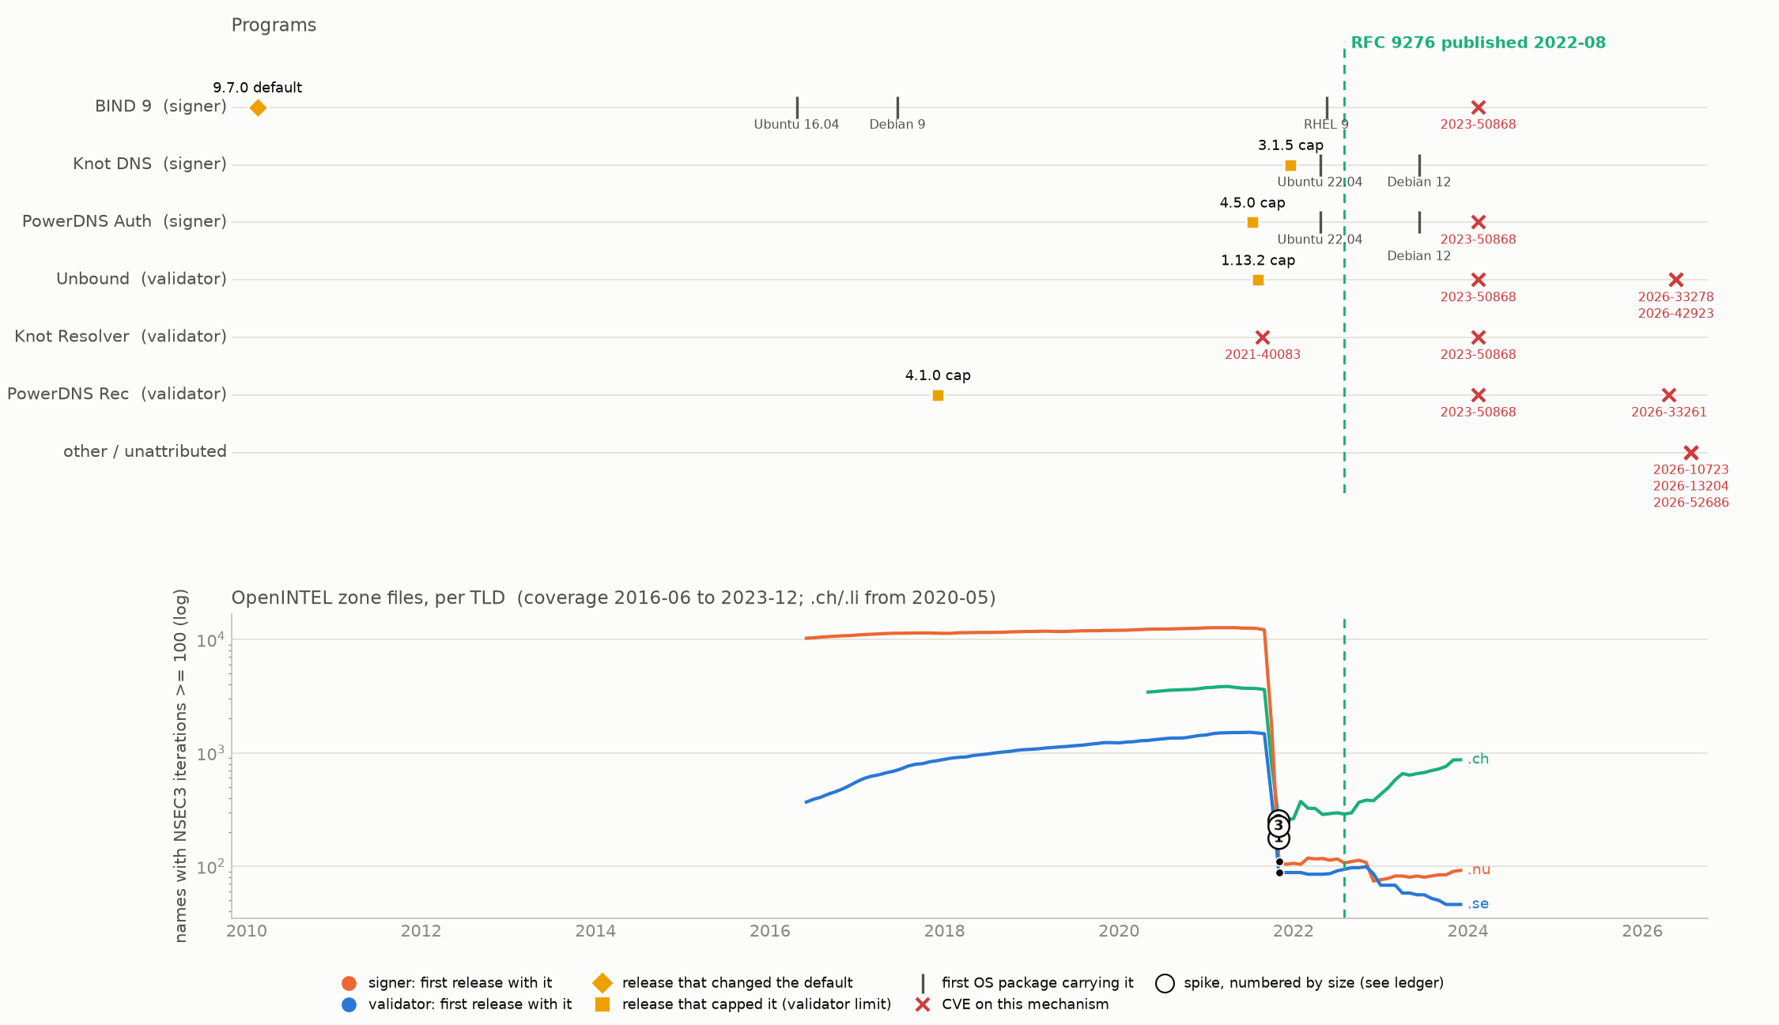
FINDING 4 · RFC 9276 NSEC3 ITERATIONS
The one vendor-triggered case, and it happened before the RFC
Names with 100 or more NSEC3 iterations collapsed in 2021-10..2021-11 in five of the six TLDs that had any (.nu 12,145 -> 110); only .gov, with 38 names, did not move. That is 10 months before RFC 9276. Two to three months earlier PowerDNS 4.5.0 and Unbound 1.13.2 had capped iterations, and CVE-2021-40083 (Knot Resolver, assertion failure on NSEC3 with too many iterations) was published.
All 3 spikes are within 3 months of a cap against a 14% chance rate. The caps and the CVE are one event: vendors moved against high counts in mid-2021 and the zones that would have failed were re-signed. Both sides capped it: PowerDNS Auth is a signer limiting what it will sign, Unbound a validator refusing what it reads. The RFC codified what the vendors had already forced. BIND's own default change (100 -> 10) was 140 months earlier and moved nothing.

Slide 7
FINDING 5 · CVEs
CVEs follow deployment; none led a push
97 of the 434 CVEs are DNSSEC mechanisms; 69 of those sit in the RFC 4033/4034/4035 core (validation, RRSIG, DNSKEY, NSEC) and belong to no single later RFC. The per-RFC sets are small: NSEC3 12, trust anchors 8, ECDSA 2, EdDSA 1, RSA/SHA-256 and CDS none; DS digests (RFC 4509) 3 and RFC 2535 one, which the per-RFC slides do not cover.
A CVE is attached to an RFC by the mechanism its description names, not by citing the RFC: 6 of the 97 DNSSEC CVEs cite any RFC in their text, and only 2 cite one of the RFCs studied here (CVE-2013-4854 -> RFC 5011; CVE-2023-50868 -> RFC 5155, 9276).
Most CVEs nearest to an adoption spike are resolver bugs (memory leak, assertion failure), but not all: CVE-2014-0591, nearest to 16 of the NSEC3 spikes, is an assertion failure in BIND's AUTHORITATIVE NSEC3 code. Median lag from a spike to the nearest CVE: 16.5 months for ECDSA, 57 for NSEC3. CVE-2022-38178 came 4 months before the second EdDSA episode; it is a BIND memory leak and not a reason to sign with EdDSA.
The one CVE inside a causal chain is CVE-2021-40083: a symptom of the iteration problem the 2021 caps fixed, published the month the caps shipped. The DNSSEC CVE surface sits on the resolvers: Unbound 16, PowerDNS Recursor 12, Knot Resolver 7. The pure signers publish almost none (Knot 4, PowerDNS Auth 0, OpenDNSSEC 0) -- but BIND, which both signs and validates, carries 40, more than any other product, of which 31 are matched by CPE and the rest by the fix landing in BIND's own repository. Knot and Knot Resolver have no usable CPE, so their counts are keyword-derived.
NSEC3 order of events: BIND 9.6.0 signs it 2008-12, the first NSEC3-signed reverse delegations appear 2009-07, the first CVE 2009-10. Code, then deployment, then CVEs, each within a year.

Slide 8
SO WHY FAST, SLOW OR NEVER
How a change reaches a zone decides its speed
RFC | verdict | how it reaches a zone | what the data shows
RFC 5702 RSA/SHA-256 | fast | signer default from 2011, acting on new zones only | first zone 2010-03; new signings 0% (2010Q4) -> 20% (2011Q2) -> 81% (2012Q2)
RFC 6605 ECDSA | slow | signer default from 2016, acting on new zones only; majority by operator rollovers | first zone 2015-11; majority only via 2019 rollovers and the 2021 .ch wave
RFC 5155 NSEC3 | already in use | a signer option; no signer ever made it the default | already 11.6% of signed reverse delegations in 2009-07, the first month it is visible -- onset not measurable
RFC 9276 iterations | vendor-triggered | validator caps force re-signing | collapse 2021-10, ten months before the RFC
RFC 7344 CDS | niche by design | only useful where the parent acts on it | 18.5% of signed forward zones
RFC 8080 EdDSA | never | never a default anywhere | 0.41% reverse, 0.01% forward today (Ed25519 and Ed448 together)
RFC 5933 GOST | never | never a default; Russian namespace not in corpora | 0.00% on the panel today; peaked at 5 delegations at RIPE in 2013-11
Fast RFCs are the ones a signer default carries into every newly signed zone. Slow ones need operators to roll existing zones, and operators do that in six-figure batches years after the default changed. Never-adopted ones had no default anywhere. The only RFC that moved on a vendor's schedule was the one where validators refused the old value.

Slide 9
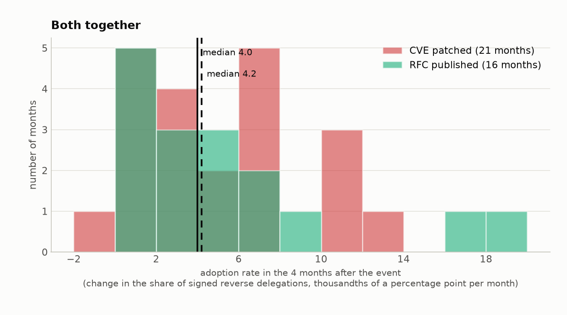
FINDING 6 · CVE PATCHES vs RFC PUBLICATIONS
Adoption moves at the same speed after either
Take every month in which a DNSSEC CVE was patched (21 months; 39 CVEs, several sharing a fix month) and every month in which a DNSSEC RFC was published (16 months inside the reverse series). The adoption rate over that month and the three after it has the same distribution in all three groups. Medians 4.0, 4.2 and 3.9 thousandths of a point per month, on 21, 16 and 140 months.
The medians are a fragile summary at this sample size -- with 16 RFC months the median falls in a gap between the 8th and 9th values -- so the comparison is also run on ranks, which use every observation. Neither separates the groups: median permutation p = 0.93, rank permutation p = 0.72 for CVE against RFC, 0.47 and 0.87 for each against ordinary months.
Measured on each event's own mechanism instead, RFC publications sit in ordinary or dead months (RFC 6605 at the 3rd percentile of the ECDSA curve) and two CVE patch months are extreme: CVE-2021-40083 is the NSEC3 iteration collapse, and CVE-2022-38177/38178 coincides with one ARIN block re-signing to ECDSA -- timing, not cause.

Slide 10
SUMMARY AND TAKEAWAYS
What decides whether a DNSSEC RFC gets adopted
1. Code is never the bottleneck. For the five RFCs whose onset is measurable, implementation came within -0.4 to +1.8 years of publication and the first zone took a further 0.1 to 3.8 years. The slowest code lag anywhere is RFC 5011 at +2.4 years, still well inside its adoption gap. The wait is operators, not vendors.
2. A default can only ever change what a newly signed zone gets. It never re-signs an existing zone, so it cannot produce a spike; the only place it could show is in what new zones choose, months to years later.
3. Operators switch in sudden batches, and the trigger is not identifiable. New reverse signings jumped to ECDSA in 4 steps, each over one to three months and 13 to 24 parent blocks. An OS release precedes every step, but no single one explains them: Debian 9, Ubuntu 18.04, RHEL 8 with Debian 10, then Debian 10 with Ubuntu 20.04. 31% of months follow some OS release anyway, and two RSA/SHA-256 steps have none at all.
4. Spikes in the adoption curve are operator decisions: six-figure rollovers by a registry or hoster, years after any default. No release month moves the curve; 95% of months contain a release, so a nearby release is never evidence.
5. Validators can force an RFC before it exists. The NSEC3 iteration collapse of 2021-10 followed the resolver caps and CVE-2021-40083 by two months and preceded RFC 9276 by ten. It is the only vendor-timed adoption event in the data.
6. CVEs do not lead adoption. CVE-patch months and RFC-publication months have the same adoption rate as any other month; the one CVE inside a causal chain is a symptom of the problem the caps fixed.
7. Never-adopted RFCs (EdDSA, GOST) share one trait: no signer ever made them a default. Niche ones (CDS) only matter where the parent acts on them.
Takeaway: to predict an RFC's adoption, look at whether a signer makes it the default, not at the RFC date, the first implementation, or the CVEs. Which delivery path carries a default to a given operator is not visible in published DNS records.

Slide 11
LIMITS
What this cannot show
Which software signs a zone is never visible from its records; 'nearest release' is timing evidence. Registry and registrar signing platforms are closed source and are not in the release list.
OpenINTEL here is monthly aggregates for seven TLDs entering between 2016-06 and 2020-05 and ending 2023-12. RSA/SHA-256 and NSEC3 are plainly present in it, but their growth happened before it opens, so only reverse DNS witnesses their adoption. Forward spikes cannot be attributed to an operator.
Reverse DNS is small (25,930 change events on 13,654 delegations) and NSEC3 is visible there only through algorithm 7.
The OS package table is Debian, Ubuntu and RHEL only. FreeBSD ports, Alpine, containers, appliances and source builds are absent, and RHEL base ships no Knot or PowerDNS at all. Package dates bound when a default became reachable, never what an operator ran.
With 3 to 31 spikes per RFC, 'beats chance' is a reading, not a test with a p-value. CVE attribution is by NVD product only.
Decks with every figure and ledger: dnssec_rfc_why.pptx (per-RFC timelines), dnssec_program_rfc_cases.pptx (per-program case studies), dnssec_algorithm_flows.pptx (what zones move between). CSVs: dns_software_*.csv, dns_cve_list.csv, dns_program_rfc_spikes.csv.

