Slide 1
FIVE RFCs · SIX PROGRAMS · OPENINTEL + REVERSE DNS · EVERY SPIKE TRACED BACK
Did a program's release, default or CVE
cause the spikes in RFC adoption?
For each RFC: the date it was published, the release in which BIND 9, Knot DNS, PowerDNS, OpenDNSSEC, Unbound and Knot Resolver first implemented it, the release that made it the default or capped it, the first Ubuntu and Debian packages that carried that release, and the CVEs on the mechanism. Then every spike in the OpenINTEL zone files (per TLD) and in reverse DNS (per RIR), with the nearest preceding release, default, cap and CVE named -- and the chance rate that check has to beat.

Slide 2
METHOD
Four checks per spike, and the trap they avoid
Spike
month-on-month change >= floor, >= 10% of the previous level, and >= 4x the median absolute monthly change of the preceding 12 months; consecutive spike months merge into one episode. Floors: 300 zones forward, 30 reverse.
Nearest release
for each spike, the latest preceding release that implements, defaults or caps the mechanism, per program, and the lag in months. Also the latest preceding release of any of the eight projects.
The trap
95% of months contain some DNS release, so 'a release came shortly before' is always true. Each lag is compared with the same lag at every month of the series: the chance rate. A spike is release-timed only if it beats that.
New vs rolled
a jump in zones on algorithm X is split into at most the growth in signed zones that month (could be new signings) and the rest (existing zones that rolled over). An automatic update can change what a NEW zone gets; it never re-signs an existing one. Rollovers are operator decisions.
Auto-update proxy
the reverse ledger records every signing with the algorithm chosen. If a default propagates through updates, the share of new signings choosing it steps up after the release and after the OS package that carried it.
Coverage
OpenINTEL: .se/.nu 2016-06 to 2023-12, .ch/.li from 2020-05, .ee from 2019-07, .gov/.fed.us from 2017-05. Reverse: five RIRs 2009-03 to 2026-08; shares hidden where a RIR has under 30 signed delegations; the strict AFRINIC+ARIN panel is the share line in black.

Slide 3
THE RFC IN EACH PROGRAM · RFC 6605
RFC 6605 published 2012-04: what each program did, in months from that date
BIND 9: signs it from 9.8.4, 2012-09 (5 mo after the RFC); default from 9.16.0 (opt-in policy), 2020-02 (94 mo after the RFC); CVE-2022-38177 2022-09.
Knot DNS: signs it from 1.4.0, 2013-12 (20 mo after the RFC); default from 2.1.0, 2016-01 (45 mo after the RFC).
PowerDNS Auth: signs it from 3.0.1, 2012-01 (3 mo before the RFC); default from 4.0.0, 2016-07 (51 mo after the RFC).
Unbound: validates it from 1.4.17, 2012-05 (1 mo after the RFC).
PowerDNS Rec: CVE-2017-15094 2018-01.

Slide 4
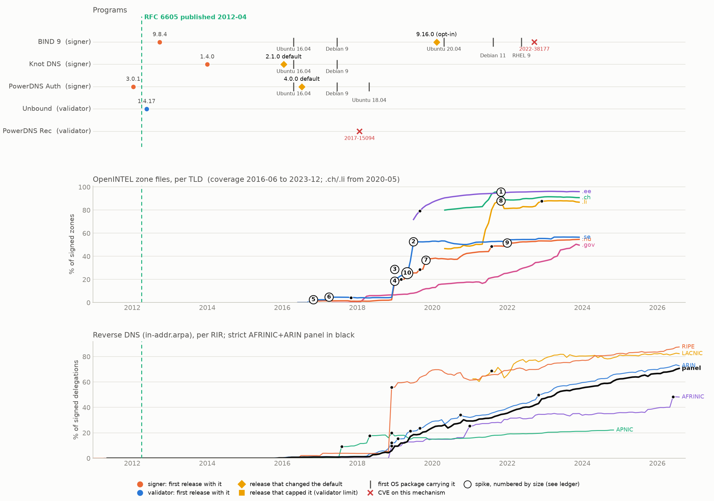
DEFAULTS FIRST, ZONES YEARS LATER · RFC 6605
ECDSA P-256 / P-384 (algorithms 13, 14)
Numbered circles are the largest spikes; the next slide names what preceded each one. Ticks: the first Ubuntu/Debian release carrying that program version (the automatic-update path).

Slide 5
WHAT PRECEDED EACH SPIKE · RFC 6605
Nearest release, default, cap and CVE before each spike
# | corpus | month(s) | size | made of | nearest signer release | nearest default / cap | nearest CVE
1 | OpenINTEL .ch | 2021-06..2021-11 | +591,333 (83% -> 96%) | new signings | BIND 9 9.16.0 (16 mo before) | BIND 9 9.16.0 (16 mo before) | CVE-2017-15094 (PowerDNS Rec) (41 mo before)
2 | OpenINTEL .se | 2019-06..2019-07 | +217,437 (24% -> 53%) | rollovers | PowerDNS Auth 4.0.0 (35 mo before) | PowerDNS Auth 4.0.0 (35 mo before) | CVE-2017-15094 (PowerDNS Rec) (17 mo before)
3 | OpenINTEL .se | 2019-01 | +119,500 (4% -> 21%) | rollovers | PowerDNS Auth 4.0.0 (30 mo before) | PowerDNS Auth 4.0.0 (30 mo before) | CVE-2017-15094 (PowerDNS Rec) (12 mo before)
4 | OpenINTEL .nu | 2019-01 | +18,247 (2% -> 18%) | rollovers | PowerDNS Auth 4.0.0 (30 mo before) | PowerDNS Auth 4.0.0 (30 mo before) | CVE-2017-15094 (PowerDNS Rec) (12 mo before)
5 | OpenINTEL .se | 2016-10..2016-11 | +17,193 (0% -> 2%) | mixed: >=10,748 rolled | PowerDNS Auth 4.0.0 (3 mo before) | PowerDNS Auth 4.0.0 (3 mo before) | -
6 | OpenINTEL .se | 2017-04 | +16,925 (2% -> 5%) | new signings | PowerDNS Auth 4.0.0 (9 mo before) | PowerDNS Auth 4.0.0 (9 mo before) | -
7 | OpenINTEL .nu | 2019-11 | +9,697 (29% -> 37%) | mixed: >=9,664 rolled | PowerDNS Auth 4.0.0 (40 mo before) | PowerDNS Auth 4.0.0 (40 mo before) | CVE-2017-15094 (PowerDNS Rec) (22 mo before)
8 | OpenINTEL .li | 2021-06..2021-11 | +8,047 (50% -> 88%) | new signings | BIND 9 9.16.0 (16 mo before) | BIND 9 9.16.0 (16 mo before) | CVE-2017-15094 (PowerDNS Rec) (41 mo before)
The first ECDSA move in the forward corpus is .se 2016-10: +17,193 zones, 3 months after PowerDNS Auth 4.0.0 made ECDSA its default (2016-07), and 10,748 of them were existing zones rolling over -- a deliberate migration by whoever runs them, not an update side-effect.
In .se the moves that took ECDSA to the majority came much later and were entirely rollovers: 2019-01 +119,500 (30 months after that default) and .se 2019-06 +217,437. The largest of all, .ch 2021-06..2021-11 +591,333, was a signing wave in which the new zones chose ECDSA 99% of the time (that is the flow share of the zones that became signed, not the stock share of ECDSA among all signed .ch zones, which ended at 96%). By 2021 every signer default had been ECDSA for five years. .nu instead crossed 50% on new signings in 2022-01, and .ch and .li were already past it on entry.
Chance check: 2 of 31 spikes fall within 3 months after a default change; a random forward month does so 9% of the time, so about 2.3 would be expected by luck. CVEs: 2 spikes within 3 months of one, both after CVE-2022-38177 -- a validator memory leak, not a reason to sign with ECDSA.
Reverse DNS shows operators switching in batches, not diffusing, and the trigger cannot be identified. New signings ignored the Knot 2.1.0 and PowerDNS 4.0.0 defaults on their upstream dates (0.2% -> 0.3% and 0.3% -> 0.2%), then stepped 4 times: 2017Q3, 2019Q1, 2019Q4, 2020Q3. The first is 157 signings of which 155 fall in one month, all but 2 in APNIC, one parent block 40% of it. Each step has a different OS release behind it and 31% of all months follow some OS release within 3 months anyway.
31 spikes (17 OpenINTEL, 14 reverse). Within 3 months after: signer release 2, default change 2, validator cap 0, CVE 2, any DNS release 31. Chance that a random month is within 3 months after a default change: forward 9%, reverse 6%. Full ledger: out/analysis/dns_program_rfc_spikes.csv

Slide 6
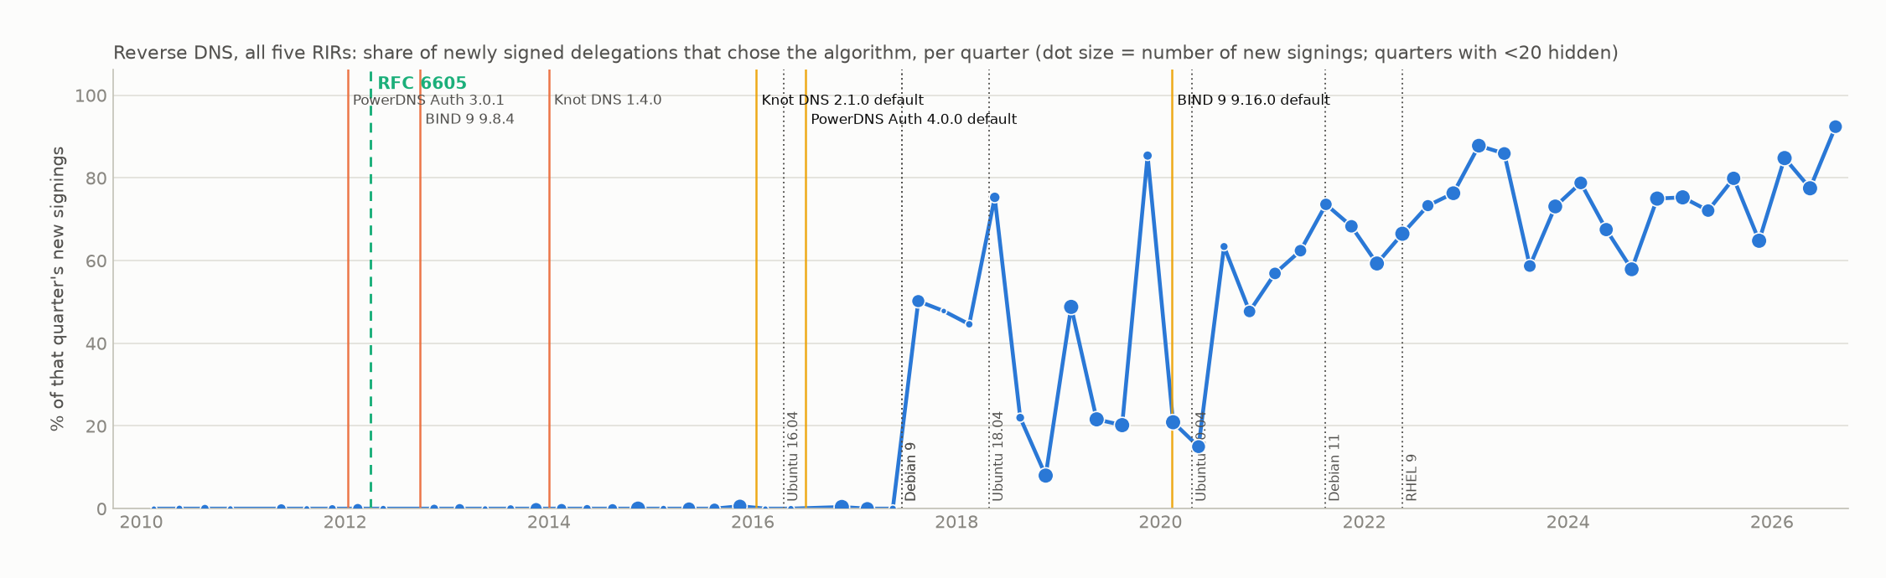
THE AUTO-UPDATE TEST · RFC 6605
Did newly signed reverse delegations pick up the new default?
release | kind | date | new signings, 12 mo before | share choosing it | new signings, 12 mo after | share choosing it
Knot DNS 2.1.0 | default | 2016-01 | 953 | 0.2% | 1199 | 0.3%
PowerDNS Auth 4.0.0 | default | 2016-07 | 640 | 0.3% | 1338 | 0.2%
BIND 9 9.16.0 | default | 2020-02 | 2169 | 22.8% | 1030 | 38.8%
Ubuntu 16.04: Knot DNS 2.1.0 | OS package | 2016-04 | 924 | 0.2% (2 blocks) | 1237 | 0.2% (3 blocks)
Debian 9: Knot DNS 2.1.0, PowerDNS Auth 4.0.0 | OS package | 2017-06 | 1247 | 0.2% (3 blocks) | 597 | 57.1% (55 blocks)
Ubuntu 18.04: PowerDNS Auth 4.0.0 | OS package | 2018-04 | 473 | 42.5% (35 blocks) | 1507 | 36.0% (58 blocks)
An update changes what a newly signed zone gets; it never re-signs an existing zone. So this share, not the adoption curve, is where an automatic update would show. Source: out/analysis/delegation_changes.parquet, kind = sign.

Slide 7
THE RFC IN EACH PROGRAM · RFC 5702
RFC 5702 published 2009-10: what each program did, in months from that date
BIND 9: signs it from 9.7.0, 2010-02 (4 mo after the RFC).
Knot DNS: default from 2.0.0, 2015-06 (68 mo after the RFC).
OpenDNSSEC: default from 1.2.0, 2011-03 (17 mo after the RFC).
Unbound: validates it from 1.1.0, 2008-11 (11 mo before the RFC).

Slide 8
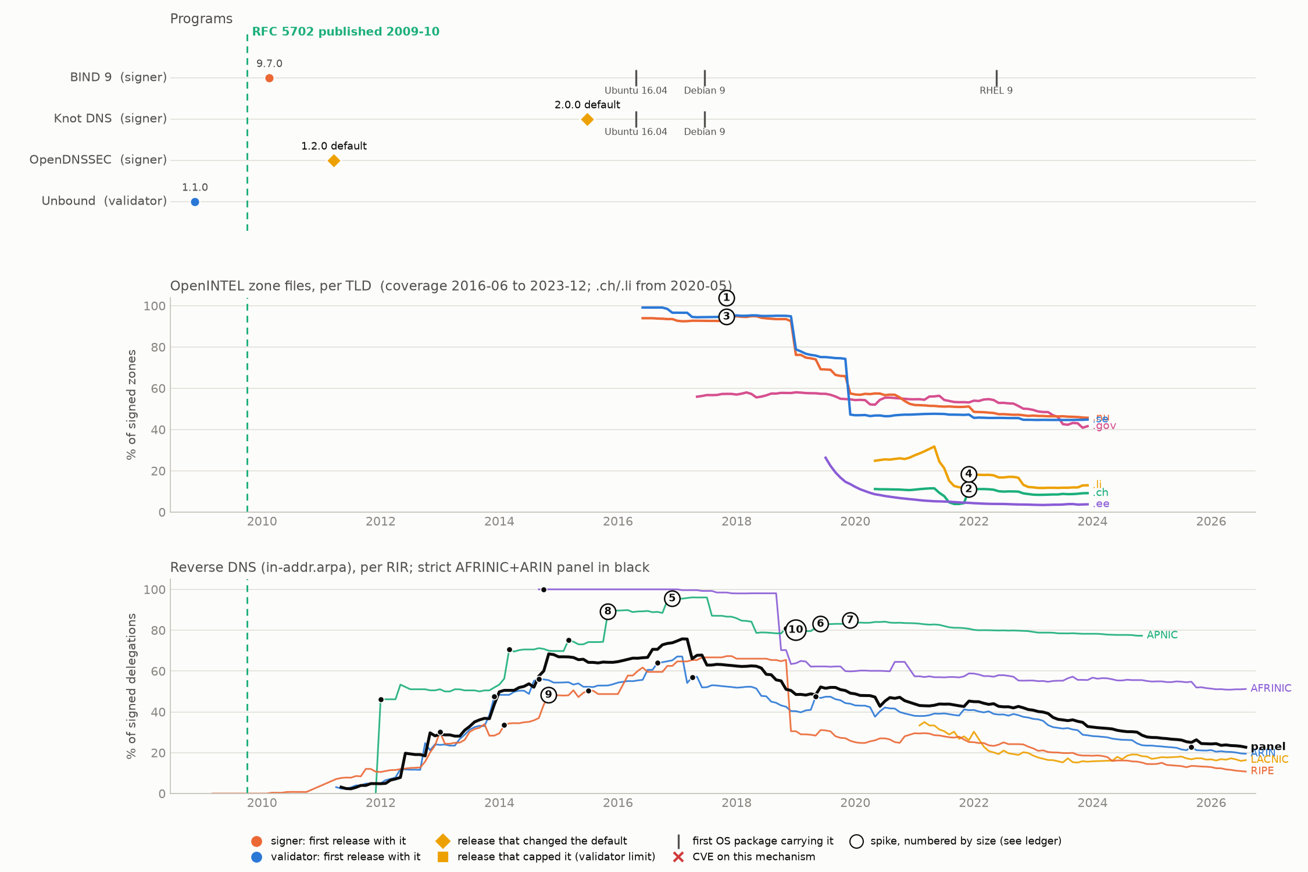
ADOPTED BEFORE THE FORWARD CORPUS BEGINS · RFC 5702
RSA/SHA-256 (algorithms 8, 10)
Numbered circles are the largest spikes; the next slide names what preceded each one. Ticks: the first Ubuntu/Debian release carrying that program version (the automatic-update path).

Slide 9
WHAT PRECEDED EACH SPIKE · RFC 5702
Nearest release, default, cap and CVE before each spike
# | corpus | month(s) | size | made of | nearest signer release | nearest default / cap | nearest CVE
1 | OpenINTEL .se | 2017-11 | +123,402 (95% -> 95%) | mixed: >=371 rolled | Knot DNS 2.0.0 (29 mo before) | Knot DNS 2.0.0 (29 mo before) | -
2 | OpenINTEL .ch | 2021-09..2021-12 | +73,741 (5% -> 11%) | new signings | Knot DNS 2.0.0 (75 mo before) | Knot DNS 2.0.0 (75 mo before) | -
3 | OpenINTEL .nu | 2017-11 | +38,615 (93% -> 95%) | new signings | Knot DNS 2.0.0 (29 mo before) | Knot DNS 2.0.0 (29 mo before) | -
4 | OpenINTEL .li | 2021-12 | +1,012 (12% -> 18%) | new signings | Knot DNS 2.0.0 (78 mo before) | Knot DNS 2.0.0 (78 mo before) | -
5 | reverse APNIC | 2016-12..2017-01 | +943 (88% -> 95%) | n/a | Knot DNS 2.0.0 (18 mo before) | Knot DNS 2.0.0 (18 mo before) | -
6 | reverse APNIC | 2019-06..2019-07 | +547 (80% -> 83%) | n/a | Knot DNS 2.0.0 (48 mo before) | Knot DNS 2.0.0 (48 mo before) | -
7 | reverse APNIC | 2020-01 | +353 (83% -> 85%) | n/a | Knot DNS 2.0.0 (55 mo before) | Knot DNS 2.0.0 (55 mo before) | -
8 | reverse APNIC | 2015-12 | +338 (74% -> 89%) | n/a | Knot DNS 2.0.0 (6 mo before) | Knot DNS 2.0.0 (6 mo before) | -
The forward corpus starts in 2016-06 with RSA/SHA-256 already at 99% of signed .se zones, so the OpenINTEL side cannot witness its adoption at all. Its forward spikes are signing waves that happened to use it: .se 2017-11 +123,402 zones, 123,031 of them newly signed, 29 months after the nearest default change (Knot 2.0.0).
Reverse DNS does witness it, and shows the same batching as ECDSA. New signings choosing RSASHA256 go from 0% in 2010Q4 to 20% in 2011Q2 and 81% in 2012Q2, and the step detector puts the step at 2012Q2 -- 15 months after OpenDNSSEC 1.2.0 made RSASHA256 its default and 27 after BIND 9.7.0 shipped it. The 2011 rise is 88 signings across three RIRs with one parent block a third of them, so it is a few operators, not a population.
Spikes vs releases: 1 of 24 spikes fall within 3 months of a default change (expected by chance about 0.6); the median lag from a spike to the nearest signer release is 40 months. No CVE names this algorithm.
24 spikes (4 OpenINTEL, 20 reverse). Within 3 months after: signer release 1, default change 1, validator cap 0, CVE 0, any DNS release 24. Chance that a random month is within 3 months after a default change: forward 0%, reverse 3%. Full ledger: out/analysis/dns_program_rfc_spikes.csv

Slide 10
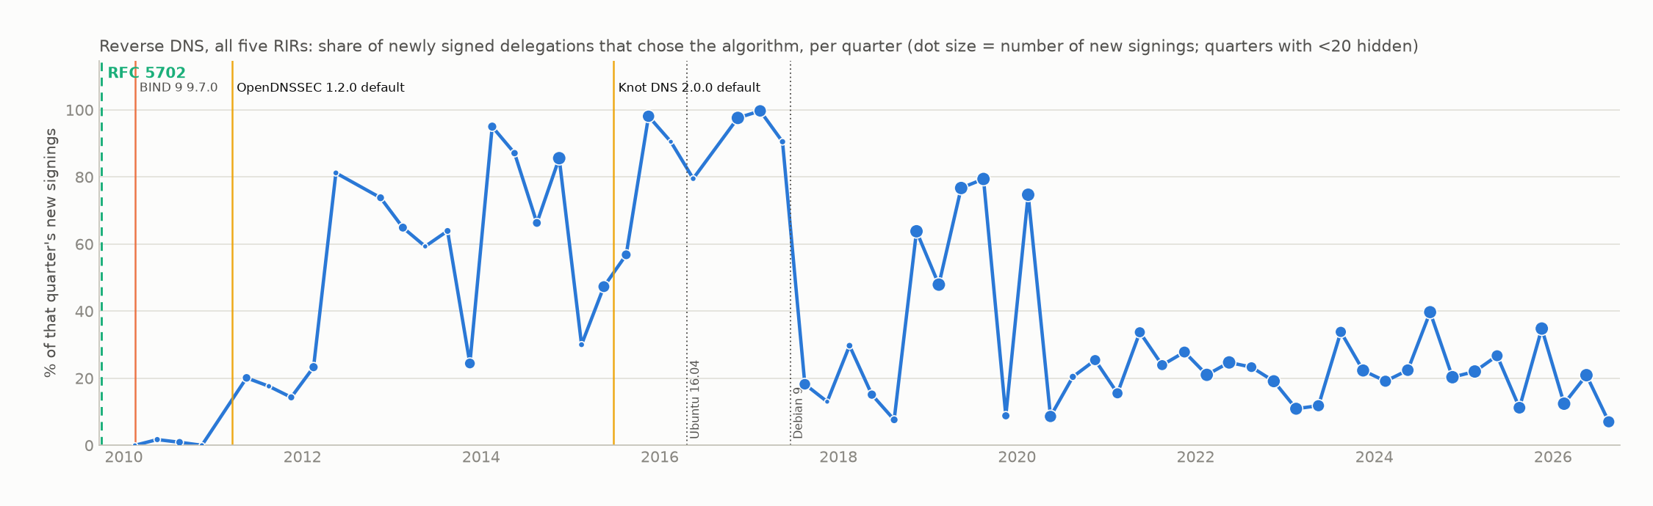
THE AUTO-UPDATE TEST · RFC 5702
Did newly signed reverse delegations pick up the new default?
release | kind | date | new signings, 12 mo before | share choosing it | new signings, 12 mo after | share choosing it
OpenDNSSEC 1.2.0 | default | 2011-03 | 212 | 0.9% | 459 | 20.0%
Knot DNS 2.0.0 | default | 2015-06 | 1093 | 78.0% | 777 | 69.6%
Ubuntu 16.04: Knot DNS 2.0.0 | OS package | 2016-04 | 924 | 70.3% (96 blocks) | 1237 | 96.8% (94 blocks)
Debian 9: Knot DNS 2.0.0 | OS package | 2017-06 | 1247 | 97.6% (96 blocks) | 597 | 18.4% (43 blocks)
An update changes what a newly signed zone gets; it never re-signs an existing zone. So this share, not the adoption curve, is where an automatic update would show. Source: out/analysis/delegation_changes.parquet, kind = sign.

Slide 11
THE RFC IN EACH PROGRAM · RFC 8080
RFC 8080 published 2017-02: what each program did, in months from that date
BIND 9: signs it from 9.12.0, 2018-01 (11 mo after the RFC); CVE-2022-38178 2022-09.
Knot DNS: algorithm-awares it from 2.4.0, 2017-01 (1 mo before the RFC); signs it from 2.6.0, 2017-09 (7 mo after the RFC).
OpenDNSSEC: signs it from 2.1.7, 2020-10 (44 mo after the RFC).
Unbound: validates it from 1.6.4, 2017-06 (4 mo after the RFC); validates it from 1.7.1, 2018-04 (14 mo after the RFC).

Slide 12
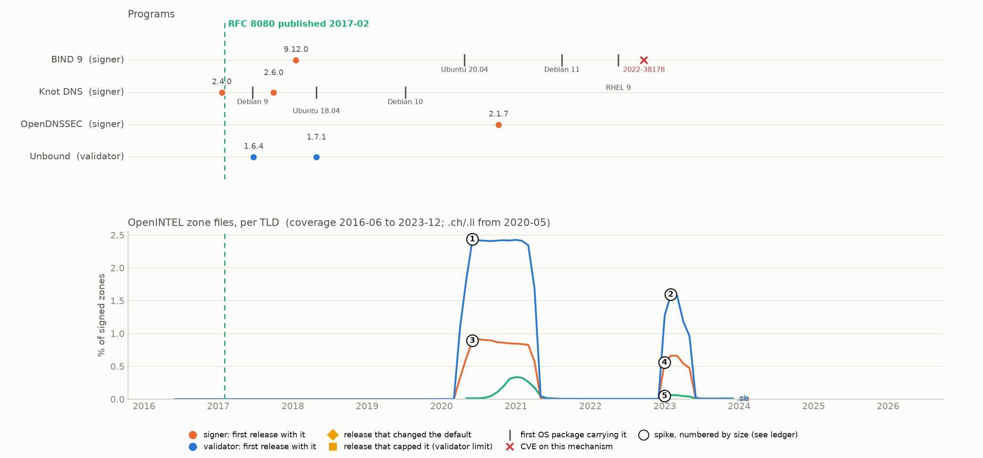
NO DEFAULT, NO ADOPTION · RFC 8080
EdDSA (algorithms 15, 16)
Numbered circles are the largest spikes; the next slide names what preceded each one. Ticks: the first Ubuntu/Debian release carrying that program version (the automatic-update path).

Slide 13
WHAT PRECEDED EACH SPIKE · RFC 8080
Nearest release, default, cap and CVE before each spike
# | corpus | month(s) | size | made of | nearest signer release | nearest default / cap | nearest CVE
1 | OpenINTEL .se | 2020-04..2020-06 | +18,746 (0% -> 2%) | mixed: >=11,718 rolled | BIND 9 9.12.0 (27 mo before) | - | -
2 | OpenINTEL .se | 2023-01..2023-02 | +13,257 (0% -> 2%) | mixed: >=12,748 rolled | OpenDNSSEC 2.1.7 (27 mo before) | - | CVE-2022-38178 (BIND 9) (4 mo before)
3 | OpenINTEL .nu | 2020-04..2020-06 | +1,125 (0% -> 1%) | new signings | BIND 9 9.12.0 (27 mo before) | - | -
4 | OpenINTEL .nu | 2023-01 | +735 (0% -> 1%) | rollovers | OpenDNSSEC 2.1.7 (27 mo before) | - | CVE-2022-38178 (BIND 9) (4 mo before)
5 | OpenINTEL .ch | 2023-01 | +490 (0% -> 0%) | new signings | OpenDNSSEC 2.1.7 (27 mo before) | - | CVE-2022-38178 (BIND 9) (4 mo before)
No program ever made EdDSA a default, and no OS package carried a default for it. The forward corpus shows two experiments, both in .se/.nu and both withdrawn: 2020-04..2020-06 +18,746 zones (11,718 rolled from another algorithm) and 2023-01..2023-02 +13,257 (12,748 rolled). The share returns to zero within a year each time.
Each episode sits 27 months after the nearest signer release, and a random forward month is within 3 months of one 18% of the time -- no spike is. The second episode came 4 months after CVE-2022-38178, a BIND memory leak on malformed EdDSA signatures; a validator bug is not a reason to sign with EdDSA, and one such coincidence among 5 spikes is expected.
Reverse DNS: no spike, and 14 rollovers to EdDSA in the whole ledger. The mechanism that moved ECDSA (a signer default that new zones inherit) never existed for EdDSA.
5 spikes (5 OpenINTEL, 0 reverse). Within 3 months after: signer release 0, default change 0, validator cap 0, CVE 0, any DNS release 5. Chance that a random month is within 3 months after a default change: forward n/a, reverse n/a. Full ledger: out/analysis/dns_program_rfc_spikes.csv

Slide 14
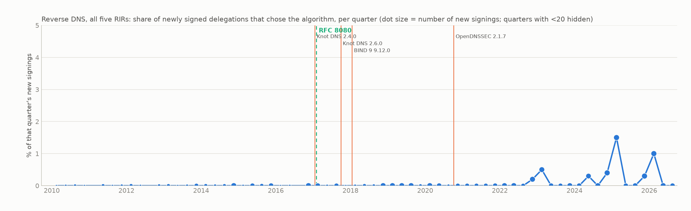
THE AUTO-UPDATE TEST · RFC 8080
Did newly signed reverse delegations pick up the new default?
release | kind | date | new signings, 12 mo before | share choosing it | new signings, 12 mo after | share choosing it
Knot DNS 2.4.0 | support | 2017-01 | 879 | 0.0% | 783 | 0.0%
Knot DNS 2.6.0 | support | 2017-09 | 1342 | 0.0% | 603 | 0.0%
BIND 9 9.12.0 | support | 2018-01 | 767 | 0.0% | 1134 | 0.0%
OpenDNSSEC 2.1.7 | support | 2020-10 | 1110 | 0.0% | 1244 | 0.0%
An update changes what a newly signed zone gets; it never re-signs an existing zone. So this share, not the adoption curve, is where an automatic update would show. Source: out/analysis/delegation_changes.parquet, kind = sign.

Slide 15
THE RFC IN EACH PROGRAM · RFC 5155
RFC 5155 published 2008-03: what each program did, in months from that date
BIND 9: signs it from 9.6.0, 2008-12 (9 mo after the RFC); CVE-2010-0097 2010-01; default from 9.7.0, 2010-02 (23 mo after the RFC); CVE-2014-0591 2014-01.
Knot DNS: caps it from 3.1.5, 2021-12 (165 mo after the RFC).
PowerDNS Auth: caps it from 4.5.0, 2021-07 (160 mo after the RFC).
Unbound: validates it from 0.7.1, 2007-11 (4 mo before the RFC); CVE-2009-3602 2009-10; caps it from 1.13.2, 2021-08 (161 mo after the RFC).
PowerDNS Rec: caps it from 4.1.0, 2017-12 (117 mo after the RFC).

Slide 16
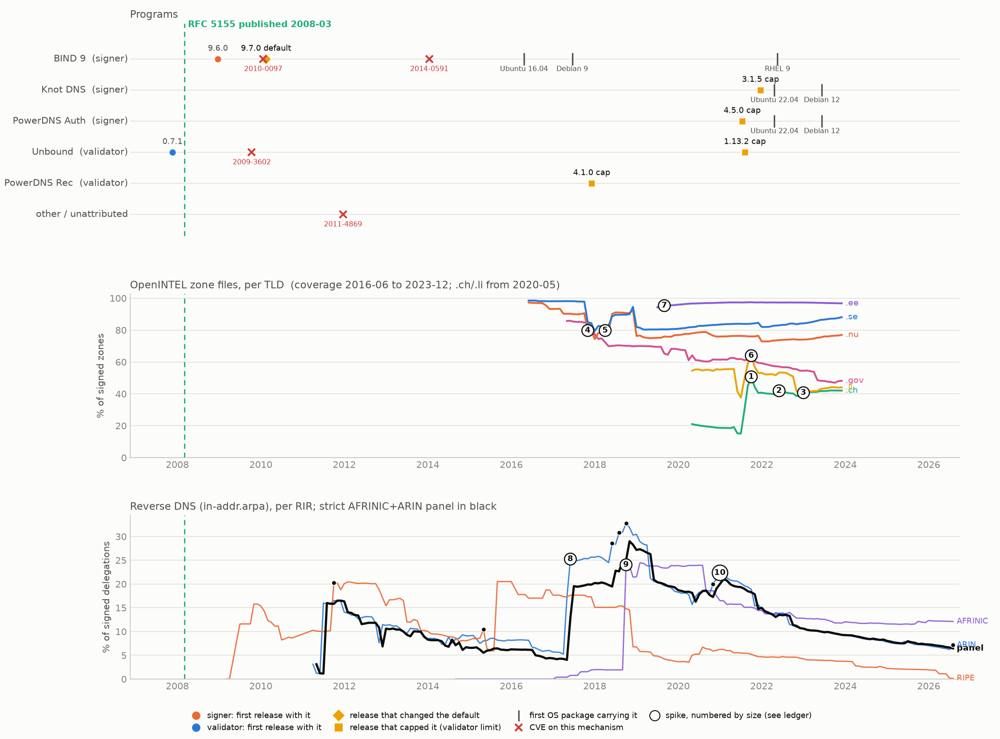
SHIPPED BEFORE THE RFC; SPIKES ARE SIGNING WAVES · RFC 5155
NSEC3 authenticated denial
Numbered circles are the largest spikes; the next slide names what preceded each one. Ticks: the first Ubuntu/Debian release carrying that program version (the automatic-update path).

Slide 17
WHAT PRECEDED EACH SPIKE · RFC 5155
Nearest release, default, cap and CVE before each spike
# | corpus | month(s) | size | made of | nearest signer release | nearest default / cap | nearest CVE
1 | OpenINTEL .ch | 2021-07..2021-10 | +296,470 (15% -> 51%) | new signings | BIND 9 9.7.0 (137 mo before) | BIND 9 9.7.0 (137 mo before) | CVE-2014-0591 (BIND 9) (90 mo before)
2 | OpenINTEL .ch | 2022-06 | +51,077 (39% -> 42%) | new signings | BIND 9 9.7.0 (148 mo before) | BIND 9 9.7.0 (148 mo before) | CVE-2014-0591 (BIND 9) (101 mo before)
3 | OpenINTEL .ch | 2023-01 | +43,894 (39% -> 41%) | new signings | BIND 9 9.7.0 (155 mo before) | BIND 9 9.7.0 (155 mo before) | CVE-2014-0591 (BIND 9) (108 mo before)
4 | OpenINTEL .nu | 2017-11 | +19,582 (91% -> 80%) | new signings | BIND 9 9.7.0 (93 mo before) | BIND 9 9.7.0 (93 mo before) | CVE-2014-0591 (BIND 9) (46 mo before)
5 | OpenINTEL .nu | 2018-04 | +12,989 (78% -> 80%) | new signings | BIND 9 9.7.0 (98 mo before) | BIND 9 9.7.0 (98 mo before) | CVE-2014-0591 (BIND 9) (51 mo before)
6 | OpenINTEL .li | 2021-08..2021-10 | +4,368 (38% -> 64%) | new signings | BIND 9 9.7.0 (138 mo before) | BIND 9 9.7.0 (138 mo before) | CVE-2014-0591 (BIND 9) (91 mo before)
7 | OpenINTEL .ee | 2019-08..2019-09 | +1,615 (94% -> 95%) | new signings | BIND 9 9.7.0 (114 mo before) | BIND 9 9.7.0 (114 mo before) | CVE-2014-0591 (BIND 9) (67 mo before)
8 | reverse ARIN | 2017-06..2017-07 | +167 (5% -> 25%) | n/a | BIND 9 9.7.0 (88 mo before) | BIND 9 9.7.0 (88 mo before) | CVE-2014-0591 (BIND 9) (41 mo before)
BIND 9.6.0 signed NSEC3 9 months after the RFC and Unbound validated it from 0.7.1, before it. The first NSEC3-signed reverse delegations (RIPE) appear 2009-08, 8 months after BIND 9.6.0; the first CVE on the mechanism came 2009-10, 2 months after that. Code, then deployment, then CVEs, each within a year.
The forward corpus opens with NSEC3 at 99% of signed .se zones. Its spikes are signing waves, not NSEC3 decisions: .ch 2021-07..2021-10 +296,470 NSEC3PARAM zones is the same wave that put 591,333 ECDSA zones in .ch, and it lands in the month of the PowerDNS 4.5.0 and Unbound 1.13.2 iteration caps (0 months) -- the wave signed with 1 iteration, which is what the caps asked for.
Reverse DNS sees NSEC3 only through algorithm 7 (RSASHA1-NSEC3-SHA1), a proxy that misses NSEC3 with 8 or 13. Its largest spike, ARIN 2017-06 +167, is 88 months after the nearest signer release. Overall 0 of 17 spikes are within 3 months of a signer release.
17 spikes (7 OpenINTEL, 10 reverse). Within 3 months after: signer release 0, default change 0, validator cap 2, CVE 0, any DNS release 17. Chance that a random month is within 3 months after a default change: forward 0%, reverse 2%. Full ledger: out/analysis/dns_program_rfc_spikes.csv

Slide 18
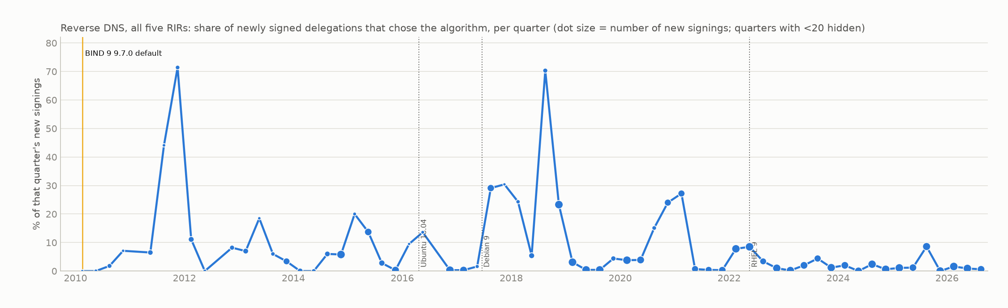
THE AUTO-UPDATE TEST · RFC 5155
Did newly signed reverse delegations pick up the new default?
release | kind | date | new signings, 12 mo before | share choosing it | new signings, 12 mo after | share choosing it
BIND 9 9.7.0 | default | 2010-02 | 18 | 50.0% | 217 | 1.8%
Ubuntu 16.04: BIND 9 9.7.0 | OS package | 2016-04 | 924 | 5.8% (14 blocks) | 1237 | 0.8% (6 blocks)
Debian 9: BIND 9 9.7.0 | OS package | 2017-06 | 1247 | 0.3% (3 blocks) | 597 | 21.1% (20 blocks)
RHEL 9: BIND 9 9.7.0 | OS package | 2022-05 | 1231 | 2.9% (7 blocks) | 1671 | 3.4% (11 blocks)
An update changes what a newly signed zone gets; it never re-signs an existing zone. So this share, not the adoption curve, is where an automatic update would show. Source: out/analysis/delegation_changes.parquet, kind = sign.

Slide 19
THE RFC IN EACH PROGRAM · RFC 9276
RFC 9276 published 2022-08: what each program did, in months from that date
BIND 9: default from 9.7.0, 2010-02 (150 mo before the RFC); CVE-2023-50868 2024-02.
Knot DNS: caps it from 3.1.5, 2021-12 (8 mo before the RFC).
PowerDNS Auth: caps it from 4.5.0, 2021-07 (13 mo before the RFC).
Unbound: caps it from 1.13.2, 2021-08 (12 mo before the RFC); CVE-2023-50868 2024-02; CVE-2026-33278 2026-05; CVE-2026-42923 2026-05.
Knot Resolver: CVE-2021-40083 2021-08; CVE-2023-50868 2024-02.
PowerDNS Rec: caps it from 4.1.0, 2017-12 (56 mo before the RFC); CVE-2023-50868 2024-02; CVE-2026-33261 2026-04.

Slide 20
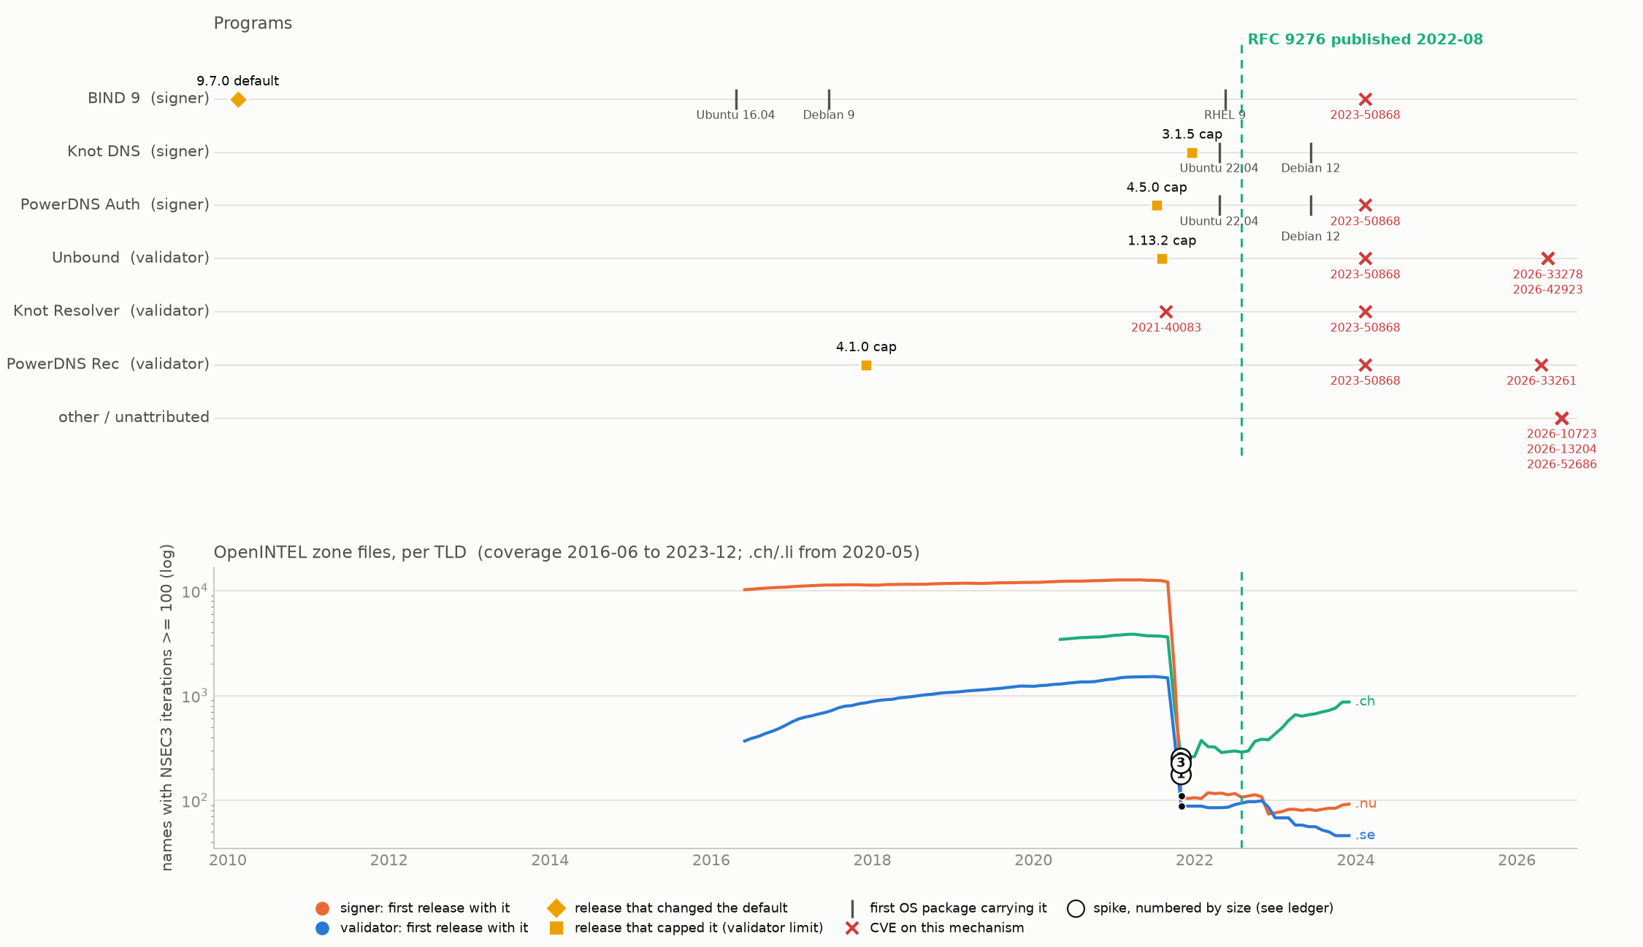
VENDOR-TRIGGERED: CAPS AND A CVE, TEN MONTHS BEFORE THE RFC · RFC 9276
NSEC3 parameters: iterations to 0
Numbered circles are the largest spikes; the next slide names what preceded each one. Ticks: the first Ubuntu/Debian release carrying that program version (the automatic-update path).

Slide 21
WHAT PRECEDED EACH SPIKE · RFC 9276
Nearest release, default, cap and CVE before each spike
# | corpus | month(s) | size | made of | nearest signer release | nearest default / cap | nearest CVE
1 | OpenINTEL .nu | 2021-10..2021-11 | -12,035 | collapse | BIND 9 9.7.0 (140 mo before) | BIND 9 9.7.0 (140 mo before) | CVE-2021-40083 (Knot Resolver) (2 mo before)
2 | OpenINTEL .ch | 2021-10..2021-11 | -3,366 | collapse | BIND 9 9.7.0 (140 mo before) | BIND 9 9.7.0 (140 mo before) | CVE-2021-40083 (Knot Resolver) (2 mo before)
3 | OpenINTEL .se | 2021-10..2021-11 | -1,388 | collapse | BIND 9 9.7.0 (140 mo before) | BIND 9 9.7.0 (140 mo before) | CVE-2021-40083 (Knot Resolver) (2 mo before)
This is the one vendor-triggered case. Names with 100 or more NSEC3 iterations collapsed in 2021-10..2021-11 in all three TLDs that had them: .nu 12,145 -> 110, .ch 3,618 -> 252, .se 1,476 -> 88. That is 10 months BEFORE RFC 9276 was published.
What preceded it: PowerDNS Auth 4.5.0 capped iterations 2021-07; Unbound 1.13.2 capped iterations 2021-08; and CVE-2021-40083 (Knot Resolver, 2021-08, an assertion failure on NSEC3 with too many iterations), 2 months before the collapse. The caps and the CVE are one event: the resolver vendors agreed in mid-2021 to reject high iteration counts, and the zones that would have failed validation were re-signed (Knot DNS 3.1.5 followed 2021-12).
All 3 spikes are within 3 months of a validator cap; a random forward month is 14% likely to be. The signers' own defaults had nothing to do with it: BIND's 100 -> 10 default change was 140 months earlier. The RFC codified what validators had already forced. CVE-2023-50868 (KeyTrap era, 2024-02) came after both.
3 spikes (3 OpenINTEL, 0 reverse). Within 3 months after: signer release 0, default change 0, validator cap 3, CVE 3, any DNS release 3. Chance that a random month is within 3 months after a default change: forward 0%, reverse n/a. Full ledger: out/analysis/dns_program_rfc_spikes.csv

Slide 22
ACROSS THE FIVE RFCs
Spikes within 3 months of a software event, against chance
RFC | spikes | after signer release | after default | after cap | after CVE | chance / month (fwd, rev) | made of (forward)
RFC 6605 | 31 | 2 | 2 | 0 | 2 | default 9%/6%; cap n/a; CVE 9%/4% | 389,932 rolled / 645,952 new at most
RFC 5702 | 24 | 1 | 1 | 0 | 0 | default 0%/3%; cap n/a; CVE n/a/n/a | 371 rolled / 236,399 new at most
RFC 8080 | 5 | 0 | 0 | 0 | 0 | default n/a/n/a; cap n/a; CVE 4%/n/a | 25,201 rolled / 9,152 new at most
RFC 5155 | 17 | 0 | 0 | 2 | 0 | default 0%/2%; cap 14%; CVE 0%/8% | 0 rolled / 429,995 new at most
RFC 9276 | 3 | 0 | 0 | 3 | 3 | default 0%/n/a; cap 14%; CVE 4%/n/a | collapse
Only RFC 9276 beats chance: 3 of 3 spikes within 3 months of a validator cap against a 14% chance rate, and they are one coordinated event (caps + CVE-2021-40083) ten months before the RFC. For the algorithm RFCs the counts are what luck predicts: 2 of 31 ECDSA spikes after a default against a 9% forward rate.
What the spikes are made of decides the causal story. Of the 1,035,884 forward ECDSA zones in spikes, at least 389,932 were existing zones rolling over -- deliberate migrations that no update performs. The rest were signing waves whose new zones took whatever the signer defaulted to; that is where defaults act, silently and years after they changed.
CVEs did not lead any push. Every CVE nearest to a spike is a validator bug (memory leak, assertion failure); the one CVE that sits inside a causal chain, CVE-2021-40083, is a symptom of the same iteration problem the caps fixed. Median lag from a spike to the nearest CVE: 17.0 months for ECDSA, 58 for NSEC3. Most are resolver bugs, but CVE-2014-0591, nearest to 16 of the NSEC3 spikes, is an assertion failure in BIND's authoritative NSEC3 code.

Slide 23
AUTOMATIC UPDATES
Where an update could act, and where it did
An update cannot roll a zone to a new algorithm; it can only change what a zone signed AFTER the update gets. So the test is the share of new signings, not the adoption curve, and the reverse ledger is the only place it can be run per zone.
RSA/SHA-256: new reverse signings choosing it go 0% (2010Q4) -> 20% (2011Q2) -> 81% (2012Q2), with the detected step at 2012Q2, 15 months after OpenDNSSEC 1.2.0's default and 27 after BIND 9.7.0. Two of its five steps have no OS release in the year before them at all.
ECDSA: the Knot 2.1.0 and PowerDNS 4.0.0 defaults changed nothing on their upstream dates (0.2% -> 0.3%, 0.3% -> 0.2%). New signings then stepped 4 times between 2017 and 2020, each step concentrated in a single month and a handful of parent blocks. An OS release precedes every step -- a different one each time -- while 31% of all months follow some OS release within 3 months, and two of the five RSA/SHA-256 steps have no OS release in the year before them at all.
An update can only change what a zone signed after it gets, never an existing zone, so this is where a default would act. That the steps exist is evidence operators moved in batches once the defaults existed upstream; which delivery path reached any of them is not identifiable from published records.
Forward DNS: the .ch 2021 wave chose ECDSA for 96% of 591,333 newly signed zones and NSEC3 with 1 iteration; by then every signer's default was ECDSA and the caps had just landed. That is an update effect in the only sense the data supports: whatever the hosters ran, its defaults were current. The 2019 .se moves were rollovers and cannot be.
EdDSA: never a default anywhere, never picked up by new signings, and its two forward episodes were withdrawn. The update path carries defaults; where no vendor set one, it carried nothing.

Slide 24
LIMITS
What this cannot show
Which software signs a zone is never visible from its records. 'Nearest release' is timing evidence only; the program named is the nearest of the six studied, not the one the operator ran. Registry and registrar signing platforms are closed source and off the list.
OpenINTEL here is seven TLD zone files as monthly aggregates from 2016-06 (2020-05 for .ch/.li) to 2023-12. RSA/SHA-256 and NSEC3 were adopted before that window; their forward spikes are later signing waves, not adoption. Per-zone forward records are not in this repo, so forward spikes cannot be attributed to an operator; 'new vs rolled' is a bound from the change in signed-zone count.
Reverse DNS is small (25,930 change events on 13,654 delegations); its spikes are one /16 block at a time and its shares are hidden where a RIR has fewer than 30 signed delegations. NSEC3 is invisible in DS records except through algorithm 7.
OS packages cover Debian 9-13 and Ubuntu LTS 16.04-24.04 by version, plus RHEL majors by date. They are one delivery path among many: RHEL base carries only BIND (Knot and PowerDNS need EPEL) and had no ECDSA-default signer until RHEL 9 in 2022-05, and FreeBSD ports, Alpine, containers and source builds are not represented at all. Package dates bound when a default became reachable, not what anyone ran.
The chance rate is per month and per series; with 3 to 31 spikes per RFC the counts are small, and 'beats chance' is a reading, not a test with a p-value. CVE attribution is by NVD product only; keyword matches are shown as 'other / unattributed'.

