Slide 1
AI/ML Project #3 Low Code
Post-Graduate Program AI and ML
10/27/2024

Slide 2
Contents / Agenda
Executive Summary
Business Problem Overview and Solution Approach
EDA Results
Data Preprocessing
Model performance summary for hyperparameter tuning.
Appendix

Slide 3
Executive Summary
The primary variables(top 3) that impact analytical findings include total transaction counts (~30%), total transaction amount (28%), and total revolving balance (14%). The Secondary variables included Total Change in Transaction Count Q4-> Q1 (8%), Relationship Count (6%), and Total Change in Transaction Amount Q4→ Q1 (4%). Together these 6 variables account for ~90% of the model’s predictions.
The model shows that customers with the following attributes are most at risk of churning:
Lower transaction counts
Lower transactions amounts
Lower revolving balances, or Overly high revolving balances
Actively utilizing only 1 or 2 financial products the bank offers
XXX combinations are more likely to churn
Recommendations:
Create incentives to encourage customers who do not use their cards frequently (lower transaction counts and/or transaction amounts) to utilize them more frequently. Perhaps- by offering cash back or other incentives.
Encourage customers who use one financial product to sign up for others through cross-selling discounts and bundling services

Slide 4
Business Problem Overview and Solution Approach
Business Problem Explained: The bank is at risk of profitability issues due to a sharp increase in chrun rates. High churn rates will lead the bank to losses.
Goal: Identify which customers will churn and the reasons for churning. The goal is to improve retention for the bank so it can retain its credit card customer base.
Solution Approach and Methodology: Build a machine learning model to predict which customers are at risk of churning, and the reasons for churning. Utilized Gradient Boosting method to build the ML and prediction model.

Slide 5
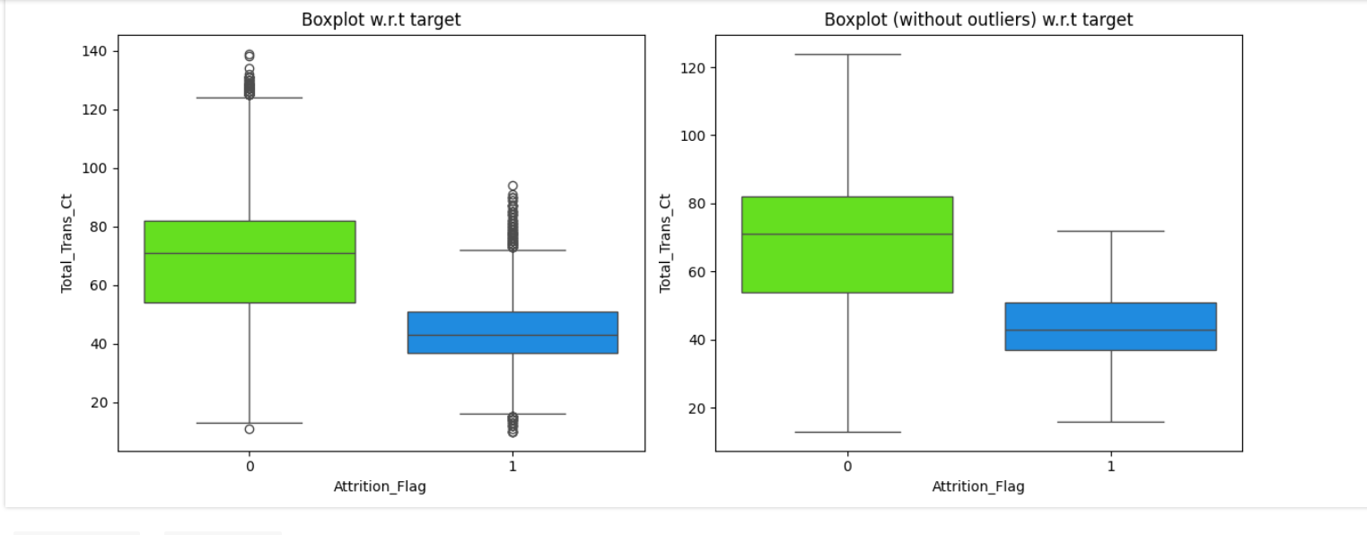
EDA Results
Please mention the key results from EDA
Compared to existing customers, churned customers had considerably lower total transactions counts; churned customers had about 40 transactions throughout their lifetime on average, but existing customers had about 70-75 on average.

Slide 6
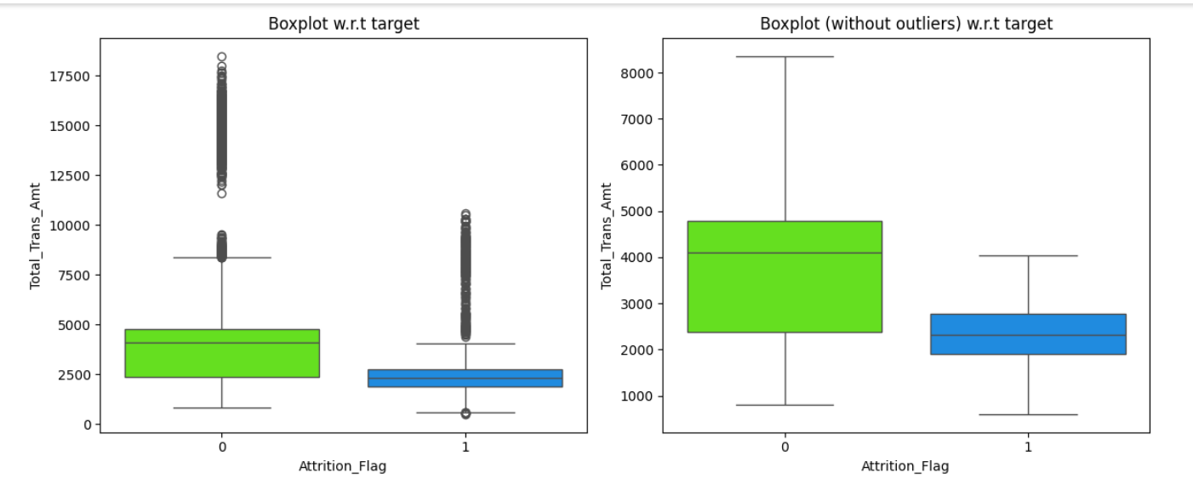
EDA Results
Churned customers spent ~40-50% less on average compared to Existing customers in their customer lifetime
Link to Appendix slide on data background check

Slide 7
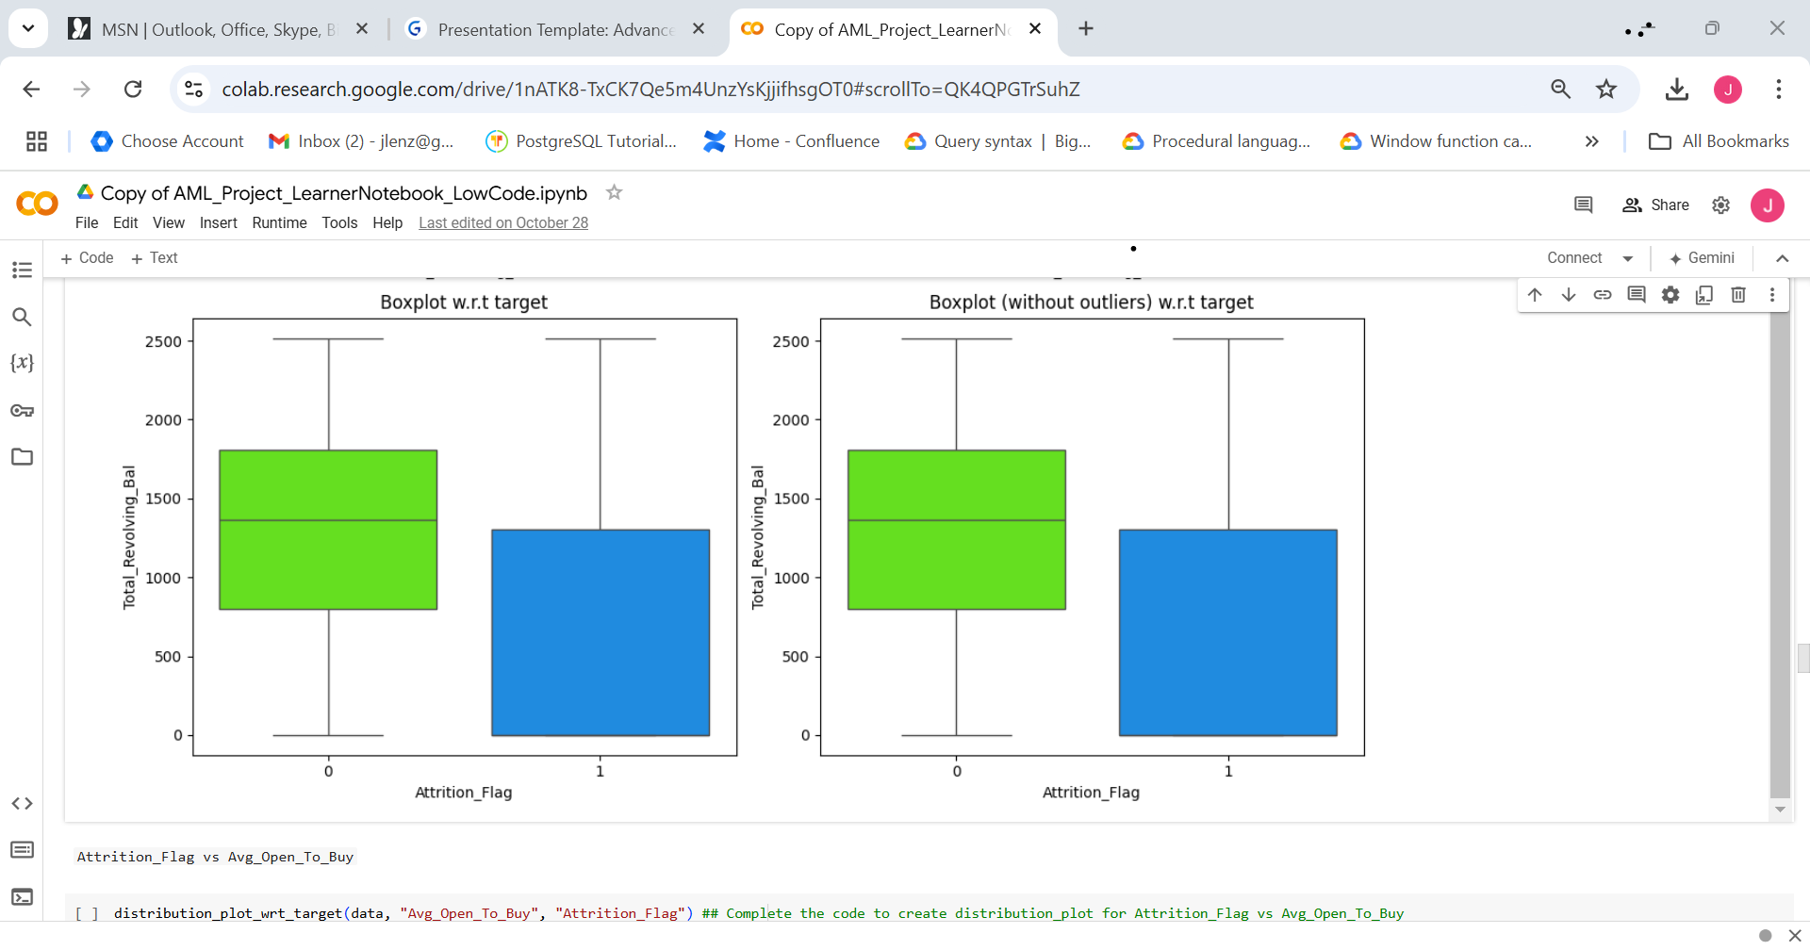
EDA Results
Total Revolving Balances for churned customers were ~10-20% lower compared to existing customers.
Link to Appendix slide on data background check

Slide 8
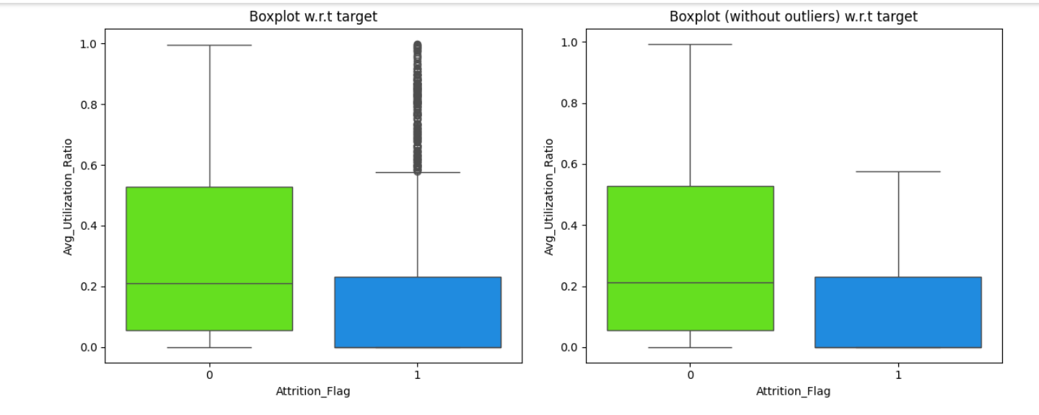
EDA Results
Utilization for existing customers appears more highly variable than utilization for churn customers.
Churned customers appear to exhibit 2 distinct subpopulations- those with minimal spending (fitting into the blue square), and those with higher-levels of spending which fit above the blue square.
In this subpopulation, utilization actual appears to be higher than those of existing customers.

Slide 9
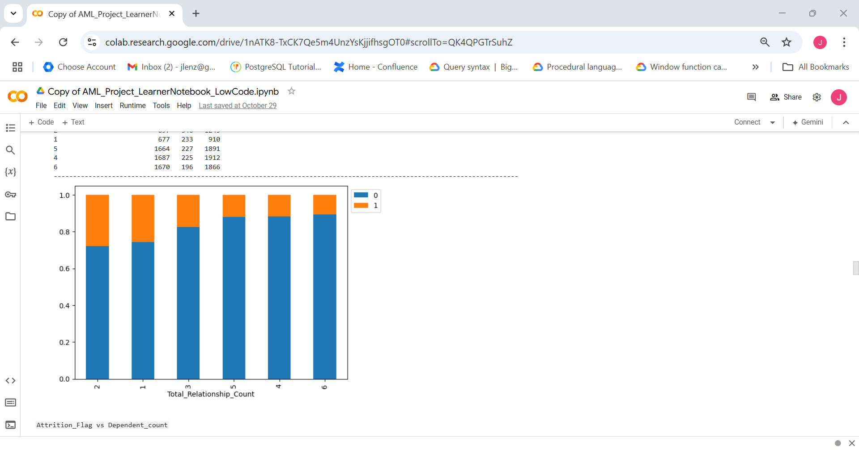
EDA Results
Attrition Flag vs Total Relationship Count
Customers using multiple financial products appear to be less likely to churn.
Viewing the stacked bar plot to the left customers who had only 1 or 2 financial products experienced ~30% churn rate.
However, the customer cohort that purchased/used 3 financial products had churn rate of ~20%, and customer cohorts that had purchased/used 4 or more had churn rates of ~10%.

Slide 10
Data Preprocessing
Duplicate value check- No duplicates found in the dataset
Outliers-
No changes made to outliers due to the target column containing the highest quantity of outliers. Too risky to modify outliers in this case due to the risk of data leakage and other issues.
All the other columns were contained at <10% and we need our model to be able to handle outliers in small doses effectively without being overwhelmed or thrown off by them. So we should not remove or truncate them in the context of banking and finance.
We know the real-world distribution likely is skewed so we should train our model to expect some “outliers” and to be able to handle them effectively.
Missing value observations-
Education- 1,519 values filled in with ‘Unknown’
Marital Status- 749 values filled as null
Income Category- 1,112 values filled in with ‘abc’

Slide 11
Data Preprocessing
Treatment- Impute all values as the mode
Reasoning- We observed a clear mode of Less than $40k in the income category and noticed cross-section with other missing values. I therefore decided the relative frequency of each category was the most important factor to determining missing value imputation. Alternatively, we could have dropped these rows.
Encoding- Encoded all categorical variables except Gender/Marital Status as label encoded variables
Both education and income category are ordinal in nature, and thus should be encoded using label encoding
Marital status/Gender – Used one-hot encoding for marital status

Slide 12
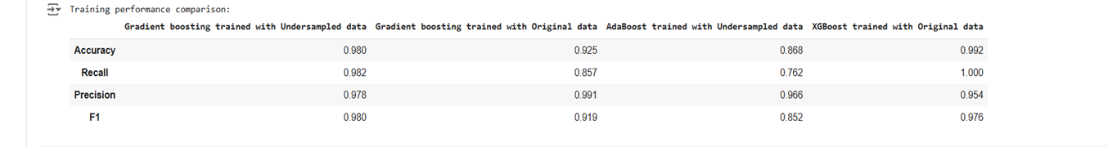
Model Performance Summary
I selected the Gradient Boosting model trained on under-sampled data. In the context of Gradient Boosting more data is likelier to cause overfitting vs a small amount of data beyond a certain volume.
Gradient boosting maintained strong performance across both original and under-sampled training sets, and was robust across training, validation, and finally testing.
Link to Appendix slide on model assumptions

Slide 13
Model Performance Summary
Gradient boosting maintained strong performance across both original and under-sampled training sets, and was robust across training, validation, and finally testing. This model maintained the lowest gap in training vs validation results while also delivering very impressive results in terms of recall.
Recall is crucial to our problem space because customers leaving the bank would cost us more than wasting resources on customers that our model predicts will leave the bank but don’t. We don’t want our model to fail to identify even a single customer that will churn in the future.
Link to Appendix slide on model assumptions

Slide 14
APPENDIX

Slide 15
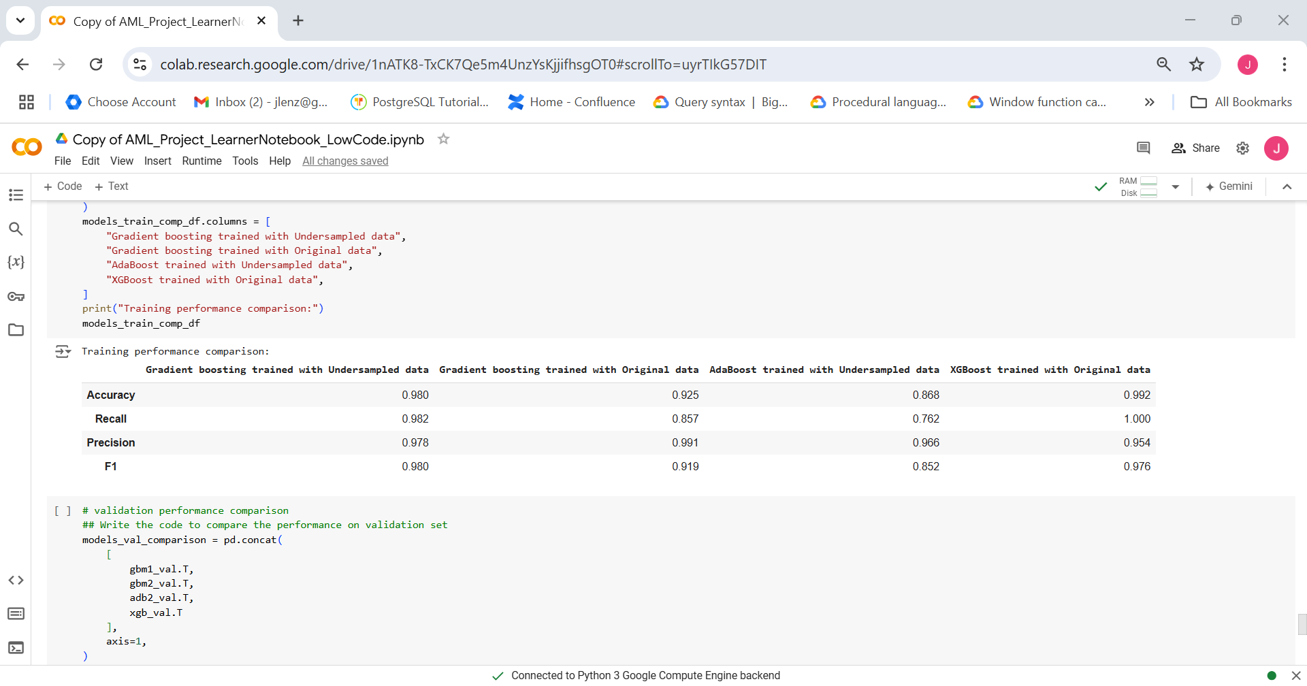
Model Performance Summary (original data)
Link to Appendix slide on model assumptions

Slide 16
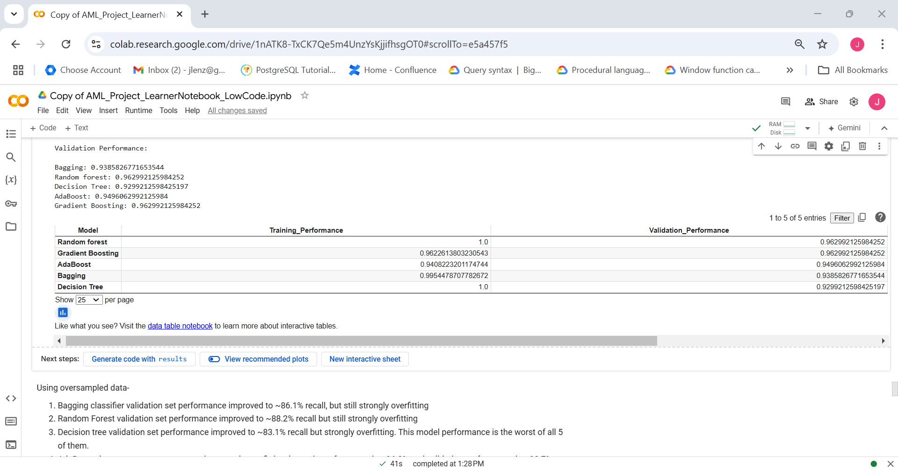
Model Performance Summary (oversampled data)
To counteract imbalances in the churned vs existing customers class, I used Synthetic Minority Oversampling (SMOTE). The final oversampled dataset had 6,810 customers that were in each of the classes split evenly between churned and non-churned
Over-sampling improved initial performance substantially and generally helped reduce overfitting.
Note: You can use more than one slide if needed
Link to Appendix slide on model assumptions

Slide 17
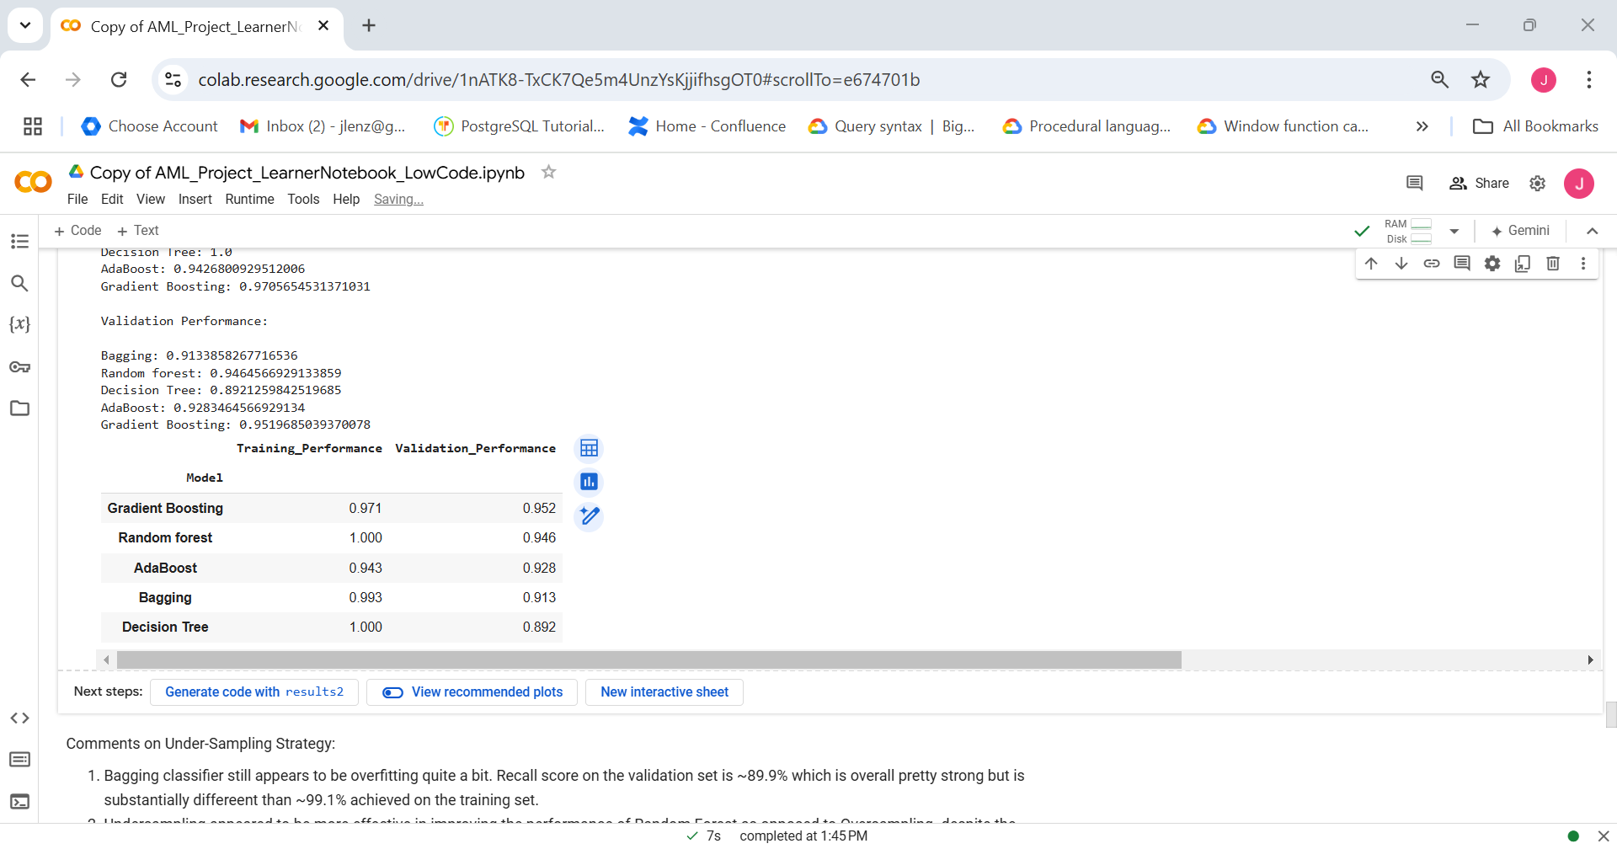
Model Performance Summary (undersampled data)
I attempted under-sampling using a balanced class distribution. This resulted in ~2,600 rows in the dataset taking a substantial amount of information from the original dataset. I was therefore surprised that the models performed reasonably strong across the board
Undersampling improved model performance but generally exacerbated overfitting amongst the simpler models (like decision trees). The more complicated models were robust to a smaller data size.
Link to Appendix slide on model assumptions

