Slide 1

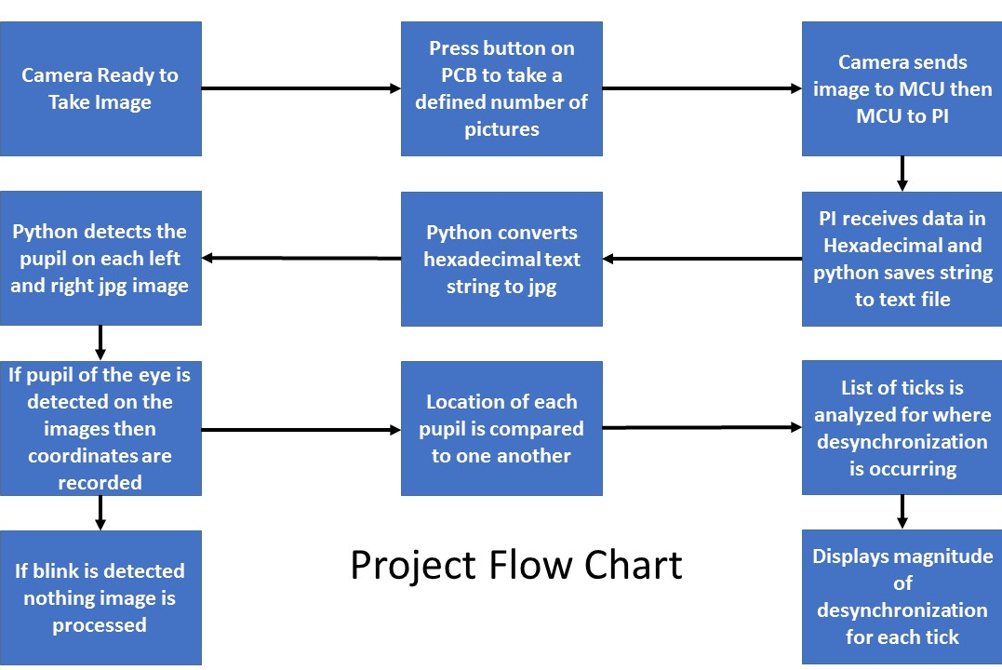
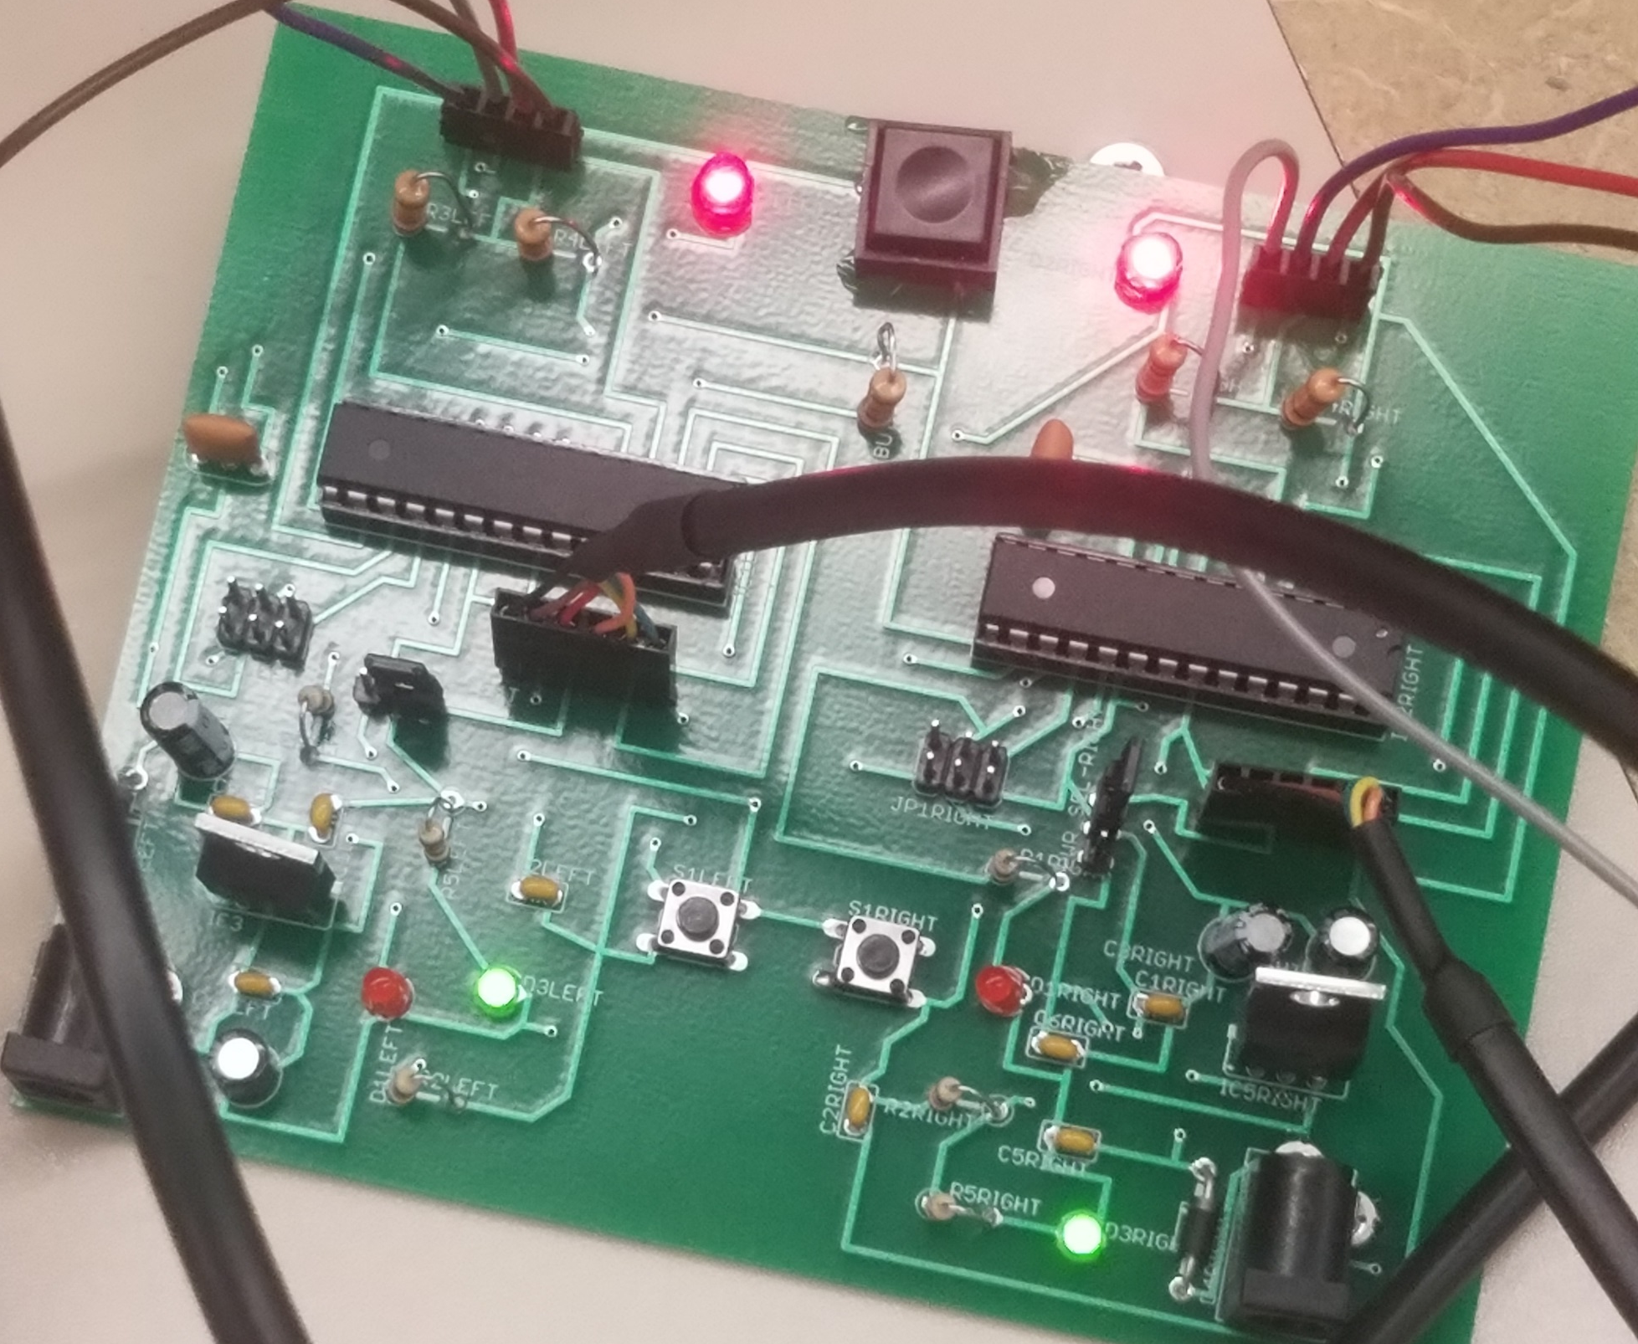
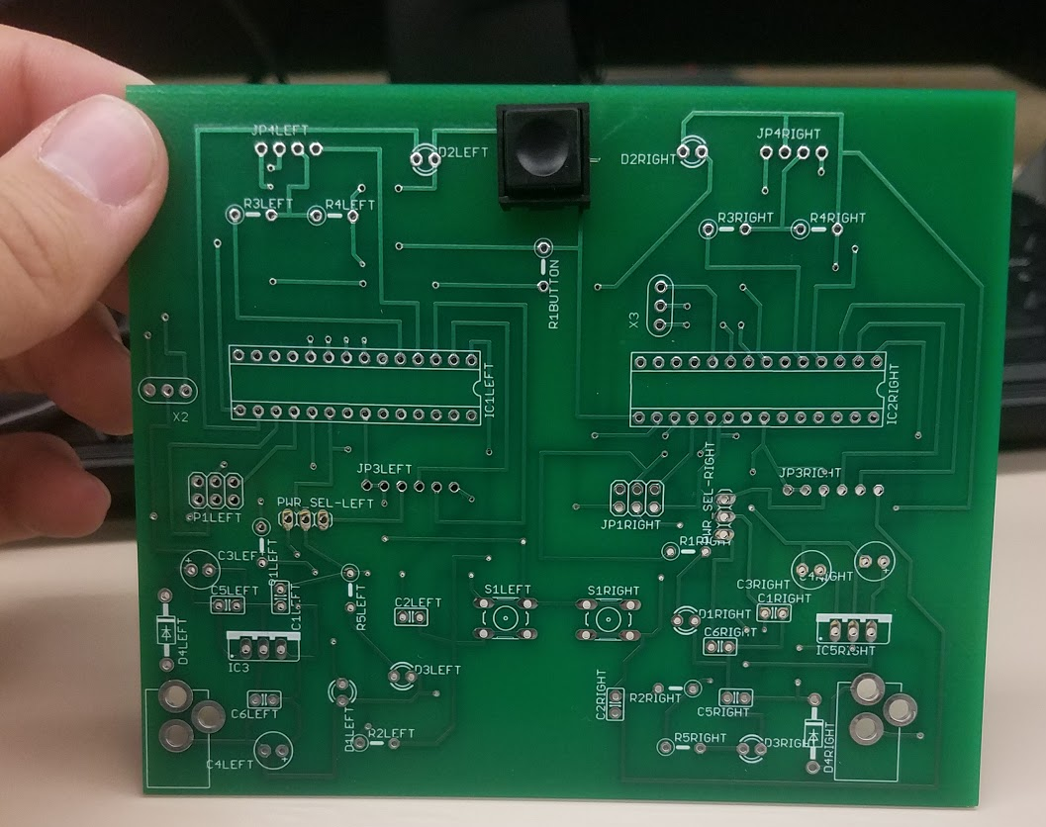
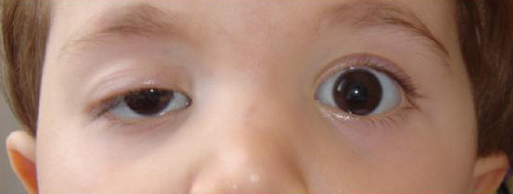
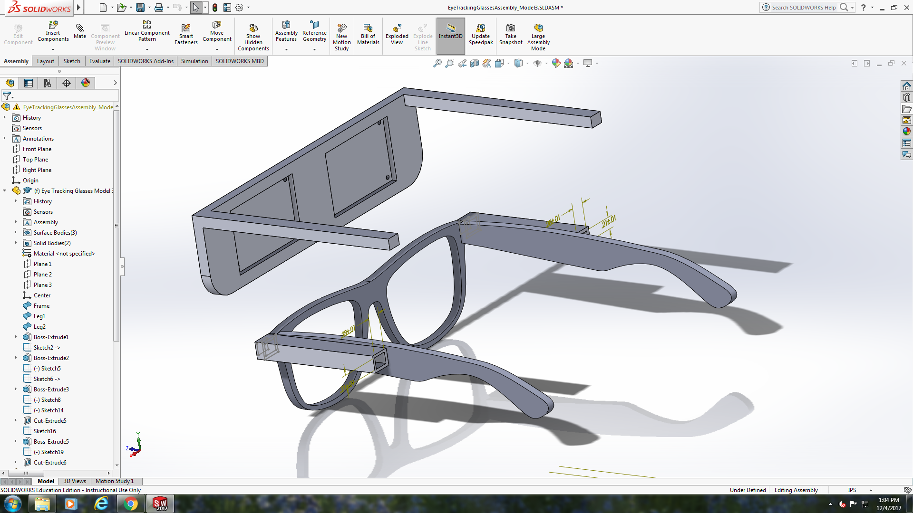
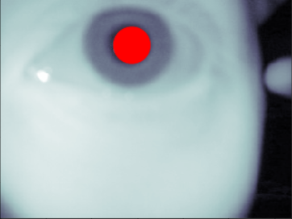
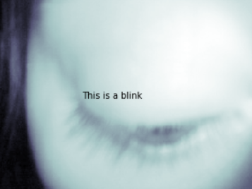
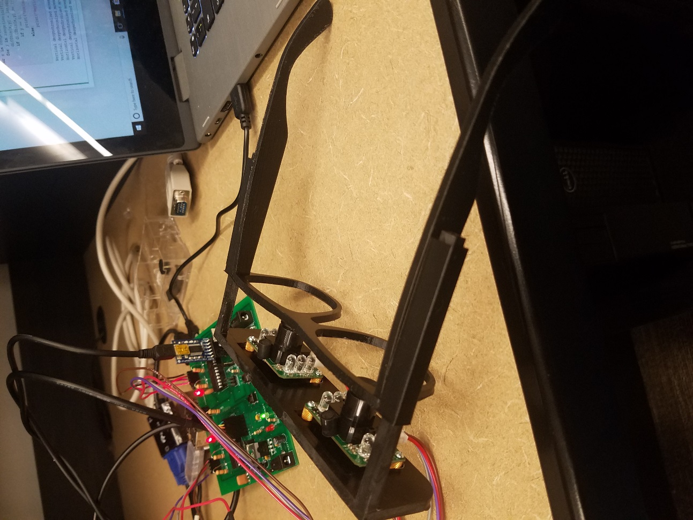
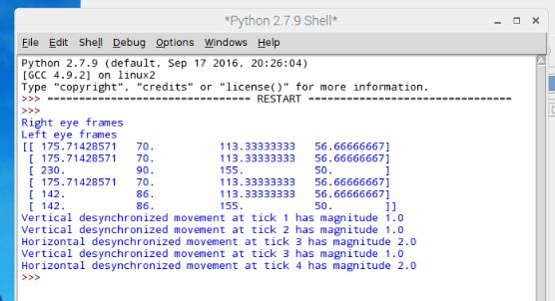
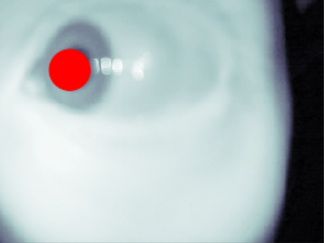
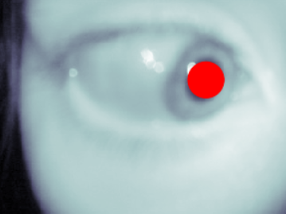
Advanced Eye Tracker for Strabismus and Amblyopia
John Marshall, James Liu, Sean McCarthy
Department of Electrical and Computer Engineering
Background
Design Approach
PCB Board
Amblyopia
“Lazy eye”
Disorder due to eye and brain not working together
Poor alignment in eyes
Strabismus
“crossed eyes”
Results in loss of Depth perception and/or double vision
A microcontroller was needed to control each camera
The design of the PCB held both microcontrollers connected by the button on the board
The microcontroller is he ATMEGA328P?
Figure 1: Child with a severe case of Amblyopia
Figure 6: Custom PCB Board was completely soldered to allow integration of multiple components
Headset
Analytic Algorithm
Conventional fabrication methods were experimented with but did not serve the purpose of an ergonomic headset
Custom frame was designed using Solidworks and 3D printed
Features a slider that allows for distance adjustment and fine focusing
Input data is an array of 4 by n (the number of coordinates that make up the pupil)
The format is as follows:
(Xa1, Ya1, Xb1, Yb1)
…
(XaN, YaN, XbN, YbN)
Computes the derivatives and stores the result as a 2 by n array
(Xb1-Xa1, Yb1-Ya1)
…
(XbN-XaN, YbN-YaN)
Compare each value with a threshold number and returns instances of irregularity
Figure 4: Overview of the Design Process
Pupil Detection
Pupil detection was initially written using Sobel and Hough transforms, but these were replaced with a custom brightness algorithm and Hough-inspired search method for efficiency
The search method allowed blink detection to be easily implemented as a "null" result
Precision of the pupil detection algorithm is limited to 20 pixels
Include
a photo
Figure 2: Solid works model of the headset
Figure 7. Output of the analytical algorithm
Acknowledgements
Figure 5. Pupil Detection software was written from scratch. This showcases the power of detecting the pupil despite rapid eye movement
We thank Professors Dickerson and Dallal for guidance on this project. In addition, credit goes to the University of Pittsburgh for sponsoring the Senior Design EXPO and for providing funding for materials.
Figure 3: Custom Headset fitted with infrared cameras and

