Slide 1

DP Speed Solver version 1 (11/05/2020)
Jet Chang, Embedded Systems at TU/e

Slide 2
Code Structure
includes
Source Files
MathFunction.c
BasicAlgorithm.c
SystemDynamic.c
MathFunction.h
BasicAlgorithm.h
SystemDynamic.h
SolverStruct.h
Header Files

Slide 3
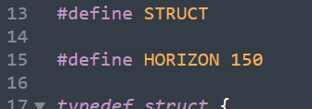

What is important
Since Simulink requires fixed length of array (pointer),
IMPORTANT: the length of horizon needs to be the same in creatSfunc.m and inc/SolverStruct.h
i.e. solverinput.GridSize.Nhrz should equal to HORIZON
./createSfunc.m
./inc/SolverStruct.h

Slide 4
How to get the results
createSfunc.m
ModelSpeedSolver.slx
showResult.m

Slide 5
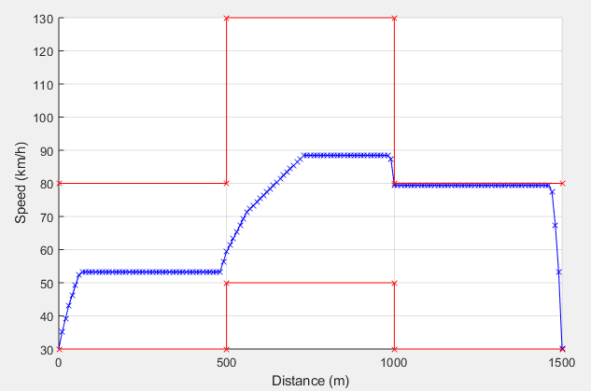
An Example Plot

Slide 6
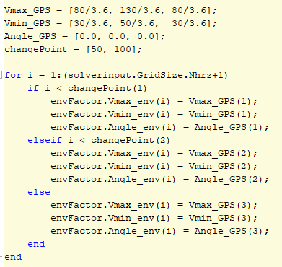
Change Parameters
All the parameters can be change in createSfunc.m
In particular, the legal speed ranges and slope angle is given by arrays. In case more parts need to be added, you can expand the array and add corresponding conditions.
No need to change showResult.m

Slide 7
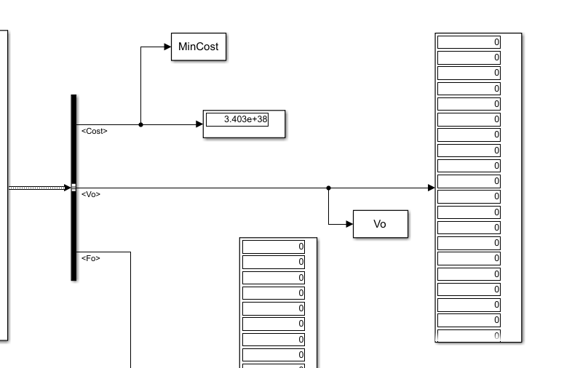

No Result..
If it happens to be like this after running simulation, it means there is no feasible trajectory found.
One reason can be:
ds is too small
For instance, if ds=1(meter), the car will not be able to decrease the speed to meet the upper bound in the third part in such a short distance.

