Slide 1
Reinforcement Learning for Business Optimization
Jimmy Kim / Jin Baek

Slide 2
01
What is Reinforcement Learning?

Slide 3
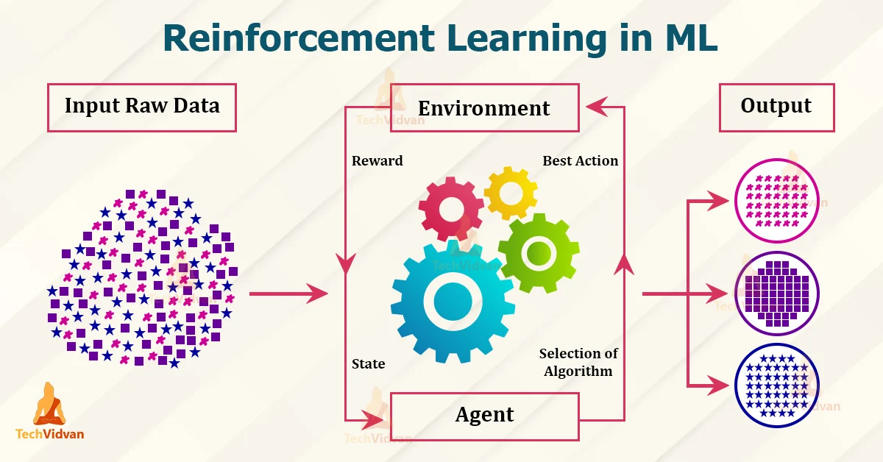
https://techvidvan.com/tutorials/reinforcement-learning/

Slide 4
Supervised vs Reinforcement
Supervised Machine Learning
Reinforcement Learning
A type of machine learning where an agent learns to make decisions by taking actions in an environment to maximize cumulative rewards
A type of machine learning where the model is trained on labeled data

Slide 5
02
The Benefits of Reinforcement Learning in Business
Efficiency
Cost Reduction
Optimizes processes, saving time and resources
Minimizes waste, lowering operational costs
Adaptability
Risk Management
Adapts to changes, keeping businesses competitive
Enables stable decision-making in uncertain conditions.

Slide 6
03
Proof of Concept:
Reinforcement Learning in Action
Taxi Game
Pole Balancing Game
-Logistics Optimization
-Route Efficiency
-Resource Management
-Time Savings
-Adaptive Learning
-Managing Risk in Dynamic Environments
-Stability in Uncertain Conditions
-Handling Market Volatility
-Strategic Planning

Slide 7

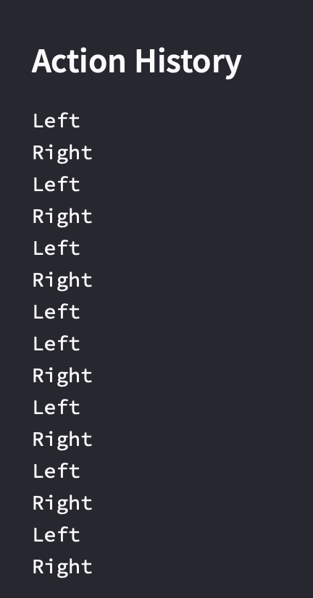
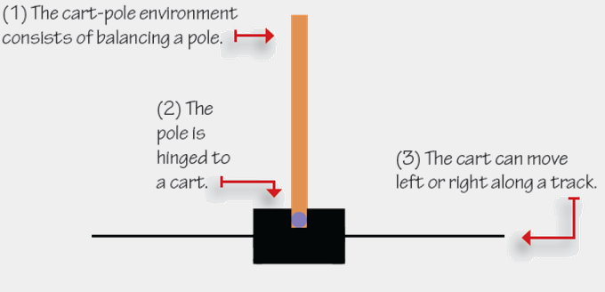
What's the Pole Balancing Game?
Learning environment in the Open-AI Gym reinforcement learning
https://livebook.manning.com/concept/reinforcement-learning/cart-pole-environment

Slide 8
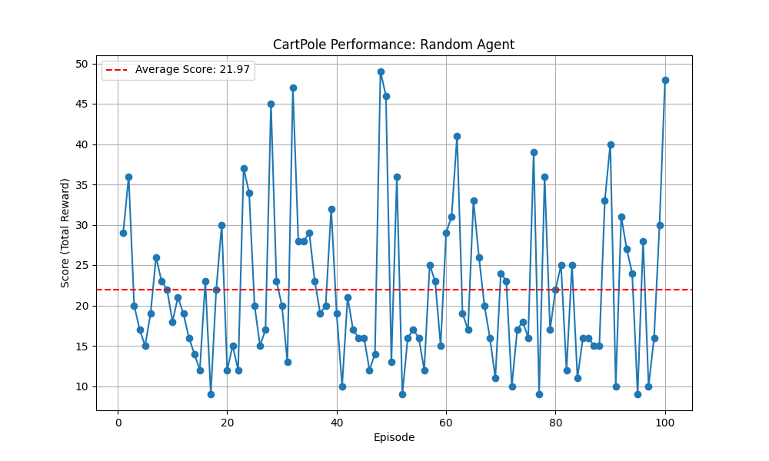
CartPole Performance: Random Agent

Slide 9
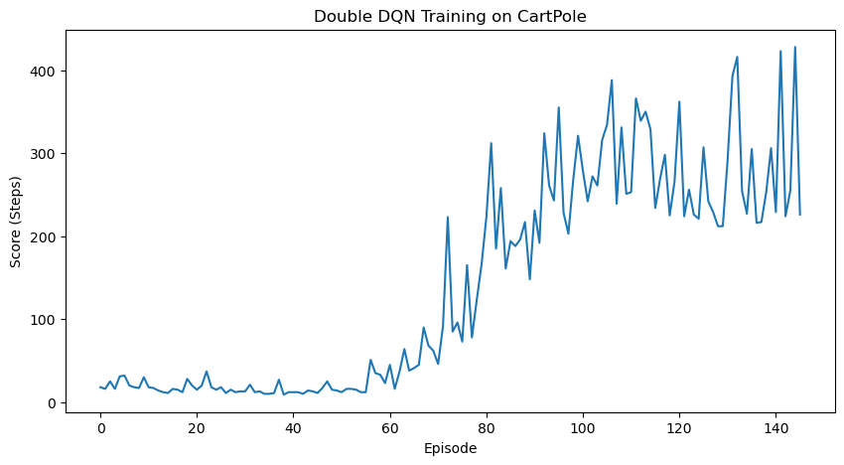
CartPole Performance: Improved Model

Slide 10
Challenges Faced
04
It's difficult to know if the model is learning efficiently.
Finding the cause of inefficient learning is hard—it could be the algorithm, a complex environment, or poorly defined rewards.
High computational demands may require significant time or specialized hardware, depending on the model.

Slide 11
Let's explore a practical example of optimizing decisions through a game simulation
Taxi Game / Pole Balancing Game

