Slide 1
Internship on Roboics and Drone
Presentation by -
Anand Jaiswal 1NT18CS190
Company -
Robotics Association of Nepal(RAN)

Slide 2
Introduction
Being part of the workforce was a great opportunity for me to put all my academic training to use. Robotics Association of Nepal (RAN) is the only national-level non-profit association that provides an outstanding platform for students and enthusiasts all over Nepal. RAN is established to promote, educate, explore, and compete in the field of robotics. Consequently, working as a Intern at RAN was a great experience for me. I managed to learn new technologies like 3D mapping and thermal imaging for my work. Moreover, interactions with project members and feedback from my project guide helped me to understand the various requirements of my tasks.

Slide 3
Background
Robotics Association of Nepal (RAN), is not-for-profit, non-governmental organization, continuously working in the field of robotics and electronics automation since its establishment (2010). Each year they celebrate festival of art, science and technology “Yantra” and a platform for women empowerment “MissTech”.
Robotics Association of Nepal has built a network of tech professionals, students, and enthusiast in Nepal through RAN membership, RAN Representatives, and Internship. This modus operandi shares responsibility and leadership within the organization network making thier programs participatory and effective and building the groundwork of strong leaders to take RAN into the future.
RAN has provided practical coding and automation workshops to more than 4000 students since 2010.

Slide 4
Contd…
Thier mission is to create platforms, partnerships, and possibilities to enable Nepali organizations and individuals to understand the implications of the science of mechanics, electronics, robotics, and coding and implement them to find solutions to everyday life problems.
Thier objective is to provide a problem-based learning environment where youths can explore solutions to automate and mechanize everyday processes and build effective and efficient systems that leads to better and dignified lives.

Slide 5
Problem Statement
Autonomous Harvesting Systems for Ophiocordyceps sinensis(Yarshagumba)
This project proposes an idea of an entire autonomous system based on AI for allocating the areas of fungus harvesting, it’s detection, collection, packing and processing as well as providing the better value for it for the development of rural mountainous areas.

Slide 6
Scope of the work
Downloading image of cordyceps directly from google
Recognition of images(cordyceps or other plants and flowers) using Machine Learning with Artificial Neural Network

Slide 7
Objectives of the project
To increase the efficiency and reduce time and cost of collection of the fungus.
To collect the fungus evenly from all the harvesting areas to reduce the risk of extinction of fungus from a particular area.
To provide a better market for fungus to reduce black marketing in seek of high rates and increase the revenue collection for the country.

Slide 8
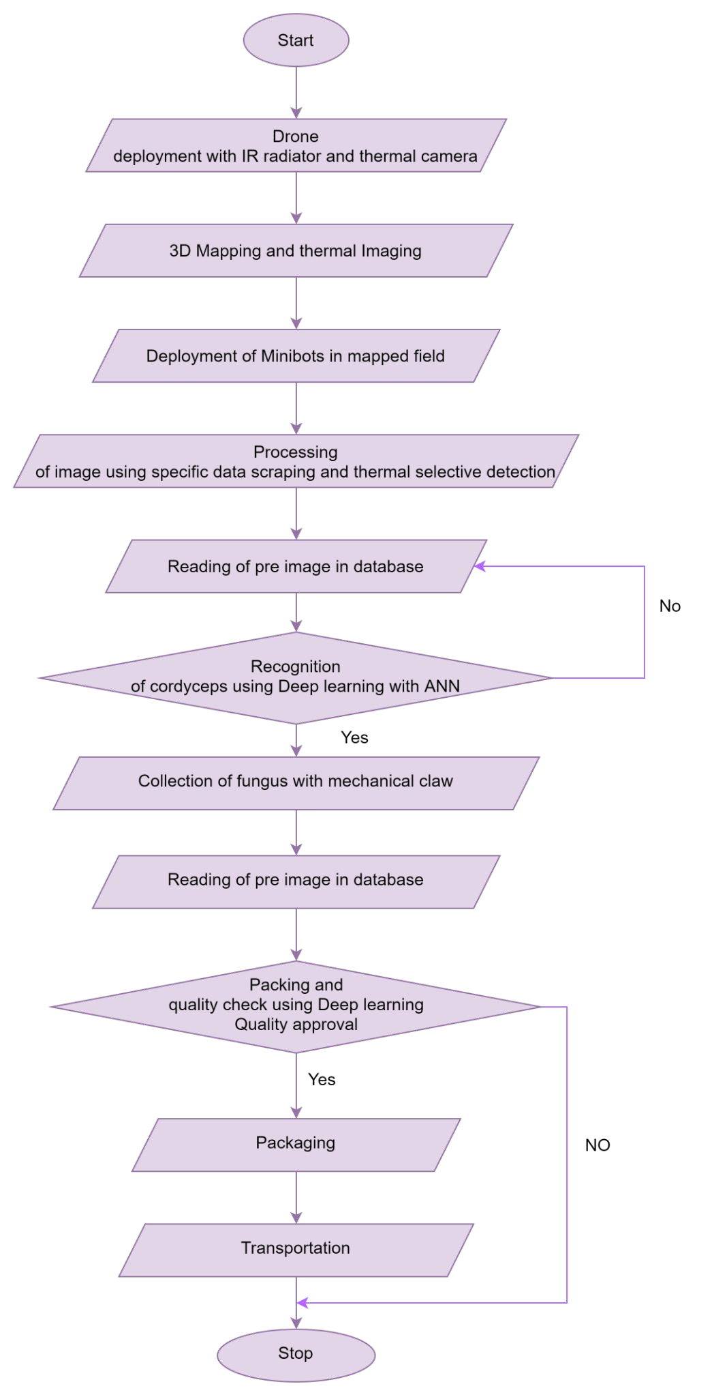
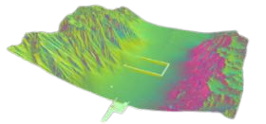
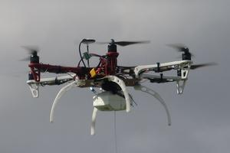
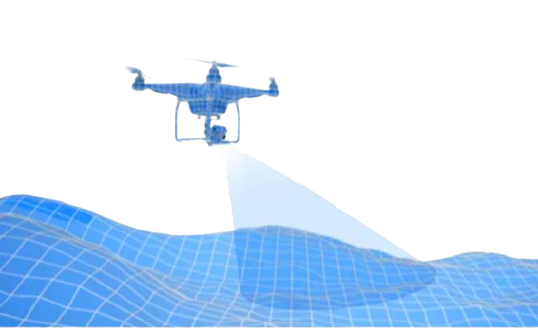
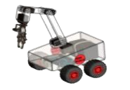
Proposed Metods
Fig 1. Surveillance drone for coordinate mapping and specific data scraping using color and thermal selective detection.
Fig 3. Carrier drone to deploy
minibots in the coordinate mapped field and used for supervision.
the required field in three axes.
Fig 4. Minibots deployed in the
coordinate mapped field to extract the fungus from ground.
Notes:
the required field in three axes.

Slide 9
Tools used
Surveillance Drone
Surveillance drone was used for coordinate mapping and specific data scraping using color and thermal selective detection.
IR radiator and Thermal cameras
Active IR systems use short wavelength infrared light to illuminate an area of interest. Some of the infrared energy is reflected back to a camera and interpreted to generate an image. Thermal imaging systems use mid- or long wavelength IR energy. Thermal imagers are passive, and only sense differences in heat.

Slide 10
Contd…
Python and its packages
Theano or TensorFlow - Backend engine to run keras on top of it.
Keras - It is a wrapper for Deep Learning libraries namely Theano or TensorFlow and to build Deep Neural Nets.
NumPy - It is used for different mathematical and data manipulation operations.
Scikit-learn - A framework to build several machine learning models.
Matplotlib - It is a plotting library for the Python programming language and its numerical mathematics extension NumPy.
Seaborn - It is a Python visualization library based on matplotlib. It provides a high-level interface for drawing attractive statistical graphics.
Keras
K-Nearest Neighbors, Decision Trees, Random Forests, Support Vector Machine and even neural networks for training and testing

Slide 11
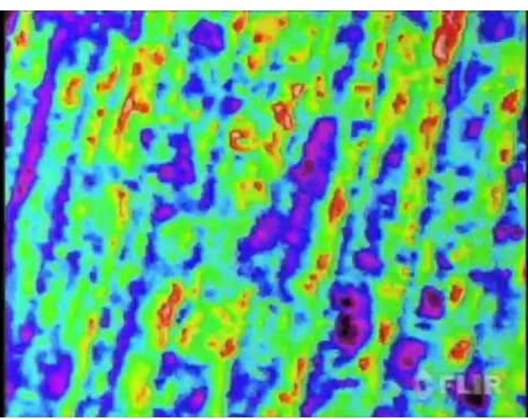
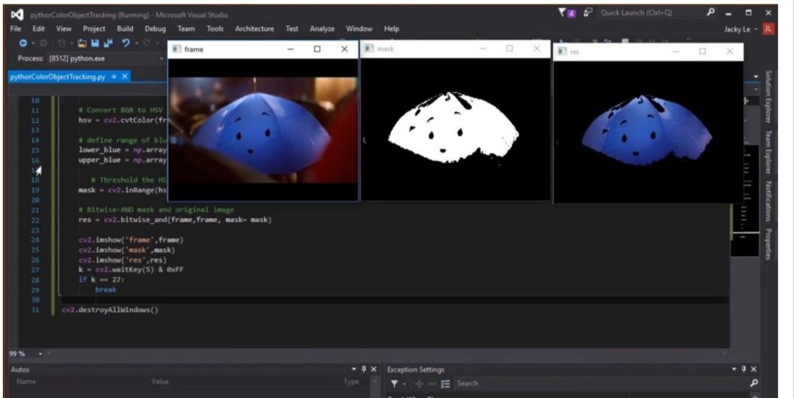
Tasks
Task 1
Introductory task.
To get images and thermal radiation of caterpillar fungus
Tool used - Survelliance Drone with IR radiator and thermal cameras
Fig 5. Heat mapping of caterpillar
fungus through surveillance drones
using infrared thermography.
Fig 6.Specific Data Scraping using
color and thermal selective detection

Slide 12
Task 2
Downloading image with python directy
A type of web scraping
Tools used - Python
- Beautiful Soup

Slide 13
Task 3
Recognition of image(fower-species) using Machine Learning and Computer Vision
Feature extraction using Deep Convolutional Neural Networks
Tools used - Python and python packages like:
Theano or TensorFlow - Backend engine to run keras on top of it.
Keras - It is a wrapper for Deep Learning libraries namely Theano or TensorFlow and to build Deep Neural Nets.
NumPy - It is used for different mathematical and data manipulation operations.
Scikit-learn - A framework to build several machine learning models.
Matplotlib - It is a plotting library for the Python programming language and its numerical mathematics extension NumPy.
Seaborn - It is a Python visualization library based on matplotlib. It provides a high-level interface for drawing attractive statistical graphics.

Slide 14
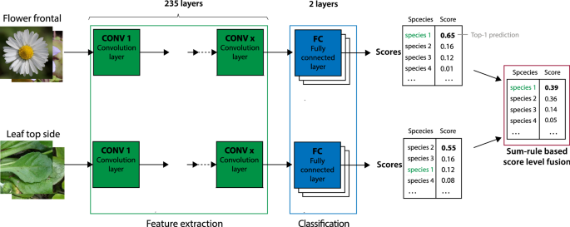

Slide 15
System requirements
On Windows:
Windows 7, Windows 8, Windows 10 or later.
An Intel i5 processor 8th generation or later.
Memory requirements: minimum storage 64gb and ram 8gb.
On Mac:
OS X El Capitan 10.11 or later.
On Linux:
64-bit Ubuntu 18.04+, Debian 10+, openSUSE 15.2+, or Fedora Linux 32+.

Slide 16
References
https://www.ran.org.np/
Cilulko, J., Janiszewski, P., Bogdaszewski, M. et al. Infrared thermal imaging in studies of wild animals. Eur J Wildl Res 59, 17–23 (2013).
https://doi.org/10.1007/s10344-012-0688-1
Neil E. Stevens, Environmental Temperatures of Fungi in Nature. Wiley, American Journal of Botany , Jul., 1922, Vol. 9, No. 7 (Jul., 1922), pp. 385-390
Swaraj Sagar Pradhan, Madan Khanal, Use of Micro Satellites for Global Connectivity, High-Speed Transmission & Data Analysis,Vol 2-Issue 5(481-523) September - October 2019, International Journal of Scientific Research and Engineering Development (IJSRED).
https://www.robots.ox.ac.uk/~vgg/data/flowers/

