Slide 1
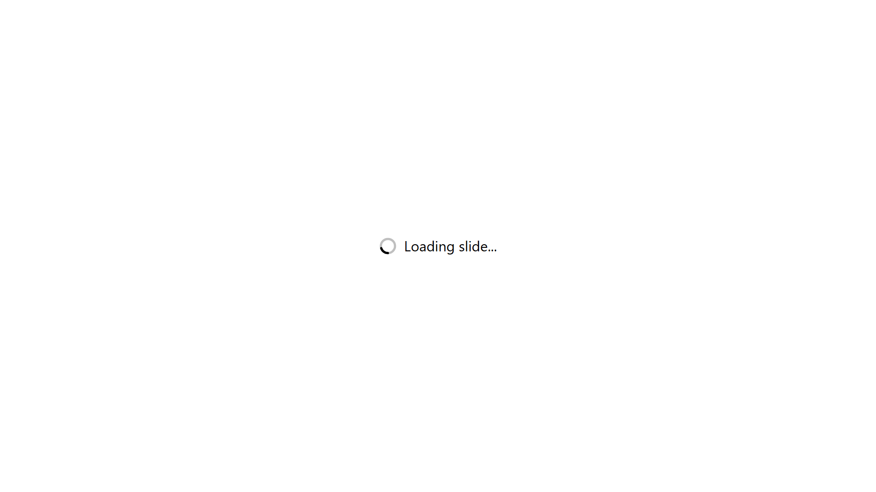
Notes:
Opening frame, 30 seconds:
"Bolt Framework is how we make AI-assisted delivery repeatable. Not a tool — a
methodology, with the governance, the artifacts and the gates already built."
Everything in this deck is sourced from the framework repository. There are no
invented metrics: where you see a number, it is either a threshold the framework
enforces or a count I verified on disk. The two external market figures are
attributed on the slide.

Slide 2

Notes:
Land the DORA finding precisely: AI adoption correlates with HIGHER throughput
and LOWER stability. The bullets in both panels are DORA; the two headline
figures are deliberately from different sources, and the pairing is the point —
the left is what developers SAY (self-report), the right is what a randomised
trial MEASURED against that self-report. People overestimated the effect on
their own time by 40 percentage points.
That is why the rest of this deck argues from enforced gates and thresholds
rather than from anybody's reported productivity gain — including ours.
The conclusion is now printed on the slide, so do not read it out. Spend the time
making it concrete instead: what decides which of the two panels a team lands in
is whether it has a delivery harness. That is the thread picked up on slide 3
("that pace needs solid CI/CD") and spelled out for delivery leads on slide 11 —
where the honest advice is to keep the Bolts and wrap them in very short Sprints
until the client's CI/CD can take the cadence.
If challenged on the numbers: they are DORA's, attributed on the slide, and they
describe the market — they are not Bolt Framework results.

Slide 3
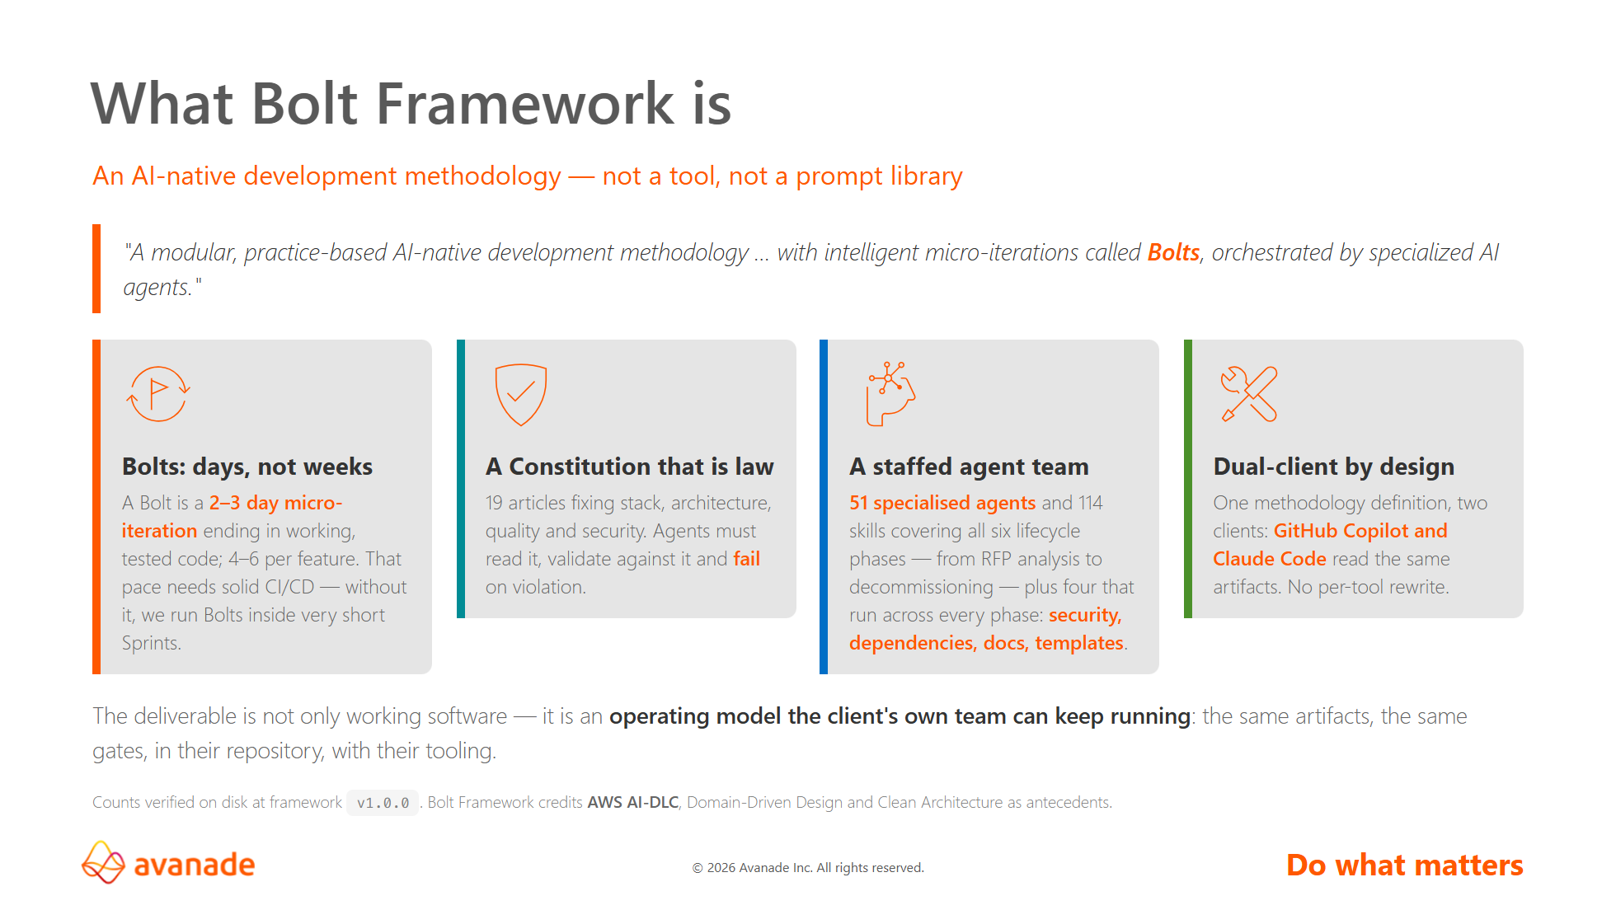
Notes:
The key reframe for any audience: Bolt does not make the AI smarter. It changes
what the AI is allowed to do, in what order, and what it must produce before it
is permitted to continue.
If asked "is this just a prompt library?" — no. The prompts are the thin part.
The substance is the constitution, the phase gates, the artifact contracts and
the handoff matrix.

Slide 4
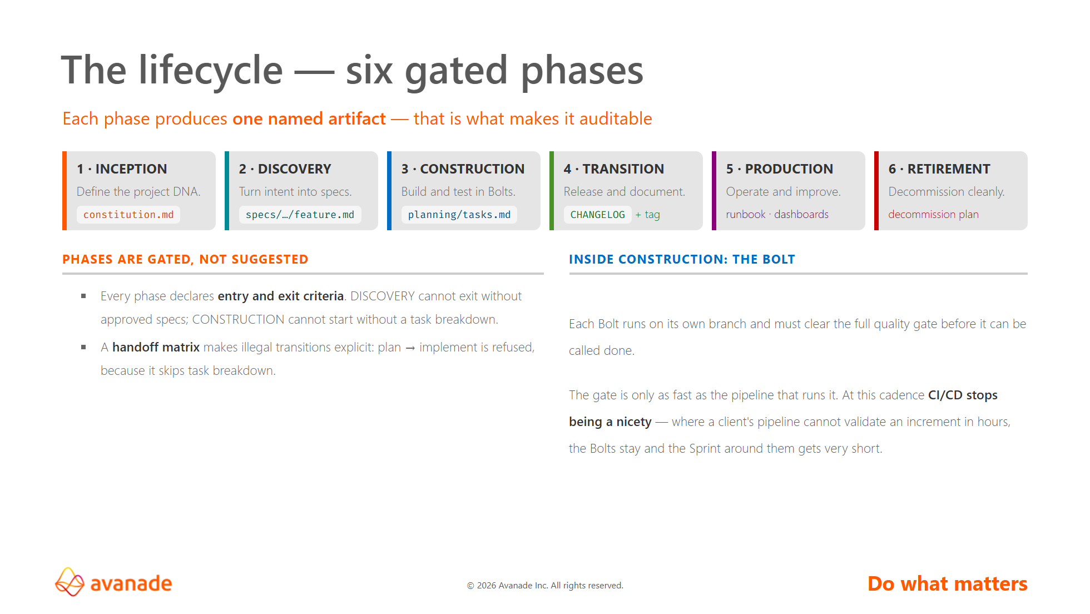
Notes:
The two things to stress here:
1. The artifact row. Each phase has ONE named deliverable. That is what makes the
methodology auditable — you can walk into any Bolt project and ask "show me
the constitution, show me the spec, show me the tasks."
2. The gates. This is what distinguishes Bolt from a workflow diagram. The phases
are not a picture of good intentions; the transitions are refused when the
entry criteria are not met.
Only if someone asks about the "eight cognitive stages" in the framework README:
perceive, analyze, reason, plan, execute, validate, adapt, reflect. They are a
vocabulary for the kind of thinking a step demands — not a gate, and not wired
into the agents. Only 4 of the 24 prompts declare a stage (business-analysis →
PERCEIVE, domain-modeling → ANALYZE, code-generation → EXECUTE, test-generation
→ VALIDATE). Deliberately kept off the slide: it cannot be explained in one line,
and it is the one item on this page that nothing enforces.

Slide 5
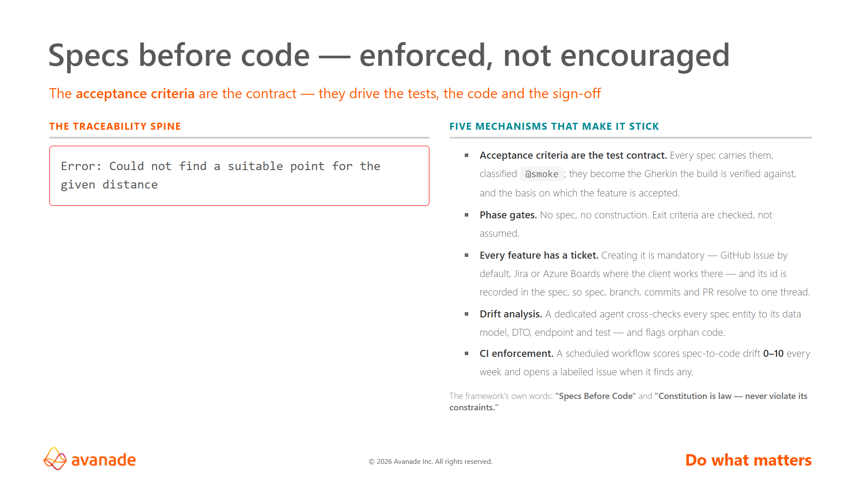
Notes:
This is the slide that answers "how is this different from just telling Copilot
to read a spec first?"
The answer is the dotted line on the diagram. Anyone can write a spec. What is
rare is a system that keeps checking, after the fact and on a schedule, whether
the code still matches it — and that raises a tracked issue when it does not.
If a technical audience pushes: the drift scan classifies findings as implemented
correctly, partially implemented, not implemented, orphan code, and assigns an
overall drift risk score from 0 to 10.

Slide 6
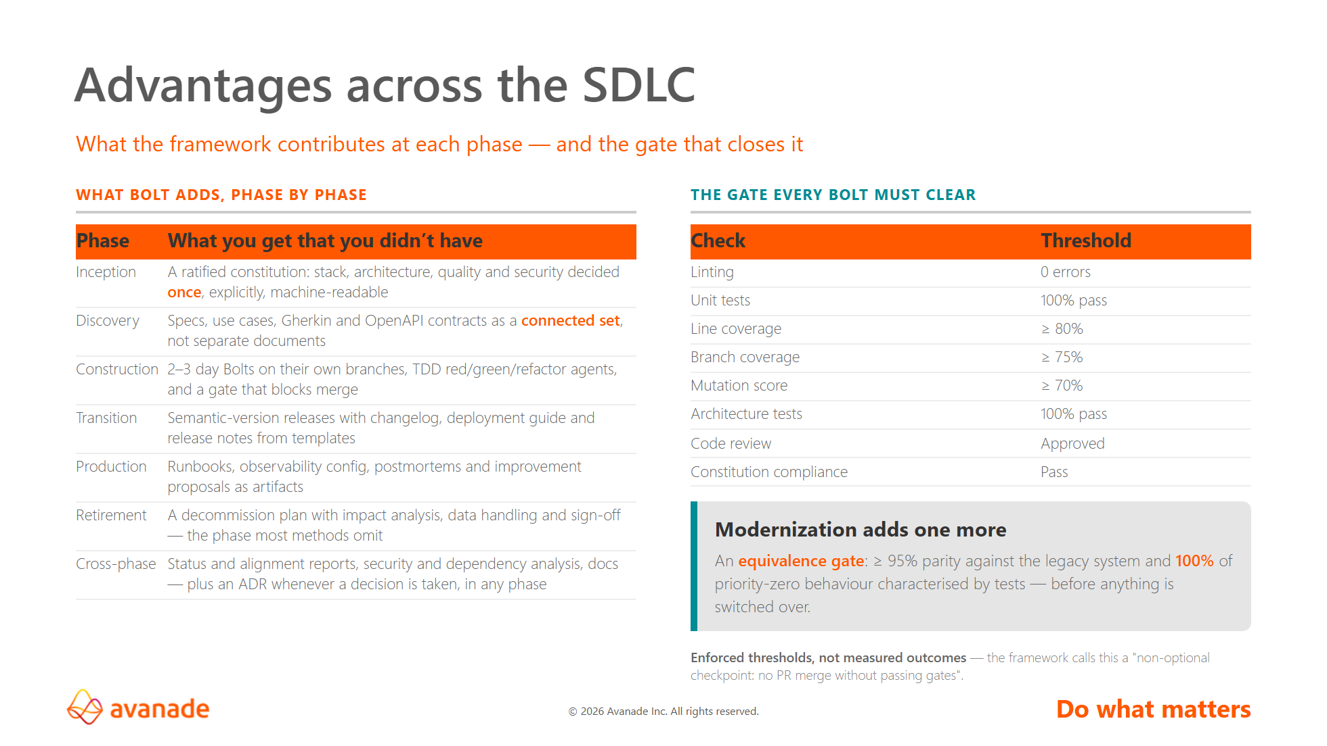
Notes:
Be precise about the right-hand column if challenged: these are gate thresholds
the framework imposes, not results it has demonstrated. That distinction is the
difference between a credible claim and an unprovable one — and it is the honest
answer, which is also the more persuasive one with an engineering audience.
The retirement row is worth pausing on. Very few delivery methodologies have
anything to say about switching a system off. Bolt has an agent, a template and
a script for it.

Slide 7
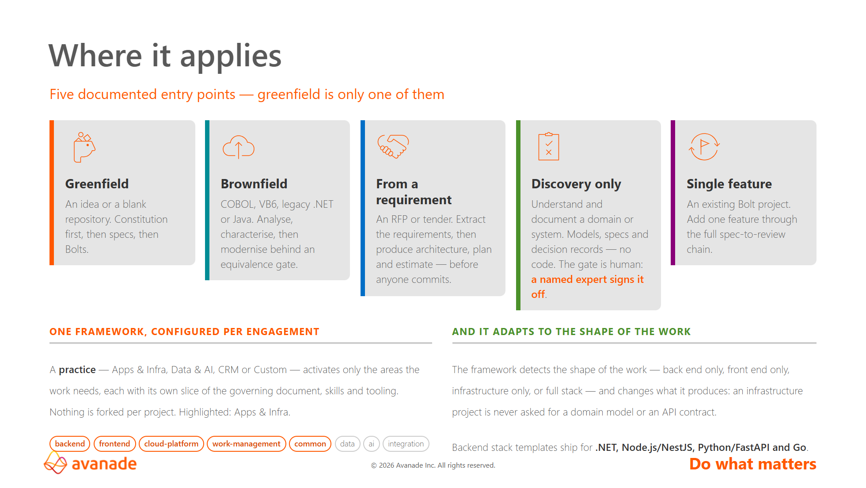
Notes:
The point of this slide is to kill the assumption that this is a greenfield toy.
Three of the five entry points are about systems or commitments that already
exist — brownfield, RFP, and discovery-only.
Note the honest boundary if asked: the data, AI and CRM scopes have constitution
definitions and MCP tooling, but their plugin content is not yet packaged — it is
still sourced externally. Apps & Infra is where the depth is today.

Slide 8
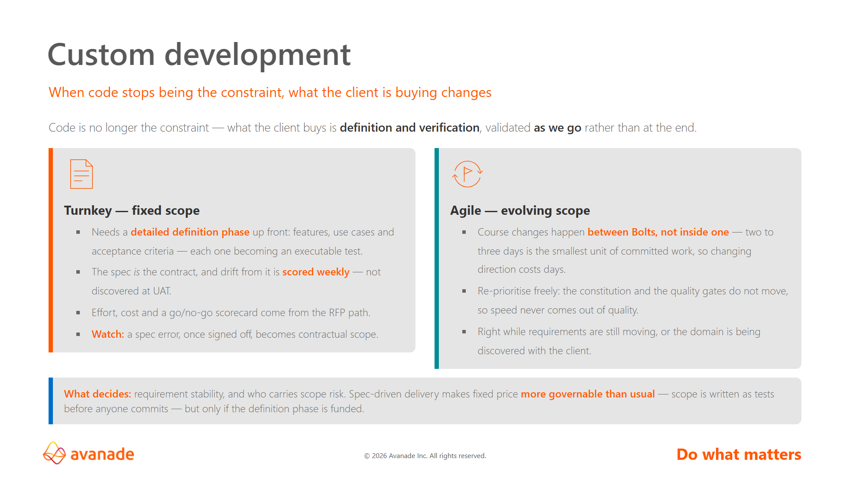
Notes:
Provenance, moved off the slide so the page is shareable with a client: both
commercial models are Avanade practice. Bolt documents neither of them — what
Bolt supplies is the definition machinery that makes fixed price governable.
Keep that straight if challenged.
This is the pre-sales slide that does commercial work, so be precise about
which half is ours and which half is Bolt's.
Bolt's half is repo-sourced even though the slide no longer lists it: acceptance
criteria as executable tests (bolt-feature), effort and cost estimation with a
go/no-go scorecard (rfp-analysis-template), and weekly spec-to-code drift
scoring (spec-drift). The two delivery models are Avanade
practice — the framework has nothing to say about pricing, and if someone
asks "where is that in the framework?", the honest answer is that it is not,
and does not need to be.
The argument worth making out loud: spec-driven delivery suits fixed price
better than most methods do, because the acceptance criteria are written as
tests before commitment and the drift scan keeps checking the built system
against them. That inverts the usual objection to turnkey.
The counter-argument to have ready: it only works if the client pays for the
definition phase. A fixed price over a thin specification is the same bad deal
it has always been — Bolt makes the spec verifiable, not free.
Do not promise a client demo every two to three days without checking their
pipeline first. That caveat is on slides 3, 4 and 11, and stated without
jargon on slide 10.

Slide 9
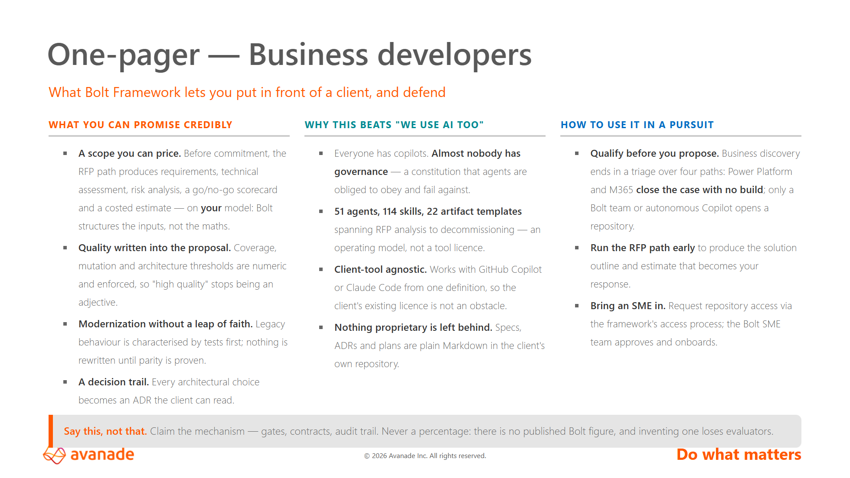
Notes:
This page is designed to be handed over on its own.
The last card matters most. Pre-sales pressure produces invented numbers, and a
client-side architect will ask where the number came from. The defensible pitch
is structural: here is what the framework refuses to let a team skip.

Slide 10
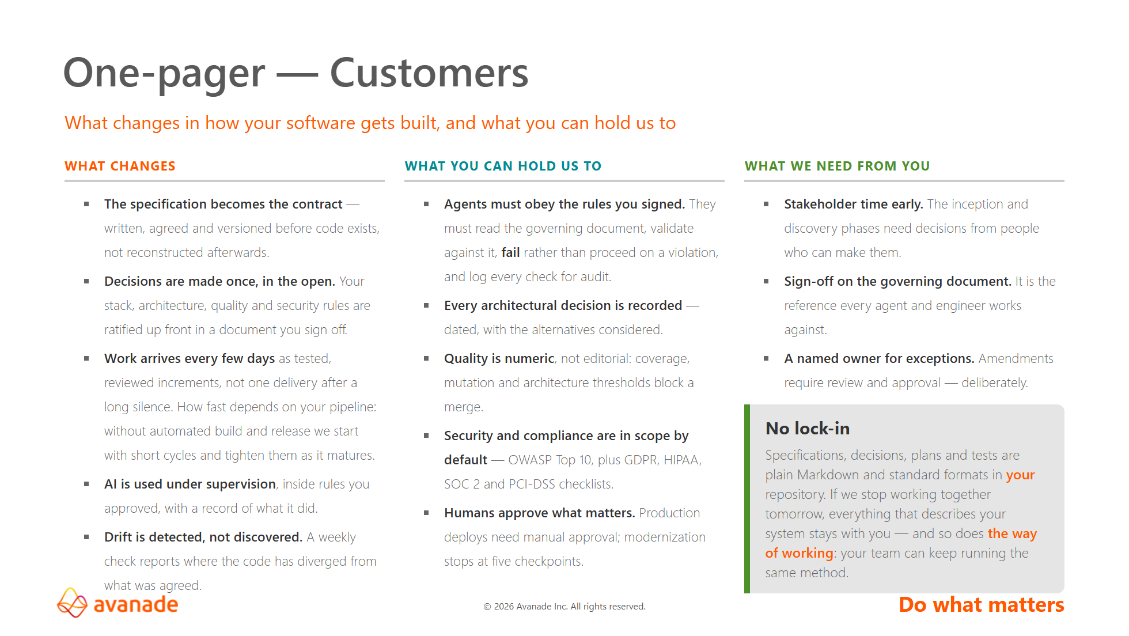
Notes:
End-to-end traceability, if they ask how the guarantees are actually wired:
spec → work item → branch → commits → PR → pipeline → tagged release, with
every state transition logged. (Kept as a note rather than on the slide — this
page is already full, and slide 5 shows the same chain as a diagram.)
Read the room on vocabulary here — this page deliberately avoids "Bolt",
"agents" as jargon, "scopes" and "constitution". A customer cares about three
things: what changes for them, what guarantees they get, and what it costs them
in time and attention.
The strongest line on the page is "fail rather than proceed on a violation".
That is the one thing an AI-sceptical client is not expecting to hear.
If asked about the AI trust question directly, the DORA figure from slide 2 is
the honest framing: scepticism is warranted, which is exactly why the gates and
the audit log exist.

Slide 11
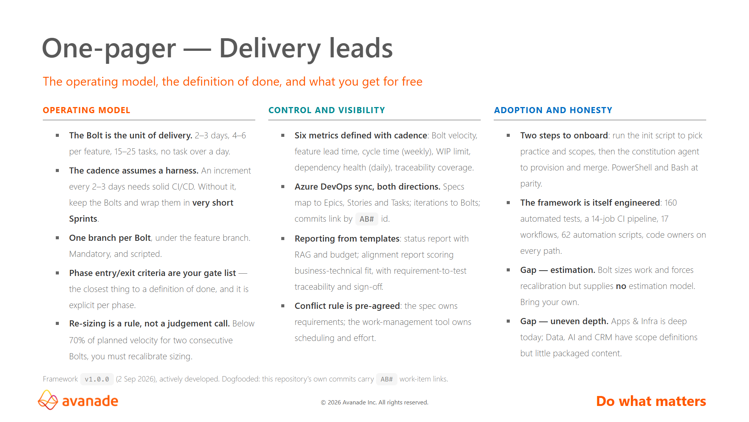
Notes:
The third column is the one that earns trust with a delivery lead. Anyone can
present a capability list; naming the two real gaps — no estimation model, and
uneven scope depth — is what makes the rest believable.
If asked "what does this actually cost me to adopt?": two scripted steps plus
the stakeholder time for the constitution interview. The interview is the real
investment — it front-loads roughly 17 irreversible decisions so they are not
made by accident later.

Slide 12
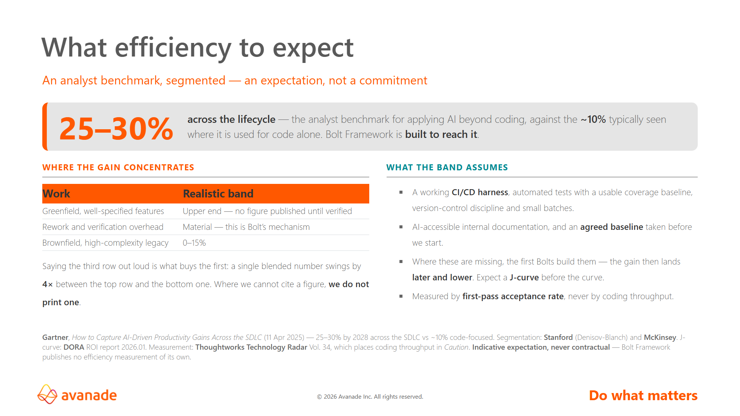
Notes:
The most dangerous slide in the deck. Three rules for presenting it:
1. It is an EXPECTATION, never a promise, and never a contractual commitment.
The wording is "built to reach it", not "delivers". If someone tries to write
a number into a contract off this slide, stop them.
2. Lead with the third row of the table, not the first. Brownfield high-complexity
is 0-15% — Stanford has it at 0-10%, McKinsey under 10%. Volunteering the weak
case is what makes the strong case believable, and every technical evaluator in
the room already knows the weak case exists.
3. "From 30%" is the phrasing to avoid. Gartner's 25-30% is a 2028 CEILING for
teams applying AI across the whole lifecycle; "from" would convert the market's
optimistic maximum into our guaranteed minimum. "Up to" survives an
under-performing engagement; "from" becomes a broken promise.
If challenged: "what is Bolt's own number?" — we do not have one, and we will not
borrow someone else's and put our name on it. Neither Avanade nor Accenture
publishes an engineering-efficiency percentage; Avanade has argued in print
against the measure. What we can show is the mechanism, which is the rest of
this deck. Full evidence base, including the counter-evidence and the answer to
each objection, is in research/efficiency-evidence.md.

Slide 13
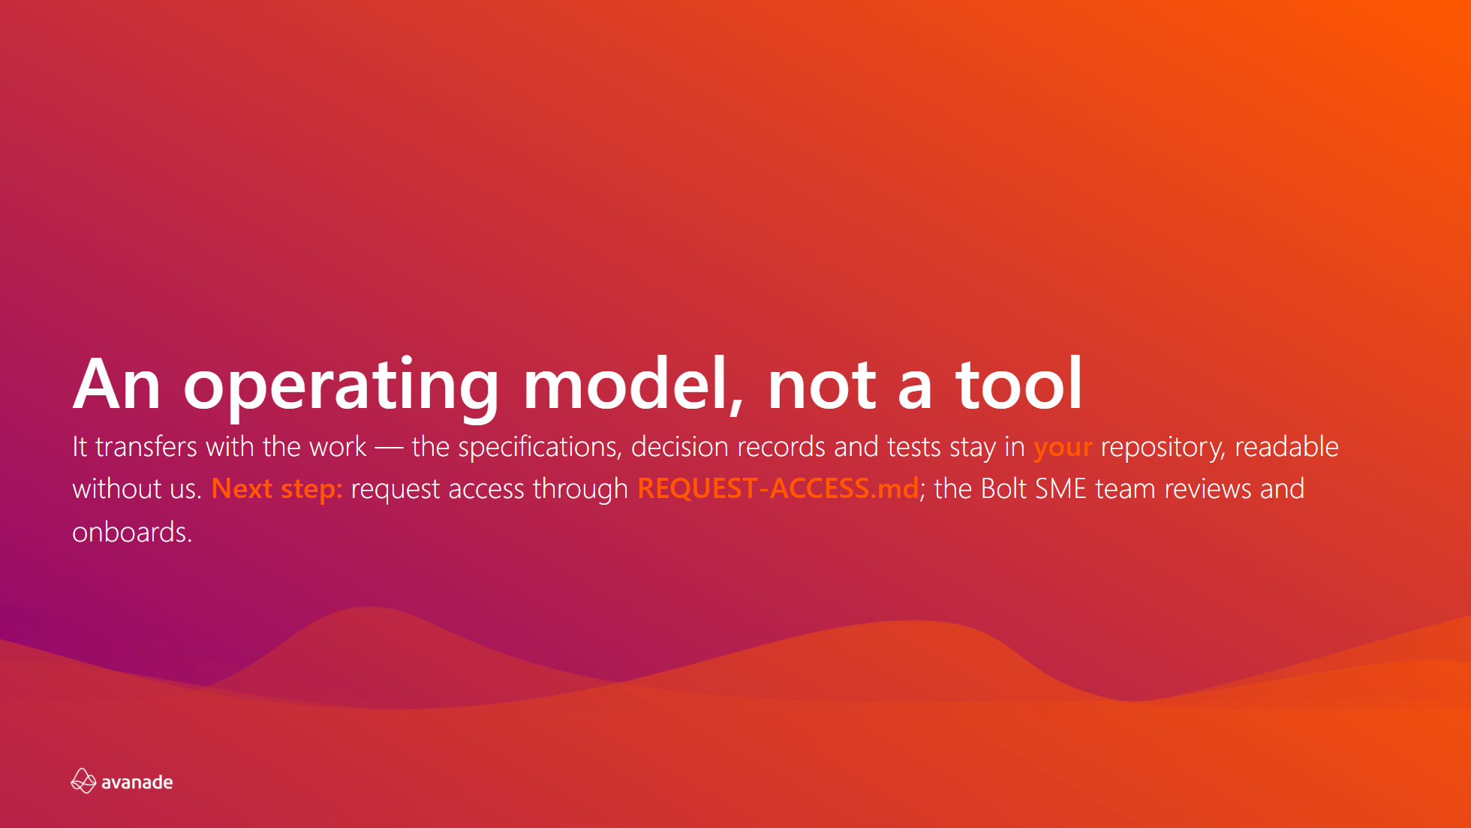
Notes:
Close on the commitment, not a recap — the through-line was already stated on
slide 2 and does not need repeating.
Both sentences are now printed, so do not read them out. Say the thing that is
not on the slide: what transfers is the operating model, so the client's own
team can keep running it after we leave — that is what separates this from a
tool licence.
The CTA on the slide is the INTERNAL one (request repository access). Running
this for a client audience, replace it out loud with the engagement next step —
an assessment to establish the baseline — and do not read the access route.
Refresh note: this deck is generated from a specific framework commit. See
REFRESH.md for the slide-to-source map and how to bring it up to date, and
research/efficiency-evidence.md before anyone writes a new number on a slide.

Slide 14
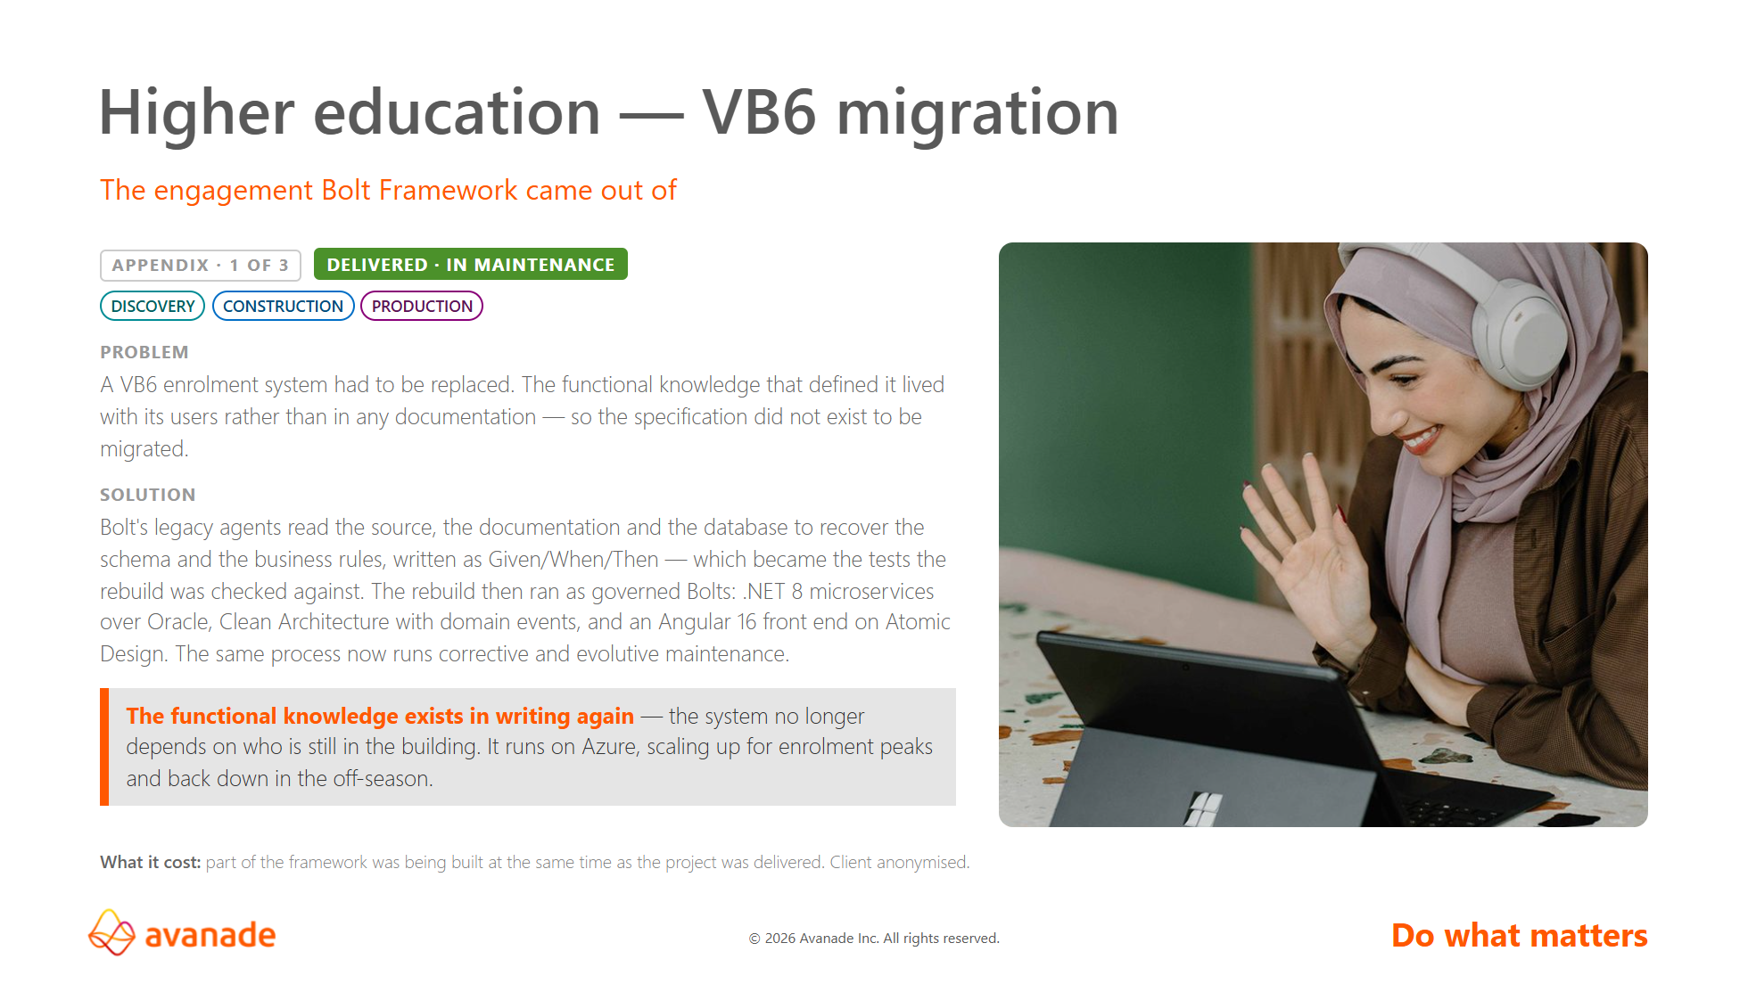
Notes:
Lead with what this one is: the engagement the framework was extracted from. That
answers the timeline question before anyone asks it — a full VB6 to .NET 8
rebuild cannot fit inside a framework released in May 2026, and the answer is
that the project came first and the methodology came out of it.
It is also a stronger claim than "we used our framework here": Bolt was not
invented in a workshop and then given somewhere to live.
Own the obvious objection yourself — a framework validated on the engagement
that produced it is not independent evidence. That is what the next two slides
are for.
If challenged on behaviour preservation: the recovered rules are written as
Given/When/Then and became the tests the rebuild was checked against. Do not
claim the formal equivalence-gate thresholds — we have no parity figure.

Slide 15
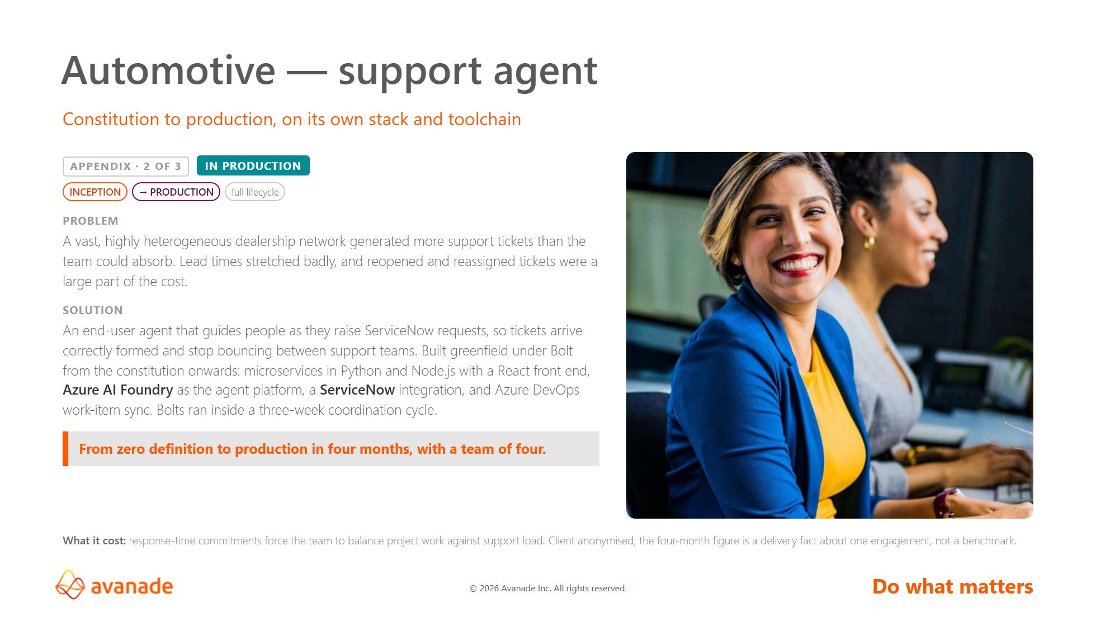
Notes:
This is the transfer case, and the most important of the three. It differs from
the origin engagement on every axis that matters: different sector, greenfield
instead of migration, Python/Node/React instead of .NET/Angular, Azure DevOps
instead of GitHub. It is the evidence the framework is not welded to where it
was born.
It is also the only reference covering the whole lifecycle — constitution
through production — which is the claim slide 4 makes.
On the four months with four people: state it and stop. Let the room do its own
arithmetic. If asked "compared with what?", the team's judgement is that it
would have needed more people and more months — say that as a judgement, never
as a measurement, and never attach a multiple or a percentage. There is no
control project and no baseline.
Two things confirmed in use here that appear nowhere else in this deck: the
azdo-sync skill, and the four bug agents — tracker, troubleshooter,
regression-test and fixer. The team is now adapting that triage, root-cause and
impact-analysis flow to the client's needs.
On the three-week cycle: the Bolts ran inside it, and the cycle length came
from internal coordination — not from a client pipeline that could not take the
cadence. Do not present it as proof of the CI/CD caveat on slides 3 and 11.

Slide 16
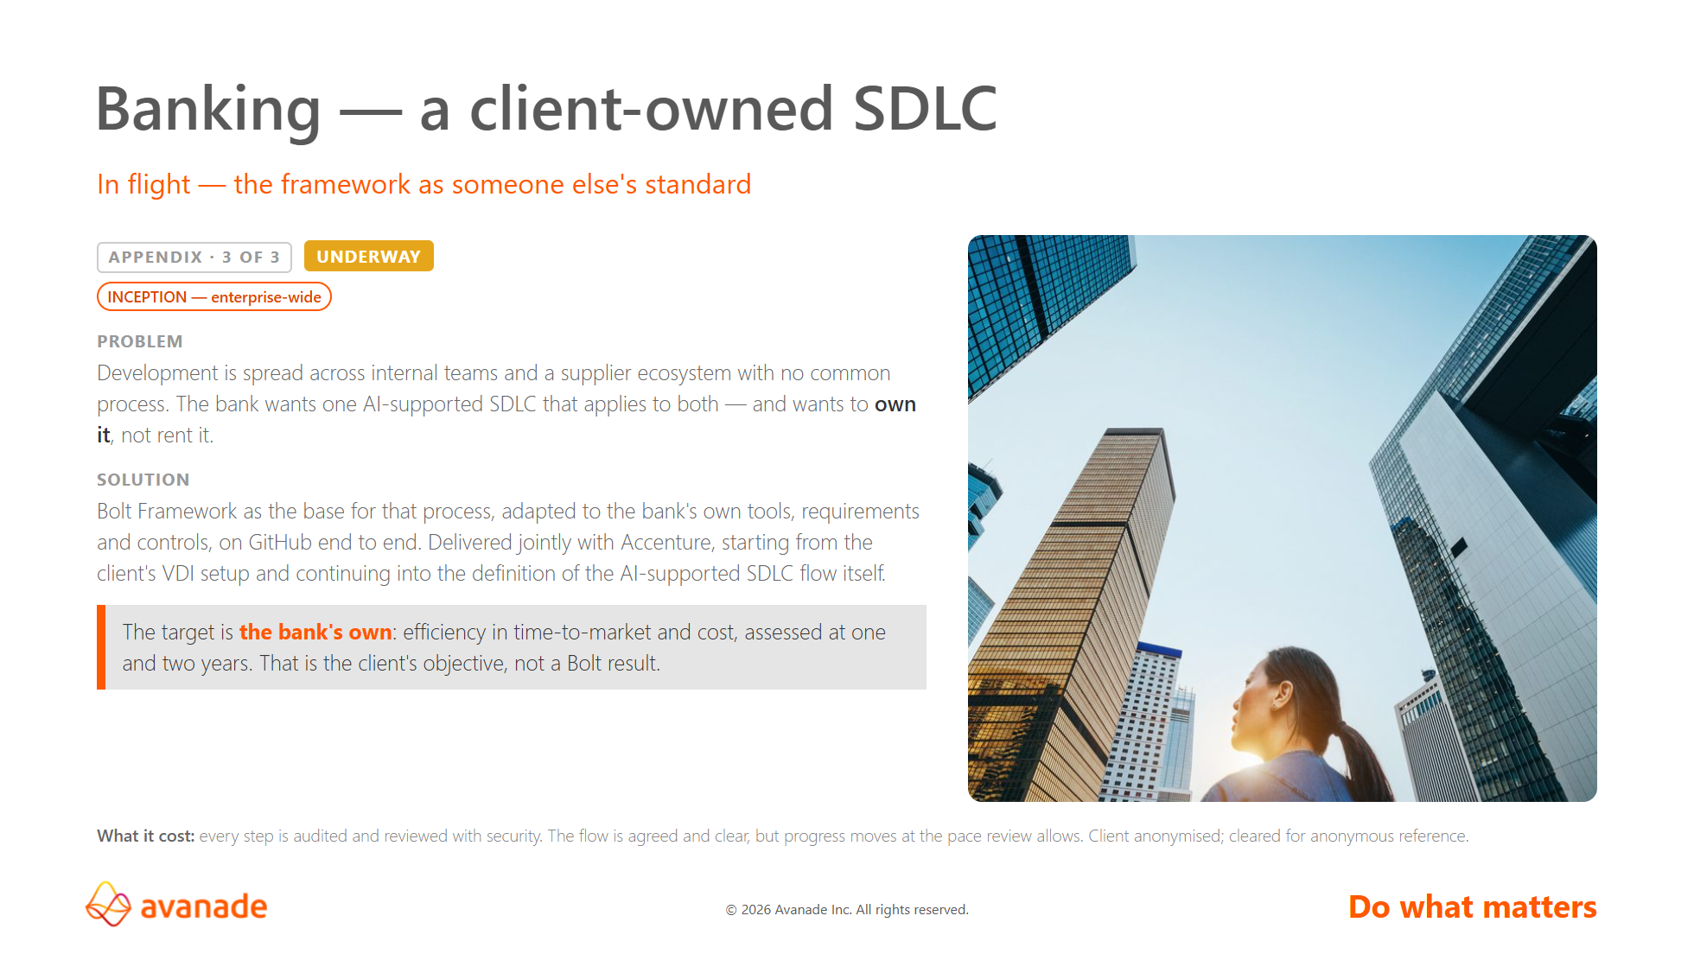
Notes:
Nothing has been delivered here yet, and the status chip says so. Do not let it
be heard as a third success story.
Its value is different, and it is the closing slide made literal: the bank will
OWN the process and extend it to its own suppliers. Slide 13 promises that the
operating model transfers. Here a bank is doing exactly that, which is a
stronger proof than any argument on slide 3.
It also completes the toolchain spread across the three references — GitHub
Copilot, Azure DevOps, and now GitHub end to end.
On the efficiency target: it is the bank's own objective, measured on the bank's
own baseline, and it belongs to them. One- and two-year horizons mean nothing
usable before 2027, so slide 12 stays on the Gartner anchor. If this programme
does measure, it would be the first engagement capable of producing a
defensible Bolt efficiency figure — and the figures would need the bank's
permission to cite.

