Slide 1
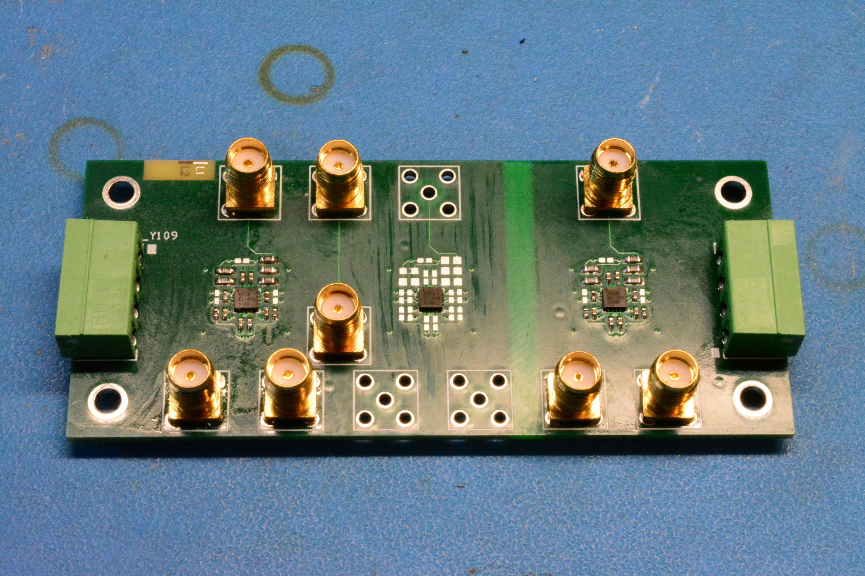
Input 1
Thru cal input
Input 2
Out 1 P
Out 1 N
Thru cal output
Out 2 P
Out 2 N

