Slide 1

Group Member 2 : Class DT2206L
Nguyễn Sỹ Hải Nam
Trần Thanh Trúc
Lê Cảnh Sang
Instructor : Hồ Nhựt Minh

Slide 2
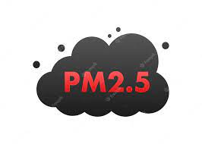
The Relationships between PM2.5 and Meteorological Factors in VietNam

Slide 3
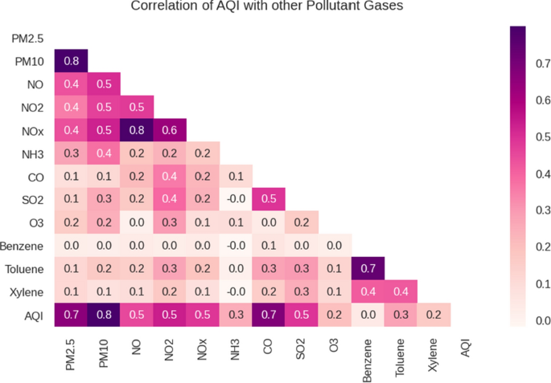
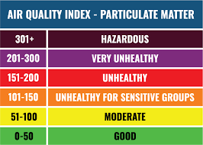
Air pollution prediction with machine learning: a case study of Indian cities
International Journal of Environmental Science and Technology (15 may 2022)

Slide 4
DATA SOURCE :
https://www.worldweatheronline.com/
https://www.stateofglobalair.org/
https://aqicn.org/

Slide 5
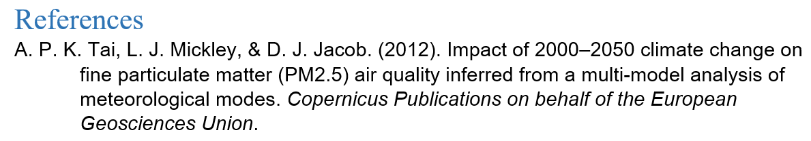

“The daily change of meteorological parameters can cause up to 50% of the change in PM2.5 concentration”
“The higher the population density, the worse the air quality”

Slide 6
Year, Month, Time
Rain: amount of rain (mm)
Cloud: Percentage of clouds in the sky
Pressure: (mb)
Wind: wind speed (km/h)
PM2.5: fine dust (µg/m³)
Area: Names of provinces of VietNam
Gust: a sudden strong wind
Temperature: Temperature of the day (ºC)

Slide 7
Temperature overview
Correlations between PM2.5 and Temperature
Pressure overview
Correlations between PM2.5 and Pressure
Rain overview
Correlations between PM2.5 and Rain
Wind overview
Correlations between PM2.5 and Wind
Cloud overview
Correlations between PM2.5 and Cloud
Correlation between PM2.5 and Meteorological Factors in VietNam

Slide 8
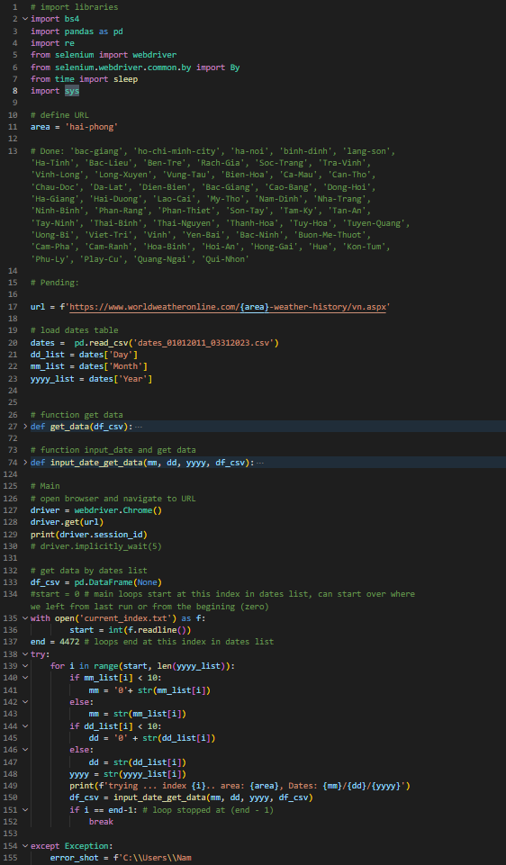
Techniques in the project
BeautifulSoup (datacrawling)
Selenium.Webdriver (web data crawling)

