Slide 1
Assignment 3
Joakim Edvardsen
Kunnskap for en bedre verden

Slide 2
My three choices
Azure - https://azure.microsoft.com/en-us/
AWS - https://aws.amazon.com/?nc2=h_lg
DigitalOcean - https://www.digitalocean.com/
Notes:
Ville prøve ut de store siden jeg ikke har vært borti det før, for å se om det er en stor grunn til at folk faktisk velger disse.
Også valgte jeg en litt mindre som nummer 3, for å sammenligne.

Slide 3
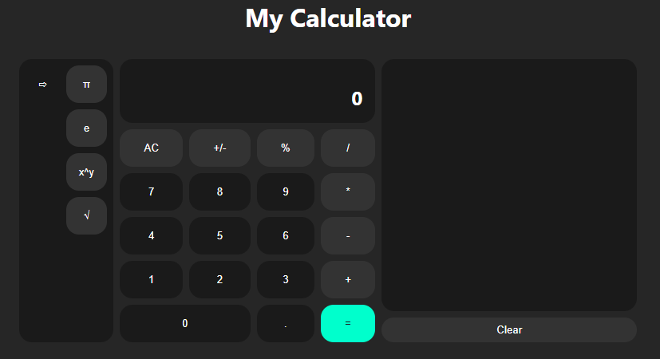
Tasks
Same tasks, different supplier
Notes:
Host vue 3 application from github repo
Initiate a VM
Use web interface over CLI
Just looked at CLI, more differences in web interface

Slide 4
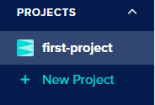
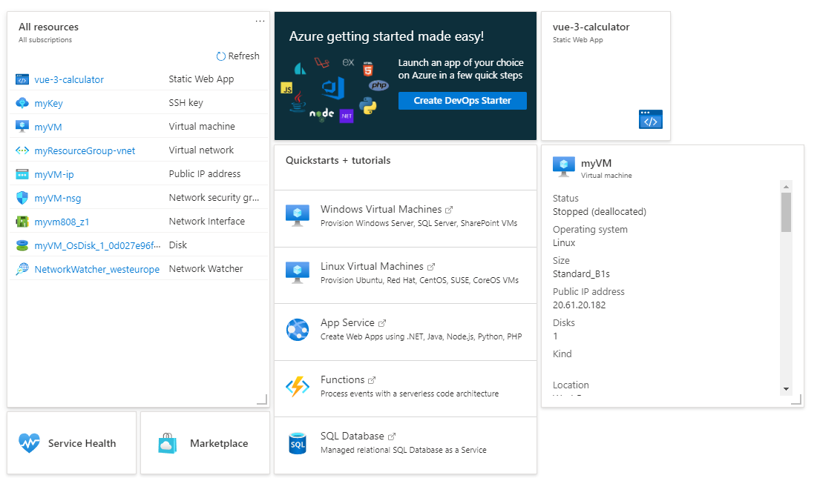
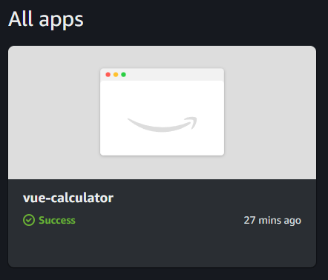
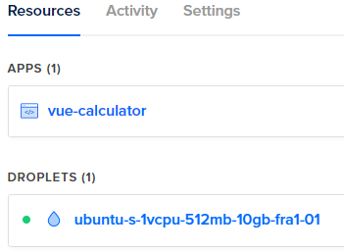
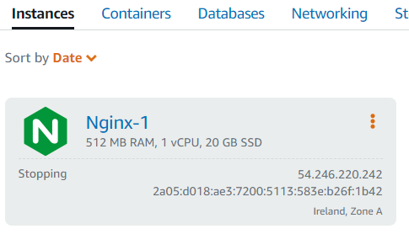
Conclusion – Azure > DigitalOcean > AWS
Setup – DigitalOcean > AWS > Azure
Dashboard – Azure > DigitalOcen > AWS
Price – Azure – AWS > DigitalOcean
Notes:
Setup:
- AWS and DigitalOcean: clear. easier to follow. simple by default, could expand
- Azure: had to google som tutorials. Some optional steps that I though was mandatory
Dashboard:
- Azure: Clear overview over all resource. Can make resource into resource that is displayed in dashboard
- DigitalOcean: Resource grouped in projects. Each project has a list of all resoruces
- AWS: Bad. Sub-webapps for different types of resource. (Amplifier/Lightsail). No clear overview
Price:
DigitalOcean was more expensive
Resources:
Less available resources on DigitalOcean
Conclusion:
Azure. If you have the money, and DigitalOcean has all the resource you need, I might would consider this

