Slide 1
Software Archaeology
with AI
Notes:
Duration ~00:03
OBS: Slides
- Welcome the room
- Frame today's topic: using AI to recover evidence, reduce uncertainty, make better decisions on inherited code
- Ask: "think of one system you'd hesitate to touch today"
- Promise: a repeatable way to turn that hesitation into a clear first move
---
Source: slides\marp\software-archaeology-with-ai.deck.md

Slide 2

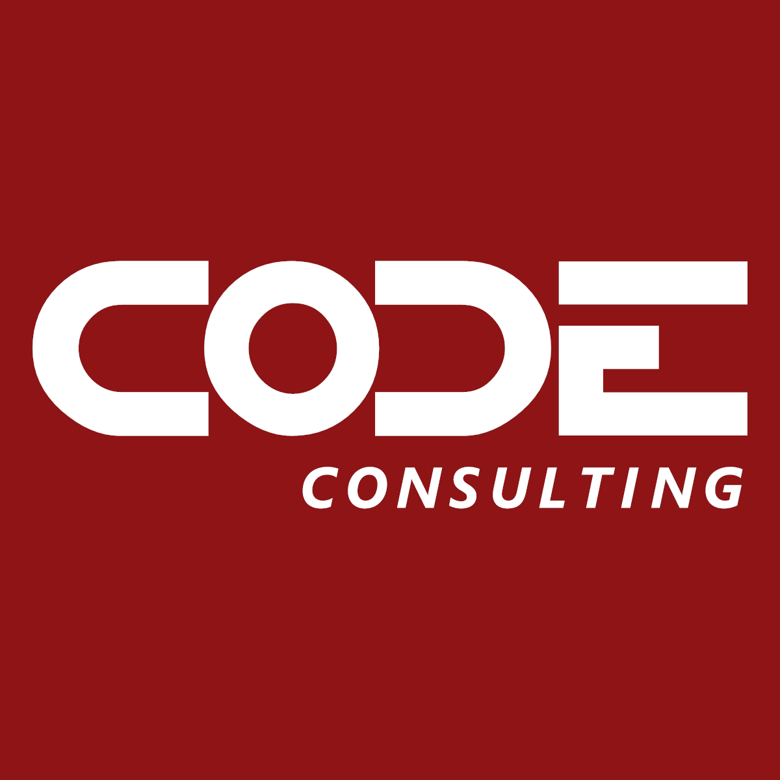
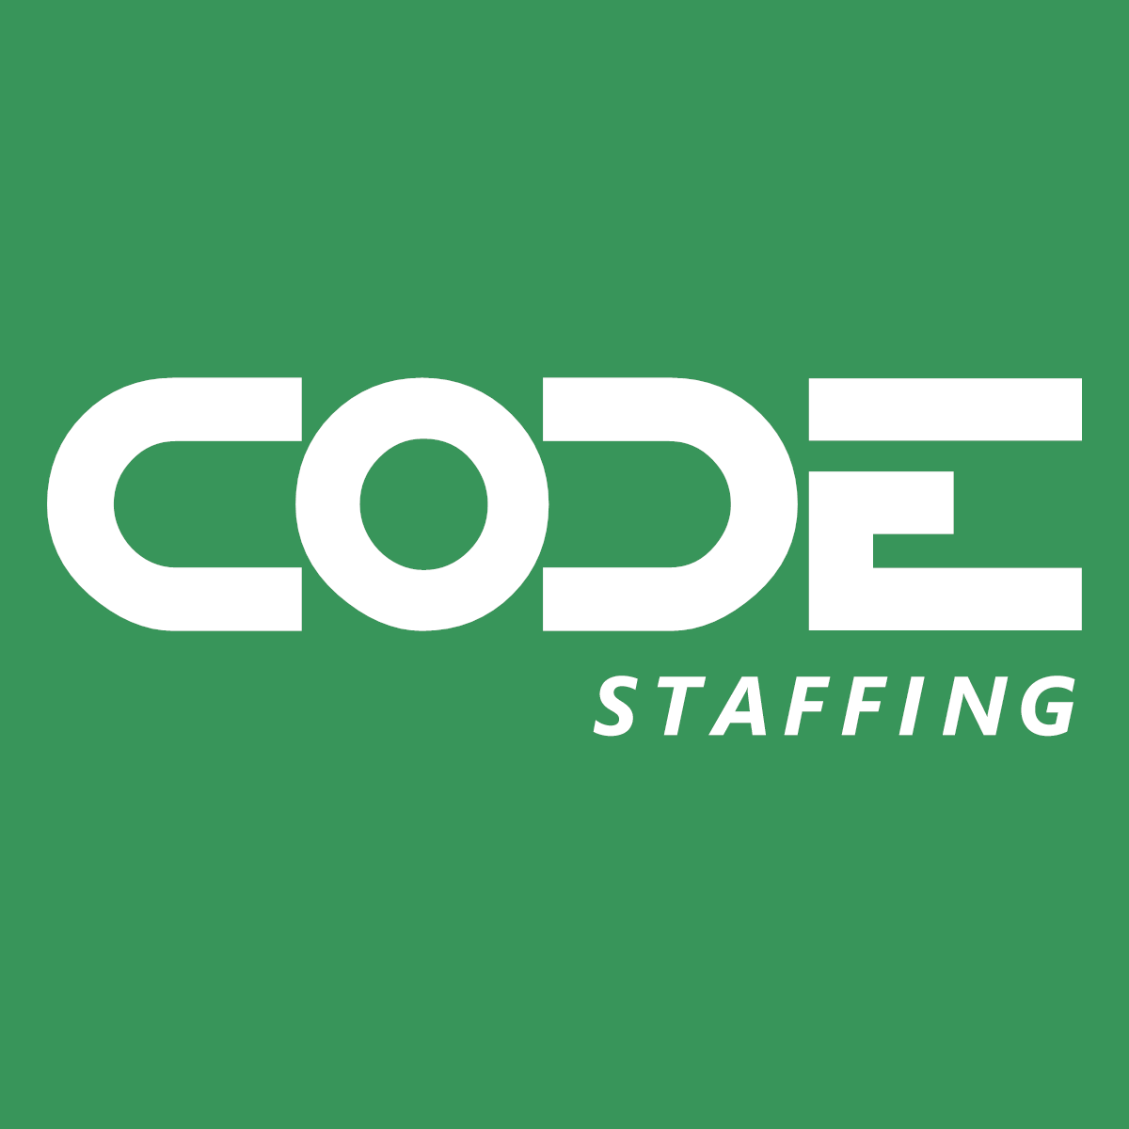
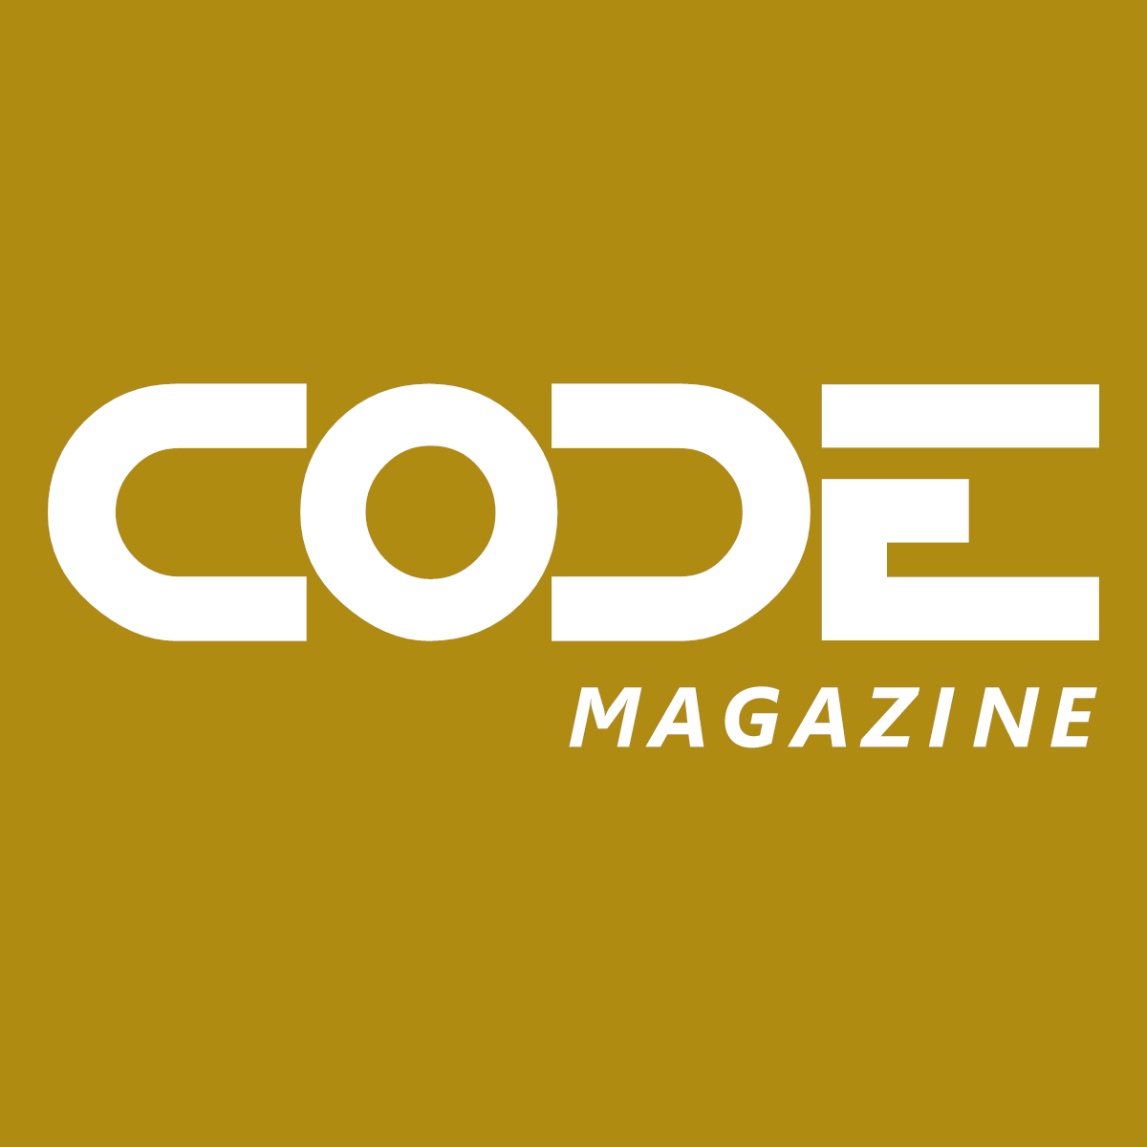
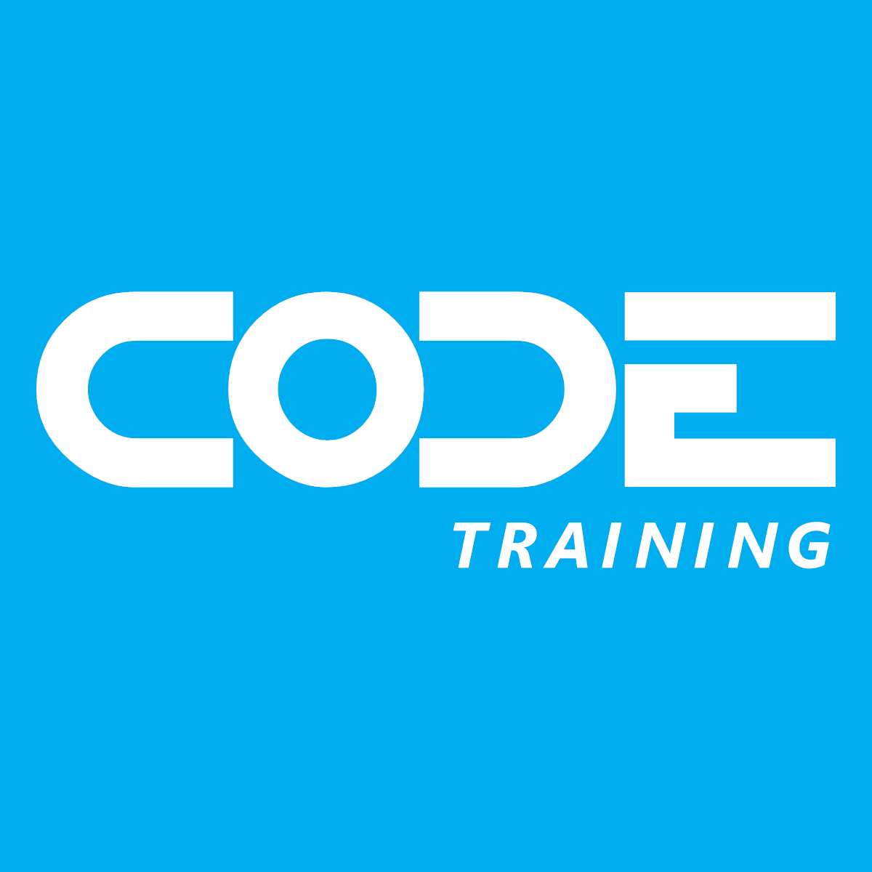
30 years of
“Helping People Build Better Software”
Notes:
OBS: Slides
CODE is a custom software company, a staff augmentation company, CODE Magazine for software developers, and training like this webinar. We've been in business for 30 years and the magazine just hit its 25th anniversary. Visit the website at https://www.codemag.com/ for more details.

Slide 3
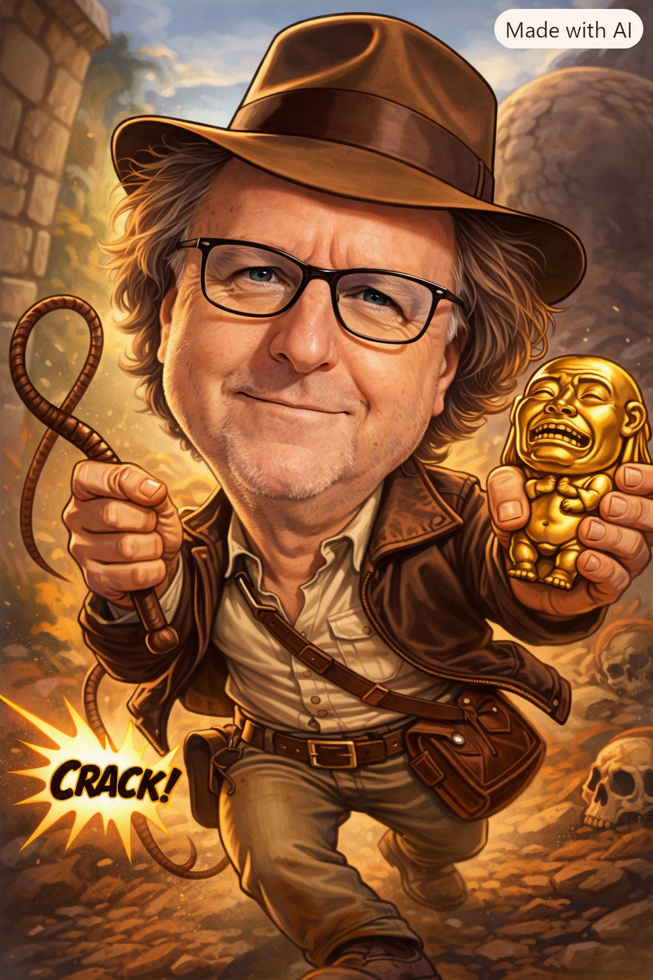
John Michael Miller
Principal Software Archaeologist/Architect/Engineer
Played roles of developer, architect, devops engineer, platform engineer, test architect, release manager
AI Practitioner and advocate for effectively using AI to write code
LinkedIn: www.linkedin.com/in/johnmichaelmiller
Email: john.miller@codegroup.io
Blog: codemag.com/blog/AIPractitioner
Notes:
OBS: Slides
John Michael Miller is a Principal Software Engineer at CODE with over 15 years of experience in software development. He has held various roles including developer, architect, DevOps engineer, platform engineer, test architect, and release manager. John is an AI/ML enthusiast and advocates for effectively using AI to write code. You can connect with him on LinkedIn, reach out via email, or read his blog posts on AI-assisted software development.
- [AI Practitioner Resources](codemag.com/aipractitioner)
---
Source: slides\marp\instructors\jMM-Software-Archaeologist.deck.md

Slide 4
Agenda
Frame the question before exploring the code
Recover evidence from code, tests, configuration, history, and runtime context
Map behavior, dependencies, risks, and unknowns with AI
Verify findings and distinguish facts from inferences
Turn discoveries into a prioritized modernization backlog
Notes:
OBS: Slides and Camera
Duration ~00:03
- Frame a question before touching code
- Pull evidence: source, tests, config, history, runtime
- Map behavior, dependencies, risks, unknowns with AI
- Verify — keep facts separate from guesses
- Land on a prioritized, defensible backlog
---
Source: slides\marp\software-archaeology-with-ai.deck.md

Slide 5
What Is Software Archaeology?
Software archaeology is the disciplined investigation of an existing system to recover:
The behavior it exhibits today
The decisions and constraints that shaped it
The dependencies and risks surrounding a change
The evidence still needed before acting with confidence
It is discovery before modification: observe, corroborate, record, and only then change.
Notes:
Duration ~00:04
OBS: Slides and Camera
- Disciplined investigation of an inherited system
- Recover: current behavior, shaping decisions, dependencies, missing evidence
- Discipline: discovery before modification
- Sequence: observe → corroborate → record → change
---
Source: slides\marp\software-archaeology-with-ai.deck.md

Slide 6
The Job Is Not "Read All the Code"
Answer a specific change, risk, or behavior question
Build a trail from observable evidence to a defensible conclusion
Separate what the system does, what we infer, and what remains unknown
Stop when the next decision is safe enough to make
Notes:
Duration ~00:04
OBS: Slides and Camera
- Not reading every line — not even possible
- Job = answer one specific change/risk/behavior question
- Separate: what it does vs. what we infer vs. what's unknown
- Stop when the next decision is safe enough
---
Source: slides\marp\software-archaeology-with-ai.deck.md

Slide 7
Why This Matters Now
Production systems carry years of business decisions and operational workarounds
Delivery pressure encourages changes before intent is understood
AI can search, summarize, and connect evidence faster than a person working alone
AI can also create plausible stories that the codebase never supported
Notes:
Duration ~00:04
OBS: Slides and Camera
- Production carries years of undocumented decisions and workarounds
- Delivery pressure pushes changes before understanding
- AI searches/connects evidence fast — but can also fabricate a plausible story
- Reframe the promise: better evidence, not skipped verification
---
Source: slides\marp\software-archaeology-with-ai.deck.md

Slide 8
Meet the Software Archeologist
What it is
A custom AI agent for investigating unfamiliar or legacy code
Starts with a question, boundary, and stop condition
Produces cited findings instead of an unbounded architecture summary
Remains non-destructive unless implementation is separately requested
What it can do
Map entry points, behavior, dependencies, data, and operational context
Mine history to recover intent, while corroborating it with tests, configuration, runtime evidence, or domain owners
Label claims as fact, inference, or open question
Build an evidence ledger and shape prioritized modernization backlog items
Notes:
Duration ~00:05
OBS: Slides and Camera
- Custom agent for unfamiliar/legacy code — not a rewrite tool
- Every investigation: question, boundary, stop condition
- Returns cited findings, not an open-ended essay
- Maps entry points, behavior, dependencies, data, ops context
- Mines history, corroborates against tests/config/runtime
- Labels every claim: fact / inference / open question
- Won't touch code unless separately asked to implement
---
Source: slides\marp\software-archaeology-with-ai.deck.md

Slide 9
The Archaeologist's Posture
Work from evidence
Read before proposing changes
Treat repository artifacts as primary sources
Capture file paths, symbols, tests, and configuration as you go
Prefer a smaller verified conclusion to a broad attractive guess
Preserve uncertainty
Label facts, inferences, and open questions separately
Ask what evidence could disprove the current theory
Keep investigation steps small and reversible
Escalate domain questions to the people who own the decision
Notes:
Duration ~00:04
OBS: Slides and Camera
- Habit 1 — work from evidence: read first, cite paths/symbols, prefer small verified wins
- Habit 2 — preserve uncertainty: label claims, ask what would disprove the theory
- Keep steps small and reversible
- Escalate domain questions to the actual owners
---
Source: slides\marp\software-archaeology-with-ai.deck.md

Slide 10
Review the Software Archaeologist Agent
Notes:
OBS: VS Code Demo
Introduces a specialized Software Archeologist agent.
Investigates unfamiliar or legacy code before changes are made.
Reconstructs code history, intent, dependencies, and hidden risks.
Uses commands such as @excavate, @date-strata, and @risk-map.
Requires every investigation to define a clear boundary and stop condition.
Separates facts, inferences, and open questions.
Produces an evidence ledger and fragility assessment.
Remains non-destructive: it recommends changes but does not modify code.
Demonstrate with @excavate on a module such as stream.py.
Emphasize the outcome: safer decisions backed by repository evidence.

Slide 11
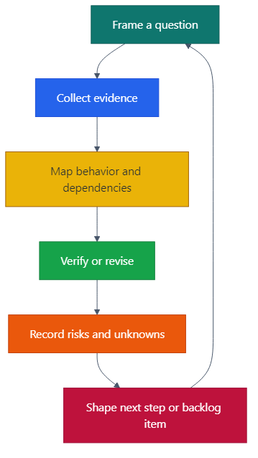
The Archaeology Loop
Each pass should make one decision safer or expose the next question
AI accelerates collection and synthesis; people validate conclusions and choose tradeoffs
Notes:
Duration ~00:05
OBS: Slides and Camera
- Frame question → collect evidence → map behavior/dependencies
- Verify or revise → record risks/unknowns → shape next step
- Loop repeats
- AI = collection + synthesis; people = validation + tradeoffs
---
Source: slides\marp\software-archaeology-with-ai.deck.md

Slide 12
Pass 1: Orient the Investigation
Locate application entry points, runnable projects, and public interfaces
Inventory ownership clues: folders, READMEs, manifests, build scripts, and runbooks
Identify the smallest plausible boundary around the question
Ask AI for an evidence-indexed map, not a generic architecture summary
Notes:
Duration ~00:05
OBS: Slides and Camera
- Find entry points, runnable projects, public interfaces
- Inventory ownership clues: folders, READMEs, manifests, runbooks
- Pick the smallest plausible boundary
- Ask AI for an evidence-indexed map — not a generic summary
- Point out: prompt demands citations + unknowns
---
Source: slides\marp\software-archaeology-with-ai.deck.md

Slide 13
Pass 2: Trace Behavior End to End
Start at a user action, API route, message, scheduled job, or command
Follow calls until you reach state changes, external effects, and error handling
Read nearby tests to learn the observable contract
Record branch conditions and side effects that could change outcomes
Notes:
Duration ~00:05
OBS: Slides and Camera
- Start at a user action: route, message, job, command
- Follow to state changes, external effects, error handling
- Read nearby tests — they define the observable contract
- Record branch conditions and side effects (that's where business rules hide)
---
Source: slides\marp\software-archaeology-with-ai.deck.md

Slide 14
Pass 3: Map Dependencies and Data
Trace inbound callers and outbound services, queues, files, and databases
Identify schemas, persistence boundaries, feature flags, and configuration switches
Distinguish a compile-time reference from a runtime dependency
Look for shared tables, implicit contracts, and one-way migrations
Notes:
Duration ~00:05
OBS: Slides and Camera
- Trace inbound callers and outbound services/queues/files/DBs
- Find schemas, persistence boundaries, feature flags, config switches
- Distinguish compile-time reference vs. runtime dependency
- Watch for shared tables, implicit contracts, one-way migrations
---
Source: slides\marp\software-archaeology-with-ai.deck.md

Slide 15
Pass 4: Recover History and Operations
Use commit history, issue links, release notes, and migrations to recover rationale
Compare code assumptions with dashboards, alerts, traces, and incident notes
Treat comments as clues, not proof, until corroborated
Identify decisions that were locally rational but may no longer fit today
Notes:
Duration ~00:05
OBS: Slides and Camera
- Use commits, issues, release notes, migrations to recover "why"
- Compare code assumptions against dashboards, alerts, traces, incidents
- Treat comments as clues, not proof
- Look for decisions that were rational once, maybe not now
---
Source: slides\marp\software-archaeology-with-ai.deck.md

Slide 16
Let AI Do the Expensive First Pass
Useful AI work
Locate likely entry points and related artifacts
Summarize a bounded file or call chain
Compare tests with implementation branches
Extract candidates for contracts, risks, and questions
Human-owned judgment
Confirm claims against primary evidence
Resolve domain intent and acceptable risk
Decide scope, sequencing, and ownership
Approve any code or configuration change
Notes:
Duration ~00:04
OBS: Slides and Camera
- AI's job: find entry points, summarize bounded chains, compare tests vs. implementation, surface candidate risks/questions
- Our job: confirm claims, resolve domain intent, decide scope/sequencing, approve changes
---
Source: slides\marp\software-archaeology-with-ai.deck.md

Slide 17
Keep an Evidence Ledger
Claim | Evidence | Confidence | Unknown / next check
/play is registered during startup | init, ALL_MODULES, play_commnd | High | Confirm import order in deployment
/playforce prepends the queue entry | PlayWrapper, put_queue(forceplay=...) | High | Check skip behavior after forced playback
Callback IDs preserve the request contract | track_markup, play_music, play_live_stream | Medium | Check stale-button and unauthorized cases
Notes:
Duration ~00:05
OBS: Slides and Camera
Every investigation leaves a ledger: claim, evidence, confidence, and next check. The format does not matter; markdown, an issue comment, or a PR description can all work. The purpose is to make the evidence durable so someone else can challenge or extend it without starting over. Confidence is evidence quality, not personal certainty.
---
Source: slides\marp\software-archaeology-with-ai.deck.md

Slide 18
Detecting Attractive but Wrong Answers
A fluent summary without file or symbol references is not evidence
A broad architecture diagram may omit runtime configuration and external contracts
An AI-generated test can repeat an incorrect assumption
A missing search result can mean a different name, generated code, or a runtime path
Countermeasure: ask, "What observation would prove this conclusion wrong?"
Notes:
Duration ~00:04
OBS: Slides and Camera
- Every investigation leaves a ledger: claim, evidence, confidence, next check
- Format doesn't matter — markdown file, issue comment, PR description
- Purpose: someone else can pick it up without starting over
- Confidence = evidence quality, not personal certainty
---
Source: slides\marp\software-archaeology-with-ai.deck.md

Slide 19
From Findings to Risk Statements
Behavior risk: a user-visible outcome may change unexpectedly
Contract risk: another system depends on an undocumented shape or timing
Operational risk: rollback, monitoring, or ownership is insufficient
Delivery risk: the change is too large to verify or release safely
Write risks in terms of a decision: "Changing X could affect Y because Z evidence shows..."
Notes:
Duration ~00:04
OBS: Slides and Camera
- Behavior risk — user-visible outcome changes unexpectedly
- Contract risk — another system depends on undocumented shape/timing
- Operational risk — rollback/monitoring/ownership gap
- Delivery risk — change too big to verify safely
- Template: "Changing X could affect Y, because Z evidence shows...
---
Source: slides\marp\software-archaeology-with-ai.deck.md

Slide 20
Shape Modernization Candidates
Add a focused characterization test around a high-value behavior
Make a hidden contract explicit at a boundary
Add telemetry before changing an uncertain path
Isolate a dependency behind a stable interface
Retire or document a feature flag after validating its real usage
Good candidate: small enough to verify, reversible enough to learn from, valuable enough to matter.
Notes:
Duration ~00:04
OBS: Slides and Camera
- Add a characterization test around valuable behavior
- Make a hidden contract explicit
- Add telemetry before touching an uncertain path
- Isolate a dependency behind a stable interface
- Retire a flag once usage is validated
- Good candidate = small to verify, reversible, valuable
---
Source: slides\marp\software-archaeology-with-ai.deck.md

Slide 21
Prioritize the Backlog With Evidence
Candidate | Value | Risk reduced | Evidence confidence | First move
Characterize /play stream handoff failures | High | High | Medium | Test YouTube, Telegram, and SoundCloud paths
Document callback payload contracts | Medium | Medium | High | Record MusicStream and playlist fields
Replace the provider resolution layer | High | Unknown | Low | Map all callers and result shapes first
Notes:
Duration ~00:05
OBS: Slides and Camera
- Columns: value, risk reduced, evidence confidence, first move
- Call out row 3: high value but low confidence → investigation item, not a commitment
- Rule: prioritize risk reduction/learning before big replacement work
---
Source: slides\marp\software-archaeology-with-ai.deck.md

Slide 22
Archaeology Does Not End at the Backlog
Keep change sets small enough for humans to review the evidence
Preserve behavior unless the decision explicitly changes it
Add tests, telemetry, or feature flags before high-uncertainty changes
Record new findings in the same evidence trail
Treat every completed item as a better map for the next investigation
Notes:
Duration ~00:04
OBS: Slides and Camera
- Keep changes small enough to review against the evidence
- Preserve behavior unless the decision says otherwise
- Add tests/telemetry/flags before high-uncertainty changes
- Keep recording findings in the same trail
- Every completed item = a better map for next time
---
Source: slides\marp\software-archaeology-with-ai.deck.md

Slide 23
Meet MusicBot
A fork of a GitHub repository written in Python
Selected essentially at random from a list of large Python repositories
Treated here as an unknown codebase we have been asked to improve
Our job is to recover enough evidence to choose a safe, useful next step
https://github.com/jMM-at-CODEGroup/MusicBot
Notes:
Duration ~00:04
OBS: Slides and Camera
- Fork of a GitHub repo, Python, picked essentially at random
- Treat it as: an unknown codebase we've been asked to improve
- Our job: recover enough evidence to pick one safe next step
---
Source: slides\marp\software-archaeology-with-ai.deck.md

Slide 24
Walkthrough
An unfamiliar path becomes a first backlog item
Notes:
Duration ~00:02
OBS: Slides and Camera
- Not here to show off a clever AI answer
- Modeling a repeatable process
- Watch for: evidence, uncertainty, decision points — not every keystroke
---
Source: slides\marp\software-archaeology-with-ai.deck.md

Slide 25
Step 1: Frame the Question
Using the Software-Archaeologist agent, submit this prompt:
Investigate what could break if we change the MusicBot /play workflow. Start by validating the question, boundary, and stop condition. Put the response in the file docs/investigations/play-workflow.md. Do not inspect code yet.
Notes:
Duration ~00:03
OBS: Slides and Camera
- Question: what could break if we change this workflow
- Boundary: entry point → handler → streaming handoff
- Stop condition: enough evidence for one safe, high-value first item
---
Source: slides\marp\software-archaeology-with-ai.deck.md

Slide 26
Step 2: Locate the Source Boundary
Using the Software-Archaeologist agent, submit this prompt:
@locate-source-boundary
Use the Investigation Framing in docs/investigations/play-workflow.md
Notes:
Duration ~00:03
OBS: Slides and Camera
- Question: what could break if we change this workflow
- Boundary: entry point → handler → streaming handoff
- Stop condition: enough evidence for one safe, high-value first item
---
Source: slides\marp\software-archaeology-with-ai.deck.md

Slide 27
Step 3: Build the First Evidence Map
1. Locate the entry point and its immediate handler
2. Identify related tests, configuration, and domain terms
3. Ask AI for cited facts, hypotheses, unknowns, and next files
4. Verify the highest-impact claims in the actual source
Run in the Software Archeologist agent:
@excavate
Use docs/investigations/source-boundary.md to investigate the MusicBot `/play`
workflow. Put the evidence map in docs/investigations/play-evidence-map.md.
Do not propose or make code changes.
Notes:
Duration ~00:05
OBS: Slides and Camera
- Find entry point and handler
- Find nearby tests/config/domain terms
- Run @excavate with the boundary and stop condition shown, asking for cited facts, hypotheses, unknowns, and next files
- Verify highest-impact claims in source myself
OBS: VS Code Demo
---
Source: slides\marp\software-archaeology-with-ai.deck.md

Slide 28
Step 4: Trace Effects and Contradictions
Follow success, failure, retry, and cancellation branches
Identify data writes, emitted events, and external calls
Compare implementation paths with tests and configuration
Record contradictions rather than forcing a single story
Run in the Software Archeologist agent:
@corroborate
Use docs/investigations/play-evidence-map.md.
Put the corroboration record in docs/investigations/play-corroboration.md.
Do not propose or make code changes.
Notes:
Duration ~00:05
OBS: Slides and Camera
- Follow success/failure/retry/cancellation
- Identify data writes, emitted events, external calls
- Run the corroboration prompt shown, comparing against tests/config
- Write down contradictions instead of forcing a tidy story
OBS: VS Code Demo
---
Source: slides\marp\software-archaeology-with-ai.deck.md

Slide 29
Step 5: Produce the First Backlog Item
Run in the Software Archeologist agent:
@shape-backlog
Use docs/investigations/play-evidence-map.md and docs/investigations/play-corroboration.md.
Put the prioritized backlog in docs/investigations/play-backlog.md.
Do not implement changes.
Notes:
Duration ~00:05
OBS: Slides and Camera
- State the risk surfaced during the demo
- Run @shape-backlog to turn the ledger into evidence-backed candidates
- State the small, safe first move
- Call out: safety improvement, not a rewrite — earns the right to a bigger change later
OBS: VS Code Demo
---
Source: slides\marp\software-archaeology-with-ai.deck.md

Slide 30
Take This Back to Your Team
1. Pick one upcoming change with uncomfortable uncertainty
2. Frame a question, boundary, and stopping condition
3. Use AI to create a cited evidence map
4. Verify the claims that could change the decision
5. Turn the result into one small, safe backlog item
The goal is not perfect knowledge. It is the next justified move.
Notes:
Duration ~00:04
OBS: Slides and Camera
- Pick one change you're uncomfortable making
- Frame a question, boundary, stop condition
- Ask AI for a cited evidence map
- Verify only the claims that would change your decision
- Turn it into one small, safe backlog item
- Close: "not perfect knowledge — the next justified move"
---
Source: slides\marp\software-archaeology-with-ai.deck.md

Slide 31
Discussion and Q&A
Where does your team lose the most system knowledge?
Which source of evidence is hardest to access or trust?
What would make an AI-assisted archaeology workflow safe in your environment?
Which modernization candidate could be reframed as a learning step first?
Notes:
Duration ~00:10
OBS: Slides and Camera
- Where does your team lose the most system knowledge?
- Which evidence source is hardest to trust or access?
- What would make this workflow safe in your environment?
- Any modernization idea that's really a learning step in disguise?
- Take questions, thank the audience
---
Source: slides\marp\software-archaeology-with-ai.deck.md

