Slide 1


Group Members:
Linda Levy
Raph Serrano
Swobabika Jena
Jason Sutton

Slide 2
Airbnb Investment Opportunities
Money to invest
Airbnb looks like easy money
How do we decide where to establish our first listing

Slide 3
Hypothesis
Proximity to the CBD will increase earnings
Train proximity will increase earnings
Neighbourhoods with the highest earnings are the most popular areas
The popularity of property types will be reflected in higher earnings

Slide 4
Sourcing Data Downloaded: 13/01/21
Inside Airbnb (Insideairbnb.com)
.gz files – zipped large files in .gz format
.csv files
Department of Environment, Land, Water & Planning (https://land.vic.gov.au/maps-and-spatial)
.csv file

Slide 5

Data from inside Airbnb:
Extremely large datasets
Not clearly defined
Multiple columns referred to location property - neighbourhood - neighbourhood cleansed – city - smart-location
Only one of these matched the coordinates stored against the Airbnb listing
Quite messy
eg room type was free form - we had 1 ”castle” in Melbourne on the listing
Typos in information
multiple spellings and configuration of suburb names)

Slide 6
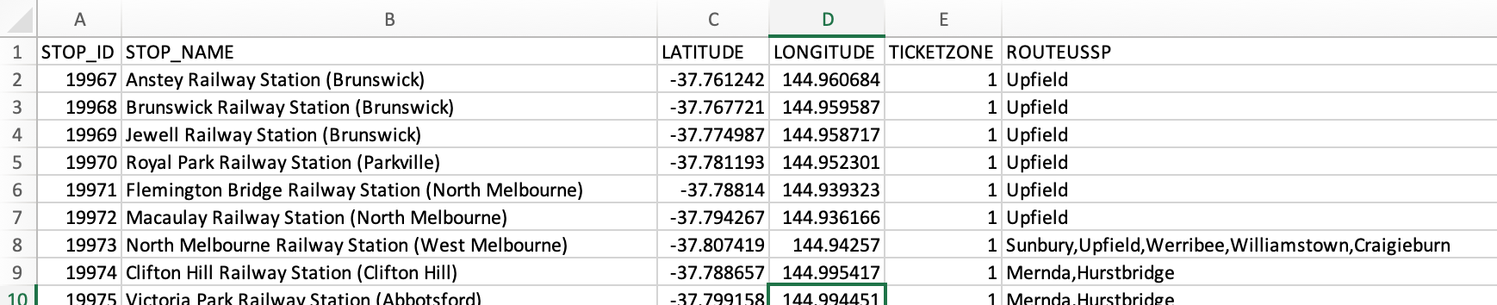

Data from DELWP was:
containing train stop name, stop id, longitude and latitude
Quite large
this was be reduced once scope for the data from insideairbnb is finalised
Clean, succinct, ready to be mined

Slide 7
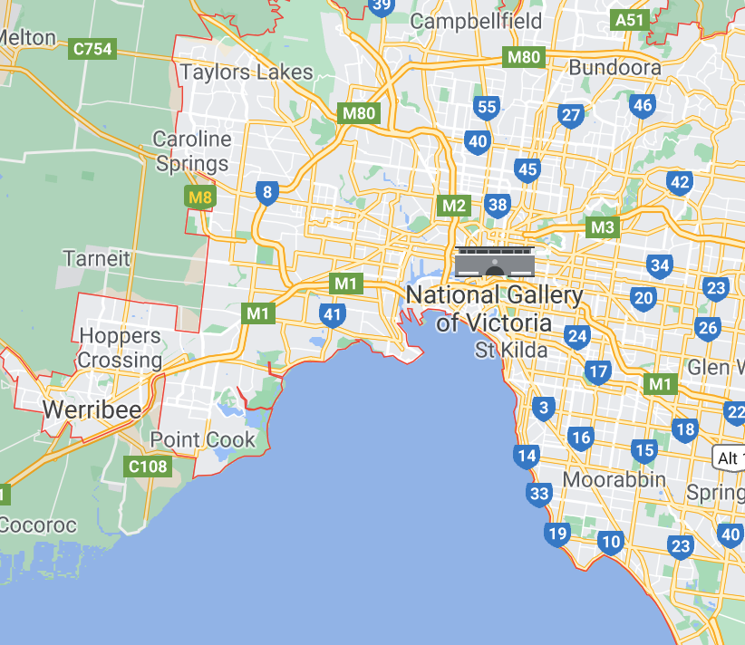

First Wave - Irrelevant records
CSV file read into Jupyter Notebook
Based on the data needs for our questions, the following records were not required and dropped from the data frame.
Room type:
The question is around investing in an Airbnb property so we are only interested in entire homes
Dropped private rooms / shared rooms / hotel rooms
Drop irrelevant columns
Neighbourhood:
To focus on purely metropolitan properties we dropped listings to within 15km of CBD
Achieved by using latitude and longitude in data to determine the distance from the CBD
Used loc property for Room type and Neighbourhood

Slide 8
Second Wave - Data clean of rubbish fields
Followed the Ultimate guide to data cleaning - towardsdatascience.com
Checked for duplicates
none identified
Check data info for null field
using df.info()
Replace null value with relevant data
Fill string values with "missing” or relevant value
Filled integer values with 0
Check the relevant columns dtypes
All columns presented as objects (strings)
converted relevant columns to integers and floats
including stripping currency of its formatting

Slide 9

Second Wave - Data clean of rubbish fields
strip leading and trailing space
checked unique values in city column
corrected spelling mistakes
formalized suburb naming conventions
dropped non-sensical data
Drop further irrelevant columns as awareness of data grew.
Lesson learned
Once the null values had been populated, each cleaning step was a discrete task – not dependant on the previous step.
The work could have been divided among the group to avoid delays.

Slide 10
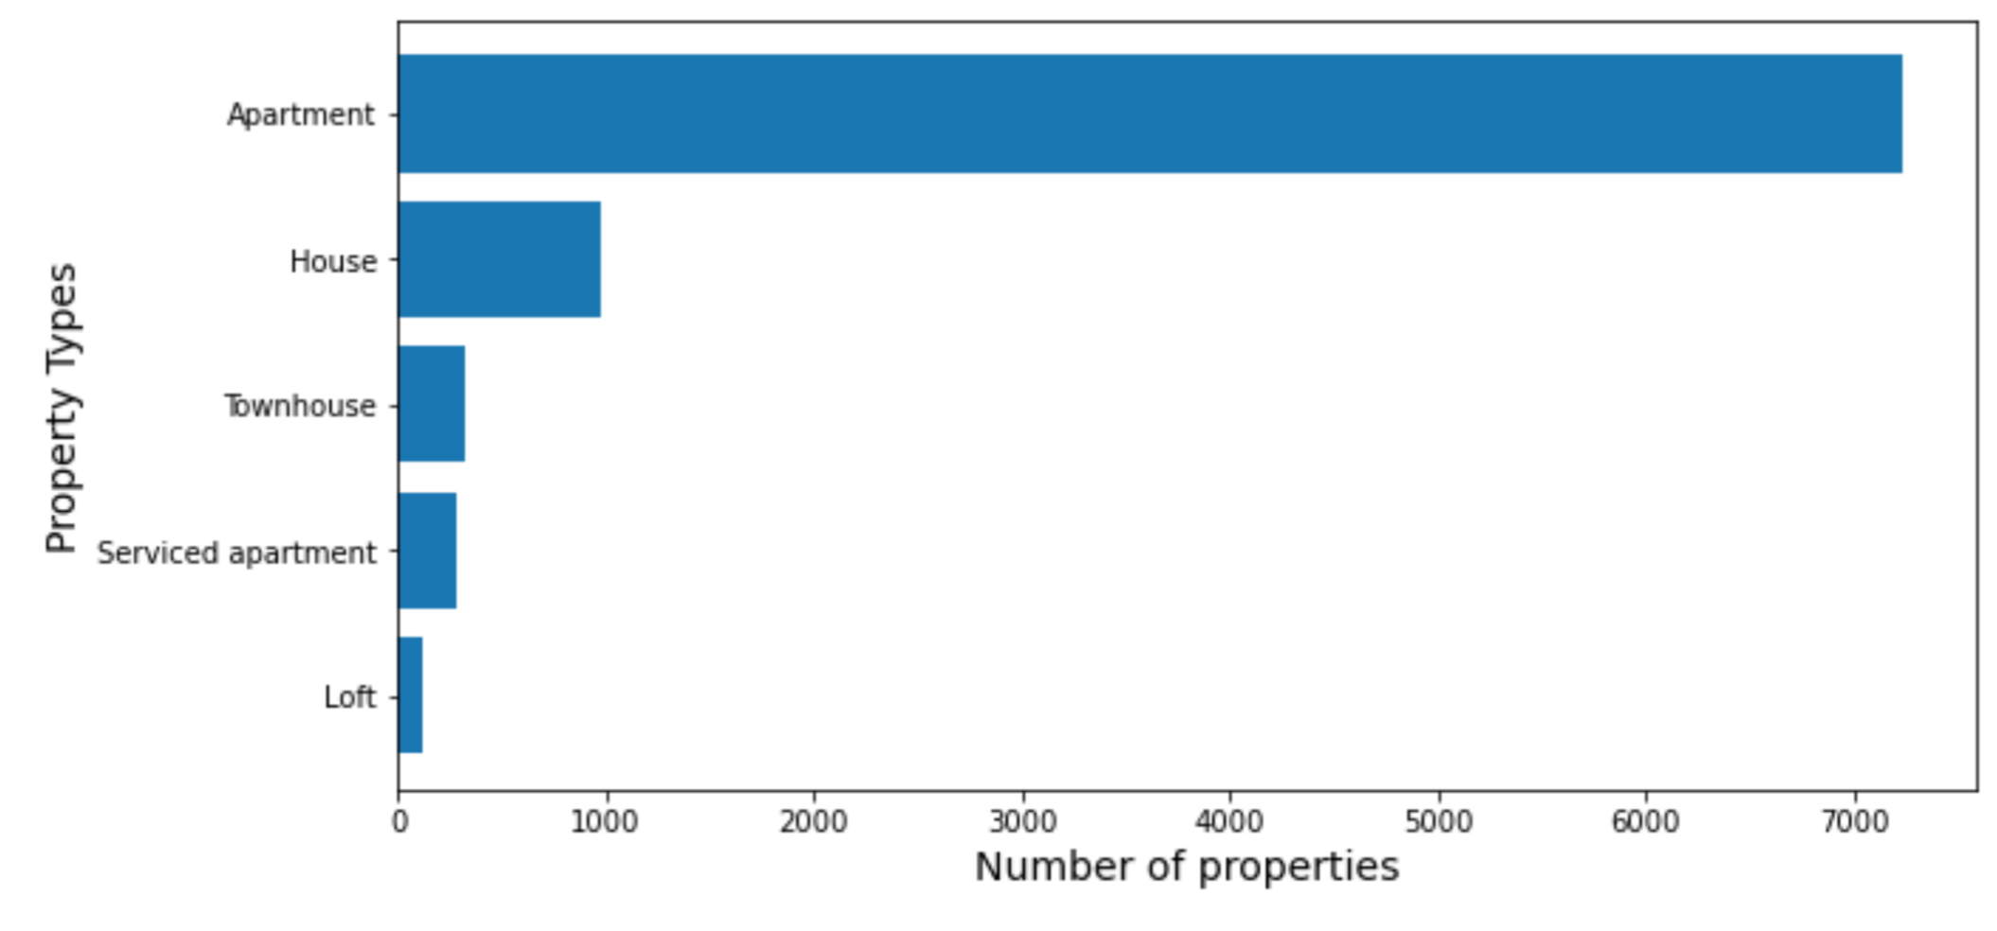
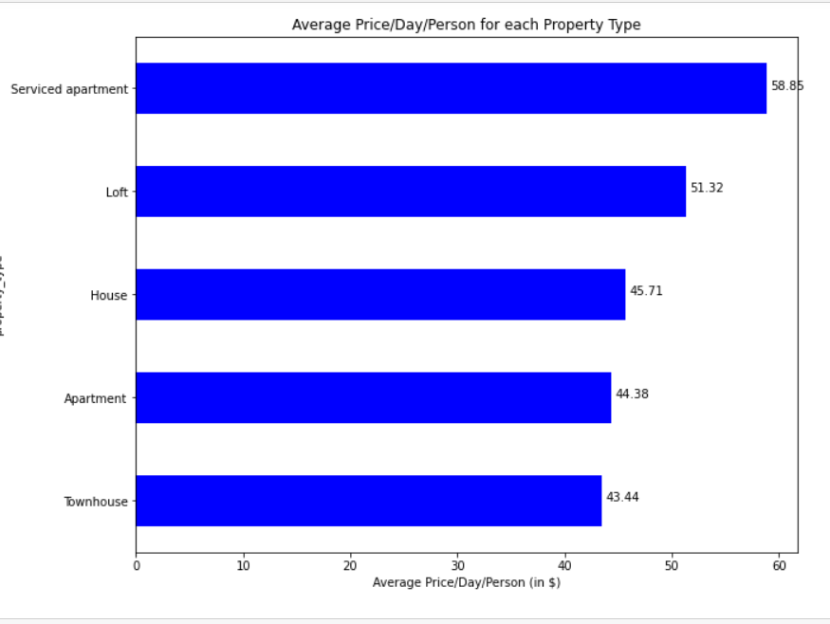

Third Wave - Decision to only analyse apartments
Apartments were the vast majority of property types.
Three other property types were showing higher rates per person
It felt unwise to be basing decisions on anything other than apartments

Slide 11
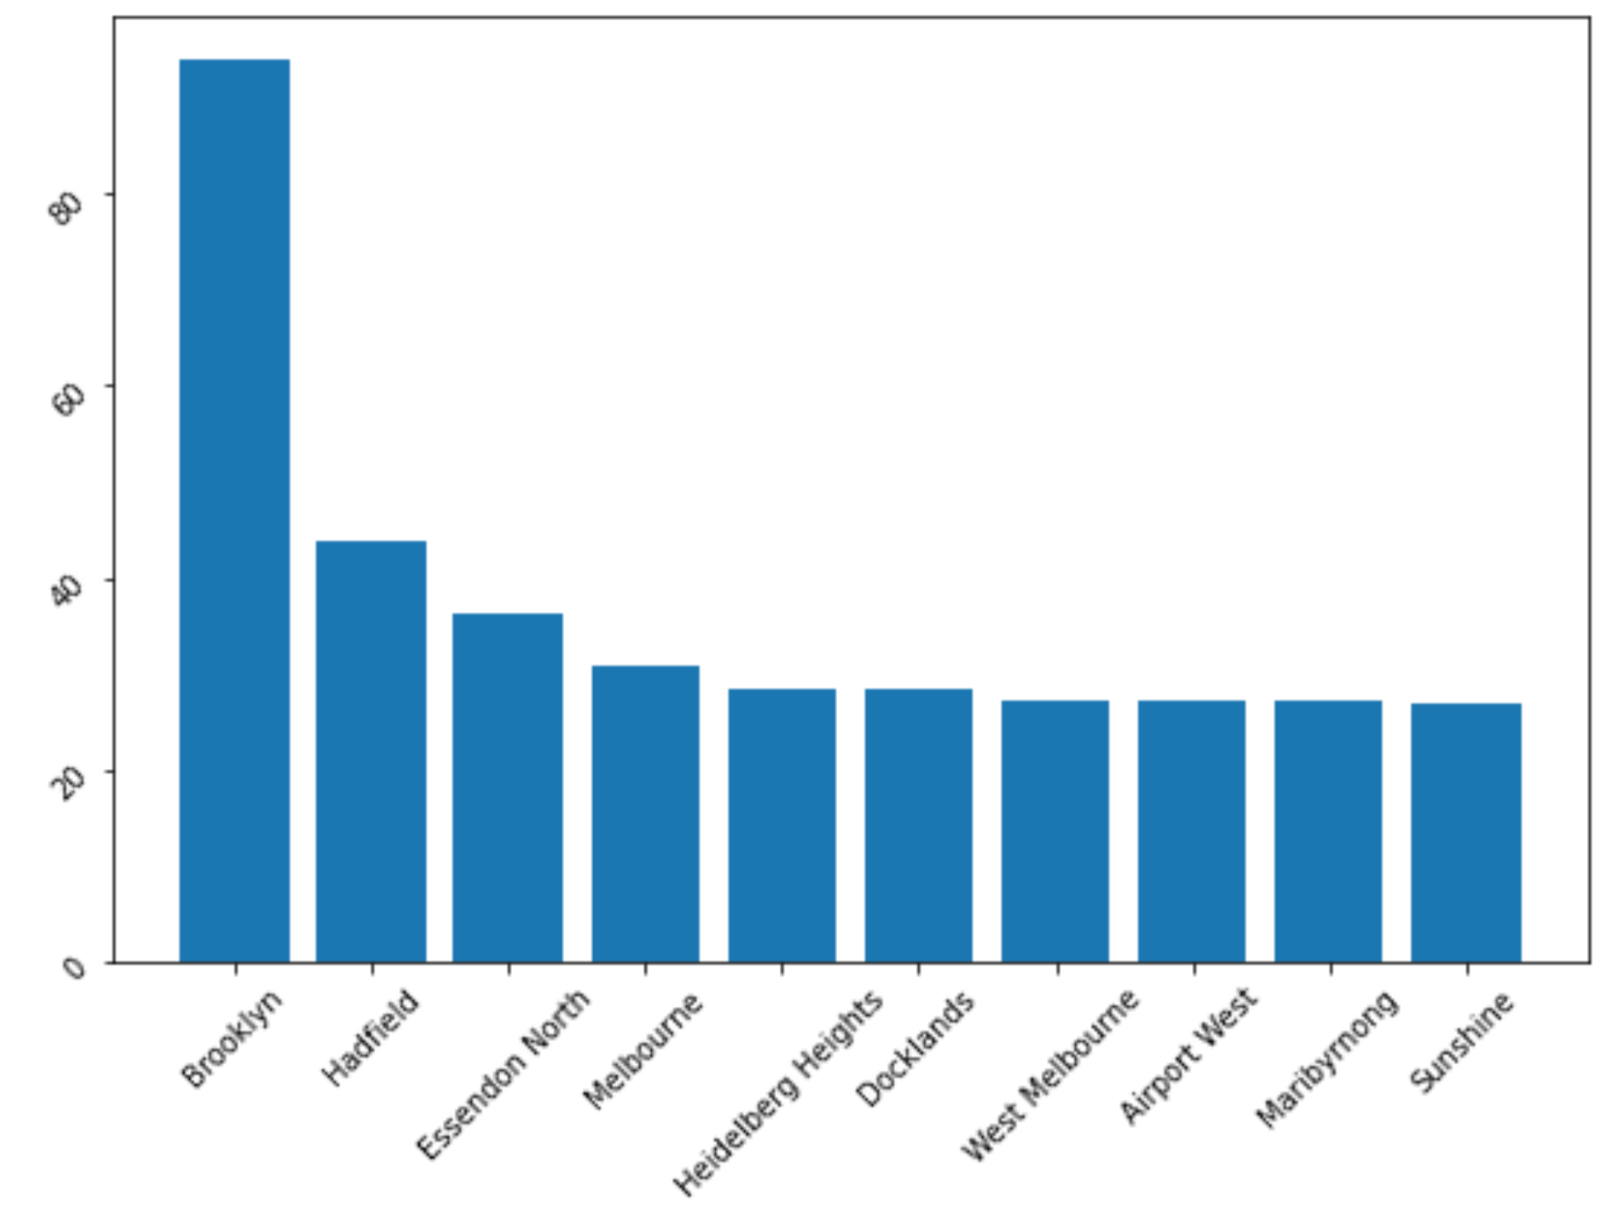


Fourth Wave - small data misleading outcomes
This led to further exploration of the data and we found a number of results didn’t ring true.
Was Brooklyn really getting the most reviews per month?
Areas of very small data sets were dramatically skewing the results in a number of areas.

Slide 12
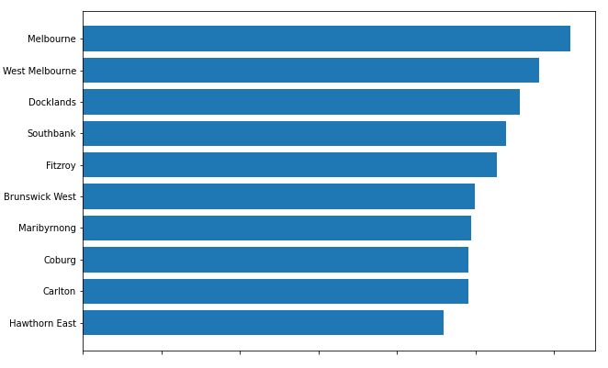

Fourth Wave - small data misleading outcomes
We made a decision to remove any suburbs with low data points as they were too small to be meaningful
The resulting data passed the common sense test
At each wave a new CSV was exported

Slide 13
DATA ANALYSIS

Slide 14
Connecting Parameters to Actual Data
 | Analysis Parameter | Indicator
1. | Proximity to CBD and Train Station | Calculated distance based on latitude and longitudinal position
2. | Earnings | Price/Day/Person
3. | Popularity of areas (Occupancy) | Reviews/month
4. | Neighborhoods | Suburbs names with more than 20 listings

Slide 15
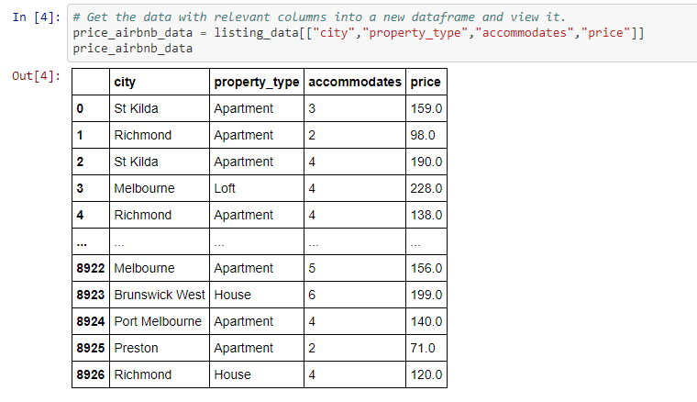
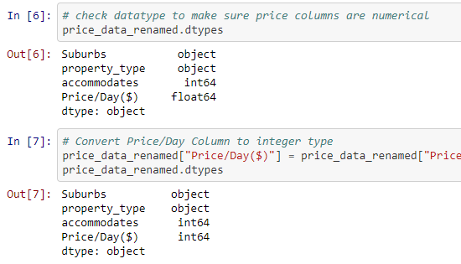
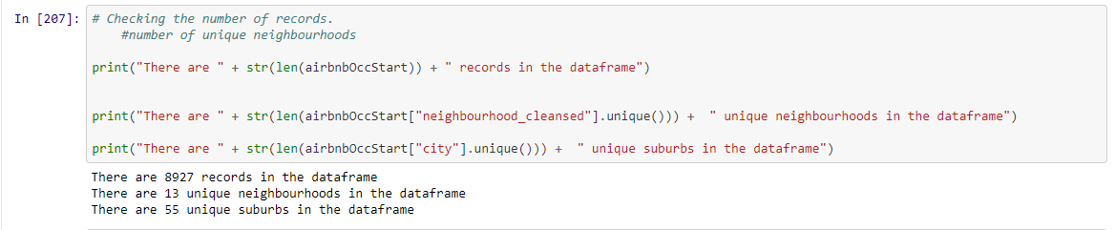
STEP 1: Filter for relevant columns: city, suburb, property type, price/day and study overall data information

Slide 16
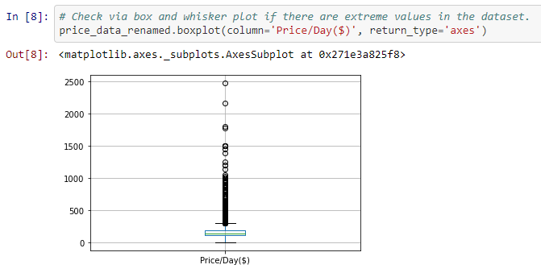
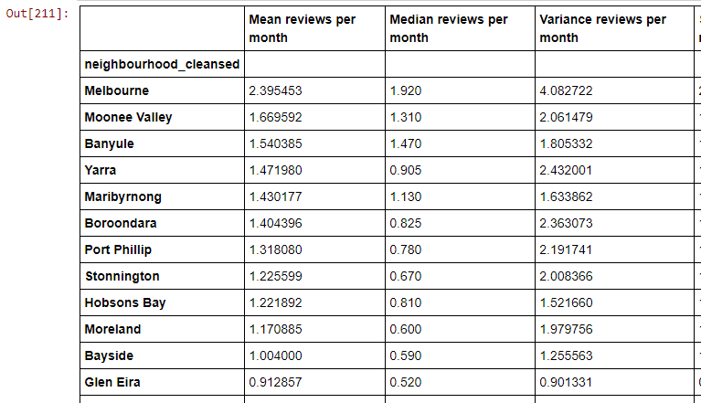
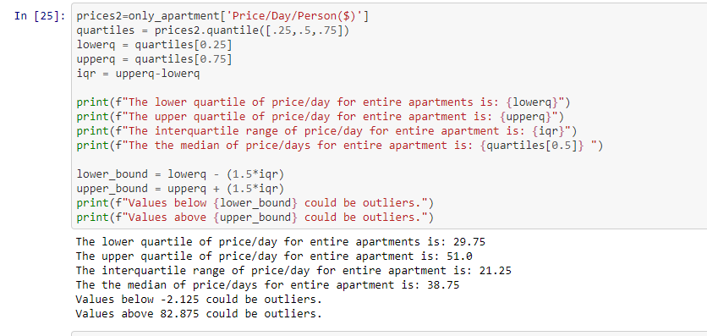
STEP 2: Statistical Analysis for checking data quality and take decisions on further filtering

Slide 17
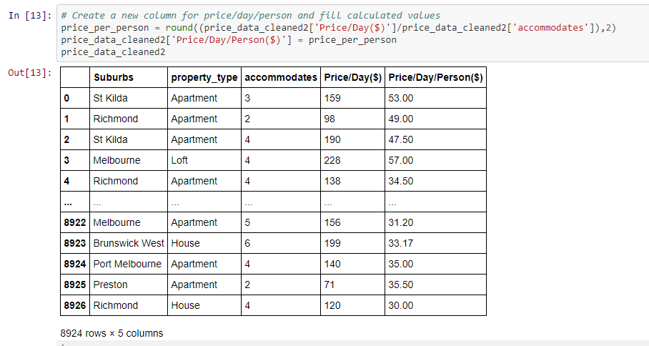
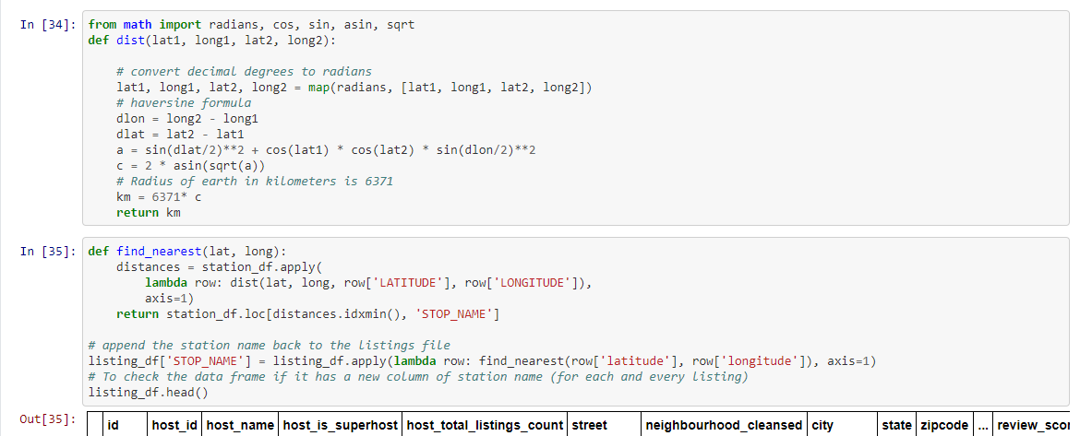
STEP 3: Perform required calculations .

Slide 18
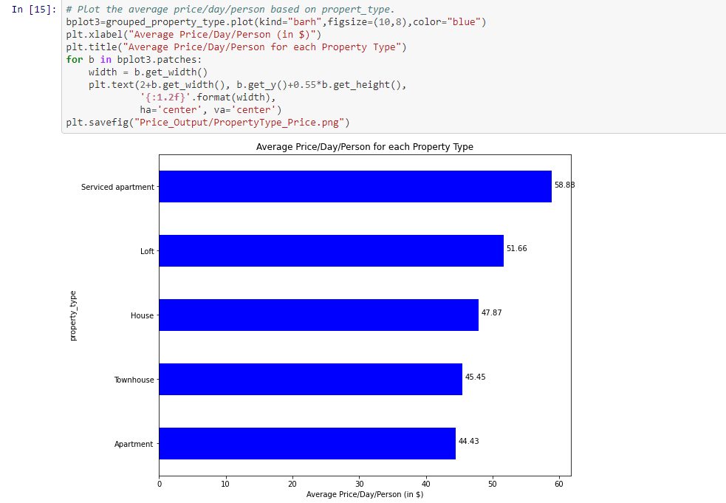
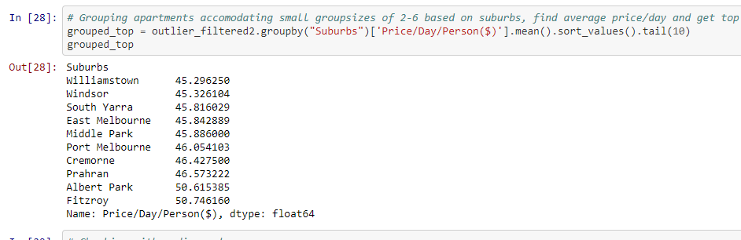
STEP 4: Group by parameters like apartment type and suburbs to study their effect..

Slide 19
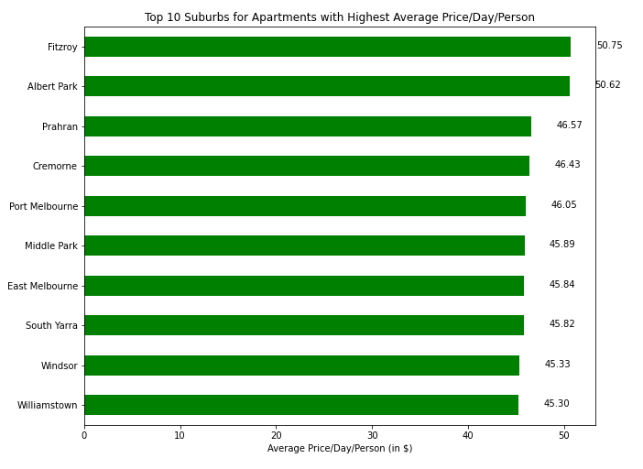
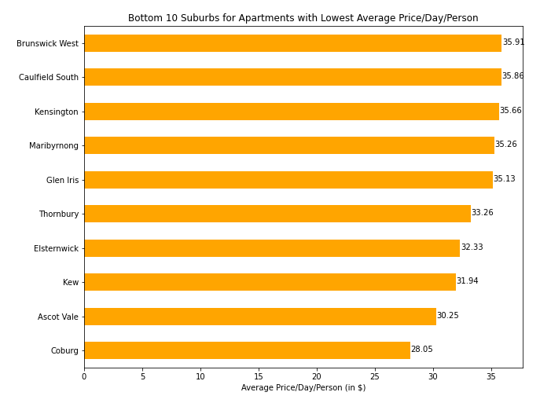
STEP 5: Rank by suburbs to analyse the top 10 and bottom 10 suburbs for our focus areas.

Slide 20
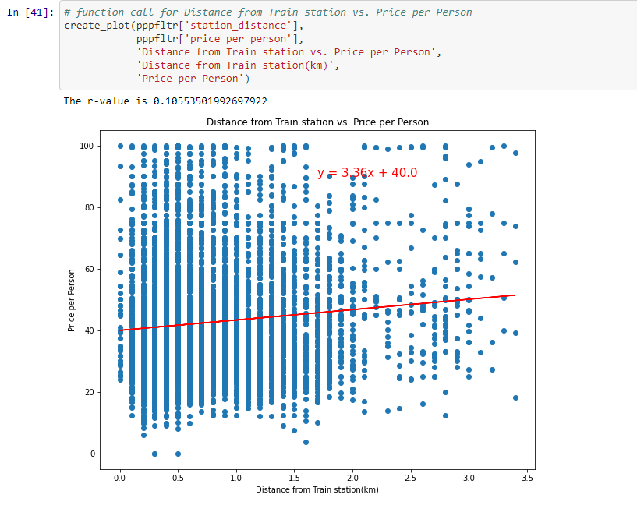
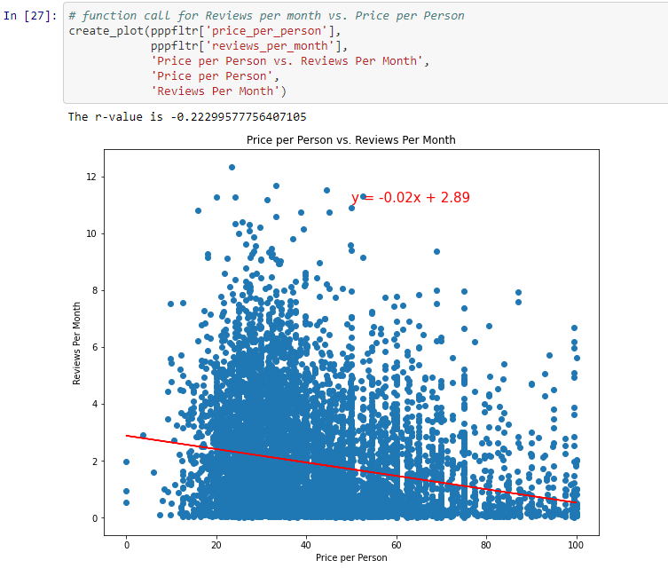
STEP 6: Use scatter plots and linear regression to establish correlation for our hypothesis.

Slide 21
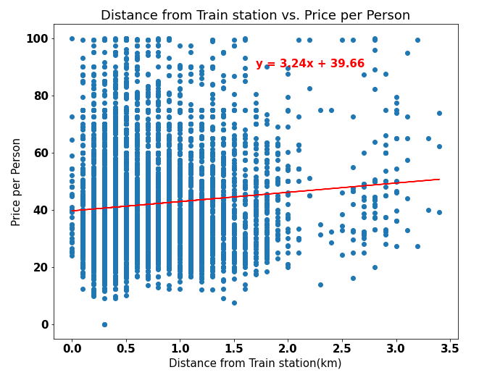
Correlations:
Earnings has a slight positive correlation with distance from train station
HYPOTHESIS:
(closer) Train proximity will increase earnings (approximate)
DATA INFERENCE:
Properties have increased prospective earnings as they are located further from the train stations

Slide 22
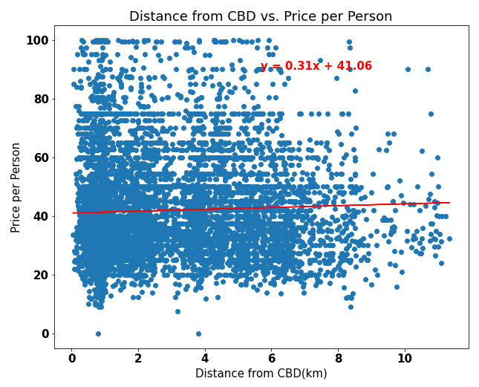
Correlations:
Price per person has a weak positive correalation with distance from CBD
HYPOTHESIS:
(Closer) Proximity to the CBD will increase earnings (approximate)
DATA RESULTS:
Approximate earnings increase slightly for properties located further from the CBD

Slide 23
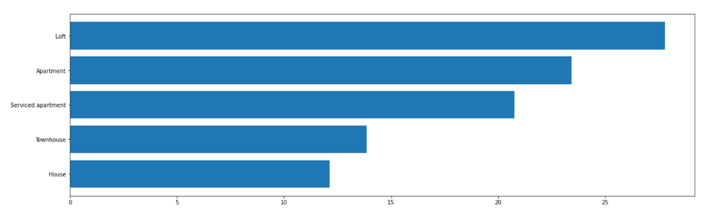
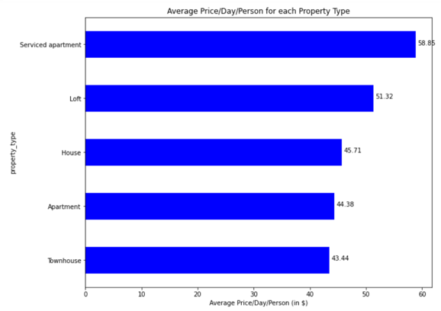
Correlations:
On property types there is no relationship between Popularity and prospective earnings
HYPOTHESIS:
Property types with highest earnings are the most popular ones
DATA RESULTS:
The data shows no correlation to prove that to be true

Slide 24
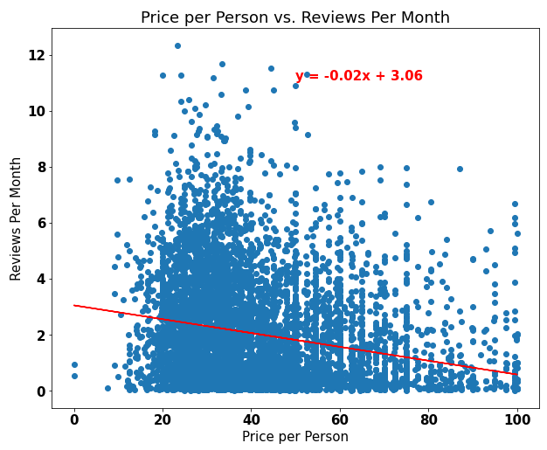
Correlations:
Popularity has a weak negative correlation with prospective earnings
HYPOTHESIS:
The Popularity of properties will be (positively) reflected in higher earnings
DATA RESULTS:
Listings with higher prospective earnings are less popular than listings with lower prospective earnings

Slide 25
Difficulties
There was not enough time to authenticate the bookings data and make use of it.
Trying to determine if this data was really going to fulfill our needs without having to search for more data later. We had to commit
Additional Questions
What aspect of the rating seems to correlate with high earners. Was location more important than quality of the property.

Slide 26
Thanks from Linda, Raph, Swobabika and Jason

