Slide 1


Group Members:
Linda Levy
Raph Serrano
Swobabika Jena
Jason Sutton

Slide 2

C. Data Wrangling
Data from inside Airbnb:
Extremely large datasets
Not clearly defined
Multiple columns referred to location property - neighbourhood - neighbourhood cleansed – city - smart-location
Only one of these matched the coordinates stored against the Airbnb listing
Quite messy
eg room type was free form - we had 1 ”castle” in Melbourne on the listing
Typos in information
multiple spellings and configuration of suburb names)

Slide 3
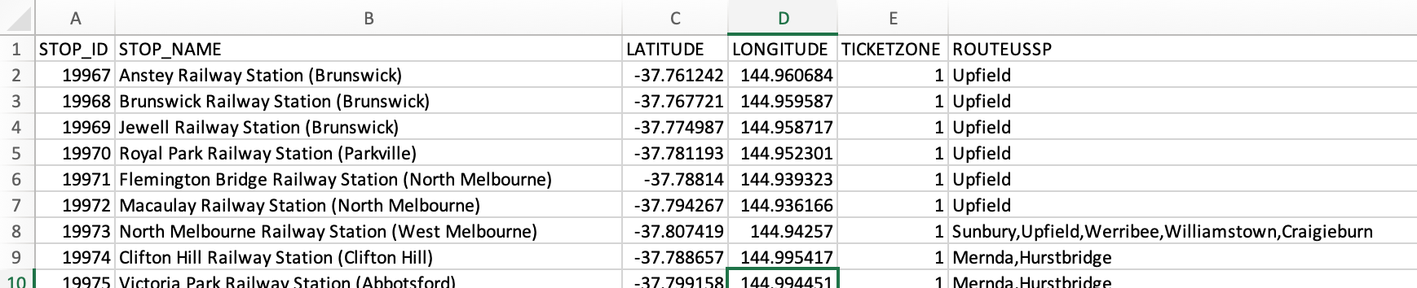

C. Data Wrangling
Data from DELWP was:
containing train stop name, stop id, longitude and latitude
Quite large
this was be reduced once scope for the data from insideairbnb is finalised
Clean, succinct, ready to be mined

Slide 4
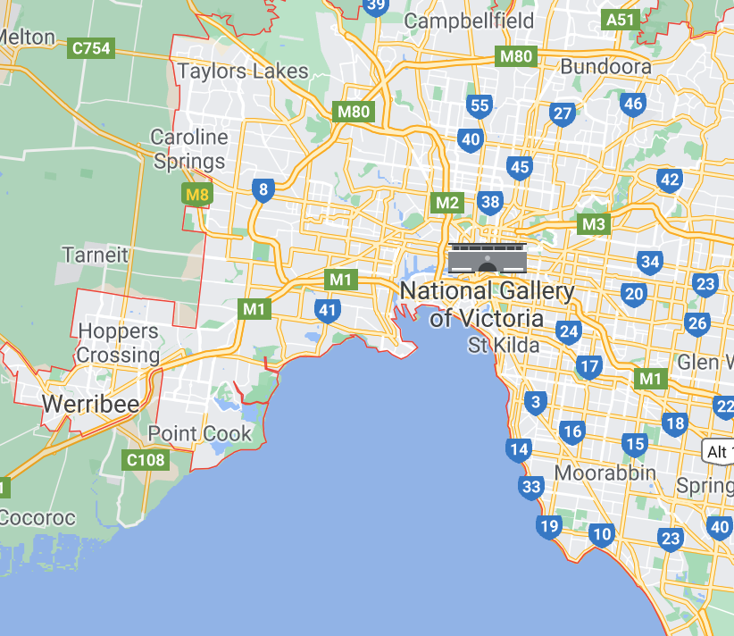

C. Data Wrangling
First Wave - Irrelevant records
CSV file read into Jupyter Notebook
Based on the data needs for our questions, the following records were not required and dropped from the data frame.
Room type:
The question is around investing in an Airbnb property so we are only interested in entire homes
Dropped private rooms / shared rooms / hotel rooms
Drop irrelevant columns
Neighbourhood:
To focus on purely metropolitan properties we dropped listings to within 15km of CBD
Achieved by using latitude and longitude in data to determine the distance from the CBD
Used loc property for Room type and Neighbourhood

Slide 5
C. Data Wrangling
Second Wave - Data clean of rubbish fields
Followed the Ultimate guide to data cleaning - towardsdatascience.com
Checked for duplicates
none identified
Check data info for null field
using df.info()
Replace null value with relevant data
Fill string values with "missing” or relevant value
Filled integer values with 0
Check the relevant columns dtypes
All columns presented as objects (strings)
converted relevant columns to integers and floats
including stripping currency of its formatting

Slide 6

C. Data Wrangling
Second Wave - Data clean of rubbish fields
strip leading and trailing space
checked unique values in city column
corrected spelling mistakes
formalized suburb naming conventions
dropped non-sensical data
Drop further irrelevant columns as awareness of data grew.
Lesson learned
Once the null values had been populated, each cleaning step was a discrete task – not dependant on the previous step.
The work could have been divided among the group to avoid delays.

Slide 7
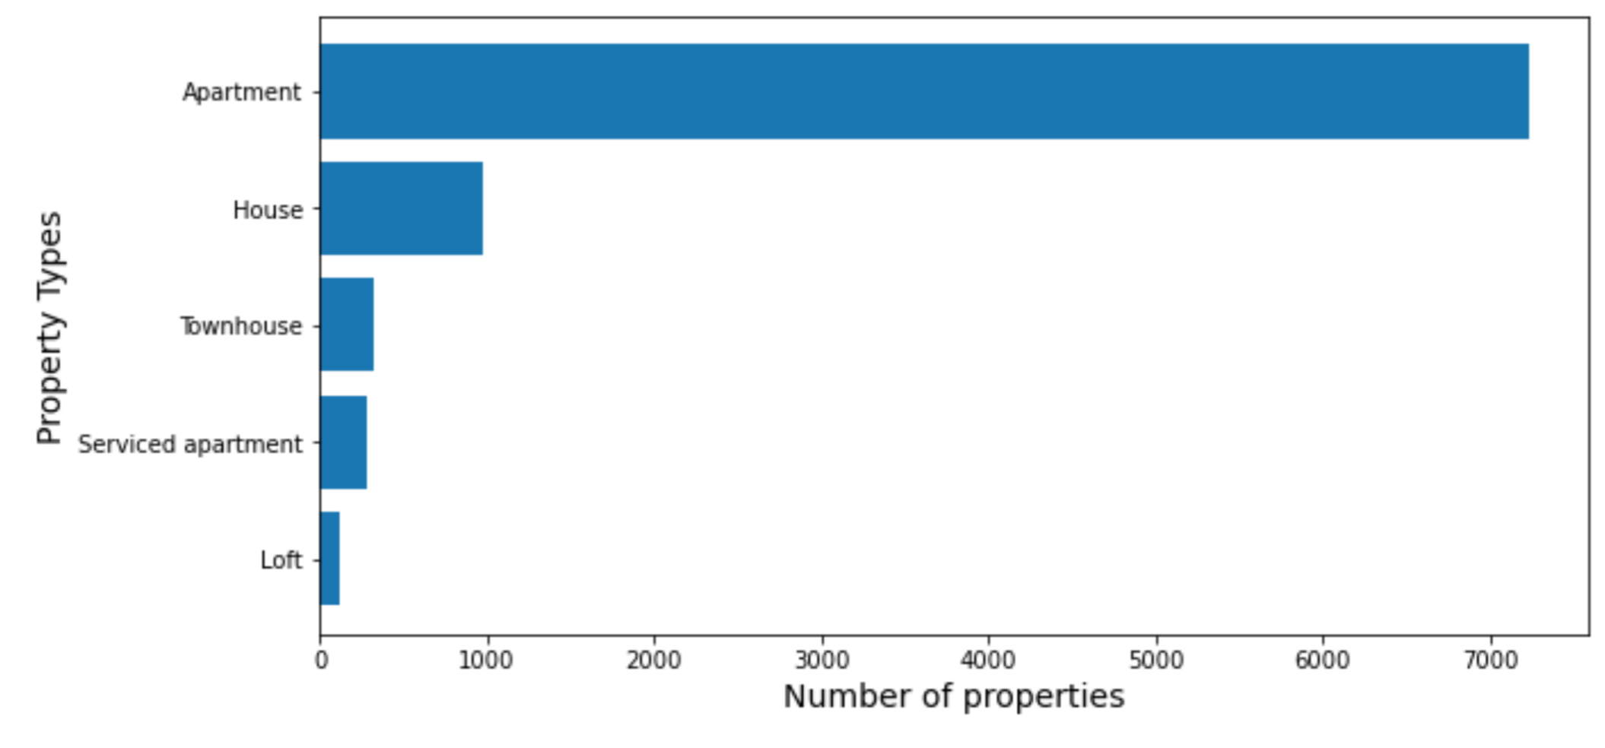
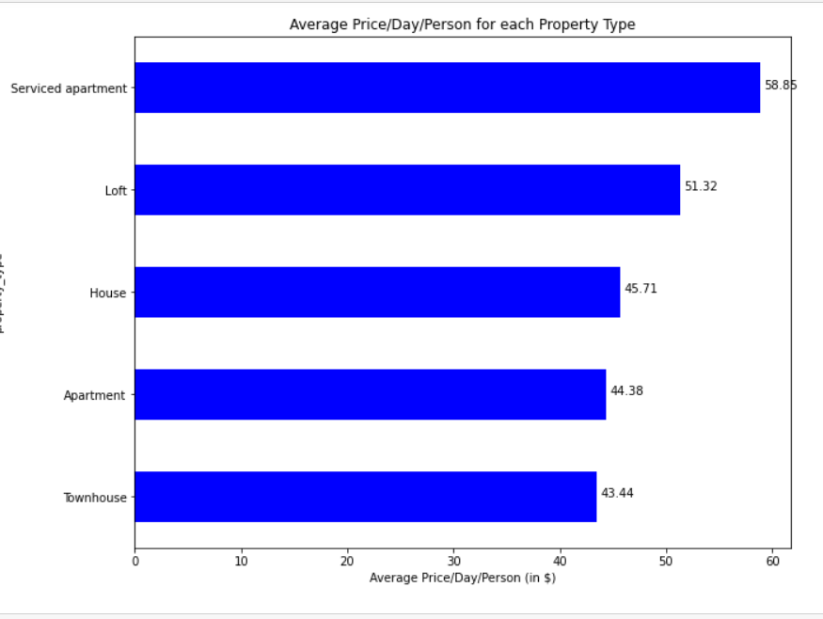

C. Data Wrangling
Third Wave - Decision to only analyse apartments
Apartments were the vast majority of property types.
Three other property types were showing higher rates per person
It felt unwise to be basing decisions on anything other than apartments

Slide 8
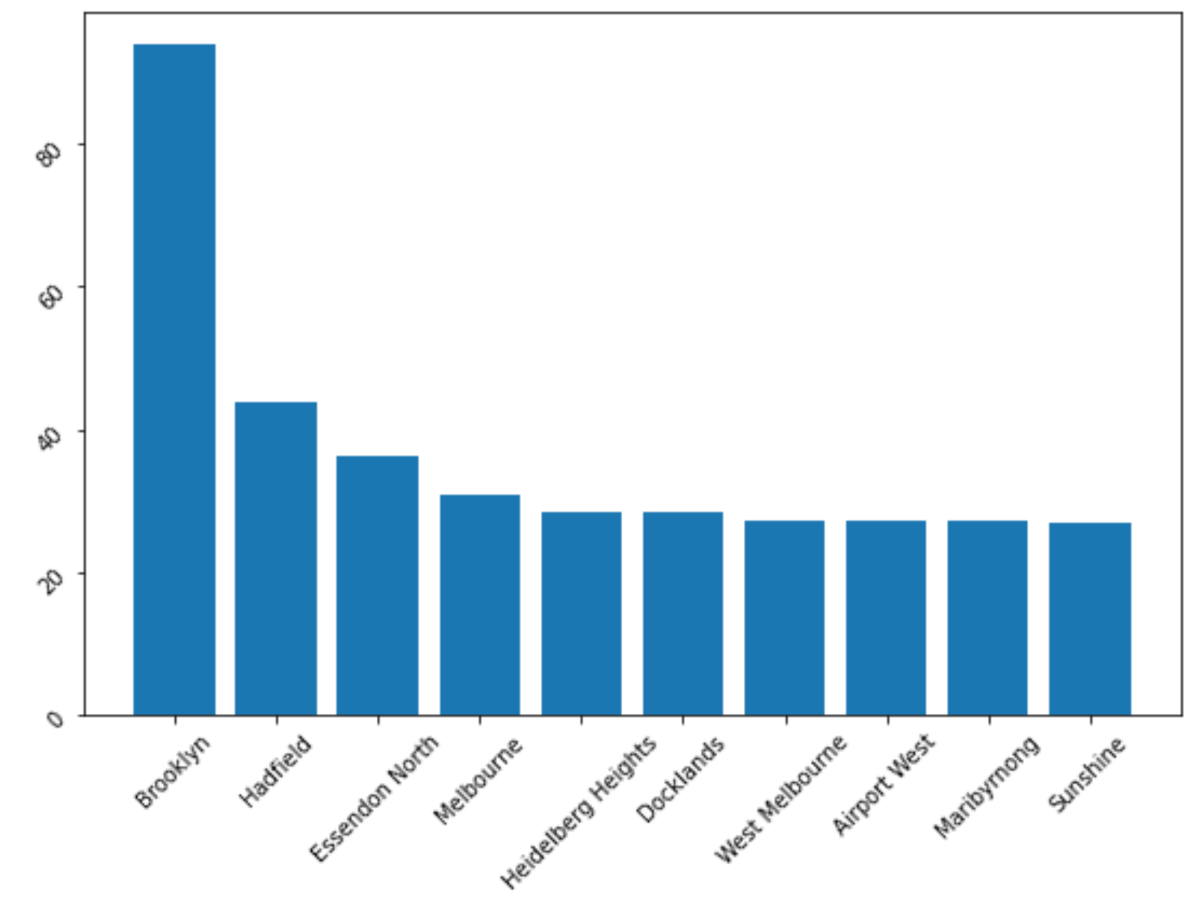


C. Data Wrangling
Fourth Wave - small data misleading outcomes
This led to further exploration of the data and we found a number of results didn’t ring true.
Was Brooklyn really getting the most reviews per month?
Areas of very small data sets were dramatically skewing the results in a number of areas.

Slide 9
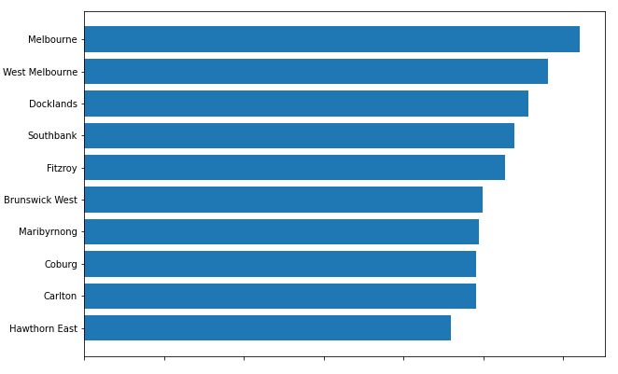

C. Data Wrangling
Fourth Wave - small data misleading outcomes
We made a decision to remove any suburbs with low data points as they were too small to be meaningful
The resulting data passed the common sense test
At each wave a new CSV was exported

