Slide 1
Applying machine learning methods to understand the distribution of rifampicin resistance mutations across species

Slide 2
Background: Rifampicin Resistance and AMR
Antimicrobial resistance (AMR) is a growing global health crisis.
Rifampicin targets bacterial RNA polymerase; resistance often due to mutations in rpoB.
Understanding mutation patterns across species can improve resistance surveillance.
Notes:
Briefly introduce AMR, rifampicin mechanism, and why rpoB mutations matter.

Slide 3
Knowledge Gap
Existing studies mainly focus on Mycobacterium tuberculosis.
Cross-species mutation data are limited and fragmented.
Notes:
Highlight the need for integrative analysis beyond individual species.

Slide 4
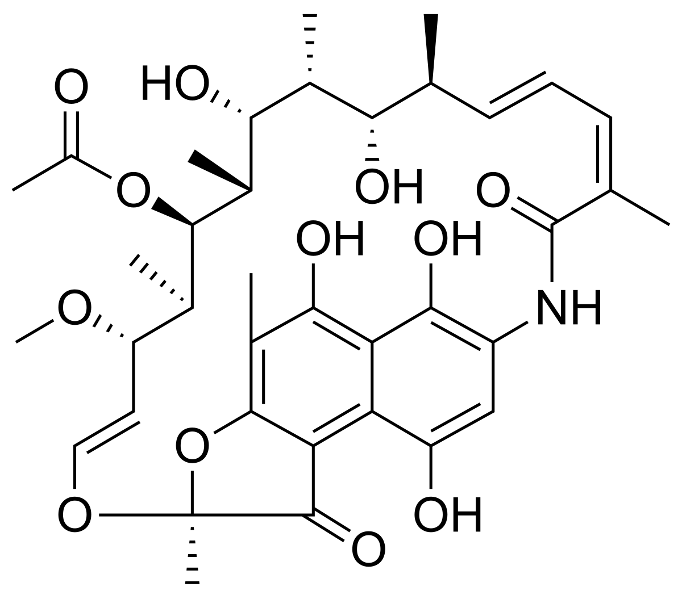
属于利福霉素类抗生素。其药理作用机制是通过结合细菌RNA聚合酶的β亚基（由rpoB基因编码），阻断RNA链延伸，进而抑制转录过程。
RIF单药耐药常被视为多重耐药结核（MDR-TB）的早期信号，因为其耐药突变往往与其他药物的抗性共同出现。

Slide 5
Lack of machine learning-driven integration across diverse bacterial genomes.

Slide 6
Project Overview
Step 1: Literature screening using ASReview (semi-automated relevance feedback).
Step 2: Mutation data integration and cleaning.
Step 3: Unsupervised ML to identify mutation distribution patterns.
Step 4: Supervised ML to predict rifampicin resistance potential.
Notes:
Show a simple workflow diagram if available.

Slide 7
Data Collection and Curation
ASReview used to identify relevant studies on rifampicin resistance mutations.
Integrated both existing rpoB mutations and newly added mutations from literature.
Final dataset: multi-species mutation matrix (e.g., X_dense_filtered).
Notes:
Emphasize reproducibility and data quality control.

Slide 8
Unsupervised Learning: Objective & Methods
Goal: Explore hidden structures and clusters among species based on mutation profiles.
Methods: UMAP for dimensionality reduction; K-means / GMM / HDBSCAN for clustering.
Evaluation: silhouette scores to assess cluster quality.
Notes:
Explain the intuition of unsupervised learning: grouping without labels.

Slide 9
Unsupervised Results
UMAP plots show species-level separation by mutation profiles.
Heatmap highlights key mutation hotspots shared across clusters.
Clusters often align with mid/high-resistance species groups.
Notes:
Interpret clusters in biological terms, linking to resistance levels.

Slide 10
Supervised Learning: Overview
Goal: Predict rifampicin resistance given mutation profiles.
Models: Random Forest, PU-learning model, and fine-tuned SciBERT (text-based).
Metrics: Accuracy, F1-score, ROC-AUC to evaluate model performance.
Notes:
Give intuitive examples: model learns mutation→resistance relationship.

Slide 11
Supervised Results
Random Forest achieved strong performance on curated datasets.
PU-learning improved recall on uncertain/unlabeled mutations.
SciBERT captured literature context, aiding cross-species prediction.
Notes:
Briefly describe comparative metrics table or ROC curves.

Slide 12
Cross-species Insights
Certain rpoB mutations (e.g., S531L, H526Y) recur across phylogenetically distant taxa.
Machine learning models reveal conserved resistance determinants.
Supports potential cross-species transferability of resistance mechanisms.
Notes:
Connect biological interpretation to computational findings.

Slide 13
Discussion & Limitations
Data imbalance and publication bias remain major challenges.
Model interpretability and generalization across unseen species.
Integration with structural/functional data could improve predictions.
Notes:
Encourage discussion around expanding dataset and multi-omics integration.

Slide 14
Conclusion & Future Work
Machine learning enables integration of literature, mutation, and species data.
Reveals conserved rifampicin resistance patterns across bacterial taxa.
Future: include protein structural features, expand to other antibiotics.
Notes:
End with key take-home message and potential collaborations.

