Slide 1
Monty Python's Stephan's search for the holy grail
Starting point: Fred's algorithm
Improvements, where and why
Hierarchical clustering → Variational Bayes
PMC → Variational Bayes

Slide 2
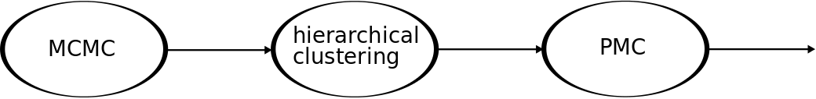
Fred's algorithm
Overall goal: Find “good” proposal for Importance Sampling

Slide 3
Fred's algorithm
does its job

Slide 4
Fred's algorithm
does its job
does not reduce redundant information

Slide 5
Fred's algorithm
does its job
does not reduce redundant information
no re-use of samples in subsequent update steps

Slide 6
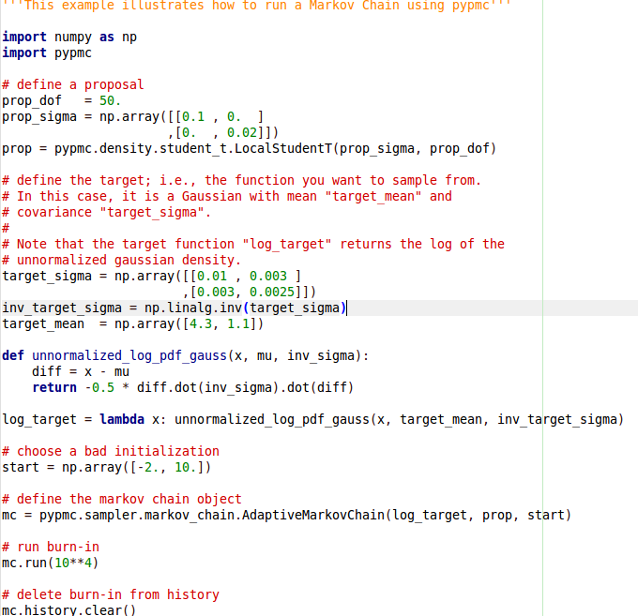
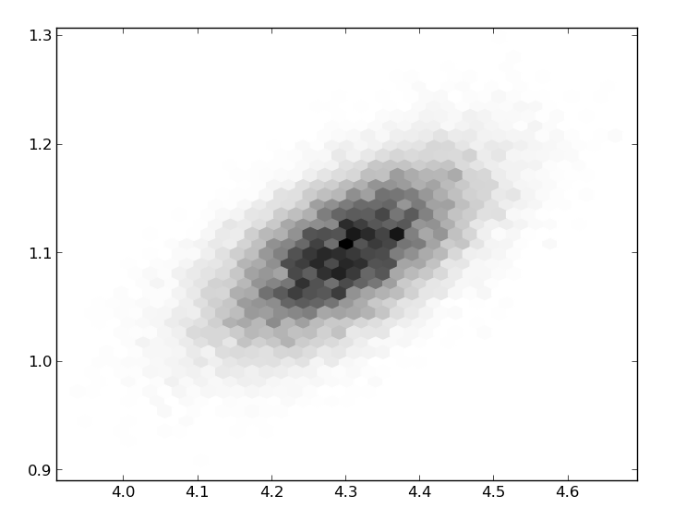
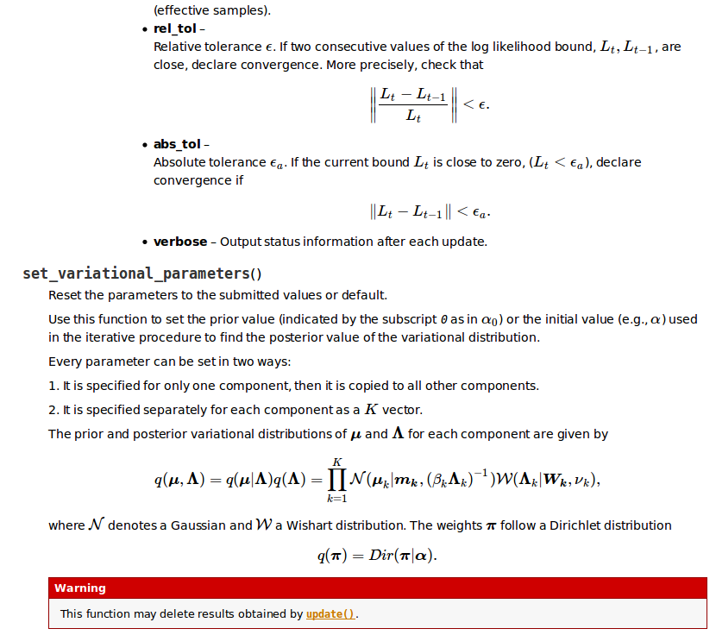
https://github.com/fredRos/pypmc

Slide 7
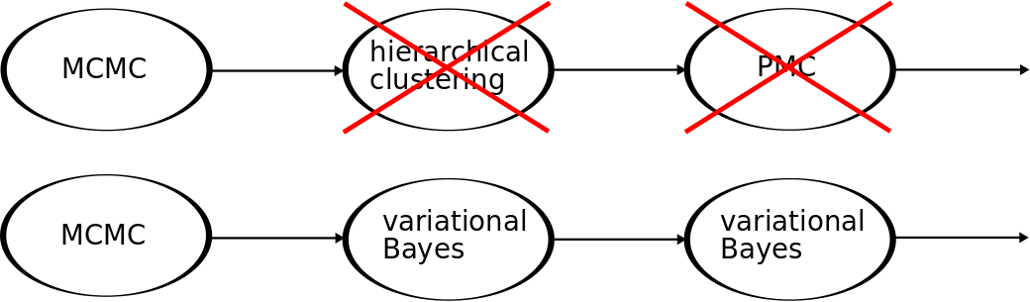
Suggested new algorithm

Slide 8
Variational Bayes
adapt Gaussian mixture to samples
Expectation Maximization (EM) with non trivial prior
Very detailed derivation in “Pattern Recognition and Machine learning” (Christopher M. Bishop)

Slide 9
Hierarchical clustering (hc) → VB
Advantages:
Can at least reproduce the hc results, most runs bring better perplexity and effective sample size
Automatically removes components with redundant information
Disadvantage:
Computationally much more expensive

Slide 10
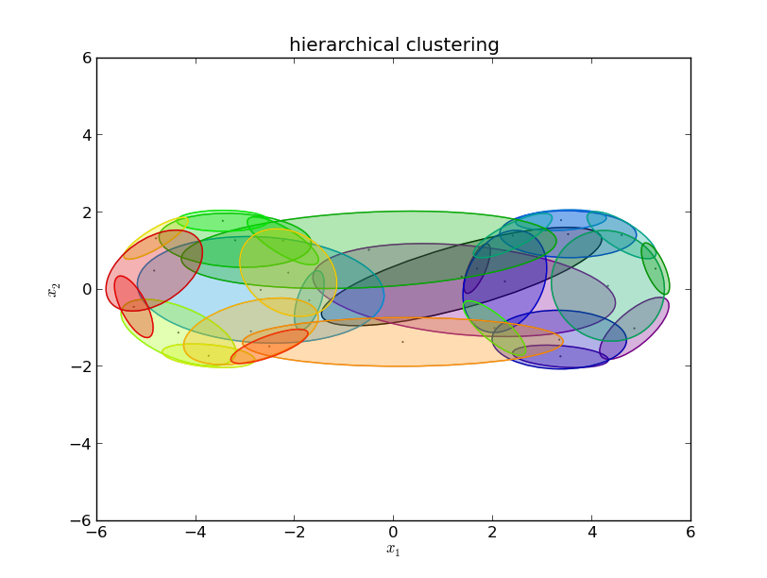
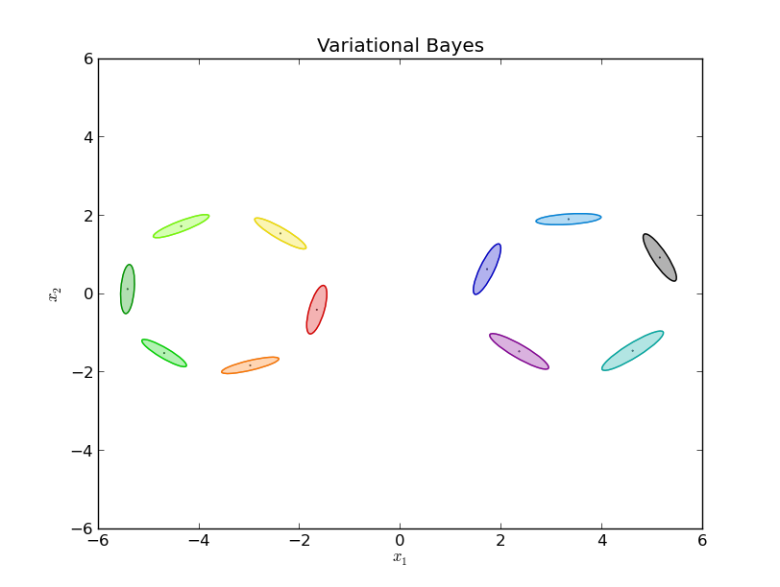
Example: Gaussian shells, 2 dim
Start clustering with 15 components per shell
Converged with 29 components after 21 steps
Perplexity: ~32%
ESS: ~27%
Converged with 11 components after 304 steps
Perplexity: ~65%
ESS: ~46%

Slide 11
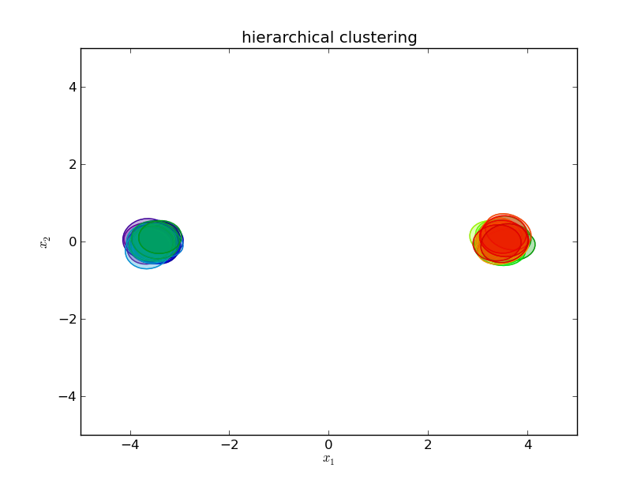
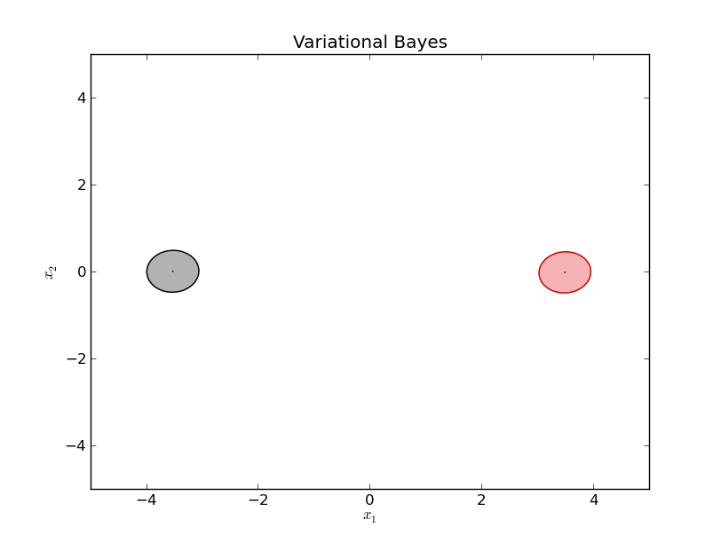
Example: Gaussian shells, 20 dim
Start clustering with 25 components per shell
Converged with 50 components after 5 steps
Perplexity: ~33%
ESS: ~23%
Converged with 2 components after 304 steps
Perplexity: ~39%
ESS: ~28%

Slide 12
PMC → VB (to come ...)
Hopes:
VB allows (forces) you to define priors for the model parameters
  We can set the posterior from the previous step as new prior. → Use all information properly.
Fears:
Unjustifiable computational effort

Slide 13
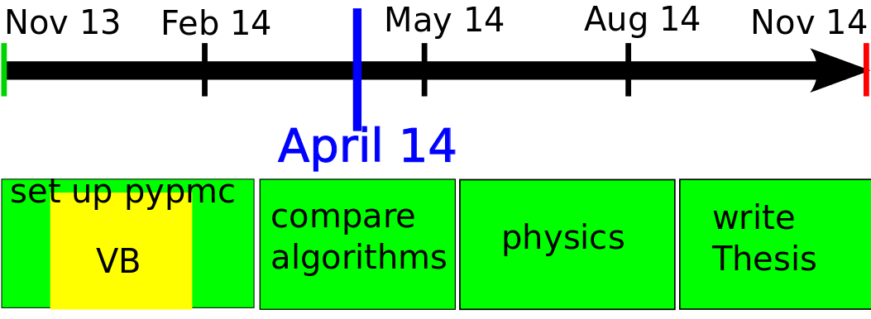
Timeline

Slide 14
Variational Bayes
where we define:
θ are model parameters
Z are “latent variables” (next slide)
Given data X, we can write for the evidence of any model:

Slide 15
Variational Bayes
Definition: Latent (hidden) variables
Be X = {x1, … ,xN} your data
Z = {z1, … ,zN} is called latent if Z contains information which can not uniquely be determined from X but inferred in a probabilistic model.
Then the index i is a latent variable
Example (Gaussian mixtures):

Slide 16
Variational Bayes
Holds for any probability distribution q
Main idea: Restrict q to factorize as below and minimize the Kullback-Leibler divergence
I.e. we look for the closest factorizing q to p in the sense of KL(q||p)
Given data X, we can write for the evidence of any model:

Slide 17
Variational Bayes
Minimizing KL is equivalent to maximizing L.
Maximizing L, in the case of a Gaussian mixture model, leads to an EM-like algorithm.
Given data X, we can write for the evidence of any model:

