Slide 1
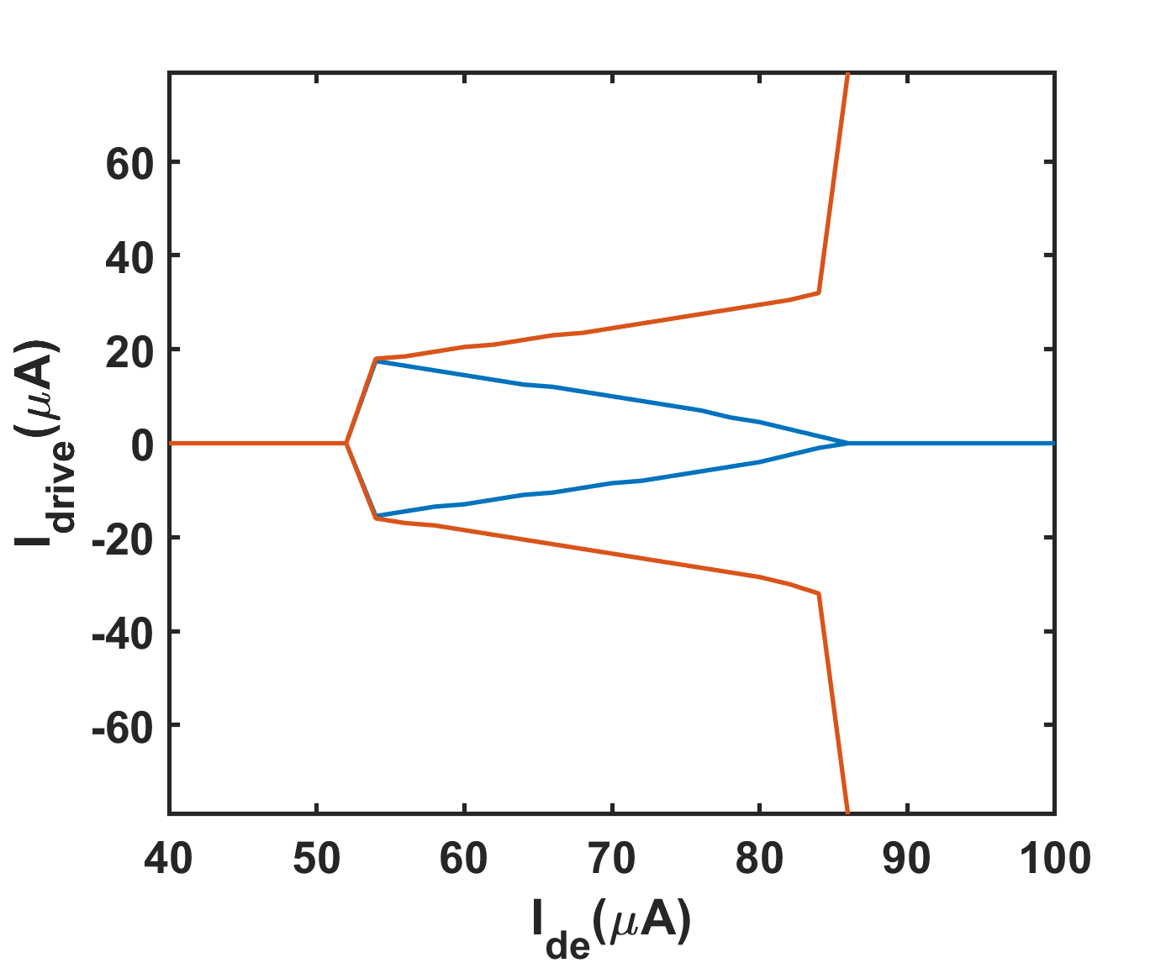
4JJ_Lleft20pH

Slide 2
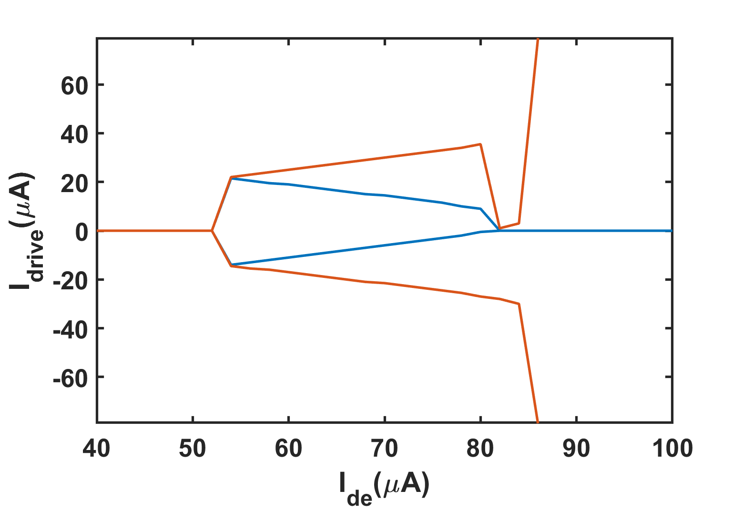
4JJ_Lleft17pH

Slide 3
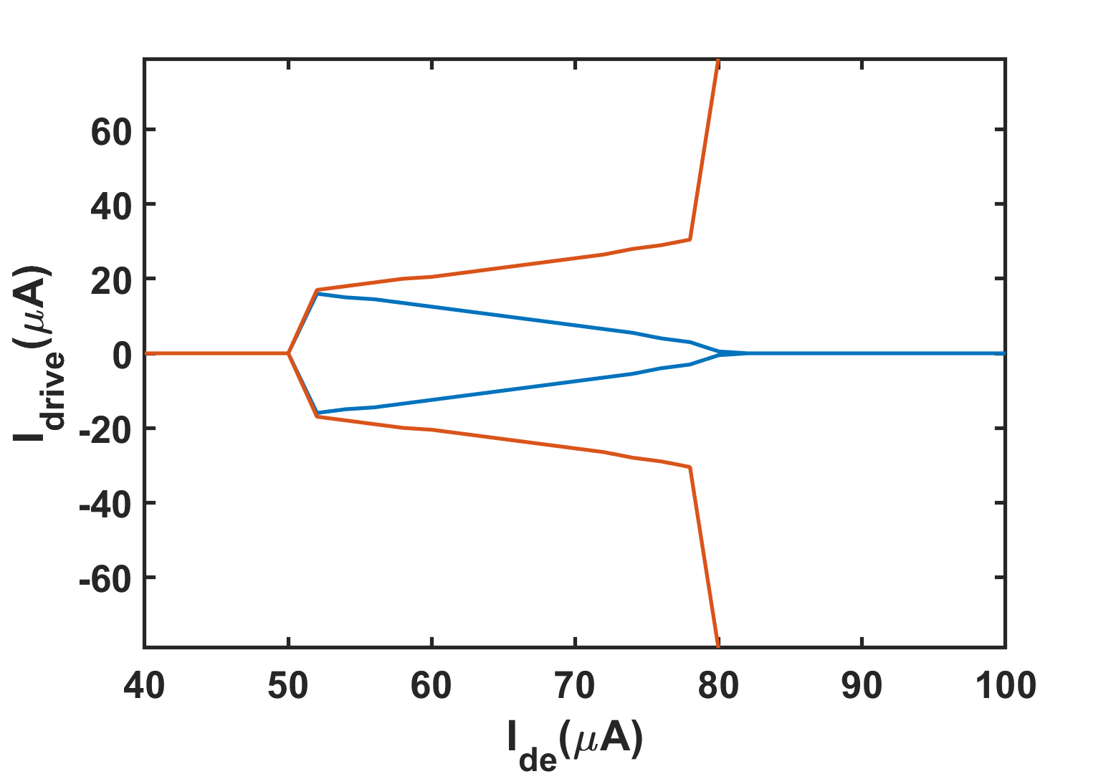
2JJ_Lleft20pH

Slide 4
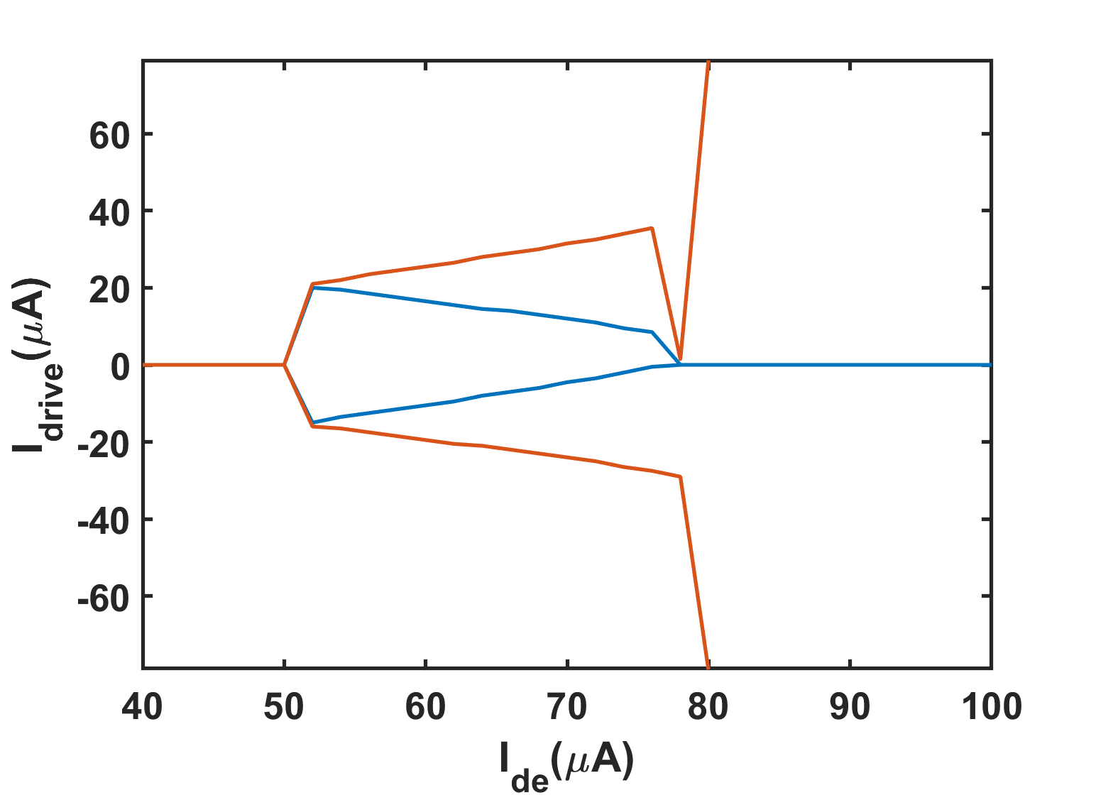
2JJ_Lleft17pH

