Slide 1
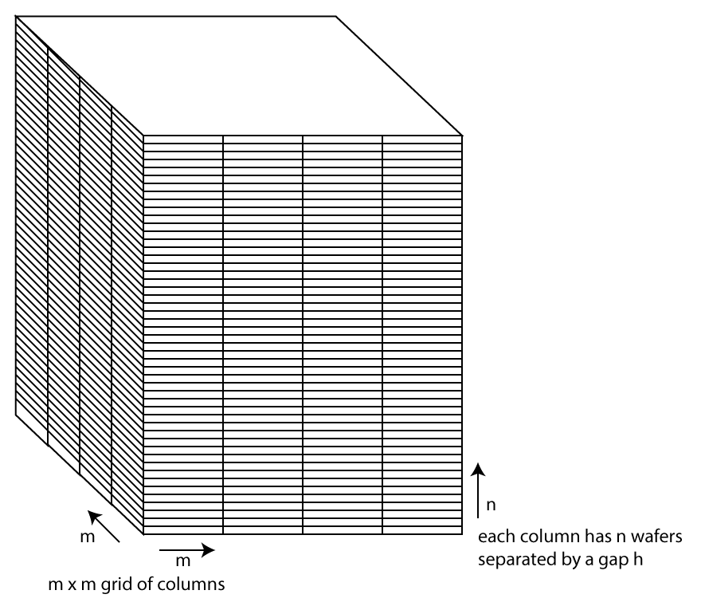
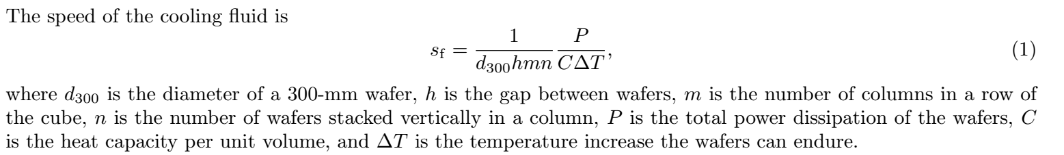

Slide 2
Can/should we make a plot like this?
3x10⁸
Super
Semi
S_{f} [speed of cooling fluid]
1
10⁻⁴
η_{LED} [efficiency of LED]
1

Slide 3
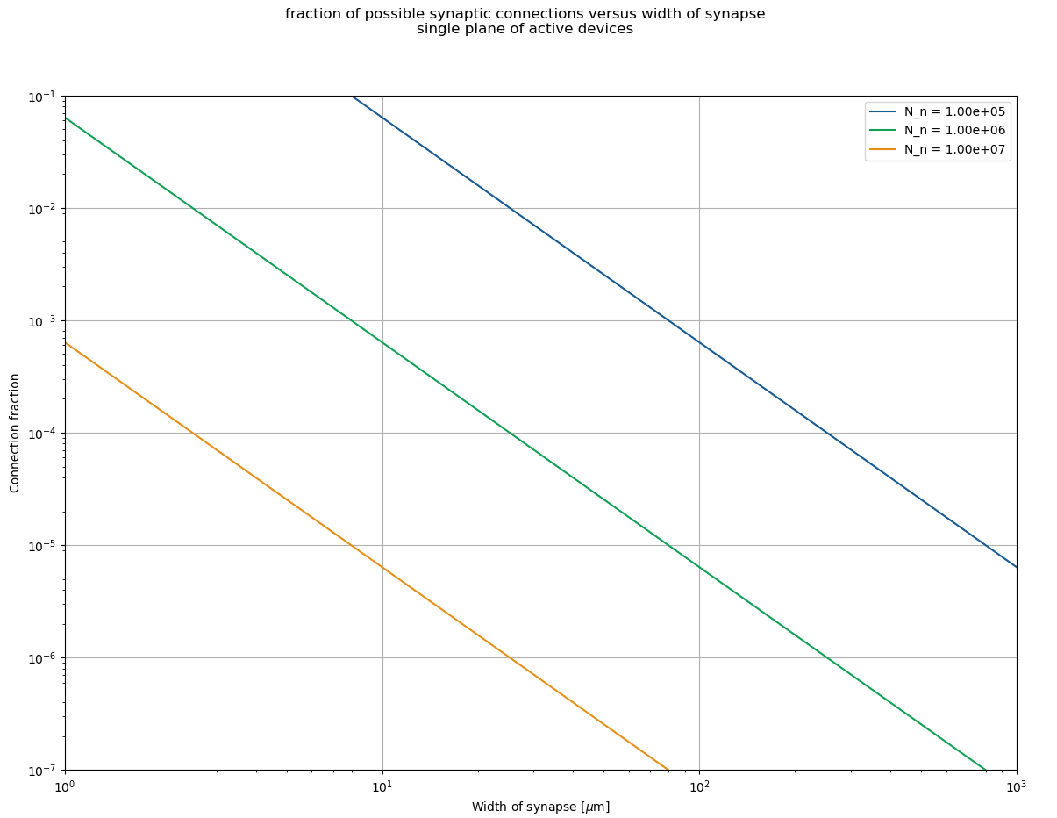

Slide 4
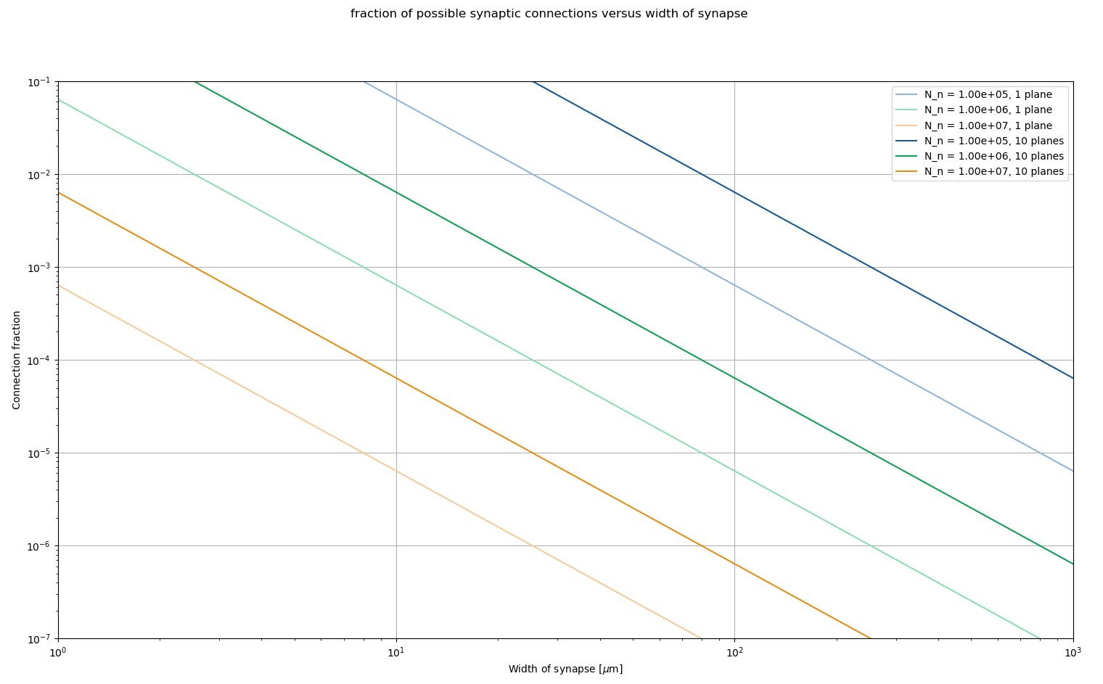
In case the previous plot was too decipherable…

