Slide 1
Votan1 – JJ series arrays
Room-temperature resistance measurements
seeking I_{c}, J_{c}

Slide 2
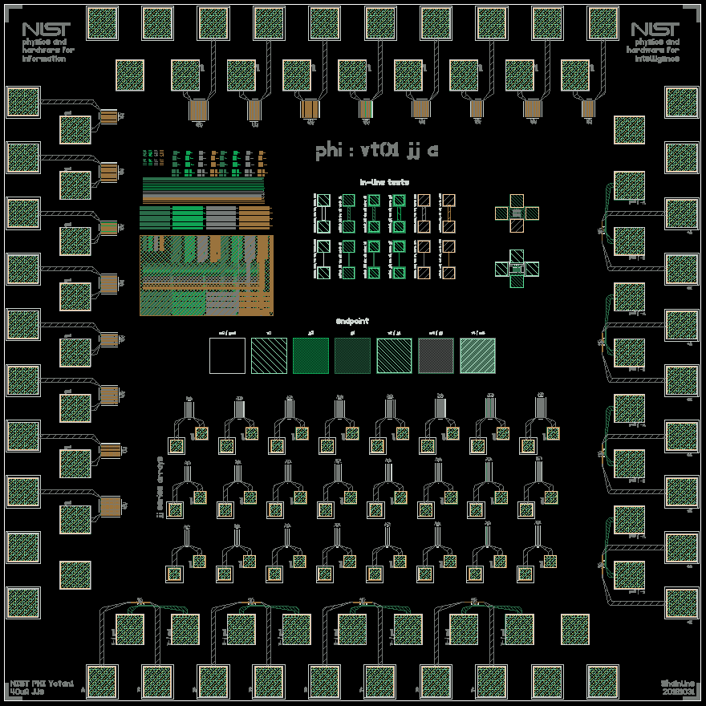
This is the basic chip layout
There are two jj chips: jja and jjb
jja has junctions targeting 40uA Ic
jjb has junctions targeting 100uA Ic
The jj diameter sweeps were intended to achieve these Ic values for a range of Jcs from 0.5 kA/cm^2 to 2 kA/cm^2
The junctions around the perimeter are shunted for low-temp Ic measurements
The jjs in the block of series arrays in the middle are unshunted for room-temperature Rn measurements

Slide 3
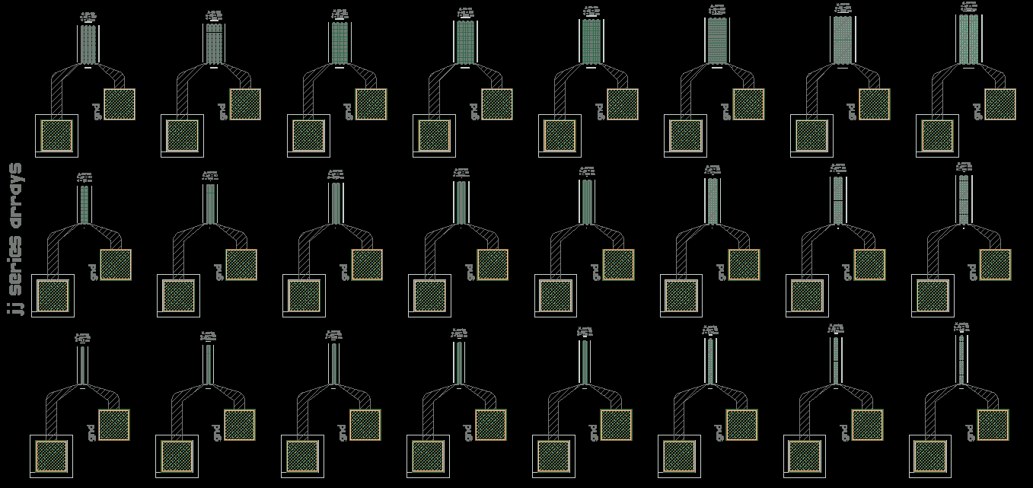
160 jjs
Here is the block of unshunted JJ series arrays
80 jjs
40 jjs
jjs in this column would have Ic = 40uA (100uA) on jja (jjb) chips if Jc = 2 kA/cm^2
jjs in this column would have Ic = 40uA (100uA) on jja (jjb) chips if Jc = 0.5 kA/cm^2

Slide 4
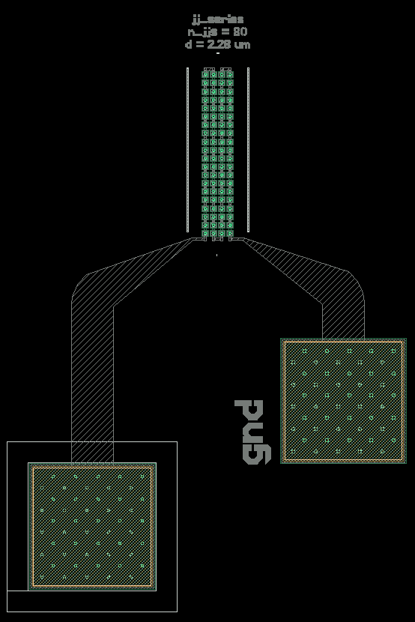
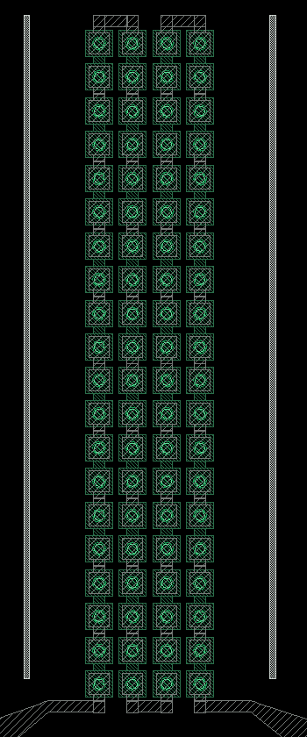
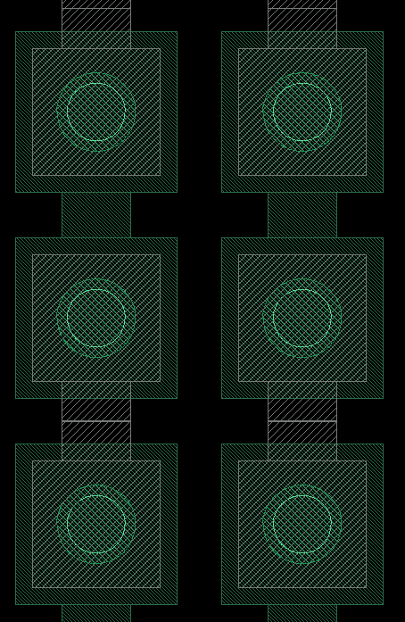
Here is the layout in more detail

Slide 5
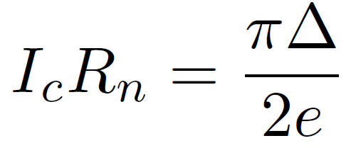
Recall that we can relate the junction critical current to the normal-state resistance provided we know the superconducting gap:
This expression is valid for SIS junctions. I am using 1.278e-22 J for the energy gap of niobium.

Slide 6
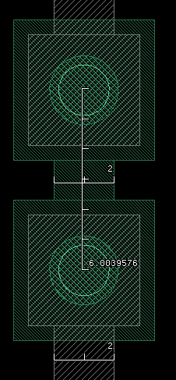
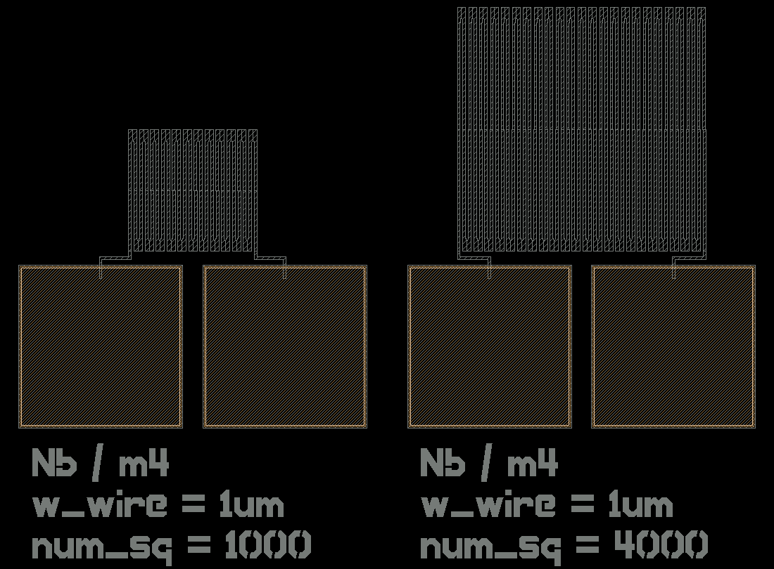
At room temperature, the Nb wiring also adds series resistance between the junctions. I am using a value of 0.725 Ohm/square for the upper metal wiring and 1.45 Ohm/square for the lower metal wiring. The upper metal wiring value was measured with a test structure on this chip (4000 squares in series), and the lower metal value is approximated. I assume one square of each of these per JJ. I also assume 30 Ohm contact resistance in these two-wire measurements, as this value was consistently observed during probing.
Geometry of jjs in series
Nb room-temp resistance test structures

Slide 7
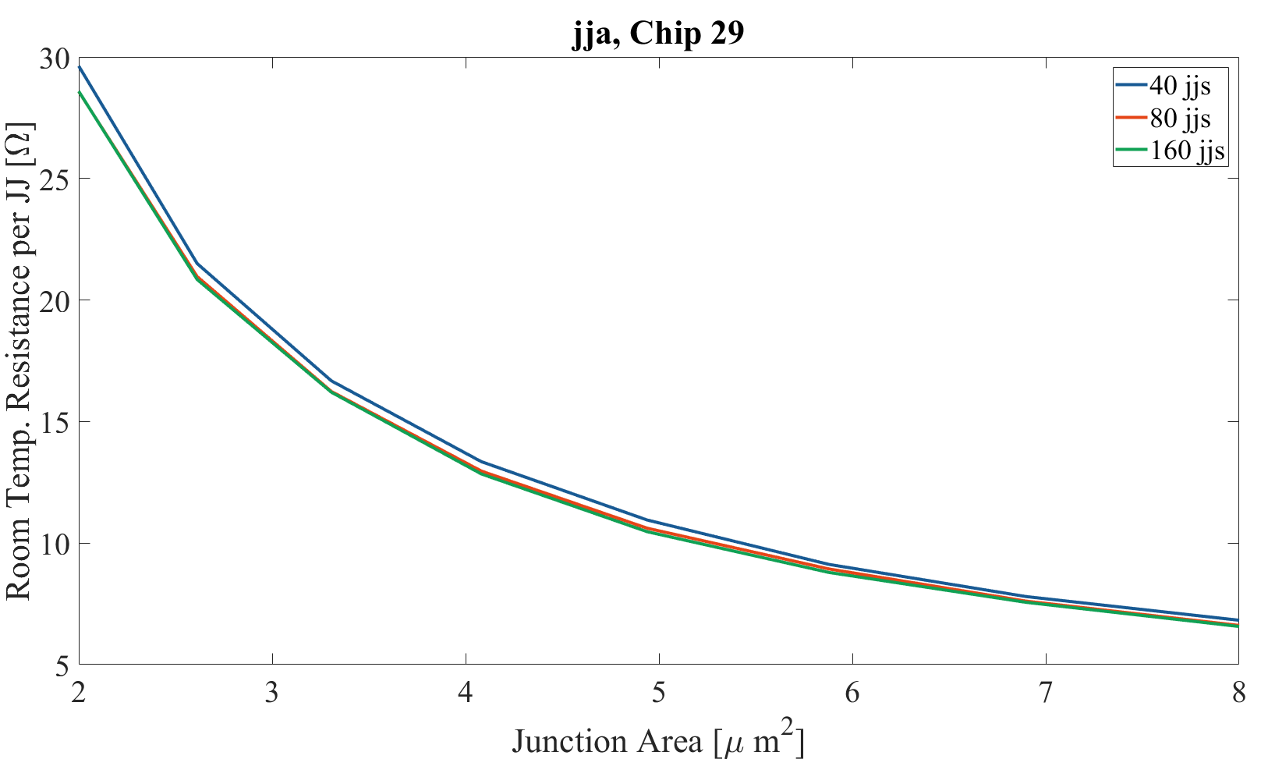
Here is the measured resistance minus the series contributions (contact and Nb wiring) divided by the number of JJs in the array.
I took this type of data for five 40uA and five 100uA chips from across the wafer.
Junctions targeting 40uA Ic
The fact that these curves align so closely indicates the parasitic series resistances have been subtracted appropriately.

Slide 8
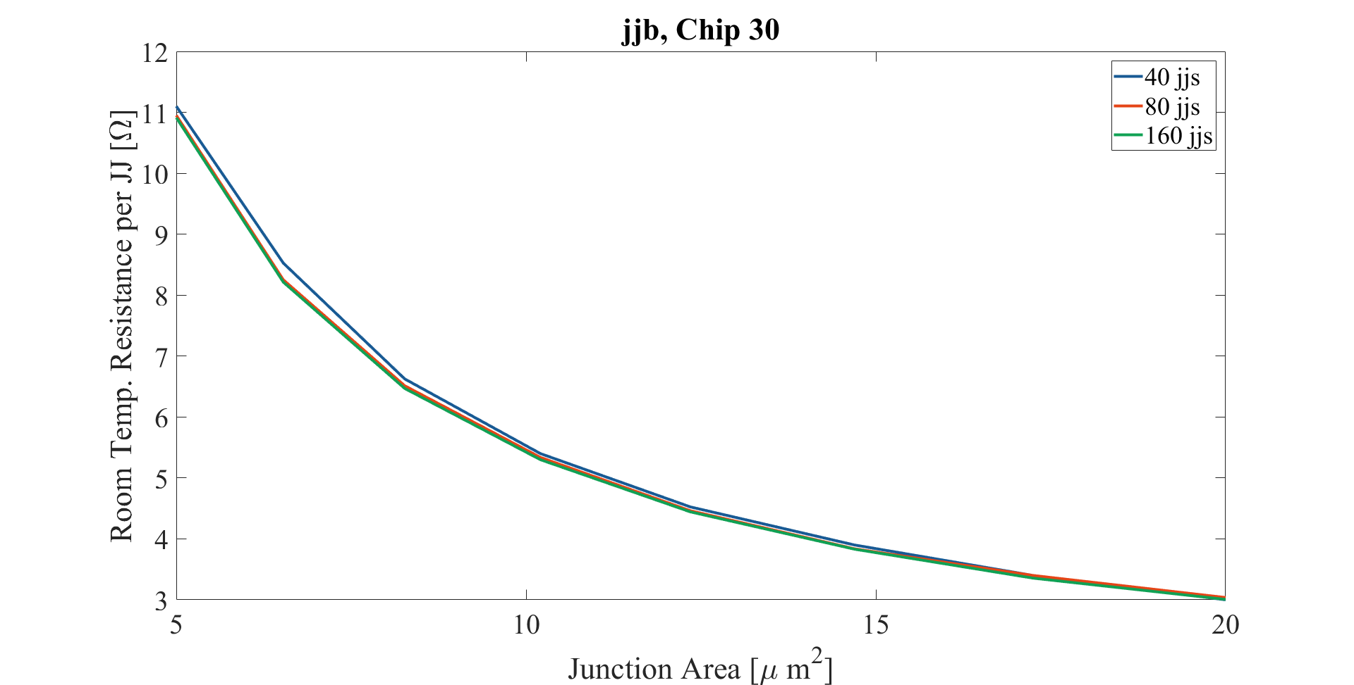
Junctions targeting 100uA Ic

Slide 9
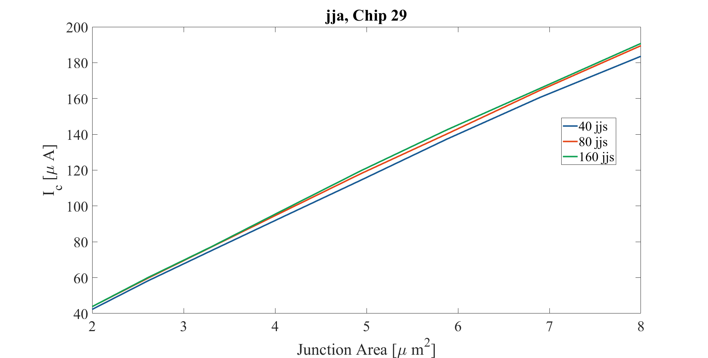
Here I use the expression to convert from Rn to Ic

Slide 10
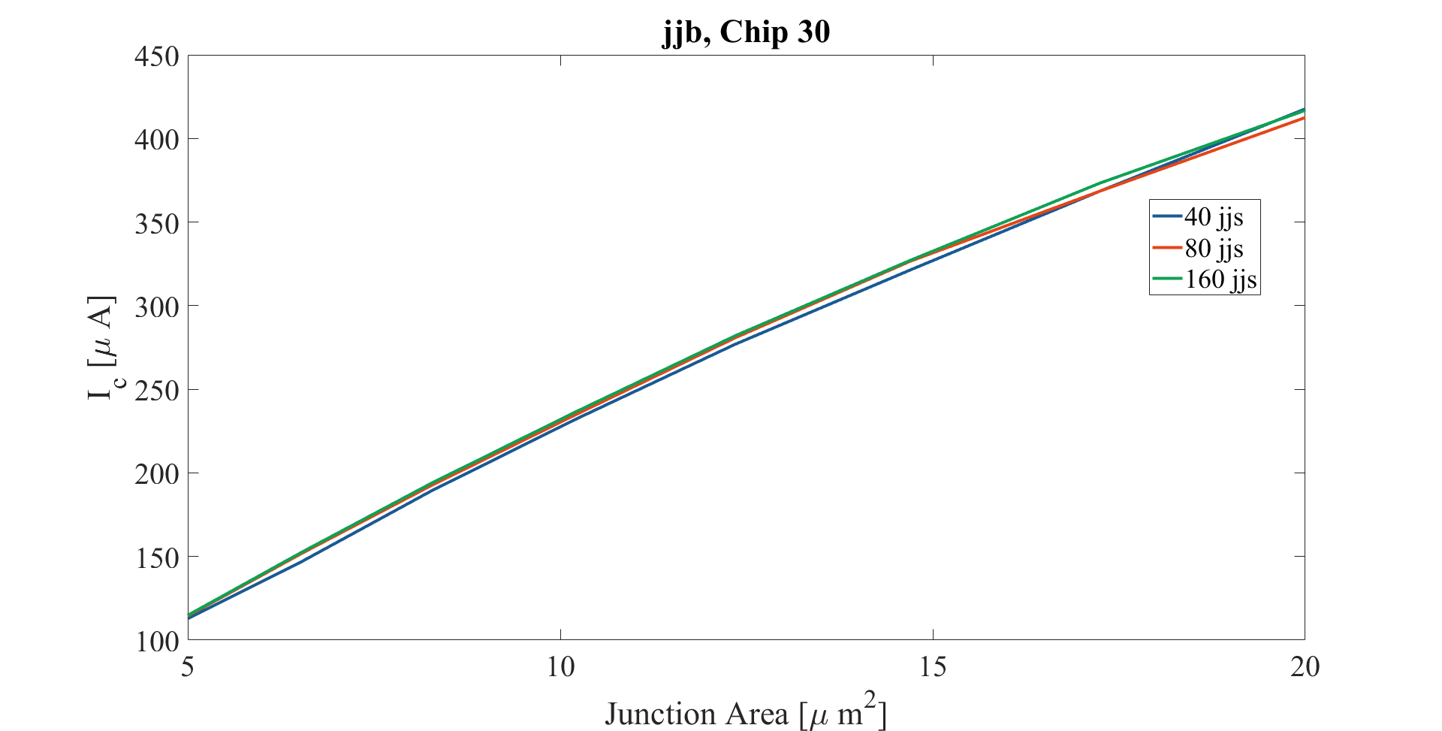

Slide 11
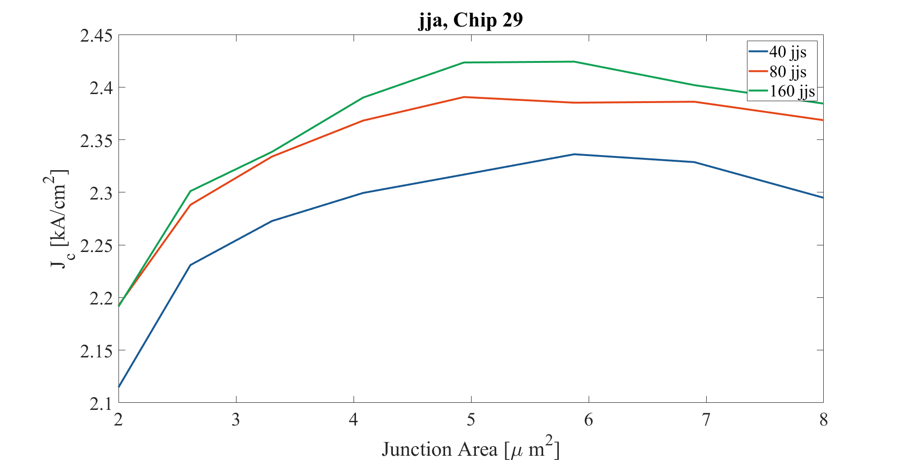
Now I divide by the junction area to obtain Jc. I don’t know why these curves have such an odd shape.

Slide 12
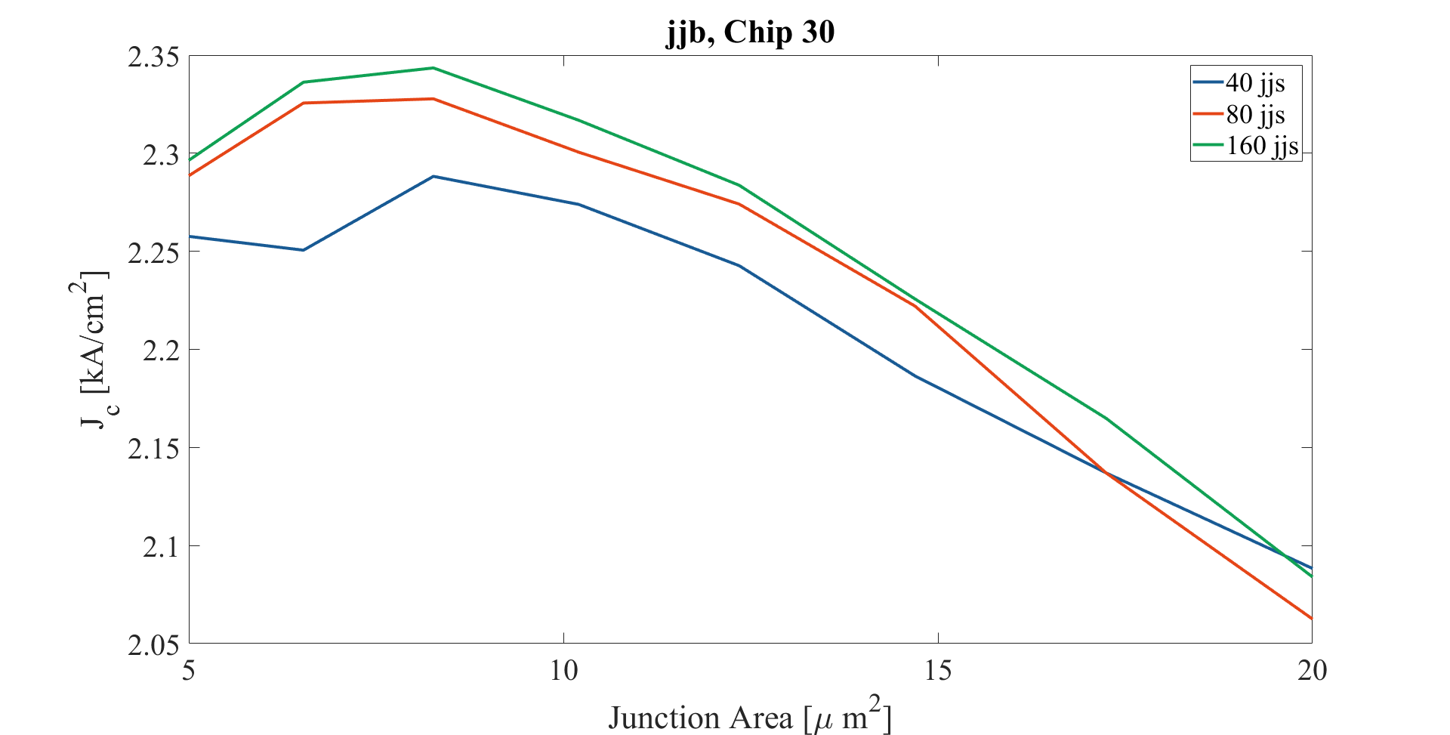

Slide 13
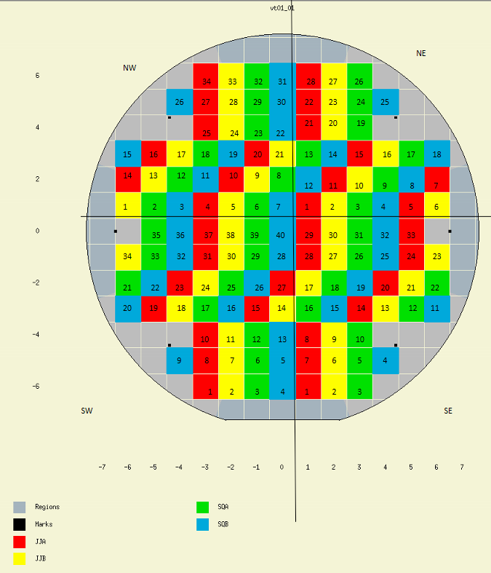
Investigating cross-wafer variation
These are the chips with 40uA junctions investigated here
These are the chips with 100uA junctions investigated here

Slide 14
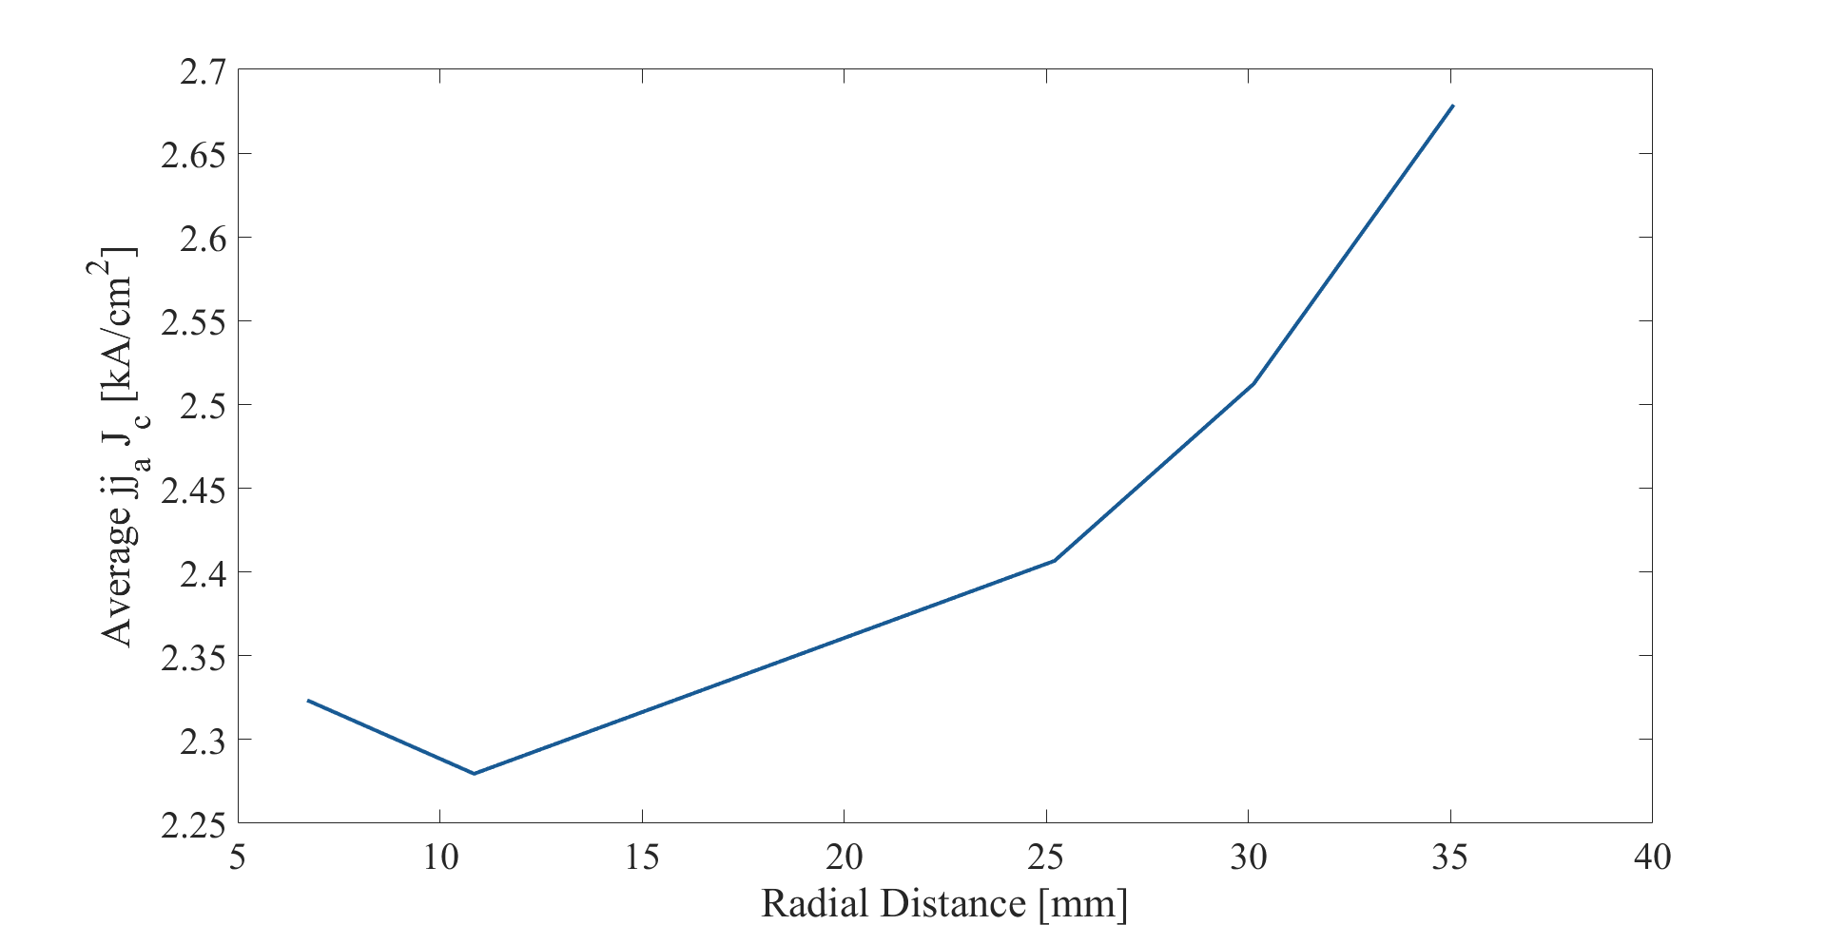
Here is the spatial variation of Jc as measured on five die intended to have 40uA Ic junctions.

Slide 15
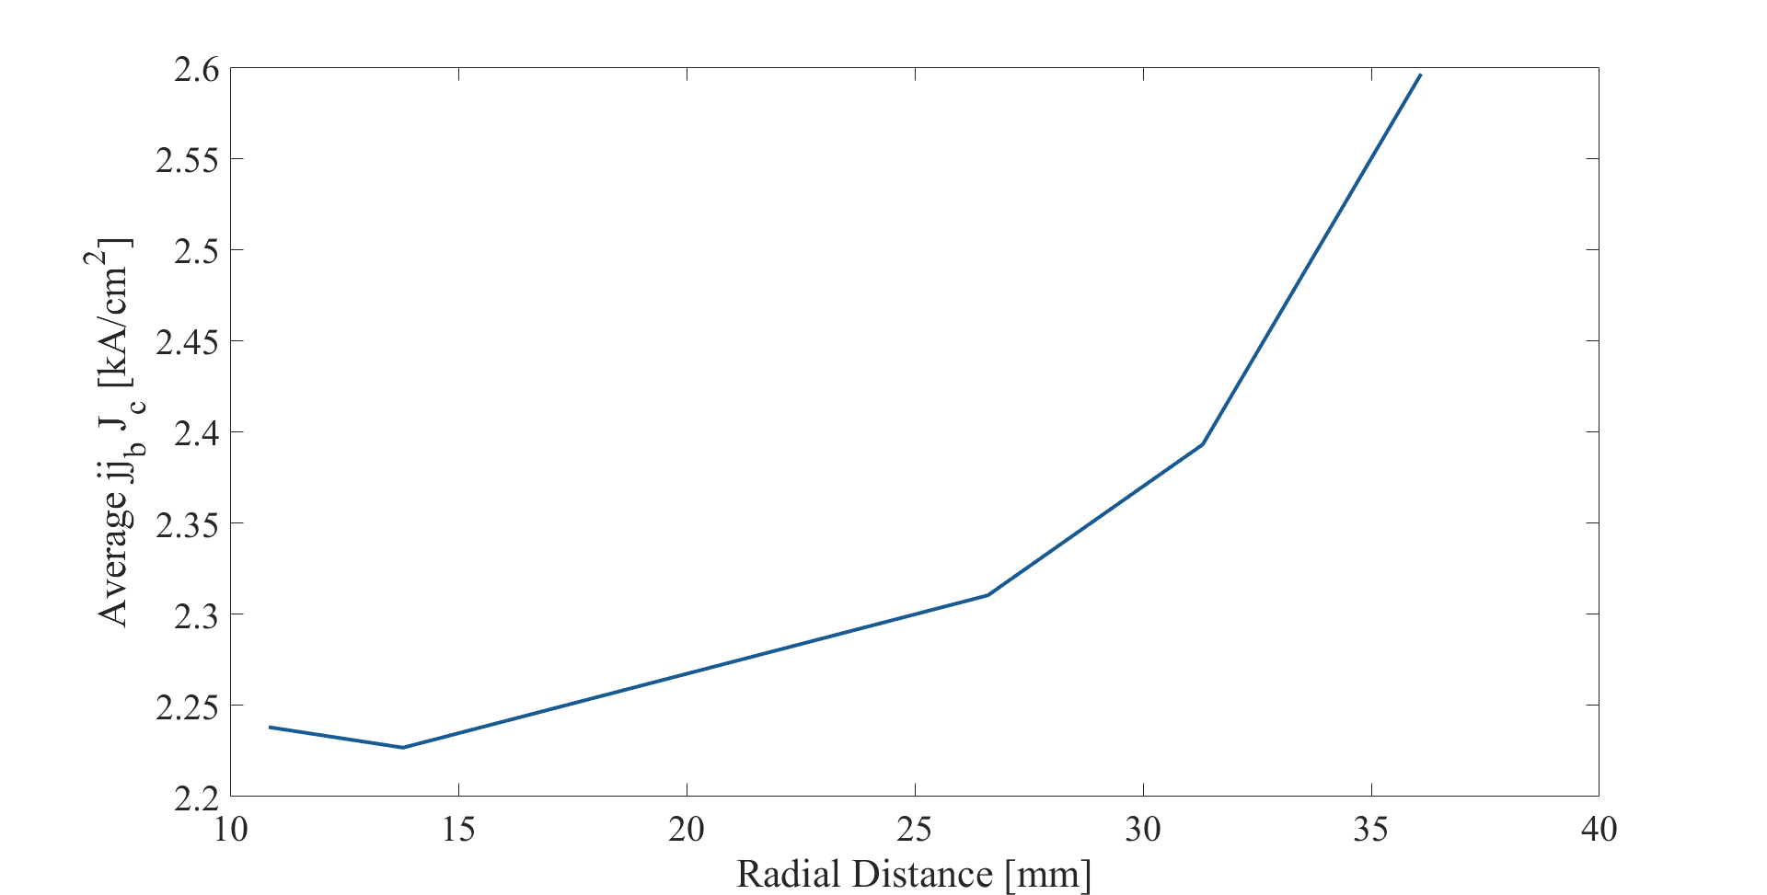
Here is similar data obtained from die intended to have 100uA Ic junctions. The fact that this and the previous plot are very similar is encouraging.

Slide 16
This is all fine, except I was targeting 0.75kA/cm^2 at the center of the wafer. I deposited the silicon barrier for 43s. I would like to try again with a slightly thicker barrier and perhaps several wafers with different barrier thicknesses. This data will be supplemented with cryogenic measurements soon.

Slide 17
For data analysis and plotting scripts see C:\Users\jms4\Documents\a4\votan\data\room_temp_jj_series_arrays

