Slide 1
vt01 _ sqb_8wire
data from 20200121

Slide 2
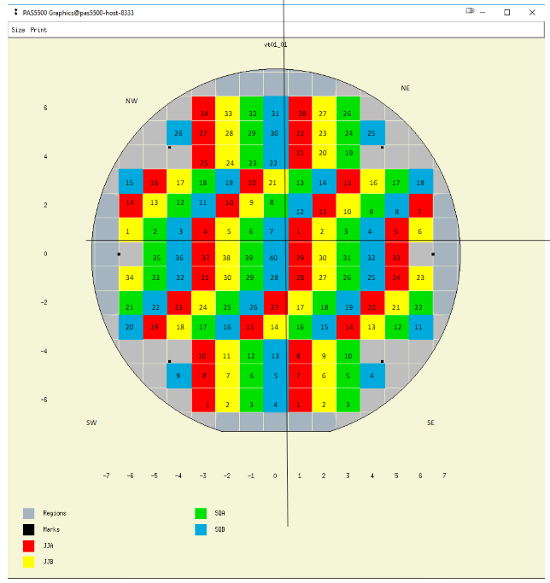
Data taken from this die

Slide 3
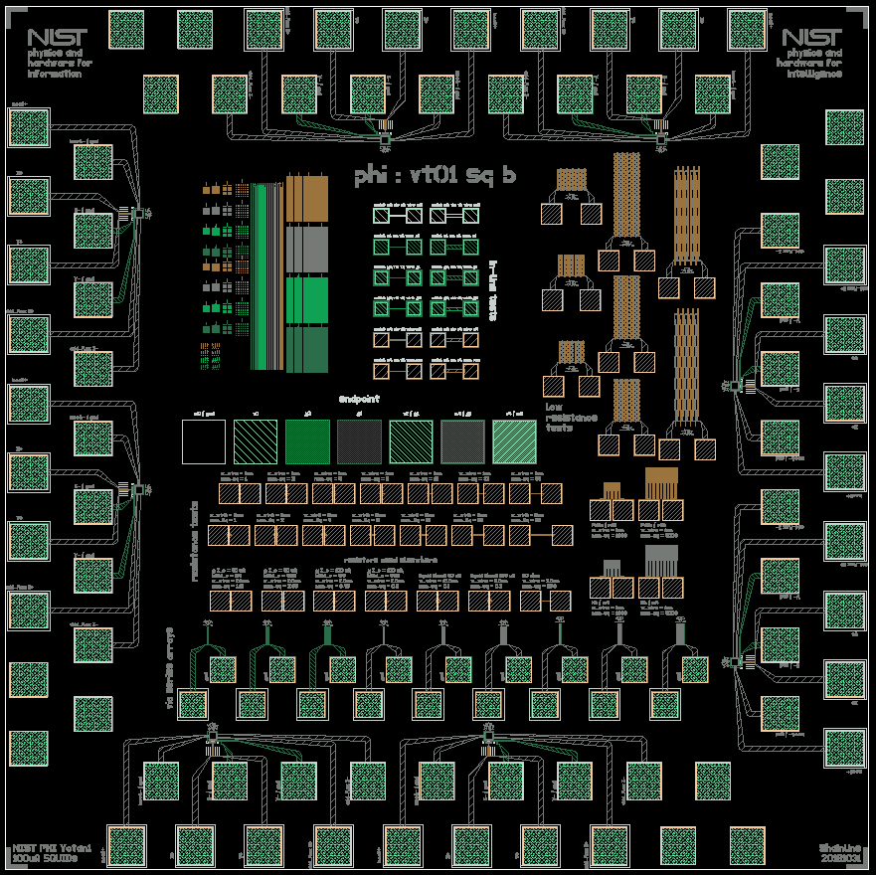
measured this device

Slide 4
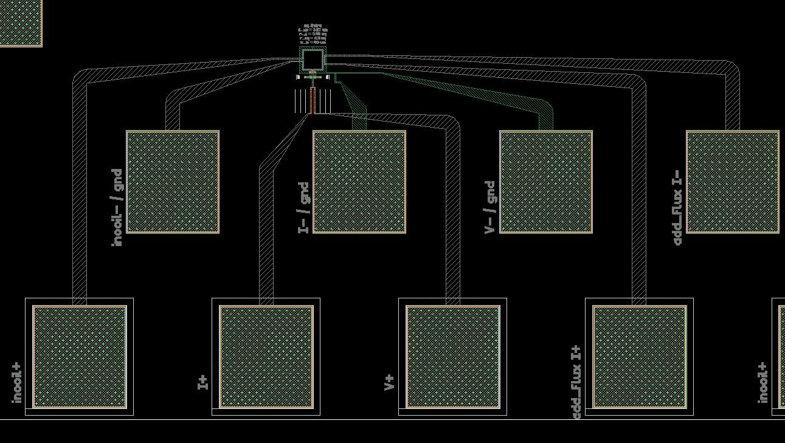
Here’s the zoom

Slide 5
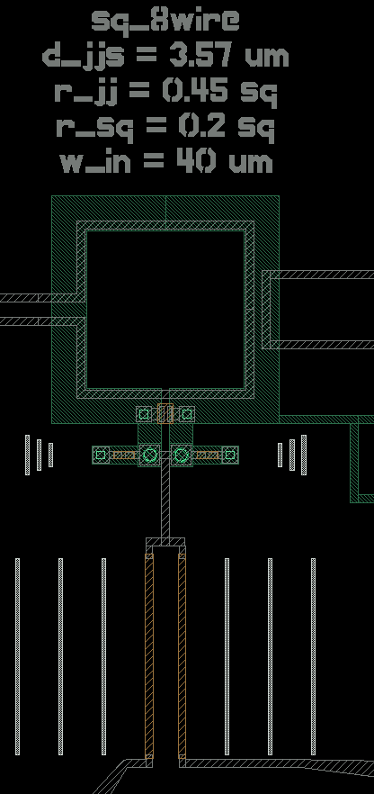
Even closer view

Slide 6
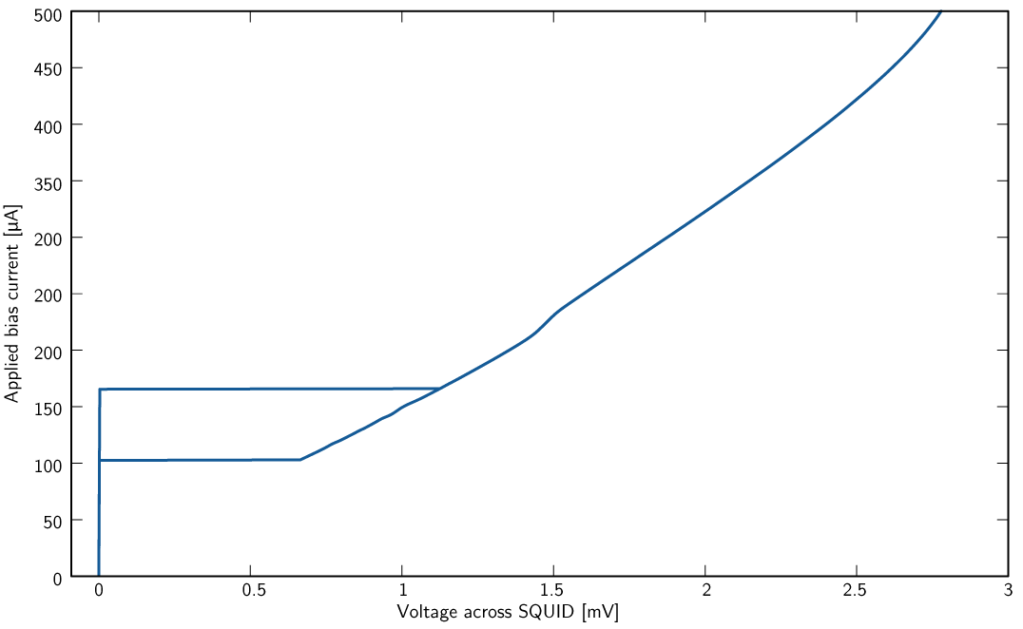
I-V curve of the SQUID
Ic close to design
Hysteretic due to beta_c being > 1 resistance higher than expected

Slide 7
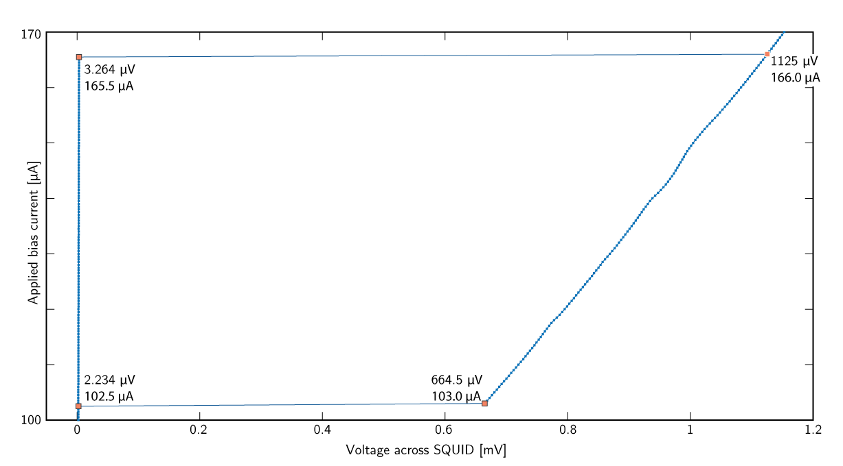
Zoom of the hysteretic region

Slide 8
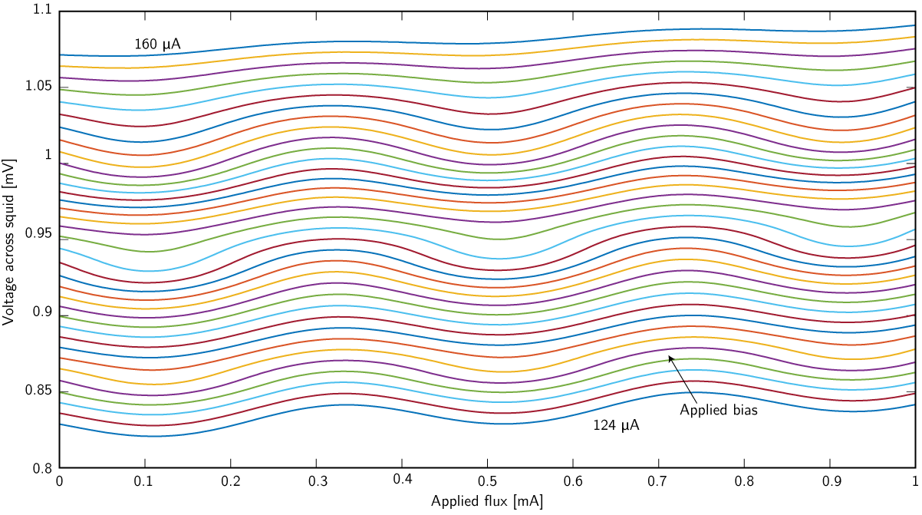
Flux modulation for many values of SQUID current bias

Slide 9
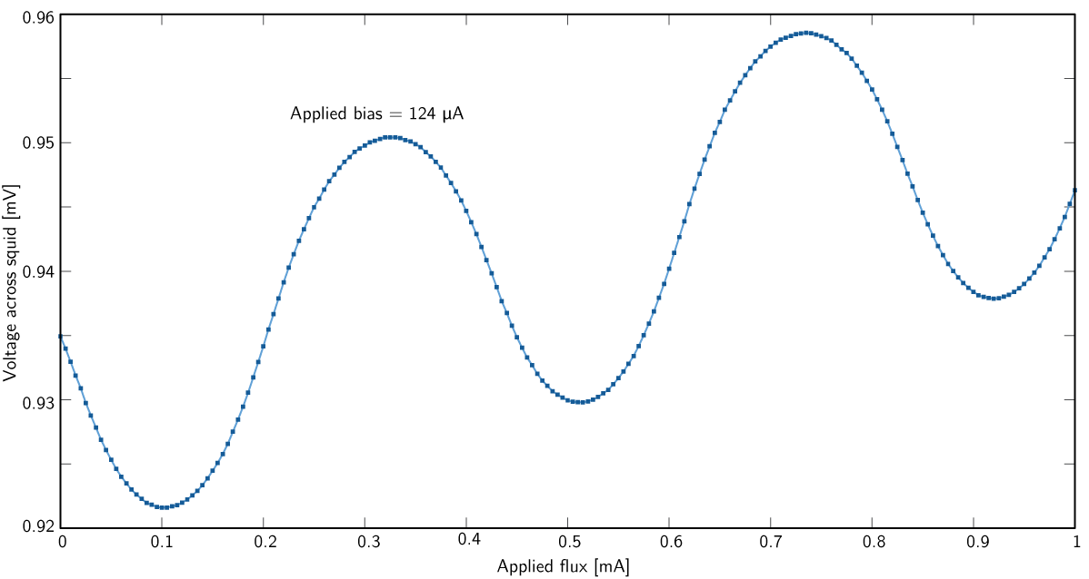
Flux modulation for best bias; linear trend due to non-ideal 4-wire

Slide 10
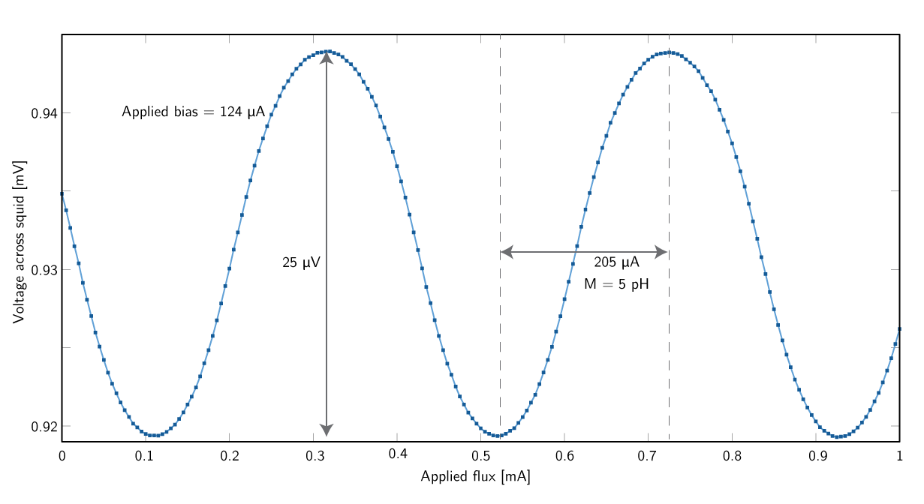
After correcting for the linear trend, extract modulation amplitude and mutual inductance.
Modulation amplitude should be closer to 50 uV; again I suspect beta_c playing a role.
Mutual inductance designed to be 6.3 pH; acceptable error, probably due to layer thicknesses.

