Slide 1
Votan 1
Circuit Designs - 20190910

Slide 2
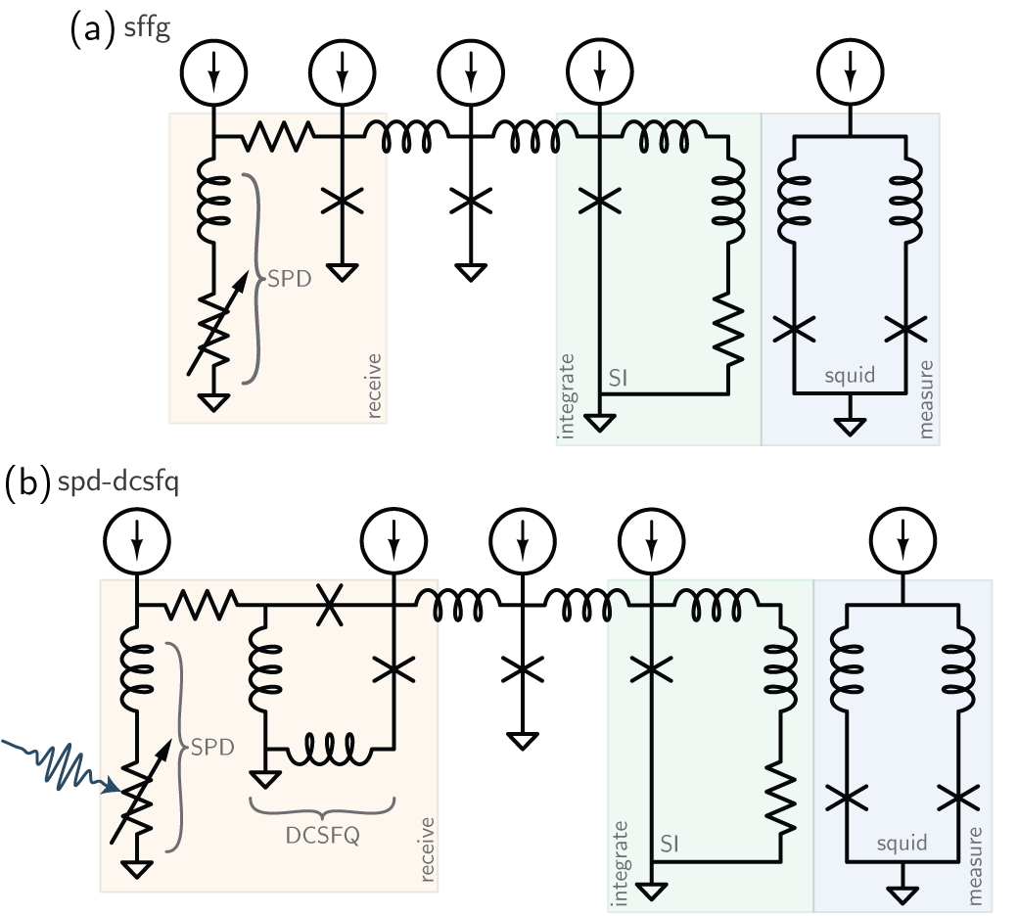
Votan 1 will explore two circuits:
synaptic-firing flux generator
single-photon to single-fluxon

Slide 3
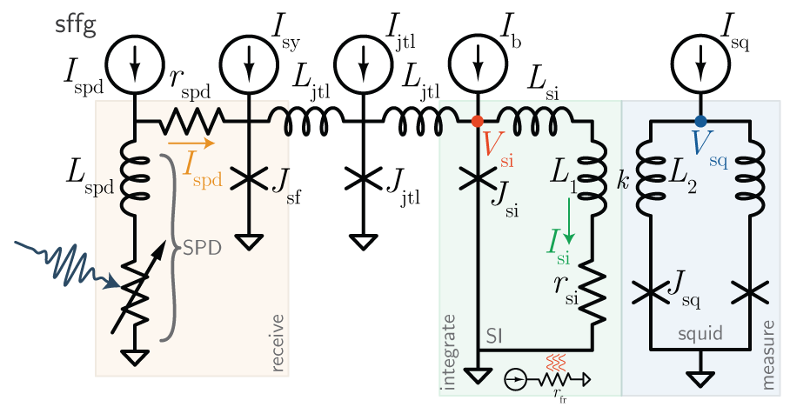
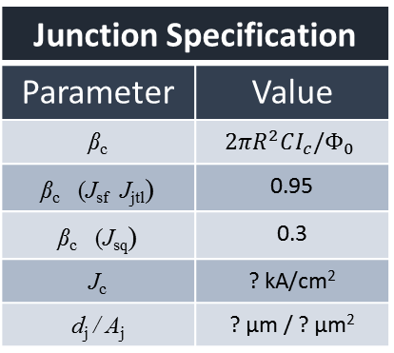
synaptic-firing flux generator (sffg)
Circuit Parameters
Parameter |  | Value
Current biases
I_{spd} | Nominal: [10 20] µA Range: [7.5-12.5 17.5-22.5] µA) | [10 20] µA ([7.5-12.5 17.5-22.5] µA)
I_{sy}
I_{jtl}
I_{b}
I_{sq}
Critical currents
I_{c}^{spd}
I_{c}^{jsf}
I_{c}^{jsq}
Inductances
L_{spd}
L_{jtl}
L_{si}
L₁
L₂
k
Resistances
r_{spd}
r_{si}
r_{fr}
Junction Specification
Parameter | Value
β_{c} | $$2πR^{2}CI_{c}/Φ_{0}$$
β_{c} (J_{sf} J_{jtl}) | 0.95
β_{c} (J_{sq}) | 0.3
J_{c} | ? kA/cm²
d_{j} / A_{j} | ? µm / ? µm²
SPD Specification
Parameter | Value
w_{spd}
L□^{WSi}
N□
Derived Parameters
Parameter | Value
τ_{spd}
τ_{si}
β_{L}^{jtl}
β_{L}^{si}
β_{L}^{sq}

Slide 4
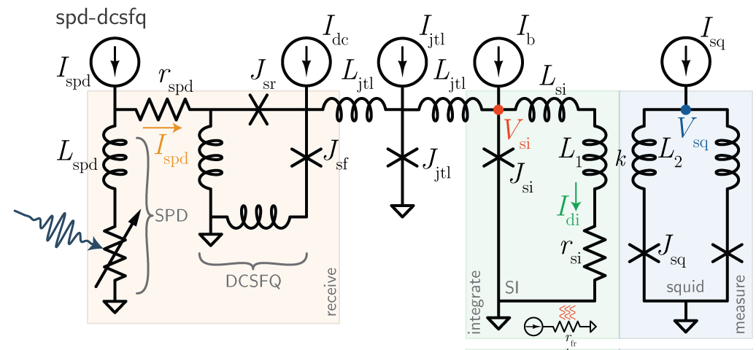
single-photon to single-fluxon (spd-dcsfq)
Circuit Parameters
Parameter |  | Value
Current biases
I_{spd} | Nominal: 20 µA (Range: [15 25] µA) | [10 20] µA ([7.5-12.5 17.5-22.5] µA)
I_{sy}
I_{jtl}
I_{b}
I_{sq}
Critical currents
I_{c}^{spd} |  | 25 µA
I_{c}^{jsf} |  | 40 µA
I_{c}^{jsq} |  | 40 µA
Inductances
L_{spd}
L_{jtl}
L_{si}
L₁
L₂
k
Resistances
r_{spd}
r_{si}
r_{fr}
Junction Specification
Parameter | Value
β_{c} | $$2πR^{2}CI_{c}/Φ_{0}$$
β_{c} (J_{sf} J_{jtl}) | 0.95
β_{c} (J_{sq}) | 0.3
J_{c} | ? kA/cm²
d_{j} / A_{j} | ? µm / ? µm²
SPD Specification
Parameter | Value
w_{spd}
L□^{WSi}
N□
Derived Parameters
Parameter | Value
τ_{spd}
τ_{si}
β_{L}^{jtl}
β_{L}^{si}
β_{L}^{sq}

Slide 5
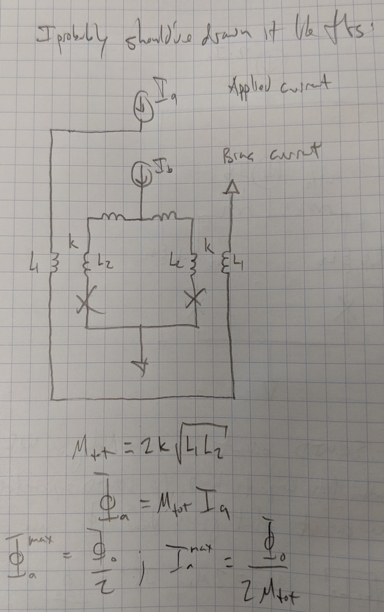
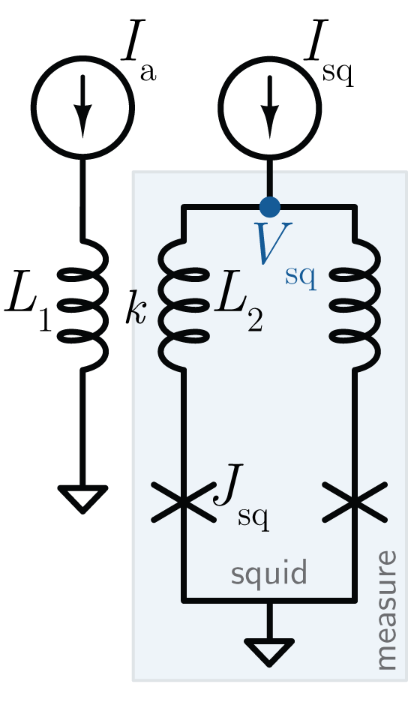
squid design
This is how it’s simulated in WR

Slide 6
squid design
Circuit Parameters
Parameter |  | Value
Current biases
I_{spd} | Nominal: [10 20] µA Range: [7.5-12.5 17.5-22.5] µA) | [10 20] µA ([7.5-12.5 17.5-22.5] µA)
I_{sy}
I_{jtl}
I_{b}
I_{sq}
Critical currents
I_{c}^{spd}
I_{c}^{jsf}
I_{c}^{jsq}
Inductances
L_{spd}
L_{jtl}
L_{si}
L₁
L₂
k
Resistances
r_{spd}
r_{si}
r_{fr}
Junction Specification
Parameter | Value
β_{c} | $$2πR^{2}CI_{c}/Φ_{0}$$
β_{c} (J_{sf} J_{jtl}) | 0.95
β_{c} (J_{sq}) | 0.3
J_{c} | ? kA/cm²
d_{j} / A_{j} | ? µm / ? µm²
SPD Specification
Parameter | Value
w_{spd}
L□^{WSi}
N□
Derived Parameters
Parameter | Value
τ_{spd}
τ_{si}
β_{L}^{jtl}
β_{L}^{si}
β_{L}^{sq}

