Slide 1
Votan 1
Circuit Designs - 20190910

Slide 2
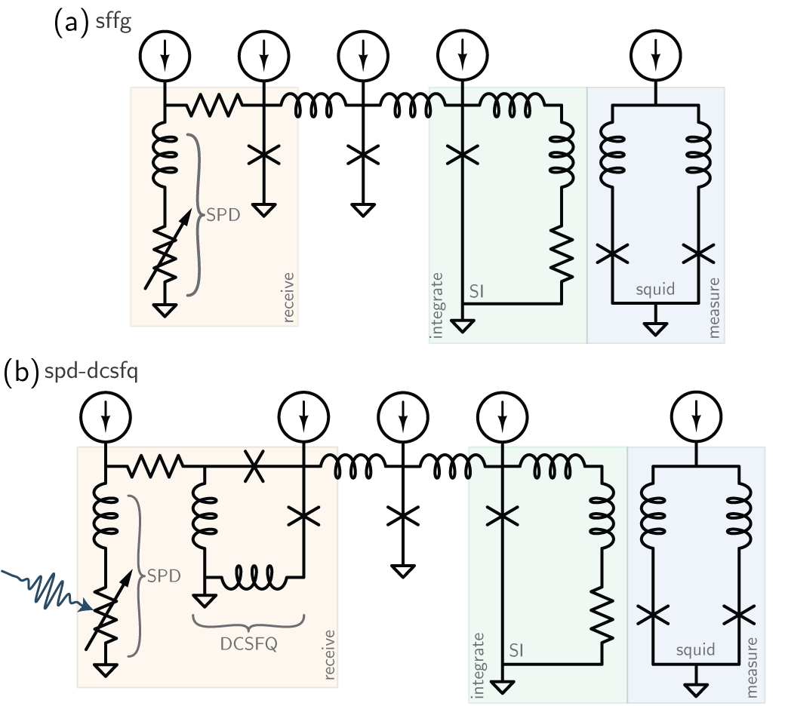
Votan 1 will explore two circuits:
synaptic-firing flux generator
single-photon to single-fluxon

Slide 3
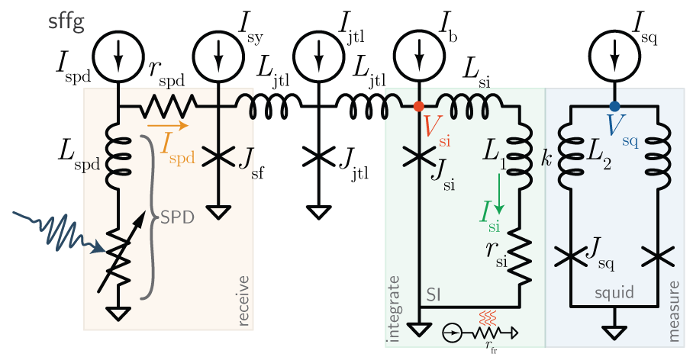
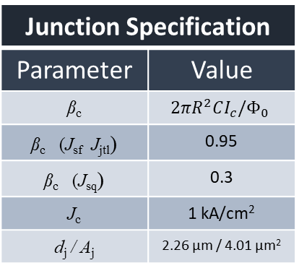
synaptic-firing flux generator (sffg)
Circuit Parameters
Parameter |  | Value
Current biases
I_{spd} | Nominal: 20 µA Range: 17.5 µA-22.5 µA | [10 20] µA ([7.5-12.5 17.5-22.5] µA)
I_{sy} | 20 µA - 40 µA
I_{jtl} | 25 µA
I_{b} | 20 µA - 40 µA
I_{sq} | 80 µA or 200 µA
Critical currents
I_{c}^{spd} |  | 22.5 µA
I_{c}^{jsf} |  | 40 µA
I_{c}^{jsq} |  | 40 µA or 100 µA
Inductances
L_{spd} |  | 1.094 µA
L_{jtl} |  | 77.5 pH
L_{si} |  | 10 pH – 10 µH
L₁
L₂
k
Resistances
r_{spd} |  | 15.625 Ω
r_{si} |  | 10 mΩ – 10 Ω
r_{fr}
Junction Specification
Parameter | Value
β_{c} | $$2πR^{2}CI_{c}/Φ_{0}$$
β_{c} (J_{sf} J_{jtl}) | 0.95
β_{c} (J_{sq}) | 0.3
J_{c} | 1 kA/cm²
d_{j} / A_{j} | 2.26 µm / 4.01 µm²
SPD Specification
Parameter | Value
w_{spd}
L□^{WSi}
N□
Derived Parameters
Parameter | Value
τ_{spd}
τ_{si}
β_{L}^{jtl}
β_{L}^{si}
β_{L}^{sq}
40 µA I_{c} junctions

Slide 4
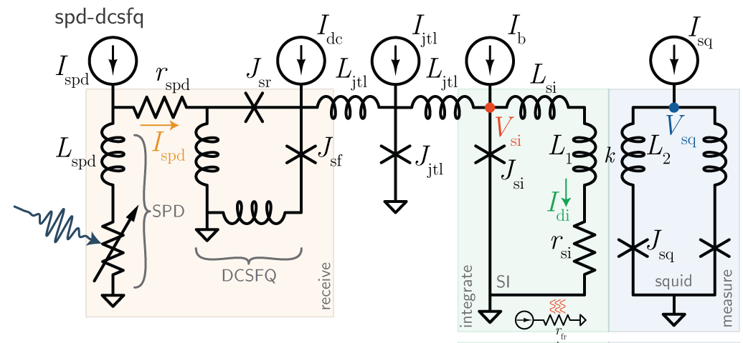
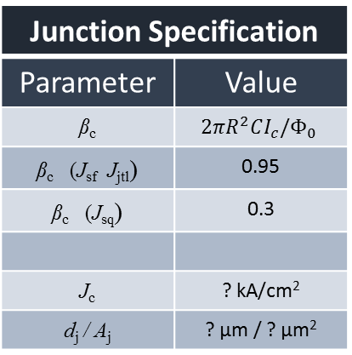
single-photon to single-fluxon (spd-dcsfq)
Circuit Parameters
Parameter |  | Value
Current biases
I_{spd} | Nominal: 20 µA (Range: [15 25] µA) | [10 20] µA ([7.5-12.5 17.5-22.5] µA)
I_{sy}
I_{jtl}
I_{b}
I_{sq}
Critical currents
I_{c}^{spd} |  | 25 µA
I_{c}^{jsf} |  | 40 µA
I_{c}^{jsq} |  | 40 µA
Inductances
L_{spd}
L_{jtl}
L_{si}
L₁
L₂
k
Resistances
r_{spd}
r_{si}
r_{fr}
Junction Specification
Parameter | Value
β_{c} | $$2πR^{2}CI_{c}/Φ_{0}$$
β_{c} (J_{sf} J_{jtl}) | 0.95
β_{c} (J_{sq}) | 0.3
J_{c} | ? kA/cm²
d_{j} / A_{j} | ? µm / ? µm²
SPD Specification
Parameter | Value
w_{spd}
L□^{WSi}
N□
Derived Parameters
Parameter | Value
τ_{spd}
τ_{si}
β_{L}^{jtl}
β_{L}^{si}
β_{L}^{sq}

Slide 5
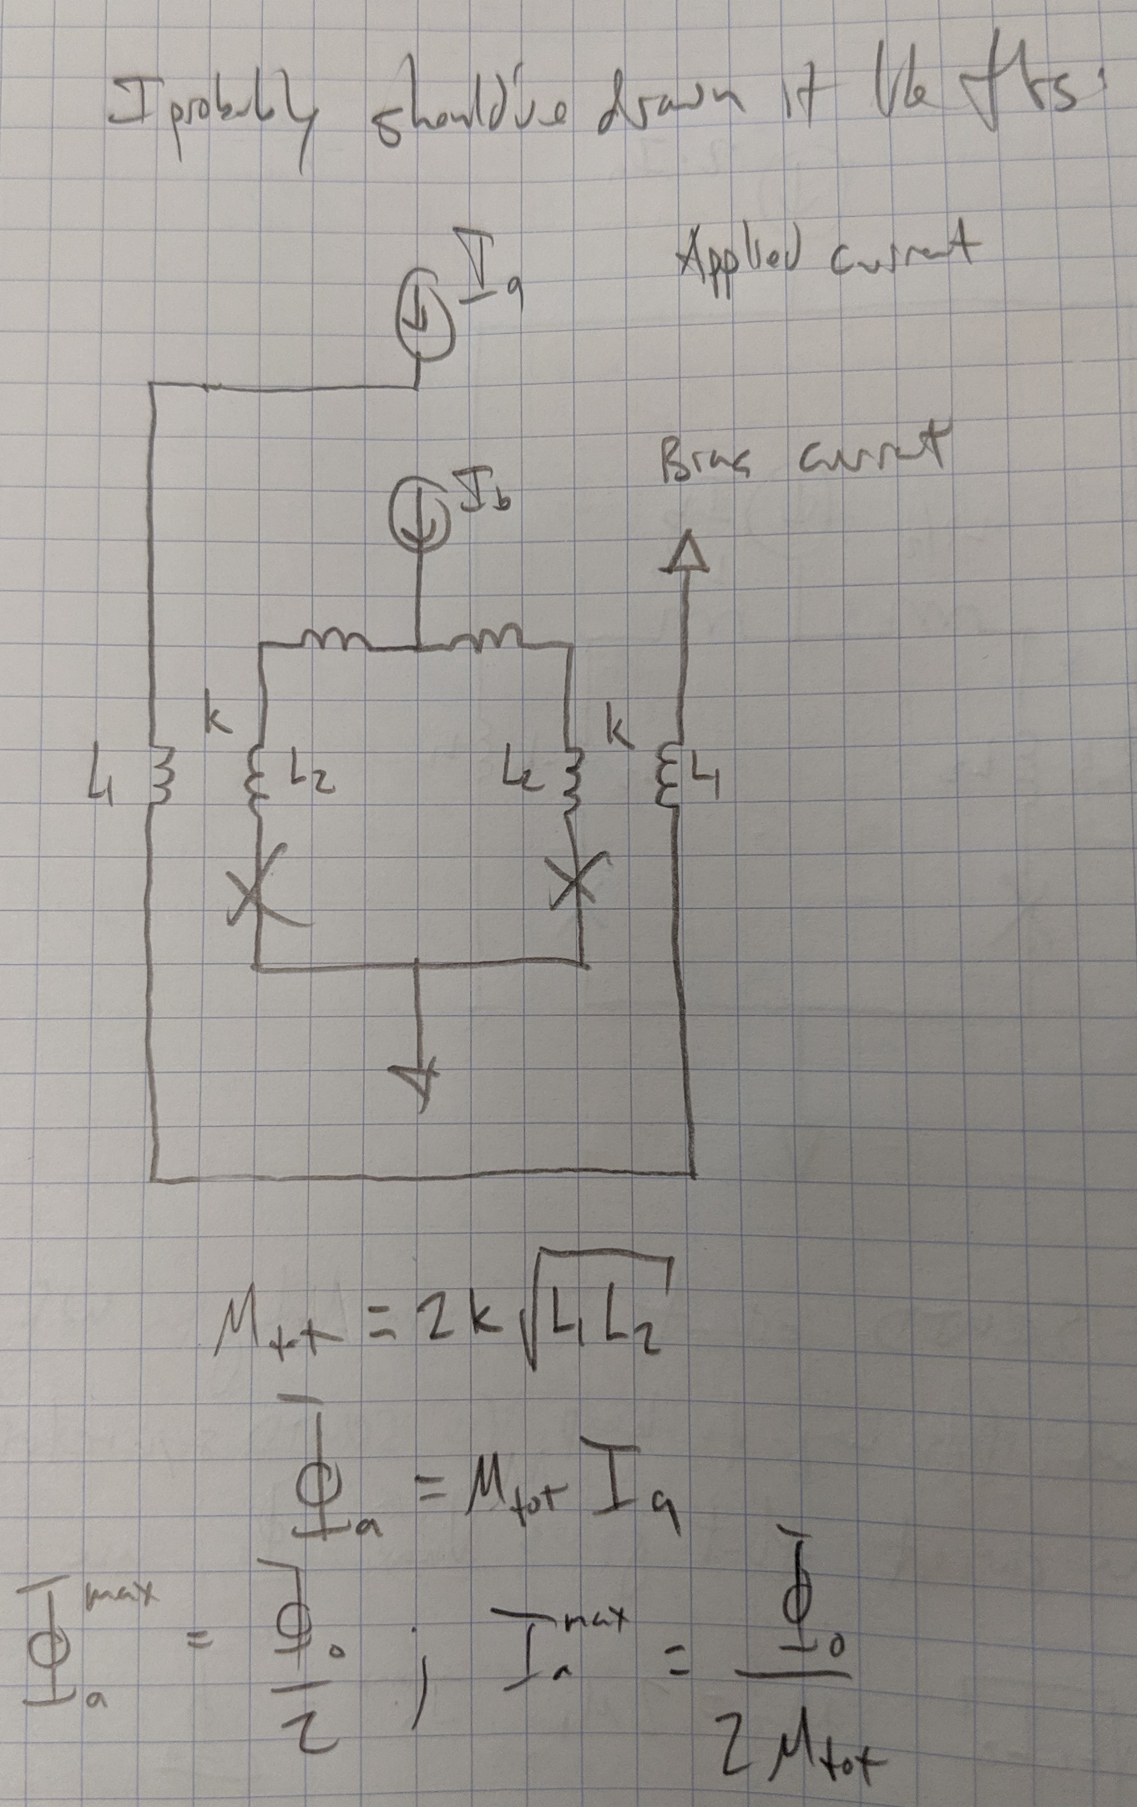
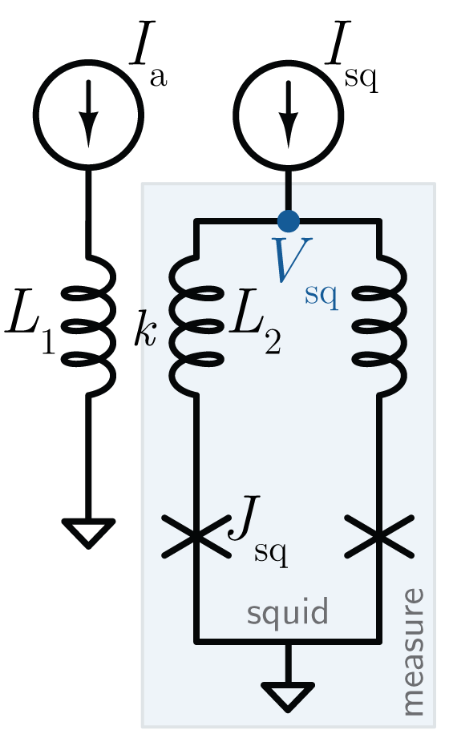
squid design
This is how it’s simulated in WR

Slide 6
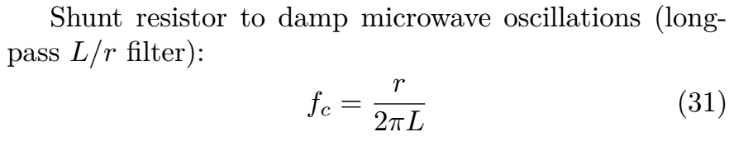
squid design
Here, if f_c is 1 GHz and L is 26pH pH (just the self-inductance of the washer, jjs aren’t in the path), then r = 0.16 Ohm (half as many squares because PdAu is 2 Ohm per square)

Slide 7
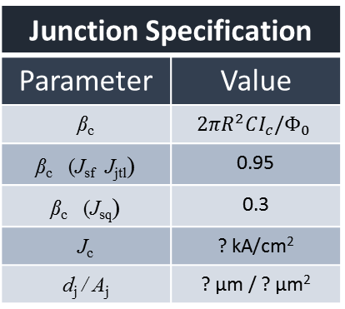
squid design
Circuit Parameters
Parameter |  | Value
Current biases
I_{spd} | Nominal: [10 20] µA Range: [7.5-12.5 17.5-22.5] µA) | [10 20] µA ([7.5-12.5 17.5-22.5] µA)
I_{sy}
I_{jtl}
I_{b}
I_{sq}
Critical currents
I_{c}^{spd}
I_{c}^{jsf}
I_{c}^{jsq}
Inductances
L_{spd}
L_{jtl}
L_{si}
L₁
L₂
k
Resistances
r_{spd}
r_{si}
r_{fr}
Junction Specification
Parameter | Value
β_{c} | $$2πR^{2}CI_{c}/Φ_{0}$$
β_{c} (J_{sf} J_{jtl}) | 0.95
β_{c} (J_{sq}) | 0.3
J_{c} | ? kA/cm²
d_{j} / A_{j} | ? µm / ? µm²
SPD Specification
Parameter | Value
w_{spd}
L□^{WSi}
N□
Derived Parameters
Parameter | Value
τ_{spd}
τ_{si}
β_{L}^{jtl}
β_{L}^{si}
β_{L}^{sq}

